Slide 1
Getting development back on track Leading Planning Conference

Slide 2
Getting development back on track
What we’ll cover
Context & Scene Setting
Reflections from practice
What can the planning system do?
Discussion & shared experiences

Slide 3
Who we are The Homes & Communities Agency
The Homes and Communities Agency is the national housing, regeneration and social housing regulation agency for England.
Aligned public funding and delivery of local priorities
Local Growth
Affordable housing
Recoverable
Investment (debt/equity)
Regulation
Land
Our vision is for successful places with homes, jobs and economic growth

Slide 4
Who we are ATLAS
Advisory Team for Large Applications
Impartial & independent advice
Supporting Local Authorities on large scale complex schemes
Non-statutory advice
Currently helping 50-60 Local Authorities
Notes:
We are the people who help get things done:
Supporting local authorities and communities deliver what they want, in the way they want, where they want it
Local Investment Plans are tailored to each area, focusing on local needs and aspirations – bottom-up approach to investment
Enabling = Working with people and places to deliver new homes, economic
growth and jobs
Land = Both HCA and wider government land. Economic Assets from the
RDAs.
Investment = Delivering programmes of investment in places
Affordable homes programme
Decent homes backlog programme
Land and regeneration
Regulation = From April 2012 the HCA became the regulator of social
housing providers, focusing on good governance, financial viability and value for money in Private Registered Providers as the basis for robust economic regulation.

Slide 5
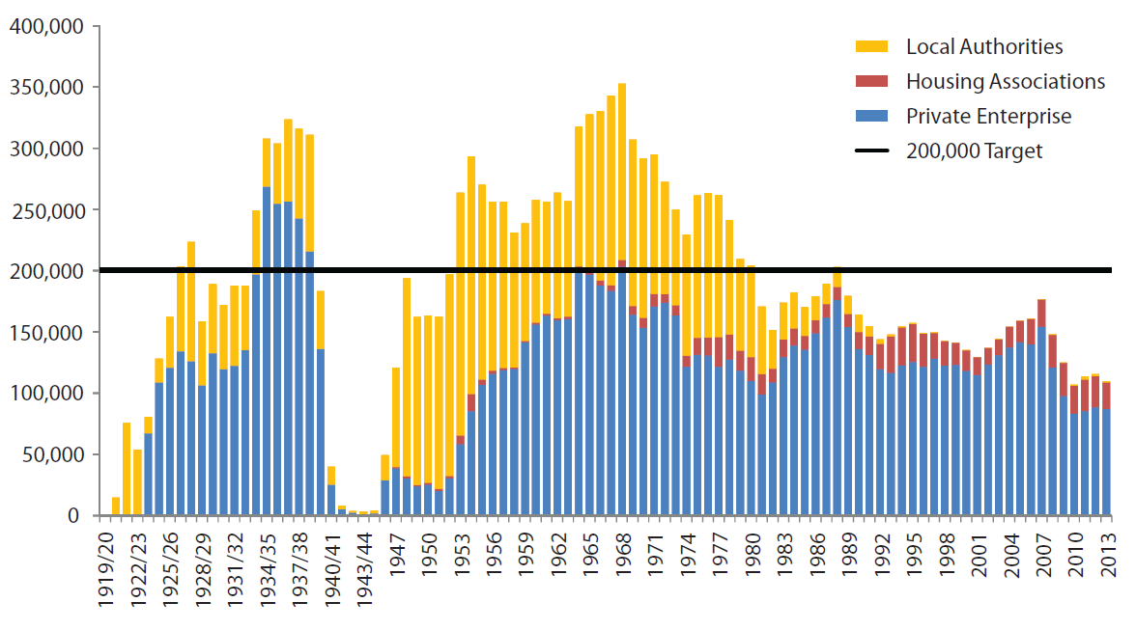
Context Annual Housing Completions
Source: Lyons Review 2014 (based upon DCLG data)

Slide 6
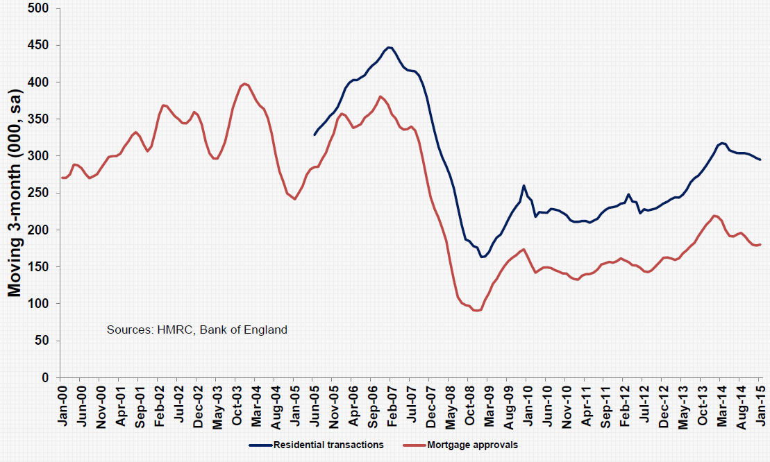
Context Residential transactions & mortgages

Slide 7
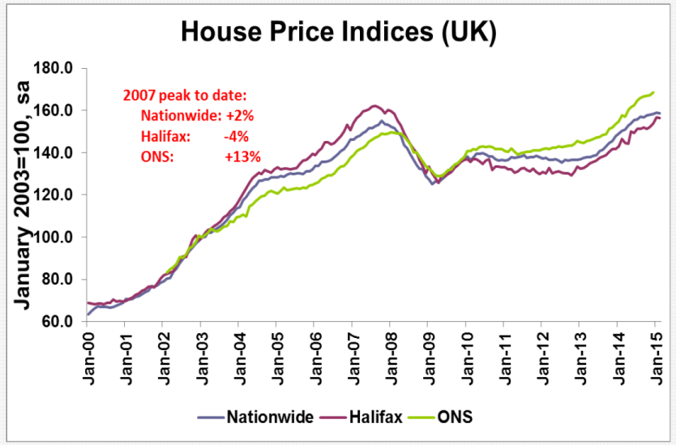
Context House prices

Slide 8
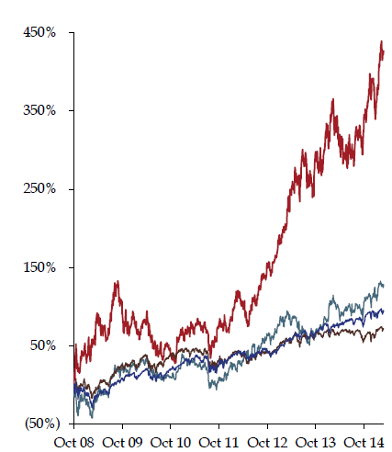
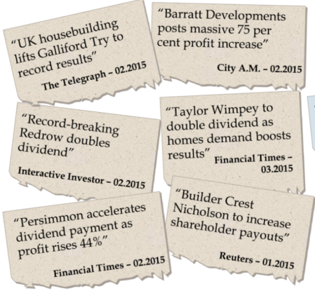
Context Sector performance
UK Housebuilders + 427%
FTSE
All share
+ 72%

Slide 9
Context New Homes in the Planning Pipeline
3m
2.5m
Pre Planning, 486,000
2m
Obtaining Outline
Permission, 513,000
1.5m
Outline Granted, Working up Detailed Plans/RMs, 578,000
1m
Detailed Plans Subm = 221,000
0.5m
Started on Site, 315,000
Detailed Permission or Reserved Matters Granted, 620,000
Not Started, 305,000
0
Getting Permission
Data from Glenigan (2015) for DCLG

Slide 10
Context New Homes in the Planning Pipeline
3m
As of September 2015, 620,000 units had either detailed permission or reserved matters granted compared with fewer than
2.5m
half a million in 2013: more projects being given the green light by planning authorities.
Pre Planning, 486,000
2m
Obtaining Outline
Permission, 513,000
1.5m
Outline Granted, Working up Detailed Plans/RMs, 578,000
1m
Detailed Plans Subm = 221,000
0.5m
Started on Site, 315,000
Detailed Permission or Reserved Matters Granted, 620,000
Not Started, 305,000
0
Getting Permission
Data from Glenigan (2015) for DCLG

Slide 11
Context New Homes in the Planning Pipeline
3m
As of September 2015, 620,000 units had either detailed permission or reserved matters granted compared with fewer than
2.5m
half a million in 2013: more projects being given the green light by planning authorities.
Pre Planning, 486,000
2m
Obtaining Outline
Permission, 513,000
However, over 300,000 of projects with full permission are yet to make a start on site. Reflecting both the increase of permissions in the system, and the time it takes between getting permission and starting.
1.5m
Outline Granted, Working up Detailed Plans/RMs, 578,000
1m
Detailed Plans Subm = 221,000
0.5m
Started on Site, 315,000
Detailed Permission or Reserved Matters Granted, 620,000
Not Started, 305,000
0
Getting Permission
Starting
Data from Glenigan (2015) for DCLG

Slide 12
Context New Homes in the Planning Pipeline
3m
As of September 2015, 620,000 units had either detailed permission or reserved matters granted compared with fewer than
2.5m
half a million in 2013: more projects being given the green light by planning authorities.
Pre Planning, 486,000
2m
Obtaining Outline
Permission, 513,000
However, over 300,000 of projects with full permission are yet to make a start on site. Reflecting both the increase of permissions in the system, and the time it takes between getting permission and starting.
1.5m
Outline Granted, Working up Detailed Plans/RMs, 578,000
1m
Detailed Plans Subm = 221,000
0.5m
Started on Site, 315,000
60-70% do start within 1 year
Why do others not progress?
Detailed Permission or Reserved Matters Granted, 620,000
Not Started, 305,000
0
Getting Permission
Starting
Data from Glenigan (2015) for DCLG

Slide 13
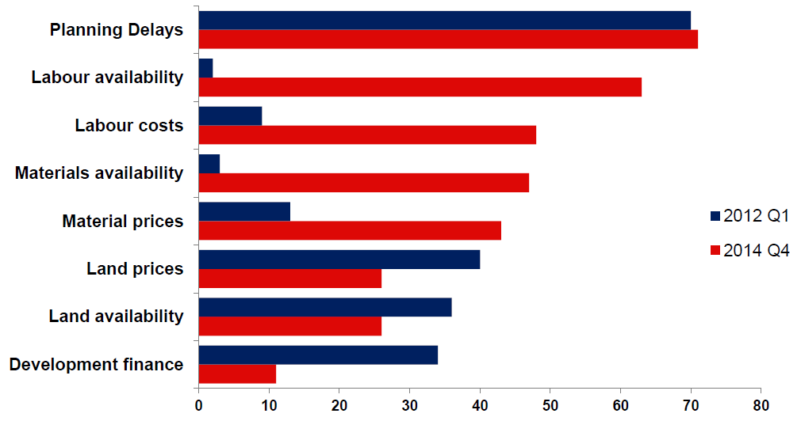
Context The housebuilder perspective
2012 Q1
2014 Q4
Constraints on New Home Supply
% house builders quoting as “major constraint”
Source: Monthly Survey (HBF, 2015)

Slide 14
Context Supporting Housing: LGA position
“The planning system is not holding back house builders from delivering the homes we need.”
Suggested planning measures
Local fee setting
More robust viability assessment process
Access to growth funds
Review CIL process & pooling
Other measures: skills to build, council capacity to build, better use of public land, RTB & social rent
Notes:
We are the people who help get things done:
Supporting local authorities and communities deliver what they want, in the way they want, where they want it
Local Investment Plans are tailored to each area, focusing on local needs and aspirations – bottom-up approach to investment
Enabling = Working with people and places to deliver new homes, economic
growth and jobs
Land = Both HCA and wider government land. Economic Assets from the
RDAs.
Investment = Delivering programmes of investment in places
Affordable homes programme
Decent homes backlog programme
Land and regeneration
Regulation = From April 2012 the HCA became the regulator of social
housing providers, focusing on good governance, financial viability and value for money in Private Registered Providers as the basis for robust economic regulation.

Slide 15
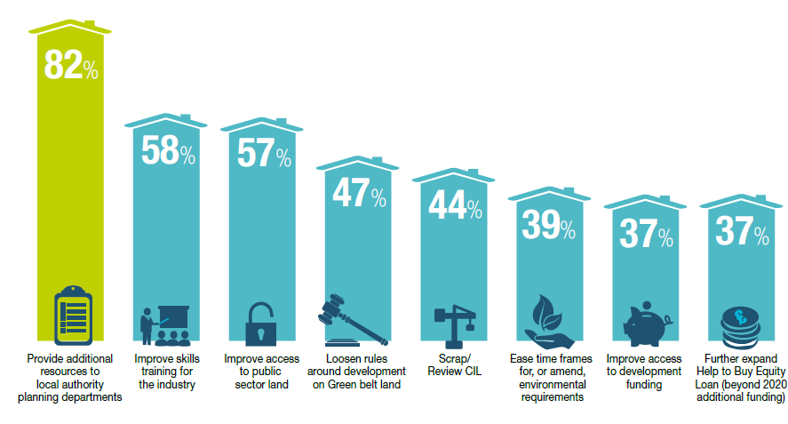
Context
What measures could boost housing supply
Source: Gaining Ground: Housebuilding Report 2015 (Knight Frank)

Slide 16
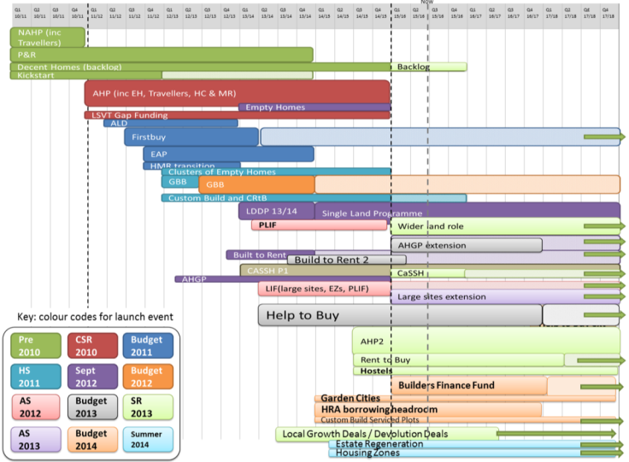
Context
A plethora of programmes

Slide 17
Reflections from practice Discussions
In your groups, discuss your perspectives on the issues & challenges -
Do you have examples of sites not progressing in your areas?
Do you know why?
What can be done?
20 mins round table
discussions
Notes:
We are the people who help get things done:
Supporting local authorities and communities deliver what they want, in the way they want, where they want it
Local Investment Plans are tailored to each area, focusing on local needs and aspirations – bottom-up approach to investment
Enabling = Working with people and places to deliver new homes, economic
growth and jobs
Land = Both HCA and wider government land. Economic Assets from the
RDAs.
Investment = Delivering programmes of investment in places
Affordable homes programme
Decent homes backlog programme
Land and regeneration
Regulation = From April 2012 the HCA became the regulator of social
housing providers, focusing on good governance, financial viability and value for money in Private Registered Providers as the basis for robust economic regulation.

Slide 18
What can the planning system do

Slide 19
What can the planning system do Potential tools & opportunities
A firm footing: establishing robust policy
A shared endeavour: securing positive collaboration
Making things happen: focus on delivery
Notes:
We are the people who help get things done:
Supporting local authorities and communities deliver what they want, in the way they want, where they want it
Local Investment Plans are tailored to each area, focusing on local needs and aspirations – bottom-up approach to investment
Enabling = Working with people and places to deliver new homes, economic
growth and jobs
Land = Both HCA and wider government land. Economic Assets from the
RDAs.
Investment = Delivering programmes of investment in places
Affordable homes programme
Decent homes backlog programme
Land and regeneration
Regulation = From April 2012 the HCA became the regulator of social
housing providers, focusing on good governance, financial viability and value for money in Private Registered Providers as the basis for robust economic regulation.

Slide 20
What can the planning system do A firm footing: robust policy
Vision & leadership
Corporate buy-in
Positive engagement
Testing Deliverability
Appropriate planning strategies
Tools: Local Plans, SPDs, Engagement Strategies, Delivery Strategies, Local Development Orders
Notes:
We are the people who help get things done:
Supporting local authorities and communities deliver what they want, in the way they want, where they want it
Local Investment Plans are tailored to each area, focusing on local needs and aspirations – bottom-up approach to investment
Enabling = Working with people and places to deliver new homes, economic
growth and jobs
Land = Both HCA and wider government land. Economic Assets from the
RDAs.
Investment = Delivering programmes of investment in places
Affordable homes programme
Decent homes backlog programme
Land and regeneration
Regulation = From April 2012 the HCA became the regulator of social
housing providers, focusing on good governance, financial viability and value for money in Private Registered Providers as the basis for robust economic regulation.

Slide 21
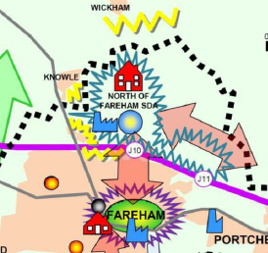
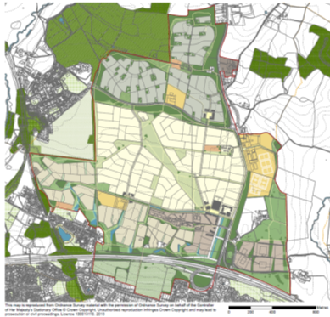
Welborne (North of Fareham) Evolution of policy
Core Strategy
Adopted Aug 2011
The Welborne Plan: Draft
for consultation Apr 2013
Notes:
We are the people who help get things done:
Supporting local authorities and communities deliver what they want, in the way they want, where they want it
Local Investment Plans are tailored to each area, focusing on local needs and aspirations – bottom-up approach to investment
Enabling = Working with people and places to deliver new homes, economic
growth and jobs
Land = Both HCA and wider government land. Economic Assets from the
RDAs.
Investment = Delivering programmes of investment in places
Affordable homes programme
Decent homes backlog programme
Land and regeneration
Regulation = From April 2012 the HCA became the regulator of social
housing providers, focusing on good governance, financial viability and value for money in Private Registered Providers as the basis for robust economic regulation.

Slide 22
Welborne (North of Fareham) Evolution of policy
Core Strategy
Adopted Aug 2011
The Welborne Plan: Draft
for consultation Apr 2013
Community Liaison Group
Visioning events
Primary schools
Cross Representative E-Panel
Residents & Business Surveys
Standing Conference
Social Media
Notes:
We are the people who help get things done:
Supporting local authorities and communities deliver what they want, in the way they want, where they want it
Local Investment Plans are tailored to each area, focusing on local needs and aspirations – bottom-up approach to investment
Enabling = Working with people and places to deliver new homes, economic
growth and jobs
Land = Both HCA and wider government land. Economic Assets from the
RDAs.
Investment = Delivering programmes of investment in places
Affordable homes programme
Decent homes backlog programme
Land and regeneration
Regulation = From April 2012 the HCA became the regulator of social
housing providers, focusing on good governance, financial viability and value for money in Private Registered Providers as the basis for robust economic regulation.

Slide 23
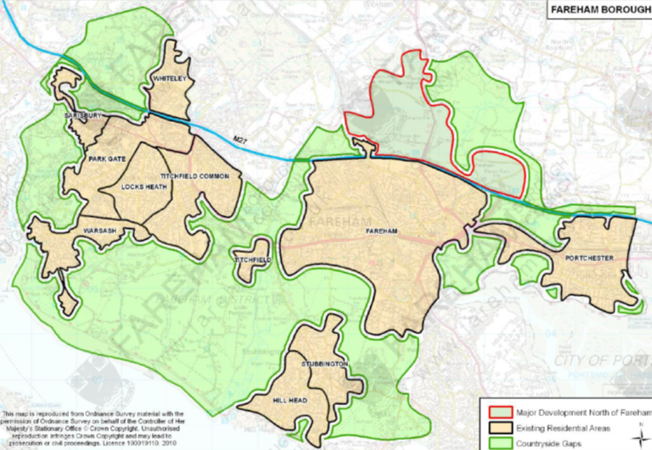
Welborne (North of Fareham) E-panel Survey

Slide 24
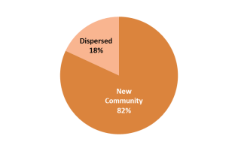
Welborne (North of Fareham) E-panel Survey
Preferred location for housing to address need
New Community | 82%
Dispersed | 18%

Slide 25
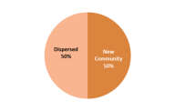
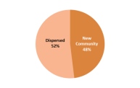
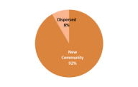
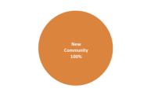
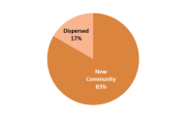
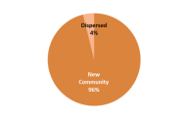
Welborne (North of Fareham) E-panel Survey
Dispersed
50%
Dispersed
52%
Dispersed
Preferred location for housing to address need
New Community | 82%
Dispersed | 18%

Slide 26
Welborne (North of Fareham) E-panel Survey
Key Facilities | No.
Primary schools | 344
Health centre | 324
Secondary school | 208
Shops | 182
Parks | 149
Community centres | 121
Play areas | 79
Supermarket | 49
Churches | 21
Dispersed
50%
Dispersed
52%
Dispersed
Preferred location for housing to address need
New Community | 82%
Dispersed | 18%

Slide 27
What can the planning system do A shared endeavour: positive collaboration
Collective vision & objective setting
Front loading issues resolution
Framework for joint evidence
Active project management
Resource & work flow planning
Structure to engagement
Tools: PPAs, MoUs, Project Plans
Notes:
We are the people who help get things done:
Supporting local authorities and communities deliver what they want, in the way they want, where they want it
Local Investment Plans are tailored to each area, focusing on local needs and aspirations – bottom-up approach to investment
Enabling = Working with people and places to deliver new homes, economic
growth and jobs
Land = Both HCA and wider government land. Economic Assets from the
RDAs.
Investment = Delivering programmes of investment in places
Affordable homes programme
Decent homes backlog programme
Land and regeneration
Regulation = From April 2012 the HCA became the regulator of social
housing providers, focusing on good governance, financial viability and value for money in Private Registered Providers as the basis for robust economic regulation.

Slide 28
What can the planning system do A shared endeavour: positive collaboration

Slide 29
What can the planning system do A shared endeavour: positive collaboration

Slide 30
What can the planning system do A shared endeavour: positive collaboration

Slide 31
What can the planning system do Making things happen: focus on delivery
Understanding the problem
Local economic markets, skills & training
Scheme phasing flexibilities
Alternative funding & delivery opportunities
Addressing finance & cashflow needs
Tools: S106, CIL, NHB, CPO Powers, Public Sector Land, Growth & Investment Funds
Notes:
We are the people who help get things done:
Supporting local authorities and communities deliver what they want, in the way they want, where they want it
Local Investment Plans are tailored to each area, focusing on local needs and aspirations – bottom-up approach to investment
Enabling = Working with people and places to deliver new homes, economic
growth and jobs
Land = Both HCA and wider government land. Economic Assets from the
RDAs.
Investment = Delivering programmes of investment in places
Affordable homes programme
Decent homes backlog programme
Land and regeneration
Regulation = From April 2012 the HCA became the regulator of social
housing providers, focusing on good governance, financial viability and value for money in Private Registered Providers as the basis for robust economic regulation.

Slide 32
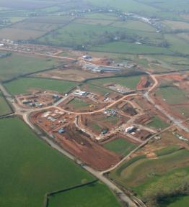
Cranbrook, East Devon Delivering the vision
Policy & permissions in place
No appetite to renegotiate S106
Strong working partnership
Attracting public sector investment:
Low Carbon funding £4m
Affordable Housing £16m
DfT funding £10m
Local Infrastructure Fund £20m
Enabled start on site & delivery of agreed obligations
Notes:
Partnership approach via a dedicated Growth Point team – meaning partners are coordinated and have a strategic approach
Recognised form the outset that viability would be challenging, and they have been excellent to date about tracking funding opportunities and securing support for different parts of the project
A good illustration relates to environmental sustainability where the site will be one of the first to include a district wide heating network. Funding was challenging but they secured nearly £4m from the Low Carbon Infra Fund to help make it happen.
The overall mix of public funding secured to date includes:
The HCA investment in Cranbrook includes:
Infrastructure funding £1m
National Affordable Housing Programme £15.6m
Growth Point funding £6.3m
Community Infrastructure Fund £7m
Low Carbon Infrastructure Fund £3.6m
Other funding
Planning and support fees 0.1m
South West RDA funding through the Regional Infrastructure Fund £12m
Department for Transport – for Junction 29 £10.4m
Sub Total £56m
They are now mindful that infrastructure triggers are looming and they will need to maintain momentum. The cashflow for the project is a particular issue and partners are actively looking as to how to make sure the project doesn’t stall.
They are looking at innovative ways to make it work and evolving a concept of a Local revolving Infrastructure Fund. This could pool New Homes Bonus, CIL and local Business Rates to help deliver infrastructure over the lifetime of the growth strategy
Good example of a place bring focussed, proactive, innovative and taking some direct responsibility to help make it happen.

Slide 33
What can the planning system do Preparing for further reform
Local Plan-making
Brownfield registers, permission in principle & fast-track certificate
200,000 Starter Homes
Housing & NSIP
Right to Build
S106 dispute resolution
Reform compulsory purchase
Planning performance
Simplifying and speeding up neighbourhood planning

Slide 34
What can the planning system do Discussion & shared experiences
Your perspectives on the tools & opportunities
What are your experiences – what has worked well / not so well?
What else do you think could be done in your area?
Which aspects of further reform may help most?
What else should be addressed?
Notes:
Integral part of spatial planning process – putting spatial development plans into action
End to end management of delivery chain for sustainable development
Cultural change underlining role of LA as place shaper in partnership
The process for considering proposals needs to be proportionate and appropriate to the impact of individual development
DM approach necessitates changes in the structure and allocation of resources in LA
Planning Performance Agreements – encapsulate a development management approach of shared vision, collaboration and clear project coordination

