Slide 1
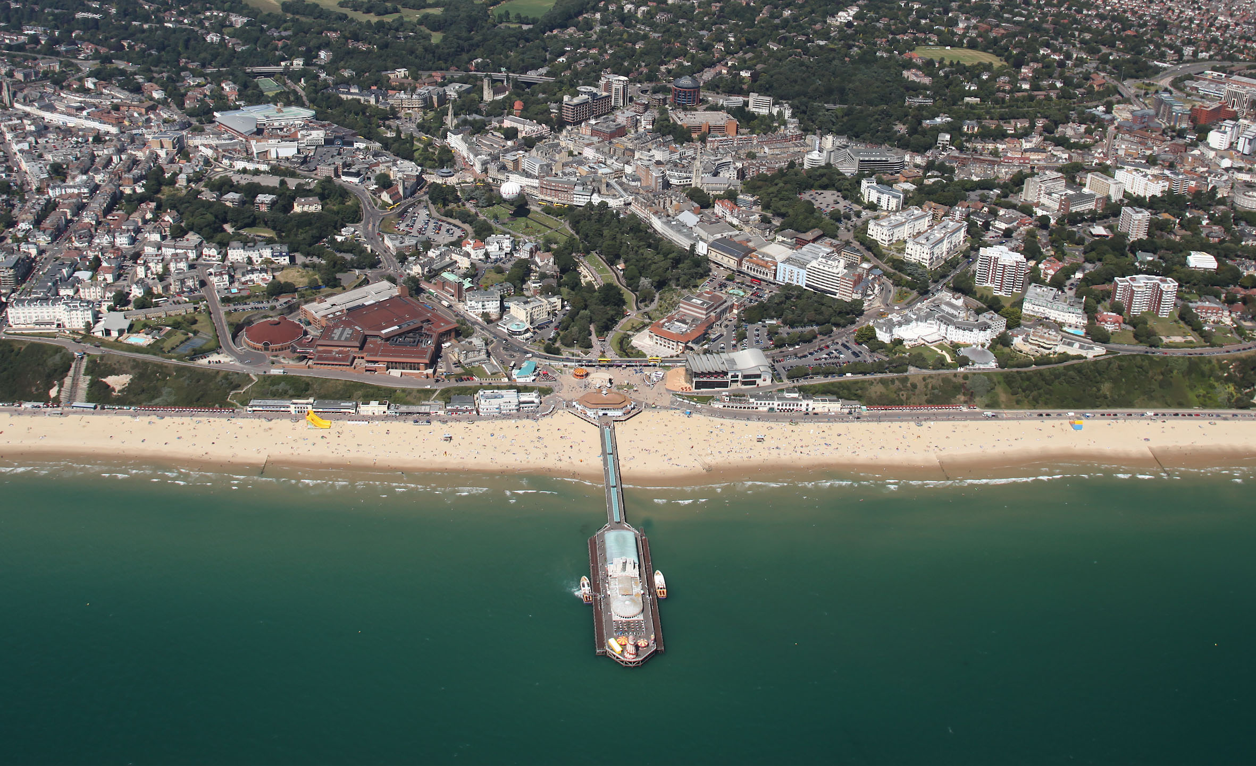


Bournemouth Borough Council
Town Centre Vision
Councillor David Smith

Slide 2
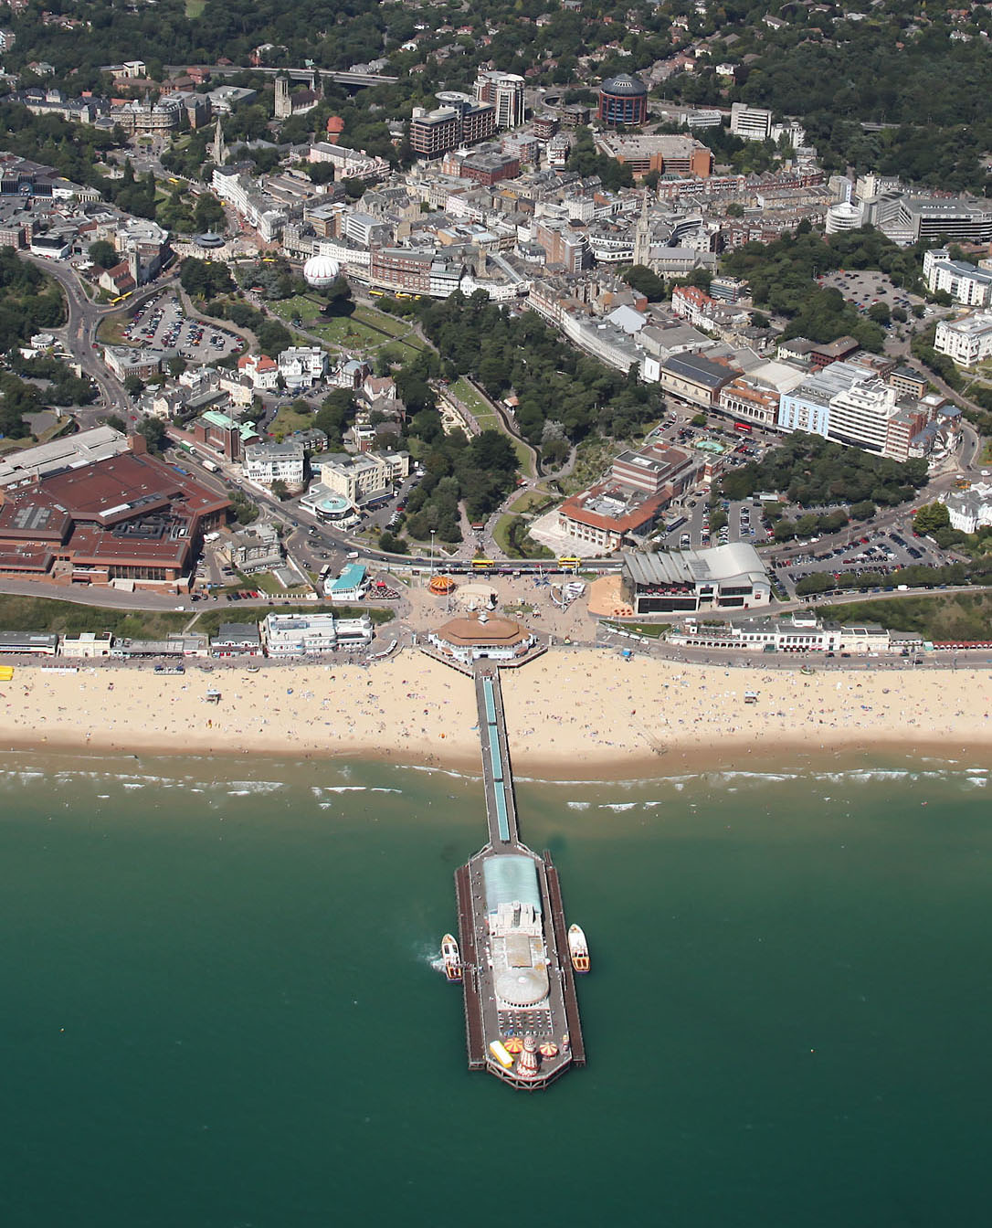
Bournemouth Identity
Town
185,000 residents
Financial services sector £1 billion
2 universities £400 million
Foreign language schools £200 million
Tourism £500 million
Council
Net assets of £650 million

Slide 3
Asset Management Strategy

Slide 4
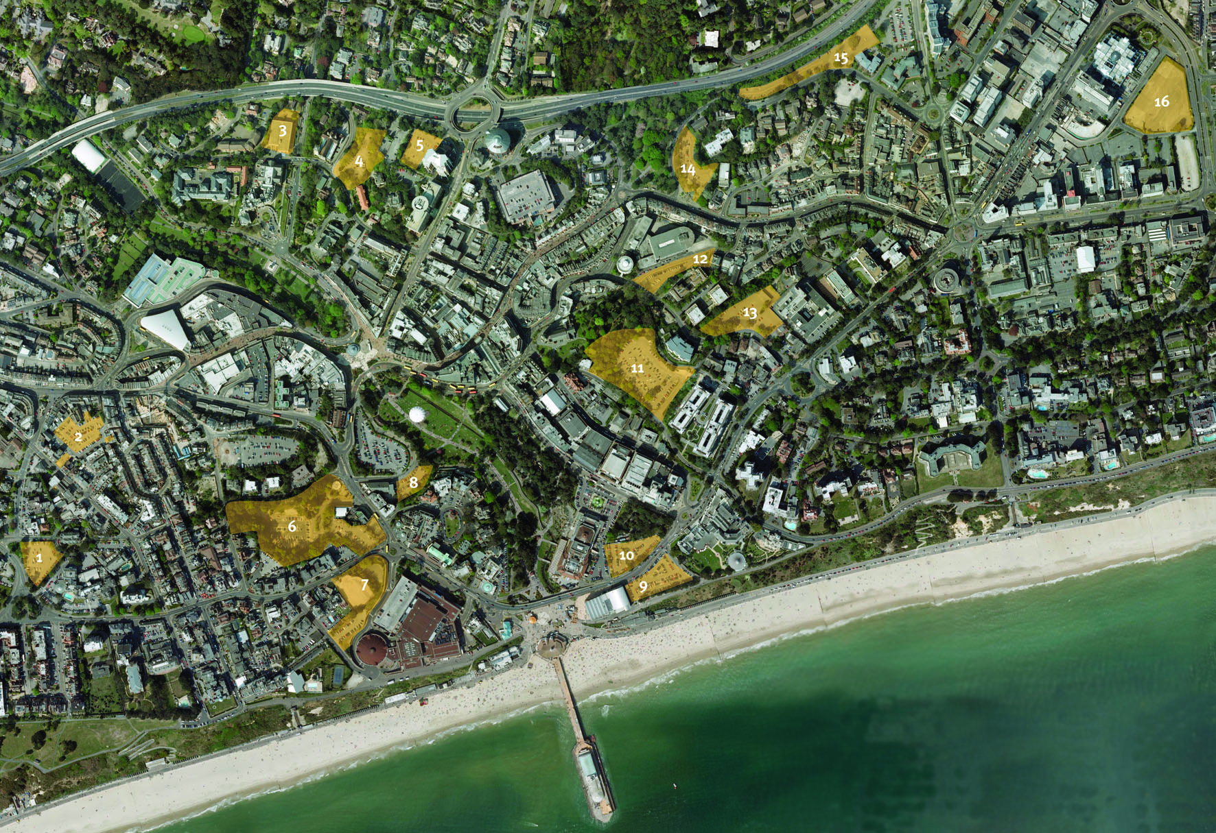
Town Centre Vision
A comprehensive, joined-up approach for the whole town centre
Harnessing underused assets to kick start development

Slide 5
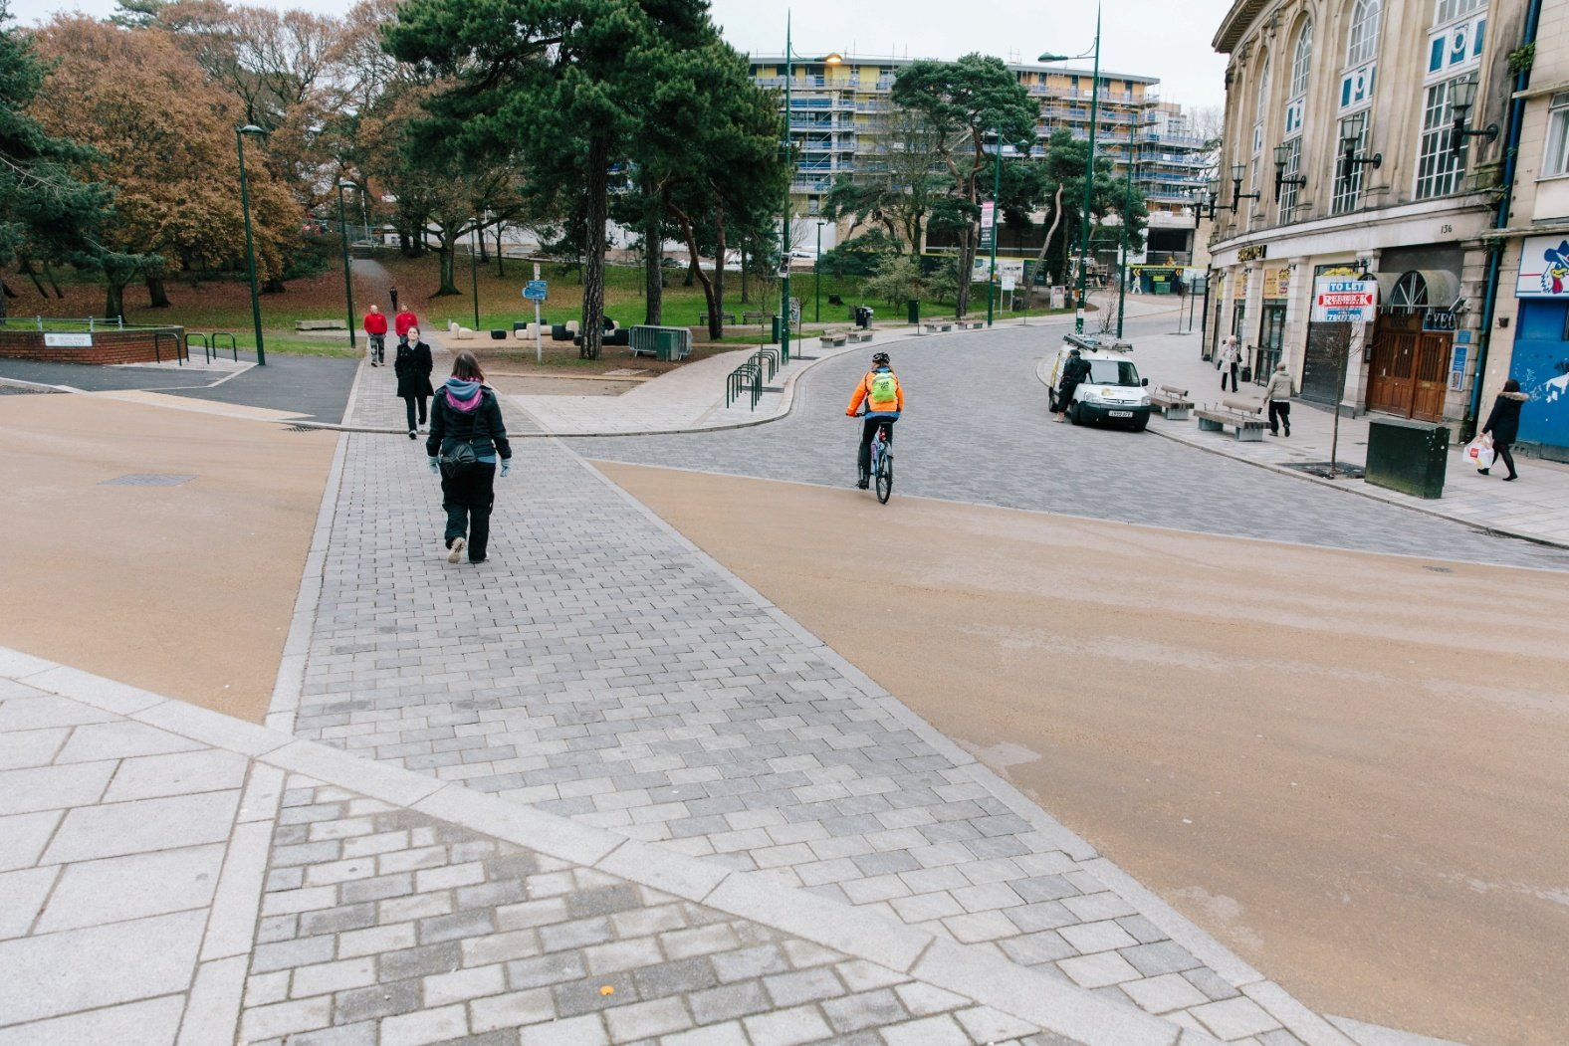
Regeneration Aims
Increasing the number of people living and working in the town centre by the creation of 2000 new homes and 23,000 square metres of office/work space
Build a more skilled
and diverse workforce
Improving the public
realm
Thriving festival/events programme

Slide 6
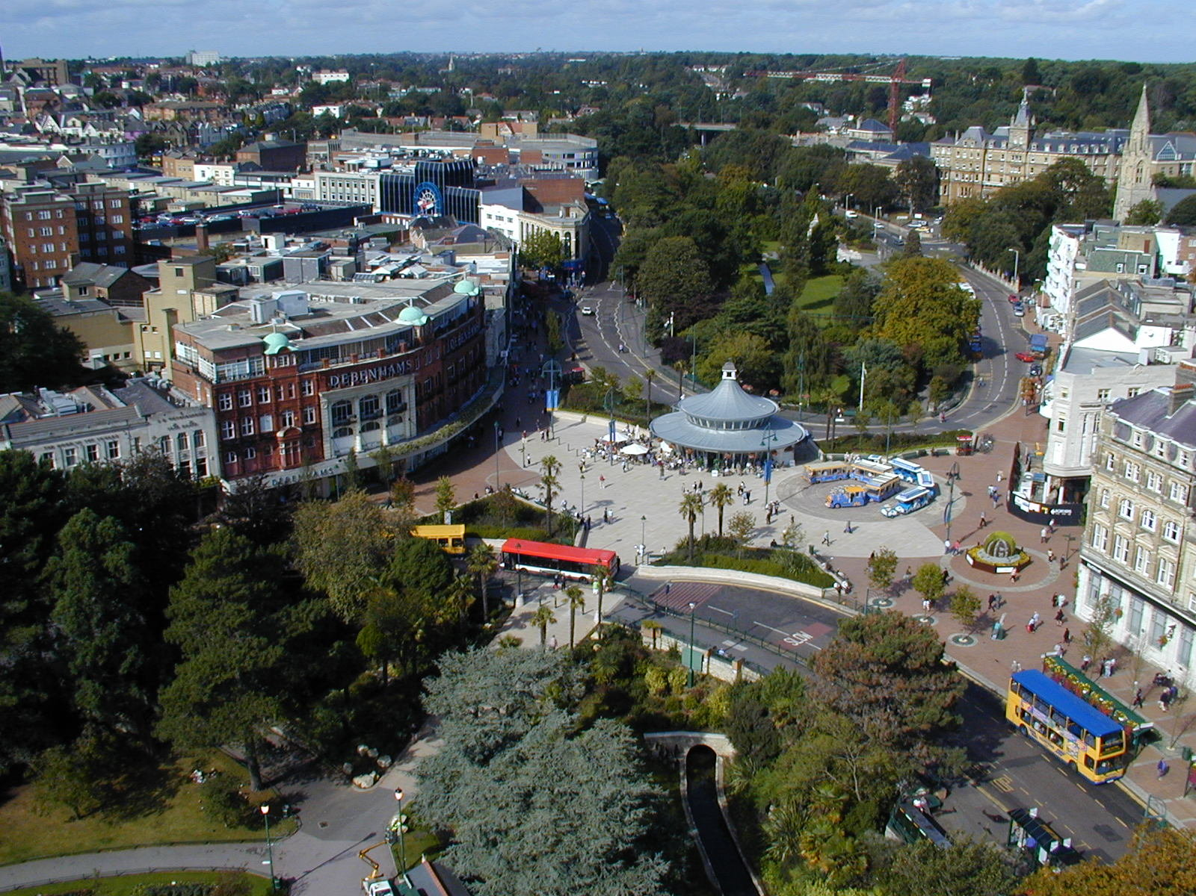
Challenges To Delivery
Very little inward investment in the so called boom years of 2002-2007.

Slide 7
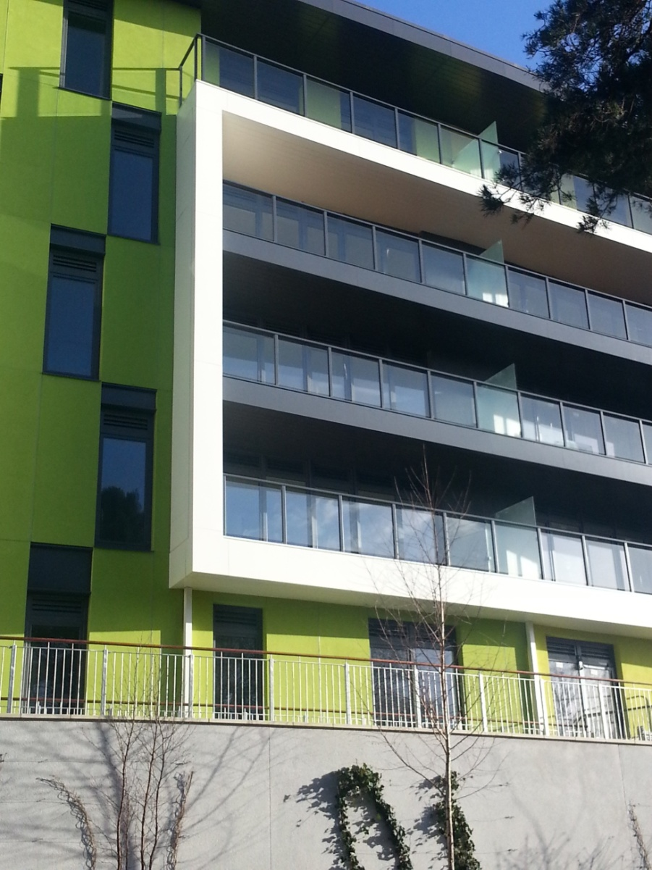
Why an LABV?
Proven investment model – mixture of public and private expertise
Enables controlled/phased development
Flexible delivery mechanism
Greater economies of scale
Council input into “quality”

Slide 8
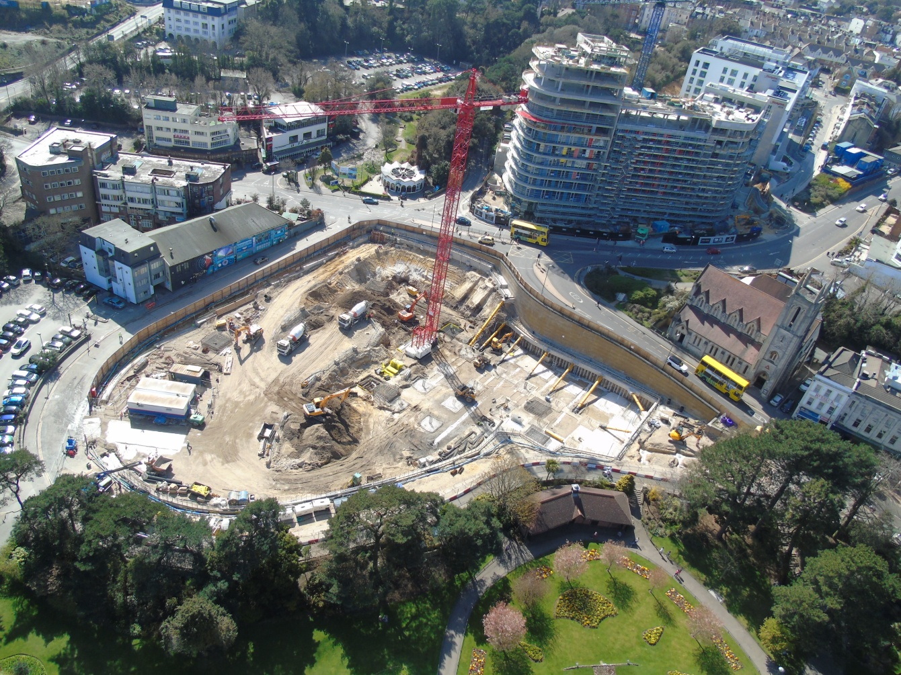
Delivery
BDC undertake first three projects in the town centre in April 2013 which are now complete
£160 million of development currently in construction
£300 million of development due to start in the next 2-3 years

Slide 9
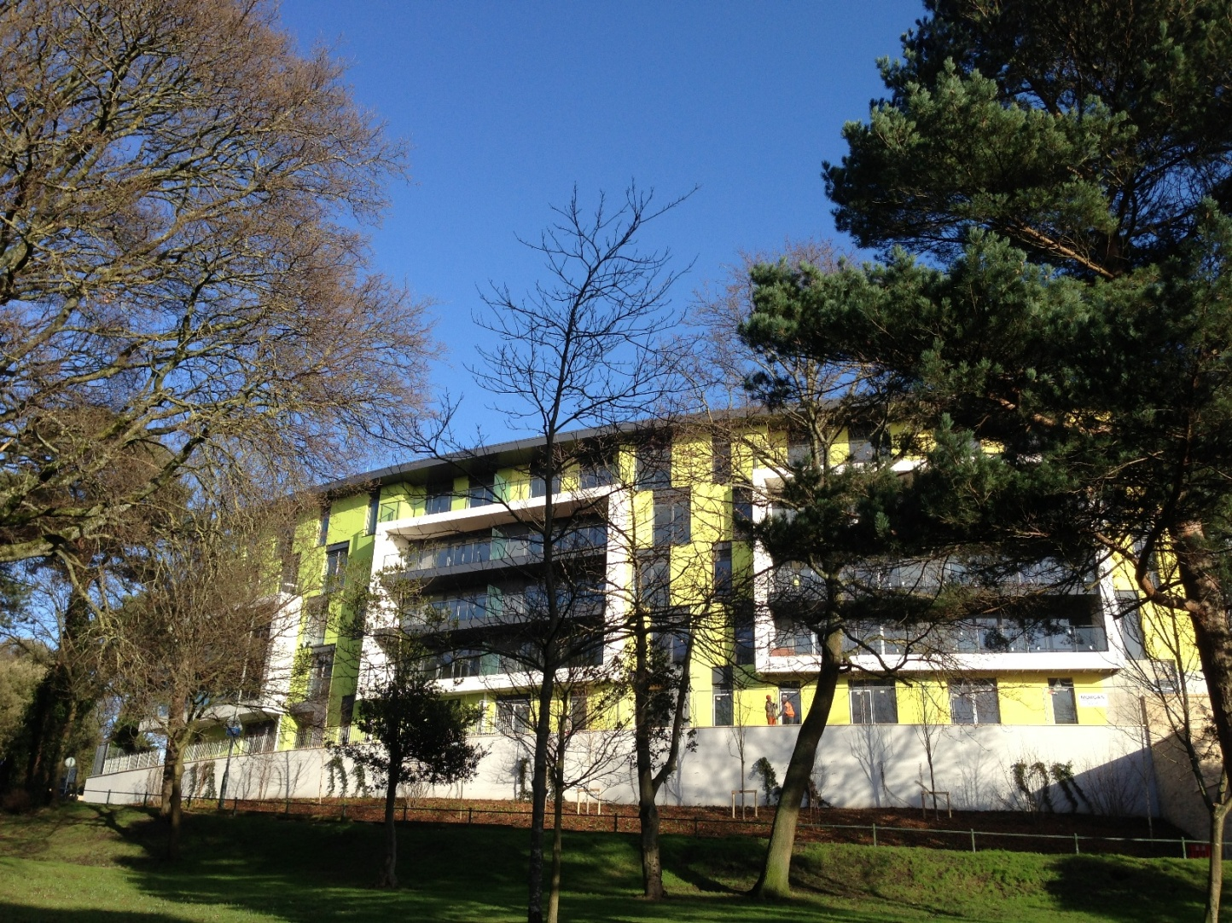
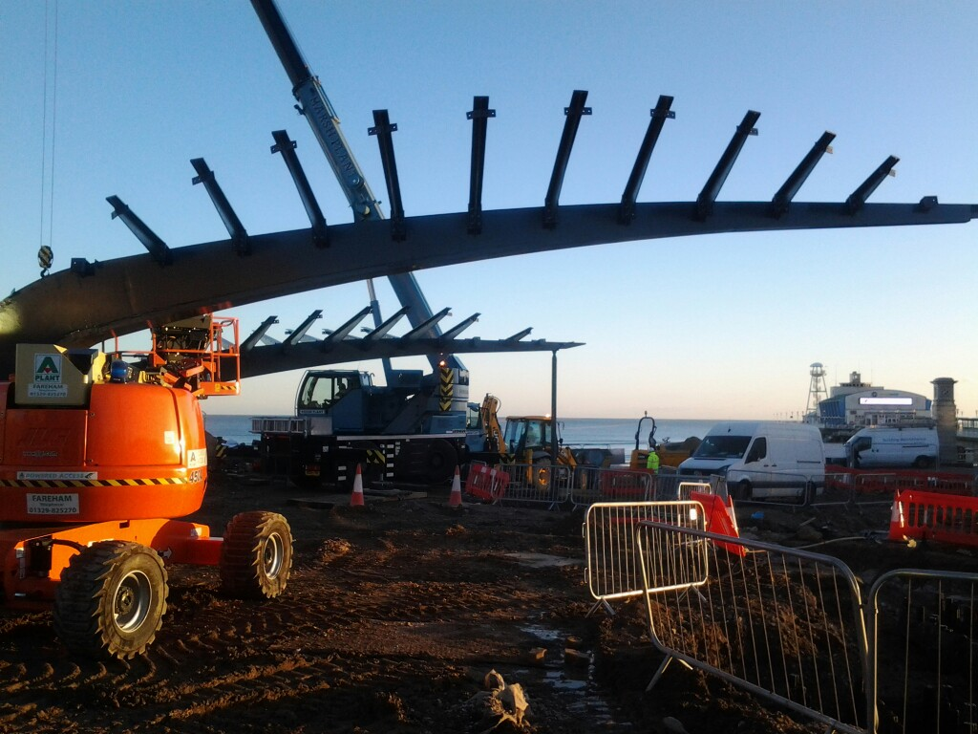
  What have we learnt
Need to think long term
Have a vision and create buy in
One suit does not fit all so be flexible
Adapt to market conditions

Slide 10
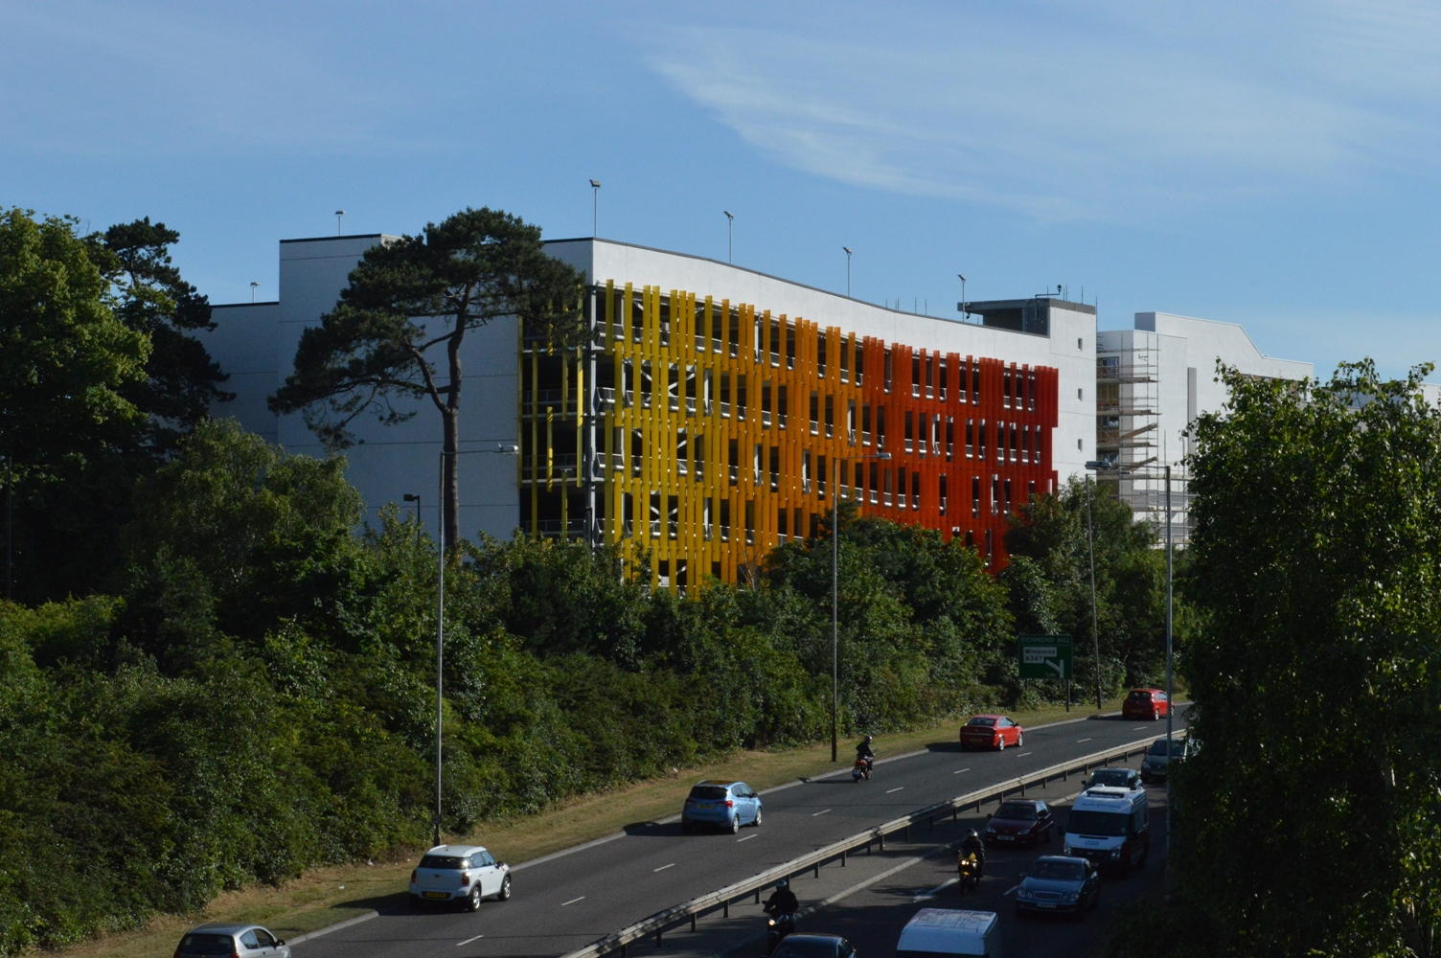
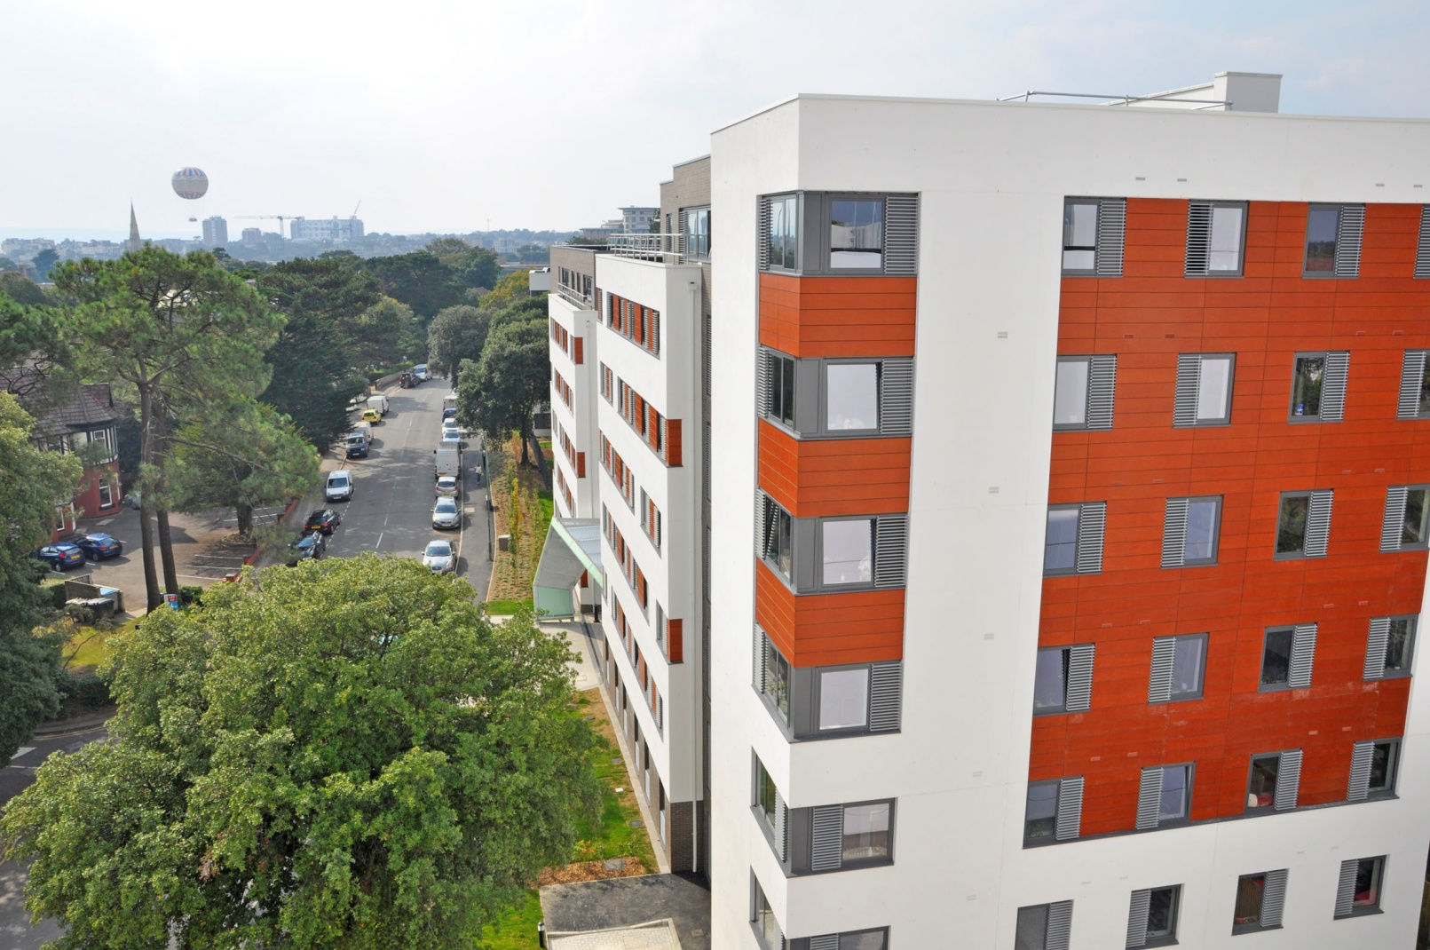
Measure of Success
Tower cranes dominating the skyline?
Voted No 1 retail hotspot in the UK?
Top 5 performing town?
£200 million of development commenced in the last 18 months. £300 million in the pipeline over the next 2/3 years.

Slide 11
Any questions?
www.towncentrevision.co.uk

