Slide 1
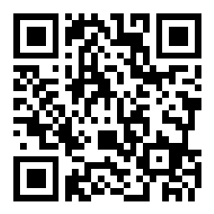
PAS & Political Groups’ Planning Update:
Planning in 2024
Independent & Green Party Group
February 2024
Due to the large number of people booked to attend we will be collecting questions via slido which can be accessed via the QR or the link below
https://app.sli.do/event/kXanf5BxKHkEVjVEyyGQkf
We will be recording the presentations
– please keep your microphones on mute

Slide 2
PAS & Independent & Green Party Group: Planning in 2024
Local Plans – Sarah Lewis
Development Management – Peter Ford
Planning for the Environment – Krista Patrick
Planning Peer Role – Steve Barker &
Cllr Julian German (Cornwall)
Q&A
Due to the large number of people booked to attend we will be collecting questions via slido which can be accessed via the QR or the link below
https://app.sli.do/event/kXanf5BxKHkEVjVEyyGQkf

Slide 3
PAS Political Groups’ Planning Update:
Local Plans
- Feb 2024, Sarah Lewis, PAS
What we will cover in this session
Recent & important developments
PAS work supporting councils
Our learning
What is on the horizon?

Slide 4
National Planning Policy Framework (NPPF) (1)
Revised NPPF 20 Dec 2023:
“Preparing & maintaining up-to-date plans; a priority”
Targets / housing numbers:
Standard method for calculating housing need: ‘advisory’
Incentives to get plans in place:
No requirement to annually update 5-year Housing Land Supply
if plan is less than 5 years’ old (from adoption)
Notes:
National Planning Policy Framework
20th Dec 2023 – Revised National Planning Policy Framework (NPPF). Key overall message is “get your plan in place” - preparing and maintaining up-to-date plans should be seen as a priority…”
Targets/housing numbers - Calculating Housing Need – not much has changed. Use of government’s standard method is still the default – and the wording accompanying it says that it is an ‘advisory starting point’ – which is really just bringing PPG wording (about the standard method approach being a ‘starting point’) into the NPPF and adding the word ‘advisory’. Remember: Standard method = Need. Local Plan delivers the ‘requirement’ (need after constraints factored in).
Incentives – Local planning authorities are not required to identify and update annually a supply of specific deliverable sites sufficient to provide a minimum of five years’ worth of housing for decision making purposes if adopted plan is less than 5 years’ old (NPPF Paragraph 76). Also, if plan is at advanced stage of preparation (NPPF paragraph 226), then only need to demo a 4-year housing land supply until plan adopted.

Slide 5
National Planning Policy Framework (NPPF) (2)
Green Belt:
Reviews ‘no requirement’, but LPAs may ‘choose to’
NPPF consultation linked GB reviews to housing, published NPPF didn’t make this link
35% Housing Urban Uplift now part of NPPF
Soundness test – “justified” requirement remains
Transition – new NPPF applies to plans at Reg 19 (or beyond) after 19 March 2024.
Notes:
Green Belt – (NPPF paragraph 145) The version of wording consulted on in December 2022 didn’t make it into NPPF (this wording said that LPAs would not have to review their green belt if that was the only means of meeting housing numbers). Main change is that there is no link to housing, and the wording now says that LPAs are ‘not required’ to carry out a green belt review, BUT it goes on to say that councils ‘may choose to review in exceptional circumstances’. So not a trump card as many thought (if the wording stayed as per the consulted on NPPF), but the ‘no requirement’ wording may embolden LPAs to not review/consider reviewing the green belt to meet housing need. However, at exam they may have to explain why they didn’t review green belt if they are not intending to meet housing need (there is this notion that inspectors will test whether councils have ‘left no stone unturned’ when looking for land to deliver housing need.
35% housing Urban uplift for cities now incorporated from PPG. Urban uplift for cities now incorporated into NPPF (paragraph 62). Always been controversial but including it in NPPF shows Govt is committed to it. There is an Interesting potential tension now for cities when combined with the green belt review situation highlighted in above bullet point.
Soundness test – ‘justified’ requirement stays. It was proposed to remove this to make the examination process easier, however not having to demonstrate that the local plan is ‘justified’ has been robustly challenged in the consultation process and (many say) rightly abandoned.
Transition New NPPF applies to plans reaching Reg 19 after 19 March 2024. So if plan has already reached this point or been submitted for examination then previous NPPF applies – so all those that paused after Reg 19 or examination wasted their time to take any advantages in the new NPPF.

Slide 6
Local Plans
Appetite for ‘intervention’ is growing
7 councils ‘directed’
Reviewing local plans
Good practice to review local plan against 2023 NPPF
Updating local plans – current system / new system
Submission deadline for examination 30th June 2025
Duty to cooperate still relevant
Notes:
Appetite for intervention is growing. Gove’s WMS on 19 December 2023. 7 councils directed to produce timetables (Local Development Scheme (LDS)) Lee Rowley is also coming down heavier on DM – signs of a growing government appetite for performance intervention
Reviewing Plans / New NPPF – all councils should be reviewing the effect of the new NPPF on the Local Plan.
Updating plans - Current system - If updating local plan in current system – plan submission for examination has to be on or before 30th June 2025. Lots of councils assuming that the duty to cooperate is no longer required. It has been rescinded (as part of LURA) but that part of the LURA has not been enacted, so still part of current planning law, PLUS all government communications refer to the duty to cooperate being part of the system of examination of local plans submitted on or before 30th June 2025.

Slide 7
PAS Support
Directly supporting the plan making process:
Project Management / resourcing
Evidence Base
Duty to Cooperate – critical friend, current system focus
Prototyping: templates, tools, how-to’s and examples:
Supporting the proposed planning reforms
Councils ‘between planning systems’
Networks, Topic-Based Events , Training Modules
Website: tools, case studies
Notes:
Direct support:
Critical friend assessments.
Advice Notes (executive summary, detailed assessment, risk and mitigations, recommendations
Follow up support
Prototyping - supporting the proposed planning reforms e.g. PID, EOR, IDS and planning in the policy ‘grey area’ (the councils that are ‘between planning systems’
Networks, events (e.g. reforms events, Supplementary Plan events) and Training (these speak for themselves)

Slide 8
What have we learned?
What is important to get right?
Programme – (Project management)
Decision making - (Governance)
Consultation & Engagement (esp. statutory cons)
Evidence (proportionality, risk averse)
Leadership - (Council’s plan)
Notes:
Intro – not got time for exhaustive list/masses of detail, but from our work with councils these are the areas that need addressing if we are going to make plan making more efficient and effective – and overall speed things up. Not rocket science, nothing new.
Programme – (Project management). Often we find that project plans councils work with do not contain sufficient enough detail, or haven’t realistically factored in the available resources properly which makes the project plan unrealistic or unachievable. Or, we find that project plans are created for the stage at hand and not beyond, so often councils will have a project plan to get them to Reg18, and then have to produce another detailed plan programme for Regulation 19 which takes time whereas perhaps setting out a fuller project plan at the outset can save time later by having a project plan that can be refined rather than having to start from scratch at each stage.
Decision making - (Governance). And then there is governance. Often, we work with councils where governance arrangements aren’t clear – it is important to have a clear governance structure for the production of the local plan so that it is clear which types of decisions can be made quickly (perhaps by officers or within a working group including members), and those that need a wider consultation and therefore the lead-in times for these decisions and sign-offs can be factored in to the project plan, rather than having to decide as and when things arise. Some decisions can wait months while waiting for internal committee cycles to come around.
Consultation & Engagement (esp. stat cons). External consultees – work to different timetables, have different priorities, their own resource pressures. Reformed system exploring ways to improve things, but there are ways of doing this now – down to good planning, forging constructive relationships/contacts, understanding agendas etc.
Evidence (proportionality, risk averse, housing numbers). Solution: encouraging signals in consultation about providing overarching guidance on what ‘good and proportionate evidence looks like’, protecting evidence bases from challenge.
Leadership - (Council’s plan), the time it takes plans to get made often leaves them vulnerable to changes in leadership and political control. This is why it’s important that the local plan is developed in the best interests of whole communities, that the local plan is a corporate priority, and that the governance arrangements are robust and can protect the plan as far as possible from wholesale change. The shortened 30 month cycle will also help.

Slide 9
On the Horizon…
Reformed Planning System:
Autumn 2024, 30-month plan making period
Levelling Up & Regeneration Act 2023
National Development Management Policies (NDMPs)
Street Votes
Infrastructure Levy
Net zero – Energy Efficiency Standards, Future Homes Standard 2025
Next Government….?
Notes:
Reformed planning system:
In October 2023, the Levelling Up & Regeneration Bill - now the Act (LURA) received royal ascent. LURA contains many changes to the planning system - many of which are yet to be enacted. Which brings us to December 2023 with the publication of the revised NPPF, and a Written Ministerial Statement from the Secretary of State (the long-term plan for housing). We now await details of the proposed reforms to the planning system due to be implemented in the Autumn of this year, 2024. Probably the most significant change is the 30-month plan. Go back to the first few slides of this session – IMPORTANT TO UNDERSTAND HOW THR TRANSITION BETWEEN THE CURRENT AND THE COMING SYSTEM AFFETCS YOUR LOCAL PLAN
Levelling Up & Regeneration Act – THINGS YOU SHOULD TAKE AN INTEREST IN AS THEY WILL HAVE A PARTICULAR IMPACT ON THE LOCAL PLAN AND YOUR COMMUNITIES
NDMPs –The policy areas that they would cover are likely to be limited to key, nationally important issues commonly encountered in making decisions on planning applications across the country, leaving development plans to deal with locally specific matters. The Government’s ambition is to support faster plan making by reducing the matters to be covered by the development plan without undermining community control. They key debates are around the ability for local councils to tweak/have their own ‘local’ take on a national policy.
Street Votes - The Levelling up and Regeneration Act 2023 introduces a new street votes process, where street vote development orders can be made by the Secretary of State on behalf of a group of individuals. These will grant planning permission for the development specified in the order for a particular area
Infrastructure Levy – attempting to find a fairer and more equitable means of securing developer contributions towards delivering the infrastructure that will help encourage a greater acceptance of development.
Net Zero – There is a separate session on planning and the environment – massive and still developing role for local plans, things are slowly changing for the better but we mustn’t pretend that the local plan alone is the vehicle to deliver our ambitions around the environment – the future has to be around how much ‘teeth’ the local plan can have in regards to, for example setting energy efficiency standards, and being able to be ambitious beyond anything over and above building regulations. New development is of course only part of the equation, and is dwarfed by requirements of retro fitting of existing buildings to bring them up to standard – however the longer we wait we are simply adding today to a stock of buildings that will tomorrow require upgrading. There was a WMS on energy efficiency standards that went out in December and the Future Homes standard for 2025 are current policy announcements that you should be interested in.

Slide 10
PAS Political Groups’ Planning Update:
Development Management (DM)
- Feb 2024, Peter Ford, PAS
In this section:
What is DM and why it’s important
The work we are currently doing to support councils
What we are learning
What's on the horizon in 2024
Source: Shutterstock

Slide 11
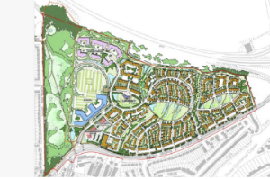
What is Development Management?
Planning applications – efficiency and outcomes
Local Planning Authorities and Planning Committee – quasi-judicial role
Planning enforcement
Source: BHCC website

Slide 12
What is important to know about DM?
local and national political interest
increase in permitted development
fees increase
recruitment and retention challenges
becoming more complex
performance rules changing
Source: Civil Service World

Slide 13
Councils in trouble
The number of councils designated increasing
17 councils currently at risk of designation over speed of decision-making
12 more councils in danger over quality – some duplication!
Source: Planning Resource
Notes:
Councils in Trouble
Performance measures
Speed: at least 70% of non Majors “in time”
Speed: at least 60% of Majors and County matters “in time”
Quality: no more than 10% of Majors and non Majors overturned at appeal
Agreed extensions of time are allowed
Three councils ow designated on the basis of quality

Slide 14
Work we are doing at the moment
Support for councils:
Supporting designated councils
DM-focused Peer Challenges
Planning Committee training and reviews
DM reviews
Appeals training
Customer service training
Web based support
PAS Bulletin
Notes:
Web based support and resources include:
DM challenge toolkit
Pre applications and Planning Performance Agreements
Scheme of delegation for Planning Committee
Code of conduct for Planning Committee
Officer reports (soon!)
These are prepared via engagement with the sector – we had a DM Focus group of over 10 councils earlier this week to discuss and agree best practice for officer reports

Slide 15
What we’re learning
The key to good decision-making is having an up-to-date Local Plan
Officers and Members need to work together and trained
Harder for councils to make quick and defendable decisions
Engaging with residents, agents and developers is more important than ever
Importance of investing in leadership and efficiency
Source: Readers’ Digest

Slide 16
What’s on the horizon for 2024?
More technical information required for decision-making e.g. BNG
More on design and ‘beauty’
More emphasis on designation for under-performing councils
Changes in performance criteria
Greater scrutiny of statutory consultees
Cost recovery for some application types
Source: IStock
Notes:
PD Rights bullet
Mainly permissive and about relaxing planning controls – example being the announcement this week on brownfield sites and tilted balance in top 20 cities. Mention Use classes and new short holiday let use class – more control

Slide 17
What’s on the horizon for 2024?
Action against irresponsible applicants
Introduction of street votes
National Development Management Policies
Changes to permitted development legislation
Income from increased fees – will it help?
Source: IStock
Notes:
PD Rights bullet
Mainly permissive and about relaxing planning controls – example being the announcement this week on brownfield sites and tilted balance in top 20 cities. Mention Use classes and new short holiday let use class – more control

Slide 18
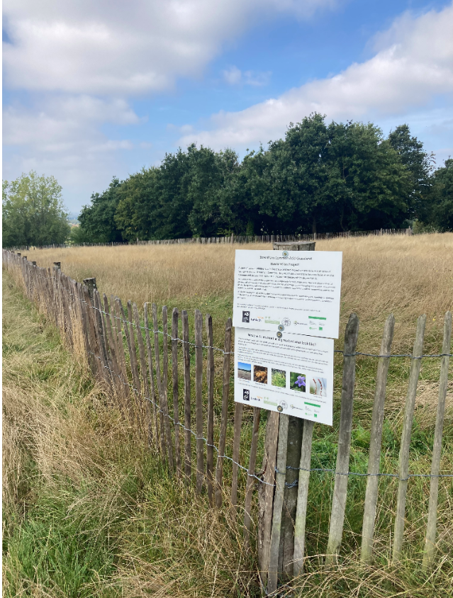
PAS Political Groups’ Planning Update:
Planning and the environment in 2024
- Feb 2024, Krista Patrick, PAS
An overview and guide to strategy for councils
What we will cover:
What are the hot topics?
How we can help
What we are learning and thinking
What’s on the horizon?
A crib sheet of questions

Slide 19
Hot topics in 2024
The Environment Act 2021 introduced lots of new things
Waste, air, water, nature, litter, reporting
It’s a big, long-term Act
Some of it we understand, other bits are works in progress
The role of local government feels important and relevant
Sometime the role is clear (biodiversity net gain)
Sometimes less clear (and not funded) eg coastal landfills
See also commitments on carbon, energy, infrastructure
Both national (2050) and maybe local ‘emergency’

Slide 20
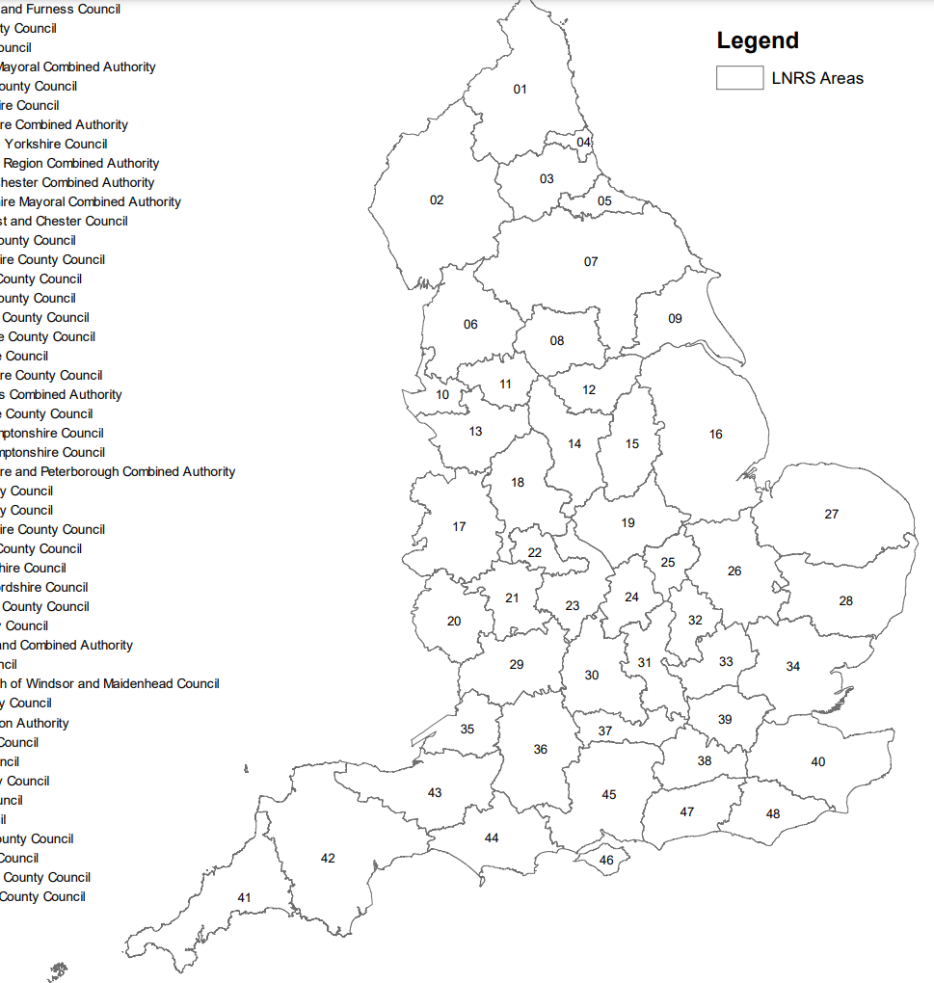
Hot topics in 2024
Local Nature Recovery Strategy
48 areas – a strategic approach to nature
First time. Finished March 2025 (?)
And then a strategy to deliver?
Mandatory 10% increase in biodiversity
BNG net gain / via planning applications 2024
Protected Site Strategies
New! Local and specific
Alongside sharpening focus on water and rivers
Availability, quality, flooding

Slide 21
How we can help
The environmental planning side of PAS is quite new
We now work with DLUHC, Defra and Natural England
At the moment mostly officer-centric
Technical and regulatory
But we recognise that politicians are central to providing leadership and long-term commitment
Many of your councils contain passionate people who don’t know how to get heard alongside pressure of budgets etc.

Slide 22
How we can help
BNG support and network
800 people belong to our BNG officer network
Training videos, readiness checklist, Councillor’s guide
Nature toolkit
What can councils do differently for nature? Launch Spring
Nutrient neutrality
Working with catchments who have been awarded £
Protected site strategies
Pilots and R&D. Launch in Spring

Slide 23
What are we learning / thinking?
This is all quite new
Do we understand the role for local government?
Incentives, risks, opportunities
Land owners, operators
The environment = “hot topic” for communities
There is a gap between new duties and funding
BNG has some £, some nutrients have £
This is much bigger than planning (and councils)
How do we involve farmers? How do we resolve competing land uses? How do we reconcile the different needs and opportunities in cities and countryside?

Slide 24
What are we learning / thinking?
Thinking about nature (at last!)
The model shifts from “protect” to “enhance”
a long-term commitment (30 years)
Nature is more relatable than carbon and climate?
Alongside market forces and supply and demand
Habitat as an investable proposition (eg Environment Bank)
Councils setting up SPVs (eg Norfolk)
Habitats, nature, biodiversity, health, economy, carbon – it’s all linked so where to start?
And how ambitious to be?

Slide 25
What’s on the horizon?
Building on the Environmental Improvement Plan (EIP)
What does this mean for councils?
Government push to speed up delivery (“project speed”)
Push to speed up infrastructure for energy, water
Simplifying Environmental bureaucracy (EOR)

Slide 26
What’s on the horizon?
Increasing public pressure on water, air, energy
Eg River Action, OEP
Also increasing pressure in the opposite direction
LTNs, pylons, reservoirs
Councils considering
Land into biodiversity banks – improve maintain for 30 years
Nature and operations - Eg Highways and public spaces

Slide 27
A cribsheet of questions
Are we ready for the basics?
Biodiversity net gain is coming
Ecology? Planning Committee?
Green infrastructure standards and local context
Local plan policy intentions?
Have you reviewed whether this matters much
Does nature help deliver corporate objectives?
How does it get air time amongst all the other priorities?
Community perspectives and buy-in?
Do staff know?

Slide 28
A cribsheet of questions
Have you already started the journey?
Have you organised yourself to do things differently?
Directorates, portfolios. A “champion”?
Projects / outcomes?
Beyond talking, doing?
Have you reviewed your opportunities
Land? Generating credits?
Corporate objectives and development? (eg green infrastructure / access to nature / tree cover)
Bids / funds
What does success look like in the short & medium term?

Slide 29
PAS Political Groups’ Planning Update:
Bringing it all together: Member Peers
- Feb 2024, Steve Barker, PAS & Cllr Julian German (Cornwall)
The Planning Peer Role
Opportunities for Members
Political Perspective
Learning & Improve’t
Critical Friend
Planning Peer Challenge
an expert team
Planning Committee Reviews
targeted development
Planning Committee Training
essentials of decision making
Individual mentoring & development
cllr.adam.paynter@cornwall.gov.uk
independent.grouplga@local.gov.uk
Notes:
So we would like to finish off this session by bringing things together and discussing the important role that you as local members play
Within the planning process the role of officers and elected members is intrinsic to the process, they work together through a number of different roles; policy and portfolio holder and policy steering committees, DM officers and planning committee members, and all ward councillors engagemnet with their communities on planning matters in their wards. – and these roles are not just from within the lead part.
We have covered a lot of ground in this session!
Reminded us all what a key role your local authority plays through its local planning functions
Sometimes the scope of that work can be quite humbling – local plan preparation, development management and decision making, infrastructure delivery, environmental improvement and protection all have their own areas of expertise and specialism which many members develop in their role as a portfolio holder or on a planning committee,
Fundamentally, as locally elected members, planning committee chairs and planning portfolio holders, I am sure that your response to this massive agenda is to try and answer some bigger questions:
“What does all this mean for my community and my local authority?”; “
“How do we as a Council make sense of all this to deliver the best service we can?”; and
“What does it mean for our planning priorities locally and how do we organise ourselves to deliver these?”
And it is this local elected member perspective that PAS also needs as we deliver our work in local authorities.
To do this, we rely on planning portfolio holders and experienced planning committee members to come forward to work with us as “member peers” who can help us deliver key aspects of our improvement programme.
A member peer brings a political perspective to our work, acting as a critical friend in another local authority and sharing their experience or insights with local members so that they can learn and improve
We need the advice of Member Peers as they understand the current challenges faced by local councils and bring credibility, trust and mutual respect to the work that PAS does. They engage and listen, explore and question, and work as a team to bring innovative ideas and experiences from elsewhere to local authorities.
So we are always keen to promote the role of member peers and encourage more planning portfolio holders or planning committee chairs to put themselves forward to become a “Member Peer” so they can help us to deliver our work, in particularly things like:
Planning Peer Challenges – where a team of external officers and members go to another local authority to review how they are delivering their planning service and help them to identify areas for improvement
Planning Committee Reviews – where PAS officers and member peers observe a local planning committee in action and bring back a report to suggest improvements to the way they operate
Planning Committee Training – one of our most popular services, where councils have new members on their committee or have been experiencing problems with the way it operates, and bring PAS in to train members on their role in the decision-making process
Individual mentoring – a new planning committee chair or portfolio requests 1:1 support and advice and we buddy them up with a more experienced member in another authority
There are lots of opportunities for you to share the expertise you have developed in your role and help PAS improve the quality of local planning practice across our sector. This is very rewarding work, but it can also be quite intense and demanding!
Cllr Adam Paynter as our National Lead Peer and also the Group Office.
cllr.adam.paynter@cornwall.gov.uk
independent.grouplga@local.gov.uk
So we wanted to pass you onto one our existing members peers to hear first-hand what is involved and why he does this work with PAS …… [Hand Over to Cllr Julian German)

Slide 30
Thank you & questions
Email pas@local.gov.uk
Web www.local.gov.uk/pas
Phone 020 7664 3000
Twitter @Pas_Team

