Slide 2
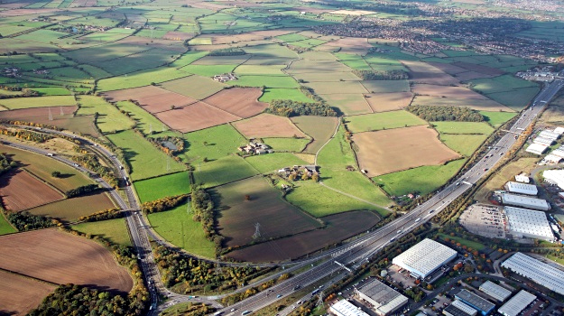

Development Services
Blaby District Council

Slide 3
Blaby District
The District covers 129km²
Situated in the East Midlands to the south west of Leicester
The District is made up of diverse settlements; being a mix of urban and rural settlements
Large scale business parks and many major business headquarters are located in the District
Unemployment rate of 0.8%
Population of 95,000; expected to increase to 102,000 by 2021
Average house price is 7.2 times the average salary in the District

Slide 4
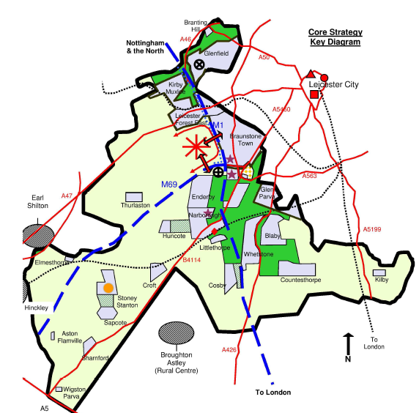
A Positive Planning Service
Fighting back from special measures
Comprehensive service approach
Customers
Members
Staff
What has worked well
On-going challenges

Slide 5
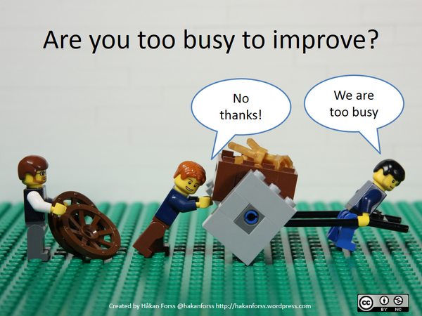

Slide 6

Start with good, reliable data

Slide 7
Systems Thinking
What did the Data tell us?
That we were driven by government targets (despite being a systems thinking authority!)
That our workload fluctuates throughout the year
There were 279 possible steps in our process for making a decision on a planning application
We had more failure demand than value demand

Slide 8


279

Slide 9
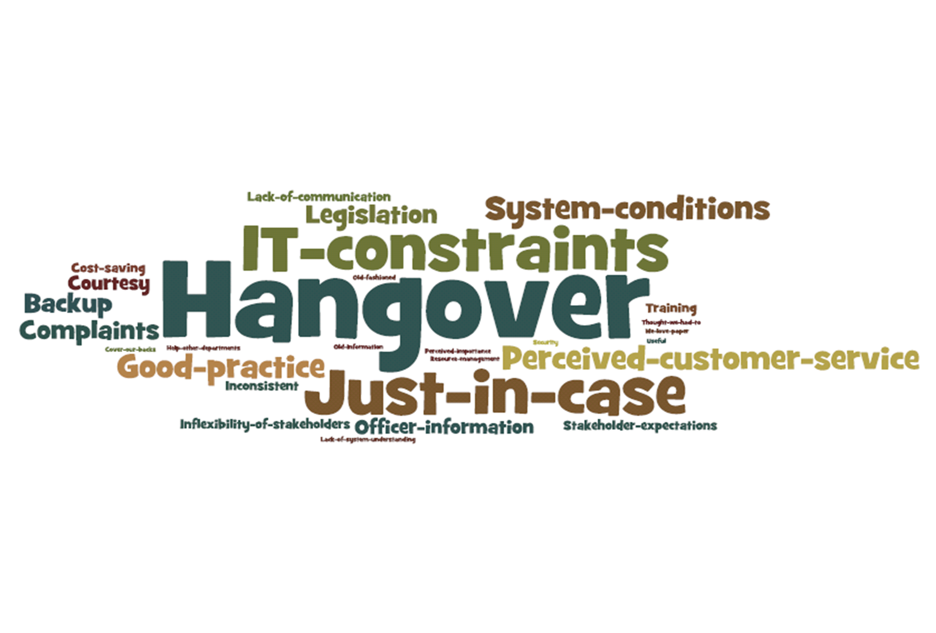

Slide 10

Our Purpose…
To ensure development is acceptable in planning terms.

Slide 11

Who are our Customers?
Our Customer…
  The person making an application or a pre-application request
  Everyone else is a
  Stakeholder
  The Planner!

Slide 12
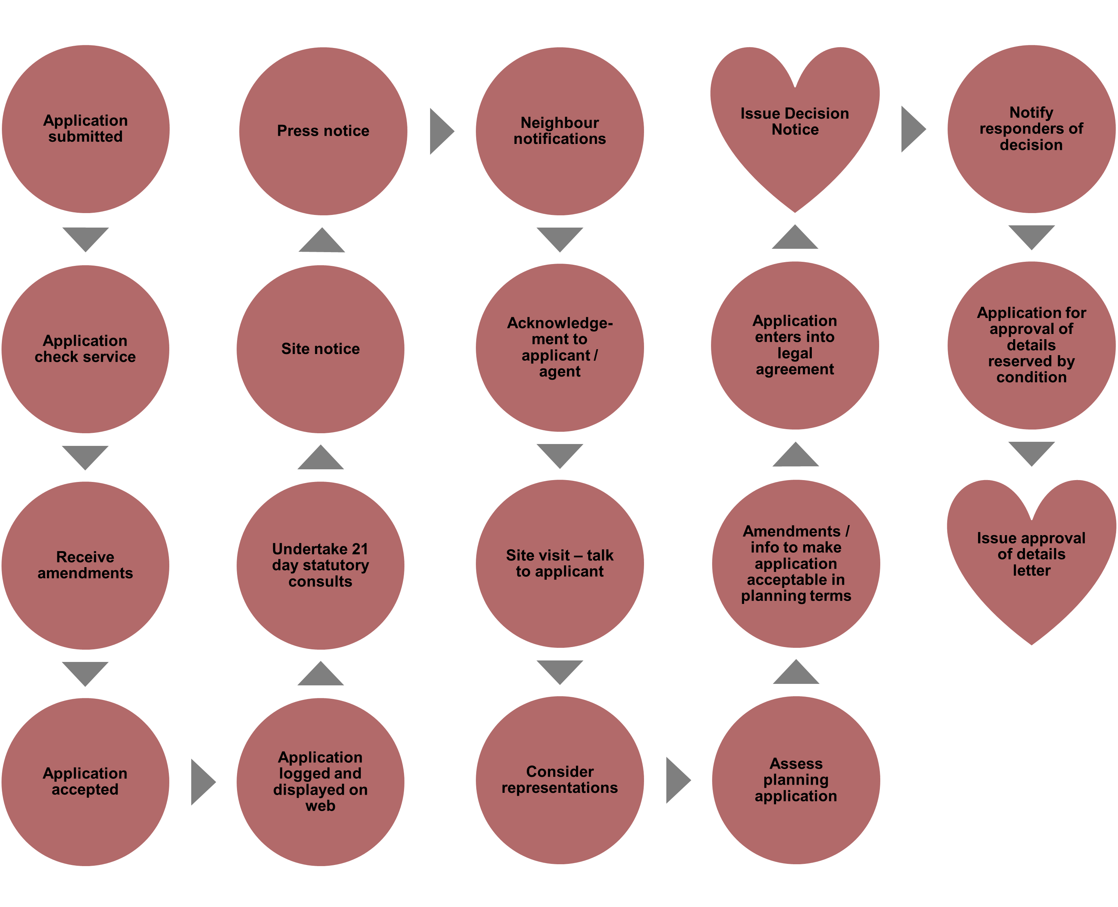

Slide 13

What has changed?
A free pre-application advice service
Working on one application at a time
All work is processed in date order
We do not have a local validation list
All Case Officers are responsible for managing their own workload
Case Officers do not take on new work until they have dealt with their existing workload
No separate validation process - the Case Officer deals with all aspects of the processing of an application
Senior Planning Officers making decisions on delegated applications – no second signature needed
Technicians have become Planning Officers

Slide 14

Planning Committee – reduction in the number of members of the committee, alterations to the room layout, better training etc
Where possible, the application is validated and the site visit takes place on the same day
Applicants encouraged to front load applications
Only one paper copy of all application documents needed
Consultations by email
Letters to local residents hand delivered
Statutory consultee comments displayed online
Case Officers working with applicants/agents to overcome issues

Slide 15
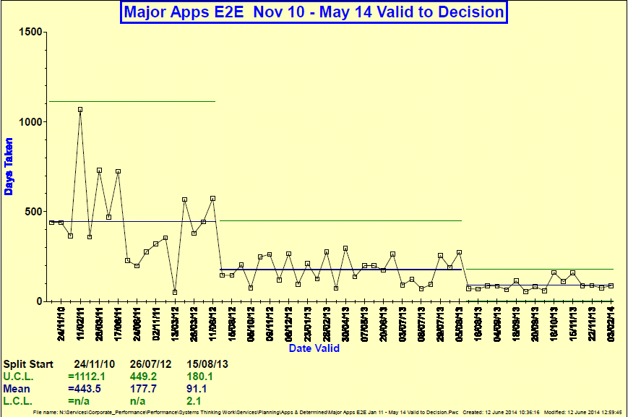

Performance
Blaby Lean Thinking

Slide 17

Savings - Financial
Blaby Lean Thinking

Slide 18
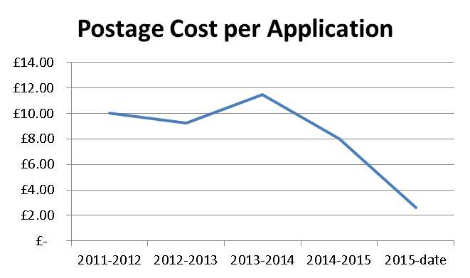

Slide 20

Savings - Time
Blaby Lean Thinking

Slide 21

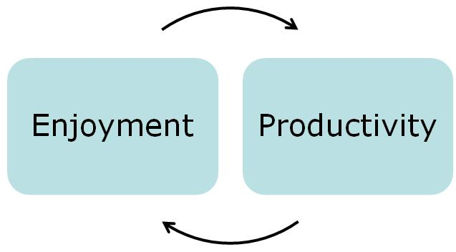

Morale

Slide 22
What next?
More data collection – have we improved? Has demand changed?
Improving information on our website to answer customers questions
How can we help customers submit a valid application first time?
Making it easier for customers to pay a fee
Making more historical planning information available online
A paperless office?

Slide 23
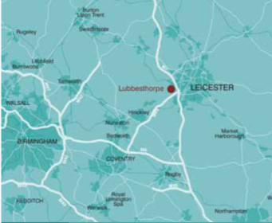
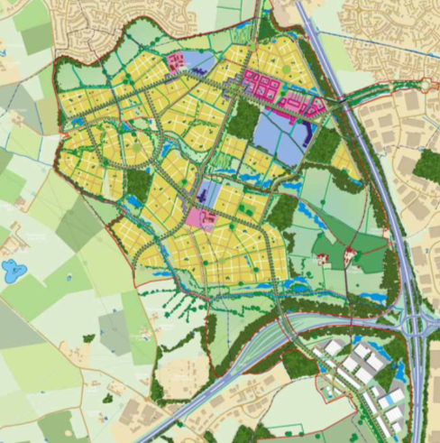
Lubbesthorpe New Community
Progressing key sites to approval
Compact and diverse sustainable new community to the west of Leicester (4,250 new homes)
21 ha employment
A proactive approach - project management and project plan
Corporate buy-in & leadership
Effective community, stakeholder & member engagement
Proactive approach to find solutions to infrastructure funding
Notes:
Set up nearly 3 years ago as a pilot project to help unblock major planning applications
We have a fairly unusual structure (PAS,CLG, EP) and whilst our primary ‘customer’ is local authorities we normally work with developers and other stakeholders providing impartial planning and development advice.
The key reason for our success is that we are perceived by all as being independent.

