Slide 1
Planning Advisory Service
Seminar 11th March 2015, Leeds
Renewable Energy

Slide 2
Centre for Sustainable Energy
Registered Charity, set up in 1979
Meeting twin challenges of rising energy costs and climate change through:
Giving energy advice to homeowners
Running energy efficiency programmes
Training
Research and policy analysis, to inform / influence government policy
Promoting community-led renewable energy projects
Promoting consideration in Neighbourhood Planning
Notes:
DS – Worked in CSE for 1 month
In RTPI
Previous experience:
BANES as a planner, dealing with renewable energy projects
Wind Prospect – as a Development Manager, trying to get planning permission for wind farms
Couldn’t claim to be an expert in what CSE does, but an interesting perspective, having seen renewable energy projects from most angles now.

Slide 3
Overview of Existing Situation
Policy Drivers:
Climate Change Act – 80% reduction in greenhouse gas emissions by 2050 (from 1990 baseline)
Renewable Energy Directive 2009 - 15% of its energy consumption from renewable sources by 2020.
UK Renewable Energy Roadmap – 30% of electricity from renewable sources by 2020.

Slide 4
Emissions in 2013 28% below 1990 level,
but
4th Carbon reduction budget commits UK to further 31% reduction from 2013 – 2025 (50% reduction from 1990). Further action / measures required to meet target.
Notes:
Climate Change Act requires yearly carbon Budgets - http://www.theccc.org.uk/wp-content/uploads/2014/07/CCC-Progress-Report-2014_web_2.pdf

Slide 5
https://www.gov.uk/government/uploads/system/uploads/attachment_data/file/386837/6_Renewables.pdf
Notes:
Currently between 18 – 20% against 30% target by 2020
Approx 5% of total energy consumption from renewables
Perspective from working in Commercial Wind Sector that all the easy sites have been done.

Slide 6
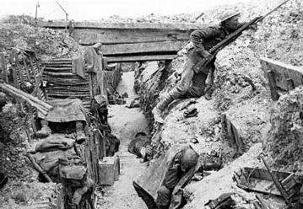
Commercial Wind Farm development – my perspective
Notes:
My perspective on working to take a commercial wind farm through the planning process - Attritional warfare on both sides, community and developer
Increasing call-ins
Politicisation of Big Wind
Huge Wasted resources: community energy fighting schemes, Community, private sector and public money resourcing planning appeals
Uncertainty for field based solar schemes

Slide 7
http://www.fabians.org.uk/wp-content/uploads/2015/01/TransitionByConsent_final.pdf
Notes:
This is reflected in Statistics

Slide 8
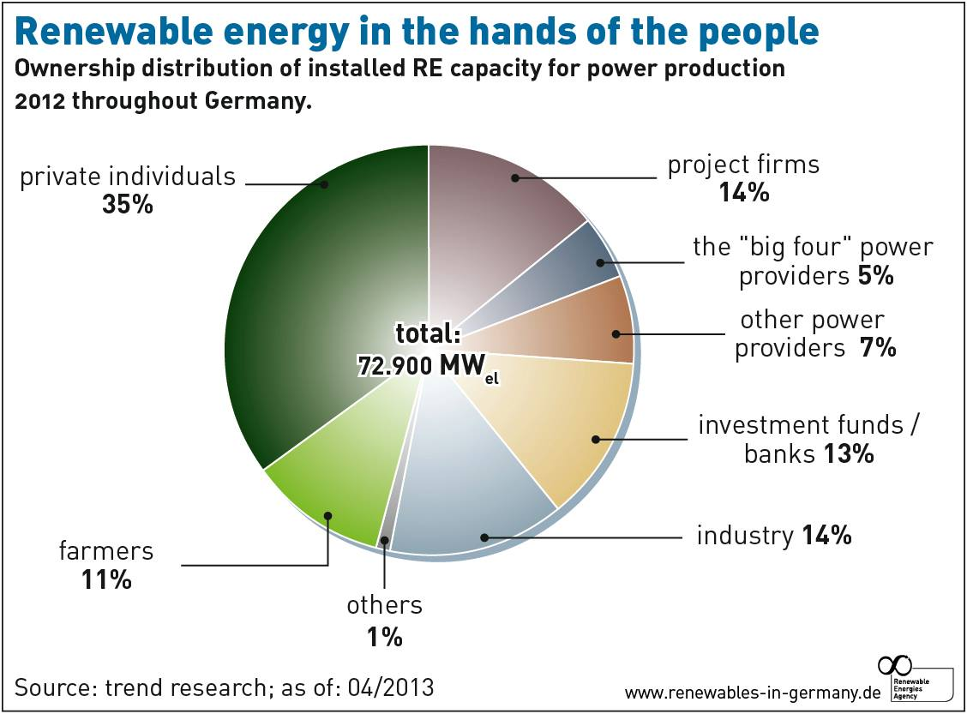
The German experience
Notes:
Renewable energy comprised 27% of total energy production in Germany in 2014
http://www.renewableenergyworld.com/rea/blog/post/2014/10/7-renewable-energy-lessons-from-germany
Also been key to the success of countries with more renewables e.g. Germany http://gaianeconomics.blogspot.co.uk/2013/09/the-wind-is-ours.html

Slide 9
Planning Policy favouring Community Led Renewables
National level: “Local Planning Authorities should.. support community-led initiatives for renewable and low carbon energy, including developments outside such areas being taken forward through neighbourhood planning”; para
97 NPPF.

Slide 10
National Community Energy Strategy (Jan 2014)
Wide range of ambition and potential for community generation – upper end = enough to power 1 million homes
Definition of ‘community’ – doesn’t include Local Authorities, Parish Councils or Social Landlords
BUT call to LAs for more recognition of positive benefits of community energy and a step-change in the support offered to projects
Stresses importance of partnerships
BANES cited – partnership working with Bath and West Community Energy (BWCE)
Identifies potential role for Neighbourhood Planning
Notes:
But LPA’ planning policy very much lagging behind

Slide 11
LPA - Community Renewable energy Policies - examples
http://www.bathnes.gov.uk/sites/default/files/sitedocuments/Planning-and-Building-Control/Planning-Policy/Placemaking-Plan/pmp_options.pdf
Notes:
Recognises the difference between community benefits (voluntary contributions) – not taken into account and community led schemes.

Slide 12
LPA Community Renewable energy Policies
Draft Cornwall Local Plan
‘Particular support will be given to renewable and low carbon energy generation developments that are led by, or meet the needs of local communities’. Such development would normally; be conceived and/or promoted within the community; and have as their primary purpose long term and inclusive economic, social and/or environmental benefits to the community.”
Notes:
1. Cornwall Local Plan policy stresses community involvement at project initiation stage, managing the use of the asset and allocation of any profit generated,.. community representation throughout the development of the project

Slide 13
Types of community benefit
Community-ownership = e.g. 1 turbine in a larger scheme
Community investment = e.g. through share issue
Benefit fund = annual payment; lump sum payment
Benefits in kind = voluntary local improvements
Socio-economic benefits = jobs, skills training, educational visits.
Material benefits = e.g. improved infrastructure
http://www.cornwall.gov.uk/media/10355169/Renewable-SPD-2014.pdf
Notes:
Recognises there is a spectrum, between outright community ownership, community-developer partnership and nothing
Most LPA’s are lagging behind, don’t have community energy policies.

Slide 14
Local Planning policy support for Community Renewables
Support for “community-led” renewables not always transferred into Local Plan policy, and community benefits not given weight in planning decisions. Why?
Planning permission goes with the land, not the applicant.
How to secure the community benefits in the long term / the ownership of the community asset. Legal agreement?
http://www.cornwall.gov.uk/media/10355169/Renewable-SPD-2014.pdf
Notes:
TCPA study of Adopted LP’s found only 4 in 10 had renewable energy policies specifically recognising community involvement
One idea for how to give community benefits weight / surety of delivery.
Community benefit society / Co-operative / Community Interest Company. The community asset protected by an asset lock, regulated by Financial Services Authority or Community Interest Company Regulator
Unanswered question – Would such a structure limit the potential to secure capital investment? E.g. Bank loan?

Slide 15
What are the benefits?
National carbon reduction targets
Energy security
Keeps money in the community
Could provide funds to addresses fuel poverty
Could fund improvements to local facilities
Community resilience & involvement
Stronger local economy & social capital
Pay interest to investors
Re-invest in local projects
Notes:
So the benefits of a community energy project depend very much on what the project is, who the intended beneficiaries are, when it’s set up, and of course the size and scope of the project.

Slide 16
Project ideas – renewable energy
Renewables on community buildings, domestic properties, standalone schemes…
Energy from waste
Biomass (individual systems / district heating) or woodfuel project
Solar water heating (solar thermal)
Solar PV panels (electricity)
Ground or air source heat pumps
Wind turbine
Small-scale hydro
Notes:
Most projects so far are wind / solar pv, but full range possible
Examples:
Awel Aman Tawe
Settle Hydro
Brighton Renewable Energy Co-op
Low Carbon West Oxford
Bath and West Energy Co-op
Low Carbon Gordano
Bristol Energy Co-op
Solar PV – BEC, Streets of solar; Wind – LCG

Slide 17
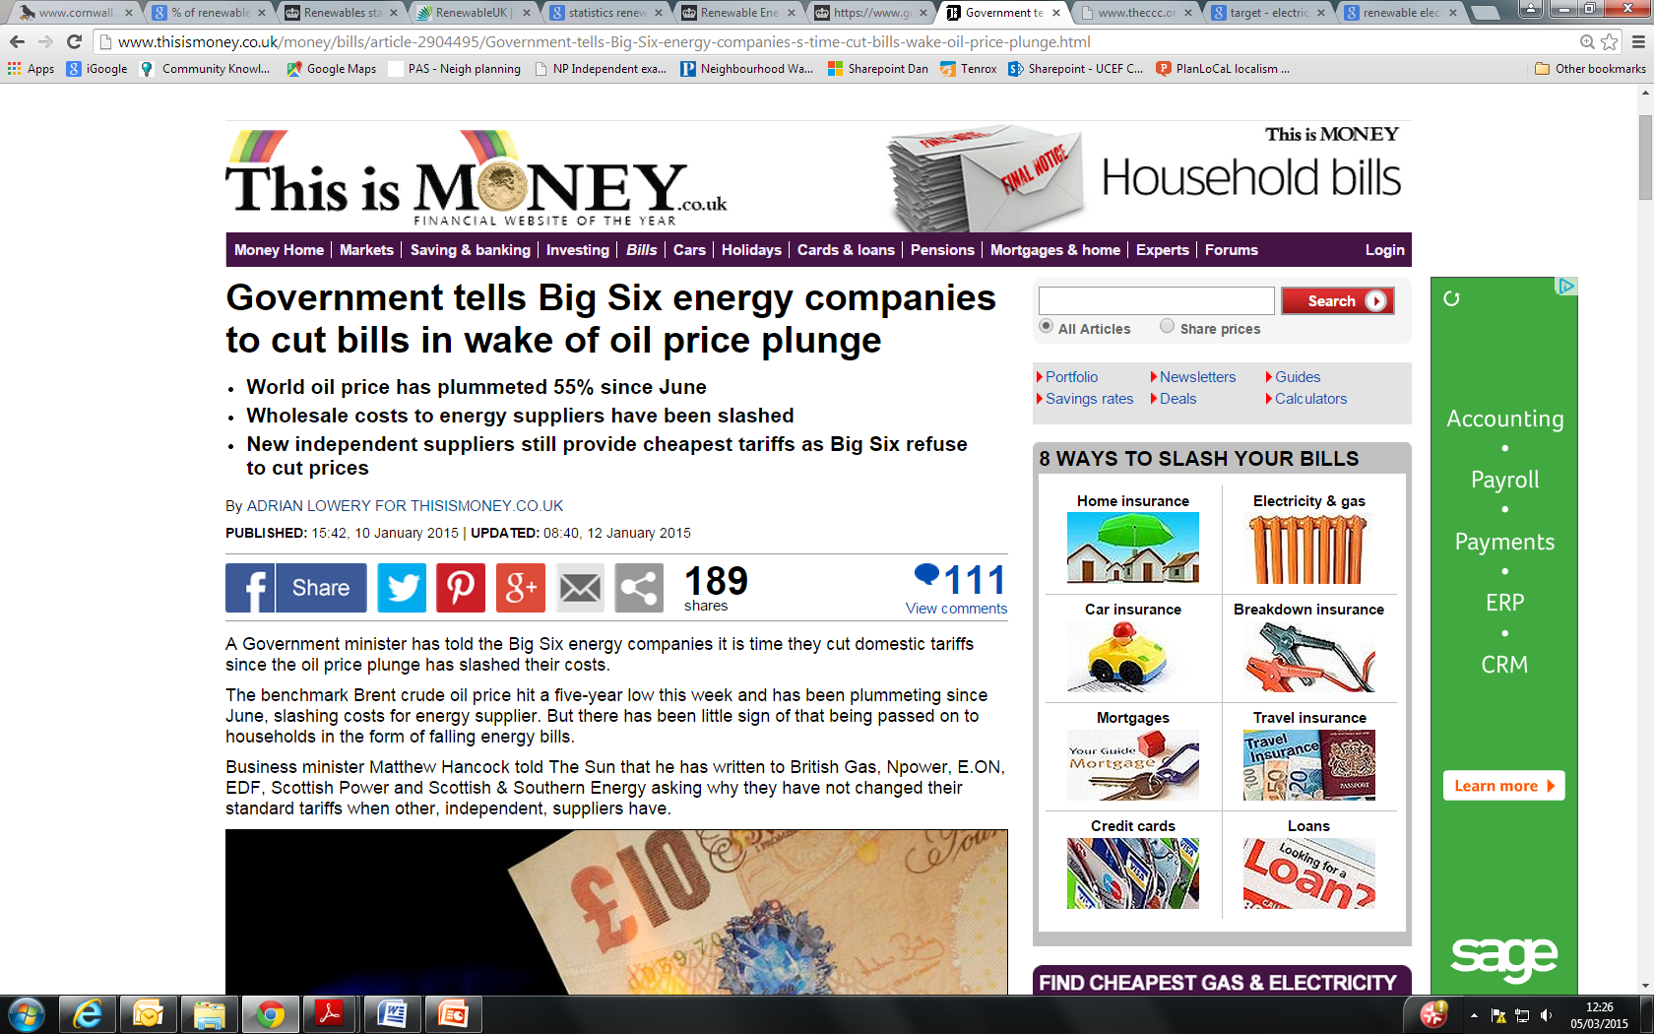
Notes:
Never have to go far to find a news article on the power of the “Big Six”

Slide 18
Urban Community Energy Fund
£10m Central Government fund
Administered by:
Centre for Sustainable Energy
Pure Leapfrog
Grants for feasibility work – up to £20,000
Local support?
What technology works?
Grid connection?
Loans for project development costs – up to £130,000
Planning permission?
Ecological permit?
https://www.gov.uk/urban-community-energy-fund
Notes:
Open since Jan 2015.
So far, approx 20 applications granted, totalling 6.2 MW :
Solar
Wind
Hydro
Anaerobic Digestion
Renewable Heat Networks

Slide 19
Neighbourhood Planning
2-year project to give detailed support to 10 Neighbourhood Planning Groups.
Objectives:
to integrate climate change and fuel poverty objectives into their neighbourhood plans
Attendance at committee meetings
Support with the delivery of public events/consultations
Research for developing an evidence base
Support with drafting policy
Notes:
Neighbourhood Planning – a great opportunity for greater community planning for resilience, including for a low-carbon and fuel-poverty ‘proofed’ future.l
A vehicle for talking about the future of a community - a test bed for policies.
Very fined grained approach possible with considerable variation: e.g. Laurence Weston - peripheral estate with poor housing stock, fuel poverty, poor transport links with employment centres and closing community resources.

Slide 20
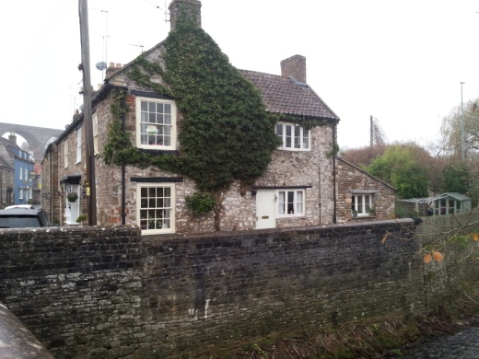
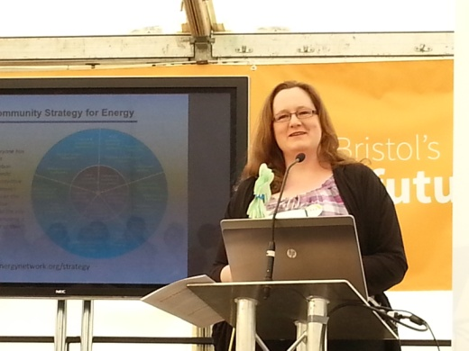
Ideas
A vehicle for debate / forming
consensus
Developing consensus for
community Renewables
Auditing of Building stock
Insulation / Draught proofing
Initiatives
Funded by Allowable Solutions fund
Contributions? (contributions for off-site abatement
from 2016 Carbon Neutral Homes requirements)
Upgrading community Buildings – retrofitting
With renewables
Renewable Energy policies
Notes:
- An opportunity to look at energy use / sustainability in the round
An opportunity to broaden out neighbourhood planning from dog poo and bins
CSE role – to facilitate communities interested in sustainability and energy to move from talk to consensus-making, then policy and plan making, project forming.
Tendency for Environment Groups to be passionate but isolated. Encouragement to treat sustainability as a theme through which talk about other issues.

Slide 21
Energy efficiency or renewables?
3. Generate
2. Reduce losses
1. Reduce demand
Power up
Power down
Notes:
Of course community energy not just about energy production, also consumption.
So. Energy efficiency or a renewable energy installation? It’s not an either-or choice.
If you want more ‘bang for your buck’ in terms of carbon reduction, ‘powering down’ - reducing energy use and using it more efficiently - is far more cost effective.
But ‘powering up’ with energy generating projects is perceived as more sexy and might get more people on board.
So sometimes turning the energy hierarchy upside down is not a bad thing.
1. Generate energy can be more attention grabbing, will get people to take notice and might generate income.
2. You can use that engagement and the income stream to do more around energy efficiency improvements and reducing energy use

Slide 22
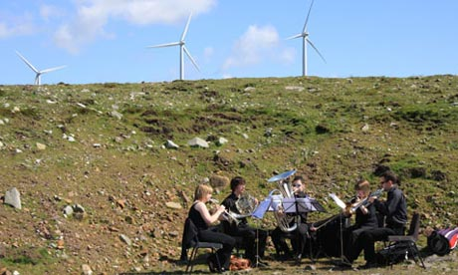
Case Study Fintry, scotland –
Feed-in Tariff payments have funded:
Energy advice line
energy efficiency upgrade of community buildings
Installation of domestic renewable energy systems at 22 properties:
6 Ground Source Heat Pumps,
7 Air Source Heat Pumps,
3 X 4kW Solar PV arrays,
5 solar thermal arrays,
2 X 16kW wind turbines
3 domestic biomass.
91 renewable energy installations so far
£500 grants to install energy saving measures such as wood burning stoves, double glazing, external insulation
Village community car club – electric car
Community Orchard
Draught-proofing workshops
Fintry Renewable Energy Show!
- Commercial Wind Farm
Community requested additional turbine for them to buy and own.
http://www.fintrydt.org.uk/

Slide 23
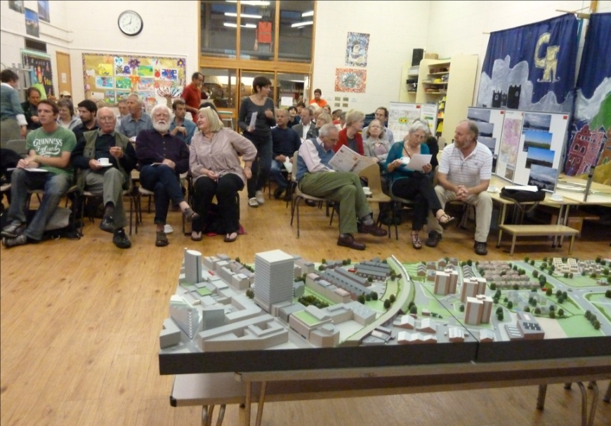
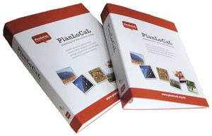
More ideas and resources
www.planlocal.org.uk
www.cse.org.uk/thesource
communities@cse.org.uk
Notes:
You don’t need to reinvent the wheel
There is lots of existing expertise, plenty of examples and free resources which have been developed to do the job, so you don’t need to start from scratch.
PlanLoCaL and The Source

Slide 24
Thanks for listening – any questions?
www.cse.org.uk | Sign up to our monthly enews at www.cse.org.uk/enews | follow CSE on Twitter
Centre for Sustainable Energy 3 St Peter's Court, Bedminster Parade, Bristol BS3 4AQ
0117 934 1419 (direct) | 0117 934 1400 (switchboard)

