Slide 1
Beyond the Duty to Co-operate…
…and towards strategic planning
Welcome!
1 March 2016
www.pas.gov.uk

Slide 2
Introduction
Andrew Pritchard
PAS Principal Consultant
Notes:
2

Slide 3
The Story So Far…
Keith Holland
Former PINS Assistant Director

Slide 4

Beyond the Duty to Co-operate…
…and towards effective strategic planning
www.pas.gov.uk

Slide 5
Background
Research into the Duty to Cooperate conducted by Shared Intelligence (Si) in 2015.
Involving interviews with over 100 planning officers, chief executives, lead members, leaders, and industry professionals.
Aiming to understand what concerns authorities have regarding the duty, and their current and future support needs.

Slide 6
Mixed views about the Duty
Research unearthed a wide mix of views about the Duty
From hostility from some who saw it as a “half measure” in the absence of “proper strategic planning”
To a cautious welcome as a locally-led alternative to the old “top down way of doing things”
Introduction of the Duty – “dropped in…at the last moment” - had created considerable confusion
Common view that it would not survive after the May election…

Slide 7
Learning curve
In that context, authorities had been on a steep learning curve
Initial perception that the Duty was a narrow process requirement
Replaced by an understanding that the Duty was a “pretty fundamental test”
Many officers faced an internal task of raising awareness amongst senior officers and elected members

Slide 8
Learning curve
“They thought regional officers had been abolished. It wasn’t – it was delegated”.
“The removal of top-down planning, whatever you thought of it, created a void”.
“Most now appreciate that the Duty is a pretty fundamental test”.
“We thought we were doing everything right. Up until the point we failed”.

Slide 9
Local context
The response to the Duty was shaped by local context
For areas with a history of cooperation and a shared / emerging vision, the Duty was a continuation of business as normal
“We have a strong bond [with neighbours]. The Duty just gives us another reason for talking at that strategic level, for seeing out inter-relationships”.

Slide 10
Local context
The response to the Duty was shaped by local context
For areas with a history of cooperation and a shared / emerging vision, the Duty was a continuation of business as normal.
For areas with little or such history and / or conflicting planning goals, the Duty raised issues that were not being answered – or even addressed
“We have a strong bond [with neighbours]. The Duty just gives us another reason for talking at that strategic level, for seeing out inter-relationships”.

Slide 11
Top 5 challenges
We asked interviewees to rate the main challenges facing their authority in terms of compliance:
“Agreeing a distribution of housing / employment land with neighbouring authorities”
“Doing effective cross-boundary strategic planning at the local authority level”
“Political differences”
“Lack of alignment with neighbouring areas in terms of local plan development”
“Capacity in the authority”

Slide 12
Reflections on the challenges
“If you have an uncooperative partner, and they’re prepared to put up with the consequences and blame the government, there is no real sanction.”
“It’s a hard duty to carry out effectively…The level of collaboration is a bit pick and mix as we’re all at different stages.”
“The difficulty is selling it to members.”

Slide 13
Support
We also asked interviewees to identify the features of a support package:
Bringing authorities together to focus on strategic, cross-boundary issues
Engaging elected member and senior managers
Providing a review / critical friend function
Illustrating examples of joint working arrangements
Working with individual authorities to develop capacity and raise awareness

Slide 14
Changing context
Devolution:
  operating at a level larger than and across strategic housing markets
  Delivering powers and resources that should enable faster delivery of planned homes
  Ramping up pressure for more housing to match ambitious growth plans
Mayoral corporations

Slide 15
That was then…
To what extent are those issues and concerns still relevant today?
What do we need to do to address them?
What other support needs remain?

Slide 16
Strategic investment plans: what they are, aren’t, and how they can really work

Slide 17
What are “area-wide strategic investment plans”?
  About plans which co-ordinate land use and infrastructure investment which cross boundaries
1) Emerging Combined Authorities Investment / Growth Plans
  Frantic devolution deals 2015: Treasury only really interested in
    A) Elected mayor as focus of responsibility
    B) Strategic planning powers for investment
  Different results in different places: Manchester, Sheffield, NE, Liverpool Mayor taking on strategic planning powers;
  Tees Valley, West Midlands CA – Mayors have smaller (stated) role
  2) Emerging Regional Partnership Investment Plans / Strategies
  (eg Northern Gateway HS2 - Stoke, Crewe, Cheshire)
3) Local authority cross-border investment plans
  eg some London Opportunity Area DIFS, County documents

Slide 18
Saving money through joint commissioning
Scale economies exist through joint commissioning
But not the real benefit?
Benefits are in
  quality of output arising from looking at wider spatial scale
  greater ability to lever meaningful infrastructure investment able to trigger private investment

Slide 19

Strategic investment plans are not about this
Notes:
These
This bloke is doing something unspeakable to Birmingham
He thought he could put his head under a towel and come up with the answer
He can’t
Modern economies are too complex and fast moving

Slide 20

They’re about this: innovation and information flows

Slide 21

Strategic investment plans are not about this

Slide 22
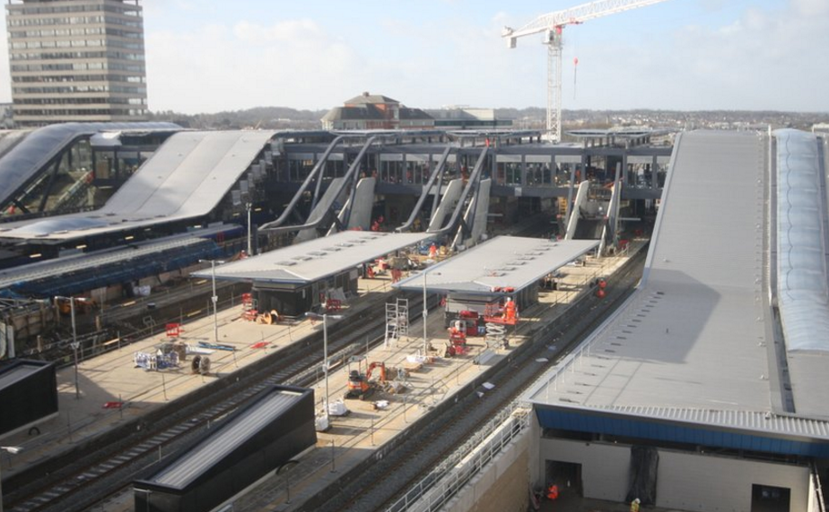
They’re about this: improving underlying economic geographies
Notes:
the project they need, not the project we want to do

Slide 23
Strategic investment plans are not about this (not really)

Slide 24

They’re about this: stimulating private sector investment

Slide 25

They’re about this: stimulating private sector investment
Your challenge:
To set up investible propositions that will get delivered
Through de-risking investment
Making intelligent use of any capital spend available

Slide 26
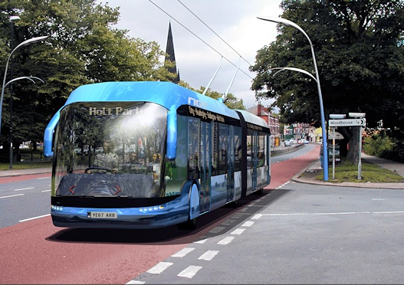
Information de-risks investment: quality

Slide 27

Information de-risks investment: neighbours

Slide 28

Information de-risks investment: S106/CIL (land price)

Slide 29
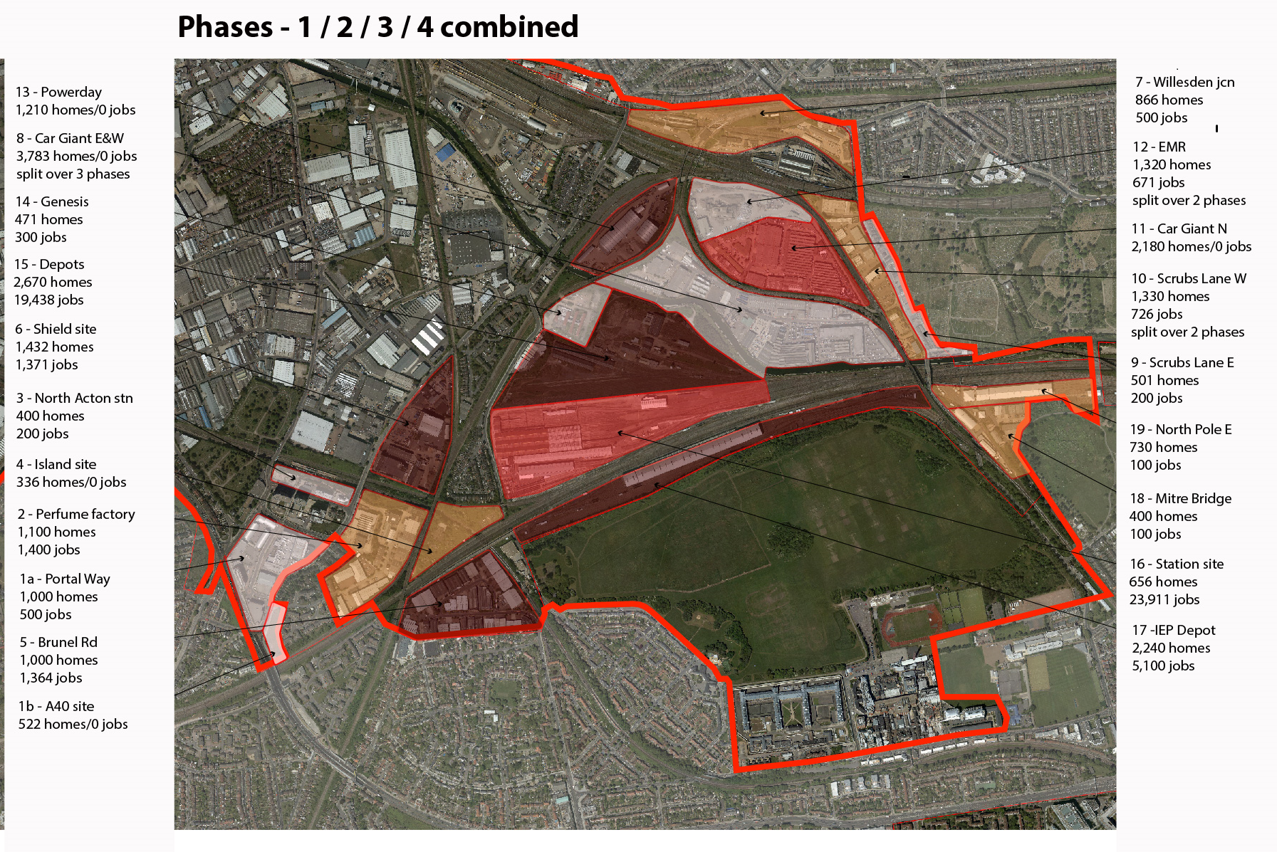
Information de-risks investment: co-ordination

Slide 30
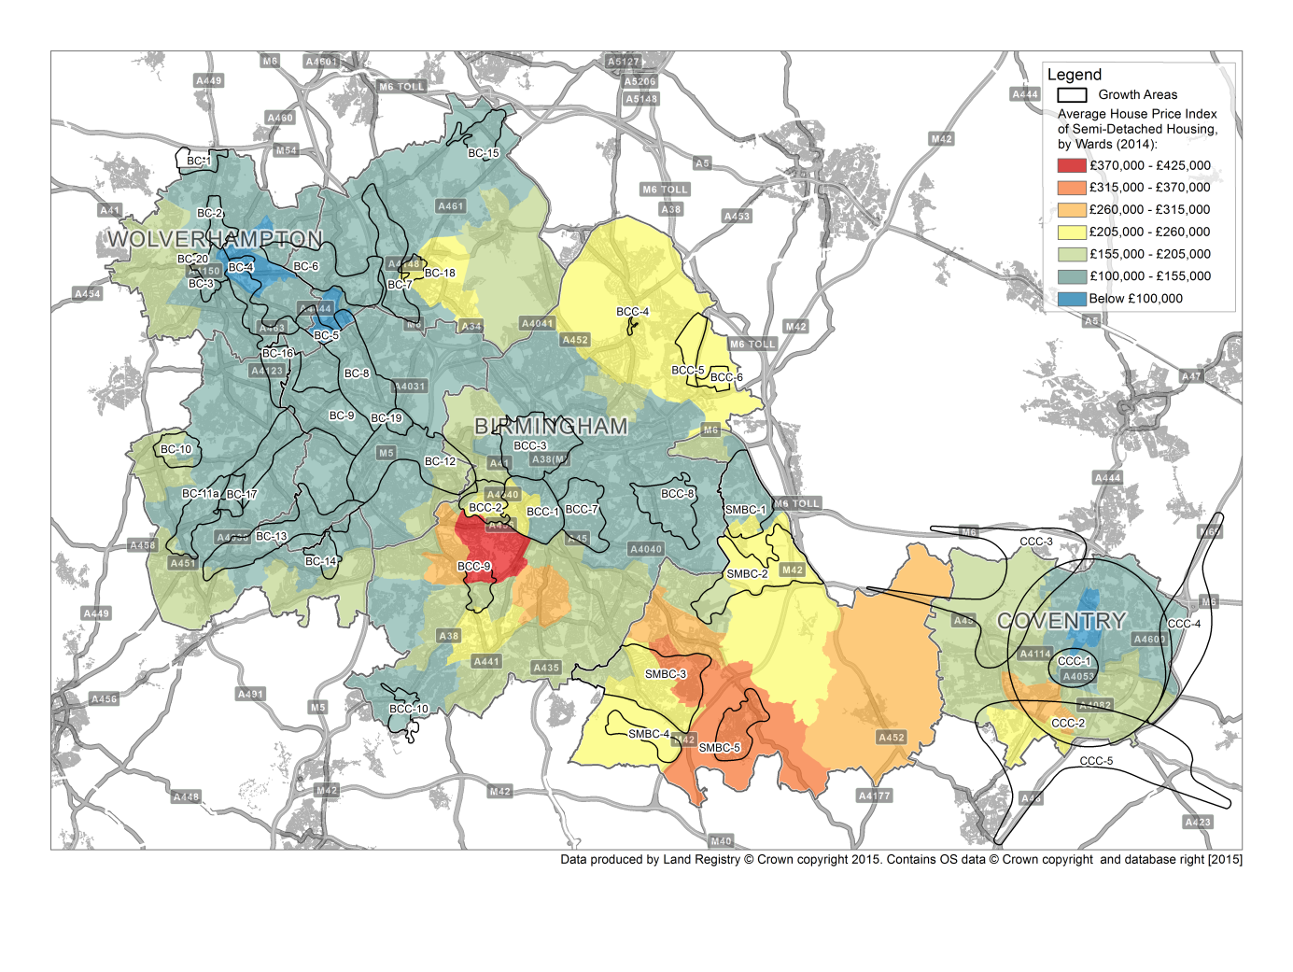
Example: West Midlands – contaminated sites, lack of viability, fractured plans?

Slide 31
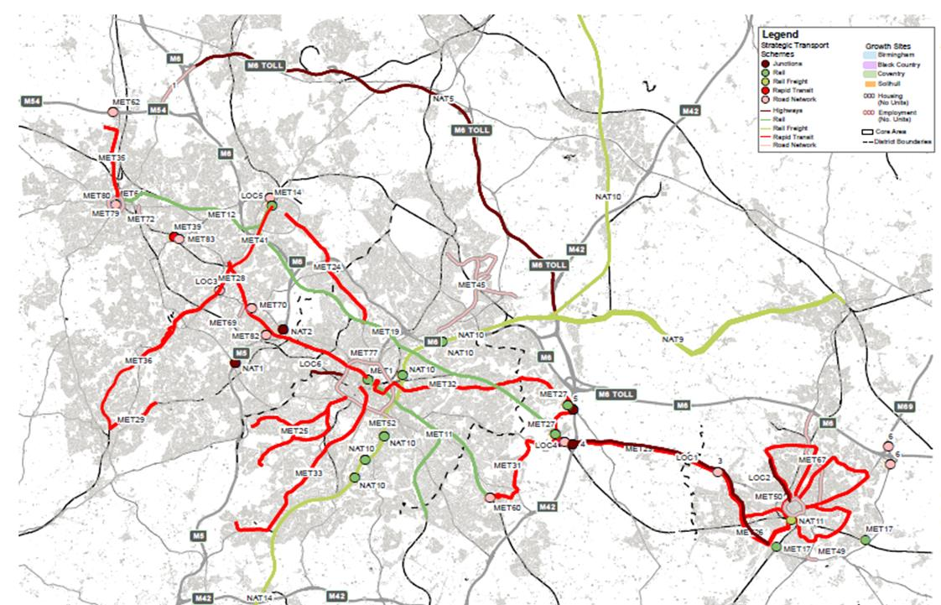
Integrating infrastructure and focused site delivery to accelerate investment

Slide 32
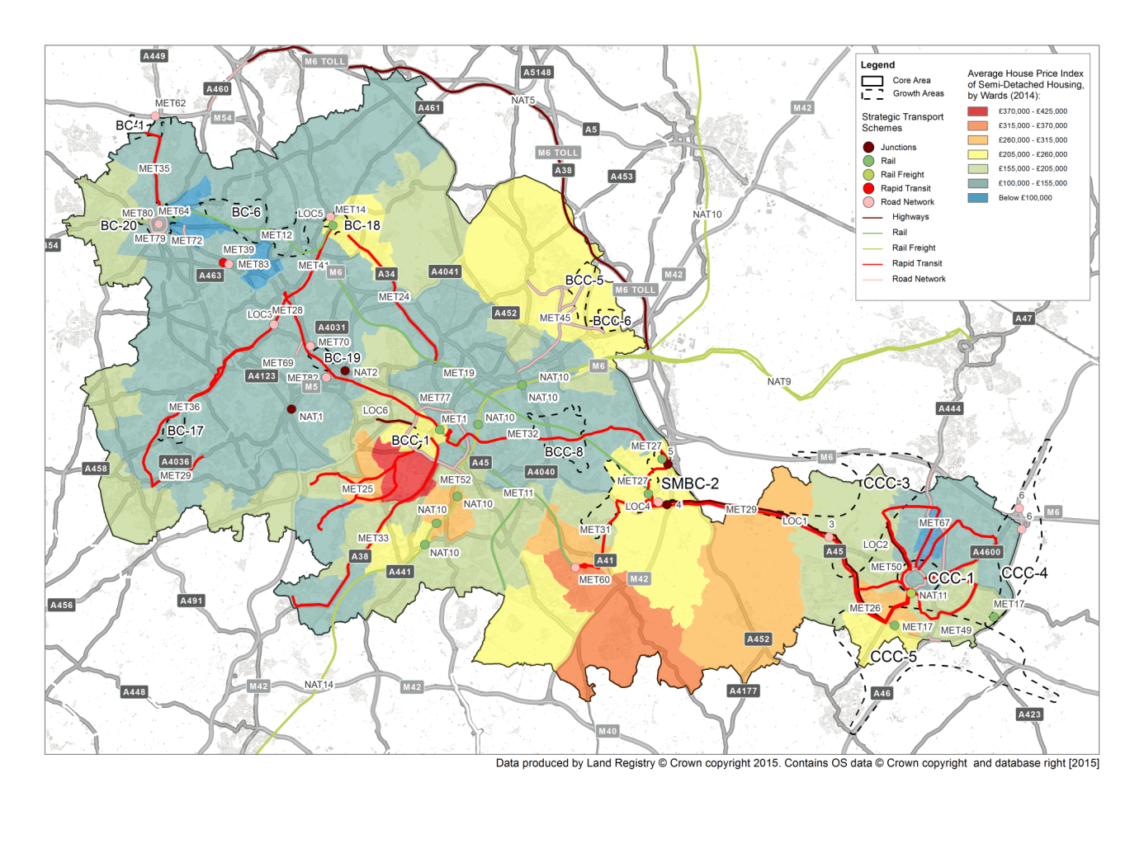
Towards “Opportunity Areas” supported by infrastructure provision to focus investment

Slide 33
Telling the delivery and implementation story

Slide 34
Focusing your firepower to get investment moving

Slide 35
Getting from LEP/Combined Authority Strategic Economic Plans to implementation
Problem: like LEP plans, SEPs frequently boosterist - big job claims
Needed to get Government’s attention at the time
But disconnected from the (statutory plan) means of delivering the targets
  Plans don’t match the targets
And possible unintended consequences?
  Jobs claims not backed by housing land supply for workers
The SEPs risk wrecking the local plans
  Eg Oxfordshire and Cheshire
Land use planning is quasi-judicial process: keep separate
  the economic aspirations in the model
  Numbers in land use plan

Slide 36
Understanding the gap, and plugging it
If there is a gap between the SEP and the total homes and jobs number
You need to understand it and quantify it
You need to know shortfall in homes and jobs
And find schemes to plug it?
Challenging local authorities to grow is part of the SEP’s role
How do you do that?

Slide 37
Challenging local authorities to grow
Planning has become a system of legal compliance
Forget all that for a day or two
Give yourselves permission to think more fluidly
The grand example: Birmingham’s 1989 Highbury Initiative
More micro examples: Northern Gateway Workshop
Some possible success factors?
Talk to each other!

Slide 38

Success factor: a willingness to think creatively, heretically about existing plans. Instead, think markets and viability

Slide 39
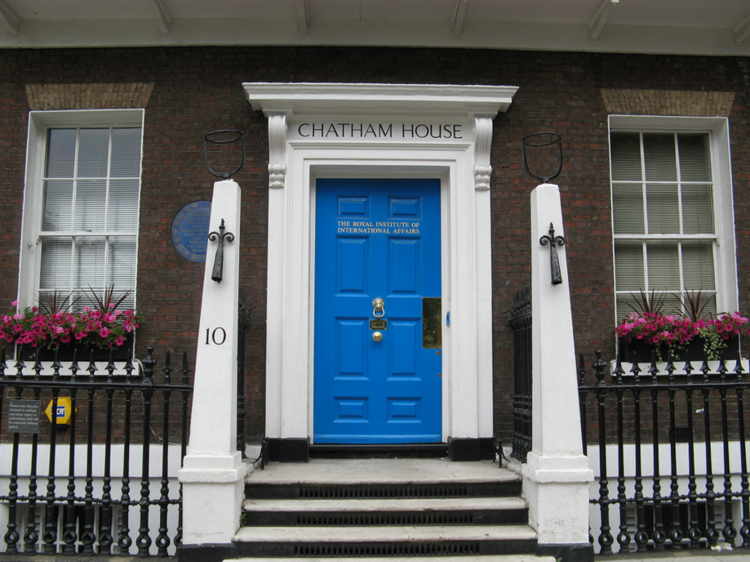
Success factor: Chatham House Rules?

Slide 40
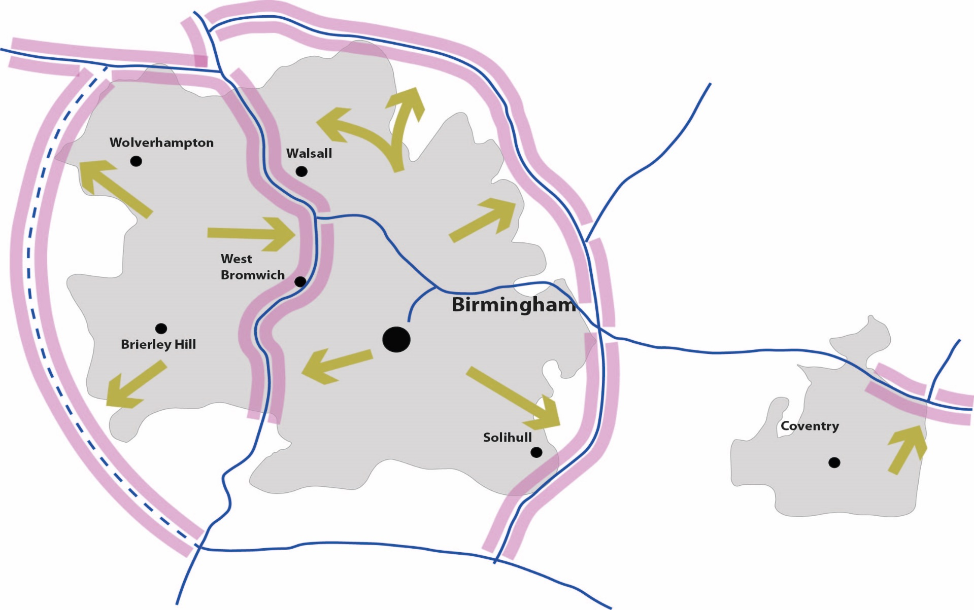
Success factor: a willingness to return to the old classics?

Slide 41

Success factor: don’t talk your silo. Think like a disinterested alien?

Slide 42

Success factor: pulling the high falutin’ back to plausible, practical local context?

Slide 43

Talk to investors as soon as you have ideas: road test concepts with them. You might be surprised
Eg Birmingham Vision for Movements
City Council and investors met informally
Found common ground
Created Vision for Movement
Helped precipitate public realm and major metro projects

Slide 44

Getting real about investment actualises creativity
Acknowledgements to Farrells
Notes:
doesn’t make you a breadhead

Slide 45
Strategic investment plans: what they are, aren’t, and how they can really work

Slide 46
Strategic Planning Under Devolution
Rob Murfin
Derbyshire County Council

Slide 47
Beyond the Duty to Co-operate…
Strategic Planning under Devolution
Rob Murfin
Director, Planning Officers Society
Head of Planning, Derbyshire County Council

Slide 48
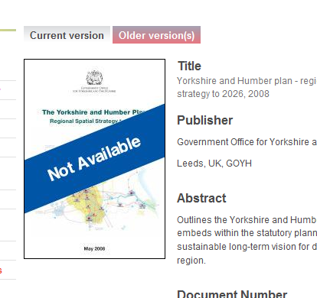
Emergence of the devolution agenda with new local governance models means opportunities for new forms of strategic planning?

Slide 49
Lessons from…
Talking to council leaders, CEs & planners
Discussions with CLG & PINS
Looking at current plan fails/DtC issues
Housing supply issue putting planning in panic mode, inherently unstrategic and unsustainable
Experience on strategic evidence issues
DTC: “sustained joint working with concrete actions and outcomes” is unlikely to be met alone by “an exchange of correspondence, conversations or consultations”

Slide 50
Keep in mind..
Localism Act - false hope for locally set housing targets to reflect political-public ‘anti RSS housing growth’ agenda?
Post RSS but pre Devo era – What is working? Gap analysis to inform future?
Local Plans and local decisions space
Government housing priority/Lyons
How LPAs best navigate DtC and Devo
The next 12 months, and beyond?

Slide 51


Slide 52
New strategic planning emerging -
Spatial framework or vision
Unambiguously built on local plan work
Implied uplift included to deliver Gainshare, SEPs, supported by SIPs
Tail wagging dog or some other description?
Delivery tools including mayor planning powers/consultee role
Possibility of SPD on back of vision
Direct delivery powers to fill housing shortfall

Slide 53
Economics, SEPs, SIPs and Frameworks
PPG: LPAs expected to “work together constructively from the outset of plan preparation to maximise the effectiveness of strategic policies”
Need to show really and meaningfully got head round interplay of issues – growth, infrastructure need and economic activity rate…or others will
Failing of first round RPG/RSS – chapter based approach

Slide 54
The Future of PLACES
Housing
Additional
Infrastructure
SPATIAL CHOKE FACTORS
LATENT DEMAND
EXPRESSED
DEMAND

Slide 55
Additional
Infrastructure
Housing
ACTIVITY RATE ?
GVA or FTE
TARGET
JOB MOVE &
COMMUTER RECAPTURE ?
NEW RESIDENT ?

Slide 56
Devo governance and DTC #1
Working arrangements need to avoid significant additional overall resource
Reflect roles/desires of all constituent authorities and not constrain decisions
Maintaining ongoing / live DtC resource will be valuable asset if working across many LPAs (and in particular) multiple HMAs
DO NOT reopen HMA working, but may need to reality check boundary assumptions if not done since RSS

Slide 57
Devo governance and DTC #2
Keeping arrangements under review* can be simpler under devo, particularly if CLG follow through on allowing mayor power to produce CA wide SPD
Easier to ensure political accountability*, leadership, and wider corporate ownership
But – no obvious or consistent wider stakeholder input route
*Golden rule issue

Slide 58
Pause - cautionary thoughts
Philosophical change - economic need v economic potential. ‘Don’t spread jam too thinly’
Selective use of available city evidence, ignores evidence on market towns/rural productivity
Planning was intended to address inequality and deliver SD. Re-emergence of economic growth v sustainability false dichotomy
Needs care in handling aspirational targets and spatial choke factors – inc skills

Slide 59
Example of approach
Extensive, fast broadband infrastructure
Access to high quality mobile communications*
Improved transport connectivity
High quality education and training
Expanded apprenticeships
New Enterprise Zones
Better regulation and streamlined planning
More housing

Slide 60

Key lessons from Devo Experience
…and some observations

Slide 61
Rule #1 Simple is transparent
“On the Method of Theoretical Physics” the Herbert Spencer Lecture, Oxford, June 10, 1933
“everything should be as simple as possible, but not simpler”

Slide 62
Rule #2 Evidence is not policy
But effective policy can be extrapolated at any stage of joint work if not anchored into clear spatial scope
Starting/joining a process is accepting logical results. Will be seen as agreeing to latent and expressed demand drivers beyond SEP sign up
Alignment of evidence and plan phases key, avoids long term aspiration impact too early in plan cycle
Structure work to avoid aspirational growth being selectively interpreted on non-strategic basis

Slide 63
Rule #3 Avoid Framework creep
Strong evolutionary tendency – strategic working abhors a perceived policy vacuum
Leave local space for everything but tight issues rooted in strategic spatial evidence issues
Not RSS “do everything” (32-314), Pt 1 UDP or SP
BUT
Agile SPD for issues between plan review cycles? SPD needs to be tied to a plan…. not just evidence?

Slide 64
Rule #4 Remember this will be semi-voluntary
Inspectors/challenges will look for gaps in decision making process. Ongoing member involvement vital
Power in marriage: City Region drivers, MCR message success
If this work is to direct our plans, is Devo/LEP work spatial enough - could it “pass” SA/SEA?
Not RSS “Table” which bedevilled Regional experiment
Risk of non-polycentric urban economic focus because of the Gainshare issue?

Slide 65
Conclusions #1
Many statements in this presentation end in ?
Comparative rural advantage = stunning view
Green belt & strategic reviews - perhaps start working on scope of consistent methodology now.
Economic growth is a delivery mechanism for spatial planning, if harnessed properly.
Fundamental tensions with localism
Non polycentric, language of urbanising impacts

Slide 66
Conclusions #2
Political ownership far more important than vehicle
Understanding economics, econometrics + infrastructure
Key difference between constraint based strategy and objective SEP aspiration/latent needs assessment
Gov planning changes seem to be heading towards as yet unstated goals including hybrid zonal
Looming gap: non core stakeholders

Slide 67
Is it Spatial Planning rediscovered?
Thank You

Slide 68
Panel Q & A

Slide 69
Where can I get some help?
Andrew Pritchard
PAS Principal Consultant

Slide 70
For More information…
www.pas.gov.uk

