Slide 1
Duty to Cooperate -the local perspective Anna Rose, Rugby Borough Council 23rd October 2014
“Remember upon the conduct of each depends the fate of all.”
Alexander the Great

Slide 2
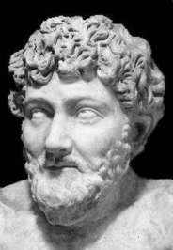
“In union there is strength”
Background
County groupings - accepted cooperation
RSS - cooperation through adversity
The end of regional planning – and cooperation?
Formation of LEP groupings - cooperation through opportunity
Aesop

Slide 3
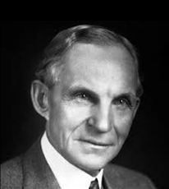
“Coming together is a beginning. Keeping together is progress. Working together is success.”
LEPs, SEPs and the NPPF
Confusion around the role of LEPs in planning
Implications of job creation figures in SEPs
Reading but then really understanding what the NPPF means by cooperation
The realisation that all of your plans have to be aligned
Henry Ford

Slide 4
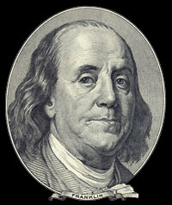
“We must all hang together or most assuredly we shall hang separately”
Joint Committees, EPBs and Combined Authorities
Dispelling the localism myth
Ensuring appropriate governance
Keeping up the momentum
Benjamin
Franklin

Slide 5
“Cooperation is the thorough conviction that nobody can get there unless everybody gets there.”
Where are we now?
DtC officer working group
Joint Committee moving towards an EPB
Joint evidence base for plans
Commitment to adoption of individual plans by 2016
Commitment to start a joint plan in 2017
Currently refreshing the SEP
Virginia
Burden

Slide 6
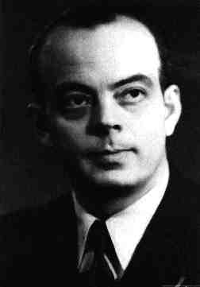
“If you want to build a ship, don't drum up people together to collect wood and don't assign them tasks and work, but rather teach them to long for the endless immensity of the sea.”
Antoine de Saint-Exupery

