Slide 1
Neighbourhood planning
April 2015 www.pas.gov.uk
Notes:
Updated April 2015
This is a long presentation, but is intended for you to dip in and out of to use the most relevant aspects for your needs. There are other councillor presentations on our website that go into certain areas in more detail.

Slide 2
What is PAS ?
PAS is a DCLG grant-funded programme but part of the Local Government Association
Governed by a ‘sector led’ board
10 staff – commissioners, generalists, support
“PAS exists to provide support to local planning authorities to provide efficient and effective planning services, to drive improvement in those services and to respond to and deliver changes in the planning system”
Notes:
We provide

Slide 3
This Briefing will…
Help councillors understand Neighbourhood Planning (NP) and their role at the different key stages
The briefing will cover:
Introduction to the Neighbourhood Planning
A short summary of the processes
The opportunities offered by NP
Understanding the needs of NP groups
Role opportunities and skills needed
What you can do to help to develop better NP
Notes:
This presentation deals with most aspects of the neighbourhood planning process with special emphasis on the role that local authority councillors can play to help their communities to understand what is involved, to get the most out of their efforts and to have the best chance of a successful plan or order being adopted.
It has been designed so that the presenter, or leader of the briefing session can dip in and out – tailoring the to reflect the stage that your council is at with neighbourhood planning.
PAS has a publication “Neighbourhood Planning: a simple guide for councillors” available on its website. We recommend that you use this briefing and the publication together. You can download the guide from our website (http://www.pas.gov.uk/neighbourhood-planning/-/journal_content/56/332612/15322/ARTICLE ) or request printed copies by contacting PAS@local.gov.uk.

Slide 4
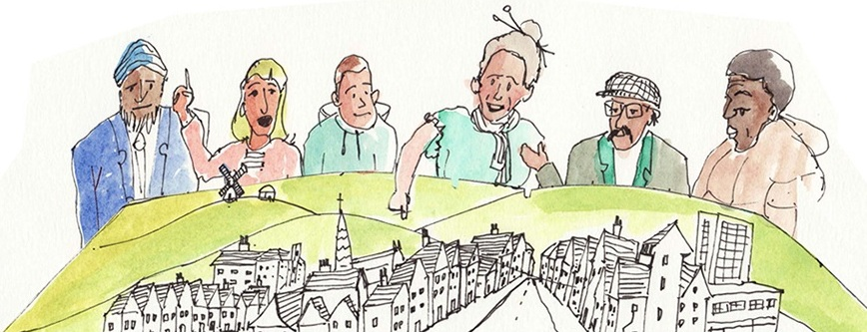
Introduction to the Neighbourhood Planning process

Slide 5
Context
Localism Act 2011
NP regulations 2012
Community rights
Community Right to Build
Community Right to Bid
Community Right to Challenge
Section 106 and Community Infrastructure Levy
Neighbourhood Development Plans
Neighbourhood Development Orders
Notes:
Neighbourhood planning is one of a suite of community rights that the Government introduced as part of its flagship Localism agenda.
The premise for creating neighbourhood planning was that local communities should be given more opportunity to consider and shape the way that they wished their local area to develop in the future. That by doing this communities would feel greater ownership in changes that will occur and greater acceptance of such change when they are able to influence and shape it and have a say in the allocation of the benefits that come from new development.
Communities are able to seek designation by their local planning authority to undertake neighbourhood planning. There are three main tools for this:
Neighbourhood development plans
Neighbourhood development orders and
Community right to build orders.
All of which, in their separate ways, and subject to process and policy tests, pass the right to shape planning decisions on developments occurring in their area back to the community.

Slide 6
Neighbourhood Plan snapshot
1335 applications for designation
1058 designated areas
76 plans at or passed examination
1 NDO passed examination
54 through referendum
37 plans made
Ave turnout 32%
Average yes vote 87%
57% LPAs with NP areas designated
Numbers from June 2014
Notes:
The right to do neighbourhood planning has been enthusiastically taken up by many communities.
The figures used in this slide were correct in march2015. Please contact PAS for more up to date figures when delivering this briefing.

Slide 7
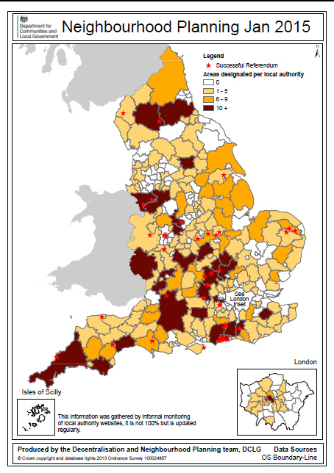
National Picture
A variety of neighbourhoods are engaging in neighbourhood planning; north and south, urban and rural. Each with a number of challenges and opportunities that are driving plans.
Notes:
The government are keen to keep the momentum going and encourage increased numbers of communities undertaking neighbourhood planning.
It is understood that neighbourhood planning has broad support across the political spectrum and so seems likely to remain a vital part of the planning system in the future notwithstanding any possible change in government following the election in 2015.
Most of the neighbourhood planning to date has been done in areas that are parished, and therefore have both a familiar focus for community leadership along with a structure and administration to take it forward. There is more challenge in urban and non parished areas where representative groups need to come together to become the body leading neighbourhood planning for their community, and where the area itself needs to be considered and defined.
Looking to the future it seems likely that more support may well be directed to helping groups to form and work in those areas.

Slide 8
Neighbourhood planning
Ultimate aim is to give communities more power over development and shift attitudes to local growth
Localism Act introduced new right for communities to draw up a ‘neighbourhood plan (NP)’
Provided NP is in line with national planning policy, with the strategic vision for the wider area set by the Local Planning Authority (LPA), and with other legal requirements, local people will be able to vote on it in a referendum;
Local authority required to bring NP into force if approved by a majority of over 50%
Notes:
There are provisos and restrictions to the neighbourhood planning powers.
Most important is the overarching expectation that neighbourhood planning should plan positively for the needs and future needs of the community. Thus where many at first predicted that neighbourhood planning would put the brakes on development and change in their community - this was immediately debunked.
Neighbourhood plans and orders need to comply with national planning policy – just as local plans do. The NPPF (National Planning Policy Framework) makes the duty to plan positively very clear.
Moreover, the neighbourhood plan needs to be compliant with the strategic policies of any local plan policies in force in the area.
But there is still huge opportunities for communities to create a vision for their area, and to use local evidence to help them shape that vision into planning policies in a neighbourhood development plan. This plan once it has been examined and has passed a referendum, gaining a simple majority of all those who cast a vote in the local referendum, will be brought into force by the local planning authority. Once done, the neighbourhood plan becomes part of the development plan for the area and all planning applications coming forward in the area will be tested against its policies.
Neighbourhood development orders, set out kinds of development that do not need planning permission to be granted through an application process. The community consider those kinds of development suitable and acceptable ( usually subject to some conditions such a design or materials etc). Or they may particularly want to encourage some development to come forward and therefore are prepared to set aside the application process in order to show potential developers their tangible support for such a proposal. Community right to build orders have a similar effect for a specific development proposal.

Slide 9
Neighbourhood planning ‘givens’
Neighbourhood led, intensely local
Proportional, light-touch but robust
Flexible enough to inspire innovation and creativity
Builds on existing evidence & deals with gaps
Supporting growth - exploring ways of enabling community supported development
Takes lead from the local plan strategic policy context and interprets locally
New, more equal? basis for partnership work with local authority
Notes:
So, how does the neighbourhood planning process differ from the preparation of a local plan?
It is led by the community – so although the local authority have a procedural role, and need to advise and support the community in preparing their plan – the lead is firmly with the community.
The process is a lighter touch than for a local plan. But its still very important that the process is fair and inclusive, based on evidence ( some local and some district wide) and all considerations and decisions can be recorded and traced.
But beyond that, the process will hopefully provide creative solutions to local issues and aspirations.
And while its community led, its vital that both political and officer involvement from the council is available to support and help guide the process to ensure better outcomes, to make sure that plans knit district wide and neighbourhood objectives and that the plans have a good shot at being deliverable. This will probably need a new kind of partnership approach to be developed with the community

Slide 10
Key stages of neighbourhood planning
Getting established
Preparing the plan
Bringing the plan into force
Source: Neighbourhood Plans Roadmap Guide. Locality http://locality.org.uk/resources/neighbourhood-planning-roadmap-guide/
Stage 3
Stage 2
Stage 1
Notes:
Looking at the process:
Three main stages with various things that need to be done within each

Slide 11
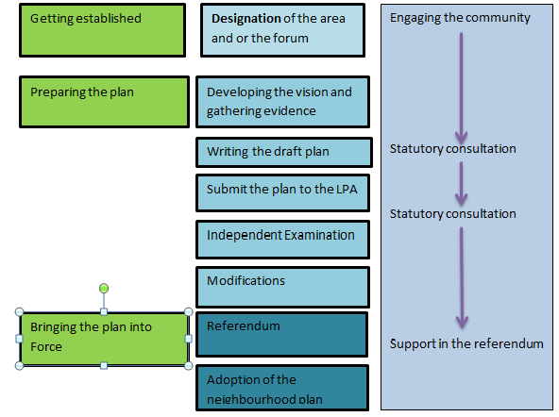
Notes:
This slide has been adapted from the one developed in the Locality Roadmap and used in the neighbourhood guide for councillors ( page 7)
Whilst developing a neighbourhood plan is a light touch compared with preparing a local plan, there are set stages that have to be observed in order to meet the requirements that the inspector and the council will have to be sure are satisfied before the plan goes to referendum.
Some of the most significant of these are in relation to the engagement of the community – making sure that all those who will be affected by the proposed plan have a chance to input their ideas. This is why the blue column for engagement of the community runs right through the process from the application to designate a NP area and/or forum to the referendum.

Slide 12
Getting started: Qualifying Bodies
Non-Parished Areas:
New body, a neighbourhood Forum with minimum of 21 members and 1 (district or county) councillor. Forum would have to show they have tried to involve a Councillor. Councillors are ‘allowed’ on to a forum.
Reflective of those living or working in the area
Community, individual and business presence
Statement explaining that the lead body is capable of being a qualifying body
Parished Areas:
Local Parish or Town Council is automatically lead body
Steering group to involve other parties/individuals. A district/county councillor can be ‘invited’ to sit on the steering group by the parish
Draft plan needs approval of full parish council
District or county councillors can sit on steering group
Multi-parish plans for less populated areas with common issues
Notes:
This slide can be adapted to give more emphasis whether or not you are in a parished area. I also suggest that you include some information about the number of designation applications that you have received and if you know of interest coming through from community groups- not forgetting that your councillors might actually be the first to hear of such things – so ask them.
Who is entitled to do neighbourhood planning – referred to in the legislation as the “Qualifying Bodies” ?
If the area is parished, then the only groups allowed to undertake neighbourhood planning is the parish or town council. Parishes can join up and work together where there are issues such as geography, common issues etc that make a collaborative approach to plan making more sensible. If this is the case they need to agree which parish council becomes the lead.
In such cases an application to the LPA to consider designation of the area is all that is required. Councils have a broad power to consider what is an appropriate area for the neighbourhood plan to encompass.
If the area is non-parished the situation is more complex:
Applications need to be made for both the composition of the neighbourhood forum as well as the neighbourhood area. The regulations contain more detail about the composition of the forum, and issues such as developing both the representative constituency and the governance of the forum become important considerations. Once again, the decision on each is in the hands of the Local planning Authority.

Slide 13
Plan preparation: Evidence and community engagement
Statutory Requirement
Gaining Support
Understanding the area
Understanding need
Avoidance of Conflict, Cost and Delay
Better Outcomes
“Effective community engagement and a robust evidence base are the pillars on which a good Neighbourhood Plan will be built.” (adapted from Locality Roadmap)
Notes:
Its in the plan preparation stage that the council will have a really big role in advising and assisting the neighbourhood group. The day to day support that a local authority can give will vary according to the resouces available. But it is important that councils don’t take this to mean that they just stand back and let the neighbourhood get on with it!
Many councils have prepared advice notes that the neighbourhoods can use as a way to reduce the demands on officer time, but for a successful interface between the local plan and the neighbourhood, councils do need to put more into working an establishing good relationships, assisting with the sharing of information and good practice. This can be especially challenging in regard to helping neighbourhoods appreciate that they need to take account of both opinion and local preference and some of the important evidence that will underpin understanding of “needs” especially in relation to housing.
It would be appropriate to talk to the councillors about how your council is set up to give support and how you envisage this fitting into your local plan making programme. In particular housing and provision of sites to deliver housing is likely to be an issue. How are you going to be able to communicate this to the neighbourhood groups?

Slide 14
Plan submission and examination
Pre-submission consultation by the neighbourhood group (6 weeks)
Submission to the local planning authority
Post submission consultation by the Local Planning Authority (6 weeks)
Selection of examiner (joint decision)
Examination (which may include a hearing)
Examiners report containing suggested modifications
Notes:
Once the neighbourhood groups have arrived at their draft plan, the formal process kicks in again with the requirement that the group provide an opportunity for all members of the community to see the plan, understand the preferred options that have come out of the consideration to date and comment through a 6 week consultation period. Following this the groups will have a chance to consider the submissions they have received. When the group submit their plan and all the supporting information to the LPA , the council will have to undertake a further 6 week consultation on the submission plan.
The LPA are responsible for arranging and paying for the examination of the neighbourhood plan by an independent examiner. The appointment of the examiner should be a collaborative decision taken with the neighbourhood group ( often utilising a list of appropriately qualified people through the NPIERS referral service run by RICS).
The job of the examiner is to consider whether the submitted plan can go forward to referendum, having satisfied him/herself that the plan meets a variety of tests or could be modified in such a way that it would meet the tests. The results of the post submission consultation will be taken into account by the examiner who will usually be able to do the examination on the basis of the written documentation, but may on occasion ask for a hearing to discuss a specific issue.
Examiners of the early plans through the process have taken pains to support neighbourhood plans by providing sometimes quite detailed suggestions as to how plan policies might be modified in order to ensure that the plan meets the tests and can be passed on to referendum.
But it’s the responsibility of the LPA in the end to satifisfy themselves that the basic conditions have been met and to decide whether the modifications suggested by the examiner should be taken forward into the plan that goes to referendum. Whilst it’s the job of the LPA to do this – good practice suggests that any such decisions should be taken in discussion with the neighbourhood group.
.

Slide 15
Independent examination
What are the ‘Basic conditions? Plans and orders must
have appropriate regard to national policy
contribute to the achievement of sustainable development
be in general conformity with the strategic policies in the development plan for the local area
be compatible with human rights requirements
be compatible with EU obligations
( for NDOs its also necessary to have regard specifically to heritage and conservation)
Notes:
So what are these basic conditions that the neighbourhood plan should be tested against?
These are set out in the legislation and regulations regarding neighbourhood planning and are collectively known as the basic conditions.
Some of these are procedural
Some are about compliance with national and local strategic policies.

Slide 16
The LPA’s responsibilities
To publish applications for NP areas and forums on your website for 6 weeks
To agree and formally designate areas and forums
To provide technical support and assistance to groups
Following submission of the draft plan, to satisfy itself that the plan complies with statutory requirements
To organise a 6 week consultation period
To pay for and arrange for examination by an independent examiner
To take a formal view on whether the basic conditions are satisfied
To arrange and pay for the referendum
To publicise and bring the plan into force.
Notes:
Here is a summary of the duties and responsibilities of the LPA in the neighbourhood planning process.

Slide 17
Neighbourhood Planning Funding
NP new burdens funding for Councils 2015-16 | NP group support 2015-18
First payment of £5000 (per designated area). Up to 20 per LPA. Plus further £5000 for NF designations. | Pot of £22,5m to fund direct support and grant payments up to 2015-18.
Second payment of £5000 when the council publicises the NP prior to examination ( to pay for examination and consultation as well as support and advice during plan preparation) | Administered by Locality , grant payments – up to £8,000 per neighbourhood area,, to contribute to costs incurred by the group preparing a neighbourhood plan or order. Some addition funding available for priority groups
Third payment of $20,000 upon successful completion of the examination (to pay for the referendum) with an additional £10,000 for a business referendum. | Direct support – advice and support, tailored to meet the needs of supported neighbourhoods. Led by Locality and
Notes:
In October 2014 DCLG announced funding of £12.5 million for Councils to support neighbourhood planning. This covers the period 2015-16 and bid can be made
Currently £30,000 is available for each neighbourhood plan that goes right through the process. This is broken up into tranches and should meet costs of designation, support to neighbourhood groups and for paying for the examination and referendum.
Additional funding is available for designating neighbourhood forums in un-parished areas and for running the additional non domestic rate payer referendum that is necessary for business neighbourhood plans.
These payments are not ring fenced. Some councils pass part of the resource through to the neighbourhood groups, but most appear to keep this in order to provide a proper level of support within the local authority.
DCLG has announced a new programme for supporting neighbourhood planning starting in April 2015. This will comprise £22.5 million available over 2015 to 2018. Two different types of support are available to help with the preparation of a neighbourhood plan or neighbourhood development order: technical support or a neighbourhood planning grant.
This support comes through a consortium of groups headed by Locality. Groups can apply for either or both direct assistance from the consortium’s partners and a grant of up to £8000 to meet costs in preparation.
How much it costs to prepare a neighbourhood plan is a question asked very often. The short answer is that it depends on the level of ambition and breadth of the issues that the plan will cover. The costs tend to mount if there is a need to employ consultants to undertake some of the technical work. Such contracts need careful specification and management!

Slide 18
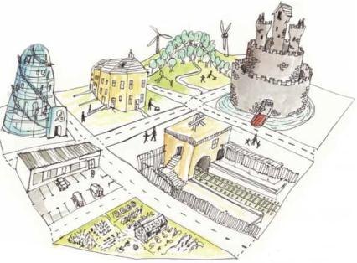
Neighbouring Planning: why are people bothering??

Slide 19
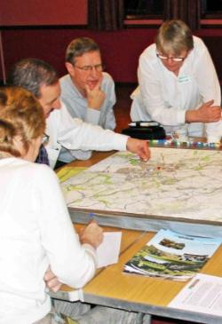
Community Motivation
Recognising local priorities
Setting up for positive growth
Influence over development gain
Regeneration possibilities
Bringing key players together
Anticipating the future
Balance of development
Getting the detail right
Notes:
Neighbourhood planning was set up to allow communities to have more say in the way their communities develop in the future. This allows greater differentiation of towns and villages to deal with the matters that are important to their area but may not be so important in the context of the whole district/ unitary council area. The grain of the matters considered and the way in which development is to be managed can be considered on a finer grain but still within the context of the strategic plan for the district as a whole.
But as I have said before – the context of neighbourhood plan making is to empower communities to manage change (plan positively) not to turn back the clock or turn off the need to plan for the needs of residents and businesses now and in the future.
Part of the incentive to encourage communities to commit their energies and time to this process has been the opportunity to direct resources and encourage the kinds of development that meet the priority needs of that community. This can be through regeneration based plans that identify underused sites or plan for the revitalisation of the town centre, or making doubly sure that new development is matched by the provision of the infrastructure to cope with the increased needs of the community .

Slide 20
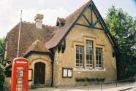
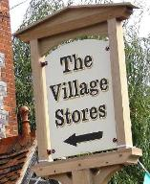
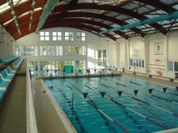
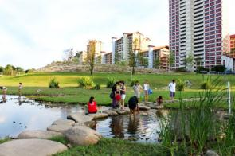
Plan implementation: CIL
The Localism Act sets out what neighbourhood CIL can be spent on:
the provision, improvement, replacement, operation or maintenance of infrastructure - or anything else that is concerned with addressing demands that development places on an area.
“If you want to re-roof your village hall, build a permanent home for your community shop, refurbish the municipal swimming pool, implement a new landscape design in your local park or save your local pub, look no further.”
Nick Boles: ‘Housing the Next Generation’ speech on 10 January 2014
Notes:
The government has been keen to ensure that some of the value of new development should be passed directly to local communities to decide for themselves how to spend this for the benefit of the people living and working in the area.
One of the major reasons why many neighbourhood groups have decided to proceed with neighbourhood planning is that where a neighbourhood plan is in place, communities stand to receive a greater share of the value from new development where the LPA has introduce a Community Infrastructure Levy.

Slide 21
Plan Implementation - CIL
Parish council ✓ Neighbourhood Plan ✓ = 25% uncapped, paid to Parish | Parish council ✓ Neighbourhood Plan X = 15% capped at £100 / dwelling, paid to Parish
Parish council X Neighbourhood Plan ✓ = 25% uncapped, local authority consults with community | Parish council X Neighbourhood Plan X = 15% capped at £100 / dwelling, local authority consults with community
Notes:
The CIL captures part of the enhanced value of development to pay for the provision of infrastructure. Where a neighbourhood plan is in place, up to 25% of the value captured through the Levy is handed over to the Parish.
A similar amount is available where a plan is in place in a non parished area, although for legal reasons, the funds need to be administered by the Local Authority who should consult with the forum on spending this money.

Slide 22
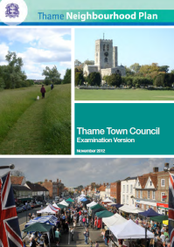
Examples of motivation for Neighbourhood Planning
Long term housing trends (Exeter St. James)
Solving neighbourhood-level housing problems (Upper Eden)
Maintaining market town character (Thame)
Development that meets local needs (Denmead)
Rebalancing the local economy (Caterham)
Notes:
The level of interest in doing neighbourhood plans can be judged by the number of plans that have already come forward.
But the importance of this process and the outcomes for the community of having a plan is better judged by the high turn out that has been achieved in neighbourhood plan referendums and the huge level of support for all the plans so far.
What has surprised the early doubters of neighbourhood planning has been the positive approach taken by the groups.
The plans that are coming forward have focused on many different priorities. They have not all been complicated mini local plans with allocations for housing and employment sites. Some have been much more focussed – on dealing with the particular issues of their area:
Exeter St James – had big problems with managing university student housing and how it impacted on the environmnet for local residents,
Upper Eden – concentrated on the particular issue of new housing on family farms
Thame – although a complicated plan related its approach back to its vision of keeping the character of a vibrant market town

Slide 23
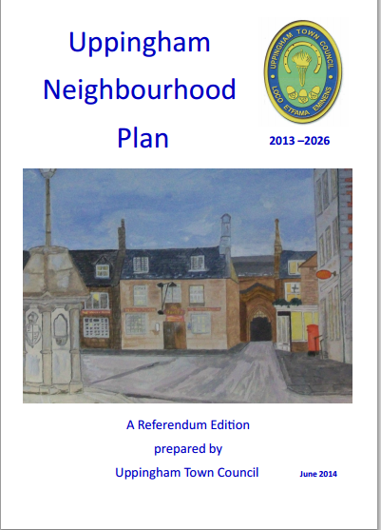
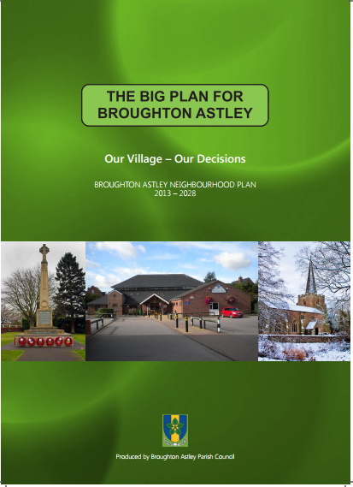
Examples of motivation for Neighbourhood Planning
Improving connectivity (Uppingham)
Choosing preferred development options (Broughton Astley)
Town centre vitality and character (Cockermouth)
Improving the image and reducing dilapidation (East Preston)
Notes:
Uppingham – started as a business group but collaborated with the town council with policies to encourage local SME businesses with specific policies about encouraging broadband and mobile phone coverage.
Broughton Astley – looked at the fine grain of potential development sites to assess which would best meet its criteria for sustainability.
Cockermouth – developed a local development order to give development permission for a range of changes of use and other development that would enhance its identity as a welcoming, characterful historic retail area.
For East Preston – the neighbourhood forum was most concerned about regeneration and giving the image of the area a lift.

Slide 24
The value for Councillors
Can neighbourhood planning help address longer term Ward concerns more effectively than traditional planning?
Can neighbourhood planning help to deliver growth in an acceptable form?
Can neighbourhood planning provide a channel for addressing common issues raised in your surgeries?
Notes:
So that was about why the community groups have been motivated to become involved – and many of these issues will be enough to encourage local ward councillors to lend the projects their active support
However as strategic leaders for the area there are some additional benefits that effective neighbourhood planning can deliver:
It can help diffuse tensions between local planning needs and the impact of these plans on local communities by giving communities real power to influence the way new development will be delivered – new housing provision may be more acceptable if it’s the type of housing that the community recognise is what is needed, is of materials and design that complement the character, is going to have consequent traffic problems dealt with as part of the development etc.
The local issues that come up in surgeries can sometimes be addressed through the plans or through other neighbourhood rights – e.g the lack of a safe playground could be addressed by making clear that provision of facilities for children should be an integral part of a housing development, or some of the CIL money should be prioritised for new equipment.
Neighbourhood planning can also be a way of bringing together disparate sections of the local community, foster better cohesion or reduce isolation by reinforcing a sense of community enterprise.

Slide 25
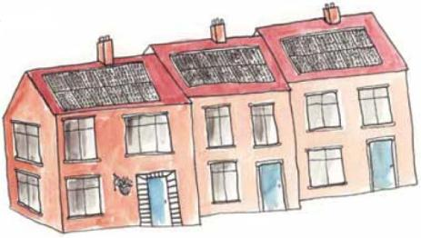
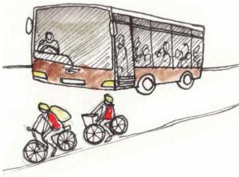
Skills and knowledge
Notes:
Finally – we should just consider some of the skills and knowledge that you as councillors might need to put into supporting your neighbourhoods in developing their plans and getting to the point where they can be implemented.

Slide 26
Skills
What skills are necessary to support a Neighbourhood Forum/Parish Council?
Role | Skill/Trait
Encourager | Enthusiasm, motivation, vision
Informer | Relating essential information
Connector | Contacts, good timing
Mediator | Honest broker
Leader | Confidence, empathy, inspiration, honesty
Technical Interpreter | Fact finding, explainer
Notes:
The role that you take will vary during the life of the neighbourhood planning process. This slide simply sets a framework to understanding what these roles are and the kinds of skill that are necessary to fulfil each role.
Its important to appreciate that while you are civic leaders, neighbourhood plans should be led by the community rather than by the local authority – thus the skills may at times be a bit different from those that you use as ward councillors or members of the cabinet.

Slide 27
Key stages of neighbourhood planning
Getting established
Preparing the plan
Bringing the plan into force
Source: Neighbourhood Plans Roadmap Guide. Locality http://locality.org.uk/resources/neighbourhood-planning-roadmap-guide/
Stage 3
Stage 2
Stage 1
Notes:
Thinking back to the three stages in plan preparation…..
The next three slides look at the roles for councillors. It is recommended that these slides be used as the basis for a discussion among the councillors – Encourage them to think about the kinds of practical help and support that they could give to the community groups at each stage of the process. The Simple Guide tfor councillors steps through the things that councillors can bring to the process at each stage and this can be used as an additional resource.

Slide 28
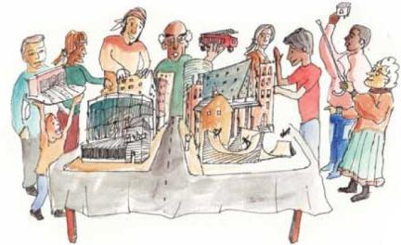
Roles for Councillors in NP
Stage 1
Getting established
joining your parish/town councils or neighbourhood forums when they first form
Leader
Put in place LA resources for advice and support
Understand and explain NP process and sources of funding
Encourage participation from the wider community and support community engagement
Talking to potential members amongst community groups, residents associations, business forums; using officer contacts
Mediate where overlapping boundaries/areas; negotiating LPA support
Informer
Encourager
Connector
Mediator
Notes:
Here is

Slide 29
Roles for Councillors in NP
Stage 2
Preparing the plan
Share and expand your local knowledge and network.
Informer
Understand and inform help/support needed by community groups
Manage community expectations
Help to promote the plan with the wider community and local areas
Feed in surgery issues & broader policy discussions in council
Ensure the issues identified in a NP are representative of needs on the ground
Work with other ward members to represent the interests of your local areas

Slide 30
Roles for Councillors in NP
Stage 2
Preparing the plan
Share and expand your local knowledge and network.
Work/connect communities, local business, residents, schools, service providers
Encouraging evidence sharing and engagement across two tiers of local government
Champion your area within the context of the authority’s strategic needs and plans
Mediate to address conflicts between stakeholders on policies to adopt
Finding support on technical skills & interpretation of strategic policy
Leader
Mediator
Technical interpreter

Slide 31
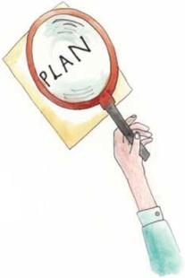
Roles for Councillors in NP
Stage 3
Bringing the plan into force
Encourager
Getting out the vote
Keep involved and informed stakeholders (e.g. web-based resources)
Check NP draft against legislation
Considering modification suggested by the examiner
Talking to developers as they come forward
Agreeing on implementation of the plan and assisting delivery
Informer
Mediator
Leader

Slide 32
Conclusions and closing remarks
Councillors play a key role in neighbourhood planning.
‘Gatekeeper’ between community and LPA
Can speed up the process, break down barriers, engage different groups
In-depth knowledge and passion for local areas
Neighbourhood planning – much more opportunity than risk!

Slide 33
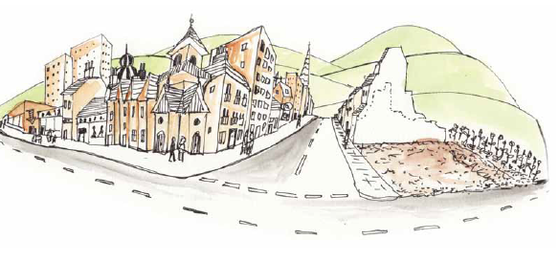
Some more technical points
Notes:
The next 5 slides have been included to capture some of the emerging themes and issues that are coming out from experience of neighbourhood plans coming through the process. For many audiences, especially in areas where neighbourhood planning is relatively new or untried, this will be too much detail. For those councils where there is already some experience, you may wish to tailor the slides to pick up issues that are most relevance to your experience.

Slide 34
Learning from experience….
“ We have, I think, now reached the point where there has been enough experience of neighbourhood planning with enough different kinds of communities for us to learn lessons and to ask whether there is not a version of neighbourhood planning that might be more easily accessible and quicker for some communities. We are doing that work, and we are very keen to hear from any hon. Members and communities with their thoughts on how we can achieve that”.

Slide 35
Government review
Following a review of processes and consultation further changes have been made. LPAs must now
make a decision on an application for a neighbourhood area to be designated in a prescribed period
submit with a neighbourhood plan a statement or environmental compatibility report to satisfy obligations under the Strategic Environmental Assessment Directive
Notes:
Time period
20 weeks in a case where the area to which the application relates falls within the areas of two or more local planning authorities
8 weeks in other cases, where the relevant body is a parish council and the area to which the application relates is the whole of the area of the parish council
13 weeks in all other cases
One of the following documents must be included with a neighbourhood plan proposal when it is submitted to the local planning authority:
a statement of reasons for a determination under regulation 9(1) of the Environmental Assessment of Plans and Programmes Regulations 2004 that the proposal is unlikely to have significant environmental effects
an environmental report in accordance with paragraphs (2) and (3) of regulation 12 of the Environmental Assessment of Plans and Programmes Regulations 2004

Slide 36
Emerging Themes - Process
Boundaries – particularly in urban areas. Wards v neighbourhoods
Enthusiasm of LPAs to actively support. Keeping positive?
Resources
for councils – how to match resources with levels of NP interest
for NP groups – commissioning support,
Motivation and Pacing – keeping an eye on the goal and trying to keep things simple.
Websites - popularity of Neighbourhood Forum websites
Diversity of groups - to give both plan making and plan itself more legitimacy
Input from businesses as well as residents
Evidence vs Opinion – what is the role of each?
Landowners and Developers - when to meet, how to handle people with sites/developments to promote
Choosing between alternatives – making sure that an audit trail exists, understand and consider impacts, a strategic environmental assessment (SEA) might be required

Slide 37
Emerging Themes - Policy
When, where and pacing of development - coming to terms with housing allocation from higher plans
Site Assessment - adopting good, fair, consistent and reliable assessment criteria and showing careful process when considering alternatives. Usefulness of a green, amber, red system
Deliverability – plans need to have a realistic chance of achievement
Relationship between the local plan and NP - particularly influence over strategic sites and situation where no up to date local plan or the emerging plan has yet to be tested for soundness
Housing - limiting density (Daws Hill), pace of development (Tattenhall) loss of family housing, limiting houses in multiple occupation (Exeter St James), boosting specialist and affordable housing (many areas)
Employment: Facilities for home-working and bolstering SMEs; high speed broadband, boosting local employment

Slide 38
Emerging Themes - Policy
Retail: Upgrading of local parades – bring back the high-street, conversion of residential to retail; limiting excessive concentration of e.g. takeaways & charity shops
Public Realm pedestrian safety, green routes, the walking neighbourhood, crossing points shade, tranquillity
Historic/ Essential Character – getting across the character of a place in planning terms, design codes etc
Education – engaging with the county and with academies and free schools
How to offer more protection - of trees, green/open spaces, buildings, allotments gardens, biodiversity (e.g. railway corridors)
Thinking sustainably – not particularly easy for rural communities reliant on car or groups without a transition town type input

Slide 39
Contact us email pas@local.gov.uk
web www.pas.gov.uk
phone 020 7664 3000

