Slide 1
CIL in Wycombe
Governance and Spending
Gerard Coll
Infrastructure Officer, WDC

Slide 2
Wycombe CIL Charging Schedule
Adopted November 2012
Residential £125/sqm or £150/sqm
Retail £125/sqm or £200/sqm

Slide 3
CIL income and comparison with S106
Received over £4.5m as of December 2015
Demand Notices to the value of £2m issued
2012/13 FY received £2m S106
2014/15 FY received £1.8m CIL
2015/16 FY received £2.4m CIL so far

Slide 4
Benefits of CIL for WDC
Relatively simple process
Up front costs
Up to 90% less S106 Agreements
More funding certainty
Local allocation

Slide 5
Infrastructure needs
Infrastructure Delivery Plan funding gap of £100m+
Transport, town centre and public realm improvements - £60m+
Education - £20m
Other - £20m

Slide 6
Governance and Release of Funds
Prioritisation – CIL in one pot; two tier authority
Consulted on broad allocations of CIL for three year period 2014/15 to 2016/17.
The outcome …
Town Centres and Transport – 65%
Education – 20%
Other – 15%
Funding certainty for service providers

Slide 7
Regulation 123 List
Lists a number of specific projects related to a town centre regeneration programme
List some specific highways and public transport projects
Lists a number of secondary schools
Open space – CIL yes but also S106 where required on site in line with policy or where full on-site requirements cannot be met on site
Strike a balance between developers knowing what CIL will be used on but not closing the door on S106 where necessary

Slide 8
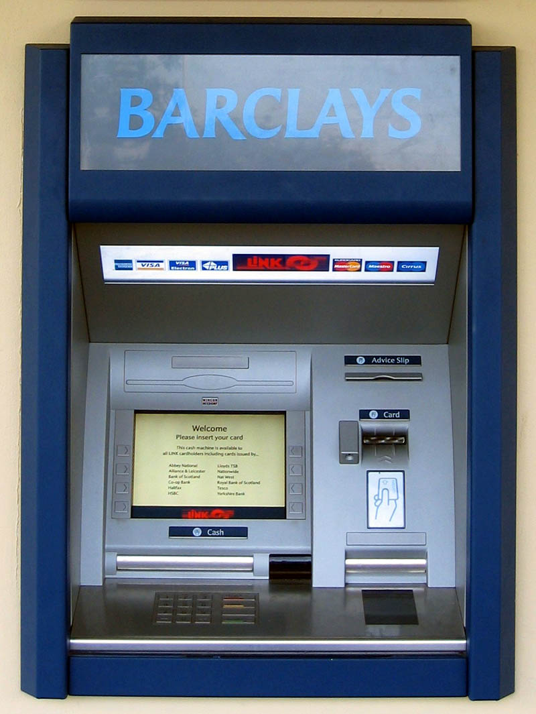
Governance and Release of Funds
Challenges

Slide 9
Governance and Release of Funds
Decision made on strategic allocation of CIL every 3 years
Services informed of available funding in Summer
Each infrastructure provider submits draft programme for following financial year in Autumn
HoP in const with CM agrees overall draft funding for publication
After consultation, overall draft programme presented to Cabinet for approval

Slide 10
Governance and Release of Funds
Criteria for ‘bids’
Bids/programmes from service providers should reflect
Available funding
CIL R123 List
IDP
Approved strategies and plans e.g. sports facility strategy, local transport strategy, DSA
Devt briefs and delivery strategies of strategic sites
Ability to deliver

Slide 11
Spending the funds
High Wycombe Town Centre Masterplan
Secondary school places
River improvements
Community centres

Slide 13
CIL and Strategic sites
5 large greenfield ‘reserved’ sites released by Members in HW
Possibility of major expansion in north of district
Development briefs and mini IDPs
Revision to R123 List where necessary

Slide 14
CIL and Strategic sites
S106 – Affordable housing, primary schools, on-site open space, junction improvements.
CIL – Wider transport and public realm schemes; secondary schools; health facilities; green infrastructure

Slide 15
Conclusions
Takes time to bed in but working well at WDC. Needs resource
Certainty
Spending linked to IDP and District and County priorities
WDC governance is evolving to a transparent and efficient process with full engagement by Members
Can work on large sites with S106 with requirements clearly set out

Slide 16
Gerard Coll
Infrastructure Officer
01494 421142
gerard.coll@wycombe.gov.uk

