Slide 1
Durham County Council “Experience of Section 106” Peter Ollivere January 2015

Slide 2
Today’s Presentation
Local Plan (Policy) Position
Viability, Developers and S106
Processing of S106
Spending of S106
Lessons from Durham

Slide 3
County Durham
New Unitary Authority – 2009
Located between 2 conurbations in NE England
504,000 population
4th biggest nationally
Rural isolated west & populated east
283 settlements ,1 City and 11 Regeneration Towns
Decline of traditional industries
Ambitious plans to drive economy
Tourist Economy

Slide 4
1. Local Plan (Policy) Position

Slide 5
County Durham Plan (CDP)
Currently being examined
CDP - Stage 1 last Oct/Nov 2014
Interim Inspectors report for stage 1
Steer on whether strategy is sound
Stage 2 sites & CIL examination starting April 2015
Hopefully, adoption late 2015
Policy vacuum - creates need for positive and consistent approach
Notes:
Sedgefield 96

Slide 6
Achieving Consistency in Durham
Legal advice to the Council suggests caution in applying emerging CDP despite NPPF para 216.
Therefore, applications should need to comply with either a saved policy or the NPPF.
With 7 existing Local Plans, the solution was to produce an interim position paper for a consistent Countywide approach.

Slide 7
Achieving Consistency (2)
“Assessing Development Proposals in a changing National Planning system - Council Policy Position Statement” was approved by Cabinet in May 2012 after consultation with HBF.
This considered: sustainability; community support; compatibility with emerging policy. Crucially, it was pro growth and endorsed by officers and members with consultation from the HBF. It ‘encouraged’ S106.
The approach supported ‘sustainable’ growth before Plan is adopted in context of recession.
Notes:
1st bullet – covered period of uncertainty with existing local plans 9 – 16 years old and new CDP then 3 years away
2nd bullet – has delivered approvals for some 2,000 units and 350 affordable units

Slide 8
2. Viability & Developers

Slide 9
Viability and Section 106
Every Site is a challenge over AH, and Local Policy S106 requirements.
Development Management was being challenged and we believe that challenging viability assumptions by developers was and is essential.
We have become very effective at negotiating S106.
because, we have these guys….

Slide 10
Durham.. S106-Team
Face – Policy Background
BA – DM Officers negotiating S106
Murdoch – Estate/Assets Officer
Hannibal – Legal

Slide 11
Challenges from Developers..
Land Prices are too low
Sales Prices are too high – we used Land registry data!
Build costs too high –we used industry standard data
Profit Margins too low – 20% of costs
Contingencies, marketing costs were too low etc.

Slide 12
Developer 1 – Mr Orange
Has long term land holdings
Land was bought cheaply 20 yrs ago
RLV out of Viability equation
Likely to have site allocated
Build out rates are slower
Less money on sales etc
Happy to pay CIL/S106

Slide 13
Developer 2 – Mr Pink
Buys land when close to Planning Permission
Land Value crucial to Viability equation
Build out rates high
More money on sales, promotions etc
Profits margin are tighter
Unhappy to pay CIL/S106

Slide 14
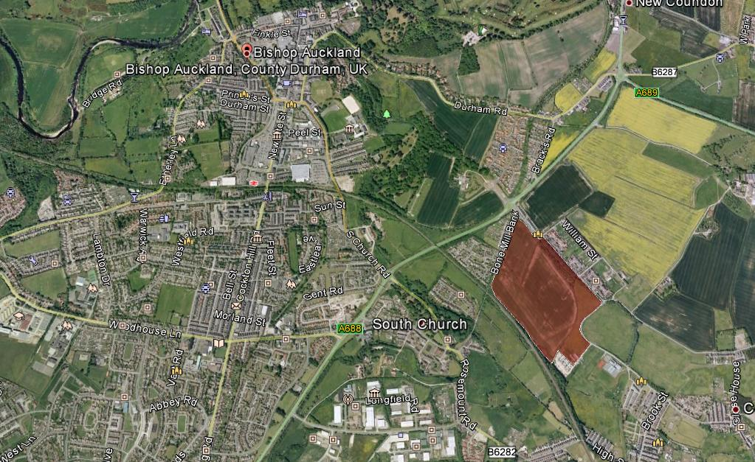
Regeneration Town

Slide 15
Original Application
616 Houses
0 Affordable Houses
£0 Contribution to S106 (despite being unsustainable site)
Council had strong Policy Card; then after back and forth appraisals…..
We were told 12% AH was their full and final offer.

Slide 16
We held out and received…
500 units with15% AH on a 70/30 split
Education – £100,000
Transport - £500,000
All possible because viability assumptions had been challenged by our S106 - team
We agreed:
A considerable increase in sales price
The 'Residual Land Value’ dropped considerably

Slide 17
S106 –Team approach
Negotiation tactics:
All viability appraisals vetted
Stand off on most applications
Appeal decision cited on viability assumptions
Alternative data presented
Measure of Success
HCA endorsed our approach to S106 - investigating stalled schemes

Slide 18
3. Processing S106

Slide 19
Challenges of Process (1)
Our systems were lacking:
Unitary Authority (2009) a combination of 7 authorities with different policies and practises i.e. 2 didn’t monitor S106
Collecting payment - developers don’t come forward, so reliant on officer memory
FOI requests created a nightmare!

Slide 20
Challenges of Process (2)
When writing S106:
Inflation, not always accounted for S106
Phasing was a disincentive for build out
Some S106 agreements were too complex i.e re-funds after 5 years for every instalment
Careful with S106 and relationship with CIL particularly with strategic infrastructure

Slide 21
CIL vs S106– Strategic Site
Originally going to use CIL to fund critical infrastructure for 2,500 dwelling site but:
Risk with long term certainty of CIL (national political change)
Developers wary of using unfamiliar tool
Greater certainty that funding will be timely using S106
Reduced competition from CIL pot
Highest CIL outside London (£200/m²)

Slide 22
Solutions to S106 process (1)
New DM system (IDOX) that will monitor S106 and CIL
IDOX will give automatic reminders for due payments
Monitoring fees in S106 agreements, £300-500 per site
PPA for management of overall projects
Having a legal team helps.

Slide 23
Solutions to S 106 process(2)
New policy approach in emerging CDP will ensure consistent approach for both S106 and CIL:
Concise reg. 123 list for CIL
Policy requirements subject to viability
Producing an SPD on contributions to support policy
Review mechanism for market changes

Slide 24
4. Spending of S106

Slide 25
Spending S106 Problems...
Previous authorities had different systems, i.e money went straight to Parish Council or to Chief Executive.
Politics of S106, managing Members, who were asking for pet projects.
Poor geography applied to spending.
Time lag and forgetting to collect.
No comprehensive record of S106 across County – lack of transparency
Where did the money go?

Slide 26
Durham S106 money..

Slide 27
Spending Solutions.. (1)
We created S106 working group of Members and chief officers to manage spending of S106
Officers from Planning, legal, assets, accountants, leisure, regeneration.
Working group makes it more transparent ensures correct geography applied
Makes sure money is spent

Slide 28
5. Lessons from Durham

Slide 29
S106 - Lessons Learnt (1)
One Size does not fit all. Every site is different.
LA’s must understand their policy context and where appropriate, use as a tool to lever in S106
Our interim strategy worked - 2000 units and 350 AH in 2 years.
Notes:
Do members want to see schemes delivered, or are they happy to see them stall if there isn’t going to be affordable housing etc.

Slide 30
S106 - Lesson Learnt (2)
Having a 5-Year supply of deliverable housing could help deliver S106 and reduce likelihood of appeal
Each developer is different with different business models and motivations.
Challenge and stand up to developers. Our approach was endorsed by HCA.
Notes:
Do members want to see schemes delivered, or are they happy to see them stall if there isn’t going to be affordable housing etc.

Slide 31
S106 Lessons Learnt (3)
Carefully consider the impact of CIL regulations.
Training for Members on S106/CIL.
Working groups can help deliver S106 infrastructure and could help spend CIL money too.
Allow review mechanisms for market changes.
Finally, always….

Slide 32
THE END
-Thank you for listening.

Slide 33
Any Questions?
Peter.ollivere@durham.gov.uk
Durham Local Plan – Ref (K7)
http://durhamcc-consult.limehouse.co.uk/portal/planning/cdpev/
Local Plan and AH Viability Study
http://durhamcc-consult.limehouse.co.uk/portal/planning/cdpev/

