Slide 1
PLANNING ADVISORY SERVICE SEMINAR
January 2015
SECTION 106 – ISSUES, APPROACHES AND CLAUSES
Presented by Shabana Anwar

Slide 2
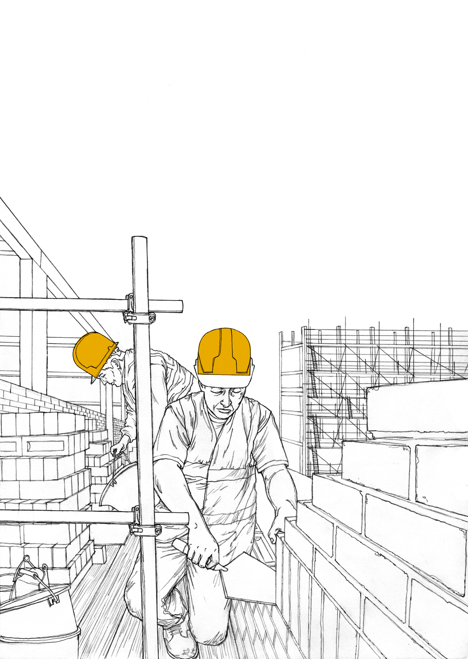
ISSUES, APPROACHES AND CLAUSES
Part 1
Scope of Section 106 and Legal / Policy Tests
S106 checklist
Obligations v Conditions?
CIL and ‘scaling back’ of s106
Common Clauses – practical examples
LUNCH BREAK
Part 2
Specific Obligations – practical examples
Affordable Housing

Slide 3
THE BROAD SCOPE OF s106 TCPA 1990
What does s106 permit?
Enables a developer to enter into a ‘planning obligation’ – agreement or unilateral undertaking.
Used to mitigate the impact of unacceptable development to make it acceptable in planning terms.
Planning obligations may:
restrict development or use of land in any specified way require specific operations or activities to be carried out in, on, under or over the land
require the land to be used in any specified way; or
require a sum or sums of money to be paid

Slide 4
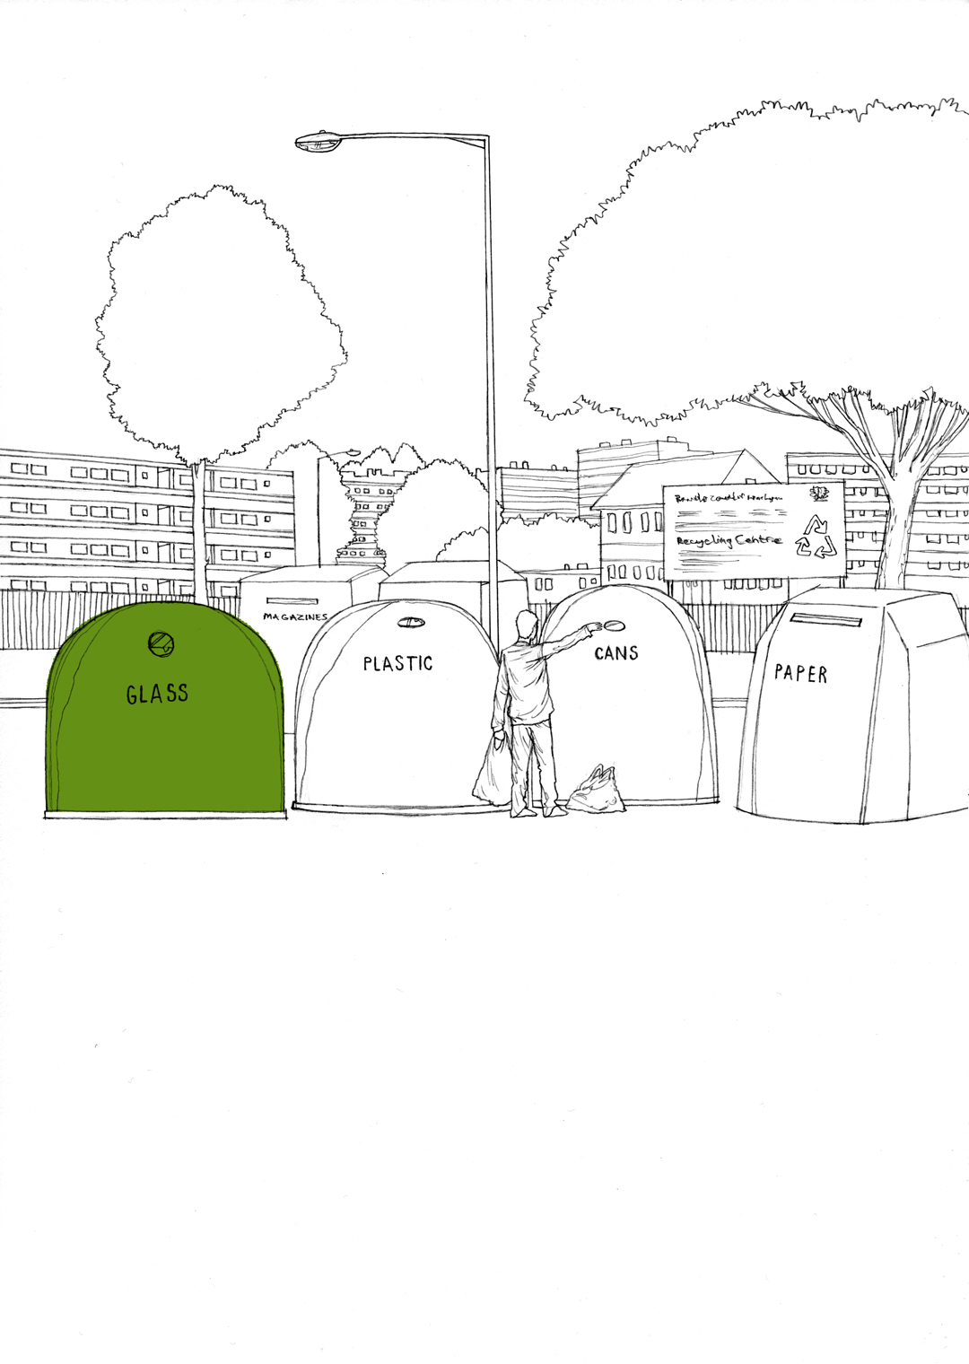
LEGAL AND POLICY TESTS
Legal (Reg 122 of CIL Regs 2010) and Policy (NPPF para 204) tests:
Planning obligation may only constitute a reason for granting planning permission for the development if the obligation is:
necessary to make the development acceptable in planning terms;
directly related to the development; and
fairly and reasonably related in scale and kind to the development
Policies for seeking obligations should be in a DPD. Must be grounded in an understanding of development viability (NPPG)

Slide 5
FORM AND LEGAL REQUIREMENTS
See our s106 agreement checklist:
Legality and policy
Relevance of CIL
Preliminary Action
Parties
Formalities
Substantive matters

Slide 6
OBLIGATIONS v CONDITIONS
NPPF Para 203: only use obligations when not possible to address impacts using conditions
Conditions must be (Para 206 NPPF):
necessary
relevant to planning and to the development;
enforceable
precise; and
reasonable in all other respects.
Planning obligations and when to use them
generally give more control / detail
unable to appeal for 5 years, but not so for unviable affordable housing obligations.

Slide 7
LEGALITY OF CONDITIONS REQUIRING S106 AGREEMENT
A solution to problems surrounding land ownership
PINS Advice in 2007 following four appeals by Arnold White Estates for development at Leighton Buzzard
West Moor Bellway Homes appeal in 2013
March 2014 DCLG guidance
DCLG ‘s ‘Technical Consultation on Planning’ dated July 2014

Slide 8
CIL AND ‘SCALING BACK’ OF s106
CIL Regulations 2010
S106 still used for site specific mitigation and Aff Housing
Threat to viability? Threat to Aff Housing?
Pooling Limit – 5 items. Looming deadline!
Big stick, but any carrots?
Reg 123 List and “relevant infrastructure”

Slide 9
CIL AND POOLING
A s106 obligation may not be a reason for granting PP if for the provision or funding of any infrastructure on reg 123 list
If no Reg 123 list, then above applies to any infra (PA 2008 – “includes” transport, flood defences, edu, med, sports, open spaces)

Slide 10
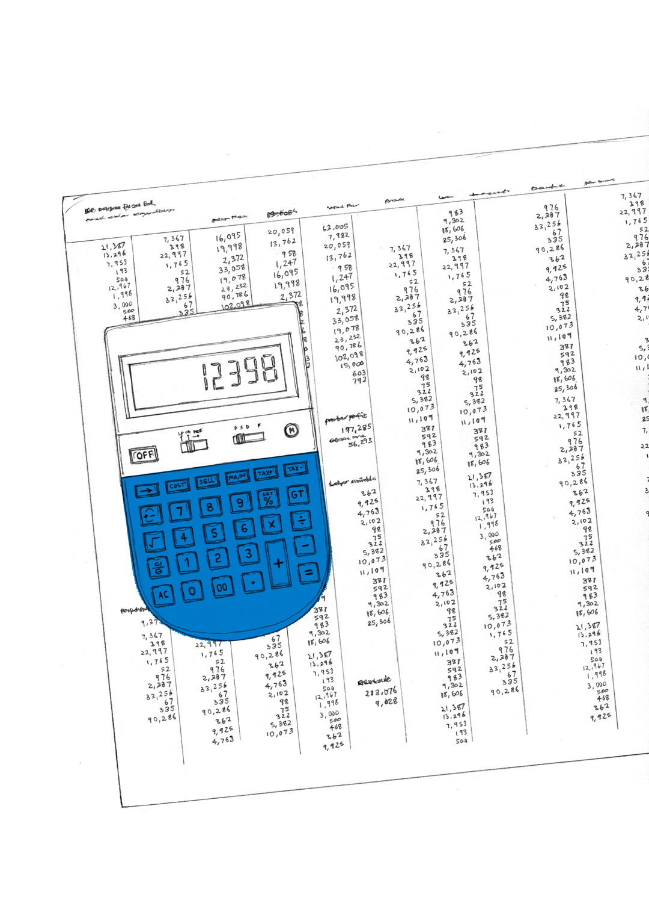
CIL AND POOLING (CONTINUED)
Pooling restrictions apply as regards s106 obligations that post date 6 April 2010 – limit of 5 planning obligations in LPA area per infrastructure project or type (doesn’t restrict s278 agreements)
Cannot via a section 106 obligation or planning condition require a s278 HA 1980 agreement to provide/fund any infrastructure on reg 123 list

Slide 11
OBLIGATIONS AND 278 AGREEMENTS - FROM 6 APRIL 2015
CIL? | POLICY POSITION | POOLING FROM 6 APRIL | S106 and 278 FROM 6 APRIL 2015
YES | S106 obligations satisfy legal (Reg 122(2)) and policy tests in NPPG | No more than 5 separate obligations for an item or type of infrastructure since on/after 6 April 2010 | Fund ‘infrastructure’ not on Reg 123 list +Aff H + site specific mitigation
NO |  |  | Cannot fund any infrastructure but can Aff H+ site specific mitigation

Slide 12
CONTENT OF s106 AGREEMENTS
See model agreement
Parties?
Every party?
Mortgagees?
LPA as landowner:
Condition requiring entry into a S106
Development agreement
Bind a lesser interest

Slide 13
CONTENT OF s106 AGREEMENTS (CONTINUED)
Phasing and timing provisions
Release clause – expired, quashed.
Implementation clause

Slide 14
CONTENT OF s106 AGREEMENTS (CONTINUED)
Annex a draft permission
Sureties and bonds
CIL – threat to viability? Clawback?
Double dipping?
Overlap with other powers / agreements
(e.g. s.278 agreements)

Slide 15
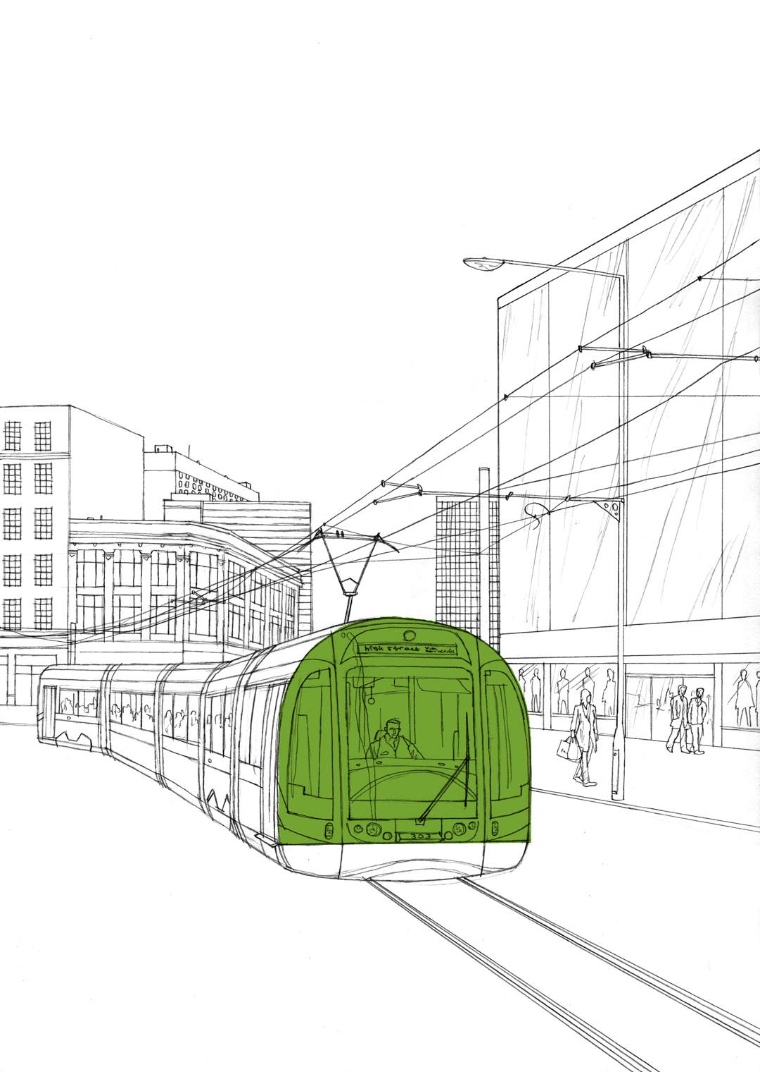
SPECIFIC CLAUSES AND OBLIGATIONS
Meet the CIL tests? When ok to use?
See Examples
public art – see NPPG.
Local labour – deliverable?
provision for the mitigation of impacts /
public realm improvements (out of town
supermarkets)
travel plans or other sustainability issues (car-free schemes)
affordable housing provision

Slide 16
S106 AND AFFORDABLE HOUSING
New trigger – 10 Units trigger (see NPG and Ministerial Statement) or 5.
“should not prevent development from going ahead.”
Affordable Housing clause (see example)
Affordable Housing Scheme (mix, location, cost etc)
Fountains, cascades, clawback
Nomination arrangements
Commuted sums
Viability appraisal – confidential?
Doesn’t apply to office to resi PD (NPG)

Slide 17
CHANGING OR DISCHARGING PLANNING OBLIGATIONS
Through agreement by deed
Can be renegotiated at any point if parties agree
Through formal application (and appeal)
After 5 years may apply to the LPA requesting it to modify or discharge the obligation on grounds that it:
“no longer serves a useful purpose”; or
continues to serves a useful purpose in a modified way
May appeal to SoS against decision or non-determination
What about other affected parties?
Formal applications must be advertised and representations may be made to the LPA as regards the modification or discharge proposed

Slide 18
CHANGING OR DISCHARGING PLANNING OBLIGATIONS (continued)
Renegotiating affordable housing requirements
25 April 2013: s106BA (right to review) & s106BC (right to appeal) TCPA 1990
Allows ‘economically unviable' affordable housing requirements to be modified or discharged by application to LPA and appeal to SoS.
Purely numerical – can’t consider planning merits
Take care with viability info submitted first time
Difficult to respond to appeals within 28 days
Has it helped or hindered the provision of affordable housing? Low uptake so far – need to maintain good relations?

Slide 19
Thank you
Any questions?

