Slide 1
Beyond the Duty to Co-operate…
…and towards strategic planning
Welcome!
February/March 2016
www.pas.gov.uk

Slide 2
Introduction
Andrew Pritchard
PAS Principal Consultant
Notes:
2

Slide 3
The Story So Far…
Keith Holland
Former PINS Assistant Director

Slide 4

Beyond the Duty to Co-operate…
…and towards effective strategic planning
www.pas.gov.uk

Slide 5
Background
Research into the Duty to Cooperate conducted by Shared Intelligence (Si) in 2015.
Involving interviews with over 100 planning officers, chief executives, lead members, leaders, and industry professionals.
Aiming to understand what concerns authorities have regarding the duty, and their current and future support needs.

Slide 6
Mixed views about the Duty
Research unearthed a wide mix of views about the Duty
From hostility from some who saw it as a “half measure” in the absence of “proper strategic planning”
To a cautious welcome as a locally-led alternative to the old “top down way of doing things”
Introduction of the Duty – “dropped in…at the last moment” - had created considerable confusion
Common view that it would not survive after the May election…

Slide 7
Learning curve
In that context, authorities had been on a steep learning curve
Initial perception that the Duty was a narrow process requirement
Replaced by an understanding that the Duty was a “pretty fundamental test”
Many officers faced an internal task of raising awareness amongst senior officers and elected members

Slide 8
Learning curve
“They thought regional officers had been abolished. It wasn’t – it was delegated”.
“The removal of top-down planning, whatever you thought of it, created a void”.
“Most now appreciate that the Duty is a pretty fundamental test”.
“We thought we were doing everything right. Up until the point we failed”.

Slide 9
Local context
The response to the Duty was shaped by local context
For areas with a history of cooperation and a shared / emerging vision, the Duty was a continuation of business as normal
“We have a strong bond [with neighbours]. The Duty just gives us another reason for talking at that strategic level, for seeing out inter-relationships”.

Slide 10
Local context
The response to the Duty was shaped by local context
For areas with a history of cooperation and a shared / emerging vision, the Duty was a continuation of business as normal.
For areas with little or such history and / or conflicting planning goals, the Duty raised issues that were not being answered – or even addressed
“We have a strong bond [with neighbours]. The Duty just gives us another reason for talking at that strategic level, for seeing out inter-relationships”.

Slide 11
Top 5 challenges
We asked interviewees to rate the main challenges facing their authority in terms of compliance:
“Agreeing a distribution of housing / employment land with neighbouring authorities”
“Doing effective cross-boundary strategic planning at the local authority level”
“Political differences”
“Lack of alignment with neighbouring areas in terms of local plan development”
“Capacity in the authority”

Slide 12
Reflections on the challenges
“If you have an uncooperative partner, and they’re prepared to put up with the consequences and blame the government, there is no real sanction.”
“It’s a hard duty to carry out effectively…The level of collaboration is a bit pick and mix as we’re all at different stages.”
“The difficulty is selling it to members.”

Slide 13
Support
We also asked interviewees to identify the features of a support package:
Bringing authorities together to focus on strategic, cross-boundary issues
Engaging elected member and senior managers
Providing a review / critical friend function
Illustrating examples of joint working arrangements
Working with individual authorities to develop capacity and raise awareness

Slide 14
Changing context
Devolution:
  operating at a level larger than and across strategic housing markets
  Delivering powers and resources that should enable faster delivery of planned homes
  Ramping up pressure for more housing to match ambitious growth plans
Mayoral corporations

Slide 15
That was then…
To what extent are those issues and concerns still relevant today?
What do we need to do to address them?
What other support needs remain?

Slide 16
Strategic Planning and Devolution
Oxfordshire Devolution Proposal
Bev Hindle
Strategy & Infrastructure Planning
23 February 2016

Slide 17
“Strategic Planning” in Oxfordshire
Context
Post-Coalition – very limited
Forced working through DtC and SHMA
“Considered Approach” – external advice
Post-SHMA – Oxford’s Unmet Need
Tri-County Alliance
Devolution – answers looking for a question

Slide 18
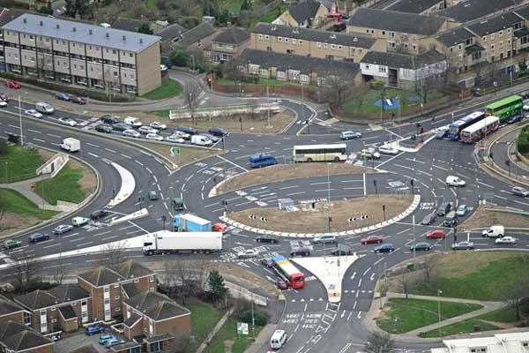













Oxfordshire Devolution
A Deal for Greater Economic Success
Ian Hudspeth
Leader Oxfordshire
County Council
Bob Price
Leader Oxford
City Council
David Smith
Chief Executive
Oxfordshire CCG
Sir Barry Norton
Leader
West Oxfordshire
David Buckle
Chief Executive
South & Vale DC’s
Nigel Tipple
Chief executive
OxLEP

Slide 19
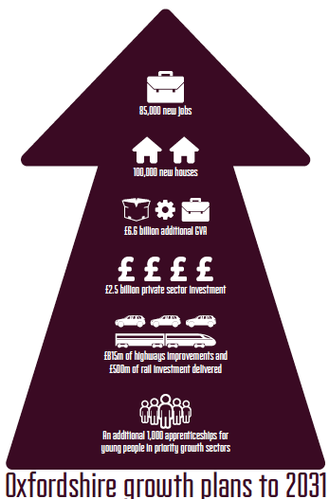
The Challenge and Opportunity
Notes:
This represents the totality of growth from 100k houses, to 85k jobs – delivers massive GVA and private sector investment

Slide 20
Oxfordshire Economy and context
OXFORDSHIRE GROWTH
Oxfordshire has a globally important and unique economy centred around key innovation and knowledge rich sectors.
One of the largest concentrations of world-leading business, research and development activity in Western Europe, hosting the global headquarters and principal research and development facilities of some the world’s leading technology companies
Over 30,000 VAT registered businesses in the county, with 3,500 new businesses created each year
GVA per head that is 17% higher than the UK average.
Knowledge intensive clusters with over 1,500 high tech companies employing around 43,000 people.
The county’s economic output was valued at £19.2bn in 2013, making us an important net contributor to the Treasury.
The fastest growing economy of any LEP area since the recession, with economic growth of over 20% GVA between 2009 and 2014 - more than double the growth rate of core city LEP areas such as Greater Manchester or the Leeds City Region, and higher than Greater London.

Slide 21
Devolution “Process”
Never a defined process – evolved
Started in earnest mid-2015
First Submission considered – further dialogue
Meet with Minister and MPs
Revised Submission January 2016…
Two Main Threads – health and infrastructure

Slide 22
Oxfordshire Devolution Proposal: Infrastructure
Infrastructure investment programme to support growth;
Integrated approach to strategic planning for infrastructure, housing and employment through a Combined Authority;
Partnership with HCA to develop a housing investment strategy and consolidated funding allocation;
Development of a Land and Property Partnership Board;
Development of Housing Development Companies;
Locally set planning fees to support the significant growth.

Slide 23
Oxfordshire Devolution Proposal: Infrastructure
Deliver:
By 2031, over £6bn will have been invested in infrastructure including rail, road and public transport networks
By 2031:
  85,600 jobs will have been created
  The jobs from 2015 – 2031 will have generated £11.8bn of GVA and a gross increase of £4.1bn of GVA each year from 2031 onwards
  Construction activity will have generated a boost to GVA of £15.5bn and support 326,000 FTE Temporary construction job years (21,000 construction jobs for 15 years)
By 2020:
  Construction job activity will generate a one off boost to GVA of £5.4bn
  21,000 Construction jobs will have been supported each year on average
  There will be an increase of 30,000 full time jobs
  An annual GVA increase of £1.5bn (that will continue each year after 2020).

Slide 24
Notes:
Developing a strategic approach to infrastructure planning and delivery
Major infrastructure delivered by authorities but expanding to include wider schools delivery, utilities and public services

Slide 25
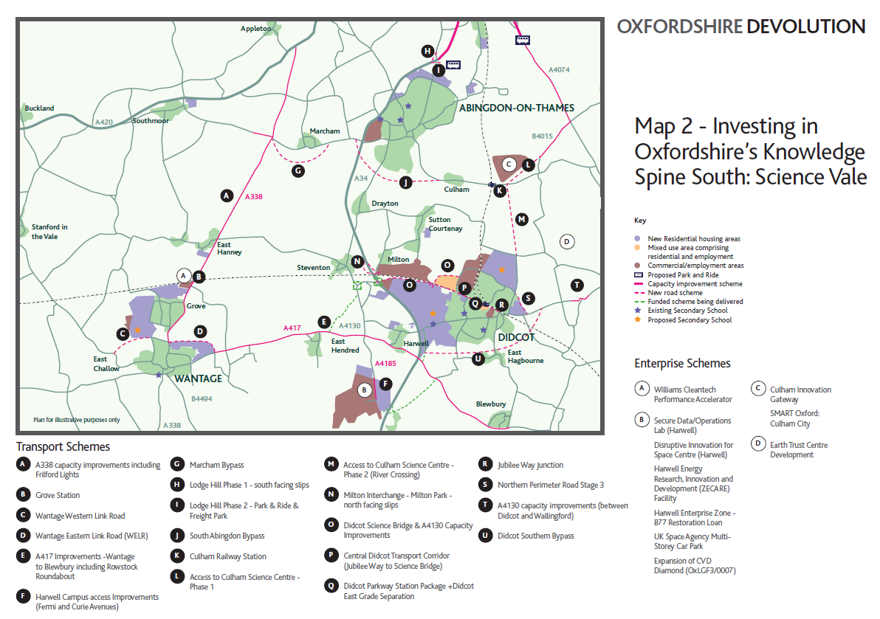

Slide 26
Where Are We Now?
Many of the second round devolution bids have fallen away
Criteria for success changed
SoS powers – where will that take us?
Emphasis on elected mayor, reorganisation
D-Evolution

Slide 27
Strategic Planning: The Way Forward
Wait…may be a further conversation
Complete Oxford Unmet Need Work
Local Plans updated and adopted
SEP Refresh to Inform LGF
Get on with what we offered
  OxSIS
  Health Integration
Sub-National Transport Bodies - EEH

Slide 28
Thank you

Slide 29
Strategic investment plans: what they are, aren’t, and how they can really work

Slide 30
What are “area-wide strategic investment plans”?
  About plans which co-ordinate land use and infrastructure investment which cross boundaries
1) Emerging Combined Authorities Investment / Growth Plans
  Frantic devolution deals 2015: Treasury only really interested in
    A) Elected mayor as focus of responsibility
    B) Strategic planning powers for investment
  Different results in different places: Manchester, Sheffield, NE, Liverpool Mayor taking on strategic planning powers;
  Tees Valley, West Midlands CA – Mayors have smaller (stated) role
  2) Emerging Regional Partnership Investment Plans / Strategies
  (eg Northern Gateway HS2 - Stoke, Crewe, Cheshire)
3) Local authority cross-border investment plans
  eg some London Opportunity Area DIFS, County documents

Slide 31
Saving money through joint commissioning
Scale economies exist through joint commissioning
But not the real benefit?
Benefits are in
  quality of output arising from looking at wider spatial scale
  greater ability to lever meaningful infrastructure investment able to trigger private investment

Slide 32

Strategic investment plans are not about this
Notes:
These
This bloke is doing something unspeakable to Birmingham
He thought he could put his head under a towel and come up with the answer
He can’t
Modern economies are too complex and fast moving

Slide 33

They’re about this: innovation and information flows

Slide 34

Strategic investment plans are not about this

Slide 35
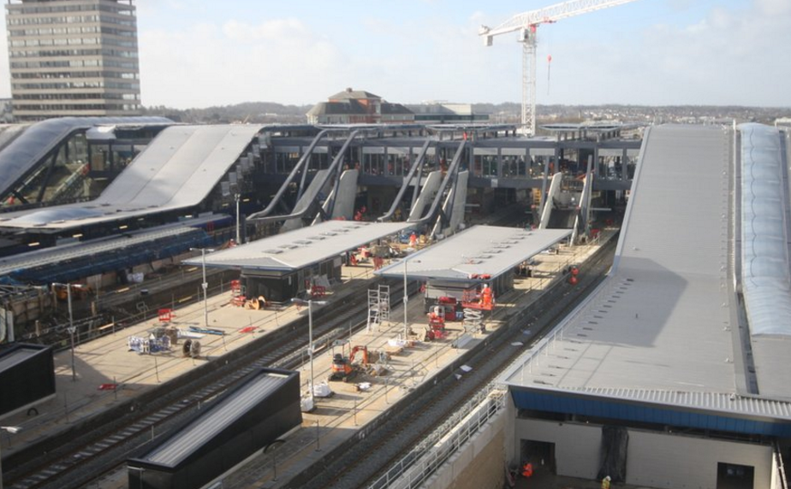
They’re about this: improving underlying economic geographies
Notes:
the project they need, not the project we want to do

Slide 36
Strategic investment plans are not about this (not really)

Slide 37

They’re about this: stimulating private sector investment

Slide 38

They’re about this: stimulating private sector investment
Your challenge:
To set up investible propositions that will get delivered
Through de-risking investment
Making intelligent use of any capital spend available

Slide 39
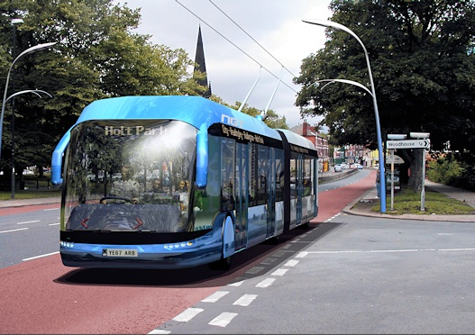
Information de-risks investment: quality

Slide 40

Information de-risks investment: neighbours

Slide 41

Information de-risks investment: S106/CIL (land price)

Slide 42
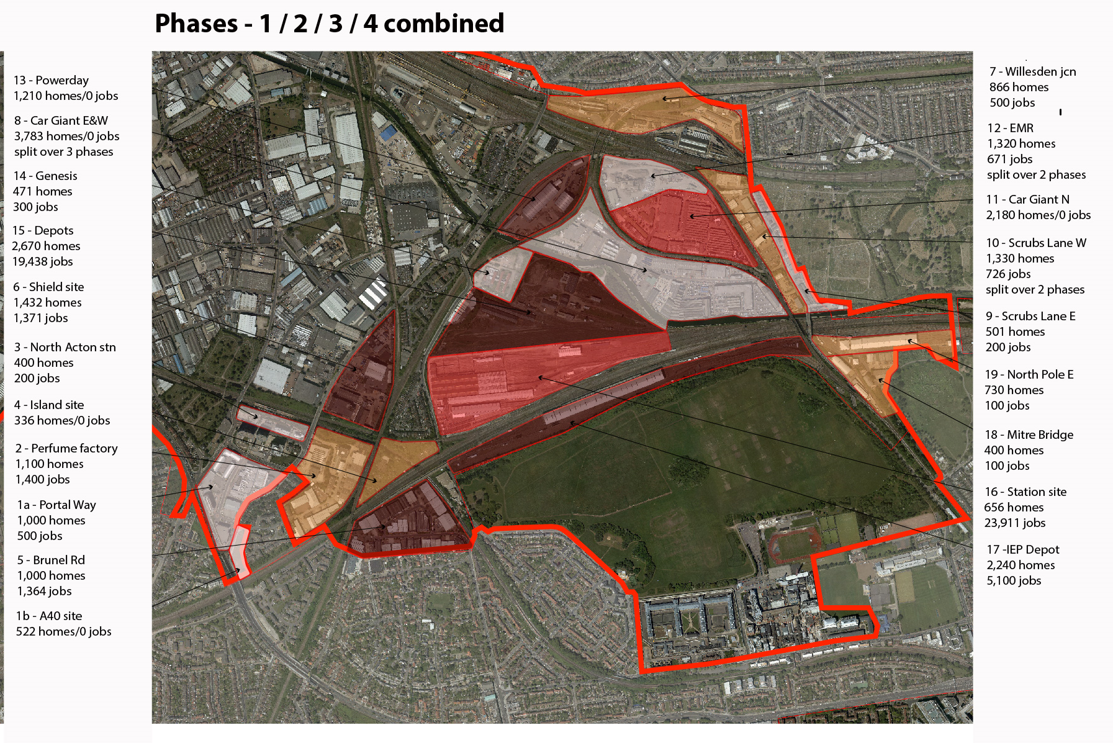
Information de-risks investment: co-ordination

Slide 43
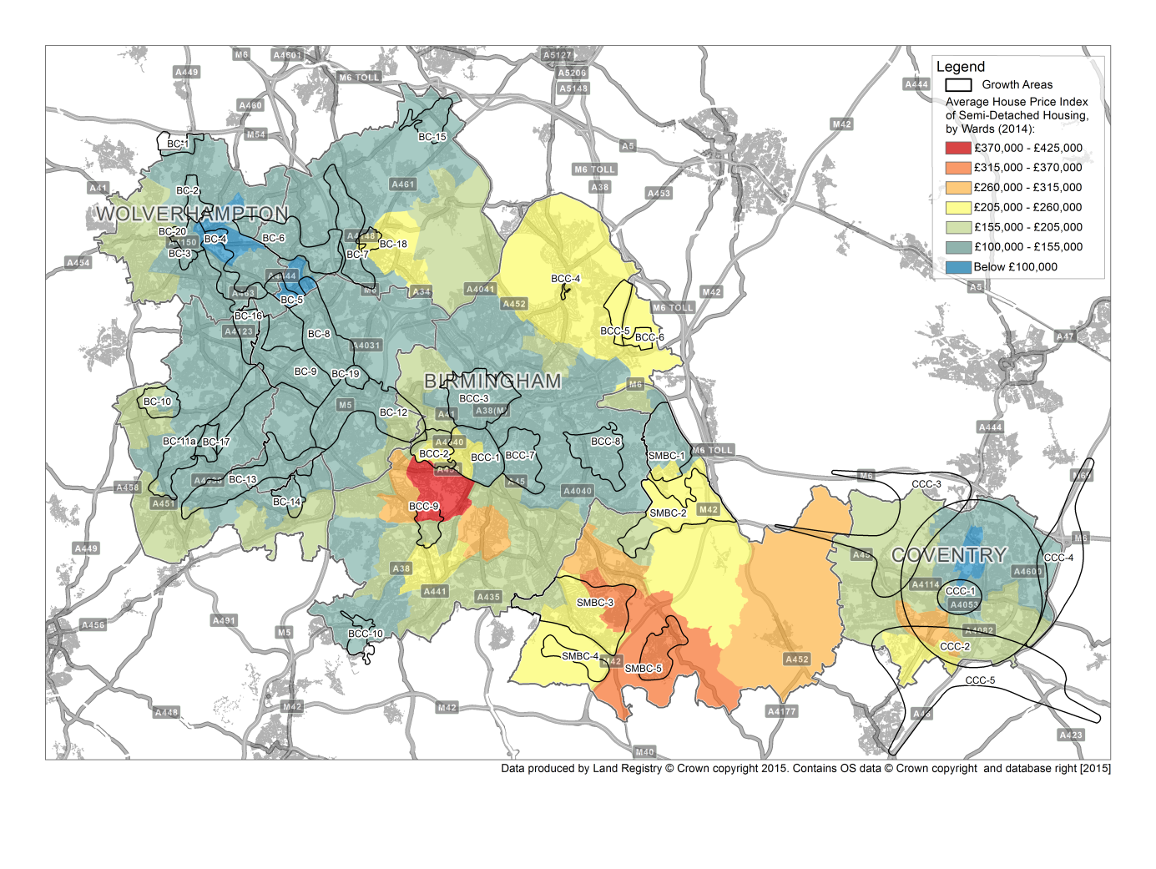
Example: West Midlands – contaminated sites, lack of viability, fractured plans?

Slide 44
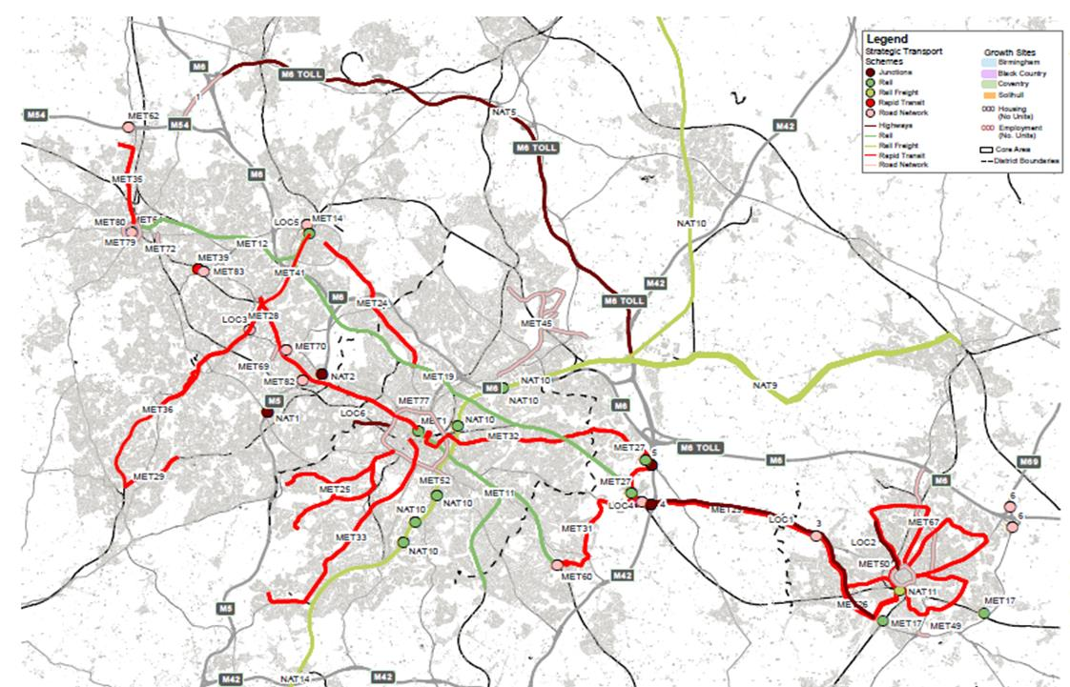
Integrating infrastructure and focused site delivery to accelerate investment

Slide 45
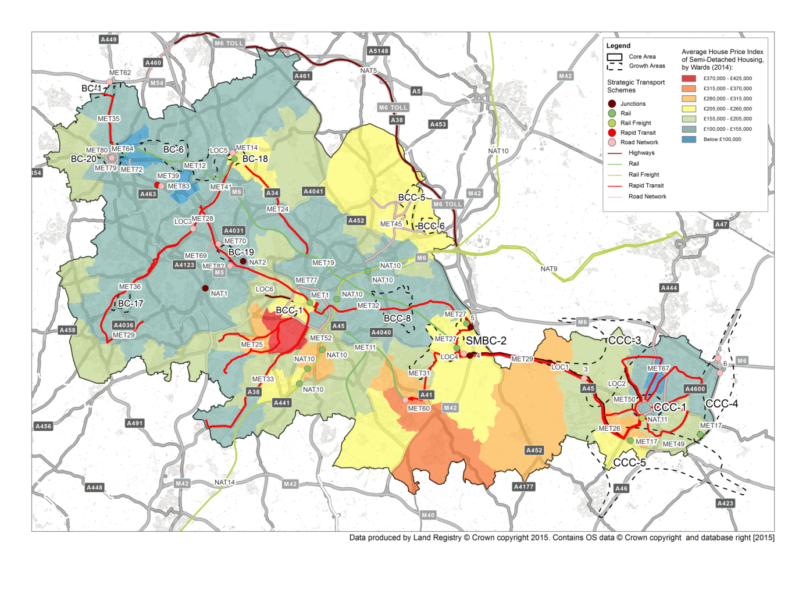
Towards “Opportunity Areas” supported by infrastructure provision to focus investment

Slide 46
Telling the delivery and implementation story

Slide 47
Focusing your firepower to get investment moving

Slide 48
Getting from LEP/Combined Authority Strategic Economic Plans to implementation
Problem: like LEP plans, SEPs frequently boosterist - big job claims
Needed to get Government’s attention at the time
But disconnected from the (statutory plan) means of delivering the targets
  Plans don’t match the targets
And possible unintended consequences?
  Jobs claims not backed by housing land supply for workers
The SEPs risk wrecking the local plans
  Eg Oxfordshire and Cheshire
Land use planning is quasi-judicial process: keep separate
  the economic aspirations in the model
  Numbers in land use plan

Slide 49
Understanding the gap, and plugging it
If there is a gap between the SEP and the total homes and jobs number
You need to understand it and quantify it
You need to know shortfall in homes and jobs
And find schemes to plug it?
Challenging local authorities to grow is part of the SEP’s role
How do you do that?

Slide 50
Challenging local authorities to grow
Planning has become a system of legal compliance
Forget all that for a day or two
Give yourselves permission to think more fluidly
The grand example: Birmingham’s 1989 Highbury Initiative
More micro examples: Northern Gateway Workshop
Some possible success factors?
Talk to each other!

Slide 51

Success factor: a willingness to think creatively, heretically about existing plans. Instead, think markets and viability

Slide 52
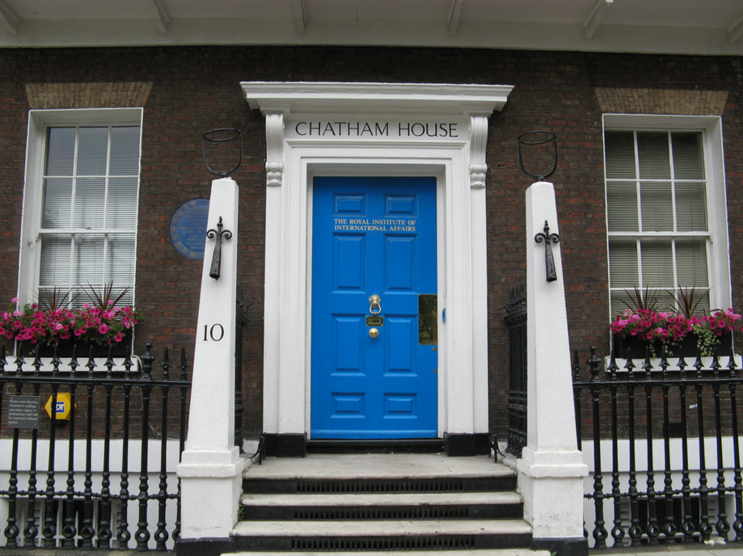
Success factor: Chatham House Rules?

Slide 53
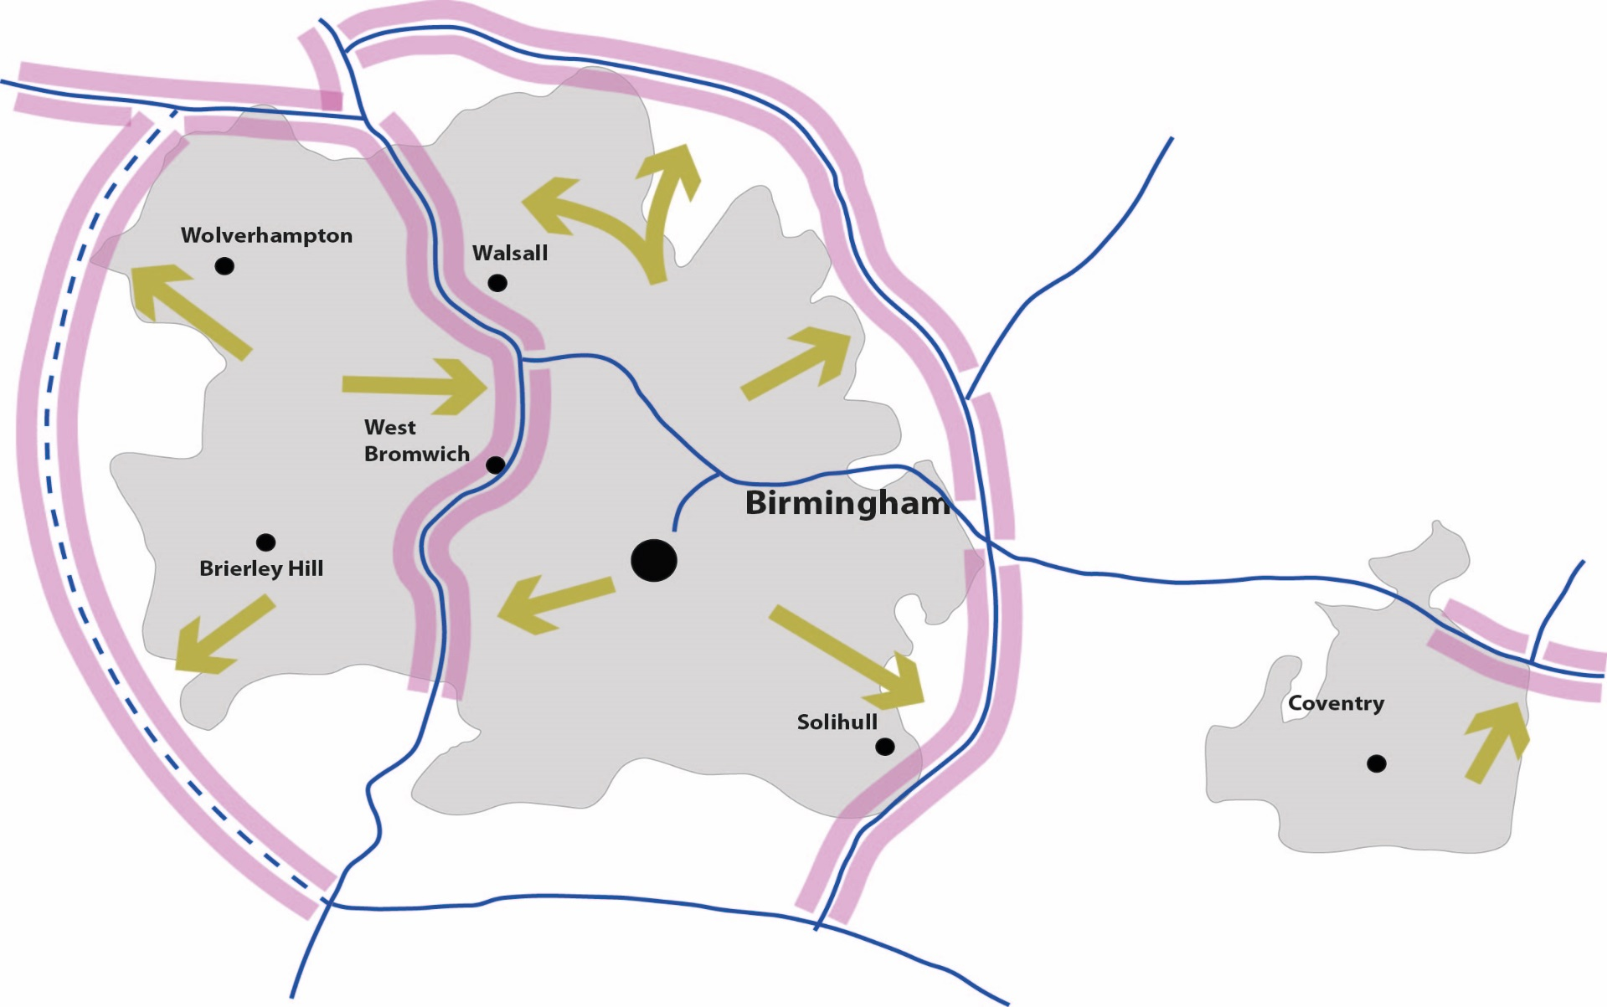
Success factor: a willingness to return to the old classics?

Slide 54

Success factor: don’t talk your silo. Think like a disinterested alien?

Slide 55

Success factor: pulling the high falutin’ back to plausible, practical local context?

Slide 56

Talk to investors as soon as you have ideas: road test concepts with them. You might be surprised
Eg Birmingham Vision for Movements
City Council and investors met informally
Found common ground
Created Vision for Movement
Helped precipitate public realm and major metro projects

Slide 57

Getting real about investment actualises creativity
Acknowledgements to Farrells
Notes:
doesn’t make you a breadhead

Slide 58
Strategic investment plans: what they are, aren’t, and how they can really work

Slide 59
Panel Q & A

Slide 60
Where can I get some help?
Andrew Pritchard
PAS Principal Consultant

Slide 61
For More information…
www.pas.gov.uk

