Slide 1
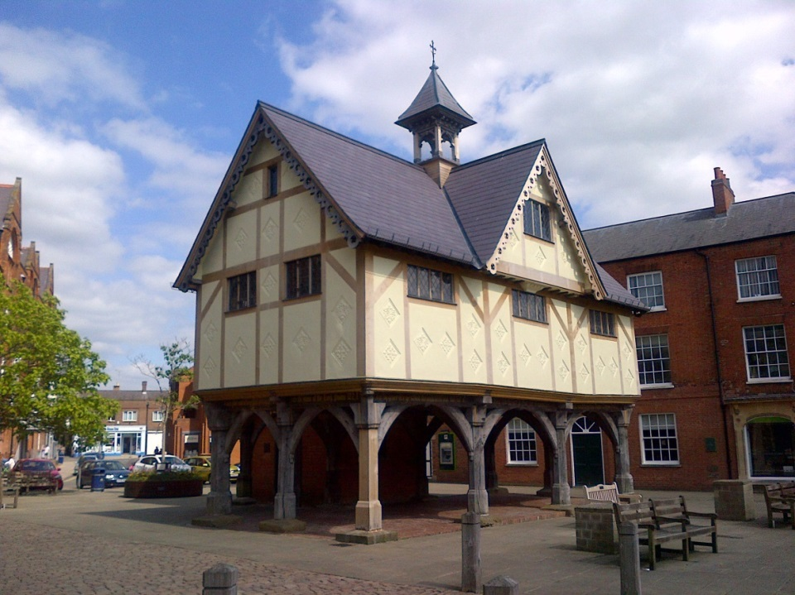
Local Authority Experience Managing an effective S106 process
Stephen Pointer Strategic Planning and Housing Manager Harborough District Council

Slide 2
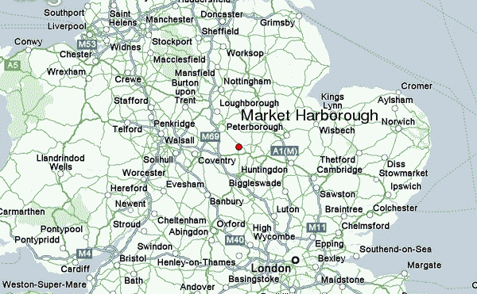
National Context

Slide 3
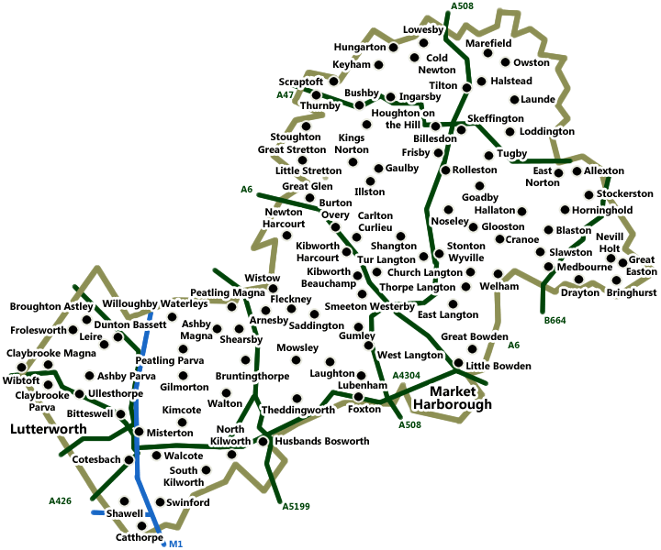
District Context

Slide 4
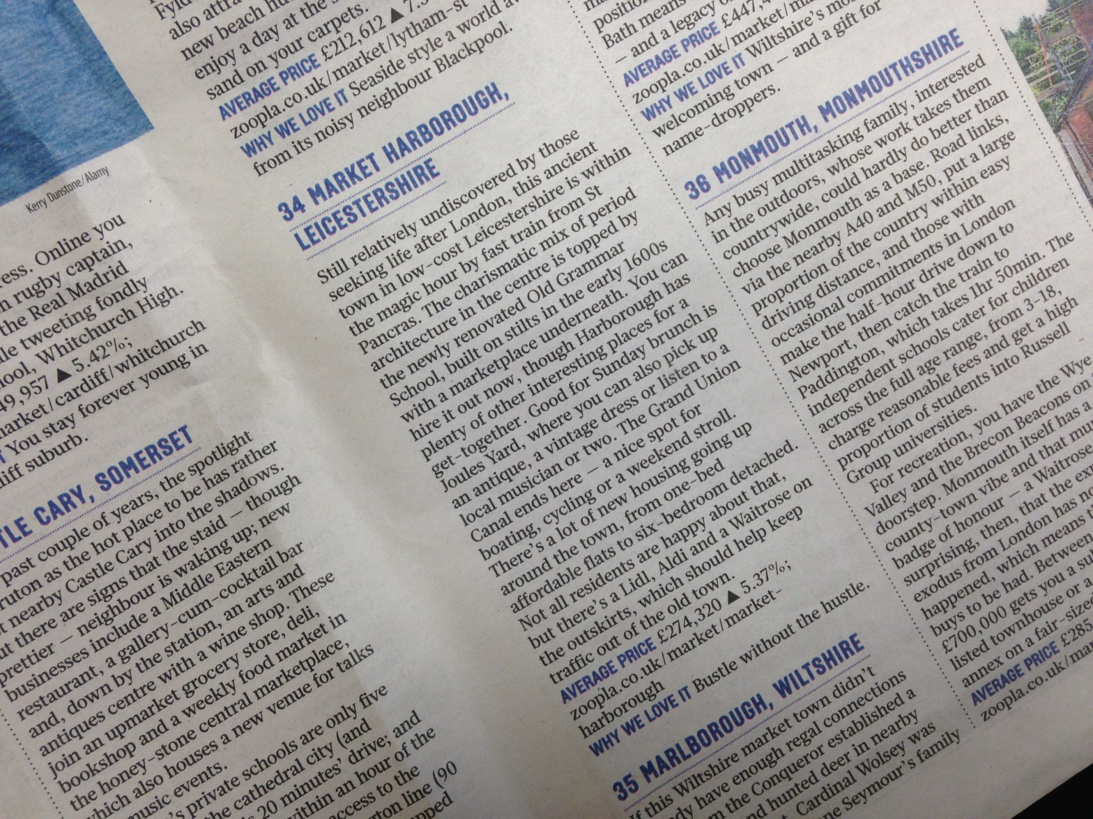
“Bustle without the hustle”

Slide 5
Fxo
Foxton Locks

Slide 6
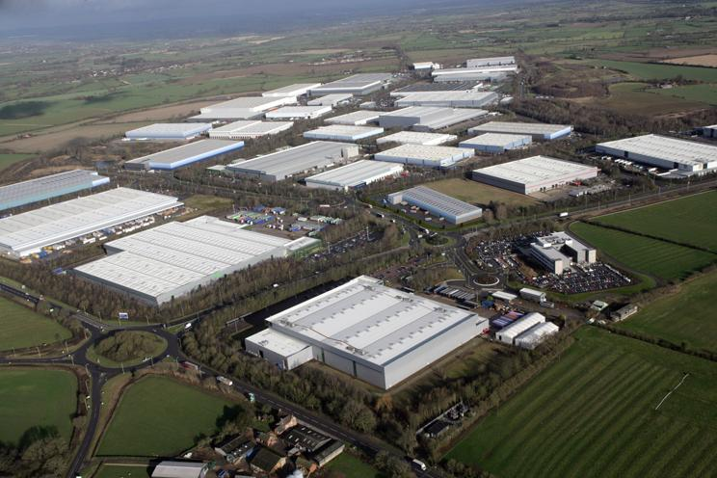
Magna Park

Slide 7
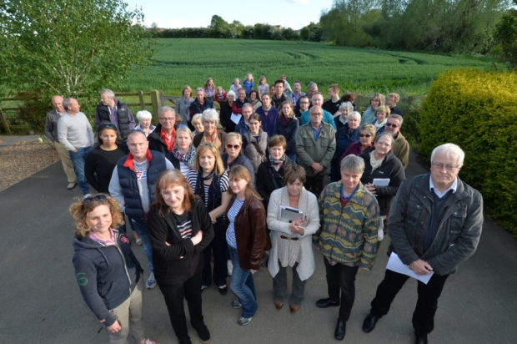
Not in my back yard!

Slide 8
District Context
Community interest
Strong Parish Councils
Member expectations

Slide 9
District Context
Affordable Housing SPD 2006
Planning Obligation Developer Guidance 2009
Core Strategy 2011

Slide 10
What we do
Corporate S106 Group
S106 Monitoring Officer
Corporate Database of S106 agreements
Manage the “end to end” process

Slide 11
Corporate S106 Group
Development Management, Policy (S106 officer), Legal, Finance, Open Space, Community Leisure, Assets,
Manages “end to end” process
Policy, applications, agreements, dicharging obligations, spend

Slide 12
S106 Monitoring Officer
Part time role (along Housing Enabling)
Monitor development, trigger points;
Invoices where obligation is a payment;
Maintain database of S106 agreements
Reports to Corporate S106 Group

Slide 13
Database of S106 Agreements
Maintained by Monitoring Officer
Details of obligations, trigger points, spend by dates. Pooling queries. FOI requests
Updated monitoring position
Accountable officer for spend

Slide 14
S106 issues
Application and pre application stage
Pre - application Stage – (advice based on Core Strategy Infrastructure Plan)
Guidance to consultees on making effective response ( Leicestershire Protocol )
Specific infrastructure requirement

Slide 15
S106 issues
Determination and Agreement stage
Viability test - internal / external assessment
Heads of Terms – clarity in reports
Wording of agreement – involvement
Bonding issue

Slide 16
S106 issues
Discharge of obligations and spend stage
Time restrictions on spend
Changes to needs and local requirements
Variations to agreements
Councillor involvement

Slide 17
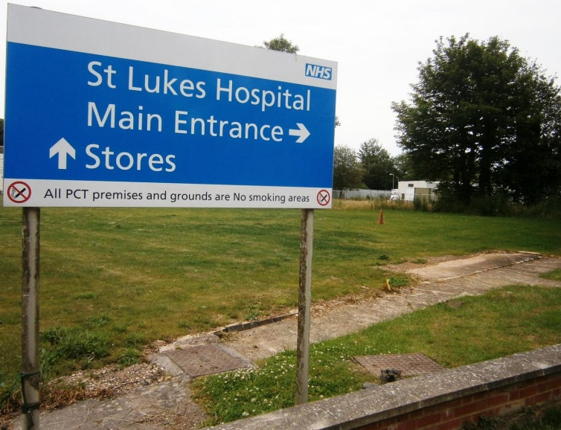
S106 issues
HDC – open space, community leisure, affordable housing
LCC – education, libraries recycling
Health services
Police

Slide 18
And finally……
Funding gap in services
Making development acceptable
Boost housing
CIL route

Slide 19
Questions

