Slide 1
Planning Service Review
Responsible for:
Minerals, waste planning
County Council owned developments such as schools

Slide 2
Planning Review
Service identified issues and supported by the Leader and the chief executive undertook a review based on best practice and identifying areas for improvement.
Two complimentary processes were undertaken
An external ‘Peer Challenge’ facilitated by the Local Government Association and funded by PAS
An internal review led by a project manager with an external consultant providing an independent perspective and challenge.

Slide 3
Issues identified
Service not providing the right level of service to their customers.
The School's program was not coordinated with other partners and was challenging to achieve.
48% of all applications were being determined by committee - this was too high
Reports to committee were too long and inconsistent and the committee process required significant change.
IT was poor ….not on Planning Portal and planning applications not web based

Slide 4
Issues identified
No charging for pre apps
Performance of the team was inconsistent and needed greater focus
Structure of the team was an issue with lack of clarification of roles
Communications to stakeholders was poor and more no inter team working required
Profile of the team amongst members was poor
Issues with team morale

Slide 5
It took 18 months to complete all the action points!
Because:
This was a thorough and in-depth review
IT barriers had to be overcome – County Hall systems not immediately up to the task.
Over 100 actions for improvement identified

Slide 6
What was achieved
A happy and valued team delivering success
A team recognised and valued by members as a strategic part of the Council
A members briefing with the team, attended by 70 people
A new office
Improved staff morale

Slide 7
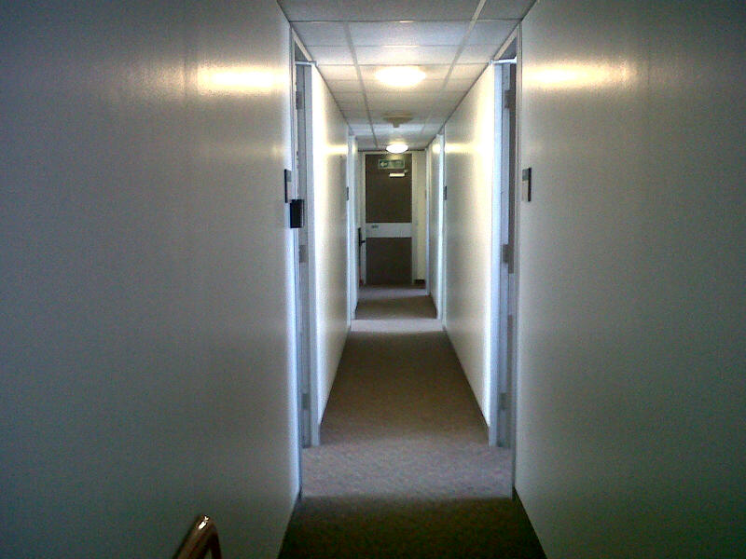
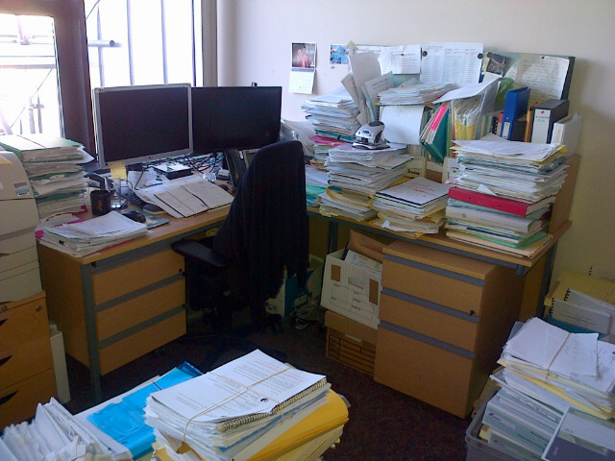
Office before

Slide 8
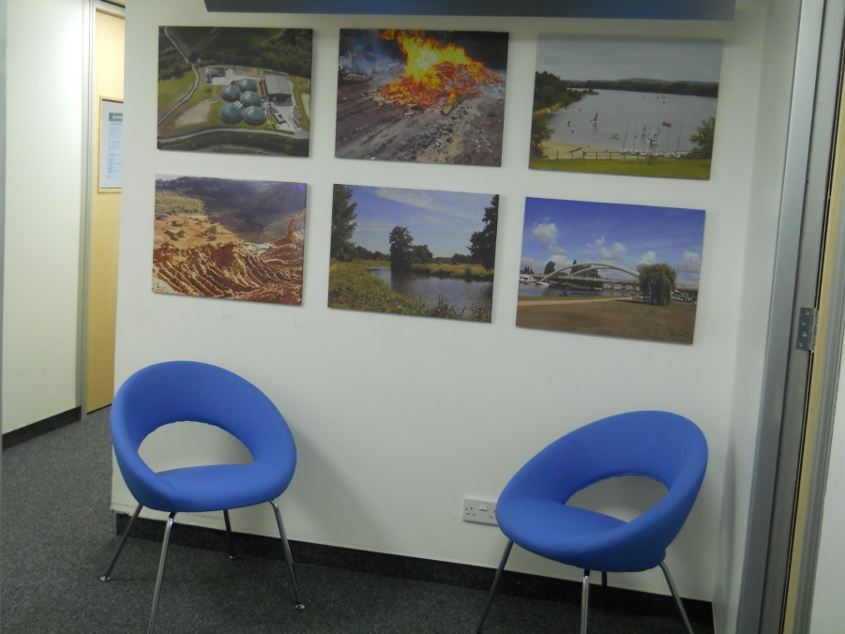
Office after

Slide 9
What was achieved
Web based portal for plans
Upgrading to Windows seven and planning IT system so that fully electronic
Charging for pre apps discussions and advice
Implementation of a monitoring and enforcement protocol
Improved format and branding for planning documents

Slide 10
What was achieved
Improved delegation with only 30% applications now going to committee
Close working with boroughs and districts and sharing expertise
Delivery of a schools program 2014-2019
The program includes building or extending 53 schools
Produced a spreadsheet to inform members of the individual schools being built or extended.

Slide 11
How did we achieve this?
Acceptance that we needed to change
Commitment from the team to work together
Support from PAS
Support from stakeholders
Appointment of an internal project manager
Delivery through an implementation plan with regular monitoring of progress

