Slide 1
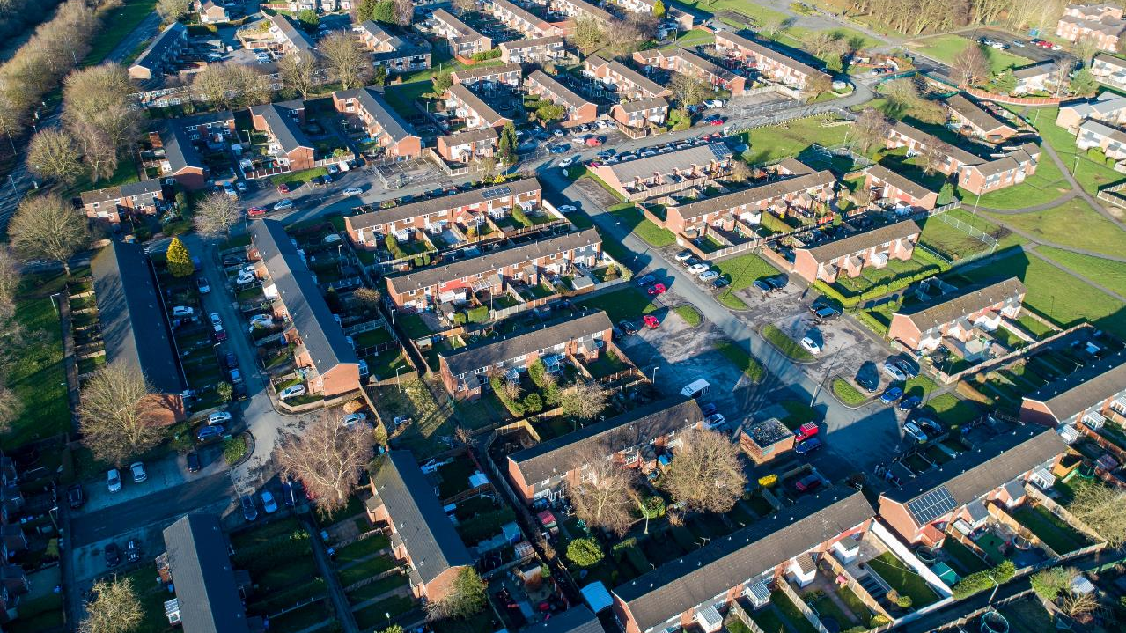
Working together with

Slide 2
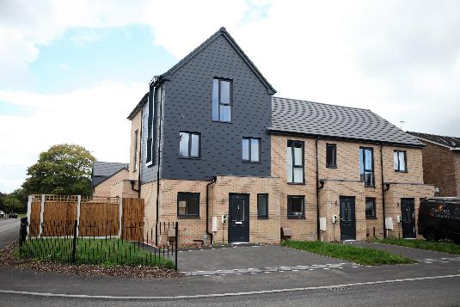
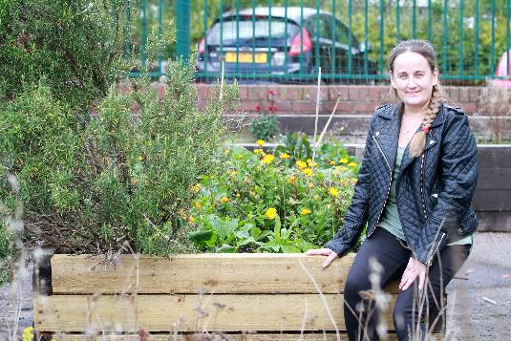
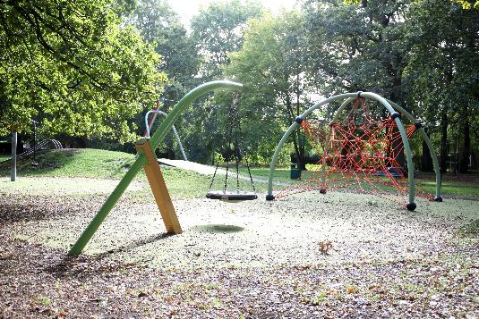
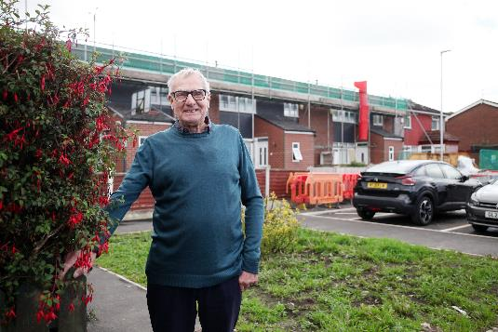
Sale West
Estate
Context
Place Making
Design
Investment in homes
Investment in the community
Green Infrastructure
Funding
Challenges
Learning

Slide 3
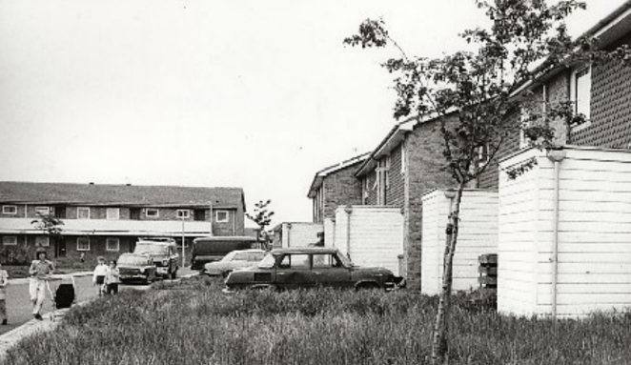
About the estate
1970’s Radburn Design in Trafford
Manchester overspill estate
Stock transfer in 2000 - council considered 80% of homes long term ‘unlettable’
3,900 residents in 1,800 homes
IVH own 1,100 of the homes
3 primary schools and 2 high schools within walking distance
Community centre and café, small supermarket, and pub.
Big Local funded group - Our Sale West
Community allotment, parks and open green spaces

Slide 4
National & Regional Context
Sale West | North West | Comparison
33% of people have no qualifications | 25% | Lower
31% people aged 16-74 are in full-time employment | 37% | Lower
83.1% of people are 'satisfied with their neighbourhood' | 76.6% | Higher
44% of households have no car | 28% | Higher
Priority regeneration area in Trafford Local Plan
Most deprived wards in the borough (top 10% nationally)
Notes:
Add Sonja stats for national context

Slide 5
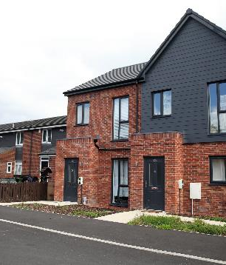
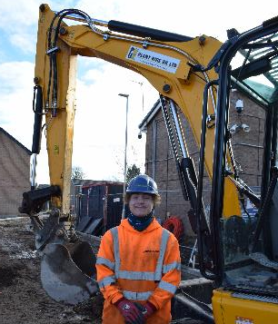
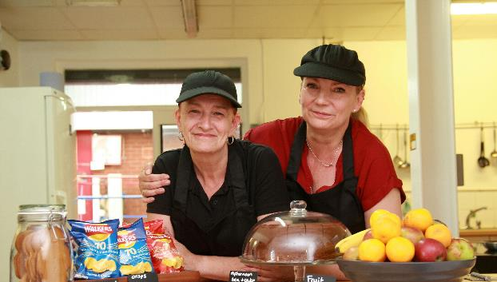
£50 million regeneration project 2020-2030
263 high quality new affordable homes for rent and sale
c£7m investment in 1,100 existing homes - new kitchens, fencing, roofs, parking areas
New roads, pedestrian linkages and cycle ways
High quality public realm and including new and improved play areas
New Community Centre providing high quality provision for community services
Investment in community projects and initiatives to meet local needs and create opportunities for residents
Economic mobility with jobs for local people, apprenticeships, skills and training.
Notes:
New Community Centre delivered by Community Group providing high quality provision for activities and services
Economic mobility with jobs for local people, apprenticeships, skills and training (Level 1 & 2 opportunities to link with GM supply chain)

Slide 6
Established community anchor
Community led collaboration
Our Sale West
Community Centre & community led housing
Community street plans
Charitable foundation
Turn a space into a place
Low carbon fabric first
Natural habitats
Energy use education
Improve ecological value
Create multi-purpose useful places
Place making
Community
Environment
Homes
Economy
New energy efficient affordable homes
Partnership with Trafford to improve housing stock within the borough
Improve quality and energy efficient in existing homes
Reduce homelessness
Rightsizing
Accessible homes
Affordable homes
Local jobs, apprenticeships & work experience
Local supply chains
Accessibility within estate & surrounding communities
Community café
Partnership working to maximising community impact

Slide 7
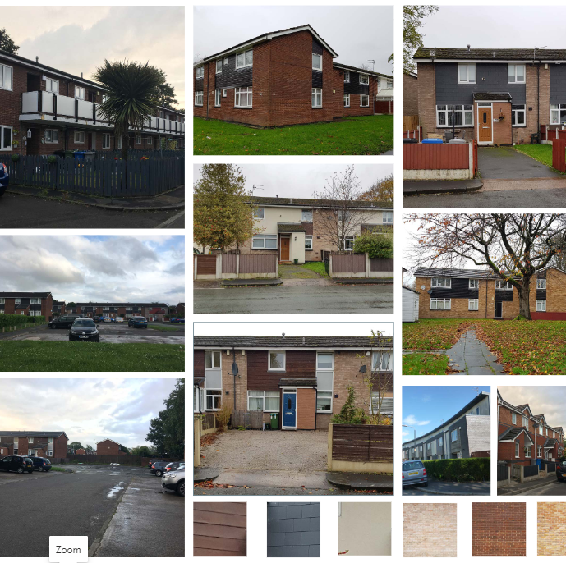
Design Challenges
Radburn design
Pedestrian walkways separated from vehicular access
Houses designed onto walkways with rear gardens onto the street with lack of natural surveillance
No boundary fencing
Car parking is facilitated with parking courts
No vehicular through routes so estate is disconnected to one another
Estate functions around a series of cud-de-sacs making access and wayfinding difficult

Slide 8
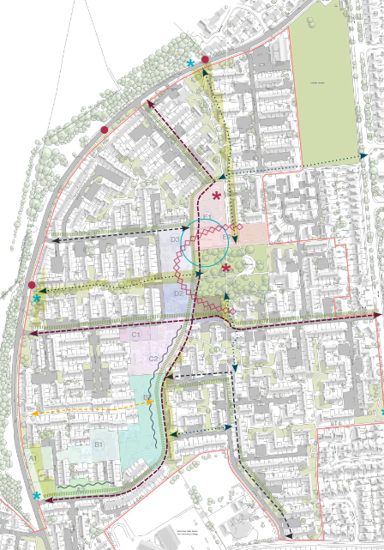
Masterplan design principles
Focal points
Re-establish park as a focal point for the estate by creating height
Retention of “green finger” with active frontage
Potential improved vehicular access through new roads
Potential future road enhanced route dependant on garden reductions
Potential improved pedestrian access through new roads
Potential improved landscape & boundary treatment
Potential enhanced landscape areas
Secondary routes
Community use
Bus stops – key pedestrian routes to provide access
Signage to Sale West
Retain and enhance main pedestrian routes
Improve the opportunity for public transport links
Enhance walking and cycling opportunities (green infrastructure plan)
Improve car parks
Improved recreational and play spaces
Create focal points and way-finding
Integration with surrounding communities and future ones

Slide 9
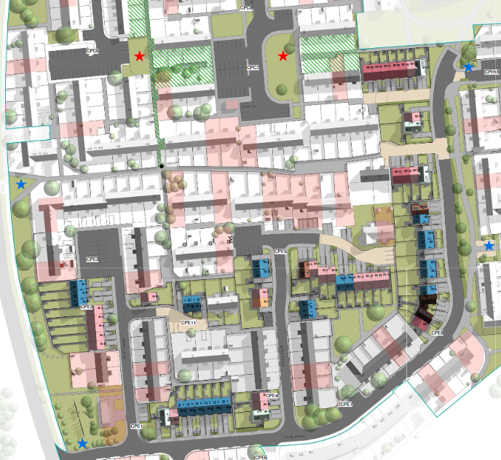
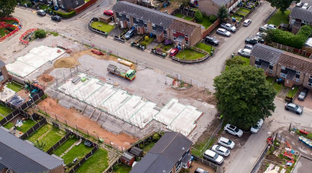
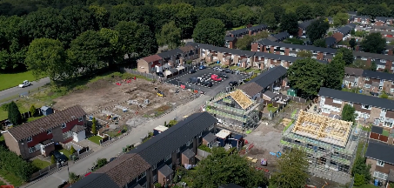
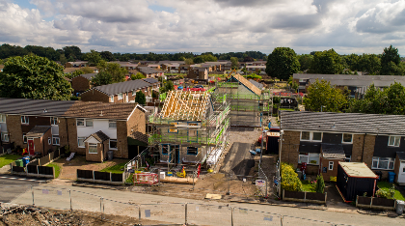
New play area and community spaces
New resurfaced parking courts across the estate
New houses rotated to avoid separation and to knit the new and existing fabrics
Additional parking added to existing properties
New seating areas
New trees across the estate
Visitor parking added following feedback from residents
Existing road ends, new road begins
Retained trees in new community space
Notes:
Red star – play areas
Blue star – new seating areas
New trees
Street plans (raised beds next to play area) residents take ownership

Slide 10
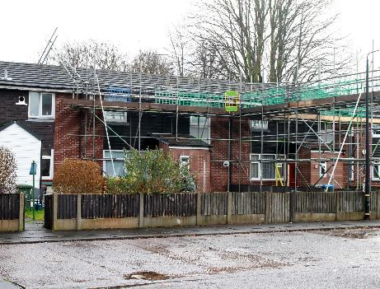
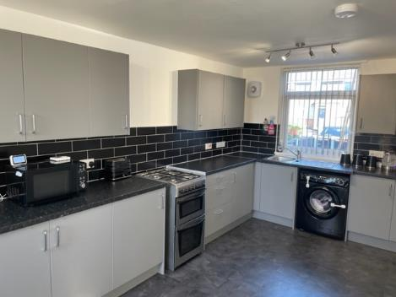
Investing in Existing Homes
5 year improvement programme
IVH investing over £7 million
New roofs, kitchens and boilers
Pilot retrofit project
New boundary treatments
Driveways and car parking
Notes:
Roof image
Kitchen replacement

Slide 11
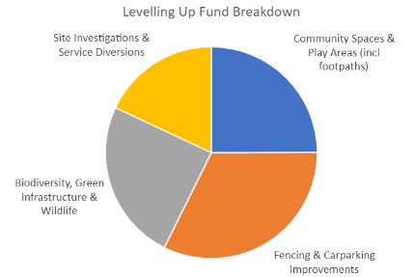
Funding
Investment partner 2021-26 Affordable Homes Programme £6,362,000
Irwell Valley Homes
Investment in new homes
£12,340,000
Recycled Capital Grant
£445,142
Investment in existing homes
£2,481,280
Investment in communities initiatives
£77,500 leveraging
£866,864 of match funding
Estate Regeneration Fund £974,434
Brownfield Homes Funding £550,000

Slide 12
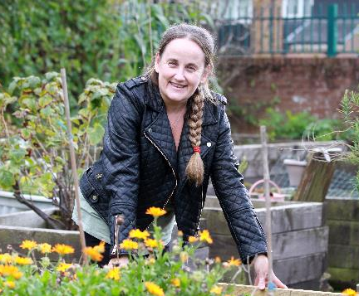
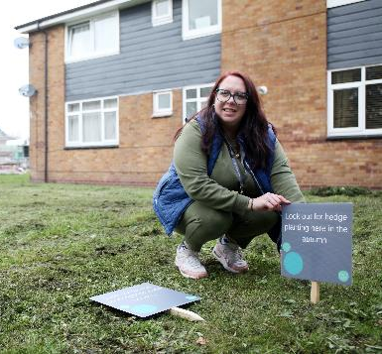
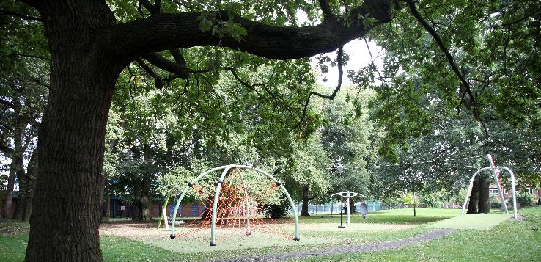
Community Projects & Green Infrastructure
Community allotment improvements
Growing facilities at 2 schools
Residents forest school
Green infrastructure plan (273 trees)
Swift boxes, small bird boxes, bat boxes, bug hotels, hedgehog highway
Improved signage and way-finding
Street plans (planting & fencing)
2 play parks & nature trail
Seating areas

Slide 13
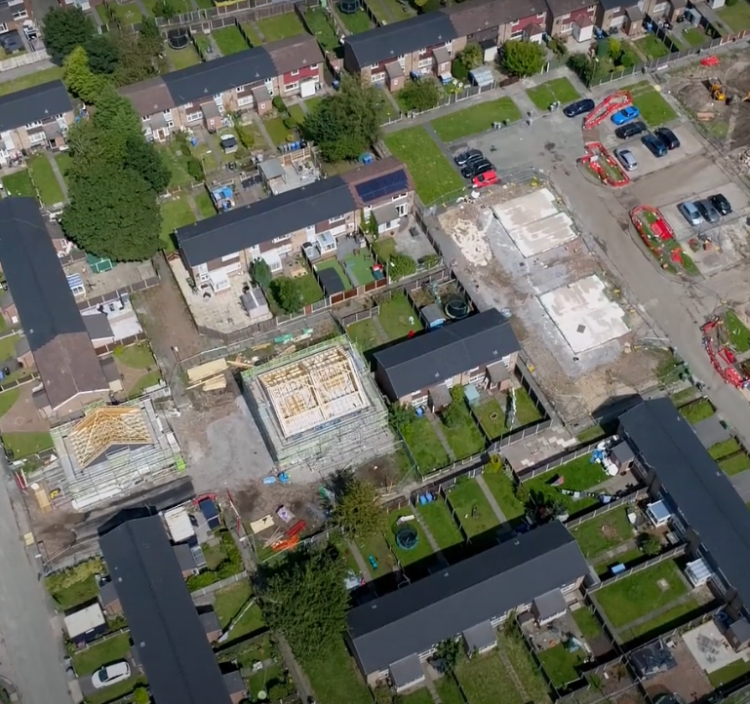
Challenges
Complex brownfield estate regeneration
Established community living in a building site
Utilities and services within the ground
Stock condition of existing homes
Market conditions (supply chain and materials)
Funding and viability for every next phase
Inclusive growth – investment that makes a difference
Notes:
Inclusive growth – investment that makes a difference (place-making, social and economic benefits, community cohesion, carbon reduction, nature capital)

Slide 14
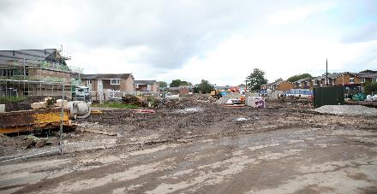
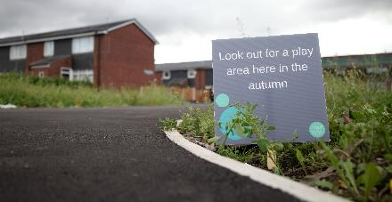
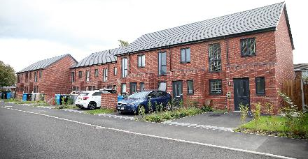
How you can help
Local Authority Support:
planning process
funding for infrastructure improvements
Bringing councilors along with us and helping us keep customers on board
Match funding for community initiatives
DLUHC support:
Grant rates that reflect regeneration and market challenges
Capital support to drive up the quality of existing homes
Carbon zero funding
Match funding for community initiatives and joining up public spending

Slide 15
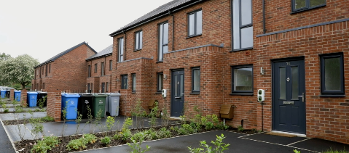
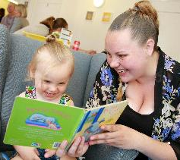
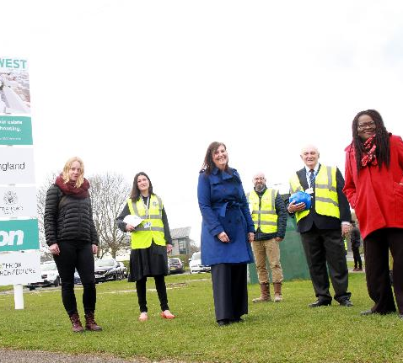
What’s gone well
Community involvement
Partnerships
Reducing housing waiting list
Internal transfers - making best use of homes
Employment for residents
Increasing financial inclusion, support for families and improving health and wellbeing
Reducing public spending on welfare and health and social care
Creating play areas with schools
Quality of new homes & customer satisfaction
Flexibility to re-programming works to progress during covid
Enhanced green spaces

