Slide 1
New Plan-Making System Update
MHCLG Local Plan team
26 March 2026

Slide 2



Recap: reforms to plan-making so far…
Where we have come from to where we are going
February 2025
Government responds to consultation on plan-making reforms and implementation
November 2025
Create and Update a Local Plan (CULP) website launched with Regulations Explainer
July 2023
Government consults on plan-making reforms and implementation
Early 2026 (and beyond)
Secondary legislation for ‘switching on’ the new plan-making system
Continued roll-out of CULP guidance to support LPAs
Funding support to LPAs
May 2022
Levelling Up and Regeneration Bill introduced to Parliament to introduce a new plan-making system
October 2023
Levelling Up and Regeneration Act gains Royal Assent
March 2025
Planning and Infrastructure Bill introduced to Parliament with proposals for spatial development strategies
December 2025
Planning and Infrastructure Act gains Royal Assent

Slide 3
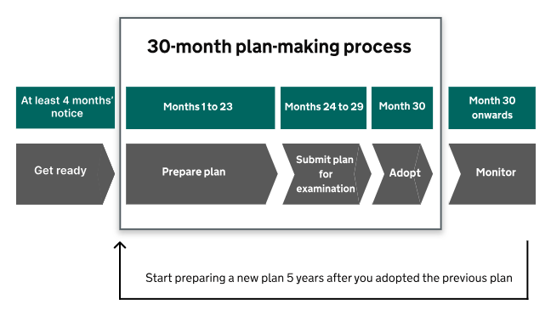
Easier, quicker, simpler
The new 30-month plan making process
Local plans are expected to be prepared within 30 months.
The new system will help meet this challenge by:
A more structured, standardised process
Templates and digital tools
Evidence base streamlined
Formal gateway processes
Much more detailed guidance
Emphasis on governance and planning
Support funding

Slide 4

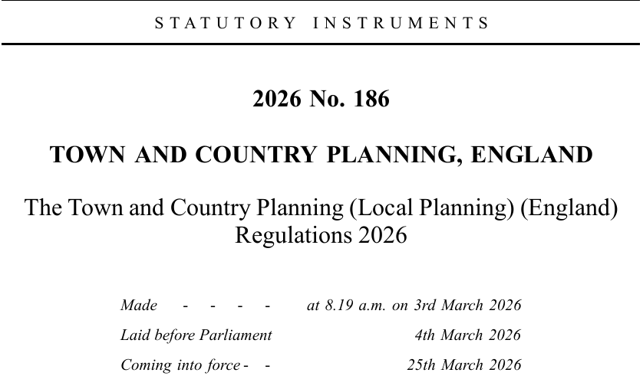
Easier, quicker, simpler
Regulations now in force to switch on the new system
Ministers laid the new regulations to ‘switch-on’ the new plan-making system earlier this month and then came into force yesterday (25 March 2026).
The Town and Country Planning (Local Planning) (England) Regulations 2026 cover:
  Plan timetables
  Form and content of plans
  Local Plans
  Mineral and Waste Plans
  Supplementary Plans
  Joint Plans
  Policies maps
  Availability of documents
  Transitional arrangements

Slide 5
Transitional Provisions
Rollout of the new system
New plan-making system in force from 25 March 2026
Transitional provisions in regulations cover when local plan preparation is required to commence
An authority can start plan-making in the new system as soon as they wish
Regulations set out ‘backstop’ dates by which certain authorities are required to start plan-making
First group - authorities required to publish notice to commence by 30 June 2026 and publish Gateway 1 self-assessment by 31 October 2026 – those caught by transitional arrangements
Second group - authorities with plans over 5 years old required to publish notice to commence by 31 December 2026 and publish Gateway 1 self-assessment by 30 April 2027
All authorities will be required to publish a notice to commence plan-making when existing plan is 4 years and 8 months old and to publish a Gateway 1 self-assessment the day after plan reaches 5 years

Slide 6
Plan Timetables
Levelling up and Regeneration Act 2023
Each LPA must prepare and maintain a local plan timetable
The Town and Country Planning (Local Planning)(England) Regulations 2026
Set out the form and content of a plan timetable
Includes the key milestone dates that have to be included in timetable when first published and milestone dates that are added as plan-making progresses
Revision of plan timetables – updated monthly if dates change
Some revisions need to be made on the same day as when published; others as soon as practicable
Publication – timetable must be published when LPA publishes notice to commence or in advance of this
LPA also needs to publish a statement that the timetable is to have effect
Guidance
CULP guidance on plan timetables published

Slide 7
Plan Evidence
A relevant and proportionate evidence base
New national policy – Draft NPPF – PM8 Evidence for plan-making
To be supported by new guidance
  what is proportional, relevant, up to date
  Scoping evidence base requirements
  Procedural guidance on preparing evidence
Supportive processes – PiD, Gateways, Statement of Compliance, Statement of Soundness
To act as checkpoints through plan-making – help identify gaps/need for additional evidence
New guidance, tools, templates
Guidance on identifying, assessing and selecting sites
  new digital tools - Site identification form ‘call for sites’, Site assessment service
Guidance on strategic environmental assessment (SEA)
Guidance on tests of soundness
Notes:
The amount of evidence produced to support a local plan takes a significant amount of time and resource to produce and can often feel disproportionate.
However, a strong evidence base will still be expected to inform and support plans. Evidence remains an important part of plan-making and monitoring, allowing planning authorities to develop robust and effective plans and allowing communities and other stakeholders to understand the decisions that have been made.
We are mindful of the need to ensure that reforms to evidence improve and do not undermine the quality or effectiveness of policies or plans, or the decision-making that relies on them.
We are
Looking at how best we can support LPAs through clearer policy on evidence expectations, policy on procedural aspects of evidence gathering, various areas where we can develop new guidance alongside digital tools and templates – an example so far is the work on Sites….
We have also introduced aspects in the new system such as standardised approach to local plan project management/PID, gateways, SoC/SoS – to act as checks and provide support on evidence expectations – help determine what is needed, when and how it will be prepared, and also where any gaps may arise.
SEA/SA
The requirement for Sustainability Appraisal of Local Plans required by s19 of the Planning and Compulsory Purchase Act 2004 is no longer in force for plans coming forward under the new system.
Plans coming forward under the new system must undergo Strategic Environmental Assessment (SEA) as required by The Environmental Assessment of Plans and Programmes Regulations 2004, subject to initial screening
The government has committed to bringing forward EORs that will replace SEA in due course
Refer back to EOR roadmap from recent gov response - Environmental Outcomes Reports: Roadmap to reform - GOV.UK

Slide 8
Gateways
Mandatory milestones to support LPAs to maintain plan preparation progress
Gateway 1: LPA self assessment
First of the mandatory gateways that support LPAs to adopt a plan within 30 months. The 30-month plan preparation process starts on the date you pass through Gateway 1
Gateway 2: progress assessment
Purpose: to check that the LPA is moving towards the preparation of a sound plan and consider whether the LPA is making progress towards meeting the ‘prescribed requirements’ set out in regulations.
Gateway 3: examination submission ‘stop/go’
The final stage that determines whether a LPA may submit their local plan for examination.
no later than 5 years after adopting your existing plan
at least 4 months after you gave notice of your plan-making, or the day after your scoping consultation ends, whichever comes later
You must pass through Gateway 1:
LPAs carry out a self-assessment of their readiness to prepare their plan
PINS will appoint a ‘gateway assessor’ to engage with the LPA and carry out the assessment with the LPA – similar to a Advisory Visit. An outcome report will be provided once the assessment is completed.
The LPA may discuss up to 5 soundness issues with the gateway assessor.
The assessment will take 4-6 weeks to complete. It is expected that LPAs will pass through this gateway only once to maintain their 30-month timetable.
PINS will appoint a ‘gateway assessor’ to determine whether the LPA has met the prescribed requirements as set out in regulations.
The assessment will take 4-6 weeks. The LPA only provides the required documentation; it does not participate in the assessment like it did for Gateway 2.
This stage does not focus or comment on matters of soundness – this will remain for the Examination of the plan to consider
If the LPA has met the prescribed requirements, the LPA can proceed to Examination. If not, the LPA will have to address any deficiencies and redo Gateway 3.
Notes:
Road map sets out that further guidance on Gateways – what you need to do - will be published soon
See PINS draft procedural guide – launched/to be launched soon
New plan making system the examination focuses only on matters of soundness and not legal compliance – legal compliance is a matter addressed at G3.This will prevent plans progressing to examination only to fail because legal matters have not been complied with.
Prescribed requirements – set out at reg 32 of the 2026 local planning regulations (and the proposed SoC guidance will provide further guidance on the prescribed requirements and gateways and a template that can be used to demonstrate how you think you have met the requirements)

Slide 9
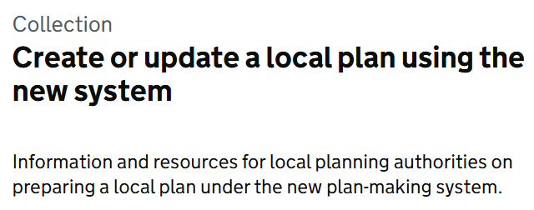
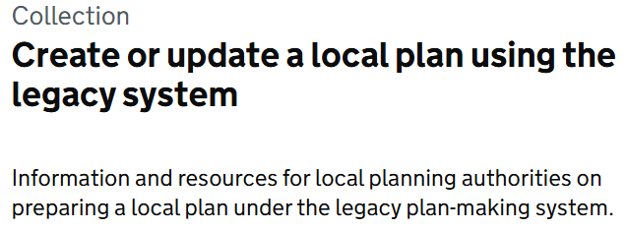
CULP – now and next
We are transitioning from the legacy to new plan-making system.
The new local plan-making system is in force from 25 March 2026.
We have officially entered the period where 2 local plan-making systems are running in parallel.
You must follow the legal requirements of the system you are preparing a plan under from start to finish.
If in doubt visit: Create or Update a local plan

Slide 10
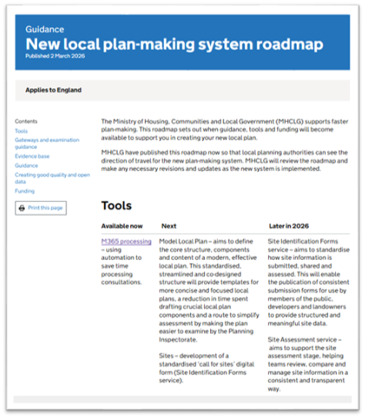
What’s next? (1)
The next series of releases that we are looking to make over the coming months
Launching an exemplar Model Local Plan - this will comprise guidance and templates aimed to illustrate what new local plans will need to include and look like.
More CULP guidance to support LPAs in the early stages of plan-making
including:
  Create a local plan timetable
  Publish local plan housing requirements
  Engaging the public when preparing a local plan
  What to include in your local plan
  Strategic Environmental Assessment (SEA)
  Statement of Compliance & Statement of Soundness
  Making your local plan documents publicly available
  Requirement to Assist
  …and more!
Data standards + guidance:
  Plan: timetables and housing requirements

Slide 11
What’s next? (2)
Releases that we are looking to make over the rest of 2026
Developing a sites identification forms service which is a digital service that will look to standardise how site information is submitted, assessed and shared.
Developing a site assessment service which will be a centralised digital tool that supports LPAs through the site assessment stage, helping teams review, compare and manage site information in a consistent and transparent way.
More CULP guidance and templates to support LPAs in the early-stages of plan-making including preparing a local plan evidence base and the tests of soundness.
Data standards + guidance:
  Sites
  Policies Map
  Annual Monitoring Report components

Slide 12

Funding
£15.8m has been made available to support local plan implementation
Successful LPAs have recently been notified that they have been awarded a share of the funding
An announcement of all LPAs successful in securing funding will be published on .gov.uk next month

