Slide 1
Local Plan Position
Local Plan is old (1994) – threat of planning by appeal
300-400 homes per annum over last 15 years
- using urban capacity / previously developed land / hospital sites
National Planning Policy Framework (NPPF), Mar 2012
Draft Plan (250 homes per annum) not progressed, late 2012
Challenge – ‘sound’ Plan balancing competing aspirations
Notes:
More detail on Local Plan issues
- Adopted Plan 1994. Second oldest plan in the Country.
- Work to replace has be considered in period since 2005. Several previous consultations on issues and options. Issue tough technically and politically.
- Lots of work has been undertaken compiling the evidence base for replacement
- Recent work has included commissioning independent reports on: Part 1 Green Belt Study with Dacorum & Welwyn Hatfield. Published October 2013. Part 2 Green Belt Study Published February 2014 December 2013 and Housing Demand / Need / Strategic housing market assessment. Published November 2013. ONS/GLG suggests 688 dwellings per year. Previous studies of the environmental capacity of the District suggest no more than 360 dwellings per year which was agreed at the EIP for the East of England Plan 2008. (Since abolished but the only good source that has been tested in public).
- Significant pressure to develop Green Belt
- Significant pressure on existing infrastructure including schools, transport links, routes factoring the green belt and historic centre constraints.
- Significant pressure to provide affordable housing.
- Duty to Co-operate evidenced by recent joint green belt report / study with neighbouring Districts.
- Duty to co-operate evidenced by joint working throughout Hertfordshire on Local Plans, and with the LEP on its Strategic Economic Plan. This is a key element of the test of soundness and is a longstanding approach taken extremely seriously by SADC, well before NPPF requirement.

Slide 2
Housing Need
Hunston, Court of Appeal – start with housing need
Housing need:
a) births, deaths and net migration; and
b) household formation
ONS based projection 550 – 700 homes per annum
Independent Assessment of Housing Need and Strategic Housing Market Assessment
10 year history used - 436 homes per annum
(circa 9,000 total 2011 – 2031)
Notes:
Link is to full evidence study.
This and other links below useful if the slides are distributed electronically after meeting.

Slide 3
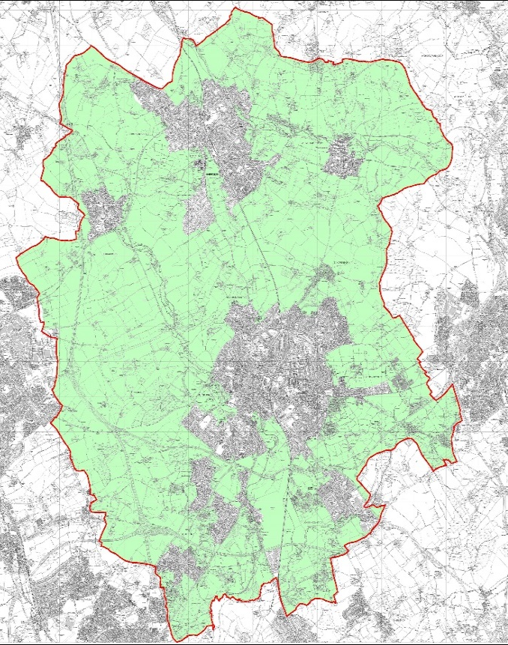
Green Belt
(all District outside main urban areas)

Slide 4
Green Belt Boundary Change – “Exceptional Circumstances”
“….Once established, Green Belt boundaries should only be altered in exceptional circumstances, through the preparation or review of the Local Plan. At that time, authorities should consider the Green Belt boundaries having regard to their intended permanence in the long term, so that they should be capable of enduring beyond the plan period.”
NPPF Para 83 – underlining added

Slide 5
Planning Practice Guidance (PPG)
Do local planning authorities have to meet in full housing needs identified in needs assessments?
“…..the local planning authority should prepare a Strategic Housing Land Availability Assessment to establish realistic assumptions about the availability, suitability and the likely economic viability of land to meet the identified need for housing over the plan period, and in so doing take account of any constraints such as Green Belt, which indicate that development should be restricted and which may restrain the ability of an authority to meet its need.”
para 45 - underlining added

Slide 6
Green Belt Review
Key building block for Plan
Comprehensive look at whole Green Belt
All Green Belt found to contribute to at least one of 5 national purposes
But identifies 8 areas where boundaries can change to accommodate housing with least damage
Independent Green Belt Review Part 2
Notes:
Note
Boundaries of areas shown are areas for detailed assessment. Specific sites have now been defined (reduced areas). The details are available at the web link provided.

Slide 7
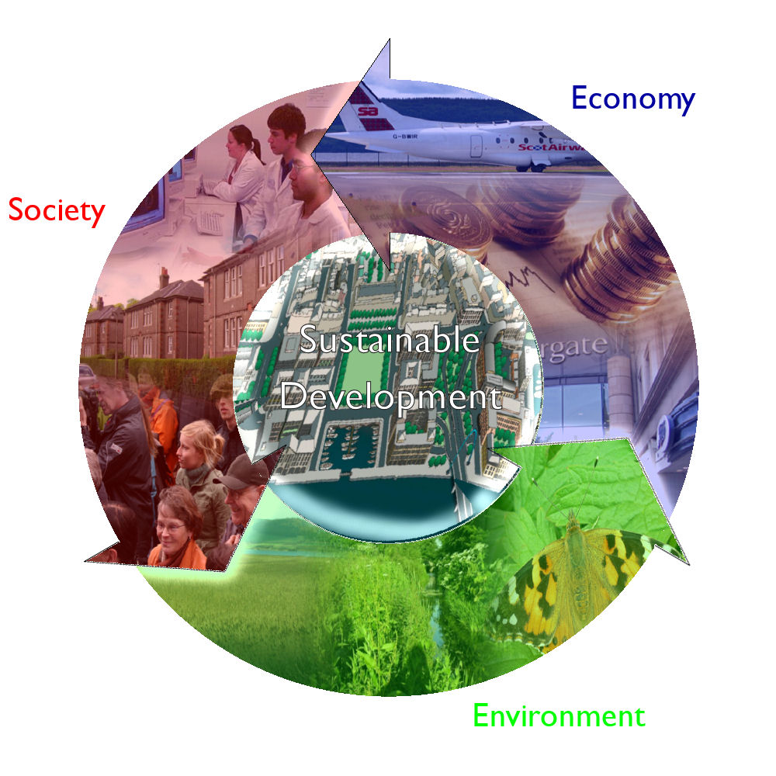
Site ranking - NPPF
Balance Sustainable Development

Slide 8
Draft SLP – Content (1)
Economic regeneration and employment for sub-region – expansion of Maylands (Local Enterprise Partnership’s Strategic Economic Plan)
Plan housing target / requirement: 436 homes per annum (approximately 9,000 homes in total)

Slide 9
Draft SLP Content (2)
5,000 homes from brownfield / redevelopment / infill in urban areas and minor adjustments to Green Belt
4,000 homes from Green Belt release
4 sites (yellow on diagram)
4 other sites considered (purple on diagram)

Slide 11
Consultation
(10 Oct – 23 Nov 2014)
>2,000 attended exhibitions
<1,000 responded
3.5% under 35 years old
50% over 55 years old
Keep Green Belt as it is? Yes - 79% (430)
Notes:
Consultation Pre-submission Publication Submission Examination Adoption
October/ November 2014 May 2015 August /September 2015 March 2016 November 2016

Slide 12
Key Areas from Consultation
Affordable housing: widely defined
Housing size/type/mix: starter/trade down homes
Density (40dph – flexible on 60:40 built to open space)
Gypsies, travellers, show people
Educational facilities
Community, sport, recreation facilities
Masterplanning
Transport
Self build
Design quality
Energy/water efficiency
Notes:
Consultation Pre-submission Publication Submission Examination Adoption
October/ November 2014 May 2015 August /September 2015 March 2016 November 2016

Slide 13
Meetings with site owners
“Community tariff”
– £0.8m+ per acre uplift shared to deliver v key areas?
- help identify exceptional circumstances
2 stage process – offered for all 8 sites
Meeting 1: ran through key areas
Meeting 2: Owners make submissions
Notes:
Consultation Pre-submission Publication Submission Examination Adoption
October/ November 2014 May 2015 August /September 2015 March 2016 November 2016

Slide 14
Attendees and use of presentation
Cons, Lab and LibDem planning leads at presentations
Owner presentations to be made public
Competitive tension
Summary report from officers & update of original assessments
Notes:
Consultation Pre-submission Publication Submission Examination Adoption
October/ November 2014 May 2015 August /September 2015 March 2016 November 2016

Slide 15
Challenge: “A sound plan”
Questions?

