Slide 1
Estate Regeneration - reflections
Andy von Bradsky, Dip Arch RIBA FRSA

Slide 2
Altered Estates
Altered Estates
How to reconcile competing interests in estate regeneration
Whose estate is it anyway?
Public assets or homes for existing communities – appraising options
Listening to the community – approach to engagement
Diversifying tenures to create balanced communities – avoiding over-dense development
Achieving good urban design – getting the design right
Delivering sustainable outcomes – long term management

Slide 3
Estate Regeneration National Strategy
Resident engagement and protection
Local authority commitment
Financing and delivering regeneration
Good practice guide and process map
Better social outcomes – place based
Community led development
No one size fits all
Estate regeneration funding, loans, enabling grants and capacity building
GLA’s – Good Practice Guide to Estate Regeneration

Slide 4
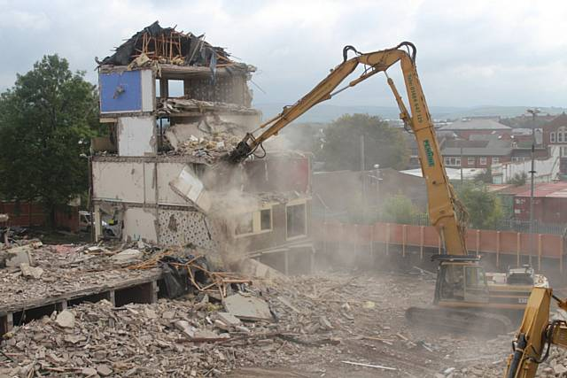
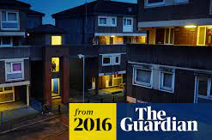
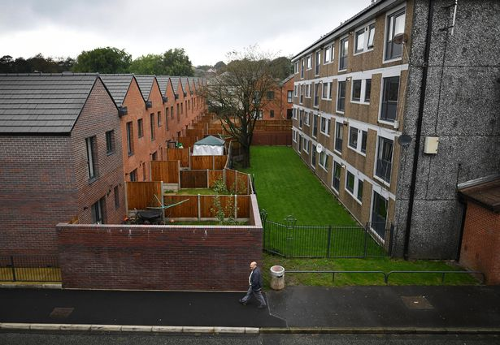
Project progress
Rochdale Boroughwide Housing
Lower Falinge and College Bank
Masterplan by Levitt Bernstein Architects and SPD in partnership with Rochdale BC
Phased demolition and refurbishment programme
55 new affordable homes delivered
RBH resources
Estate Regeneration Fund grant, Towns Fund, Brownfield Land Release Fund, Community Renewal Fund
In partnership with private sector partner to deliver mixed tenure

Slide 5
Altered Estates 2 - How to address changing priorities in estate regeneration
Planning for social value
Building community support
Supporting lifetime neighbourhoods
Giving pride to place
Addressing climate change
Delivering responsible regeneration
Case studies

Slide 6
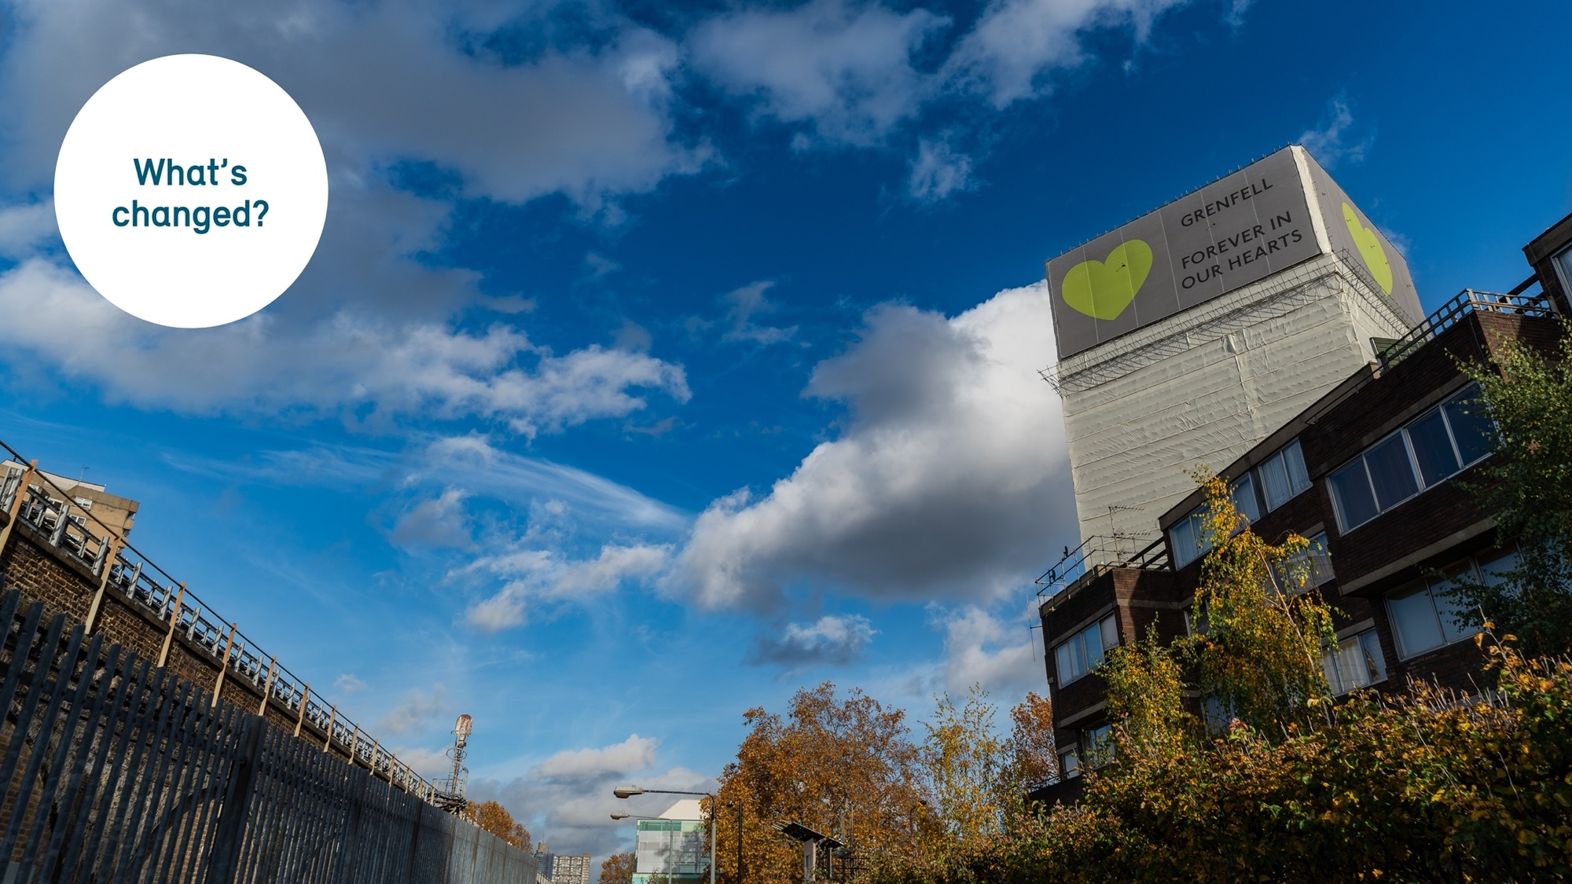
What’s changed?
Climate change
Post pandemic
Post Grenfell
Building safety
Cost of living

Slide 7
What’s next?
Changing policy context
Economic growth

Slide 8
Delivering quality - In the planning system
Focus on design quality and community engagement
Use of design codes
Setting design parameters with community input
Viable and deliverable vision set in local plans

Slide 9
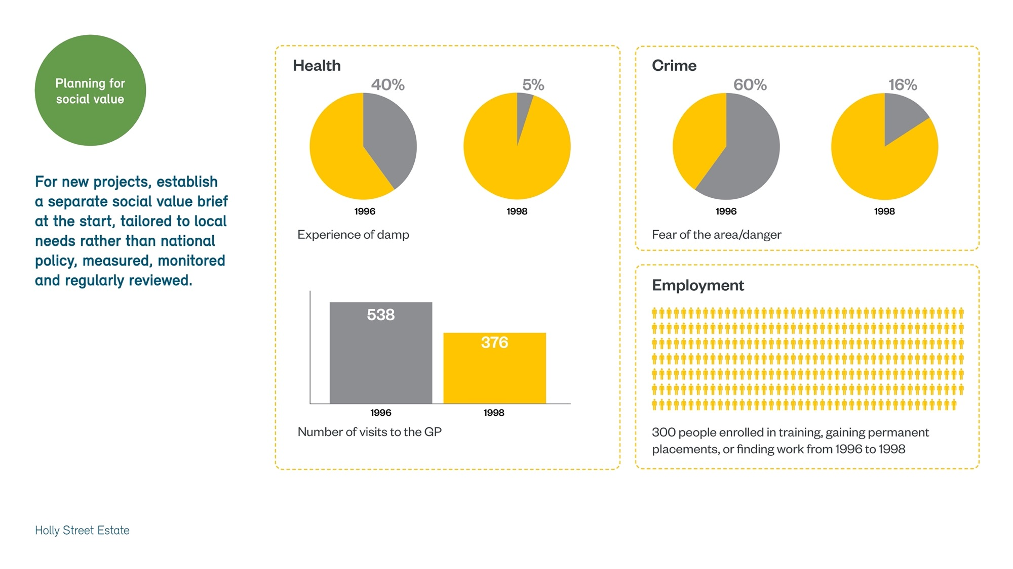
Delivering social value
Setting a social value brief tailored to local needs
Measuring health, education, crime and social outcomes
Importance of monitoring and reviewing

Slide 10
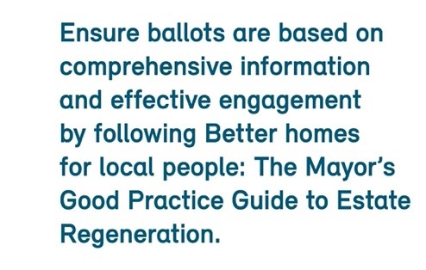
Engaging communities - throughout the process
Continuing commitment to community engagement as planning practice guidance
Consider extending use of mandatory ballots beyond London
Good practice set out in GLAs Better Homes for Local People: The Mayor’s Good Practice Guide to Estate Regeneration

Slide 11
Building community support
Learning and improving through use of post occupancy evaluation techniques
Review social, environmental, qualitative aspects
Use a recognised methodology such as RIBA toolkit

Slide 12
Balanced communities and lifetime neighbourhoods
Enshrine right to remain in all projects
Provide a sustainable balance between existing and new residents without recourse to hyper dense development
Ensure new homes are built to good space standards for flexibility and adaptability for older people and changing life circumstances

Slide 13
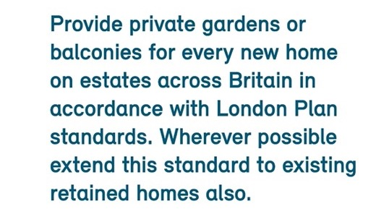
Quality places and spaces
Addressing Provide a minimum of 5m2 of accessible and useful shared open space for planned population
Provide private gardens or balconies for all new homes in accordance with London Plan standards
Plan for reduction in car ownership over time by conversion of parking spaces to open space or other beneficial uses

Slide 14
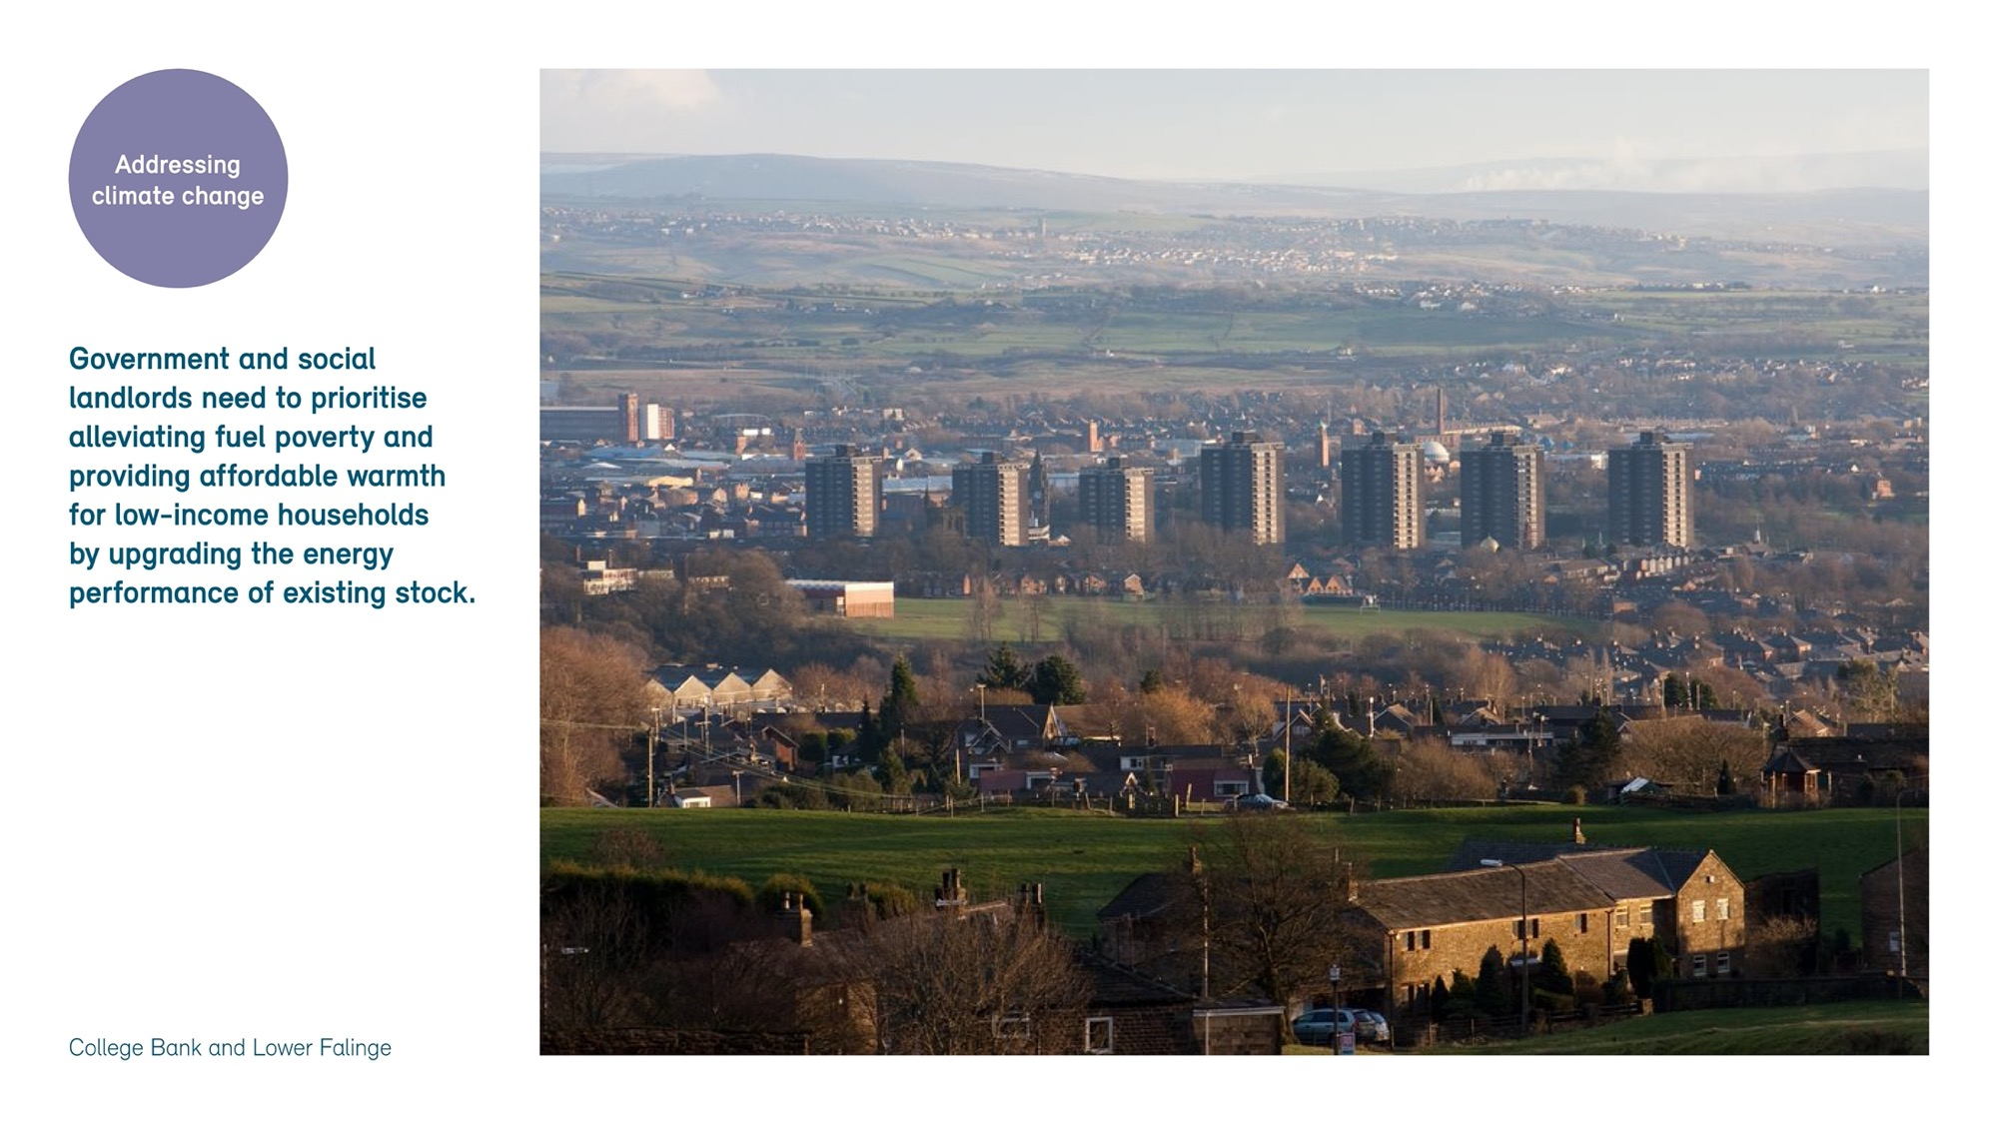
Addressing climate change
Government needs to:
prioritise impact of rising cost of living and affordable warmth for low income households by upgrading the energy performance of the existing stock
provide a comprehensive funding programme for energy efficiency and climate change mitigation to existing housing stock
Scrap VAT on renovation and remodelling to bring in line with new build

Slide 15
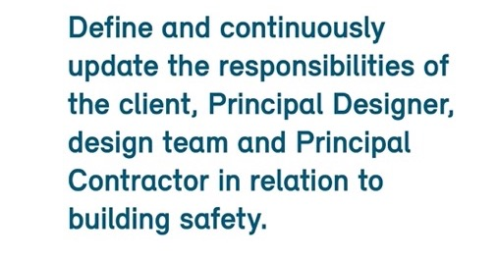
Addressing quality and building safety
Housing providers need to:
Provide continuity of stewardship so that design quality aspirations remain undiluted from design, to building handover
Define and update responsibilities of client, Principal Designer, design team and Principal contractor in relation to building safety
Provide training programmes in client, design and construction organisations in respect of the Building Safety Act

Slide 16
Financing regeneration
Consider within the context of regeneration of the wider area
Increase in gap funding and pump priming to enable more projects to come forward in low value areas
Wider benefits in improved health, reduced crime, increased employment and improved education outcomes need to be taken into account
Simplify funding streams as bidding for multiple funding sources is time consuming and inefficient

Slide 17
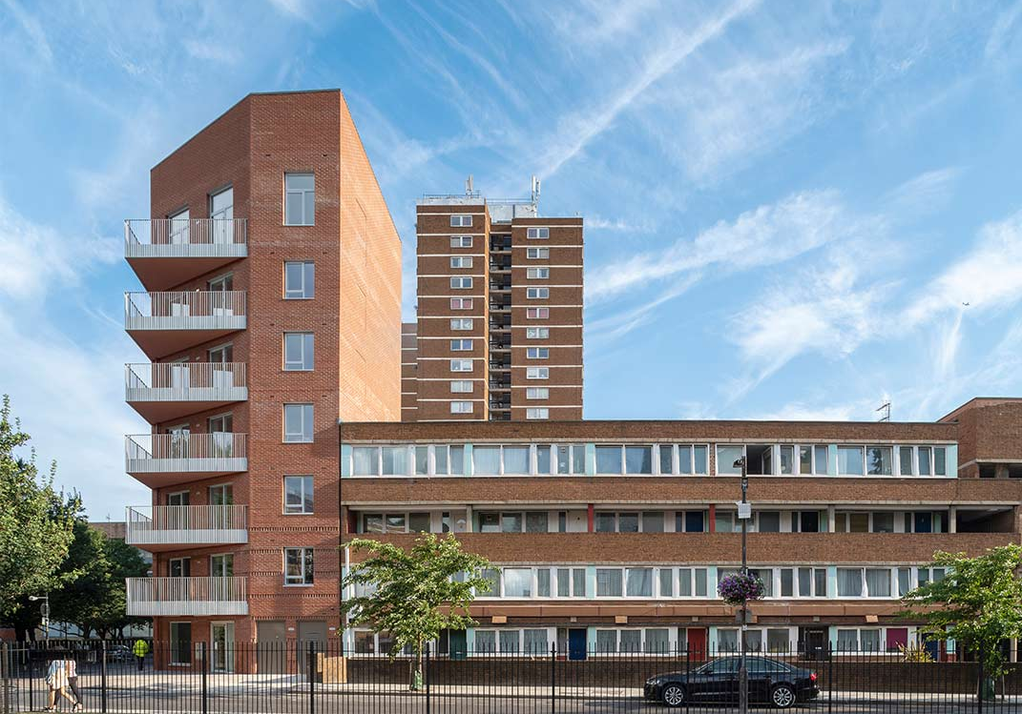
Case studies
More consideration given to retention of existing buildings and infill of spaces between buildings – due to community preference, embodied carbon and other factors
Many estates delivered in high value areas, funding model required for estates in low value areas is required
DLUHC website needs to be updated with case studies of new and emerging projects for learning
Marklake Court, Bell Philips
Wensley Road, Reading, HTA
Aberfeldy New Village, Levitt Bernstein Architects
Agar Grove, Mae

Slide 18
Summary
Engagement
Design quality
Social value
Economic growth
Funding

