Slide 1
Barking and Dagenham Place Pilot case study
May 2025
Version | Date | Author | Amends
1 | May 2025 | Caroline Laitner | Approval from client 27 May 2025

Slide 2
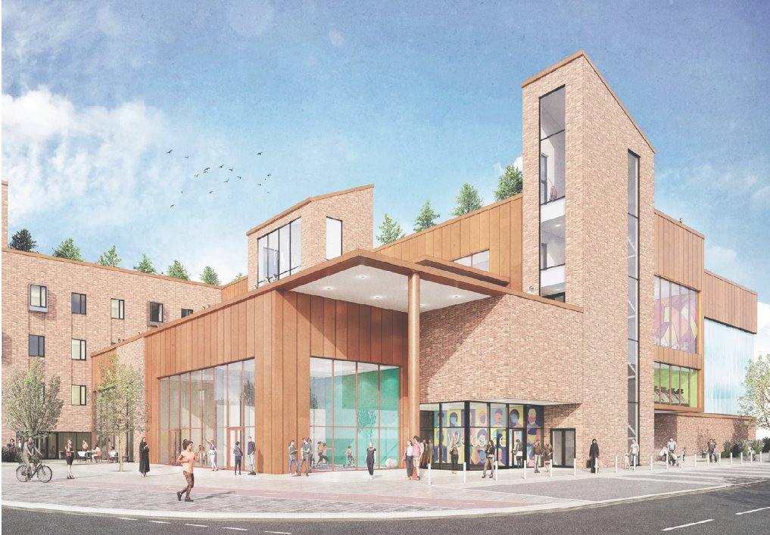
Barking & Dagenham Place Pilot builds community by delivering essential, co-designed social infrastructure and connections in North-East London
Barking Riverside is an ambitious new development along the Thames Estuary, in an area that has historically seen limited investment. Multiple partners are currently delivering new homes, rail and river transport links, schools and services. As part of the development, a new health hub is being planned in an area where there is currently no GP provision.
In 2023, £75,000 of OPE Place Pilot funding brought project partners Barking Riverside Ltd, LBBD and the NHS together to revisit the feasibility of the site for the health hub and ensure the needs of both new and existing communities could be met. Part of the funding helped restart the hub project, and in 2024 project partners and citizens held a co-design workshop that produced an understanding of what a successful wellbeing hub would look like for everyone. Next, the team will focus on reaffirming the project vision, identifying which partners to co-locate with and realigning key stakeholder interests, to inform value-engineering.
The remainder of the funding is supporting outreach activities to connect new and existing communities in the South Barking area of Thames Road which has capacity for 3,500 homes but requires a collaborative approach to funding and delivering the social infrastructure needed to sustain this population.The place pilot approach is enabling a more holistic way of thinking about what new and existing communities need to thrive, recognising that successful growth in what has become a higher cost delivery environment, also requires innovative solution to delivering social infrastructure.
OPE brought partners together and encouraged them to think differently. Partners had the space, time and support to collaborate and 'join the dots’, thinking about how to deliver services and assets that meet local needs, now and in the future.
Immediate Outputs:
Co-location of services in to the new health hub.
Longer Term Outcomes:
Improved, integrated, community designed schools, health hub and green spaces.
Connecting communities in Barking Riverside with nearby Thames Road area to ensure communities can be better connected and all communities benefit from growth.
Notes:
One element of the project in Thames Road provided funding for community engagement and co-design of the future Thames Road area which blends industrial and residential development and connects the older community in Thames Road to the new Barking Riverside development.
LBBD have now adopted a Vision and Design Code for the area building upon the work that Place Pilots funded.

