Slide 1
Hurst Farm Community Hub 05/10/22 Roundtable Presentation

Slide 2
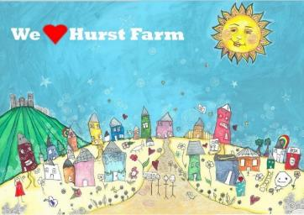
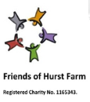
Hurst Farm Regeneration Project
Start Project September 2017:
Received DCLG ‘Estate Regeneration Funding ‘
1 of 100 estates in the UK
DDDC £100k
Waterloo Housing £80k

Slide 3
Simon Redding
Project Team here today:
Rob Cogings
Marie Schmidt
Director of Housing
Project Initiator
Estate Regeneration Manager
Landscape Architect
Vision Architect
Community Business Development Manager
Community Hub Project Manager
Hurst Farm Regeneration Partners:

Slide 4
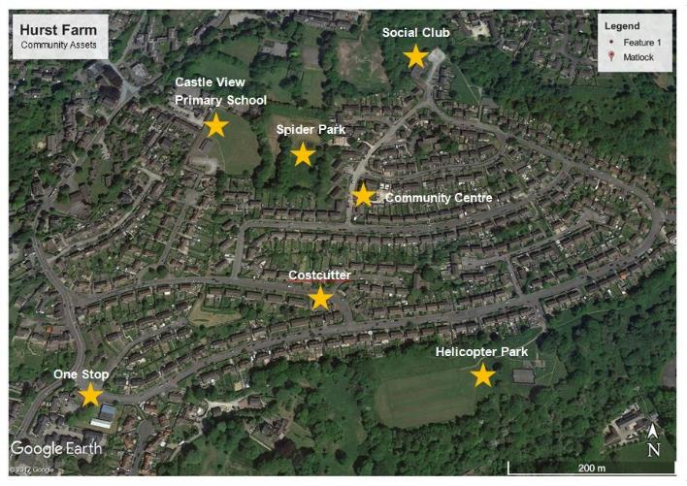
Hurst Farm in Matlock, Derbyshire
Community Centre
Hurst Farm Location in Matlock
Hurst Farm Key Community Assets

Slide 5
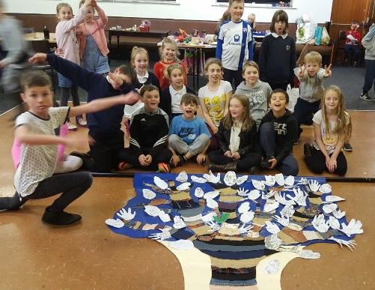
This is where it started- with the children:
“What do you love about Hurst Farm?”
December 2017:
Art Workshop for
Hurst Farm Youth Club
led by
Artist Rosanna Scrase

Slide 6
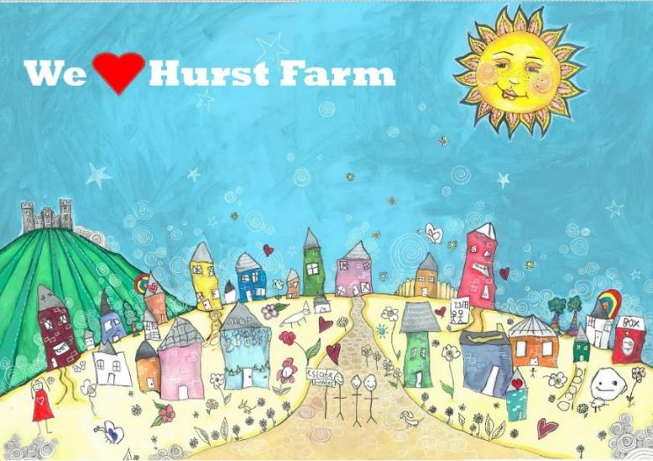
…and this is the art work the children created!

Slide 7
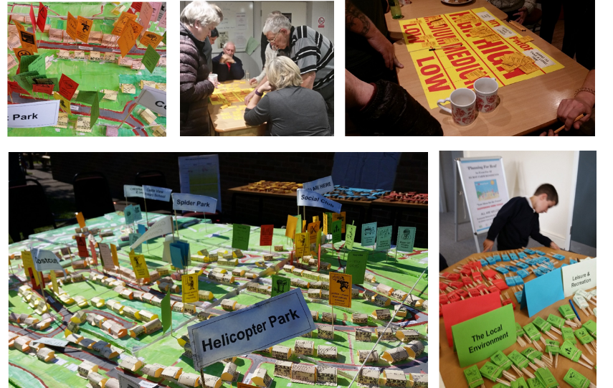
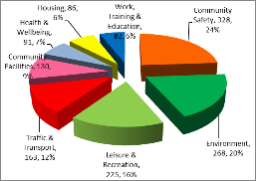
@Planning for Real’ Community Consultation 2018
Outcome:
Most streets where engaged
PFR 3D Model = 1,373 individual suggestions recorded
Consulted on 8 Themes
Top 3 Priorities representing Total 60%:
1. Community Safety 24%
2. Environment 20%
3. Leisure Recreation 16%

Slide 8
Our Regeneration Aims
Change negative perceptions of the estate;
Create opportunities for the children to grow into their full potential;
Create long term financial sustainability- social enterprise, not rely on grants;
Improve existing ‘community assets’;
Build strong partnerships;
Improve the estate infrastructure- green spaces, pavements, parking;
Build new skills and employment;
Improve health and well being (exercise, food, housing, connectedness);
Ultimately make Hurst Farm be just a part of Matlock!

Slide 9
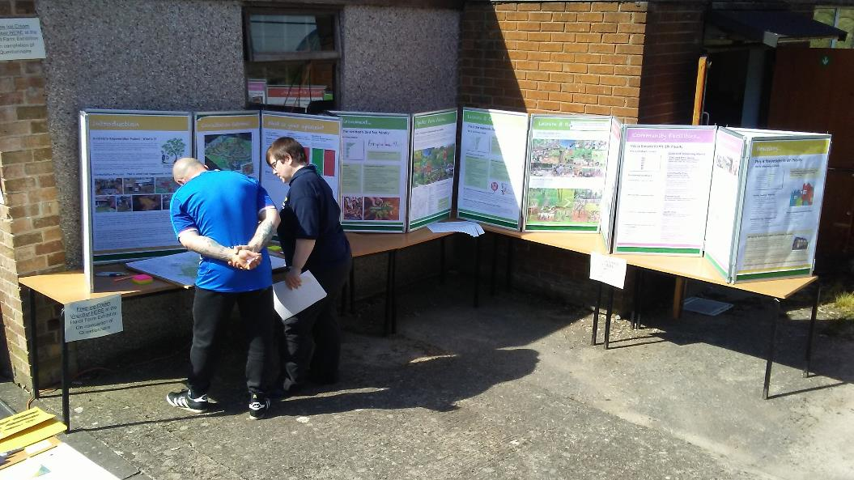
Easter 2019 Community Consultation Feedback

Slide 10
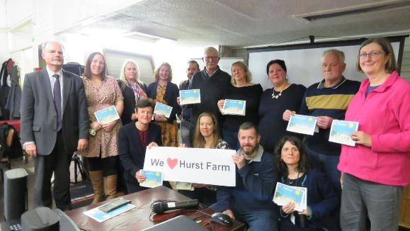
Hurst Farm Regeneration Vision
Launched in November 2019:
‘8 Key Projects’

Slide 11
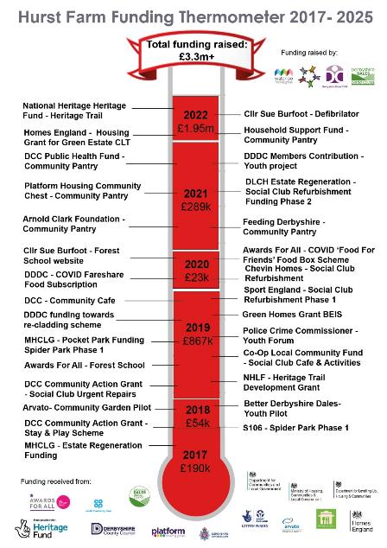
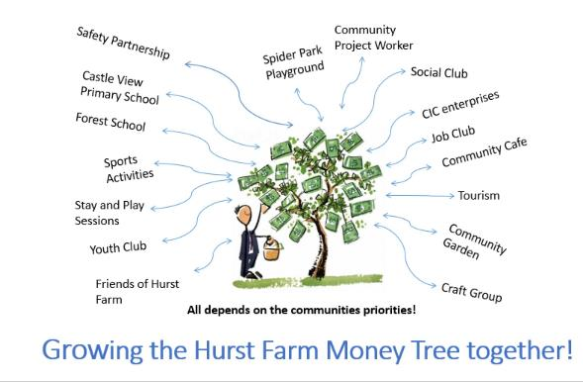
Hurst Farm Funding Strategy
To date raised £3.3m+!
Further plans for further £2m+ by 2025.

Slide 12
Hurst Farm Community Hub
Refurbished and Opened May 2022
Total £550k funded by:
Sporting Assets Grant: £10k
Sport England £95k
DDDC Cash-flow loan £110k
DDDC Grant £20k
Social Loan £25k
DLUHC £251k
Chevin Homes £5k
Covid grant £10k
Co-Op £29k
Awards for All £10k
DCC Action Grant £7k
Friends of Hurst Farm £3,2k
Police and Crime Commissioner £1k

Slide 13
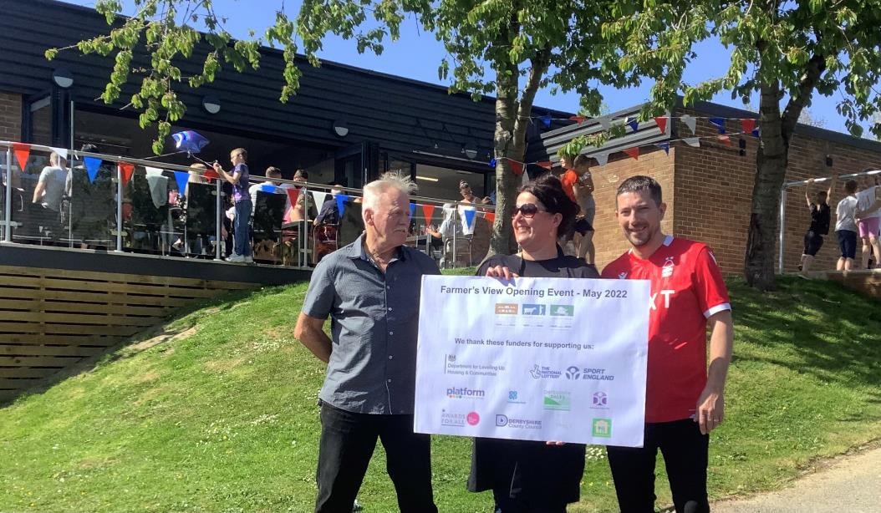
Farmer’s View Opening

Slide 14
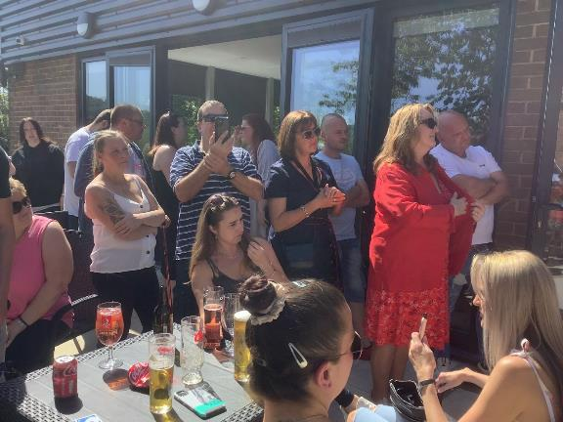
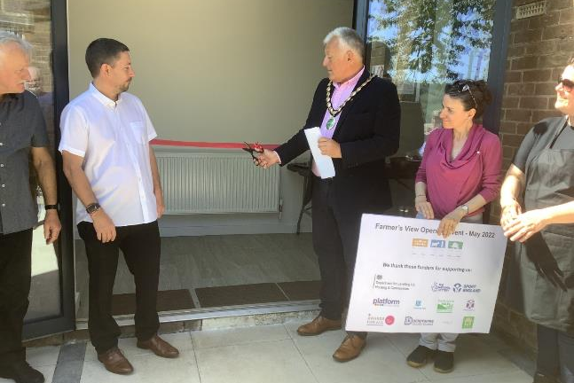
Community Hub Opening May 2022
Supported by MP Sarah Dines (in red)

Slide 15
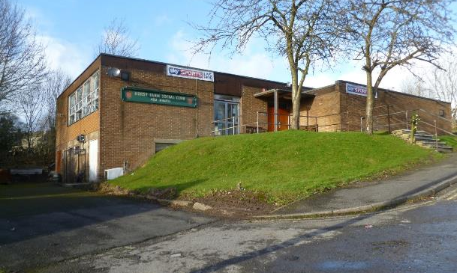
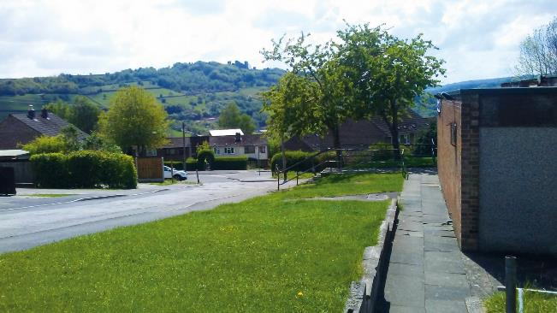
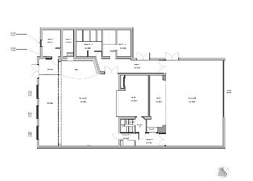
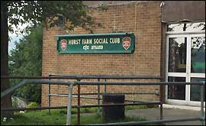
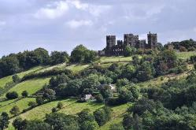
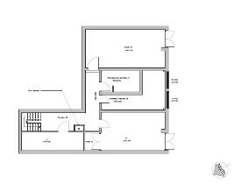
Original Floorplan – 1st Floor & Basement
Before: Old Social Club build in 1964
Great Views of Riber Castle
The ‘old’ Hurst Farm Social Club…

Slide 16
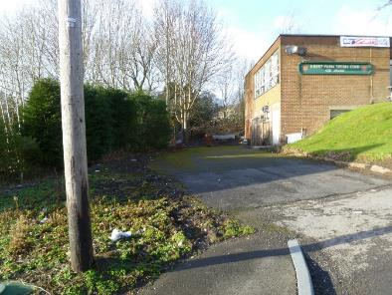
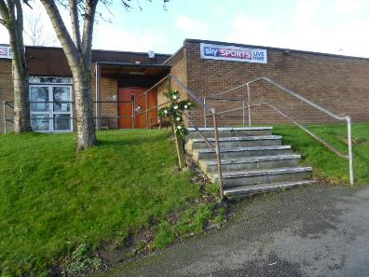
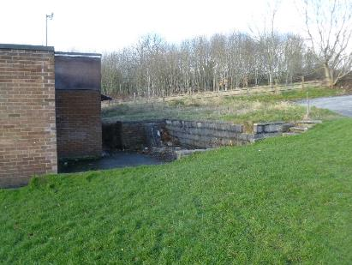
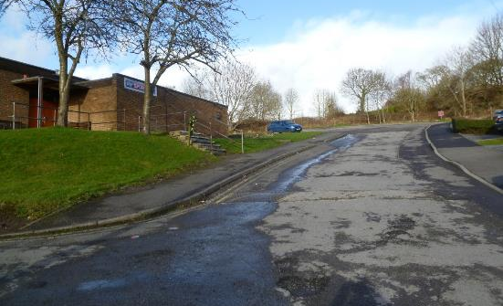
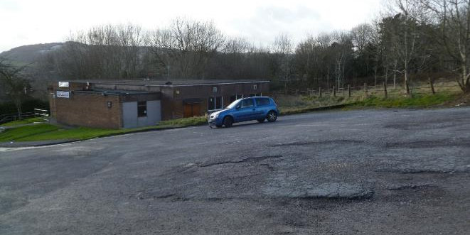
Before: Run down building
Before: Unstable retaining wall
Un-attractive approach
Before: Broken tarmac and leaky roof

Slide 17
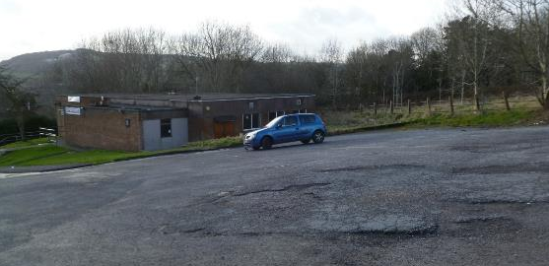
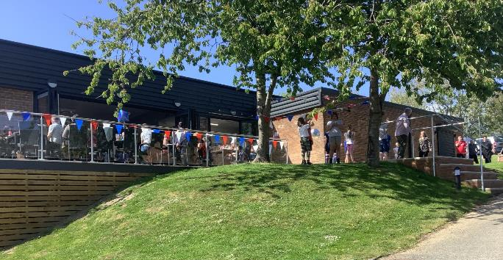
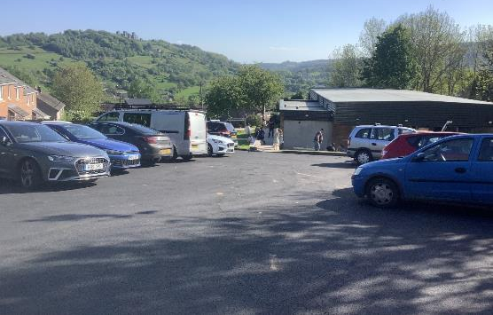
Before
Before
The ‘old’ Hurst Farm Social Club…
After
After

Slide 18
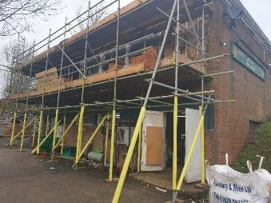
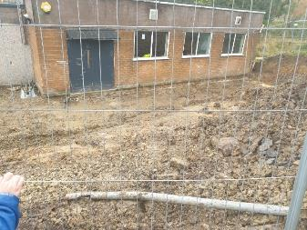
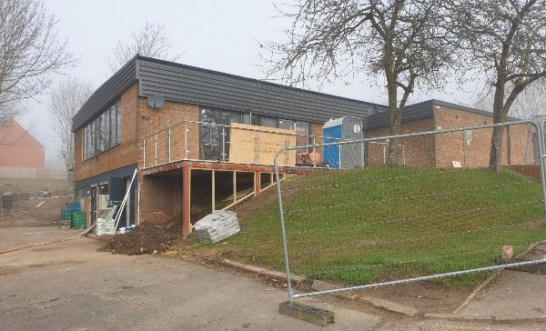
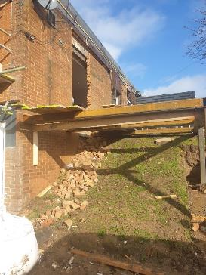
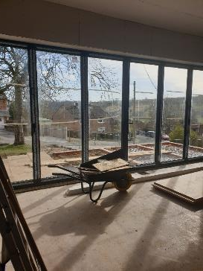

Slide 19
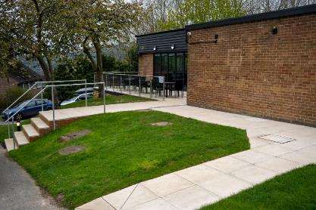
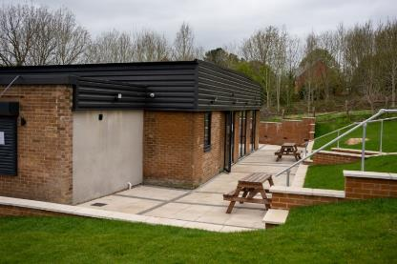
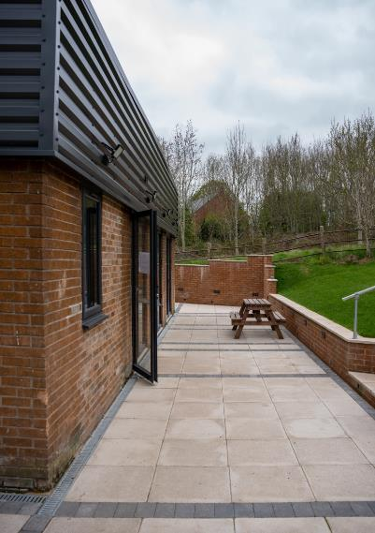
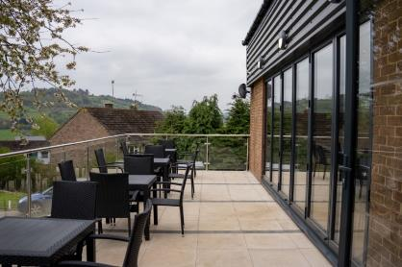
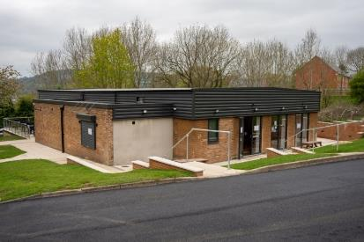
Great Views
Now: Large sun terrace
Now: Resurfaced car park
Now: New Café seating area

Slide 20
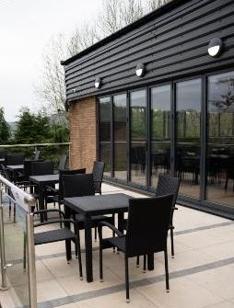
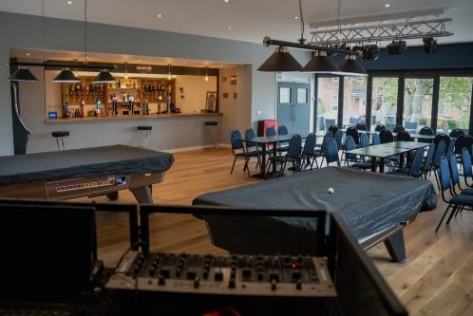
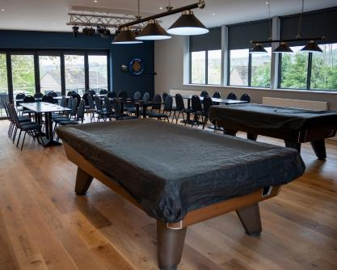
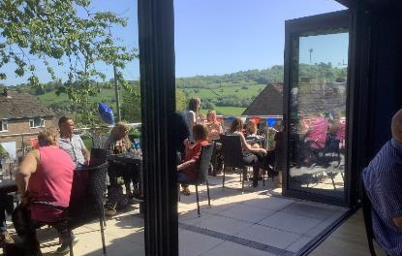
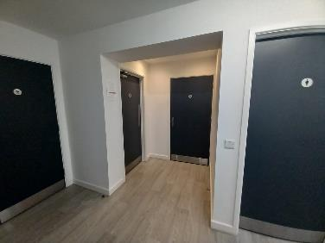
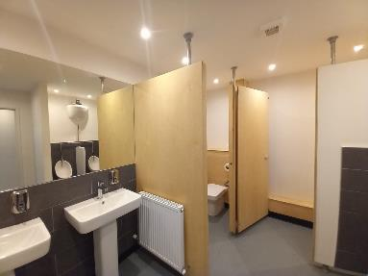

Slide 21
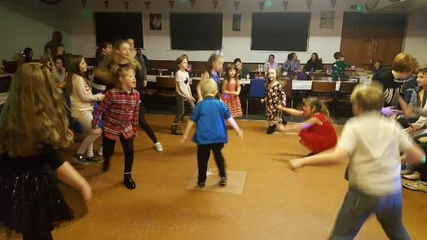
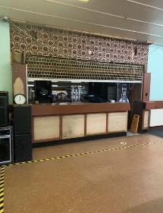
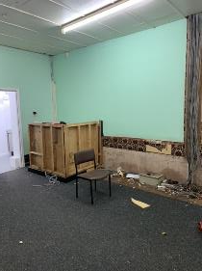
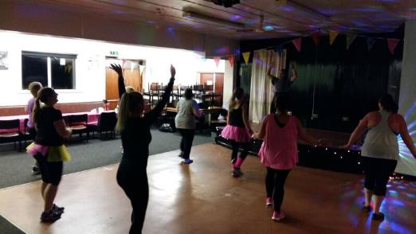
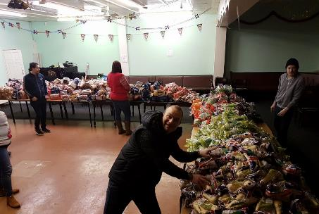

Slide 22
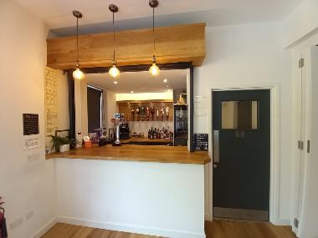

Slide 23
Community Pantry
Pantry opened in September 2021 and stayed open throughout the renovations.

Slide 24
Before
After
The work to convert the pantry was all done by volunteers.

Slide 25
Success of Community Hub Refurbishment
Dedicated project manager on site 5 days week,
We managed keep the building (Pub and Pantry) open during the building works,
Completed ‘asset transfer’ from council to community,
Community Ownership increased as we widened the purpose of the building (Café, Community centre, Advise centre, Food services),
Greater diversity of people involved,
Positive change has increased engagement, which will support community projects we are building.

Slide 26
Challenges of the Refurbishment Project
Timing of the Estate Regeneration funding:
Short notice, made it difficult to plan,
Short delivery window, pressure on project team,
Affected capacity within District Council, such as legal and finance team,
Day to day supply chain difficulties due to Covid requiring daily project management decisions

Slide 27
Photos of the Community Forest School Training Oct 2020.

Slide 28
Hurst Farm Heritage Trail
Baileys Tumb
Wishing Stone
Social Club
Lumsdale Industrial Heritage Site
Project has been awarded £1.2m Heritage Lottery funding in July 2022.
3 year project 2022-25.
Hurst Farm
Hurst Farm Woodland
Outcomes:
1x Ranger
2x Apprentices
1x Business Manager
14.4 Hectares woodland improved
2.3km New path created
250lm Historic path repaired
200lm Drystone walling built
800 New trees planted
1800m2 Wildflower created
John Bowne Memorial

Slide 30
John Bowne Memorial & new Lime Tree
Baileys Tumb (WWII Embattlement site)
Signage at Baileys Tumb
Victorian Wishing Stone
Lumsdale Industrial Heritage Site
Lumsdale Waterfalls
Current Wishing Stone

Slide 31
Rare Wall Butterfly

Slide 32
Entrance Point to the Heritage Trail
Farmer’s View Car Park
Large grassed area will be transformed into a wildflower meadow.
Artist Impression only.

Slide 33
Success of Regeneration Funding
Initial estate regeneration funding enabled us to build a larger vision and funding strategy, resulted in £3.3m funding success,
Helped us develop the project: Surveys, consultation, project manager time, QS support,
Completed Asset transfers (Social Club),
Build social enterprises (Forest School, Pantry & Green Estate),
Large scale consultation helped to build engagement and ownership,
Build strong partnerships,
Services for the community, impacting wider Matlock.

Slide 34
Barriers to Regeneration (for a small rural council)
Council capacity to develop and manage projects:
This needs to be paid for,
Lack of preparation time due to short notice of funding,
Lack of Revenue funding:
Project Development (surveyors, architects, QS support)
Staff time for 3 years or more- to build community capacity, jobs & enterprise
Opposition by some sections of community,
Planning restrictions, eg. Peak National Park,

Slide 35
Gaps and funding support needed
Funding for the development work, not just capital funding!
On Hurst Farm further funding is needed:
To join up what we have already got,
For community economic development- build social enterprise,
Complete project around food security we are developing – including natural environment & food growing,
Larger scale funding to improve the estate infrastructure:
Improve the ‘visual markers of deprivation’- damaged roads, pathways, etc.
Improve public green space through community ownership and maintenance,
Ensure people and organisations are resilient:
by building internal community support and resources (Covid, cost of living crisis, service cuts),
Community energy self-sufficiency needs investment: large scale solar panel farm, wind turbines, heat pumps,etc.

Slide 36
What is next?
Create footpath extension to connect communities,
Build a Community garden- food growing,
Develop a Youth Strategy,
Entrepreneurial training,
Transform Community Centre into Information Hub and Estate Office,
Apply for a large Arts Council Grant.
Find funding for Infrastructure improvements.

Slide 37
Thank you- Any Questions?

