Slide 1
Croydon council – our transformational case study. Aiming for advantage from adversity.
Dean Shoesmith, Chief People Officer

Slide 2

Events of late 2020

Slide 3
Transformation the only option…
A burning platform:
£1.4bn legacy debt
Need to improve and modernise access to services
Need to reduce organisation layers and simplify processes

Slide 4

Future Croydon

Slide 5
Workforce development
A fallow field, preventing transformation readiness and impacting leadership and management
Need for improved leadership and management which had not been invested in for a decade
Need for talent development programmes so the council grows its own talent
Need for positive action talent development programmes to develop inclusivity and improve workforce lived experience

Slide 6
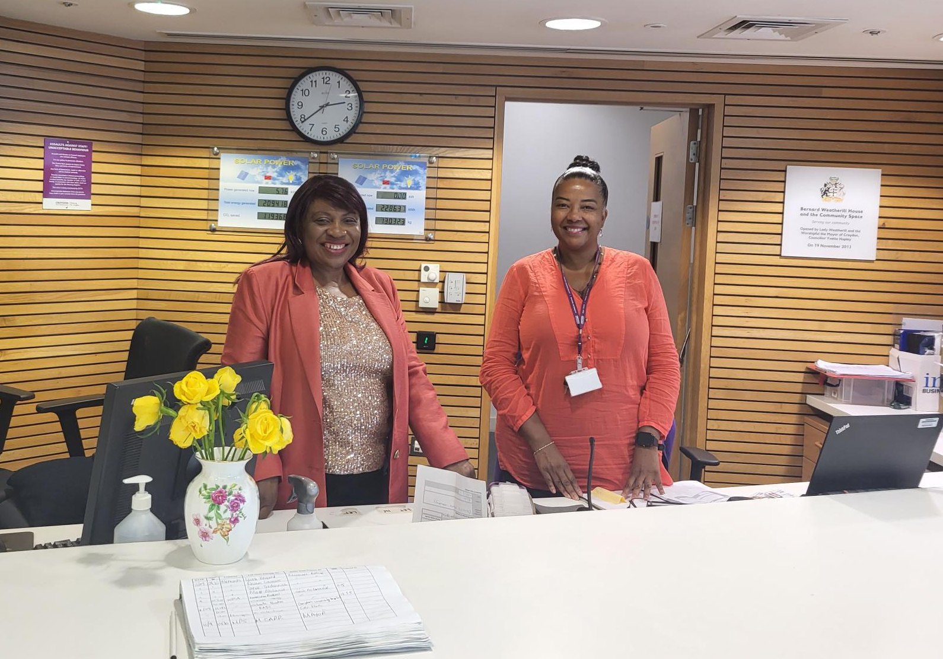
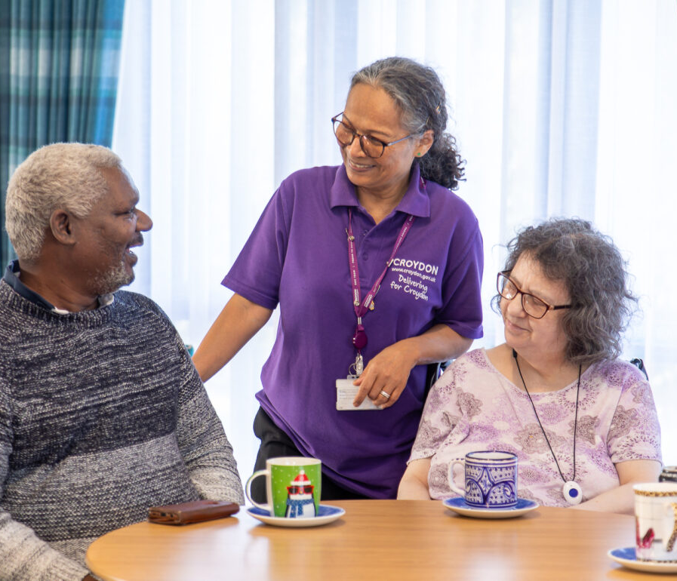
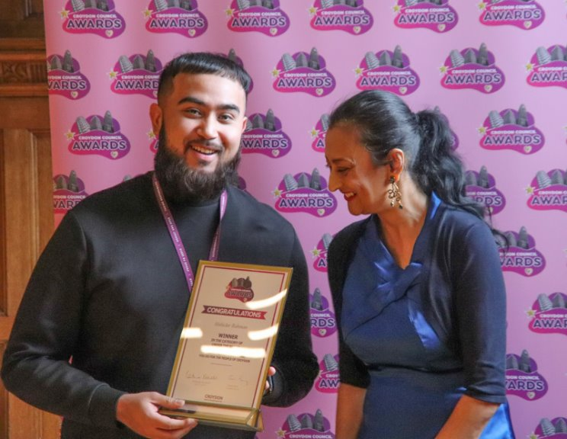
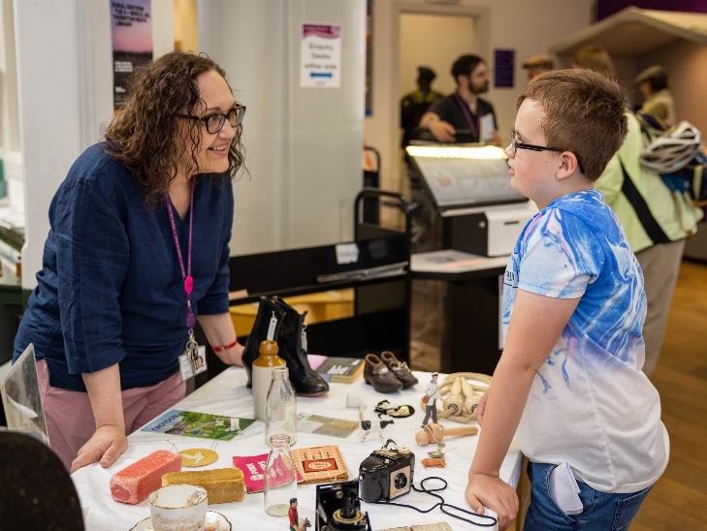
Developing our
people
Notes:
Importance of our people
Lots of our people live as well as work in Croydon
The council touches many lives, people have families here, went to school here, you might know people who use our services or might have joined us because we’re on one of the biggest organisational change programmes in local government
We proud to be a diverse workforce (maybe some headlines around demographics)
We work in so many roles, right across the borough (could give examples?).
We’re an ambitious council, we’ve spoken about our past but also how we want to change, how we are transforming – right now - and what we want to achieve for our residents.
That’s not possible without our people.

Slide 7
Transformation workforce initiatives
Simpler organisation
Integrated corporate services
Culture and governance

Slide 8
Croydon council is undertaking holistic organisational redesign, including developing career and skills pathways to ensure systematic approaches to workforce development, continuous learning, and continuous improvement
Develop a data-driven analytical capability, to provide organisational insights driving effective workforce decision-making
Provide opportunities and support for people from challenging backgrounds by partnering with the CIPD trust
Provide GAS for non-HR members but who have HR responsibility built into their job role, such as their people management community. (Note: our ‘Invest’ management development programme has focused on developing 430-line managers’ people management skills and was launched last year. We remain committed to the programme, both for new managers and for further continuing professional development especially in a transformation context). CIPD
Working with the CIPD

Slide 9

The CIPD is pleased to announce that Croydon council is the first English council to be awarded People Development Partner status. Croydon Council's Transformation Strategy and objectives are centred on promoting cost effective and efficient services for residents, equality diversity and inclusion, fostering collaboration through strategic partnerships, and ensuring a responsive and modern HR & OD function. Through these efforts, the council is committed to building a resilient, skilled, and customer-centric workforce, capable of delivering high-quality services to the community.

