Slide 1

REDESIGNING FROM THE INSIDE OUT: LEARNING AS WE CHANGE
Notes:
Redesigning from the inside out: learning as we change
Adur & Worthing Councils' journey through transformation
Noel Hatch, Assistant Director for People & Change

Slide 2
1. WHY WE NEEDED TO CHANGE
Notes:
Redesigning from the inside out: learning as we change
Adur & Worthing Councils' journey through transformation
Noel Hatch, Assistant Director for People & Change

Slide 3




OUR WIDER CONTEXT
Increasing inequalities and the housing crisis
The climate crisis
Reduced trust in institutions
A new government
Notes:
If we are to be a steward of place that can tackle these challenges & opportunities, we need to design our services in a way that:
Focus on what we are best placed to do and work with residents and partners to make the best use of their strengths to improve lives.
Create the pathways that enable staff to develop the skills that help respond to future challenges and can adapt to the skills needs of the future of work.
Transition our services to be more resilient in finding ways to deliver with less direct funding while attracting resources from other
Our main role is to look after the long-term future of our local area.

Slide 4



OUR FINANCIAL CONTEXT
Poor economic outlook of recession and higher inflation
Short term funding certainty
Low level of reserves
Notes:
If we are to be a steward of place that can tackle these challenges & opportunities, we need to design our services in a way that:
Focus on what we are best placed to do and work with residents and partners to make the best use of their strengths to improve lives.
Create the pathways that enable staff to develop the skills that help respond to future challenges and can adapt to the skills needs of the future of work.
Transition our services to be more resilient in finding ways to deliver with less direct funding while attracting resources from other
Our main role is to look after the long-term future of our local area.

Slide 5



The world has changed so we need to change
We need to design our services in a way that:
Identify what work we are the best people to do, and how we can work with residents and partners on ways to improve our places.
Help our staff to develop their skills so they can thrive in our new way of working.
Become better at providing services with less government support, while looking for new ways to fund our work.
Notes:
If we are to be a steward of place that can tackle these challenges & opportunities, we need to design our services in a way that:
Focus on what we are best placed to do and work with residents and partners to make the best use of their strengths to improve lives.
Create the pathways that enable staff to develop the skills that help respond to future challenges and can adapt to the skills needs of the future of work.
Transition our services to be more resilient in finding ways to deliver with less direct funding while attracting resources from other
Our main role is to look after the long-term future of our local area.

Slide 6
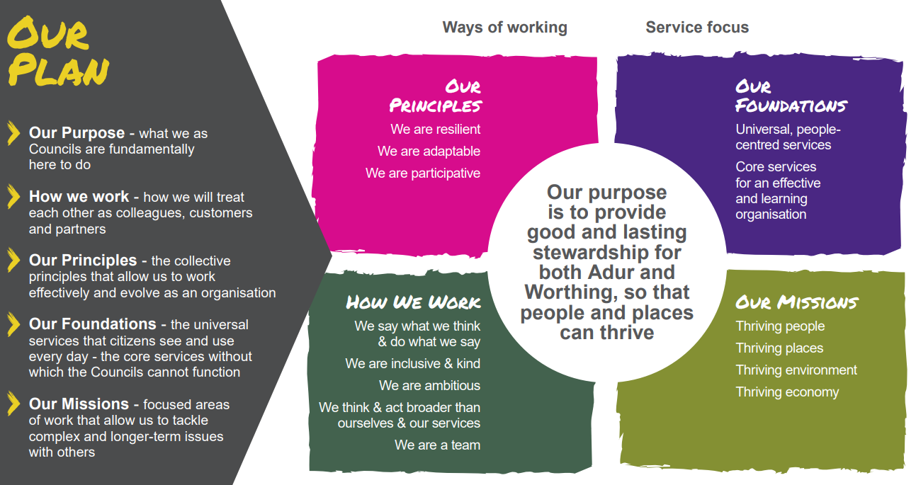
Notes:
Slide 1: Why this matters to us
We didn’t start out trying to “transform.”
We wanted to listen, rebuild trust, and make change that lasts.
What we found is that real change doesn’t happen through plans. It happens through people.“
The most meaningful changes didn’t start with a new structure or strategy. They started with honesty."

Slide 7



TACKLING THE CHALLENGES
If we are to be a steward of place that can tackle these challenges & opportunities, we need to design our services in a way that:
Focus on what we are best placed to do and work with residents and partners to make the best use of their strengths to improve outcomes.
Create the pathways that enable staff to develop the skills that help respond to these challenges while also being best prepared to progress into the capabilities that are most needed in the future economy.
Transition our services to be more resilient in finding ways to deliver with less government funding while being able to attract resources from people who want to invest in the local area.
Notes:
Focus on what we are best placed to do and work with residents and partners to make the best use of their strengths to improve lives.
Create the pathways that enable staff to develop the skills that help respond to future challenges and can adapt to the skills needs of the future of work.
Transition our services to be more resilient in finding ways to deliver with less direct funding while attracting resources from other
Our main role is to look after the long-term future of our local area.

Slide 8
DEVELOPING OUR CAPABILITIES
Delivery Management
Developing our specialist capabilities is key to:
Help achieve the outcomes of the organisational design & mission approach
Anticipate the key skills that we need to develop & improve over the next five years
Develop an offer that helps retain & attract a skilled workforce
Show all staff what are the key skills that will be most important in the future
Leadership
Digital & Data
Adaptive
Resilient
Participative
Commercial
Participation

Slide 9
OUR THEORY OF CHANGE
 | Getting organised | Exploring what people want | Working together
Staff | Teams understand the scope for the areas of focus and next steps | Access support and learning to help them through the change | Sustainable workload, clarity of purpose and feel more connected to people they support, and clearer routes to advance in their career
Residents | A simpler front door and clarity around who does what | Shape how they want to make a difference in their communities and involved in changes to their service | A good basic service Opportunities to work with us on projects that make a difference
Members | Members understand the aim of the programme and areas of focus | Members shape how they can champion local neighbourhoods | Champion local neighbourhoods
Partners | Partners understand what the changes mean and opportunities to engage | Develop together opportunities to combine forces on major priorities | Improved collaboration makes it easier for people to meet their needs Increased opportunities to pool resources and attract external funding
Notes:
Now: Staff understand the outcomes & approach to the programme and take part in learning & development so feel more confident and supported in delivering the improved services.
Next: Staff see how their role is helping deliver outcomes, and feel more connected to the people they support. In addition they will benefit from a skills framework & training; helping them develop. Digital technology that simplifies processes will free them up to solve problems on complex issues.
Now: Residents see how the changes will help them better access and use services and improve their neighbourhoods, and how they can get involved in the change.
Next: Residents can share how they would like to get involved and supported in making a difference in their communities.
Future: Residents access our services in an easier way through the help of digital and get the support to work with us to improve our neighbourhoods
Now: Partners understand what the changes mean for our residents, places and their organisations and how we can work together with them to pool our resources to improve our communities and the economy.
Next: Sessions to update on proposed changes and explore opportunities to work together on key needs and opportunities and build coalitions on major missions to pool resources and attract investment.
Future: Partners work together with us to tackle the needs our residents and places have, helping them improve our communities and achieving shared missions on improving people, economy, place and planet.
Now: Members understand what the changes will mean for our local communities and how they are being planned and delivered to better champion the improved services.
Next: Members shape how their role could help people make a difference in their communities and champion local neighbourhoods.
Future: Members see how we have worked to improve how residents access our services in an easier way through the help of digital technology and get the tools and support to work with our staff and partners to improve our neighbourhoods.

Slide 10
REDESIGNING EVERYTHING WE DO
Future Operating Model Canvas
Discovery: Develop the new service offer
Vision
Background | Outcomes & Target Audiences |  | Risks & Mitigations
Service Offer
Role of Council | Role of Residents |  | Role of Partners
Infrastructure
Physical | Digital | People | Savings
Roadmap
Embed: Learn and extend to other areas
Design: Develop the future operating model
Test: Deliver the new model

Slide 11
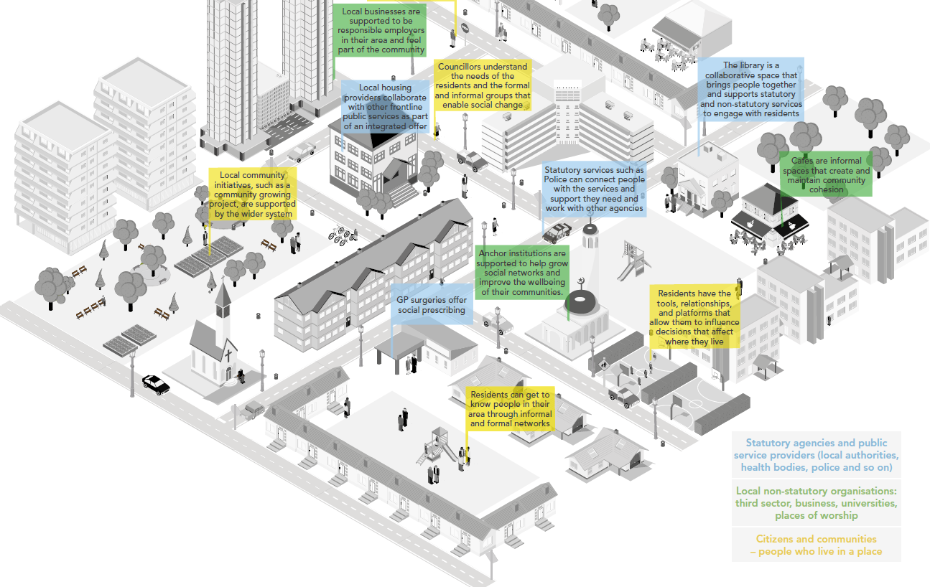
Regeneration shapes & and builds future places that provide affordable housing and places people want to work and invest in
Neighbourhood teams tackle common issues to help keep our streets and spaces clean, safe and enjoyable
Council provides a single digital front door to enable residents to access services quickly
Community participation is supported to bring together staff, communities and partners to make a difference
Housing teams ensure homes are safe and residents are involved and supported.
Core services provide support to help deliver and embed the change.
Council and partners build on delivering the shared change to attract external investment to achieve our shared missions.
Proactive teams help residents before they need urgent help
Council becomes better at generating income and becoming less dependent on time-limited funding.
FUTURE OFFER

Slide 12
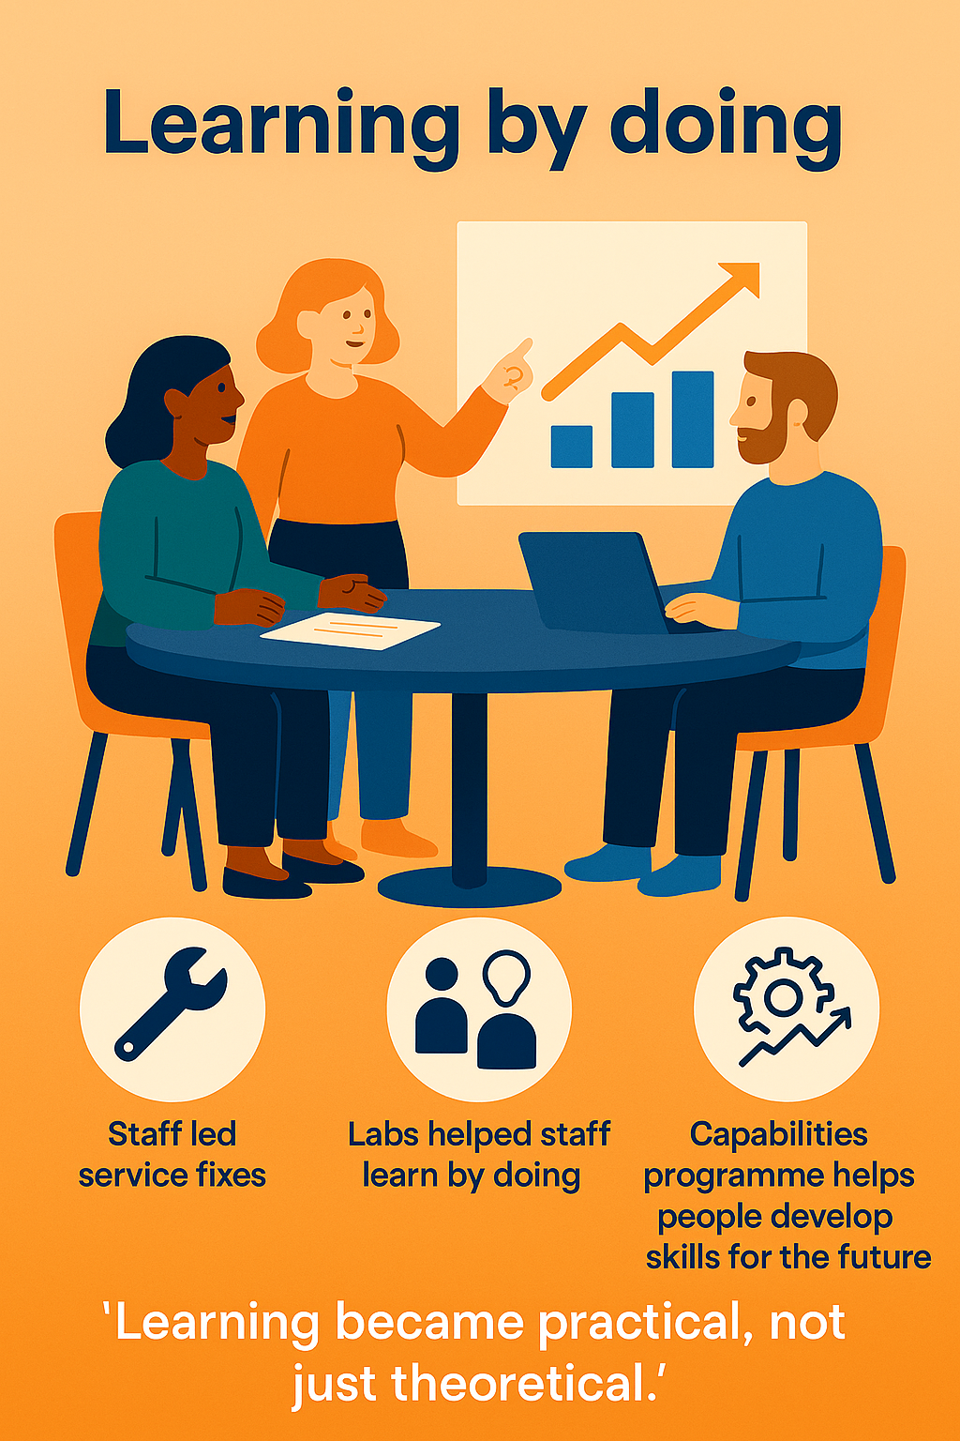
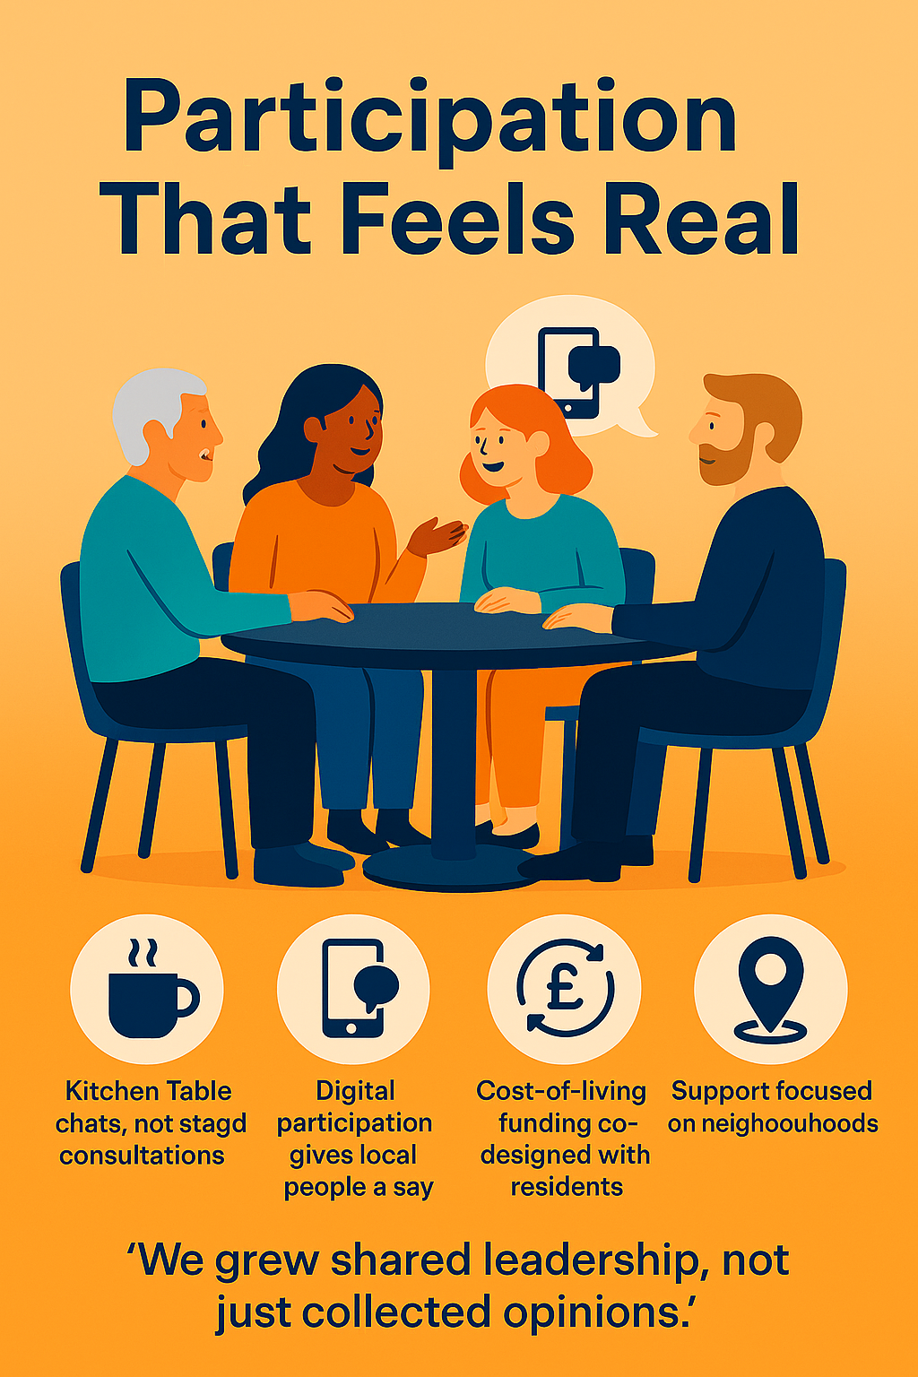

Slide 13
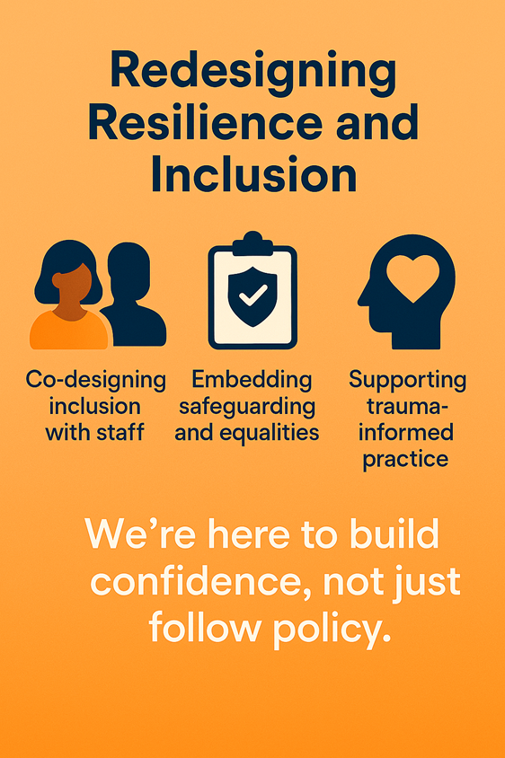
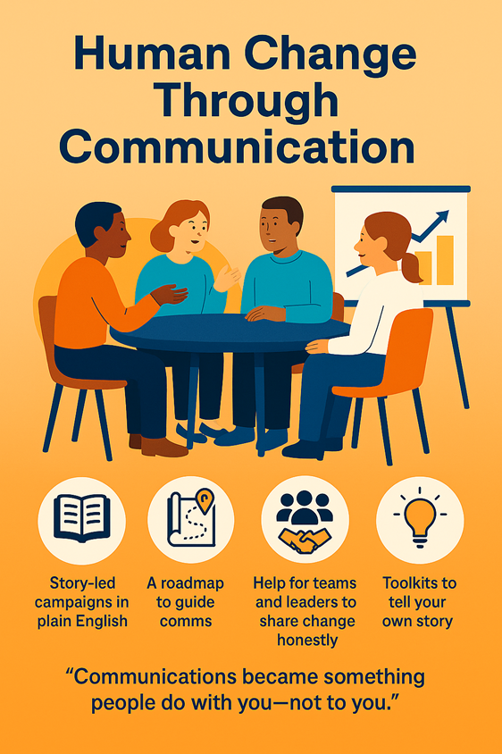

Slide 14
2. FROM ORGANISATIONAL DESIGN TO WHOLE PLACE DESIGN

Slide 15

Notes:
Thriving Together is about how we shape the future of Adur & Worthing with our communities. It’s more than a plan — it’s a movement, and this moment gives us the chance to lead that change locally, regionally, and nationally.
Start with one powerful question:
“When you think of the places you call home, what helps you feel like you belong?”
(Let them reflect or turn to someone next to them to chat for 2 mins)
Share the Thriving Together purpose: “Shaping the future of the places we call home.”

Slide 16
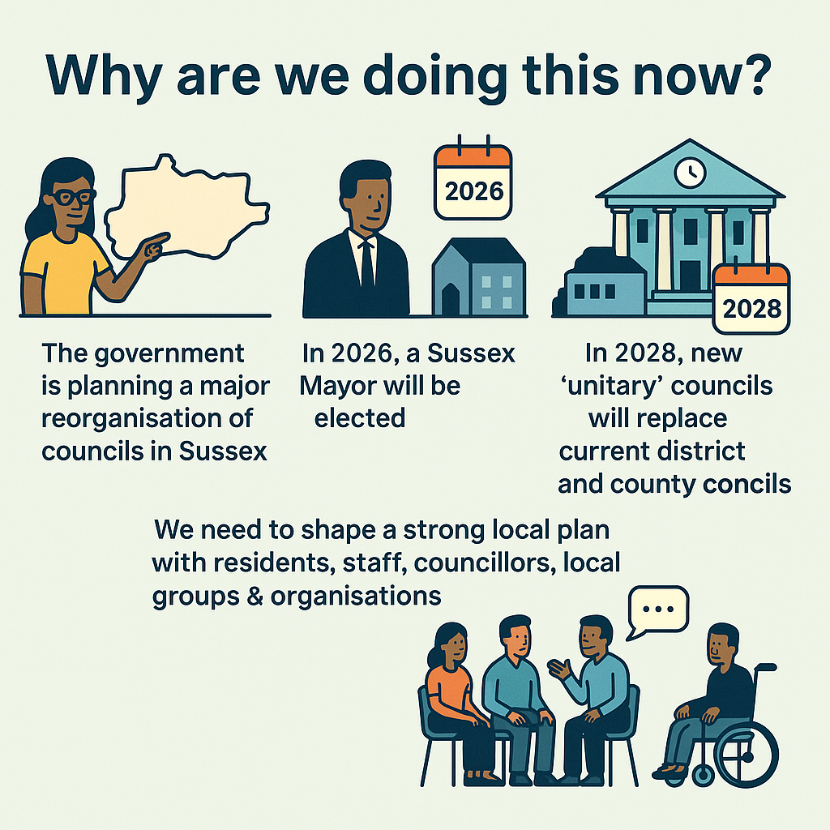
Notes:
We're using Thriving Together to shape our Local Government Reorganisation submission — but also to spark long-term change in how we work with our neighbourhoods and plan for the future. This is happening in the context of the Sussex Mayoral Combined County Authority. We’re responding to national asks, but driving it through local leadership and values.

Slide 17
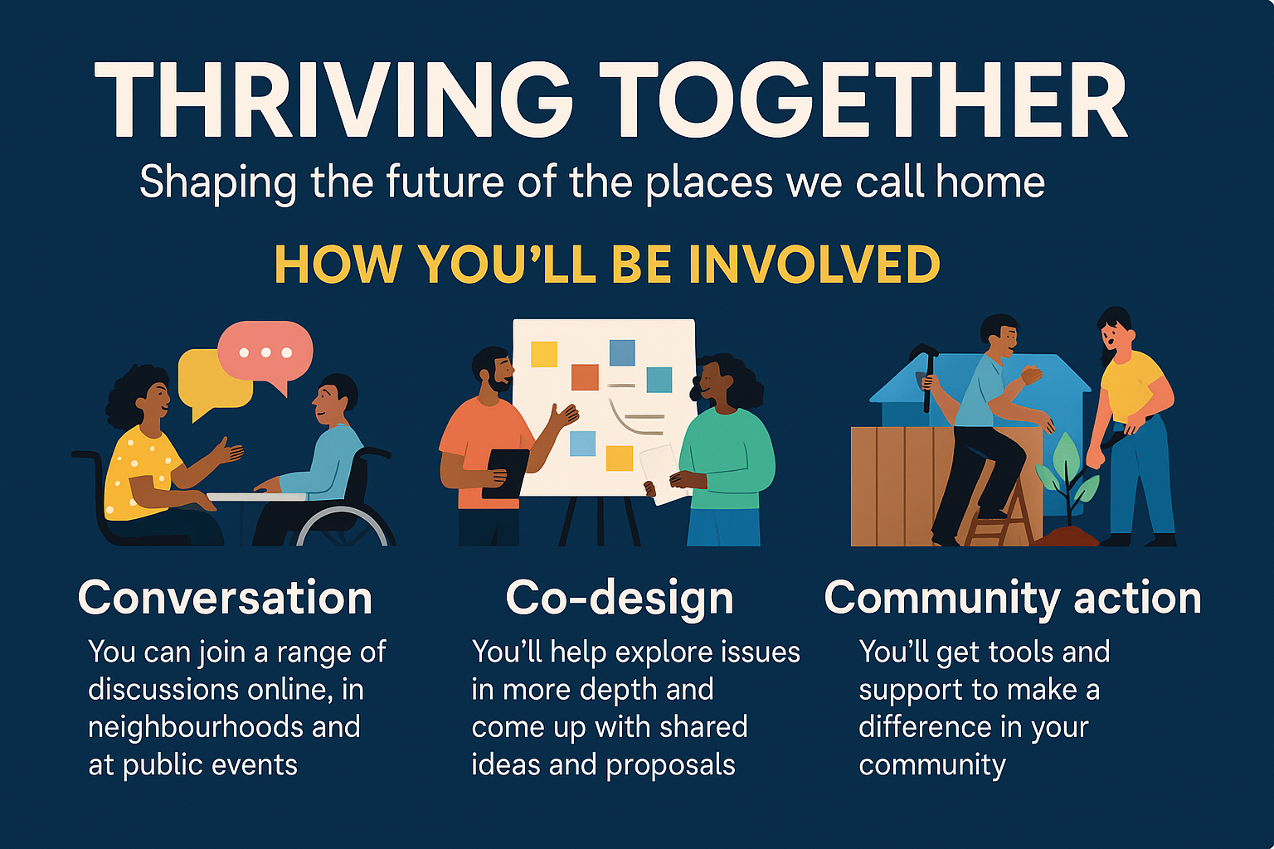
Notes:
The programme is structured to shape the LGR plan but also embed change into the way we work as a council and with communities from now to 2028

Slide 18
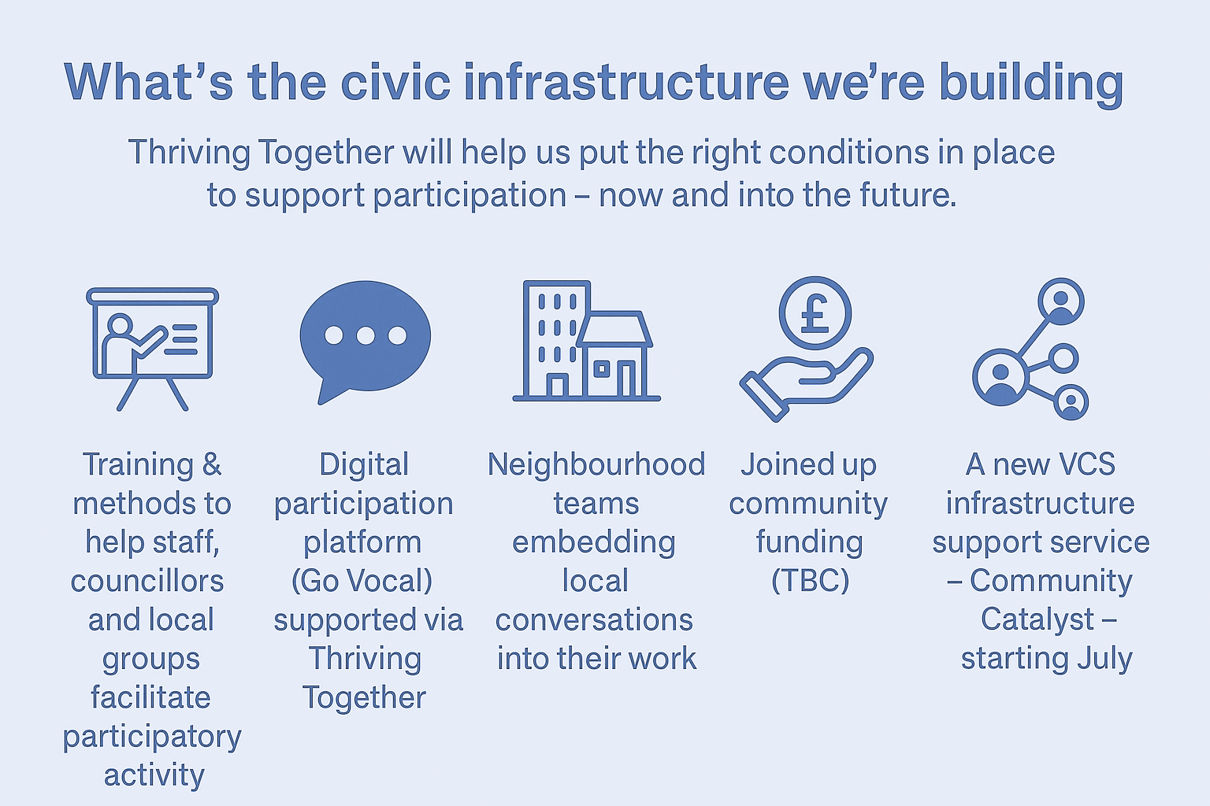
Notes:
Let’s pause and remember: this is about hope. About agency. About shaping places we’re proud to live in — and leaving a legacy of participation that lasts long after the September deadline.

Slide 19
