Slide 1
Local Leadership Framework for Councillors
Workshop pack for councils
August 2023
www.local.gov.uk

Slide 2
Guidance notes
This workshop pack has been produced to support councils to use the Local Leadership Framework for Councillors. It has 3 sections:
The Local Leadership Framework
Example workshop activities
Further resources
The slides can be edited to meet your council’s requirements. Some slides contain guidance notes which should be removed before presenting.
All slides contain facilitator notes in the ‘Notes’ section of this presentation.
For further information or support, please contact leadership@local.gov.uk

Slide 3
Local Leadership Framework for Councillors
Insert council name
Insert date
www.local.gov.uk

Slide 4
Introduction
The Local Leadership Framework supports councillors in their local leadership role as they work with communities to make a difference.
The framework includes suggestions, prompts and further resources to help you think about the skills you use as a councillor.
The framework is here to help:
Prospective councillors
New councillors
Experienced councillors
Executive members, chairs and councillors in other roles
Notes:
This framework includes suggestions, prompts and further resources to help you think about the skills you use as a councillor.
We have produced this framework with the following people in mind:
Prospective councillors – we hope this framework will give prospective councillors a good overview of the ways that councillors can make a difference and the skills that you might need when you get elected
New councillors – we anticipate this framework will give new councillors a good starting point in their work as local leaders and help them to map out the things they might explore through induction and beyond
Experienced councillors – this framework should be a useful tool for experienced councillors when they are thinking about their further development
Executive members, chairs and councillors in other roles – we believe this framework will also be useful to executive members, chairs and councillors in other roles as they think about their development – many skill sets are relevant across different leadership roles, for example, within a council or within a party.

Slide 5
How was the framework created?
Review of existing materials
Including Political Skills Framework and 21st Century Councillor
Events with councillors
Three online facilitated events where research team heard from councillors
Survey of councillors
Survey open to all councillors, received 100 responses
Roundtable events
Two roundtable events with leadership experts to refine the framework
Notes:
The Local Leadership Framework was developed by a team of academics alongside the LGA.
The development of the framework began with a review of existing materials, including the Political Skills Framework and 21st Century Councillor, which you may be familiar with.
The aim was not to replace these documents but to create a refreshed framework that is relevant to councillors in the context of the challenges society faces today, including a focus on EDI and challenges post-Covid.
Following the review, we held a series of engagement events and sent a survey to councillors to gain their feedback and thoughts on the skills they use in their roles and how important those skills are.
We also held two roundtables with leadership experts to test and refine the framework.

Slide 6
Skill sets for the 21st Century Councillor
The 21st-century Councillor report sets out seven key future roles for councillors.
The leadership skills in this framework will enable councillors to fulfil the ‘seven roles of the 21st-century councillor’:
Find out more: https://21stcenturypublicservant.wordpress.com
Steward of place
Advocate
Buffer
Sense-maker
Catalyst
Entrepreneur
Orchestrator
Notes:
The framework builds on the roles and skills set out in 'The 21st-century Councillor' research report – which sets out seven key future roles for councillors. These show how councillors are adapting to a series of new challenges such as perma-austerity, evolving citizen expectations, new technologies, different scales of working and the changing organisation of public services at local level. The leadership skills in this framework will enable councillors to fulfil the 'seven roles of the 21st-century councillor', identified in the research report namely:
Steward of place – working across the local area in partnership with others
Advocate – acting to represent the interests of all citizens
Buffer – seeking to mitigate the impact of austerity on citizens
Sensemaker – translating a shift in the role of public services and the relationship between institutions and citizen
Catalyst – enabling citizens to do things for themselves, having new conversations about what is now possible
Entrepreneur – working with citizens and partners to encourage local vitality and identify creative new solutions
Orchestrator – helping broker relationships, work with partners and develop new connections.
Note: a slide pack on the 21st Century Councillor is available at https://21stcenturypublicservant.wordpress.com/21st-century-councillor/.

Slide 7
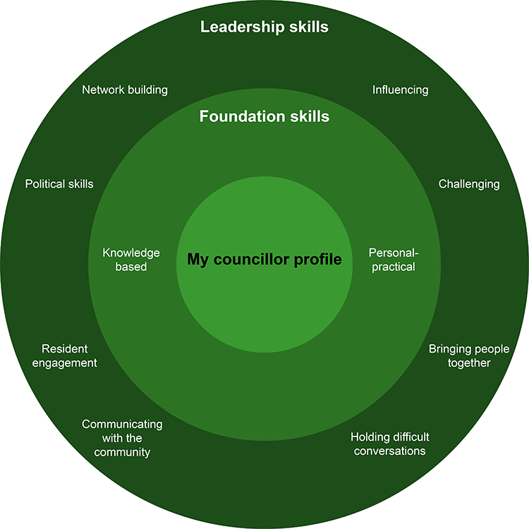
The framework
Notes:
The Local Leadership Framework for Councillors is intended to help you in your local leadership role as you work with local communities to make a difference. The framework has three layers:
Your councillor profile – the framework positions the individual councillor in the centre and suggests that this is where any development conversation should start – with the aspirations, strengths and priorities of the person in the role
Foundation skills – divided between knowledge-based and personal / practical skills, these are the essentials that councillors need to navigate their role
Leadership skills – these skill sets are how councillors make the biggest difference and respond to the many challenges that they face in their communities.
Each layer is explored further in the sections that follow. There is no single right way to use the framework.

Slide 8
My councillor profile
Councillor Smith
I hope to make a difference by…
What people appreciate about me as a councillor…
As a councillor, it is important to me that I…
To support me well in my councillor work...
Notes:
There is no single right way to be a councillor. Everyone brings different things to the role and everyone’s approach is unique. When developing as a local leader, it’s helpful to practice self-awareness, to know your strengths and values, and to use this understanding to help you to thrive and develop.
The starting point for the Local Leadership Framework for Councillors, therefore, is the councillor profile – a short, positive summary of the most important things about you as a councillor, on a single page. This idea is adapted from the ‘one-page profile’ – a tool now used widely in education, health, social care and personal development.
Developing your councillor profile can help you to be clear about how you approach the role and provide you with insights into how you work. Sharing your councillor profile can help others understand you better and work with you more effectively.
You can see an example of a councillor profile later in this workbook.
You could consider the following four questions for your profile:
What difference do I hope to make as a councillor?
What do people appreciate about me as a councillor?
What is important to me to me as a councillor?
How can I be supported well in my councillor work?

Slide 9
Knowledge-based skills
Council knowledge
Understanding the role of officers
Subject knowledge
System knowledge
Understanding council finances
Knowing the local area you represent
Keeping up to date
The ‘need to know’ things that help councillors to work effectively
Notes:
There are some things that councillors ‘need to know’ to help them work effectively. The key skill here is knowledge acquisition – you don’t need to know everything as a councillor; but, knowing where to go can be important.
Types of knowledge essential for councillors include:
Council knowledge – about meetings, councillor code of conduct, the constitution and committee roles, performance data, scrutiny reviews, and so on
Understanding the role of officers – including key statutory roles such as the monitoring officer, for example
Subject knowledge – for example, housing, education, or the planning system
System knowledge – ‘how things work around here’ and how to get things done
Understanding council finances – the commercial context, how the budget works and other funding systems, for example, health
Knowing the local area you represent
Keeping up to date – 'having a finger on the pulse' and using horizon-scanning to gain knowledge of future events.

Slide 10
Personal / practical skills
Personal resilience
Taking advantage of learning
Making use of information & data
Active listening
Meeting skills
Communication skills
Working with others
Personal safety
Being organised and keeping track
Good time management
Prioritisation
Notes:
There are many personal and practical skills that people have before they become a councillor that help them in their councillor role.
However, being a councillor involves unique and challenging pressures that can affect wellbeing and confidence.
It is important to think about how you manage your role as a councillor in order to be most effective as a local leader.
We’ve included on screen some of these personal and practical skills that are useful for councillors.
I’ll leave this on screen for a moment, and ask you to reflect on which you feel are the most helpful?

Slide 11
Leadership skillsets
Network building | Political skills | Community engagement | Communicating with the community
Influencing | Challenging | Bringing people together | Having difficult conversations
Notes:
Alongside the foundational skills that we’ve outlined, there are skills that, when grouped together, reflect what it means to be a local leader specifically. Being a local leader means working with local communities to make a difference. It means using soft skills and good relationships to get things done.
This list of local leadership skill sets builds on previous frameworks and the research for this framework:
Network-building – making the connections that others can’t, bringing people together to solve problems they might not solve alone
Political skills – demonstrating good political awareness and understanding when working to achieve goals
Resident engagement – keeping up to date with local concerns and understanding local ambitions for the area, ensuring that all voices are heard
Communicating with the community – regular and effective communication with all parts of the community, using a range of different methods
Influencing – employing skills of negotiation and diplomacy to help get things done
Challenging – contributing to good governance, inside and outside the council, by acting as a critical friend and challenging discriminatory language or behaviour
Bringing people together – helping to resolve conflicts in the community and to solve problems
Holding difficult conversations – supporting residents, or people using services, who have complex, emotional or distressing issues.
We look at each of these skill sets in more detail.

Slide 12
Leadership skillset: Network building
Councillors are uniquely placed to be connectors
Looking at the whole system
Bringing together officers, partners and the public
Working in formal partnership structures
Interpersonal skills
Relationships across sectors
Notes:
Councillors are uniquely placed to be connectors across the whole system within a locality, encompassing wider partner organisations. By bringing together officers, partners and the public, councillors can help find solutions to challenges that might not be obvious to individuals.
Network-building is key to councillors' orchestrator role because they help to broker relationships, work with partners and develop new connections.
Some examples of what councillors say helps them to make a difference:
“Working hard to support residents and link community groups, parish councils and the county council”
“Engaging with local people and organisations to work for the residents”
“Volunteering (for example, ‘in our local larder’) gives new connections with residents and partner agencies”
"Knowing what needs changing, make connections with other organisations to work in partnership”
"Being a 'super-connector', building relationships with officers, members and community”
"Working with others to change a housing association's plans for a site within the area”.
Network-building skills that you might find useful include:
Working in formal partnership structures
Interpersonal skills (to work collaboratively to achieve shared goals, demonstrate trust and humility)
Relationship-building across different sectors
Having a clear, strategic view of the full range of services in the community
Maintaining key relationships with officers, for example the monitoring officer
Network mapping to identify strengths and gaps
Engaging and galvanising partners.

Slide 13
Leadership skillset: Political skills
Political environment, demonstrating awareness and understanding
Healthy local democracy, civility in public life
How the community engages with local politics
Valuing all councillors of all parties, across boundaries
Your values and vision
Notes:
Councillors work within a political environment and, so, they need to demonstrate political awareness and understanding when they are working to achieve their goals. Councillors also need to promote a healthy local democracy, civility in public life, and community engagement with local politics.
Political skills are key to councillors' steward of place role as they work across their local area in partnership with others.
Some examples of what councillors say helps them to make a difference:
“Collaborating with other parties for change, for example, health scrutiny”
“Valuing all councillors, of whatever party label, as helpful contributors to decisions”
“Liaising with other parts of the council to get things done”
“Encouraging all residents to have more of a say in local decision making and making politics part of day-to-day conversations”
“Engaging people who might not otherwise think that politics or the workings of local government is for them”.
Political skills that you might find useful include:
Working across boundaries – with MPs and representatives from other bodies, and across political divides
Communicating values and a political vision
Promoting public participation in local issues and politics
Balancing the needs of local people, the council and the party group (if a party member)
Maintaining key relationships with officers, for example, the monitoring officer
Lobbying and engaging with national policy-making
Understanding accountability (for example, for key services which may sit with external partners, or with other tiers of government such as a combined authority).

Slide 14
Leadership skillset: Community engagement
Key to local leadership, keeping up to date with local concerns and understanding local needs
Represent all voices within the local community, irrespective of political views
Facilitating meetings and social media skills
Working with diverse communities
Engaging seldom-heard groups
Notes:
Engaging with the community is a key aspect of local leadership as it helps councillors to keep up to date with local concerns and understand local needs. As local leaders, councillors use a variety of consultation and engagement methods to reach all parts of the community and to hear multiple viewpoints. The aim is to effectively represent all voices within the local community, irrespective of their political views.
Community engagement is key to councillors' advocate role because they act to represent the interests of all residents.
Some examples of what councillors say helps them to make a difference:
"Talking to residents as much as possible”
"Surgeries, attendance at all parish meetings and local events"
“Good local networks / structures including residents' groups, local boards and community partnerships”
“Public meetings where we can learn what is important to residents”
“Visiting groups in the ward to identify needs or issues”.
Community engagement skills that you might find useful include:
Asking the right questions
Facilitating meetings
Social media skills
Digital engagement
Engaging seldom-heard groups
Engaging young people
Working with diverse communities.

Slide 15
Leadership skillset: Communicating with the community
Regular and effective communication
Councillors share important messages with residents e.g. new initiatives
Public speaking, narrative and storytelling
Thinking about different media channels
Notes:
Regular and effective communication with all parts of the community, using a range of different methods, is a key element of the councillor role. As local leaders, councillors share important messages with residents and help people to make sense of new challenges and initiatives.
Communicating with local communities is key to councillors' sensemaker role because they help residents to understand changes in the role of public services and the relationship between institutions and residents.
Some examples of what councillors say helps them to make a difference:
“Prioritising good communications with ward residents in order to give them useful and helpful information”
"Continuing to communicate with all residents through regular newsletters”
"Circulating through the area helpful information that comes our way”
"Explaining to local residents what the council is doing (or not able to do) and why”
"Sharing important community information”.
Communications skills that you might find useful include:
Public speaking
Working with the mainstream media
Social media and digital communications
Narrative and storytelling.

Slide 16
Leadership skillset: Influencing
Negotiation and diplomacy to help get things done
Sharing of power and resources
‘Soft power’ and relationships
Contributing to live issues
Representing resident views
Importance of listening and constructive challenge
Notes:
Councillors often need to employ skills of negotiation and diplomacy to help get things done on behalf of residents. This is particularly true in partnership settings where local leaders need to find ways to share power and resources. Similarly, in non-executive roles, councillors must draw on ‘soft power’ through the strength of their relationships and the credibility of their contributions to meetings.
Influencing is a key skill in councillors' advocate role because they represent the interests of individuals and communities – within their councils and to partner organisations.
Some examples of what councillors say helps them to make a difference:
"Contributing constructively to discussion of live issues such as planning applications at local and planning committee”
“Raising issues in cabinet and council and looking for policy and process improvements”
“Representing the views of residents when dealing with outside bodies”
“Bringing residents’ issues to committee”.
Skills for influencing that you might find useful include:
Negotiation
Diplomacy / interpersonal skills
Listening
Analysis and information skills
Constructive meeting contributions
Questioning.

Slide 17
Leadership skillset: Challenging
Councillors contribute to good governance
Being a critical friend
Inviting decision makers to give public accounts
Constructive feedback
Challenge toxic culture and model positive behaviour
Listening, analysis, and concise contributions
Notes:
Councillors contribute to good governance, inside and outside their councils, by acting as a critical friend and inviting decision makers to give a public account of their plans and performance. This involves providing constructive feedback and playing 'devil's advocate'. To challenge effectively, councillors need to be able to analyse information and make concise and meaningful contributions.
Challenging is a key skill in councillors' buffer role, for example, when they seek to mitigate the impact of austerity on residents by raising the issues faced by residents within their councils and to other service providers.
Some examples of what councillors say helps them to make a difference:
"Asking important questions at scrutiny panels"
"Effectively scrutinising council initiatives”
"Successfully challenging council department decisions on residents’ behalf”
“Being persistent”
“Guiding residents regarding petitions and presenting these to full council and cabinet”
“Challenging toxic culture and modelling positive behaviour”.
Skills for challenging that you might find useful include:
Constructive feedback
Interpersonal skills, such as communicating and interacting positively with people
Listening
Analysis, data and information skills, including skills in financial oversight
Constructive meeting contributions
Questioning.

Slide 18
Leadership skillset: Bringing people together
Appreciate different viewpoints
Be able to help people to work together for the benefit of the community
Facilitate positive local change
Conflict resolution, mediation, listening
Notes:
Local leaders will often become aware when there are tensions between different parts of the community they represent. At the same time, councillors may want to bring people together to solve a particular problem. Either way, councillors will need to demonstrate a good understanding of what is happening, appreciate different viewpoints and be able to help people to work together for the benefit of all.
Bringing people together is a key skill in councillors' entrepreneur role, for example, when councillors work with residents and partners to encourage local vitality and develop new solutions
Some examples of what councillors say helps them to make a difference:
“Bringing together community groups, local authorities and other partners to facilitate positive local change”
“Meeting regularly with local police”
“Working with local heritage groups in the development of an overall borough strategy”
“Helping groups to raise funds and given money to create solutions”
“Promoting... And encouraging black, asian and minority ethnic communities to engage in the political process”.
Skills for bringing people together that you might find useful include:
Interpersonal skills
Facilitation and capacity-building
Conflict resolution
Mediation
Listening
Solutions-focused questioning.

Slide 19
Leadership skillset: Having difficult conversations
Difficult conversations require local leaders to provide time, attention and respect
Demonstrate good listening skills
Make referrals in a sensitive way
Signposting residents to services they may require
Showing empathy
Notes:
Councillors may often find themselves talking to residents, or people using services, who have complex, emotional or distressing issues to deal with. These difficult conversations require local leaders to provide time, attention and respect and to demonstrate good listening skills. Councillors can also help by making referrals in a sensitive way.
Holding difficult conversations is a key skill in councillors' catalyst role because they help residents to do things for themselves, signpost sensitively and have conversations about what might be possible.
Some examples of what councillors say helps them to make a difference:
“Being approachable and visible, showing solidarity, supporting and linking them to others”
“Signposting residents in need and supporting them through difficult times such as referring people struggling with the cost of living crisis to local resources and council services”
“Directing residents to relevant contacts or information and escalating their issues when required”
“Just 'be there’”.
Skills for holding difficult conversations that you might find useful include:
Interpersonal skills
Listening
Sensitive signposting
Empathy – solutions-focused questioning.

Slide 20
Using the framework
Councillors can use the framework for:
Councils can use the framework for:
Development and self-reflection
Skills scan
Peer networking
Coaching or mentoring
Councillor development strategy
Councillor inductions
Training needs analysis
Notes:
Here we offer some suggestions that you might find useful in doing that. While this framework can be used for self-reflection in a number of different ways, we know that many councillors find it helpful to discuss these things with others – either as a one-to-one conversation or as part of a group. The framework might also be used strategically to support member development. There is no ‘right’ way to use the framework and it is worth speaking with councillors to find out how it would be most useful for them.
Some examples of how it could be used include the ones on this slide, but there may be other practical ways to make the best use of the framework on a day-to-day basis.
Further information on using the framework can be found in the Local Leadership Framework: https://www.local.gov.uk/publications/local-leadership-framework-councillors

Slide 21
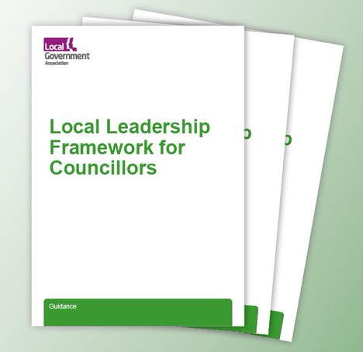
Thank you
Find out more about The Local Leadership Framework for Councillors online:
https://www.local.gov.uk/publications/local-leadership-framework-councillors

Slide 22
Example workshop activities

Slide 23
Activity 1 Create your Councillor Profile
Question 1: What difference to I hope to make as a councillor?
Question 2: What do people appreciate about me as a councillor?
Question 3: What is important to me as a councillor?
Question 4: How can I be supported well in my councillor work?
Notes:
In this first activity, councillors can create their ‘Councillor Profile’ by considering these four questions and writing down their answers. Councillors can be encouraged to work independently, and perhaps share their answers with fellow councillors in the workshop.
Examples of councillor profiles can be found here: https://www.local.gov.uk/publications/local-leadership-framework-councillors

Slide 24
Activity 2 Which personal/practical skills are most important to you?
Personal resilience
Making use of information & data
Taking advantage of learning
Active listening
Working with others
Communication skills
Meeting skills
Personal safety
Good time management
Being organised and keeping track
Prioritisation
Notes:
In this second activity, councillors can work either independently or in groups to pick the ‘top 3’ personal/practical skills that are most important to them. Councillors can be invited to share their answers with the group, and have a discussion about which of these skills are most important for councillors today.
More information about the personal/practical skills can be found here: https://www.local.gov.uk/publications/local-leadership-framework-councillors

Slide 25
Activity 3 Focus on leadership skillsets
Network building | Political skills | Community engagement | Communicating with the community
Influencing | Challenging | Bringing people together | Having difficult conversations
Notes:
In this third activity, councillors can pick one or two leadership skillsets that they would like to enhance or develop. Councillors can start by reflecting, either individually or with a peer partner, where they feel they are at right now in terms of their ability and confidence with this skillset. Councillors can then work with a partner to have a micro coaching/mentoring conversation focused on developing in this area.
Suggestions for discussion questions:
What is your objective/what are you looking to achieve?
Where are you right now in terms of your confidence and ability in this area?
What could you do to improve in this area? What else could you do?
How will you implement this? What are your next steps, and what support do you need?
More information about the leadership skillsets can be found here: https://www.local.gov.uk/publications/local-leadership-framework-councillors

Slide 26
Workbook for councillors
The LGA has created a workbook for councillors on the Local Leadership Framework
The workbook can be completed digitally or can be printed
Download the workbook here:

Slide 27
Further resources

Slide 28
Further resources
LGA Highlighting Political Leadership: Development programmes for all councillors including our flagship Leadership Academy, our Leadership Essentials series of residential events, Next Generation, e-learning and support for disabled councillors
LGA Political Groups: Mentoring and support for councillors in political groups and those who are independent
21st Century Councillor (University of Birmingham)
Further support and enquiries: leadership@local.gov.uk

