Slide 1
Mildenhall, Suffolk multi-agency colocation case study
June 2025
Version | Date | Author | Amends
1 | June 2025 | Caroline Laitner | Approval from client 06.25

Slide 2
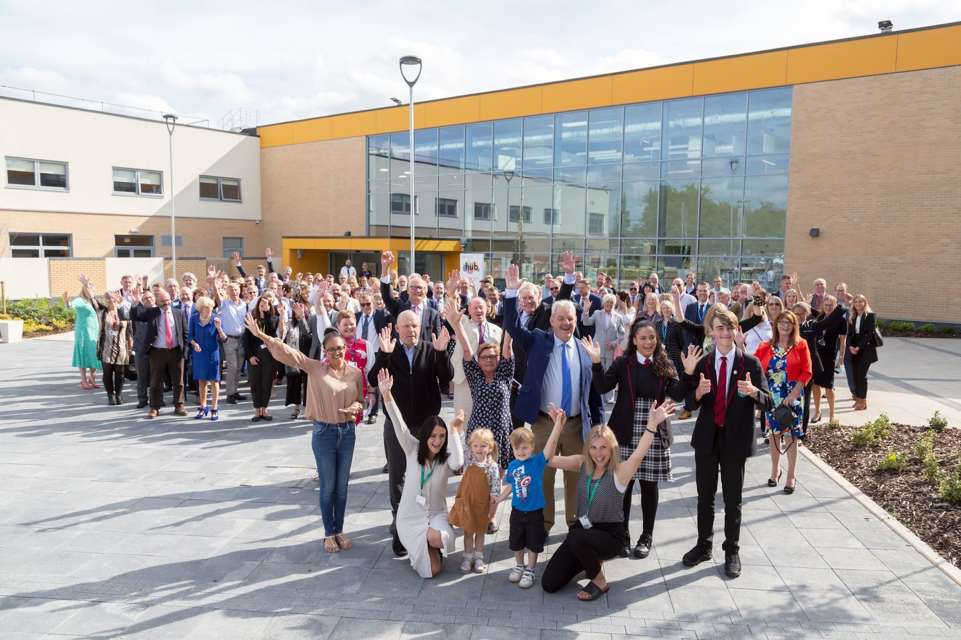
Integrating public services and improving health, wellbeing and education outcomes in Mildenhall
Watch OPE’s short video case study: One Public Estate (OPE) – Mildenhall Hub - YouTube
Winner of the Government Property Award for Project of the Year in 2022
Like many English market towns, public services in Mildenhall were delivered from multiple sites across the town and many were in ageing buildings that were not well used and costly to run. In 2014, as part of OPE’s pilot phase, West Suffolk Council developed a vision to deliver an innovative scheme to co-locate the majority of the public estate in a market town onto one site, radically improving services, achieving savings of over 50% and releasing 12 hectares for growth.
OPE provided £100k early-stage seed funding to West Suffolk and Suffolk County Councils in 2015/16 to support feasibility and master planning in Mildenhall, bringing together central and local government, wider public sector and voluntary partners to explore alternative ways to deliver services. The councils, Academy Transformation Trust, the Department for Education, Sport England, Police, NHS, Department for Work and Pensions and Citizens Advice developed an ambitious plan to exit five properties and create a multi-agency hub on a single site.
The Mildenhall Hub opened to the public in 2021, bringing together a range of public services on one site, making access easier and cutting costs. The project has been recognised for its innovative approach, winning a Government Property Award for Project of the Year in 2022. The Mildenhall Hub continues to deliver better school, leisure and other facilities, and brings together partners in education, health, leisure and other services to work collaboratively for residents.
As well as ongoing support for partner collaboration, the OPE programme provided resources to help build the business case and worked with the Department for Education to persuade maintenance funds to be rerouted into the new hub so ensuring the scheme’s viability.
Immediate Outputs:
Over 10 public and voluntary services collocated under one roof.
New school, leisure centre, library and facilities for council and health services for the community.
Vacated sites have released 1.7 hectares of land for housing
Over £700,000 saved from reduced public estate footprint in 2022/23.
Upgraded, accessible and integrated approach to improve health outcomes, lift education attainment and provide a better leisure offer.
Library and leisure participation rates have doubled compared to pre-Covid levels.
Full time family hub supporting children’s health and leisure services.
Community health teams and leisure services collaborate on a joined-up exercise referral scheme that supports patient rehabilitation.
Longer term outcomes:
Plans to deliver around 50 new homes on the already vacated land.
Further public estate footprint savings are forecast of at least £725,000 per year over five years.

