Slide 1
One Council Programme
Newcastle Under Lyme Borough Council

Slide 2
Collaborative Design
Right from the start, wider Leadership Teams came together to consider what lessons we wanted to capture and what our FOM should include.
Information was captured in a number of ways…
Benchmarking
Performance
Qualitative
“Wouldn’t it be great if….”

Slide 3
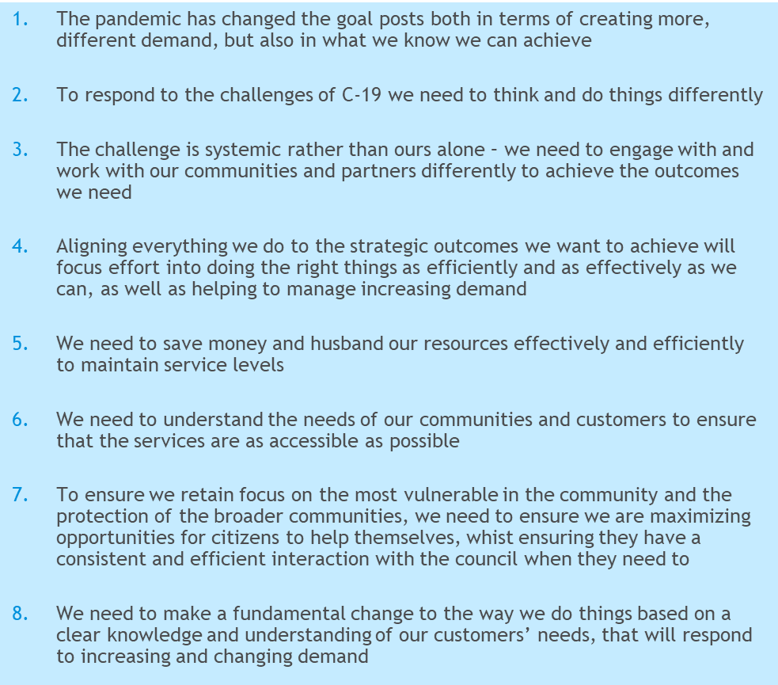
The drivers for change
Financial uncertainty – need to bridge the 21/22 gap and create headroom for future years - £1m+ problem to solve – more if elements of Council Plan are unfunded?
Major programme to deliver – The Council Plan
Opportunity to respond to the challenges & impact of C-19 - do things differently
Future Operating Model
(FOM)

Slide 4
Design principles for the Future Operating Model (FOM)
Establish line of site to strategic outcomes
Delivery in Partnership
Proactively Manage Demand
Efficient and Effective Ways of Working
Digital Delivery
Customer Focussed
Empowering People

Slide 5
Pre-Launch Activity T- 6months!
Jul
Sep
Oct
Nov
Dec
Jan
Purpose
High level opportunity assessment
High FOM design and business case for implementation
Transition to implementation
Mobilise
Activity
Benchmarking
Activity analysis
Maturity assessment against benefit drivers
Historical/post c-19 learning reviews with EMT and SLT
Case for change, design principle development with EMT
Review sessions with service heads – initial assessment, research, challenge session with EMT
Development of FOM ‘big ideas’ with EMT
Business case development
Implementation options
Case for change
Draft design principles
Initial opportunity assessment:
Commercial
Efficiency
Operating model
Strategic reduction
Long list of refined opportunities (90+) agreed with portfolio leads
Initial high level design for FOM – the ‘big ideas’
Initial business case
Implementation approach
Outputs

Slide 6
Basic building blocks of the FOM
Self serve and empowerment
Enables customer delivery
Rapid initial response & signposting
Customer
Efficient transactions
Self serve and empowerment
Internal Support
Effective casework & use of specialists for most complex cases
Community
Strategy
Mobile & multi-functional working
Commissioning and funding
Research and Data for decision making
Connection into community
Strategy, Performance & Governance
Enabling & demand management

Slide 7
Core activity elements of the FOM
The big ideas
Strategy
Leadership
Single strategic brain
Strategy and policy
Performance and governance
Programme management
Customer & Community
Initial customer contact – broad & deep, deal with most queries at first point of contact
Digital by default
Transactional and rules based cases - script and processes require definition
One Front Door
Mobile/multi function team working – enforcement, visible, multi-skilled ambassadors
Specialists only to concentrate on complex case management
Mobile/ Multi function teams
Community delivery units e.g. markets/town centre/community safety
Commercial delivery
Commercial delivery units e.g. Pest Control/MOTs/J2
Internal Support Services
Self Serve
Initial customer contact and transactional/ rules based cases
Adding value
Specialist advice and complex casework
Business partnering
Internal delivery units e.g. Assets/FM

Slide 8
Approach to implementation
Thematic focus for the FOM; starts with the high level design and then takes what is coming as requirements from below and tests and iterates ideas and designs. Also takes top-down systematic approach to considering and implementing operating model change
Big operating model building blocks
Leadership and management
IAG and website
One Front Door
Internal Support
Mobile/ multi-functional
Strategic brain etc
Decisions can be made as we go about whether benefits can be realised, and design can be delivered in an agile, service-by-service way, or by bigger single changes
New operating model
But the approach to this will have an impact on benefits delivery and realisation…
Incremental changes and specific improvements
Discovery – service based/customer focused
Implementation
Scrum Zero - data discovery
Service Scrums (Design)
High volume/key processes
Service Scrums (Design) - remainder
Implementation Scrums – as per backlog
Agile and iterative delivery – scrum approach (incl. customer journeys): keeps momentum; builds operating model from the bottom up; will enable movement towards a target operating model

Slide 9
Baseline and Data Management
Data Discovery
Where do we want to be – what is the art of the possible?
What does success look like?
What did we achieve?
Take / reinvest the savings
Can be units of time, contract spend, reduced demand, removal of duplication
Notes:
We explored key customer journeys and mapped contact points, data, hours spent, processes etc. through this process we identified the journeys from which we could release most benefit and addressed these first.

Slide 10
MISSION (developed in focus groups): We meet the needs of our communities by empowering and enabling our people to deliver on shared goals VALUES (developed in focus groups): Empowering and enabling our staff Performing Well and Getting things Done Working Together BEHAVIOURS (developed through staff survey): Positive and Negative indicators (what we will and won’t do)
“Culture Eats Strategy for Breakfast” Peter Drucker

Slide 11
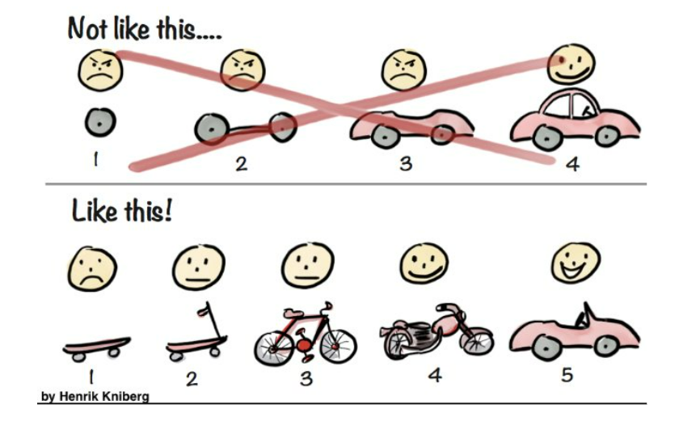
Agile Methodology

Slide 12
Outcomes
Customer Hub dealing with a wider and deeper variety of customer transactions
24% reduction in incoming phone calls (2022-23) (1627 hours worth of calls)
28% increase in sign ups to our citizens account
Neighbourhood Delivery Team - growing in capacity
6% reduction in overall budget (savings of £1m recurring)
Cultural Development and annual improvement in staff survey outcomes
Ownership and Buy in

