Slide 1

Members’ Local Plans Briefing Pack:
‘Legacy’ and New Plans System
March 2026
Notes:
Welcome - hello
Please find your name and delegate pack
Introduce the four
We will get to know you better if you say your name
Quick hand ups - who wasn't a councillor before the local elections in may last year, who wasn't on the council, who wasn't on committee - ok who has more than 3yrs experience on committee (you've just identified yourself as the yoda/fountain of all knowledge of the sessions)

Slide 2
Local Plans: An Overview

Slide 3
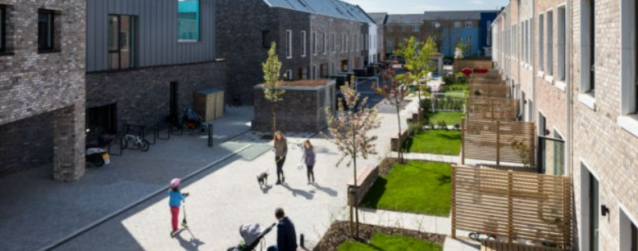
Local Plans - the what, why and how’s
Sets a vision for your place and the strategy for getting there
Strategic policies, including plan for housing delivery
It’s not just about housing: Jobs, Infrastructure, Climate, Environment, Health and wellbeing and Design and place-making
Can contain ‘development management’
policies and site allocations
Minimum 15-year horizon
Marmalade Lane, South Cambridgeshire

Slide 4
Planning in England is policy-led
Why make a Local Plan?
It’s a plan led-system
"The planning system should be genuinely plan-led. Succinct and up-to-date plans should provide a positive vision for the future of each area; a framework for meeting housing needs and addressing other economic, social and environmental priorities; and a platform for local people to shape their surroundings." NPPF 2024
At the heart of the National Planning Policy Framework is a presumption in favour of sustainable development.

Slide 5
Legislation/policy/guidance
Town & Country Planning Act 1990
Planning & Compulsory Purchase Act 2004
Levelling Up and Regeneration Act
National Planning Policy Framework (NPPF)
Planning Policy Guidance (PPG)
Localism Act 2011 (Duty to Cooperate, Neighbourhood Plans)
Self & Custom Build Act 2015
Environment Act
Planning and Infrastructure Act

Slide 6
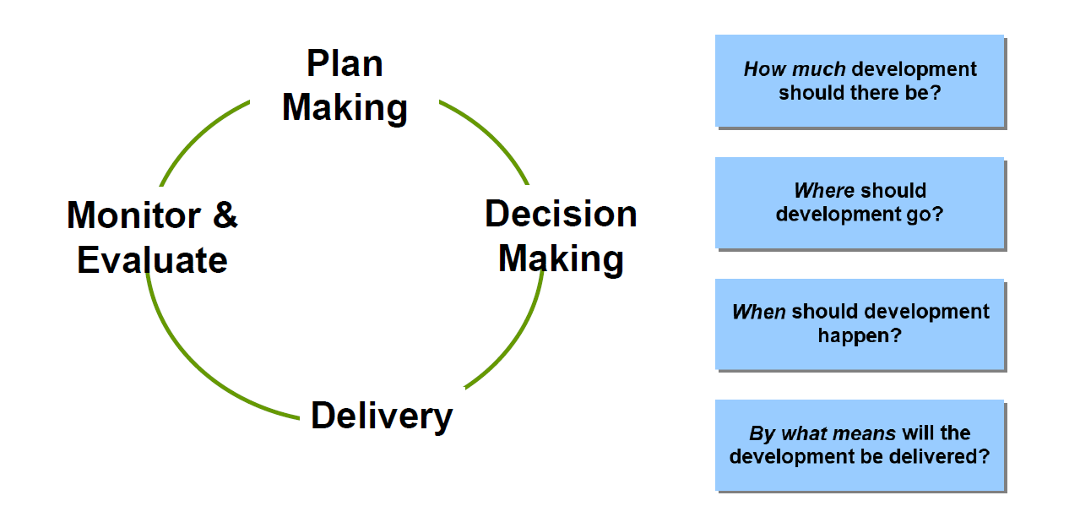
The Circle of Planning

Slide 7
Why do Councils need to plan?
Allows for an assessment of need
Demonstrates that needs have been met
Sets the framework for consistent decision making
Allows for meaningful engagement
Only plan that is independently examined
We have a plan-led system ….for this you need a plan

Slide 8
Local Plans: The ‘Legacy’ System

Slide 9
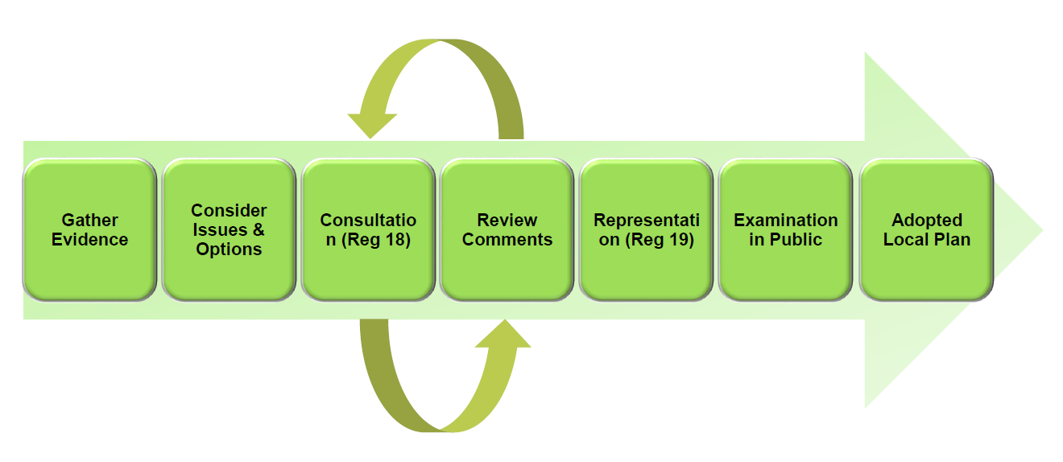
Local Plans: Stages of Plan-Making
1. Scoping/ Evidence collation | 5. Publish the Local Plan for comments (Reg 19)
2. Consult (Reg 18) – there can be multiple stages | 6. Submit the Local Plan for examination – based on ‘tests of soundness’ set out in the NPPF
3. Consider consultation responses | 7. Examination and Inspector’s Report
4. Prepare ‘submission’ Local Plan | 8. Adoption

Slide 10
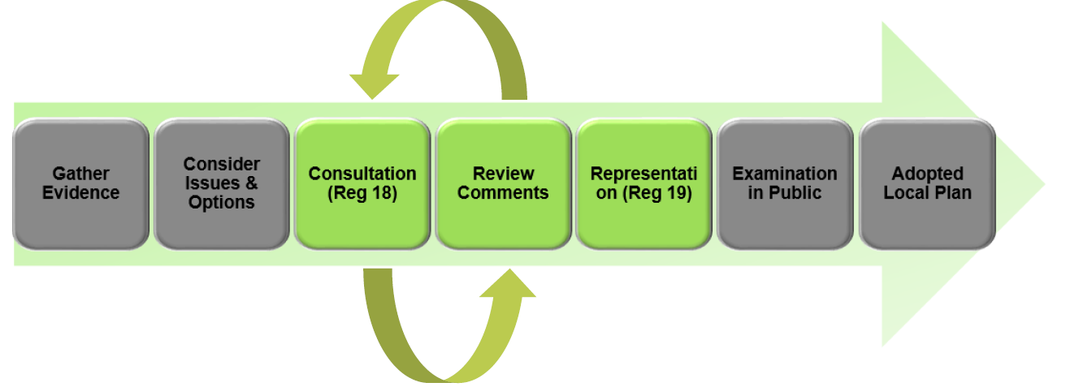
Consultation
Who to engage with?
Communities: community groups, parish councils, exhibitions
Neighbouring Planning Authorities: Statement of Common Ground, Duty to Cooperate
Regulatory agencies: The Environment Agency, English Heritage, Natural England
Physical infrastructure delivery agencies: highways authority, Highways England, utilities companies, Network Rail, public transport providers, airport operators
Social infrastructure delivery agencies: local authority education dept, social services, primary care trust, strategic health authority, the Police, charities/NGOs
Major landowners including the local authority itself and government departments and agencies
Housebuilders and other developers
Minerals and waste management industries
Consultation (Regulation 18) – Rinse and Repeat
The plan goes out to the public for consultation. Residents and stakeholders are invited to comment on the options/policies and/or submit land for consideration.
Review comments
The council reviews comments and after careful consideration of the comments received and how they shape the development of the plan, publishes the next stage of the Local Plan.

Slide 11
Consultation
What are the challenges to good consultation?
Ensuring early and constructive engagement with neighbouring councils
Involving ‘hard to reach’ groups
Too often tokenistic
Communities struggle to understand the local plan process and are late to the party
Usual Suspects / gatekeepers
Virtual = more inclusive future?
Good engagement is people and £££ heavy

Slide 12
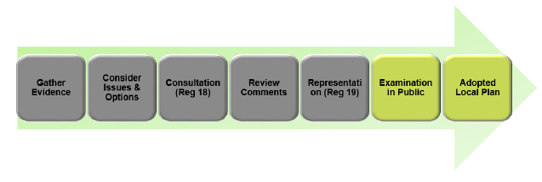
Examination & Adoption
Examination in public (EIP)
Planning Inspectorate
‘Public’ hearing
Often amendments – can mean more consultation
Tests of ‘Soundness’
Report –binary yes/no or withdraw

Slide 13
Local Plan Essentials:
A revised method
The ‘Standard Method’ for calculating housing need has changed too:
A target of 1.5 million new homes
Starting point a multiplier of 0.8% of existing housing stock, plus a revised affordability adjustment.
The modified NPPF removes the previous 40% cap on any uplift above the previously adopted local plan housing figure as well as the 35% uplift that applied to the 20 largest cities.
Applied nationally, the revised method equates to 371,541 dwellings a year, around 21% higher than the previous method. This figure excludes proposals for New Towns – further details for which are to follow.

Slide 14
Housing Numbers
Revised NPPF 2024:
  Standard method for calculating housing need: move to stock-based approach and mandatory starting point
  Bigger numbers where affordability is acute
  Many cities and urban areas saw a no change or a dip
  About 2/3 of councils have a proposed increase of 200dpa
  Incentives on 5-year Housing Land Supply removed
Get Britain building is a key economic growth driver
Notes:
LISA:
The 2024 revisions to the NPPF saw an amendment made to the Standard Method (SM) calculation, which is used for calculating the Local Housing Need (LHN) of an area
It moved to a stock-based approach rather than relying on projected household growth, with a mandatory starting point
This resulted in much larger LHN numbers for the majority of councils
However, many cities and urban areas saw either no change in their housing need, or experienced a dip
Around 2/3s of councils have a proposed increase of 200 dwelling per annum
The 2024 revisions also re-established the requirement for all local planning authorities, regardless of local plan status, to continually demonstrate 5 years of specific, deliverable sites for housing - removing the incentive to demonstrate a 5YHLS. (To remind you, the previous iteration of the NPPF stated that where a local planning authority had an up-to-date plan which met certain criteria, it was exempt from having to continually demonstrate a 5-year housing land supply while that plan remained up-to-date. And where authorities were in the late stages of plan making, they needed only demonstrate a 4-year housing land supply.)

Slide 15
Overview of the standard method
Baseline number of homes (Per annum)
Affordability adjustment
Local housing need
Using an affordability ratio based on median house prices and intermediate workplace earnings in your area plus a multiplier
Unconstrained assessment of demand
Calculated as 0.8% of existing housing stock
Notes:
LISA:
If we dig a little deeper into the detail of some of the key changes to the standard method calculation, these include:
At step 1 – a Baseline Shift to Housing Stock (Step 1): The starting point is now calculated as 0.8% of the existing housing stock in the local authority, rather than relying on outdated 2014-based projections for household growth.
At step 2 – the use of an Enhanced Affordability Multiplier (Step 2): The affordability adjustment is strengthened, using a 5-year average of the median workplace-based affordability ratio (instead of the single most recent year).
The Mandatory Nature of the calculation Reinstated: The standard method is now a mandatory starting point, removing the previous wording that made it only an "advisory" starting point
Also...
Increased Uplift Formula: For every 1% the affordability ratio is above 5, the baseline is increased by 0.95% (a sharp increase from the previous 0.25% factor).
Removal of Caps and Urban Uplifts: The new method removes the 40% cap on increases that existed in the old method, along with the 35% "urban uplift" previously applied to the 20 largest cities.
Housing and economic needs assessment - GOV.UK

Slide 16
Housing need Vs Housing requirement
Housing Need = Number of homes required to meet the demand in a specific area, based on the standard method for calculating local housing need. Housing need is a technical calculation designed to provide a baseline figure which does not take into account local constraints or other relevant considerations.
Housing Requirement = Number of homes an LPA plans to deliver through its Local Plan. This figure considers the housing need but where evidence is robust and justified the housing need can be adjusted based on local constraints. The housing requirement is a policy-driven figure that reflects what can realistically be delivered, balancing housing need with local constraints and sustainability objectives.
Unconstrained assessment of demand
  Deliverable target set through local planning processes.
Notes:
LISA:
Lets re-cap on the definitions of a couple of commonly-used terms: (read slide)
Housing Need = Number of homes required to meet the demand in a specific area, based on the standard method for calculating local housing need. Housing need is a technical calculation designed to provide a baseline figure which does not take into account local constraints or other relevant considerations.
Housing Requirement = Number of homes an LPA plans to deliver through its Local Plan. This figure considers the housing need but where evidence is robust and justified the housing need can be adjusted based on local constraints. The housing requirement is a policy-driven figure that reflects what can realistically be delivered, balancing housing need with local constraints and sustainability objectives.

Slide 17
New System Local Plans

Slide 18
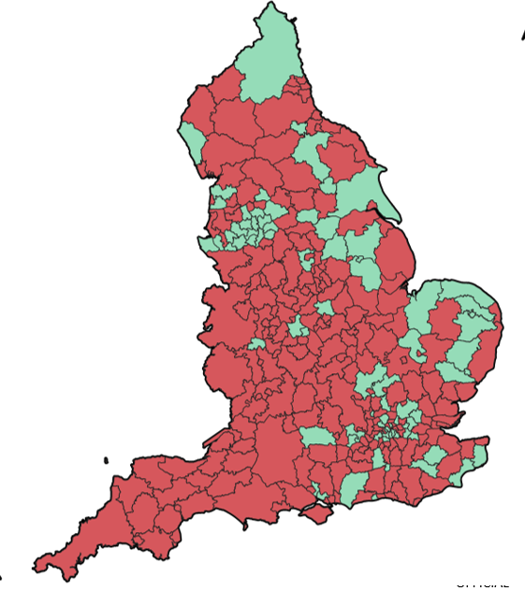
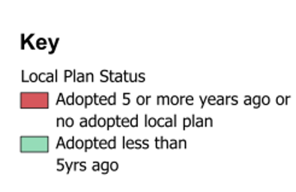
New System Local Plans
Focus on ‘speeding up’, ‘streamlining’, ‘modernising’
Development focus: infrastructure, housing - ambitious
The system: targets, performance, ‘removing blockers’
Updated National Planning Policy Framework (NPPF) – bigger housing numbers
Local Plan = control. Less than half of councils have up to date local plans. Impact on decision making?
More and more Ministerial interventions (Spelthorne, South Tyneside, Stockport, Solihull, Bucks)
Planning reform – speeding things up, simplifying, easier to keep up-to-date, responsive
So, big push to get local plan up-to-date.
Notes:
LISA:
A lot of change has happened in the planning policy world, and lately it all seems to be happening all at once!
The focus of the latest local plan-making policy reforms have been to speed up, streamline and modernise the whole process.
Some councils have been caught in the NPPF 2024 'transitional arrangements', meaning...
those who LPs were submitted for examination on or before 12 March 2025 (but the document was not adopted or approved on or before this date); and
Where the Plan met less than 80 per cent of local housing need; and
the plan as submitted did not relate to an area in which there was an operative Spatial Development Strategy (SDS)
… must publish their notice of intention to commence plan-making by 30 June 2026 and publish their Gateway 1 self-assessment by 31 October 2026
Essentially, the likelihood is that they'll be in the examination process for their emerging plan, whilst also commencing a new LP within the new system. It's where the 2 systems intertwine.
As we've discussed - the Government is focused on growth, and so targets relating to infrastructure and housing developments are ambitious!
This is evidenced by the 2024 revisions to the NPPF which saw an increase in the LHN as a result of amendments to the Standard Method calculation.
The Government wishes to remove 'blockers' of growth – aiming to accelerate the delivery of 1.5 million homes by streamlining processes, reducing legal delays, and strengthening central intervention. One of the key changes to be implemented is the removal of the legal "Duty to Cooperate" to speed up adoption.
As was highlighted earlier, less than 30% of Local Plans are considered up-to-date. This has a significant impact on decision-making, not least the loss of control over the schemes being approved due to speculative applications being made by developers as a result of out-of-date policies and a likely lack of a 5-YHLS.
We're seeing more and more Ministerial interventions, which only serves to further evidence the ambitions of Government and the need to push to the progression of LPs.

Slide 19
Local Plans: Big Changes?
Stays the same
Changes or New Processes
30-Month Timetable: Local planning authorities must prepare and adopt new-style local plans within a strict 30-month timeframe.
Three-Gateway System: A new process involving three checkpoints for assessment:
  Gateway 1: Self-assessment of readiness.
  Gateway 2: Consultation on plan content and evidence.
  Gateway 3: Final check before examination.
Digital-First Approach
Abolition of 'Duty to Cooperate'
5-Year Review Cycle: Plans must be reviewed at least every 5 years to ensure they are up to date
Many elements remain the same – setting vision/strategy and allocating land to meet corporate objectives, undertaking public consultation, producing evidence and policies.
Notes:
LISA:
Despite the reforms, many elements of the plan-making process remain the same:
The need to set a vision and strategy;
The need to allocate land to meet corporate objectives;
The requirements to undertake public consultation; and
To produce evidence and policies to support the LP being produced.
However, some of the key changes include:
On average, LPs take 7 years to complete – from initial preparatory work and consultation, through to adoption. You're now required to reduce this to 30 months within the new system.
Within this 30-month period are strict checkpoints called 'Gateways'. There are 3 Gateways, each serving different purposes...
The first requires a self-assessment of the council's readiness to proceed into the 30-month plan-making process;
The second includes a consultation on plan content and evidence; and
The third is a final check before examination .
Other changes include:
Adopting a digital-first approach - replacing lengthy, PDF-based documents with interactive, map-based, and standardized digital content;
The abolition of the 'Duty to Co-operate' - this is no longer a formal legal requirement, but councils are encouraged to continue to collaborate with neighbouring authorities to ensure the 'soundness' of the plan; and
The necessity to review LPs every 5 years.

Slide 20
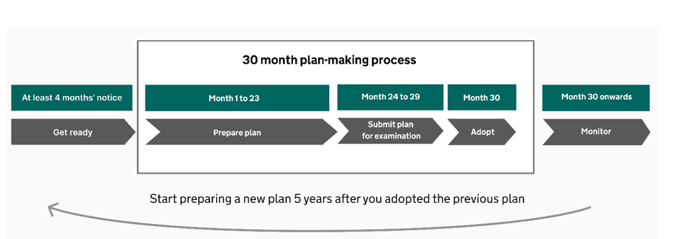
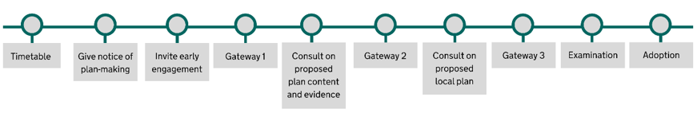
Stages of Plan-Making: 30-months
Notes:
LISA:
This new 30-month process includes:
"Get Ready" Period: Officers undertake any "Pre-start" work, including a 4-month notice period.
Months 1-23: Includes further preparation, evidence gathering, and consultations.
Months 24-29: Submission to the Planning Inspectorate and examination.
Months 30-31: Adoption of the plan
Despite this streamlined process, plans will be subject to independent examination and will still need to be found sound to be adopted.
The next slide, which has been prepared and is narrated by our fabulous Shelly, goes into greater detail on the process...

Slide 21
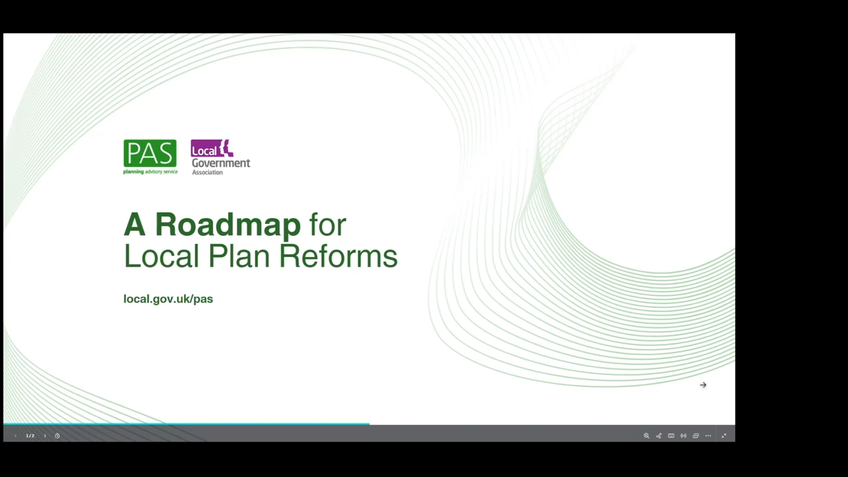
https://youtu.be/8C6-etv0wt8

Slide 22
The Importance of Local Plan-Making

Slide 23

Local Plans: Their Importance
Heart of the planning system
Decisions must be taken in line unless there are material consideration that suggest otherwise
Legal requirement to have a local plan and to keep it updated
Clear message from the government

Slide 24
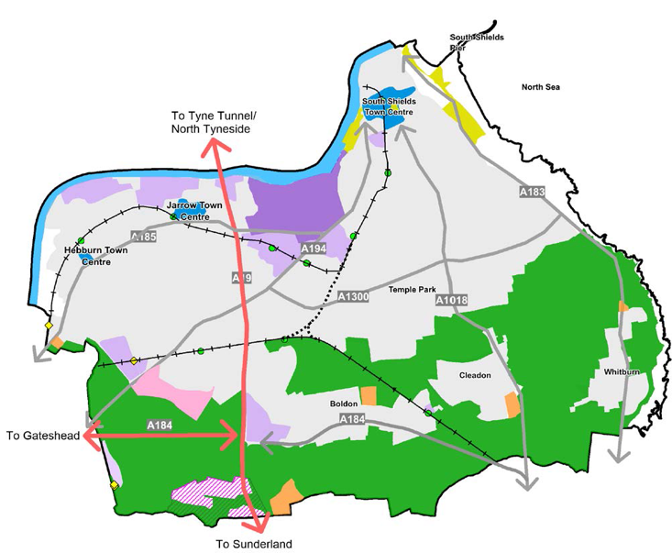
The Value of a Local Plan 1: Shape Development
A local plan is the single most important tool you have at your disposal to shape and influence the form development takes across your area – with impact beyond our lifetimes.
It allows you to:
Set the pattern for growth – growth/ development strategy
Set development and design parameters for specific sites (site allocations)
Plan more strategically for local infrastructure requirements – and flag infrastructure concerns upfront.

Slide 25
The Value of a Local Plan 2:
Deliver on Corporate Objectives
Income & Investment
Planning Strategy
Council Tax
Local Housing Need
Developer contributions
Business Rates
Town Centres
Transport
Grants, Funding
THE
LOCAL
PLAN
Commercial Income
Affordable Housing
Corporate Strategy
Infrastructure
Employment
Freeports
Climate Change
Open Space
Education, Schools
Biodiversity
Conservation
Regeneration
Health &
Wellbeing
Culture
… And more
Energy
Social Care
Retail
Transport
Environment health
Industry
Sport, Recreation
Notes:
Local plans are much more than just planning, there are broader corporate interactions and relationships [Diagram]

Slide 26

The Value of a Local Plan 3:
Transform places
The Local Plan can play an important role in unlocking and projecting place-based initiatives:
  Town Centre Improvements
  Estate renewal
  Protecting/ enhancing nature sites … or even bespoke tailoring establishments!

Slide 27
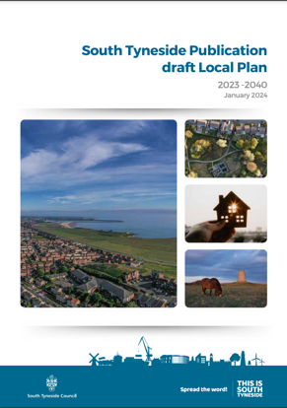
The Value of a Local Plan 4:
Meeting your community's needs for a home
Set out a strategy for meeting the housing needs of your community, including group-specific affordable housing requirements:
  Homes for an ageing population – including affordable homes
  Family homes
  Student housing
“There continues to be demand for affordable housing units across the borough. The SHMA found that there was a need for an additional 361 affordable units per year, which would include social / affordable units or intermediate tenure.” Regulation 19 Local Plan

Slide 28

The Value of a Local Plan 5:
Managing development impacts
Better manage cumulative development impacts:
  HMOs
  Night-time economy impacts
  Logistics and associated servicing for retail/ large scale commercial activity
© 2011 J. Ronald Lee.

Slide 29
No Local Plan:
Risk of inappropriate development
Not having a plan does not stop development, it just limits your ability to shape it and manage its impacts. Without a plan the balance is tilted away from local considerations and towards ‘sustainable development’ is prescribed in NPPF, July 2024 proposed changes state:
“…where there are no relevant development plan policies, or the policies for the supply of land⁸ which are most important for determining the application are out-of-date⁹, granting permission unless: (i) the application of policies in this Framework that protect areas or assets of particular importance provides a clear reason for refusing the development proposed⁷; (ii) or any adverse impacts of doing so would significantly and demonstrably outweigh the benefits, when assessed against the policies in this Framework taken as a whole, in particular those for the location and design of development (as set out in chapters 9 and 12) and for securing affordable homes.”

Slide 30
No Local Plan:
Risk of inappropriate development
In practice, the absence of a Local Plan, it makes it more difficult to defend against inappropriate ‘speculative’ development
It can also lead to ‘planning by appeal’ and increase risk of associated costs.
Here it is important to think about the potential cumulative impact of development too

Slide 31
No Local Plan:
Threat of intervention
“The Government is committed to taking tough action to ensure authorities have up-to-date local plans in place… Currently, decisions on intervention are made in line with relevant legal provisions and on the basis of intervention policy criteria set out in 2017 Housing White Paper… We are considering updating them to better align with Government’s priorities for planning to be a key driver for growth. We want future intervention action to be swift and proportionate; justified by the local circumstances. We want to ensure that the Secretary of State has the flexibility, in a range of possible scenarios, to ensure that communities around the country can benefit from the positive changes that local plans provide.”
Proposed reforms to the National Planning Policy Framework and other changes to the planning system Published 30 July 2024 (Chapter 10 – our emphasis)

Slide 32
Recent Interventions
South Tyneside Intervention letter
The rationale the Minister gave was “In light of the repeated failure of South Tyneside Council to vote to submit your Regulation 19 Local Plan to the Secretary of State for examination, I am writing to confirm that the Secretary of State is now directing it be submitted for examination.”
Stockport intervention letter
Minister stated the lack of meaningful progress such as over four years since Stockport withdrew from the preparation of the Greater Manchester Spatial and a failure to carry out a Regulation 18 consultation in line with an updated Local Development Scheme. The direction sets mandatory timescales for plan consultations and submission.
Spelthorne Intervention Letter
Previous Government intervened over concerns that Spelthorne Borough Council might withdraw the emerging local plan from examination. This was on the proposed intention to vote and the letter landed only a few hours before the meeting. (N.B the plan is now at main modifications consultation https://spelthornelocalplan.info/submission-of-local-plan/news-and-updates/)
Buckinghamshire
Minister stated there is no leeway within the current plan timetable for milestones to slip, or for additional consultations to be undertaken. The Council has not yet made any site allocations available to the public, nor has it published a number of key evidence base documents. Minister directed the council to implement a measurable timetable and commitment to Reg19 in July and submitting a plan by 31 December 2026.
Solihull
The council updated their LDS to show the plan would be produced in the new system because the council considered the SDS production would interact with plan production. Letter said 'We have been clear that the strategic planning reforms should not be used as an excuse to delay local plan progress in the current system and that local authorities are expected to work towards the adoption of an up-to-date local plan by December 2026.' The council had to justify the rationale to PINS and is now back in the current system.

