Slide 1
Digital transformation approach
Becoming a high performing organisation
Clare Evans – AD Transformation
Notes:
Hi everyone, I’m Clare Evans –it’s a pleasure to be here and to be presenting on this topic. This is actually my first day in my new role as director for digital and organisational change at Tewkesbury Borough Council, where I was previously AD for Transformation. So I’m really excited to share what we’ve been up to at Tewkesbury, but – as we are currently developing a framework to become a high performing organisation, I’m really interested to hear how others approach transformation too.

Slide 2
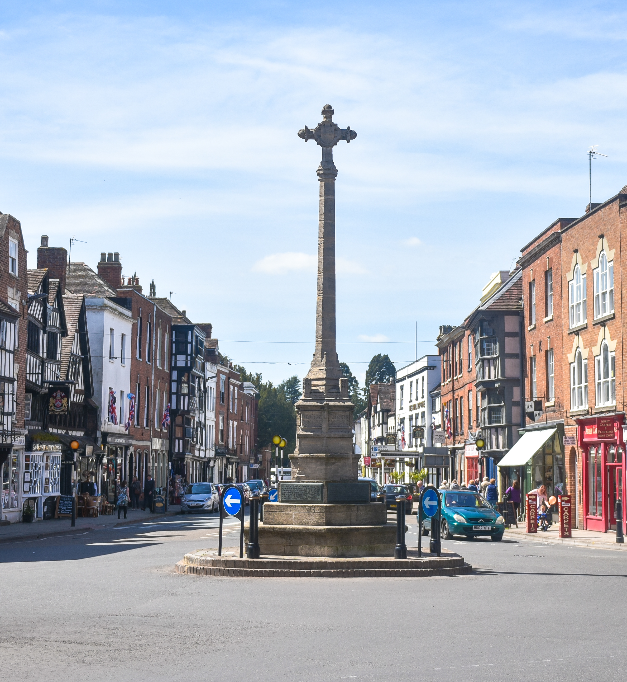
About Tewkesbury Borough
Gloucestershire district
Predominantly rural, spanning 160sq miles.
Small authority (ranked 257 of 309 English authorities)
Poorly funded – low council tax
Third fastest growing district in the country
New administration May ‘23
Notes:
Before I do go into detail on how we approach transformation, I thought it might be helpful to give a bit of background on the council itself – I know when I listen to presentations on transformation, I’m always keen to know how the council itself compares to Tewkesbury in terms of size, location etc.
Tewkesbury Borough is predominantly rural and located in the north of Gloucestershire but it also extends southwards beyond Gloucester and Cheltenham, and the eastern part lies in the Cotswolds AONB. We have a population of 94,000ish, with around 45,000 households spread across 160 square miles. We have an excellent strategic location, at the heart of the M5 corridor, and the borough includes a wide range of multi-nationals and microbusinesses. Because of our location, the borough is seeing significant growth. We are one of the fastest-growing borough’s outside of London, and so with that growth and amid the financial challenges we’re all facing, the council is becoming more innovative with how it can manage it all.
In May 2023 for the first time in a very long time – 16 years - we no longer have a Conservative majority leading the council and although there is no overall control we have the Lib Dems as the largest party and a new Lib Dem leader and deputy leader, and we are in the process of developing a new Council Plan setting out the council’s priorities for the next four years.

Slide 3
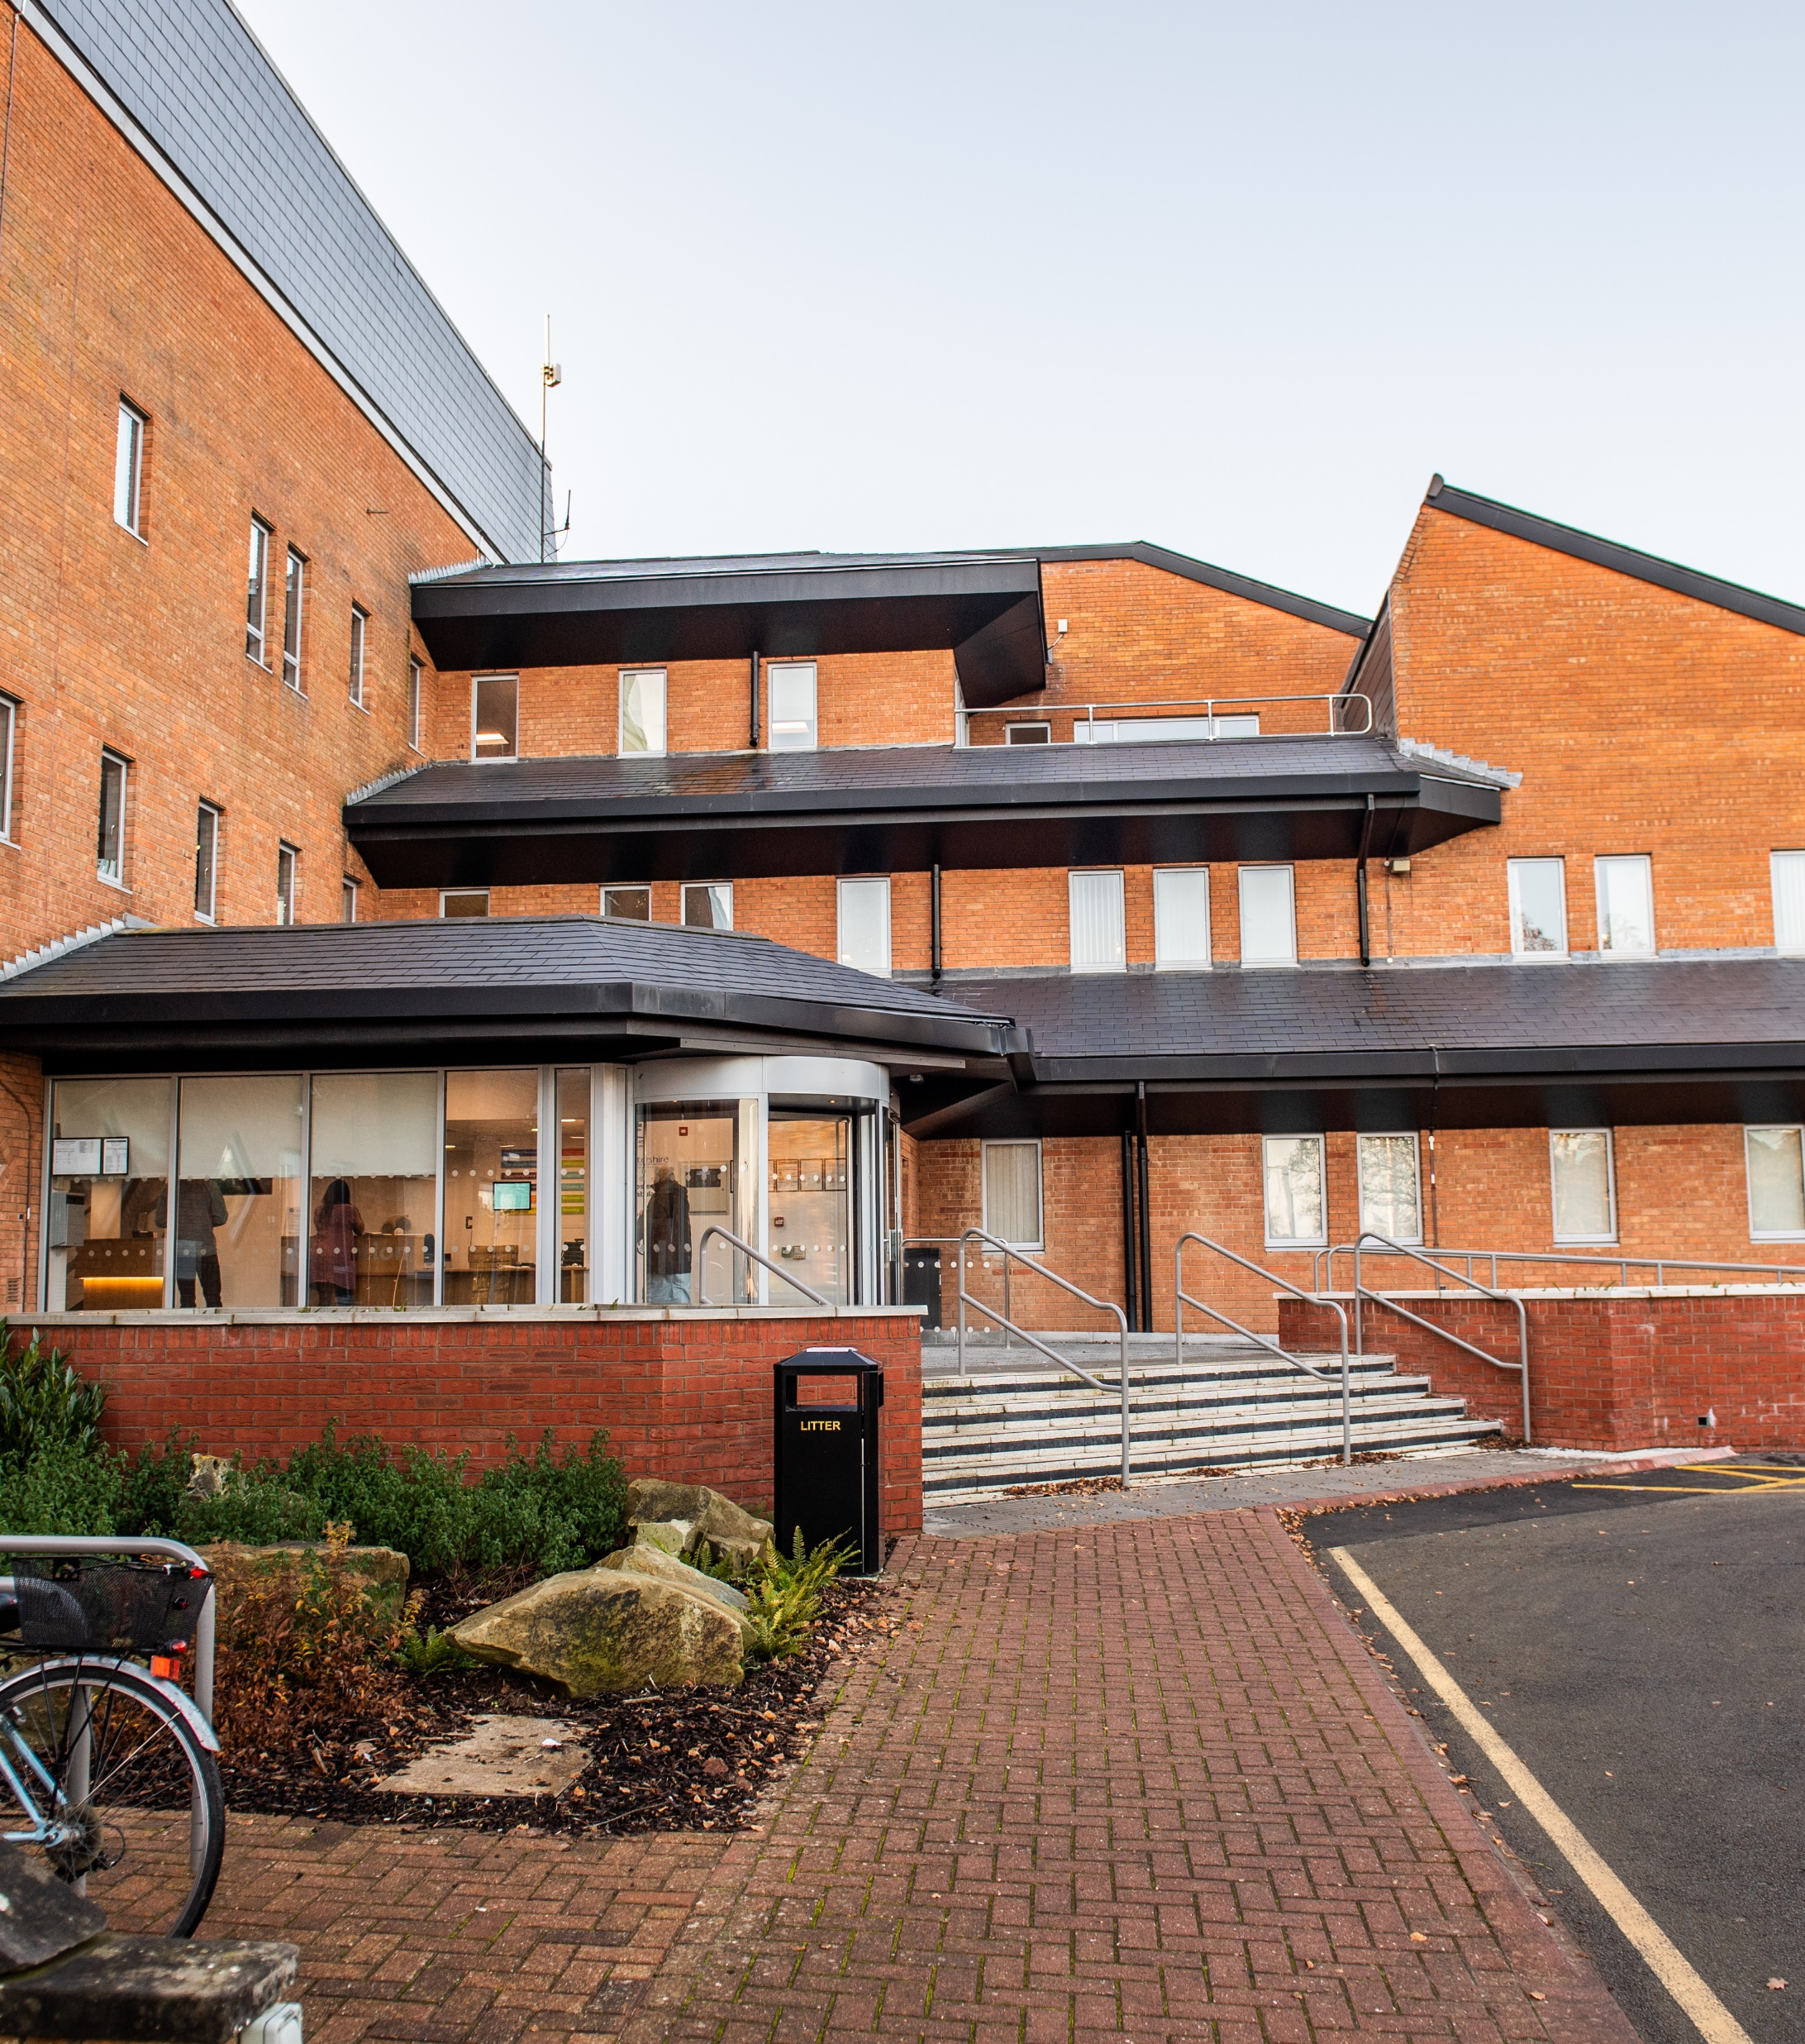
Transformation – where we’ve come from
Prior to 2020: ​
Lots of improvement and efficiency projects – no resource to deliver.
Single developer!
​
- Creation of the business transformation team:
Bringing together unique skills including project management, business analysis, front-end design and developers. ​
Customer-led not technology -led. ​
User experience a priority
Empowered team supported by senior leadership and members.
Big impact across the organisation
Notes:
So transformation at Tewkesbury has accelerated since 2020. Prior to that, it’s fair to say that the council didn’t have an identified approach to transformation – there were some great things happening across the council but what we started to find was that as we looked at each improvement project that was in the pipeline across the council, we simply didn’t have the resource to deliver or the corporate oversight in respect of what the drivers and outcomes should be. We had no transformation framework, but an increasing pressure to deliver services differently to meet customer need and expectation and to create savings and efficiencies.
In 2019 we took the decision to invest in a single team to drive forward our improvement projects, with a particular focus on digital transformation. We purposefully split IT and digital so that digital could truly focus on the customer and business requirements – reflecting the importance we place on user experience - and IT on infrastructure and security.
The transformation team went live in 2020 and brought together unique skills and experience including project management, business analysts, front end designers and developers – with a clear focus to deliver transformation across the council, and meet our customers’ expectation in service delivery.
The progress, impact and flexibility that having an in-house team focussed on transformation has been amazing. The team is empowered and trusted to make important decisions on service delivery – they question why things are being done in a certain way and encourage trying new technologies. Members recognised the impact the team was having early on, and further invested - enabling the team to become more resilient and deliver projects at a faster pace. As the team grew from five to 13, its scope grew - in addition to digital transformation, the team now provides GIS specialist support and critical project management support to other service areas within the organisation (including a major garden communities programme) and plays a fundamental role in driving an organisational-wide culture shift towards ‘digital by preference’ for service design and delivery.
The team has a strong identity, and places importance on being friendly, approachable and curious – these things might not sound worthy of mentioning but they go a huge way in bringing people along with the change they’re implementing. Engagement is a priority for the team – and it issues regular newsletters and briefings on what it’s working on and why.

Slide 4
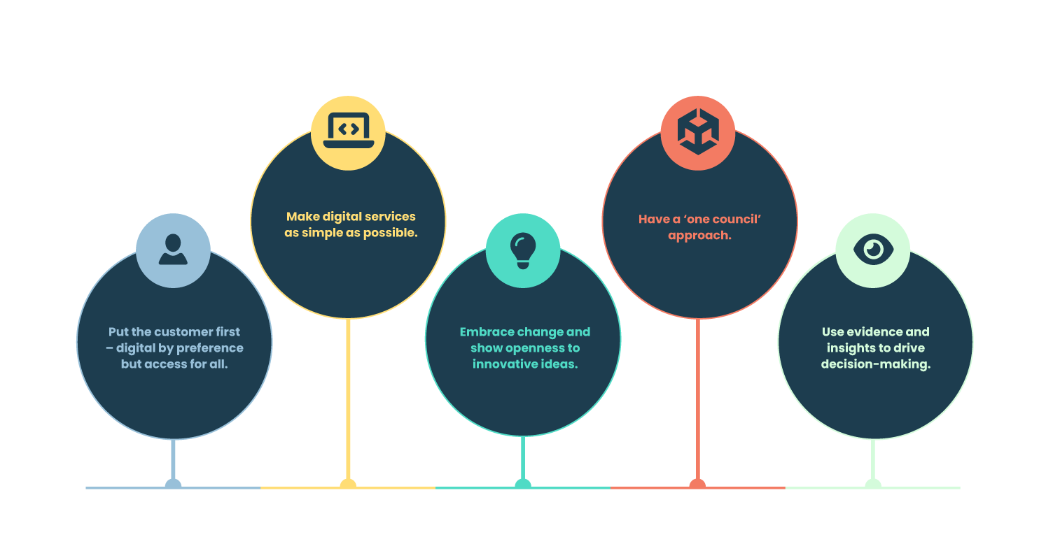
Digital declaration principles
Notes:
When setting out as a transformation team, it was important for buy-in that we could easily explain what sits at the centre of our approach to the projects we work on. So we developed the set of principles you can see on the screen, reflecting the ambitions within the Local Digital Declaration:
1. Put the customer first – digital by preference but access for all.
2. Make digital services as simple as possible – we want our service delivery online to be really enjoyable for everyone, no matter how digitally skilled.
3. Embrace change and show openness to innovative ideas
4. Have a ‘one council’ approach so that we are all pulling in the same direction.
5. Use evidence and insights to drive our decision-making – looking at data to understand what current demand the service has and why.

Slide 5
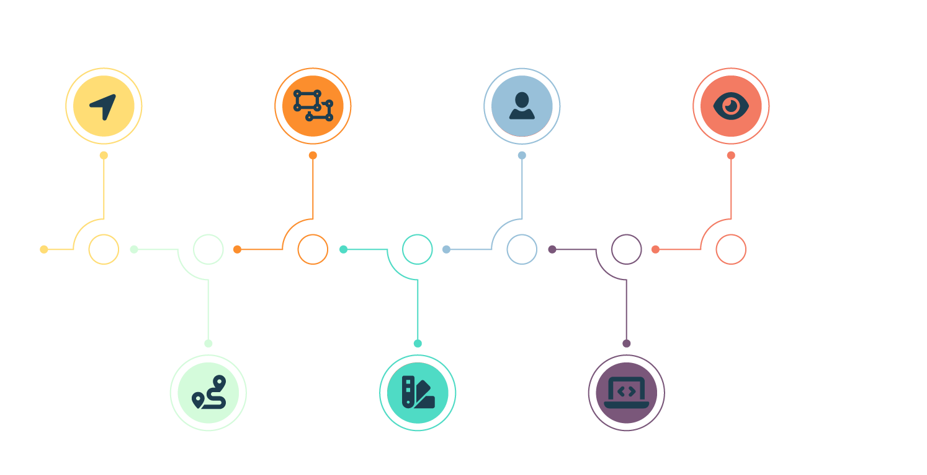
Operating model
Notes:
Now, this session is focussed around operating models – and truth be told, I do think that the term operating model probably means different things to different people – but for us at Tewkesbury, we do have a tried and tested way of delivering our service, or operating if you will!
Strategic direction: So our transformation priorities are identified largely through the Council Plan and service plans – the team works together to produce a six-monthly programme of deliverables, which is signed off at chief officer level. We quickly realised that the nature of the team and what it is delivering means that priorities can change unexpectedly, which is why we work to a six-month plan with longer-term projects in our pipeline plan.
Design: The service design drivers are naturally rooted in efficiencies and streamlining our processes – both of which are being achieved. But a further significant benefit is around shaping our services to meet the needs of our users to significantly enhance their experience with Tewkesbury Borough Council. The team uses an agile approach to programme management, and at the beginning of each project, the requirements are categorised using the MoSCoW prioritisation technique, which compliments the team’s agile way of working and ensures the systems launch on time.
Tools: Supporting our corporate approach to transformation is our digital platform, and I just wanted to mention this today because it really has been the foundation for us to be able to deliver change at speed. Our developers can build very quickly thanks to low code technology that doesn’t require coding skills. It means our long list of digital transformation projects isn’t overwhelming – and we can manage both smaller projects and end-to-end service reviews at the same time. Perhaps it’s a benefit of being a small council but we keep the technical building on our digital platform within the team - it means we can strongly stick to our ethos of user-centred service design because it is being delivered by the central team who live and breathe that approach. As a team, we are quite determined to move away from traditional online local government services, and we feel to do that then the user experience needs to be as slick as possible – and so the platform’s option to add in custom code to further improve the customer experience is something we use a lot.
Buy-in: As part of our user-centred and agile approach, we emphasise the importance of the buy-in from services across the council. Without the input of our service specialists, our online services will fail to meet the needs of its users - both from a customer point of view as well as an officer and process perspective. Our Business Transformation Team’s approach is to engage fully with everyone it works with, communicating regularly and getting clarity early on in terms of expectation and results.
Launch: The launch aspect of working in an agile way has probably been the most challenging to get buy-in with. Services are used to traditional ways of managing projects, with no mention of minimal viable products or continuous improvement – and so there has been a lot of learning along the way about the huge benefits of launching a service or product that can be improved with user feedback on an ongoing basis.
Review: And finally, review – iterative development and using feedback from users and customers to keep making our launched services better. We are slowly phasing out the idea that once something is launched, it doesn’t need looking at again!

Slide 6
What results have we seen so far?
Reduction in
unnecessary
customer contact
Increased income
Transformed
customer experience
Time savings
in producing
performance reports
Knocking out ad-hoc
software and reducing
reliance on the
legacy systems
Notes:
As I’ve touched on, this approach is seeing great results. In two years, we have saved over 450 days of officer time, which equates to just under two years of working days and have saved more than half a million pounds. In addition, the team has successfully bid for more than half a million pounds in funding to support its approach and deliver better services for our residents and communities. The team is transforming our customers’ experience with us, reducing demand and avoiding it by launching innovative solutions earlier on in a customers’ journey. They are using automated communications to keep users updated on their important issues – be that planning, bins or council tax - so they don’t have to waste their time getting in touch with us for a status update. They are using live data to provide instant information to our teams on issues, and we are significantly reducing the need to rely on the big system providers who would previously charge us thousands of pounds a day to make simple changes to their platforms.

Slide 7
Some of our challenges
Working in an agile way
Recruitment
Demands on the team
Keeping up with the speed of tech growth
Notes:
I won’t go into detail on all of these – but let me be honest and say it hasn’t always been plain-sailing.
Recruitment has been hard – repeated adverts and increasing salaries to match the private sector and attract talent. We are currently looking a career pathways – alongside our other benefits - for our existing developers so that we can retain them. After difficulties recruiting developers, we have taken an approach of investing in junior roles with the intention of ‘growing our own’ and that’s working out well for us so far.
Another significant challenge is how we now manage the growing demands on the team vs the cost of resourcing it – we don’t want to end up the wrong end of the scale where we’ve invested so much into the team that reaping financial benefits as well as customer ones from it becomes impossible.

Slide 8
What’s next?
2024 – becoming a High Performing Organisation
Simplicity, good governance, data and insights, continuous improvement.
We want to get to a better position – avoiding demand and solving problems before they happen!
Notes:
Things never stay still! Our digital transformation operating model is working well, and it will continue to deliver with a significant number of projects in the pipeline. But we are looking at how we can use it to support the council’s ambition to become a high performing organisation.
As we develop our Council Plan, which sets out clear areas of focus for us to deliver meaningful outcomes for residents and communities, our High Performing Organisation programme will shape how we will deliver it.
We are in the early days of developing this but we will be looking closely at our customer engagement (listening to what they’re telling us and asking them for input), processes (which are often overcomplicated) and our data management – so that we can be really confident in ensuring our service delivery meets our residents’ needs or responds to demand in the most effective way.
Effectively, we want to get to a position whereby we have such impressive ways of managing and using data and customer insight that we are able to avoid demand, and offer more proactive solutions. A really good example of that is in our flooding response – using geospatial data to map river levels and properties, and provide the required support before the event hits

