Slide 1
An ageing population : a public health approach to challenges and opportunities for local government
Elaine Rashbrook, FFPH, MSc, National Lead for Older People

Slide 2
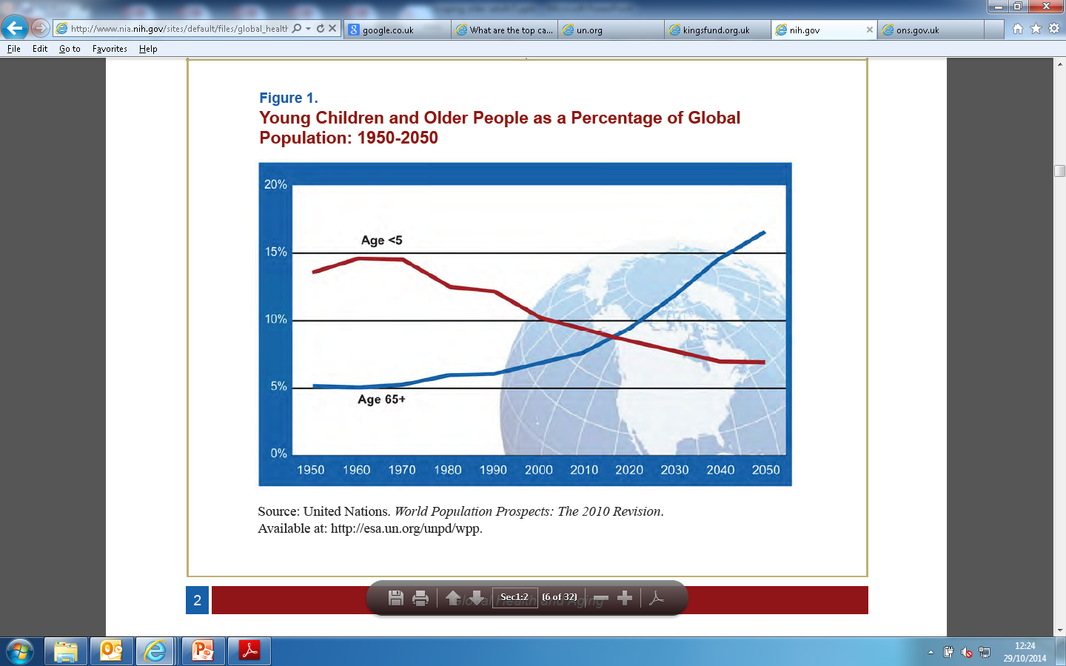
The global ageing population trajectory
The number of people today aged 60 and over has doubled since 1980.
The number of people aged 80 years will almost quadruple to 395 million between now and 2050.
Within the next five years, the number of adults aged 65 and over will outnumber children under the age of 5.
Between 2000 and 2050, the proportion of the world’s population over 60 years will double from about 11% to 22%.
Notes:
Since the beginning of recorded history, young children have outnumbered their elders. In about five years’ time, however, the number of people aged 65 or older will outnumber children under age 5.
Driven by falling fertility rates and remarkable increases in life expectancy, population aging will continue, even accelerate (Figure 1). The number of people aged 65 or older is projected to grow from an estimated 524 million in 2010 to nearly 1.5 billion in 2050, with most of the increase in developing countries.
The remarkable improvements in life expectancy over the past century were part of a shift in the leading causes of disease and death. At the dawn of the 20th century, the major health threats were infectious and parasitic diseases that most often claimed the lives of infants and children.
Currently, noncommunicable diseases that more commonly affect adults and older people impose the greatest burden on global health

Slide 3
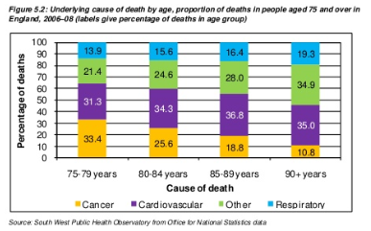
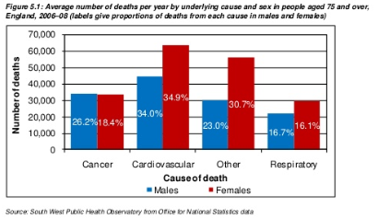
Mortality: Leading causes of death in Older Adults (65+)
There are differences in underlying causes of death in people aged 75+ depending on age.
The proportion of deaths from cancer decreases , and cardiovascular disease increases with increasing age,
The risk of dementia rises sharply with age so there will be a dramatic increase in the number of people with dementias as people live longer.
The largest cause of death for people aged over 75 is cardiovascular disease
There are differences between men and women in relation to underlying causes of death
Notes:
Europe eurosstat: buchow et al ref: http://epp.eurostat.ec.europa.eu/cache/ITY_OFFPUB/KS-SF-12-007/EN/KS-SF-12-007-EN.PDF
UK: http://www.ons.gov.uk/ons/dcp171778_331565.pdf (http://www.ons.gov.uk/ons/rel/vsob1/mortality-statistics--deaths-registered-in-england-and-wales--series-dr-/2012/sty-causes-of-death.html)
----------------
--------------------------------
Global epi: Main causes of death in in both male and female aged 60 and over (1990 -2010:
Older people generally die of noncommunicable diseases such as heart disease, cancer and diabetes, rather than from infectious and parasitic diseases. In addition, older people often have several health problems at the same time, such as diabetes and heart disease.
The number of people living with disability is increasing due to population ageing and because of the greater risk of chronic health problems in older age. For example, about 65% of all people who are visually impaired are aged 50 and older, with this age group comprising about 20% of the world’s population. With an increasing elderly population in many countries, more people will be at risk of age-related visual impairment.
Globally, many older people are at risk of maltreatment. Around 4-6% of older people in developed countries have experienced some form of maltreatment at home. Abusive acts in institutions include physically restraining patients, depriving them of dignity (by for instance leaving them in soiled clothes) and intentionally providing insufficient care (such as allowing them to develop pressure sores). The maltreatment of older people can lead to serious physical injuries and long-term psychological consequences.
Worldwide, there will be a dramatic increase in the number of people with dementias such as Alzheimer’s disease, as people live longer. The risk of dementia rises sharply with age with an estimated 25- 30% of people aged 85 or older having some degree of cognitive decline. Older people with dementia in low- and middle-income countries generally do not have access to the affordable long-term care their condition may warrant. Often their families do not often have publicly funded support to help with care at home.

Slide 4
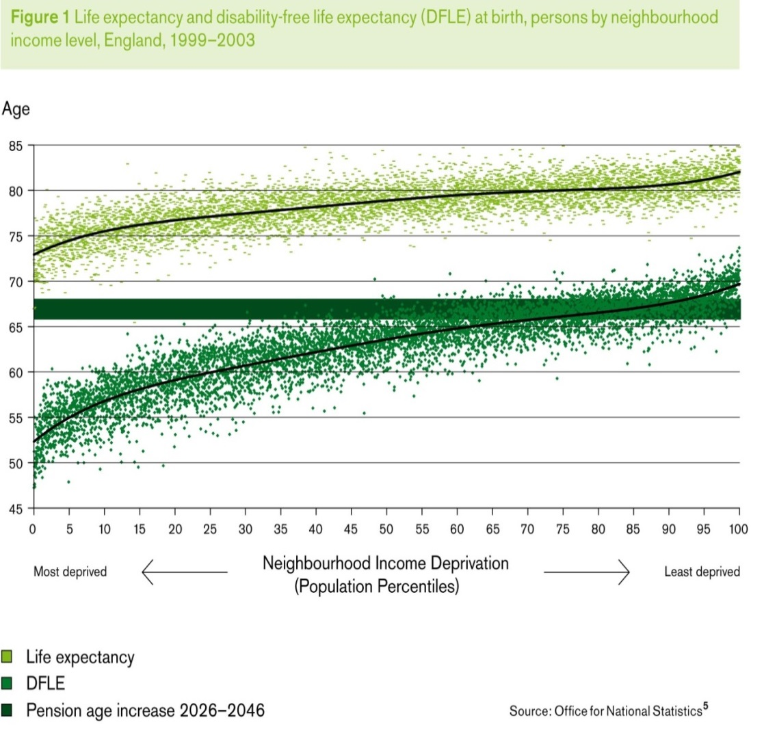
Many of our later years are troubled by ill health
Although life expectancy continues to increase, we are living longer with long-term & multiple conditions
An ageing population, with greater risk of chronic health problems, increases the number of people living with disability
Musculo-skeletal problems are the most common conditions to limit daily activities and are the largest single cause of years lived with disability.
The costs of ill health continue to rise, with impacts on the NHS and LA budgets and the wider economy

Slide 5
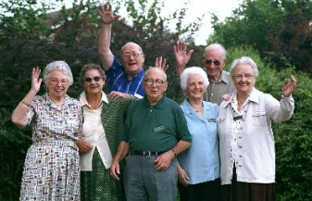
It’s about living well, not just living longer
An estimated 70% of new cases of depression in older people are related to poor physical health.
Four fifths of people over the age of 50 fear that they will develop dementia
Isolation is a particular risk factor for older people from minority ethnic groups, those in rural areas and for people older than 75 who may be widowed or live alone
      Giving people as much choice as possible about personal routines and activities increases self determination and independence
Social activities, social networks, keeping busy and ‘getting out and about’, good physical health and family contact are all frequently mentioned by older people as important to their mental wellbeing
Changes in society impacting on older people : in household composition; attitudes about obligations and responsibilities, women as carers. More older people living alone, with less opportunity to share resources : risk of isolation, depression.*
Notes:
Healthy, normally functioning older adults are at no greater risk for depression than younger adults. What seem to be age-related effects on depression are attributable to physical health problems and related disability.” Roberts et al http://www.ncbi.nlm.nih.gov/pubmed/9326820
Depression affects 1 in 5 older people living in the community and 2 in 5 living in care homes. This in turn impacts on economic circumstances and on ability to participate in society.
(Adults In Later Life with Mental Health Problems, Mental Health Foundation quoting Psychiatry in the Elderly, 3rd edition, Oxford University Press, 2002)
http://www.mentalhealth.org.uk/content/assets/PDF/publications/fundamental_facts_2007.pdf?view=Standard
Office of deputy prime minister 2006
Third sector First 2005; Audit Commission 2004)
NICE draft guidance: Occupational therapy and physical activity interventions to promote the mental wellbeing of older people in primary care and residential care, Oct 2008

Slide 6
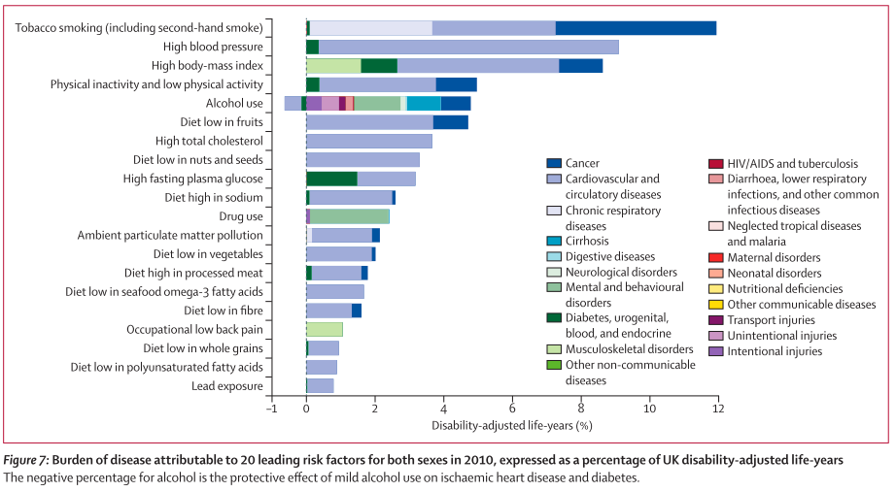
The major risk factors are clear
The way we live our lives has significant impact on our health. Good diet, exercise and healthy weight would see us living healthier lives
Notes:
Increased blood pressure alone accounted for 9·0% (7·5–10·5) and high body-mass index for 8·6% (7·4–9·8). These risk factors largely increase rates of cardiovascular diseases and cancers. However, the DALYs attributable to each of these risks cannot be simply added together, because some are mediated through each other— eg, fruit consumption has one of its primary effects through lowering blood pressure
More individuals are living into the period of life when prevalence of chronic disabling conditions is high; the increase in life expectancy at birth is greater than the increase in HALE (table 1), meaning more years are lived with disability.
Despite falling rates of tobacco-attributable burden for both men and women, the UK has a more advanced epidemic than most high-income nations; tobacco remains the leading risk factor in the UK in 2010.
Higher incidence rates could be related to factors such as housing and social inequalities; higher case fatality rates in the UK compared with other nations theoretically could be a factor, because lower respiratory outcomes are sensitive to the quality of care

Slide 7
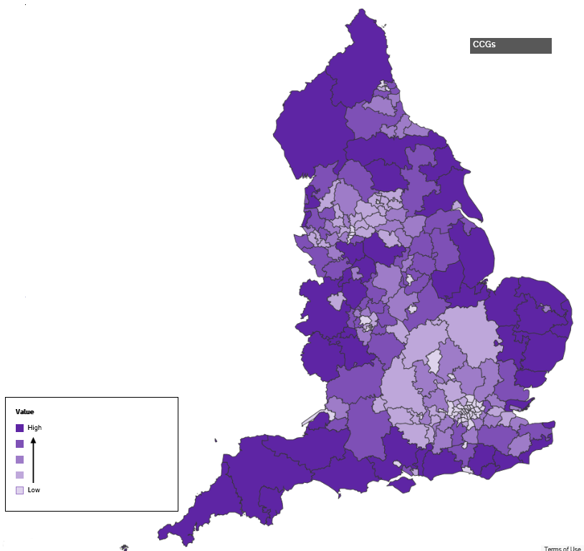
Variations in ageing
Rural and coastal areas have the highest percentage of older adults
Isolation is a particular risk factor for minority ethnic groups, those in rural areas and for people older than 75 who may be widowed or live alone
Life expectancy is increasing (82 W/ 78 M) , there are variations in healthy life expectancy*, lowest in Tower Hamlets (M. 52 years) and Manchester (W 55 years)
There is diversity in the health, social, and economic circumstances of older people

Slide 8
Tackling these issues requires an integrated approach to Public Health
Government
Local
authorities
NHS
Public Health
England
Notes:
The Health & Social Care Act 2012 introduced wholesale system change across health and social care
Key developments included:
Refocusing on public health and prevention
Localism
Focusing on outcomes not targets
Added value of PHE:
System Leadership: Work transparently, provide government, local government, the NHS, MPs, industry, public health professionals and the public with evidence-based professional, scientific and delivery expertise and advice
Protection: Ensure there are effective national and local arrangements for preparing, planning and responding to health protection concerns and emergencies, including the future impact of climate change
Local Support: Support local authorities and clinical commissioning groups by providing evidence and knowledge on local health needs, alongside practical and professional advice on what to do to improve health

Slide 9
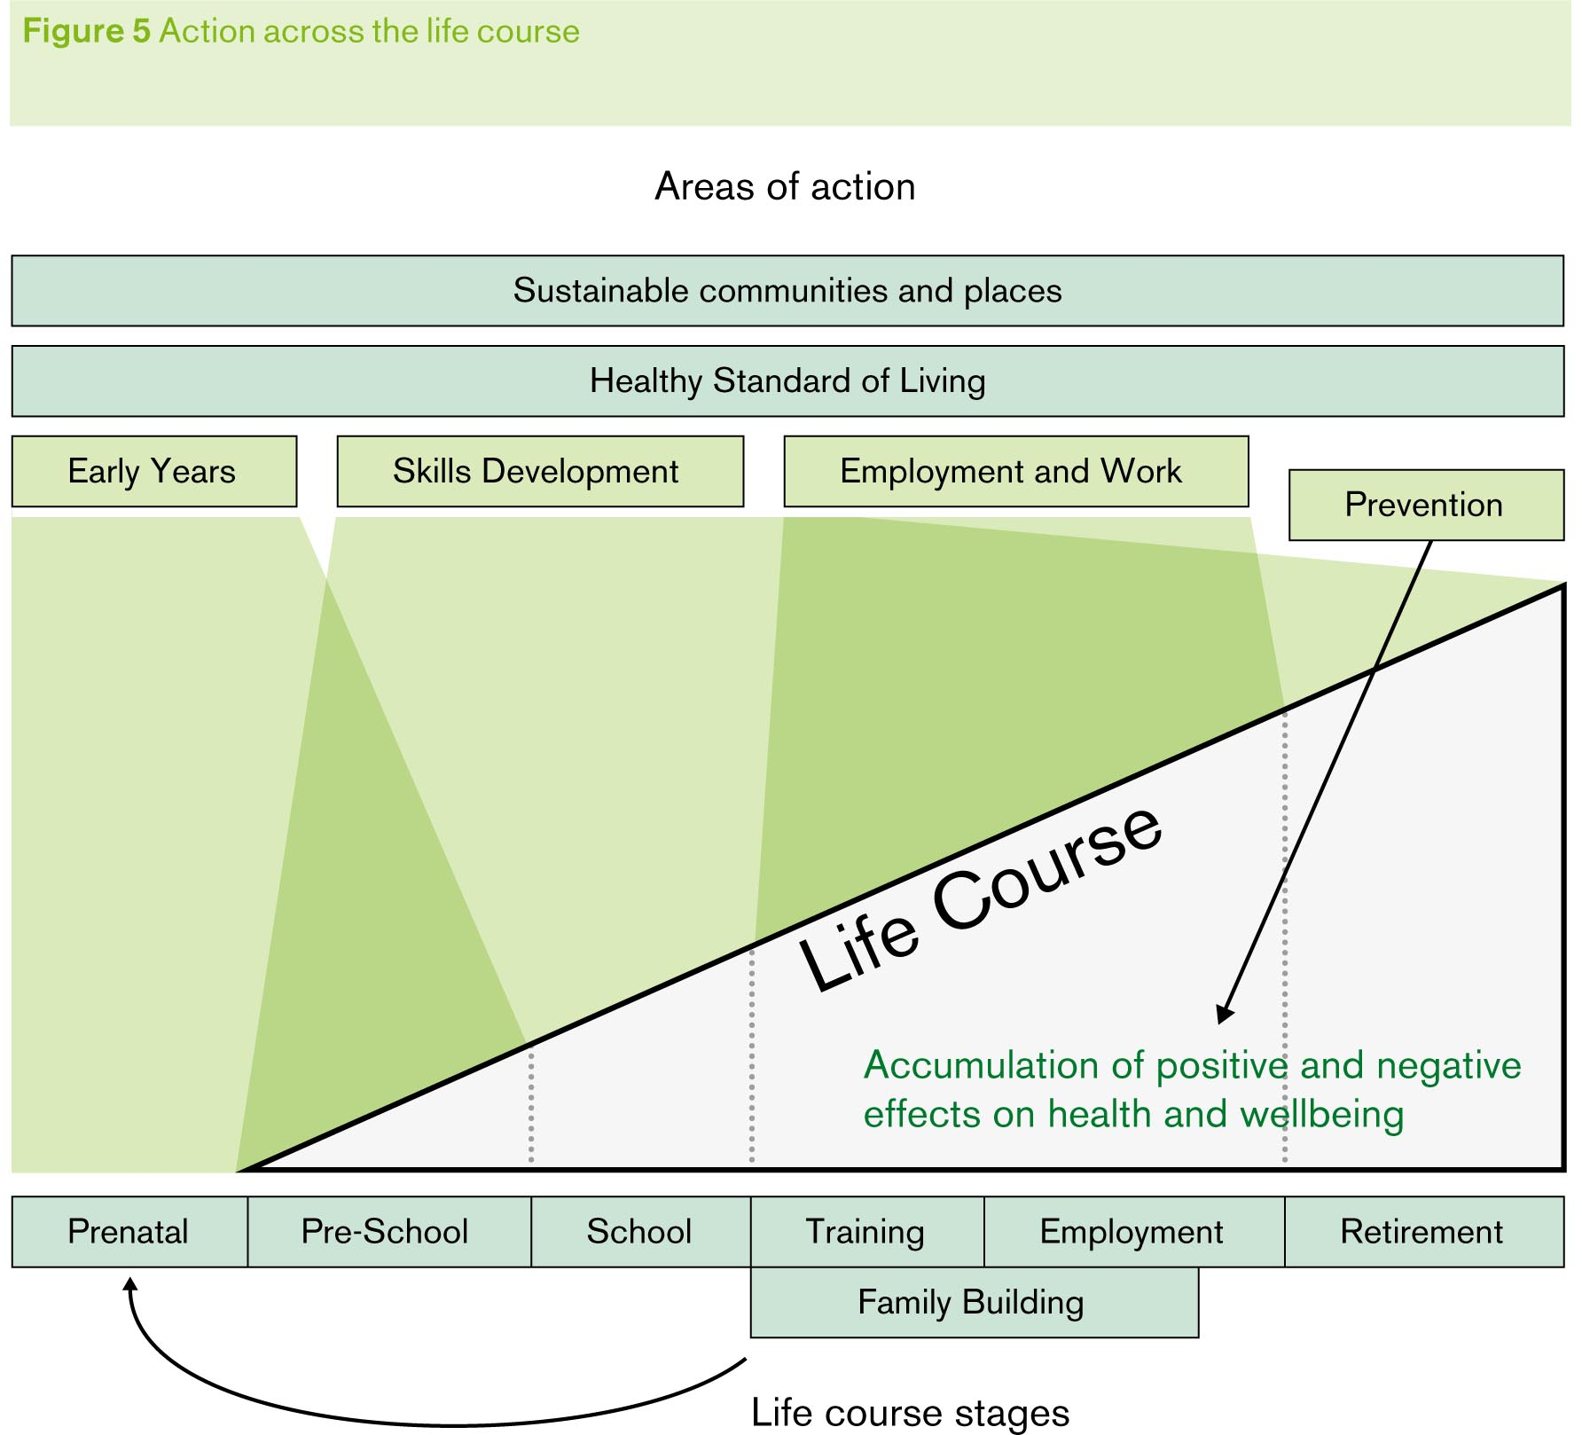
Adopting a life course approach
Strengthens the transition between adolescence and adulthood, and promotes mental well-being
Facilitates a wide perspective of action across the range of determinants rather than a narrow topic based approach
Ensures action is not concentrated on one age group only
Acknowledges that older people are not a homogenous group and age alone is not necessarily the determinant of health and wellbeing

Slide 10
Life course Conceptual Model
Children & Families
Young People
Working Age Adults
Older Adults
Schools
Workplaces
Outdoor spaces
Health and social care services
Built environment and transport
Notes:
This conceptual framework will form the basis of the framework and its development.
Essentially life stages overlaid with settings.
It attempts to encapsulate current thinking, including:
Need to focus on individuals and communities and how people live their lives – therefore need for cross-sector thinking and action
Importance of looking across the life course (from Marmot)

Slide 11
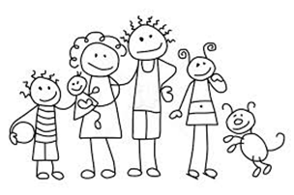
Healthy People, Healthy Places, Healthy Communities
Healthy People, Places and Communities
People, places and communities are key to framing our efforts in the way that people think about the structure of their lives: their own choices and behaviours as individuals, and the importance of their environments and of their communities.
Mental health and well being
Obesity
Smoking
Health and Work
Healthy People
We are not passive bystanders in the creation of our health. Our chances of good health are very largely shaped by the lifestyles we lead. But our lifestyles are, in turn, heavily shaped by the context and circumstances of our lives.
Dementia
Alcohol misuse
Diet
Physical Activity
NHS healthchecks
Children and young people
Blood pressure
Drug dependence
Sexual and reproductive health
HIV
Healthy Places
Healthy people need healthy environments. Consider our schools, our workplaces, our homes and our streets; these all help to create health.
Healthy communities
Communities create and protect our health by connecting us as individuals and by promoting certain norms of behavior. Communities have many assets that can be tapped to enhance people’s health.
Notes:
Collectively we can promote an environment that makes healthy choices easier through taking the right measures: a transport infrastructure that encourages active travel, access to affordable, healthy food, decent homes and safe neighbourhoods

Slide 12
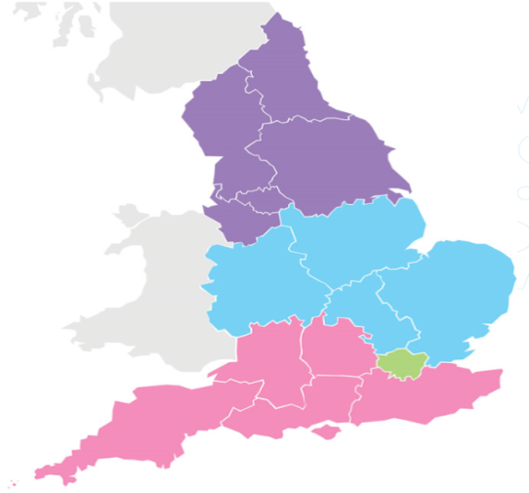

Opportunities – healthy people
Service organisation and delivery :
      Integrated approach to risk factors. Multiple risk factors in less advantaged areas
      Targeted intervention at times in life when substantial change occurs (e.g. retirement, children leave home, becoming a carer, menopause)
      Awareness raising & health promotion
      Use of Digital tools to promote behaviour change - capitalising on the opportunity afforded by today’s digital and mobile technology, eg assistive and wearable devices
      Everybody Active Every Day. Tailored advice for older people and carers in how to exercise safely for 30 minutes a day on 5 days each week or more, using examples of daily activities that would help achieve this (e.g. housework, gardening)
      Promotion of screening services available in the local area

Slide 13
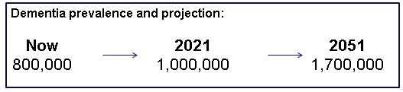
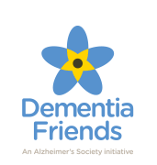
Dementia
Tackling dementia is our priority programme for the older adults agenda
With our partners, over the next 18 months PHE will:
Run a healthy living marketing campaign aimed at 40 to 60-year-olds
Develop a new personalised risk assessment calculator for incorporation into the NHS Health Check
Build dementia risk reduction into care and support for predisposing conditions
Raise awareness of inequalities in dementia,
Support people to receive a timely diagnosis and the care and support they need.
Develop measures for modelling of dementia incidence and prevalence, while continuing to build the evidence base for dementia risk reduction
Dementia costs the UK £26.3bn a year

Slide 14

Opportunities – healthy places
The workplace – keeping the workforce healthy
      LAs and public sector partners to lead by example as champions, also older workers champions
      Mid-life career review planning – including pension & financial planning
      Skill up the older workforce in the use of digital technology
      Tackling ageism in employment – employment models for working longer : recruit, retain, retrain
      Flexible working arrangements for those living with disability or carers
      Support older people with health conditions back to work
      Provide healthy lifestyles through
      information and support

Slide 15
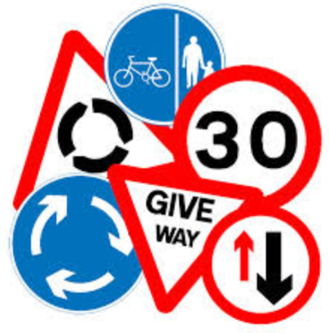
Opportunities – healthy places
City* and Town planning & road safety
      Safe & pleasant environments to encourage physical activity & prevention of falls (e.g. safe cycle paths, parks and green spaces), close to home
      Access to public toilets, and seating in public spaces : older people say these are crucial for social engagement
      Traffic management and highway schemes to make walking & cycling more attractive, traffic calming, (impacts on economy, health, crime rates)
      Small Economic investment for longer term gain: E.g. benches in each park
      Use of local policies and regulatory powers
      Extending smoke-free policies into wider range of public places (e.g. public parks, open air markets, sports grounds)
      Take local health needs and existing licenses into account when considering whether to grant a new alcohol license
      Measures to reduce or limit the number of fast food outlets

Slide 16
Opportunities – healthy places
Housing
Ensure that the home environment is considered in commissioning and delivering integrated services to support people to remain independent and safe in their own homes for as long as they choose
Tackle poor quality homes, including homes that are unsafe, in the private rented sector by offering a wide-ranging approach, including supporting self-regulation, empowering tenants and enforcement,
Target activity and advice to improve energy efficiency and affordable warmth of homes amongst vulnerable groups, also keeping homes cool in summer
Lifetime homes and ‘independent living’ – how to achieve better community mix of young and old

Slide 17

Opportunities – healthy communities
Reframe older people as an asset, not a drain (contribution to spending, caring and volunteering - £40 billion contribution)
Shift social norms: E.g. add update banners on buses with ‘walking time to next stop is 10 minutes ’
Use community capacity building approaches to strengthen social networks, build resilience and empower communities to tackle local health issues
Address loneliness and social isolation, through commissioning universal, multi-cultural social activities and preventive services throughout the life course, and at points of transition.
Promote volunteering opportunities that will improve residents’ quality of life and wellbeing and offer a return on investment for public services. Include sport, conservation, intergenerational and educational activities, or activities such as promoting physical and mental health as health champions, community navigators, peer educators.
Innovations
Supervised physical activities (e.g. walking schemes)
Dementia friendly communities
Incentivised volunteering schemes
Active citizens
Better Value Healthcare
Notes:
National Institute for Health and Care Excellence. PH9 Community engagement. London: National Institute for Health and Care Excellence; 2008.
O'Mara-Eves A, Brunton G, McDaid D, Oliver S, Kavanagh J, Jamal F, Matosevic T, Harden A, Thomas J. Community engagement to reduce inequalities in health: a systematic review, meta-analysis and economic analysis. Public Health Research 2013; 1(4).
Knapp M, Bauer A, Perkins M, Snell T. Building community capital in social care: Is there an economic case? Community Development Journal: An International Forum 2013; 48(3): 313-31.
Buck D, Gregory S. Improving the public's health: A resource for local authorities. London: The King's Fund; 2013.
UCL Institute of Health Equity. Review of social determinants and the health divide in the WHO European Region. Copenhagen: World Health Organization Regional Office for Europe; 2014.
Joseph Rowntree Foundation. Risk, trust and relationships. http://www.jrf.org.uk/work/workarea/risk-trust-relationships (accessed 19th August 2014).
Holt-Lunstad J, Smith TB, Layton JB. Social relationships and mortality risk: A meta-analytic review. PLoS Medicine 2010; 7(7): e1000316.
O'Donnell G, Deaton A, Durand M, Halpern D, Layard R.Wellbeing and policy. London: Legatum Institute; 2014.
Social Care Institute of Excellence (SCIE) Briefing 39 Preventing social isolation and loneliness: interventions and outcomes. 2011.
Joseph Rowntree Foundation. Neighbourhood approaches to loneliness. http://www.jrf.org.uk/topic/loneliness (accessed 19th August 2014).
O'Donnell G, Deaton A, Durand M, Halpern D, Layard R.Wellbeing and policy. London: Legatum Institute; 2014.
New Economics Foundation. Five ways to well-being. http://www.neweconomics.org/projects/entry/five-ways-to-well-being (accessed 01 July 2014).
Naylor C, Mundle C, Weaks L, Buck D. Volunteering in health and care: Securing a sustainable future. London: The King's Fund; 2013.
British Red Cross. Taking stock: Assessing the value of preventative support. London: The British Red Cross Society; 2012.
Hex N, Tatlock S. Altogether better social return on investment case studies. York: York Health Economics Consortium; 2011.
National Institute for Health and Care Excellence. PH9 Community engagement. London: National Institute for Health and Care Excellence; 2008
South J, Meah A, Bagnall AM, Kinsella K, Branney P, White J, et al. People in public health - a study of approaches to develop and support people in public health roles. London: Her Majesty's Stationery Office; 2010.
O'Mara-Eves A, Brunton G, McDaid D, Oliver S, Kavanagh J, Jamal F, et al. Community engagement to reduce inequalities in health: A systematic review, meta-analysis and economic analysis. Public Health Research 2013; 1(4).
Friedli L. Mental health, resilience and inequalities. Copenhagen: World Health Organization Regional Office for Europe; 2009.
Moore SG. Persistence of tubercle bacilli in butter from tuberculous milk. British Medical Journal 1926; 2: 855.
Florence C, Shepherd J, Brennan I, Simon TR. An economic evaluation of anonymised information sharing in a partnership between health services, police and local government for preventing violence-related injury. Injury Prevention 2014; 20(2): 108-114.
Public Health England. PHE alcohol learning resources: Addenbrooke Hospital A&E data sharing. http://www.alcohollearningcentre.org.uk/LocalInitiatives/projects/projectDetail/?cid=6433 (accessed 19th August 2014).
Public Health England. PHE alcohol learning resources: reducing violence & alcohol harm - sharing ED data. http://www.alcohollearningcentre.org.uk/Topics/Latest/Resource/?cid=6396%20%E2%80%93%20Data%20sharing%20London (accessed 19th August 2014).
Department of Health. Resources to support information sharing to tackle violence. https://www.gov.uk/government/news/resources-to-support-information-sharing-to-tackle-violence (accessed 19th August 2014).

Slide 18
Global example: The Japanese model
Vision of a ‘total care’ future through localised comprehensive and integrated health and social care. Comprised of 4 key components:
      Maximising integration of health and social care through local multidisciplinary teams
      Promoting policies for prevention and outreach, with safeguarding
      Embedding supported living programmes and dementia friendly community initiatives
      Addressing ‘late life specific’ housing needs
Innovative initiatives
Neighbourhood watch style schemes for older people at risk
Incentivised volunteer supporter scheme – volunteers earn points towards public social care insurance premiums
4000 facilities set up with inclusive core day care provision: healthcare, personal care, domestic support & respite
Financial incentives for affordable housing in protected environments access to ‘soft care’ - clinical, medical & personal
Dementia friendly community initiative
4m people trained in Japan. Now a UK scheme
Proved popular with different cohort of volunteers than expected
Only 30% being evaluated so impact unclear
Proving cost effective, user friendly & popular. Subject to ‘warehousing’

Slide 19
Lewisham case example: Tackling Socioeconomic inequality
MindCare dementia information and support service:
A jointly commissioned model by Lewisham CCG and the London Borough of Lewisham. It is an integrated part of the Lewisham Dementia Pathway.
MindCare’s Dementia Advisers aim to reach out to the many diverse communities in the borough, linking those affected by dementia into existing services and sources of support.
There are high levels of deprivation in the borough, alongside some pockets of significant wealth. The vast majority of MindCare’s clients are struggling to cope financially, and many have limited literacy.
Service is free and accessible by referral, phone, email or through the Age UK high street shop
A Reading Aloud group which attracts a lot of people who cannot read and/or come from ethnic minority backgrounds and Practical support to those with low levels of literacy and health literacy
Holistic assessment including finances & supporting people to maximise their benefits.
Appointments can be provided flexibly, offering weekend appointments to carers that work during office hours
Free weekly exercise class for clients at a local leisure centre and link people into other free or low cost services and activities locally, with affordable and accessible transport
Work to find affordable and accessible transport
Refer people for the free assistive technology which is available to Lewisham residents with a diagnosis of dementia
Provide advocacy and often make phone calls to other agencies on behalf of clients

Slide 20
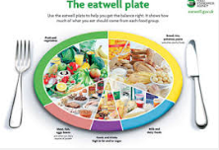


In summary : 3 key areas for action
    Healthy People : Take a life course approach. Promote mid-life interventions with a view to promoting health in older age. Target today’s 40-60 year olds, think about digital opportunities
2. Healthy Places: workplaces, towns, cities, parks. Use levers that exist within Local Authorities to develop cross-cutting interventions, in town planning, use of local policies and regulatory powers
3. Healthy Communities : older people as an asset not a drain. Capitalise on their contribution to volunteering, caring, spending.

Slide 21
Questions?
Elaine Rashbrook, FFPH, MSc, National Lead for Older People

