Slide 1
The UnitingCare Partnership
An ageing society – the long
term implications for health and
social care: a health perspective
Our approach in Cambridgeshire
& Peterborough
Deborah Cohen
Director of Service Integration

Slide 2
The UnitingCare Partnership
The NHS’ Five Year Forward View (Oct 2015)
A radical upgrade in prevention & Public Health
Patients with greater control over their own care including option of sharing health & social care budgets
Breaking down barriers between in how care is provided: [New models – Multispecialty Community Providers, integrated hospitals and primary care]
Consensus – shift in care away from hospitals and other institutions

Slide 3
Background
All adult’s and older people’s community services put out to tender by the CCG in 2013
    acute unplanned care;
    community and mental health services for older people
    adult community services (adults with LTCs)
5 +2 year outcomes based contract total value c £726m.
5 year saving of £168m (19%) over the current estimated CCG projected spend in a ‘do nothing’ scenario (£886m)
A further 10 -15% of revenue dependant on achievement of agreed outcome measures during years 2-5
Savings to be achieved through acute admission avoidance and operational efficiency into a redesigned, fully integrated model of care

Slide 4
An NHS led partnership (CUH & CPFT) of NHS, Third and Private Sector organisations to bid for the OPACS procurement
A limited liability partnership (LLP) set up and owned by CPFT and CUH to deliver the Adults and Older Persons contract
Fulfils the role of lead provider/system integrator required by the CCG

Slide 5
What’s different?
It is a provider vehicle with commissioning capability:
  Holds the contract for the entire pathway with the CCG
  Holds and manages the contracts with each sub-contractors in the pathway
  Ensure that the system works in an integrated fashion across organisational boundaries: Driving cultural change
  Ensuring the necessary improvements to the care delivered to our patients, monitored through agreed patient centred outcome metrics
Prime provider contract
(ref: Commissioning & contracting for integrated care Kings Fund Nov 2014)

Slide 6
Outcomes Framework: version 3
Outcomes Framework
Domain A: Patient Experience
Pathway 4: End of Life
Domain B: Safe Care
Pathway 3: Recovery & rehab.
Domain C: Organisational Culture
Pathway 2: Urgent Care
Pathway 1: Long Term Conditions

Slide 7
The Role of the Integrator
CPFT & CUH
C&P CCG
Ownership
UCP LLP
5 year Contract
Single Point of Co-ordination
Wellbeing Service
Integrated Community
Services
End of Life Care
Acute Care
Two EOL
consortia
5 Acute Trusts
CPFT
Two Third Sector Consortia
Ambulance Service
GP OOH
Contracts
‘System OD’
UCP
Single View of the Patient Record
IT Prime Contractor

Slide 8
Service Model: Key Principles
Care that is personalised, joined up and co-ordinated around patients
Promoting community resilience, self management and choice
Functionally integrated, co-located, multi disciplinary working including aligned social care built around Neighbourhoods
Aligned model to manage proactively complex cases through case management and care co-ordination
24/7 Rapid Response to crisis
Aligned outcomes between the partners

Slide 9
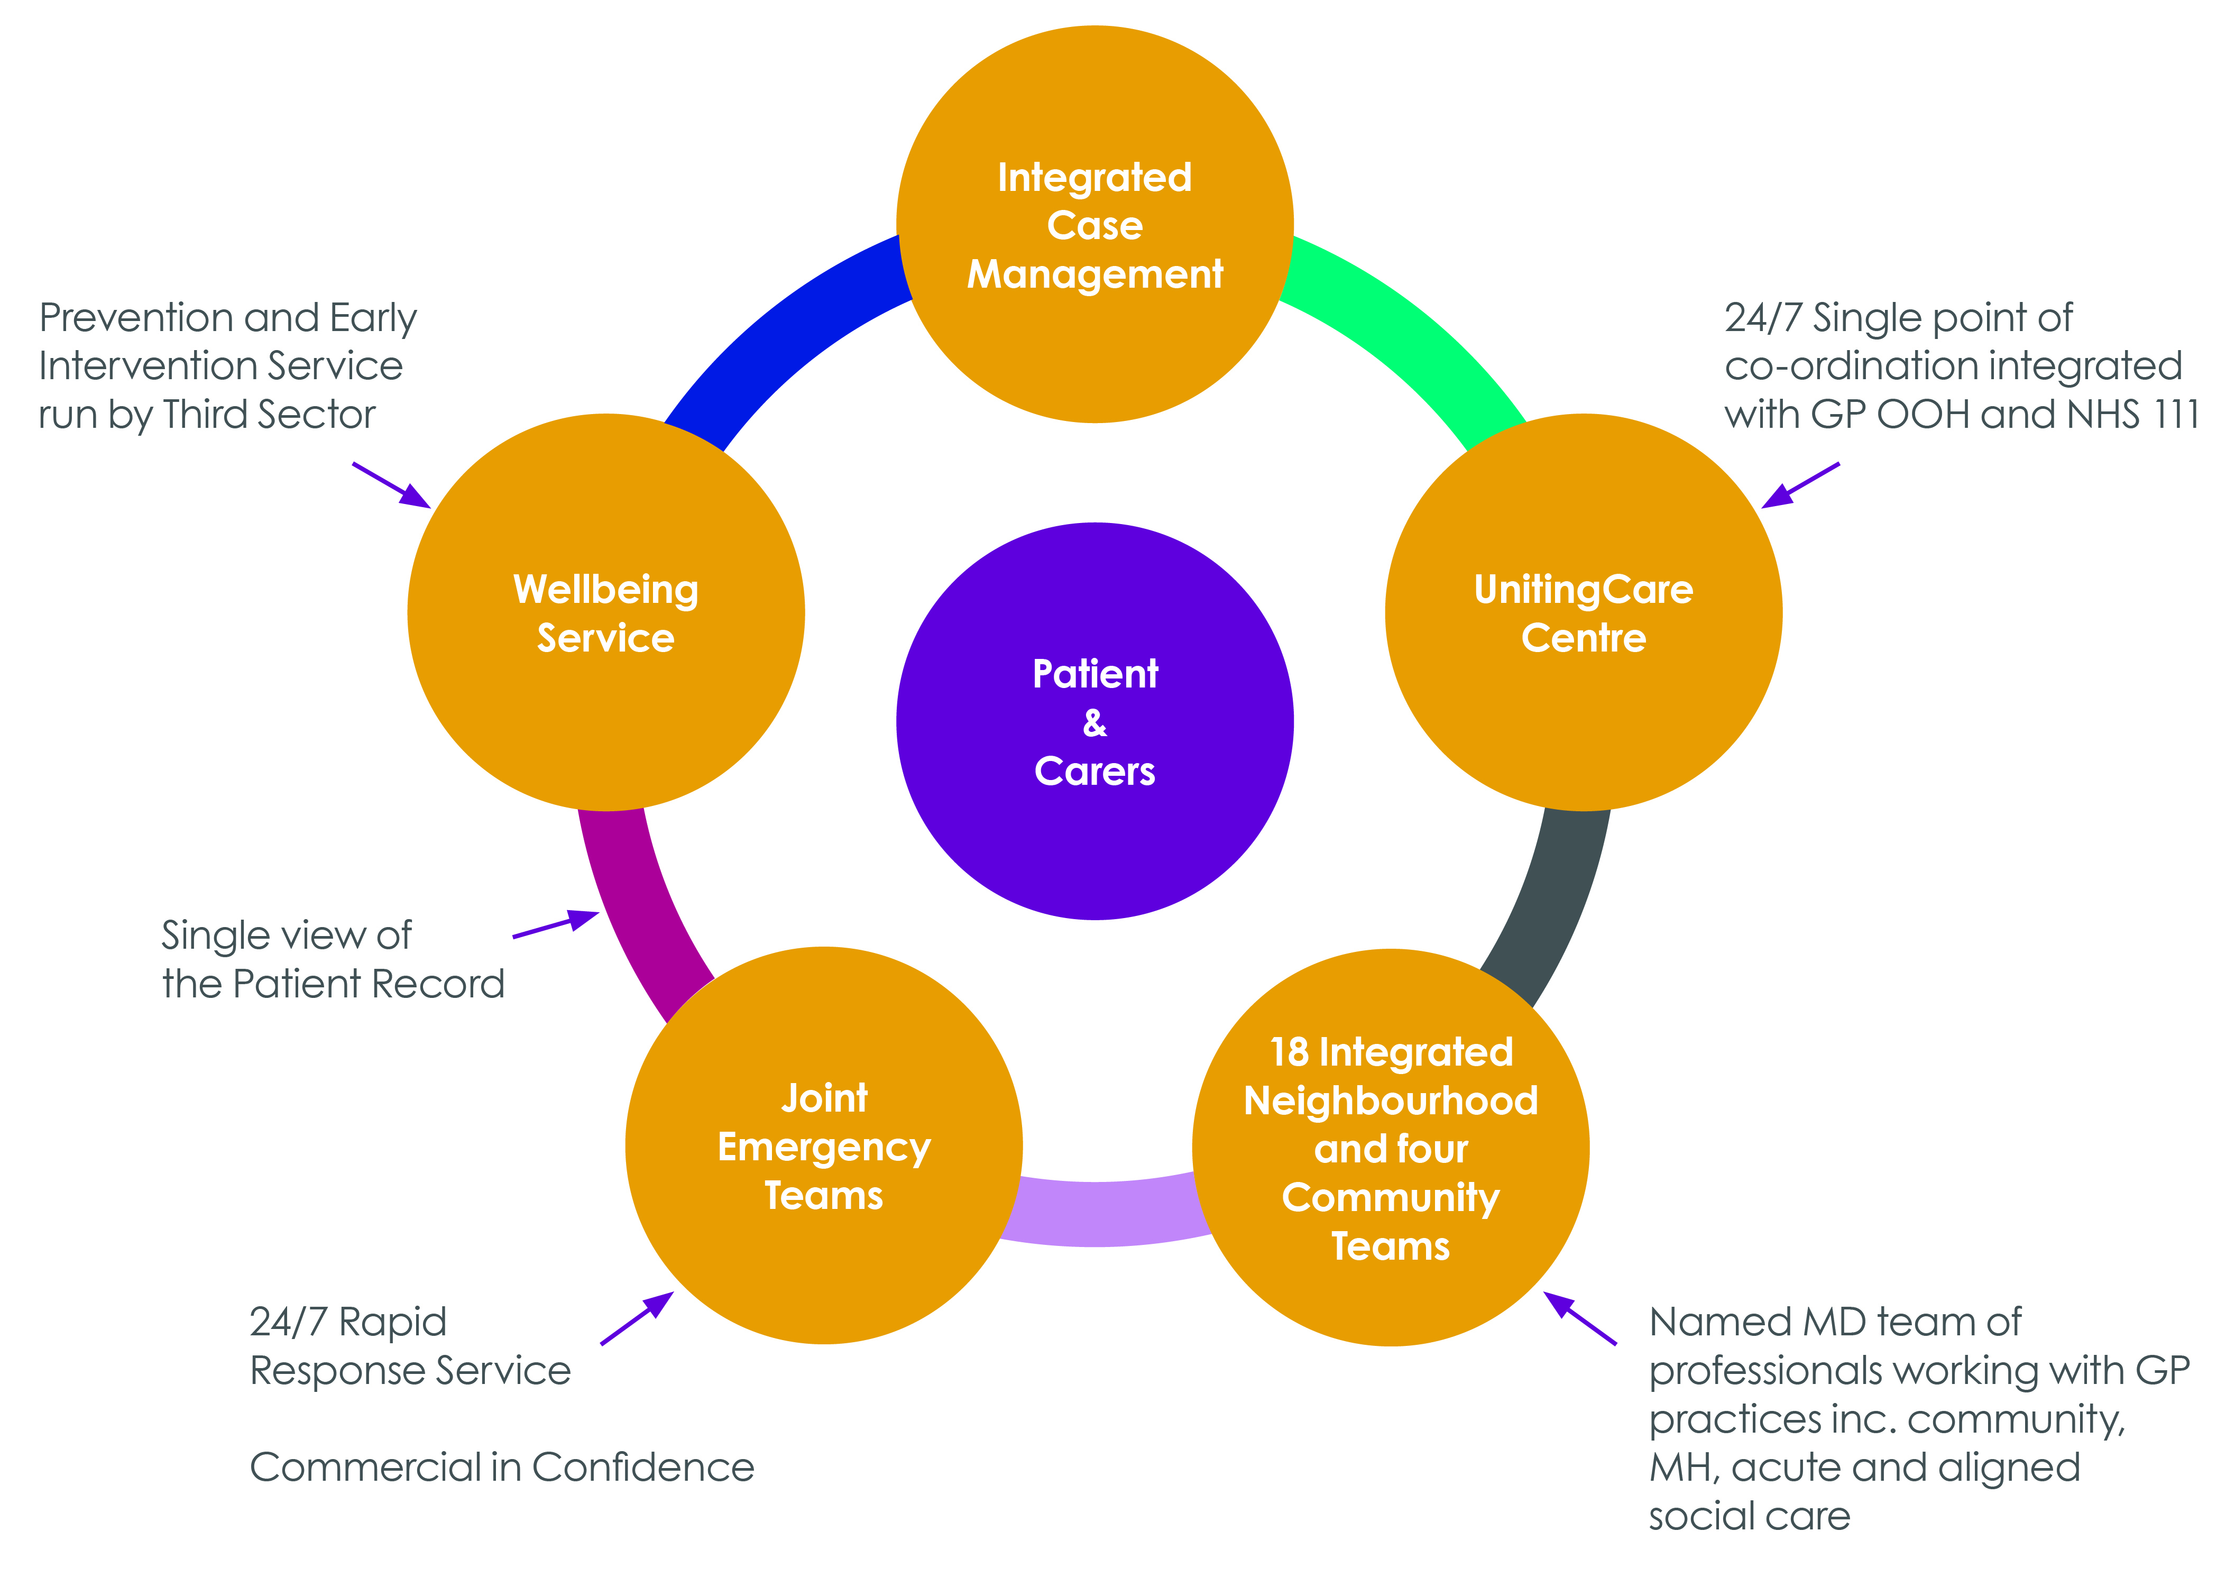
Service Model

Slide 10
Integrated Community Service
Integrated Care Team
Specialist Advice & Support
Neighbourhood Team
GP
Patient & Carer
Configured to reflect needs
  Addresses the needs of groups
Named Team for each GP Practice
Named Team with continuity of care for patients & carers
Calling resources: step up/step down beds
Co located with Practices
Specialist
Nursing/Doctors
Dementia
IST
End of Life
Joint Emergency
Team
Housing
Community
Nursing
Community
Development
Expanded
OoHs
Rehab
Aligned
Social Care
Integrated
Care
Worker
Therapy
Mental
Health
OT
Wellbeing
Service

Slide 11
Key Success Factors
Know our population – really know it
Reorient service to being about prevention
Tertiary Prevention = reducing/stopping progression of a condition
Secondary Prevention = detect and treat an
existing condition
Primary Prevention = avoidance of illness

Slide 12
Prevention
Key ingredients lie outside NHS:
Housing
Warmth
Meaningful activity in communities
Social contact and access to leisure activities
Transport
UCP: Wellbeing Service and the development of Neighbourhoods

Slide 13
Some points for discussion
Dangers of retrenchment to “statutory duties” under financial pressure
Different views of “commissioning” – how could you include the LAs in UCP prime provider contract when most LAs do NOT “commission” their care management services [i.e. specify outcomes and goals for these services]
Care Act Opportunities
Commitment to a 5+2 year contract which enables transformational change in an era of uncertainty over future funding – can LAs commit to this?
As reduce length of stay/admissions to hospital LAs and NHS have to work together to upskill community services (most unchallenged part of NHS)

Slide 14
Conclusion
The new exam question is how local authorities align themselves with new
NHS configuration
Simon Stevens: “radical new care delivery options”
LAs joining up in “combined authorities”/
sharing services

