Slide 1
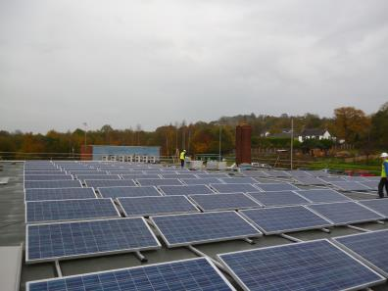
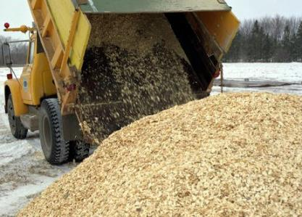
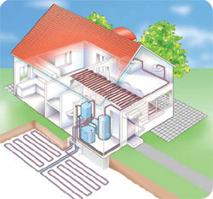
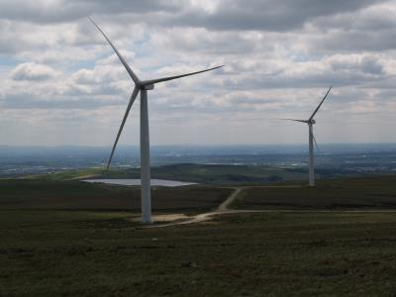
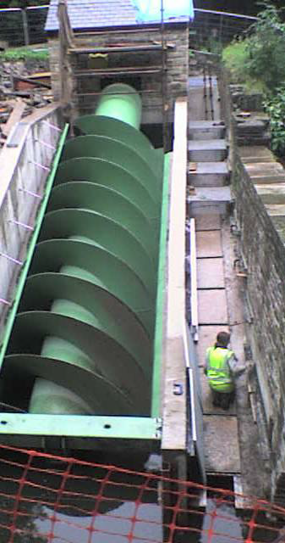
Stockport Renewable Energy Experiences
Angie Jukes
Stockport Council
Technical Policy & Planning
angie.jukes@stockport.gov.uk
0161 474 4385

Slide 2
Content
About Stockport
Developing the policies
A Steep Learning Curve
‘Great Leap Forward’
Political attitudes
Renewables in Stockport

Slide 3
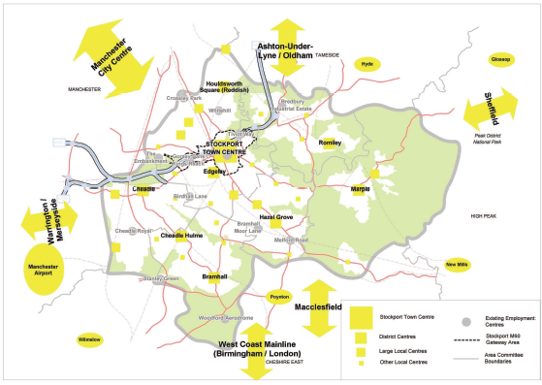
Notes:
46% green belt
Peak District National Park
Small scale development – super majors are not usual in Borough

Slide 4
Health & Environment Advice Role to Planning
Co funded by Director of Public Health & Technical Policy & Planning Team (responsible for Planning Policy)
Non planner embedded into the team
Sustainability Appraisal
Sustainable Design & Construction
Low and zero carbon technologies
Monitoring
www.stockport.gov.uk/planningsustainabledevelopment

Slide 5
Policies
Making Improvements to Existing Dwellings
Delivering the Energy Opportunities Plan
Network Development Areas
Microgeneration Areas
Delivering District Heating
Community Energy Areas
Adapting to the impacts of Climate Change

Slide 6
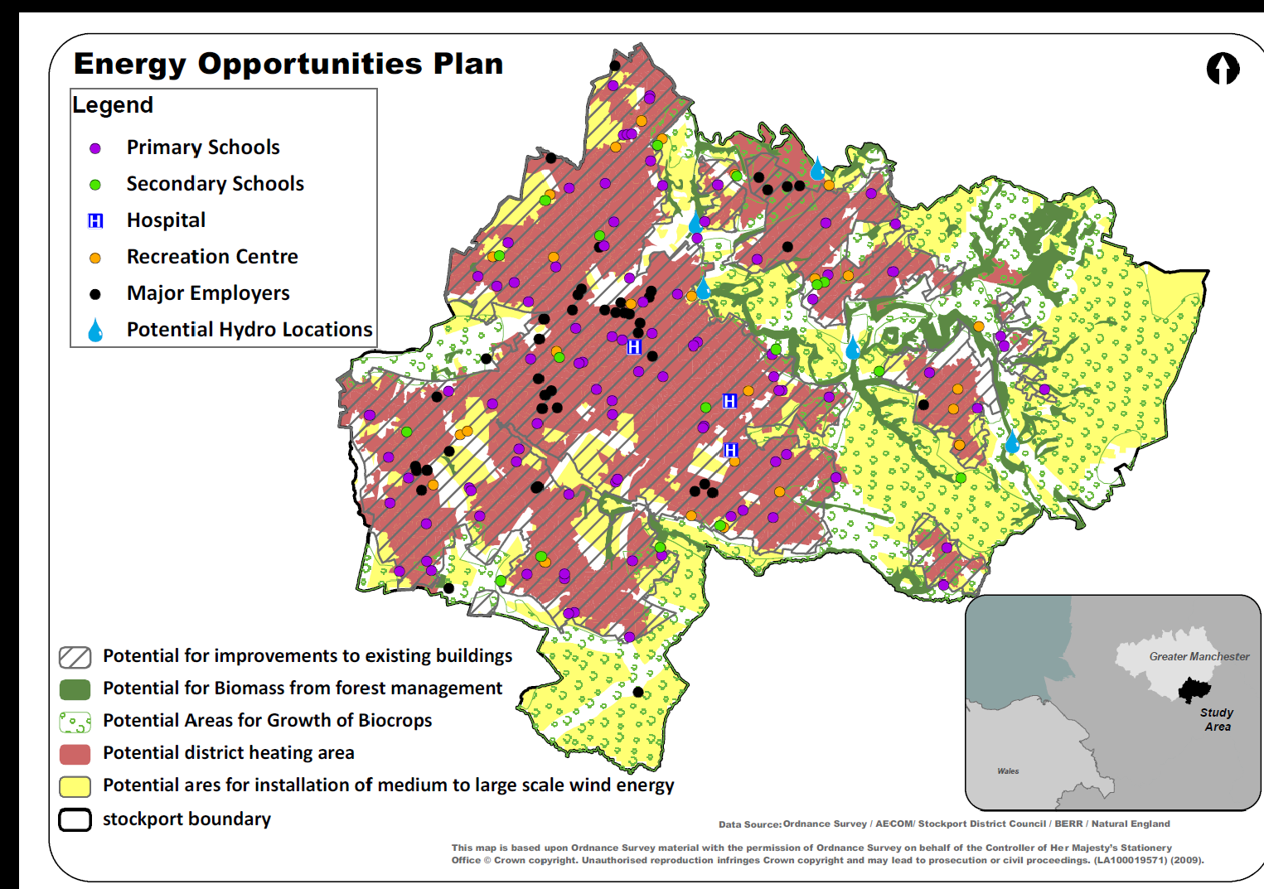
www.stockport.gov.uk/ldfevidence

Slide 7
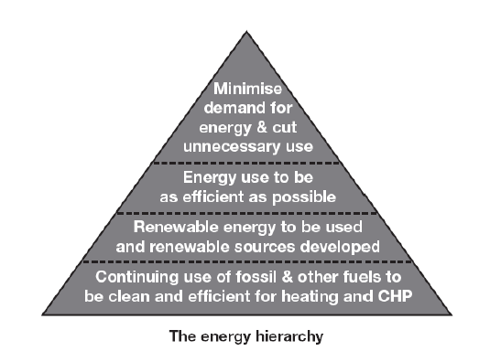
Aims of the Policies
Energy hierarchy
Early stages consideration not ‘bolt on’
Familiarisation with technologies / experts
Preparation for the Building Regulations changes
Social and economic benefits
Tackle climate change!

Slide 8
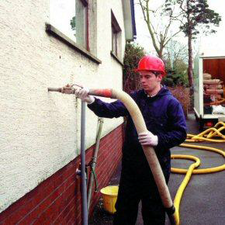
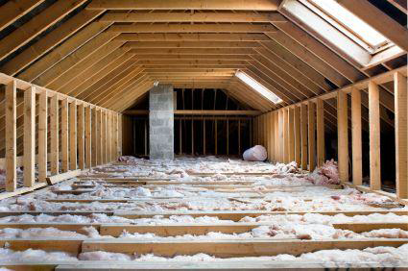
Making improvements to existing dwellings
Planning applications for existing dwellings will be required where possible and practical to undertake reasonable improvements to the energy performance of the existing dwelling

Slide 9
Delivering the Energy Opportunities Plan
Flexibility
Two spatial Areas
Network Development Area
Microgeneration Area
Target thresholds
10 or more dwellings
1000 sq m
Domestic = 40% improvement over 2006 Part L
Non-residential = 30% improvement over 2006 Part L
Requirement for an ‘Energy Statement’
Technically feasible / financially viable

Slide 10
Providing District Heating
Where appropriate, applicants may be required to provide land, buildings and/or equipment for an energy centre to serve proposed or multiple developments. It is expected that requirements will be discussed in pre-application discussions and will be included as part of a planning condition.
New Development:
Residential development of at least 55 dwellings per hectare and at least 100 dwellings
Large scale mixed use development
Proximity to high heat density areas of existing buildings
Proximity to existing heat sources
Existing Development
Heat demand density of at least 3,000 kw/km2; res density of 55 dwellings per hectare or presence of public sector building
Proximity to heat sources

Slide 11
Community Owned Resource
The Council recognises the important role that community owned energy generation will play in reducing CO2 emissions and increasing installed low carbon and renewable energy capacity.
Wind Priority areas:
Good local wind resource
Close to electricity infrastructure
Close to roads etc., for easy transport of parts
Close to the community
Environment / archaeological impacts
High landscape quality areas
Aviation & Defence Infrastructure
500m from residential areas & properties

Slide 12
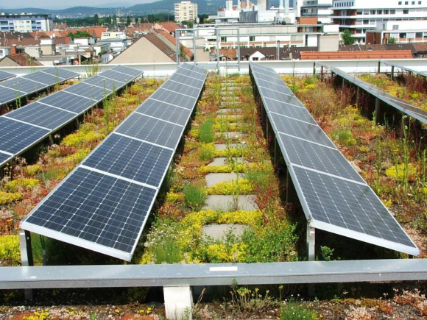
Adapt to the Impacts of Climate Change
Design to avoid, mitigate or reduce the impacts of climate change
Sustainable Urban Drainage Systems
Brownfield: reduce run-off by min 50%
30% for sites outside CDAs
Greenfield: no increase in run off
Permeable surfacing
Tackling the Urban Heat Island effect:
Appropriate green cover
Green roofs, walls and boundaries
Natural air flow in design
Passive Cooling & Natural Ventilation
Solar Shading
Blue Infrastructure – lakes, ponds, fountains and watercourses
Promote BREEAM, Code for Sustainable Homes, CEEQUAL etc.

Slide 13
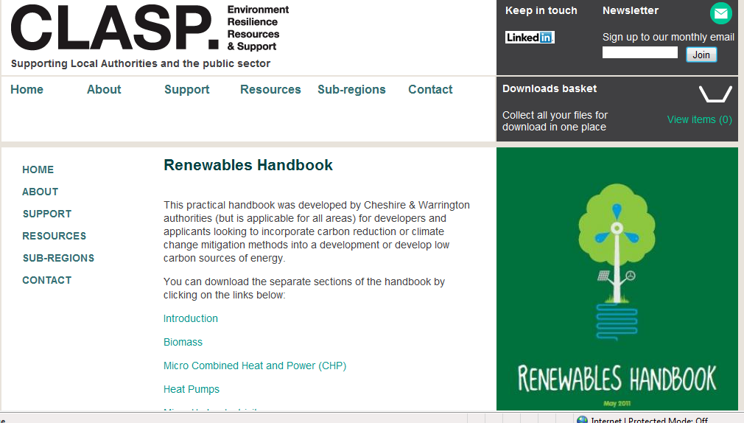
A Steep Learning Curve
Clear Guidance
Training
Capacity
Pre-application
Phone
Email
Events?
Signposting

Slide 14
Stockport’s Guidance
House Extension Energy Checklist
Sample Energy Statements
Low Carbon Design Guidance
Guide to Technology Costs
District Heating Feasibility Guidance
District Heating Feasibility – Case Studies
Sustainable Design & Construction SPD – Energy Topic
Sustainability Checklist – Energy Elements

Slide 15
Small scale sample energy statement

Slide 16
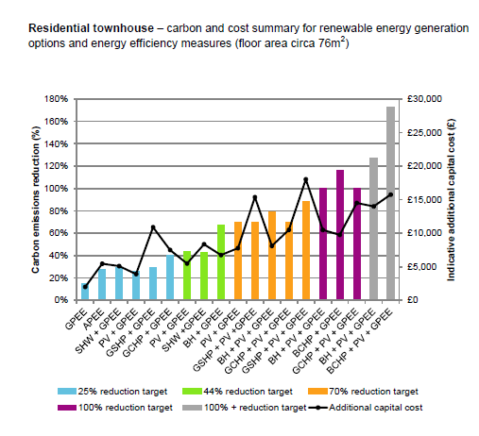
Guide to Technology Costs

Slide 17
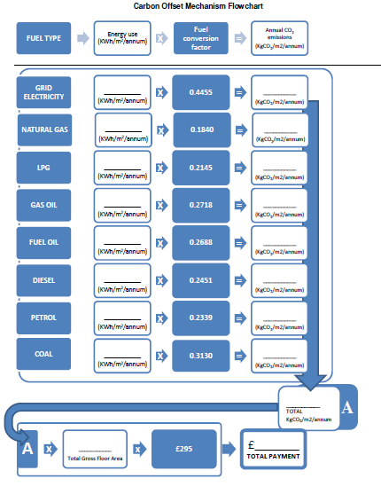
Carbon Offset - Allowable Solutions

Slide 19
Applications for Renewable Installations
Anaerobic Digestion
Wind Turbines
Hydro Schemes
Biomass District Heating
Carbon Savings – before and after
Cost savings
Address planning constraints

Slide 20
Great Leap Forward . . .
Validation Checklist
People don’t always read guidance
Major hand holding required particularly for smaller developers
A need for greater national activity in terms of skills development
Growing realisation by developers of benefits
Economic benefits
Energy consultants like Stockport’s approach

Slide 21
Personal frustrations
I know how the technologies work generally – how would they work on the site . . .
How much is ‘too expensive’?
Endless pages of SAP reports . . . .
Planning doesn’t like wind turbines . . . .
It’s a heritage site . . .

Slide 22
Success?
Percentages of energy statements present, and inadequate. Where targets apply and an ES is available, the targets are addressed
Notes:
49.57 tonnes of carbon saved per year from new development 2013/14
Existing dwellings: 503 metric tonnes / year

Slide 23
Members
Portfolio support
Executive support for policies
Evangelical?
Resources to help with Member training
Evidence base simplified
Economic and social benefits

Slide 24
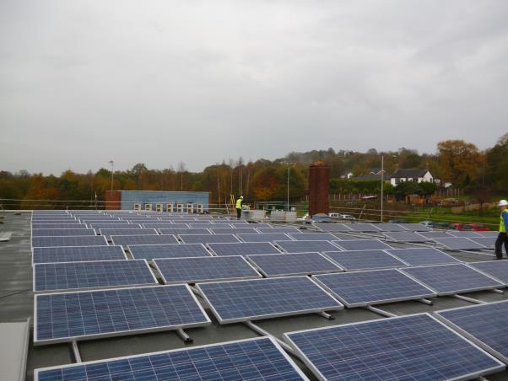
Renewables in Stockport
April 2010 to September 2012 there were 2,928 applications for FIT
Stockport Homes
Biomass
Solar PV
Biomass
Hydro
Anaerobic Digestion
Solar PV and Hot Water
Ground Source Heat Pumps
Wind

Slide 25
Lessons learned
Validation Checklist
Viability considerations
Building Regulations
Targets
Energy statement – most useful element
Pre-application crucial
Training critical – regional / national
Still not a priority . . . but demand is rising

Slide 26
Sustainable Drainage
Policy in Core Strategy
Lack of enforcement to date
SUDS Approval Body
charging
Process in Development
Guidance – SPD

Slide 27
Questions?

