Slide 1


Community Infrastructure Levy
Project Planning and Infrastructure Evidence

Slide 2
Project planning for CIL

Slide 3
What have we learnt so far?
You need a senior project sponsor and project manager
You need to sell the benefits of CIL
Keep focused; a CIL examination remains a relatively narrow affair
Notes:
The three key lessons identified from our work with councils across the country related to delivering a successful CIL project are that:
As a minimum you need an identified project manager and project sponsor – without these fundamental components of project governance councils have found that CIL projects rarely remain on programme
Selling the benefits of CIL – without doing this CIL becomes exclusively a bad news story and your CIL project will be the subject of delays whilst the these are debated.
Keeping a focus on the CIL examination – A CIL examination typically lasts between 0 and 2 days and therefore a relatively short hurdle

Slide 4
Setting the objectives, scope and deliverables
Team and resources
Timeline
Budget
Objectives, scope and deliverables
objectives, scope and deliverables
team and resources
timeline
budget.
What comes first?
Notes:
By setting and agreeing objectives for your CIL project with senior officers and members early on; when it comes to the more challenging moments such as rate setting you can use the objectives to frame the proposition

Slide 5
Selling CIL
Members and executives
Fellow officers
Development market
Community
Regulations and timing
Regulations and timing
Regulations and timing
Regulations and timing
Regulations and timing
Regulations and timing
Regulations and timing
Likely increase in income
Support to strategic planning approach
Strategic infrastructure investment to support development
Community projects and reinvestment
Powerful tool to support growth
Easier to administer
Transparent, upfront cost
Greater involvement in priority setting
Notes:
There are four cohorts that you are selling your CIL project to; members and senior officers, fellow peers, development market and the community. You can use slightly different messages for each cohort to secure the most positive response. Set out in this slide are those messages that Councils have found the most helpful.

Slide 6
CIL Project Team and Resources
Project Management
Infrastructure planning and funding gap
Viability
Planning and regulatory compliance
Project
Sponsorship
Implementation - processes, procedures systems
Project Quality Assurance
Project direction and assurance
Project structure and components
Notes:
This is a model CIL project governance structure. As we describe previously the only fundamentals are a project sponsor and project manager. Councils have taken various approaches to supplementing these resources. The vast majority appoint viability advisors and a large number appoint consultants to help them prepare the infrastructure evidence or to undertake a review of the infrastructure evidence for CIL compliance.

Slide 7
Model Programme
 | 1 |  |  |  | 2 |  |  |  | 3 |  |  |  |  | 4 |  |  |  | 5 |  |  |  | 6 |  |  |  |  | 7 |  |  |  | 8 |  |  |  | 9
Mobilisation
Preparation of PDCS (min 6 weeks)
Consultation of PDCS
Preparation of draft Charging Schedule
Consultation on draft Charging Schedule and preparation for examination
Submission to examiner
Notes:
This is a model programme for a CIL project. The greatest time variance typically occurs in the period leading up to the publication of the Preliminary Draft Charging Schedule whilst the technical evidence is prepared and the internal discussions are held during the CIL rate setting process.

Slide 8
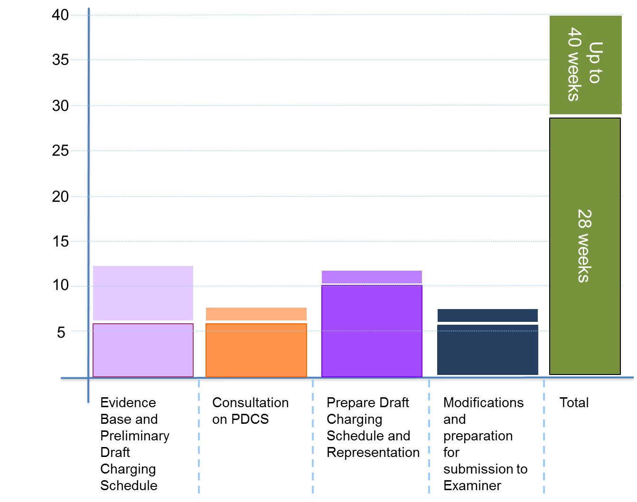
Programme - Building blocks

Slide 9
Programme – Stages, actions and deliverables
Evidence Base
Preliminary Draft Charging Schedule and Consultation
Draft Charging Schedule and Representation
Examination and adoption
ACTIONS
Collate infrastructure planning and cost evidence
Prepare funding schedule
Prepare development projections
Collate viability evidence
Prepare working hypothesis charging schedule
Assess evidence gaps
Fill gaps
Procure external support, if required.
ACTIONS
Finalise evidence base
Prepare consultation strategy
Prepare statement on
Installments
Finalise preliminary draft charging schedule
Undertake consultation for a minimum period of six weeks
Analyse consultation responses and, if necessary, refine evidence base and rates.
ACTIONS
Prepare draft charging schedule
Undertake representation for a minimum six week period
Analyse representations s and, if necessary, refine evidence base and rates.
Prepare statement of modifications, if required.
Prepare information for Examiner
ACTIONS
Procure a examiner
Issue information to examiner and set examination date
Undertake examination
Receive and review examiners report
Prepare adoption report for Full Council
Take report and charging schedule to Full Council and gain approval
DELIVERABLES
Infrastructure and funding analysis that demonstrates a funding gap
Development projections by usage (and potentially by area)
Working hypothesis charging schedule
Estimate of CIL income with sensitivity analysis
DELIVERABLES
Preliminary draft charging schedule
Supporting evidence base
Consultation report
Updated evidence base
DELIVERABLES
Draft charging schedule
Representation report
Statement of modifications (if required)
Information for examiner
DELIVERABLES
Examination
Examiners report
Report to Full Council
Notes:
This table sets out the actions and deliverables at each of the stages in the CIL project.

Slide 10
Consultation and representation strategy
Two elements:
  consultation on Preliminary Draft Charging Schedule
  representation on the Draft Charging Schedule.
Our recommendations are:
  to make the consultation as meaningful and comprehensive as possible whilst containing it within the specified time period and to interested parties; by conducting it in this manner you will draw out and address the significant issues in advance of representation
  you want the representation to be quick, efficient and contained leading up to the examination.
Notes:
When approaching consultation on a CIL project we recommend making the PDCS consultation as meaningful as possible, to draw out any issues in order that they may be addressed prior to the publication of the Draft Charging Schedule.

Slide 11
Typical Project Risks
Risks | Likelihood of becoming issue
Failure at examination due to insufficient evidence base | Unlikely
Failure at examination due to unreasonable interpretation of viability evidence | Unlikely
Failure at examination due to incorrect interpretation or application of the regulations | Unlikely
Discouraging development through poor engagement or inappropriate rate setting | Likely
Disruption to project timeline due to poor/ inappropriate engagement with members/ senior managers | Highly likely
Not having the procedures, processes and systems in place for implementation and collection | Highly likely
Notes:
These are the risks that the Councils we have worked with commonly identify for their CIL projects. The first three risks relate to the correct application of the CIL regulations and are considered unlikely. The remaining risks are all related to how the CIL project is managed and there have been many examples of these manifesting and causing difficulties for the councils involved

Slide 12
Five key points on successful CIL project delivery
CIL is a good news story; sell the project to make life easier.
Proper planning prevents poor performance.
Resource it properly with the correct expertise.
Know the regulations and guidance; there are no shortcuts.
Keep it simple and contained.
Notes:
These are the five key points that Councils have identified for a successful CIL project

Slide 13
Infrastructure Planning

Slide 14
What have we learnt so far?
Still relatively minor component of examinations
All councils have an infrastructure funding gap
Greater emphasis on CIL vs S106 and ‘double dipping’
Notes:
The three key lessons identified from our work with councils across the country related to infrastructure planning are:
It is still a relatively minor component of a CIL examination – Whilst the regulations and guidance may have been updated to place a greater emphasis on the examiner still only tends to dedicate 2-3 paragraphs to the infrastructure planning in the examination report.
All councils have an infrastructure funding gap
Greater emphasis on CIL vs S106 – Settling on the correct approach between CIL and S106 remains the greatest challenge for councils

Slide 15
Infrastructure Funding Gap
total cost of infrastructure
funding from other sources
aggregate funding gap
projected CIL Income
residual funding gap
Aggregate
Funding Gap
Residual Funding Gap
Projected CIL Income/ CIL Target
Other
sources
Total Cost of Infrastructure
Funding
Funding
Notes:
The essential test within the regulations is for the Council to demonstrate that it has insufficient funding to pay for the infrastructure required to support growth. This is achieved by:
Calculating the total cost of infrastructure required to support growth – this is typically done from the list of infrastructure projects accompanying the relevant plan (ensuring to only include projects that are likely candidates for CIL funding
Calculating the amount of funding available from other sources – this is typically done in conjunction with colleagues in the councils finance team
Projected CIL income to prove a residual funding gap – this is typically done by linking the development trajectory to the rates in the charging schedule

Slide 16
Golden thread
Relevant Plan Infrastructure Evidence
CIL Infrastructure Evidence
Regulation 123 List
Funding Gap
Project List
Drawn from infrastructure evidence that underpins the plan
Total cost of infrastructure for projects that are potential candidates for CIL funding
Regulation 123 list
Need to understand approach to S106 and S278
Notes:
The regulations and guidance combine to create a golden thread of infrastructure evidence that stems from infrastructure evidence that underpins the plan. If the council understands which pieces of infrastructure it will deliver using CIL and which pieces using S106 or S278 then the evidence base for CIL can be determined.

Slide 17
Waltham Forest Case Study 2 (1)
Context
Adopted Core Strategy in 2012
CS supported by SIP produced 2009
PDCS consultation based on SIP
Council commissioned update to support DCS consultation
Considerations
Should additional infrastructure planning be undertaken for CIL?
How to align plan making process to delivery?
Notes:
In this case study the Council had adopted a Core Strategy in 2012. The infrastructure evidence underpinning that plan was Strategic Infrastructure Plan form 2009. The Council had been to consultation on PDCS using the SIP though had received some feedback that the document did not capture the latest priorities of the council. The Council commissioned an update to the infrastructure evidence in advance of consulting on the Draft Charging Schedule

Slide 18
Waltham Forest Case Study 2 (2)
Approach
additional infrastructure planning undertaken in 2013 to align IDP to spending priorities
work undertaken during a 12-week intense period.
update to viability work undertaken concurrently
Outcomes
Updated IDP that can inform capital programme
Successful CIL examination in spring 2014.
Notes:
The council commissioned consultancy support and undertook this update during an intense 12-week period whilst also updating the viability evidence.
The outcome for the Council was a successful CIL examination in Spring 2014 and an updated list of infrastructure projects that could inform the councils capital programme

Slide 19
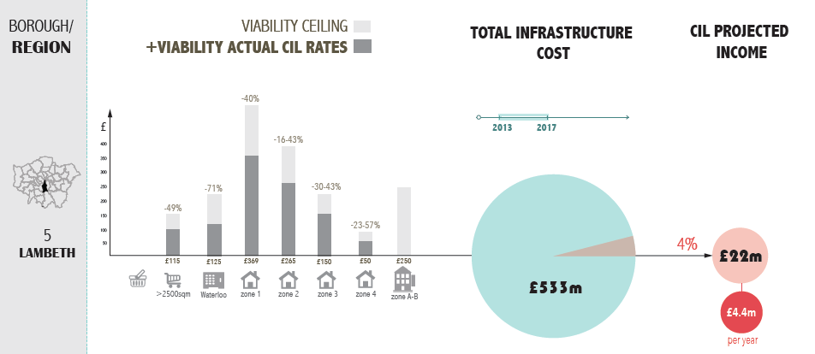
Approach by Councils
Notes:
The following four slides provide information on the infrastructure evidence that four councils have prepared to take them through a successful CIL examination.
On this slide you can see that Lambeth could demonstrate a total cost of infrastructure of £533m for the 5-year period 2013-2017 and were projecting £22m (or 4% of the total cost) income form CIL during the same period

Slide 20
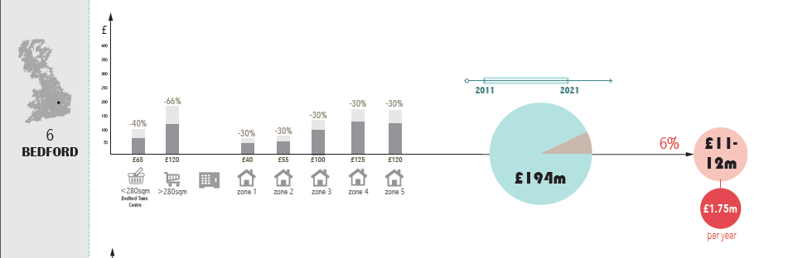
Approach by Councils
Notes:
On this slide you can see that Bedford could demonstrate a total cost of infrastructure of £194m for the 10-year period 2011-2021 and were projecting £12m (or 6% of the total cost) income form CIL during the same period

Slide 21
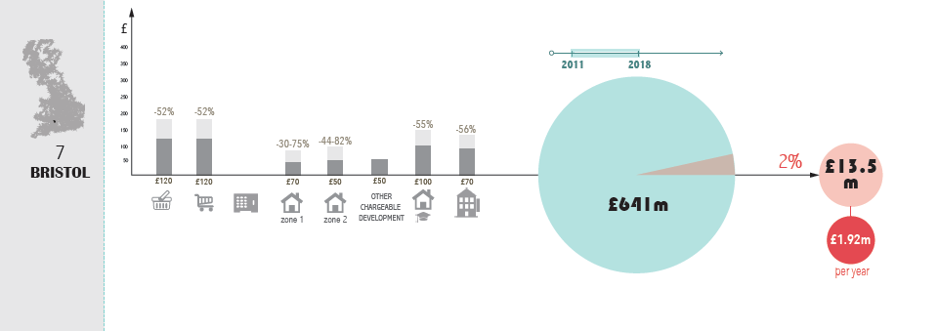
Approach by Councils
Notes:
On this slide you can see that Bristol could demonstrate a total cost of infrastructure of £641m for the 7-year period 2011-2018 and were projecting £13.5m (or 2% of the total cost) income form CIL during the same period

Slide 22
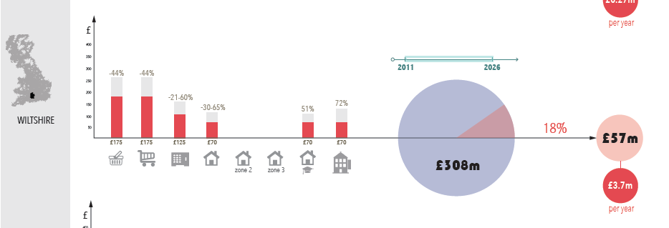
Approach by Councils
Notes:
On this slide you can see that Wiltshire could demonstrate a total cost of infrastructure of £308m for the 15-year period 2011-2026 and were projecting £57m (or 18% of the total cost) income form CIL during the same period

Slide 23
Feedback from examinations
Relatively minor part of CIL examinations to date (2-3 paragraphs in the examiners report)
Most authorities undertook additional bespoke infrastructure planning for CIL.
Notes:
The feedback from examinations is that:
infrastructure remains a relatively minor feature at the examination (an assessment backed up by the PINS inspector in attendance at the seminars.
Most councils undertook additional bespoke infrastructure planning in preparation for the CIL examination

Slide 24
Infrastructure Evidence - Questions
Have you identified the total cost of infrastructure they wish to fund wholly or partly through the levy? (para.2:2:2:1)
In identifying your CIL target, have you considered what additional infrastructure is needed in your area to support development and what other funding sources are available? (para.2:2:2:1)
Is your information on infrastructure need directly related to the infrastructure assessment that underpins your plan (para.2:2:2:1)?
Notes:
If you are deciding whether or not you a ready to go to an examination consider these three questions; if you can answer yes to all of them then you are prepared to go to examination.

Slide 25
Viability

Slide 26
Introduction
The legislative requirements
What evidence is required?
Relationship between the evidence and PDCS/DCS
Consultation with stakeholders
The examination and post-examination follow up
Keeping a sense of proportion
Key messages
Questions

Slide 27
1
Legislative requirements

Slide 28
Viability considerations firmly embedded in planning
National Planning Policy Framework – para 173
“Plans should be deliverable. Therefore, the sites and the scale of development identified in the plan should not be subject to such a scale of obligations and policy burdens that their ability to be developed viably is threatened”
“To ensure viability, the costs of any requirements likely to be applied to development, such as requirements for affordable housing…should… provide competitive returns to a willing land owner and willing developer to enable the development to be deliverable.”

Slide 29
Viability test for CIL rate setting
CIL regulations (2010) as amended
Charging authorities ‘must aim to strike what appears to the charging authority to be an appropriate balance between’
‘The potential effects (taken as a whole) of the imposition of CIL on the economic viability of development across its area’
Raising funds for infrastructure

Slide 30
2
What evidence is required

Slide 31
What evidence is required?
Appropriate available evidence
Proportionate
    Not every single site needs to be tested
    Key sites/types of sites
    Types of development that actually get built
Emphasis on key sites that are critical to the Plan
Capable of being put into the public domain

Slide 32
What evidence is required?
What is required?
Same approach as for individual schemes – just more appraisals!
Residential:
      A range of typologies that represent entire anticipated housing supply
      Taking account of other policy requirements (standards; affordable hsg etc)
      Strategic sites (on-site S106; infrastructure burden; cashflow profile)
Commercial
      Main types of development expected to come forward (retail, offices etc)
      Testing developments to justify nil rates?
Other uses
      D1/D2 – predominantly reliant on public subsidy etc
      Sui generis – too many to test – plan not reliant on one particular SG use

Slide 33
What evidence is required?
RESIDUAL LAND VALUE

Slide 34
What evidence is required?

Slide 35
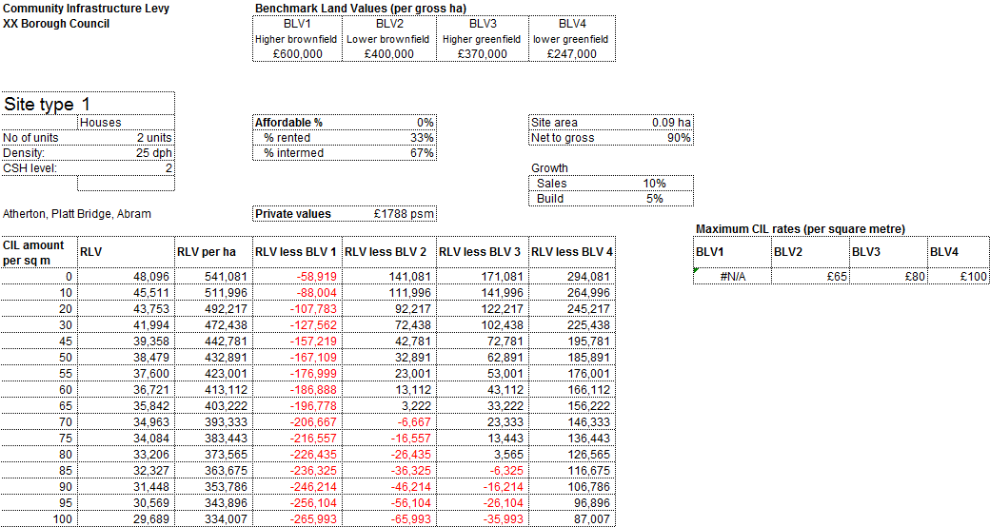
What evidence is required?

Slide 36
What evidence is required?
Strategic sites – why separate testing?
Critical to delivering the Plan
Important to test impact of CIL
On-site infrastructure/utilities - £250-£750k per ha
Subject to receiving information from Developer
Might be delivering on-site Section 106 (eg schools)
Timescale for delivery/capital tie-up/cashflow
Critical issue is nevertheless the impact of CIL

Slide 37
What evidence is required?

Slide 38
3
The relationship between the evidence base and the PDCS / DCS

Slide 39
Evidence and the PDCS
‘Room for pragmatism’
Number of zones
The viability buffer
Nil rates
Is [use] critical to the delivery of the Plan?
Focus on where development will actually happen
BUT CIL is not a tool to incentivise/disincentivise

Slide 40
Evidence and the PDCS – how to determine boundaries
Difficult in urban areas – markets not black and white
Postcodes – often of relevance to market boundaries
‘Natural’ barriers – railways, major roads
Settlements (if not contiguous built up area)
Combined approach of
      Individual site testing
      Land Registry/other source data by sub-postcodes
Unlikely to be a perfect match

Slide 41
CIL and other policy objectives
Urban areas are complex – range of viability outcomes
Affordable housing policies – ‘maximum reasonable’
CIL and AH effectively competing for scheme value
No different under Section 106
Each £ taken for S106 = £ less for AH
BUT cost of delivering AH is far greater than CIL
PD to AH – typically £4,000 psm, CIL = £200 psm

Slide 42
CIL and Affordable Housing
Impact of increase in CIL from £250 to £350 psm
42

Slide 43
Broad test of reasonableness
Site type | CIL as % of scheme value | CIL as % of development cost
Strategic brownfield | 3.7% | 4.2%
Large greenfield | 3.5% | 4.0%
Medium greenfield | 3.4% | 3.8%
Small greenfield | 3.4% | 3.8%
Below AH threshold | 2.7% | 3.2%
Specialist housing | 3.4% | 3.8%

Slide 44
4
Consultation with stakeholders – what to expect

Slide 45
Consultation with stakeholders
‘…early engagement with local developers and others in the property industry is clearly good practice and should help the CS consultation and examination process run more smoothly…’
‘…the extent to which charging authorities can do this will depend on the level of engagement from local developers…’

Slide 46
Consultation with stakeholders
Should be an evidence gathering exercise
    Developers better placed than anyone to provide evidence
    Sales values on new build schemes
    Build costs
    Fees, finance etc
Consultation not working in the manner envisaged
    One way flow of information (CA to stakeholders)
    Reps typically un-evidenced assertions
    Developers hide behind ‘confidentiality’ of data
    Consultants act as a barrier between CA and developers
    Ultimately just a messy exercise in negotiation

Slide 47
Consultation with stakeholders
Each £ in CIL is £ less for land
Developers fearful of impact on land supply
In practice, uplift in land still significant
Concern regarding impact on AH and political pressure

Slide 48
5
The Examination and post-Examination follow up

Slide 49
Viability at examination
Examiners often based topics on respondents’ issues
Likely issues:
    Land value assumptions
    Market value vs current use value approach (more later)
    Benchmarks reflective of sites that are likely to come forward
    Extent of buffer and its adequacy
    Assumptions re on-going S106 after CIL adoption
    Realism of sales values and build costs
    Phasing of CIL
    Effect of CIL on strategic sites/opportunity areas
    Zones – are boundaries in the right place
    Adequacy of evidence – sufficient number of appraisals

Slide 50
Post examination
Examination not closed until Examiners report issued
Opportunity post-hearing for additional evidence
CAs cannot pre-empt discussions at hearing
      Islington: new issues raised on hotel appraisals requiring re-model
      Lambeth: new evidence on yields became available
      Tandridge: critique of small sites – developers invited to evidence
Examiner can hold further hearings if necessary

Slide 51
Issues at Examination – affordable housing
Affordable housing – ‘compliance’ with policy
Conflicting approaches adopted by examiners
‘Mid-Devon’ approach vs London approach
Newham Examination:
      Examiner accepted LBN not achieving 35%
      Acceptable to base viability on a lower proportion of AH
Waltham Forest Examination:
      20% not viable at current time – cost of 20% to 50% - £7m
      Cost of proposed CIL - £0.5m
      Setting a nil CIL would not enable schemes to deliver 50%

Slide 52
Why is ‘market value’ inappropriate for CIL rate setting?

Slide 53
Why is ‘market value’ inappropriate for CIL rate setting?
MV

Slide 54
6
Keep it in proportion

Slide 55
Keep it in proportion
CIL does not account for significant % of total costs
Typically less than 3% of total costs
Lower % when existing floorspace deducted
Largely replaces existing S106 ‘ask’
S106 limited by Regulation 122 to:
Necessary to make development acceptable in planning terms
Directly related to the development
Fairly and reasonably related in scale and kind to the development

Slide 56
Keep it in proportion
Can schemes be so ‘on a knife-edge’ for CIL to tip the balance?
In vast majority of cases, no
CIL can be absorbed through modest reduction in land value
Alternatively CIL can be offset by small reduction in Aff Hsg
Other policy requirements can vary
Instalments policies can help mitigate the impact
Ultimately, exceptional relief can be made available
Despite the fuss, other appraisal factors far more important

Slide 57
CIL in the wider context of development economics
Risk Margin
Grant funding
Affordable Rent
Mayoral CIL £35
Borough CIL £150
57

Slide 58
But – there are practical issues to overcome
Tariff approach - NEVOA
    Tariff of £40,000 per unit
    Timetabled increase in 2016
    Money ring-fenced for NLE
    All units pay tariff
    Ability to negotiate but rarely applied
CIL
    Tariff converted to CIL
    £265 per sqm
    Degree of uncertainty
      Existing floorspace
      Exceptional relief
      Discretionary relief
    Receipts could be lower
    No ring-fencing
    No ability to increase in NEV
    Whole CS review required

Slide 59
7
Key messages

Slide 60
Key messages
Focus on what matters to the delivery of the Plan
Remember there is room for pragmatism
Inability to flex in response to market cycles is an issue
Process of establishing and adopting rates can be a minefield
The test under the regulations in now more onerous
BUT
CIL accounts for only a small proportion of costs
Relatively insignificant in major projects
Other policy objectives have more influence (and can flex)

Slide 61
Community Infrastructure Levy
Rate Setting

Slide 62
Context
Notes:
It is important to get rate setting right.
This presentation starts off with two issues that contextualise the rate setting process (these should be considered alongside all other advice giving in this seminar series).
It then goes in to share some approaches and techniques developed when we worked with the CIL Front Runners.
Collectively these tricks and tips should help you navigate the CIL rate setting process.

Slide 63
The Funding Pie
The levy cannot be expected to pay for all of the infrastructure required:
5-10%
Consider CIL as just one small part of a more complex blend of funding.
Notes:
When setting CIL rates it is important to understand CIL in context. You are required to consider your infrastructure funding requirements and what contribution CIL will make. Whilst CIL is an important source of funding for infrastructure, it is just one of many funding mechanisms.
The Levy is unlikely to contribute more than 5-10 per cent of funding for your infrastructure requirements (depending on you local circumstances, such as, the extent to which you have prioritised your infrastructure requirements, and the level of growth expected in your area).
Other significant sources of infrastructure funding will include:
Section 106 planning obligations, which will still play an important part in on-site mitigation
Capital receipts from the sale of existing assets
Business Rate retention, which can make a significant contribution in growth areas
Grants such as education funding, albeit that a proportion of these may go directly to Academies or Free Schools, and
Borrowing
It is worth noting that many Authorities that were early adopters of CIL have used it as leverage (or match-funding) to attract far greater sums of money for infrastrutcure. CIL rarely pays for whole items of infrastructure alone.

Slide 64
The proportional impact of CIL on development viability
Notes:
When setting rates you are also required to consider CIL’s potential impact on development across the area, as well as the impact on the delivery of your local plan. You will often be engaged in discussions with objectors that focus on the impact of CIL on particular developments. It is important to understand that CIL has a relatively minor impact on development viability when considered against other factors impacting on viability.
This diagram shows the relative impact of a £10 variation in CIL against a 10% variation in build costs and sale values.
The impact of 10% variance in build costs will be 20 times as significant as a £10psm variation in CIL
The impact of 10% variance in sales values will be 40times as significant as a £10psm variation in CIL

Slide 65
Preparatory work

Slide 66

Getting started
Developing a Working Hypothesis
What might the schedule of rates look like in your area?
Notes:
We recommend that those Charging Authorities that are at the beginning of the CIL research process develop a working hypothesis for your CIL rates.
You will know your area better than many. You will have an understanding or a hunch as to where rates may vary across your area or between uses in your area.

Slide 67

Charging Authority:_________________________
Development Type/ scale | Area 1 _______________ | Area 2 _______________ | Area 3 _______________ | Area 4 _______________
Type 1 | £ | £ | £ | £
Type 2 | £ | £ | £ | £
Type 3 | £ | £ | £ | £
Type 1, Scale A | £ | £ | £ | £
 | £ | £ | £ | £
 | £ | £ | £ | £
Notes:
In order to record your working hypothesis we recommend you develop a simple matrix and host a short workshop for key decision-makers and technical experts within your Authority. In that workshop ask them to complete the matrix based on their knowledge.
This should enable you to develop an understand of what variations / scenarios to test thoroughly through technical viability.
The outcomes of this workshop will also help you develop a brief for viability consultants should you need to appoint them.

Slide 68
Simplicity v Complexity
Simplicity
single rate (?)
requires minimal evidence
need to set near the lowest value use / area (an opportunity cost?)
Complexity
differential rate (probably) optimises income for infrastructure
“Progressive”: the most profitable developments pay more
too complex may be off-putting and awkward to operate
too complex likely to require greater justification through evidence.
Notes:
Another factor that should be considered at the early stages of developing a CIL charging schedule is the issue of Simplicity vs Complexity.
A single rate or simple set of rates requires less evidence to justify variations – spatial variations can be difficult to justify if there is not clear difference in viability across your area. Several Charging Authorities have chosen a simple approach because it is easy to operate and easy for the development industry to understand. However, the nature of a simple rate means that you need to set your single rate at a level that does not have a significant impact on your local plan delivery, which usually means the rate not only doesn’t impact on housing, but also commercial developments (these are usually lower value). The nature of this approach means you may well be forgoing potential income from higher value developments.
Setting differential rates is most likely to optimise CIL income and therefore provide a greater contribution towards your infrastrutcure. Some have seen this as a more progressive approach in that it sets a levy commensurate to the profit for each development type. Furthermore, greater investment in infrastructure can support development viability in your area. However, be warned, the greater the number of rates, the more evidence is needed to justify each variation in the context of one another. This can create a complex picture of the development industry (when it’s purposes is to provide a clear, predictable up-front cost that is absorbed in land transactions). Complex rates can also be more complex to administer.
The message from the early adopters of CIL is to strike an appropriate balance between simplicity and complexity (leaning to the side of simplicity if in doubt!!)

Slide 69
Differential vs Single Rate
Differential Rate 2
income (£/time)
Differential Rate 1
income (£/time)
CIL Viability levels
Single Rate
income (£/time)
Use / Area A
Use / Area B
Use / Area C

Slide 70
Workshop
Notes:
The rate setting process is a local judgment that should be informed by and consistent with the technical evidence. The technical evidence can be highly complex and there is no technically perfect answer to CIL, so viability consultants should not be the final arbiters of CIL rates: that is for the Charging Authority (and the Examiner!).
We strongly recommend you set rates through a Rate-Setting Workshop, where key decision-makers in your local authority a brought together, getting to hear from those that have produced the technical evidence, then discuss their options, finally coming to a consensus on the preferred rates (prior to formal consolation).

Slide 71
Format and considerations
Hosted by project sponsor
With or without members depending on level of knowledge
Viability advisor in attendance
CIL income projection model linked to charging schedule
A buffer of around 25% below maximum CIL rates
How do changes in CIL rates effect income
Notes:
Having worked with the early adopters we believe that there are some pre-conditions to a successful rate setting workshop.
It needs to be hosted by the CIL project sponsor – usually a senior manager.
It may or may not include elected members – if members are in attendance it is vital that they are fully briefed beforehand. Receiving a barrage of complex technical evidence is very unlikely to result in a clear decision being made quickly.
Your technical viability advisor should be in attendance to present the findings and answer technical questions
You should be able to project CIL income for the various rates discussed so that decision-makers can sensitivity test the impact of their decisions on addressing the infrastructure funding gap (as well as viability).
You should not set rates at the maximum level. You should considered rates that allow for unusual circumstances for developments.

Slide 72
CIL Income Projections
Notes:
An example of income projections

Slide 73
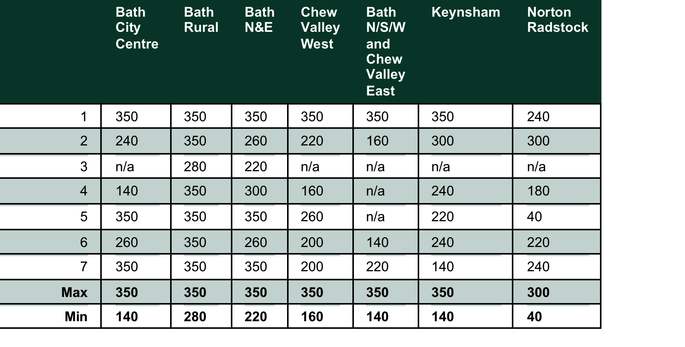
Maximum CIL Rates
Notes:
An example of rates indicating maximum and minimums.

Slide 74
Summary

Slide 75
Summary
Direct the viability work using your own local knowledge.
You are required to involve developers prior to the publication of draft rates
Use a rate setting workshop that brings together viability and projected income to reach an optimal solution
Notes:
In summary rate setting is an evidence-based judgement. It is best undertaken through a process that allows key decision-makers to understand the technical evidence, debate the implications of rates and come to consensus on their preferred rates.
There are many ways this can be achieved, however, lessons from the CIL Front Runners group showed clear benefits to:
Developing a working hypothesis for CIL rates (this helped shape the commissioning of viability studies as well as developing understanding and buy-in from decision-makers at an early stage)
Hosting a rate setting workshop with all key decision-makers in attendance (ensuring attendees were very well briefed beforehand)

Slide 76
Community Infrastructure Levy
Implementation

Slide 77
Contents
what you need to know
administration
new in 2014
  infrastructure in-kind contributions
  phased payments
  self build
  vacancy test
Polices
  Instalments
  Exceptional circumstances
CIL spending
Notes:
This part of the seminar series provides a high-level overview of the various aspects of implementing CIL.
We will cover the administration issues that have changed under the 2014 CIL guidance and regulations, and the basic policies you need to set in place.
Please note that preparing for the implementation / administration of CIL is at least as complex and time-consuming as setting rates. In fact it is almost certainly more complex and involves well orchestrated corporate working.

Slide 78
What you need to know

Slide 79
What you need to know
Implementation is technically more complicated than developing a charging schedule
The 2014 regulations have introduced some useful amendments
A number of policies are discretionary and require a decision to ‘turn on’
There is little in the regulations regarding how to spend CIL.
Notes:
The 2014 regulations have introduced multiple amendments. Many of these were covered by CLG’s earlier presentation.
There remains a number of policies that are discretionary and require a decision to ‘turn on’. This is your decision as the charging authority.
There is little in the regulations regarding how to spend CIL. This means you have a reasonable degree of flexibility, which is important for you to be able to respond to local circumstances. Nevertheless, spending remains a corporate matter for your Authority that requires careful business planning.

Slide 80
Implementation
Process

Slide 81
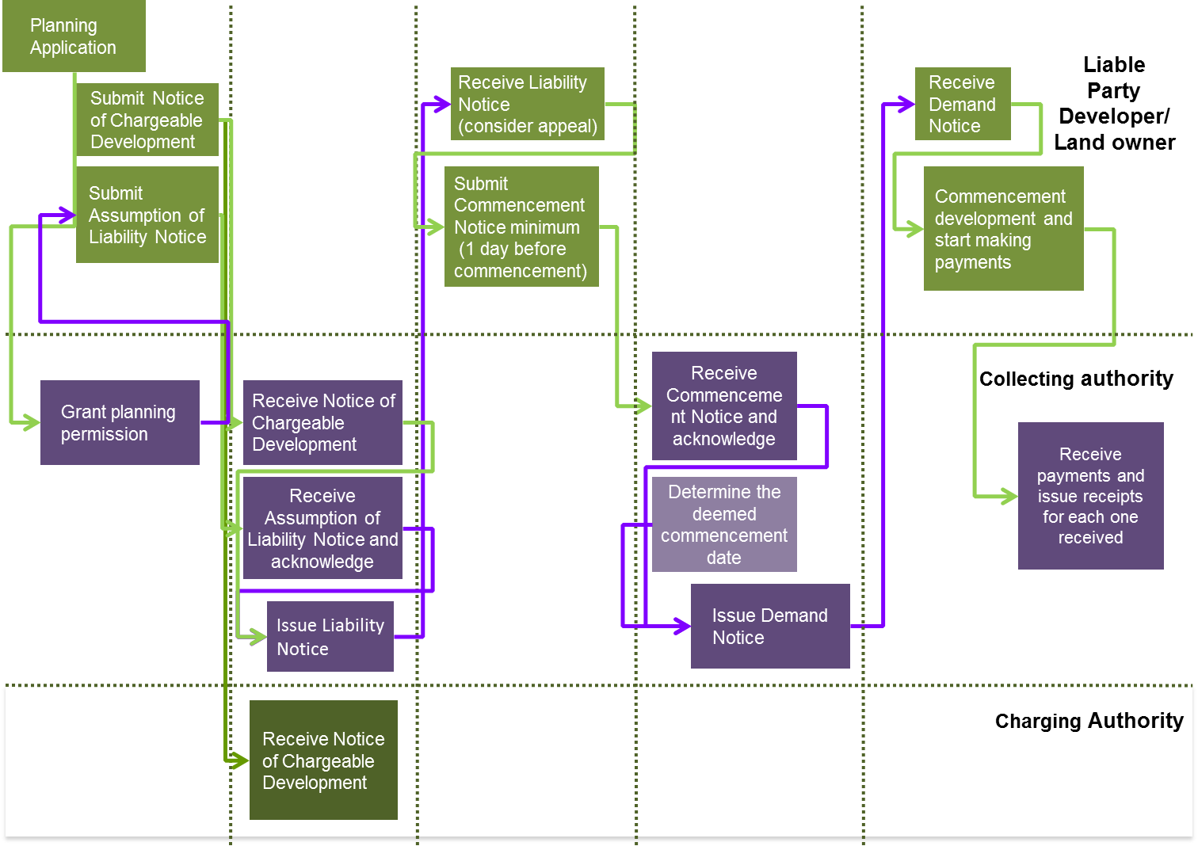
Administration flow chart
Notes:
This flow charge is a basic representation of the CIL collection process. There are hundreds of permutations that will need to be considered in practice.
The most important thing to take away from our discussion on this slide is that you will need to map the CIL collection process in detail. You will then need to compare that against existing processes within your authority for collecting s106 and council tax. Then you are well placed to consider how the existing process may be able to collect CIL. You will inevitably finds gaps, which will need to be addressed by adapting the processes.

Slide 82
Administration notices
Notice of chargeable development
details of development size (net increase) and usage.
Assumption of Liability
  details of parties assuming liability for CIL charge.
  Withdrawal of Assumption of Liability
  Transfer of Assumed Liability
Claiming exemption or relief notice
  details of claim for relief or exemption.
Liability notice
  charge due and payment procedure.
Commencement notice
  sets out date of commencement.
Demand notice
  sets out payments due in line with payments schedule.
Notes:
There are a series of Administrative Notices that need to be issued by you the Charging Authority or received by you from the developer.
Standard forms are available on the Planning Portal.
Many Charging Authorities have adapted the standard forms and sought to fully integrate the forms for the early stages of CIL into their Planning Application administrative process. We recommend all Authorities explore this from a point of view of keeping this as simple as possible for the customer.

Slide 83
Administration – enforcement
Schedule of surcharges
captured in regulations 80 to 86
late payment interest
warning notices
stop notices
  contravention carries a fine of up to £20,000 (or more on indictment).
Authority may apply to courts for an injunction
Liability reminder
  If no payment received within 7 days then authority may apply for a
  Liability order
  From magistrates court
Charging order
Local land charge
Prison…
Notes:
The Community Infrastructure Levy Regulations make provision for the collection of money and, where necessary, enforcement of collection of money.
Collecting authorities are able to impose a range of financial penalties on person(s) when the liability, collection and/or payment processes outlined above have not been followed correctly. These penalties are designed to ensure that authorities do not lose out financially.
In addition to the surcharge for late payment, a collecting authority must charge interest on any late payments.
Where development has started, the Levy has not been paid and the authority thinks it expedient to stop the development from progressing any further until payment is made, you may issue a stop notice. The process include first issuing a warning notice.
Ultimately the authority may apply to the Magistrates Court for a liability order against the relevant person.

Slide 84
Administration – appeals
Appeal against chargeable amount
within 28 days from date of liability notice
Calculation check undertaken by a person ‘more senior’ than the person who originally calculated the amount.
Appeal against apportioned liability
Appeal against surcharges
Appeal against deemed date of commencement
Appeal against a stop notice
Appeal for grievance against levy or attempt to levy to magistrates court
Notes:
There are a number of appeals open for liable parties which you need to be aware of:
Appeal against apportioned liability
Appeal against surcharges
Appeal against deemed date of commencement
Appeal against a stop notice
Appeal for grievance against levy or attempt to levy to magistrates court

Slide 85
New for 2014
Infrastructure in-kind contributions

Slide 86
Overview
Discretionary policy on both land and infrastructure in-kind
One or more infrastructure payments in satisfaction of the whole or part of the CIL
Infrastructure must support development of the CA area (maybe outside of area)
Must be relevant infrastructure
Must not be necessary to make the development acceptable in planning terms
Notes:
Regulation 73A(7)(b) allows the developer to pay for some or all of its CIL through the provision of infrastructure in-kind. This means giving the Charging Authority infrastructure rather than cash.
This is only allowed to happen if the infrastructure to be provided is identified on the charging authority’s regulation 123 list, and is not necessary to make the development granted consent acceptable in planning terms.

Slide 87
Process
The liable party must issue an agreement in writing stating:
  Value of infrastructure
  Date by which infrastructure will be provided
  That the CIL cash amount + interest that will be paid if the infrastructure is not delivered by that date (or otherwise
The value of the infrastructure (including related design costs) is determined by an independent person (joint appointed and suitability qualified) on the day the valuation takes place.
Notes:
Where a charging authority chooses to adopt a policy of accepting infrastructure payments, they must publish a document which sets out conditions in detail.
This document should confirm that the authority will accept infrastructure payments and set out the infrastructure projects, or types of infrastructure, they will consider accepting as payment
Land or infrastructure must be valued by an independent valuer who, in the case of land, will ascertain its ‘open market value’, and in the case of infrastructure the cost (including related design cost) to the provider. This will determine how much liability the ‘in-kind’ payment will off-set.
Payments in kind must be provided to the same timescales as cash payments, or otherwise on an agreed basis, subject to the provisions in the regulations and any other state aid considerations.

Slide 88
New for 2014
Phased payments

Slide 89
Overview
Where a planning permission is phased, each phase of the development is treated as if it were a separate chargeable development for levy purposes (see Regulation 8(3A) as amended by 2014 Regulations). This may apply to schemes which have full planning permission as well as to outline permissions.
Process
Must be set out in the planning permission
Each phase treated as separate chargeable development
Notes:
Previously Instalments policy was the only means of phased payments. It needed to be constructed around the variables of:
Number of payments
Proportion of CIL due at each payment
Time from commencement of development
Threshold (s) when instalments apply
Now, where a planning permission is phased, each phase of the development is treated as if it were a separate chargeable development for levy purposes. This may apply to schemes which have full planning permission as well as to outline permissions.
This is designed to ease cash flow for developers.

Slide 90
New for 2014
Self build

Slide 91
Overview
The exemption is applicable to homes built or commissioned by individuals for their own use.
Community group self build projects also qualify for the exemption where they meet the required criteria.
Conditions
Applicants can apply at anytime up to date of commencement
Property must remain principal residence for three years
For multi-unit developments recommendation is that phased planning application is used to make each unit a separate chargeable development.
Notes:
One of the more hotly debated changes has been the provision of relief for “self built’ homes because some feel it is open to abuse. The exemption is specifically applicable to homes built or commissioned by individuals for their own use.
Community group self build projects also qualify for the exemption where they meet the required criteria.
There are specific condition that need to be met:
The property must remain principal residence for three years
Proof of self build can take several forms including Self-Build mortgage certificates
You should note that for multi-unit developments recommendation is that phased planning application is used to make each unit a separate chargeable development.

Slide 92
Updated for 2014
Vacancy test

Slide 93
Overview
Parts of an existing building that are to be demolished or retained can be taken into account when calculating the chargeable amount
Lawful use for continuous period of 6 months within past 3 years
Notes:
The regulation relating to the vacancy test have changed in response to public consultation.
Where a building has been in lawful use for continuous period of 6 months within past 3 years it can be considered when calculating the amount of net additional development that is liable to pay CIL
Parts of an existing building that are to be demolished or retained can be taken into account when calculating the chargeable amount

Slide 94
Policies
Instalments

Slide 95
Instalments Policy
Instalments policy constructed around the variables of:
number of payments
proportion of CIL due at each payment
time from commencement of development
threshold (s) when instalments apply.
Authority must publish an instalments policy to allow payment by instalments.
Where no instalments policy in place default is full payment at end of 60 days after development has started.
Threshold of CIL Charge | Proportion of CIL Charge | Time from start of development
£0 | 100% | 60 days
Notes:
Instalments policy constructed around the variables of:
number of payments
proportion of CIL due at each payment
time from commencement of development
threshold (s) when instalments apply.
You should consider the impact on developer cash flow. Bear in mind this may be more significant for smaller developers.
Here are some examples from other authorities

Slide 96
Instalments Policies
Havant
Threshold of CIL Charge | Proportion of CIL Charge | Time from start of development
£20k | 100% | 120 days
£20k to £100k | 25% | 60 days
 | 25% | 180 days
 | 50% | 240 days
£100k to £250k | 25% | 60 days
 | 25% | 180 days
 | 50% | 360 days
£250k to £750k | 25% | 60 days
 | 25% | 180 days
 | 25% | 240 days
 | 25% | 360 days
Above £750k | 25% | 90 days
 | 25% | 180 days
 | 25% | 360 days
 | 25% | 540 days

Slide 97
Instalments Policies
Wycombe
Threshold of CIL Charge | Proportion of CIL Charge | Time from start of development
£20k | 100% | 60 days
£20k to £100k | 25% | 60 days
 | 75% | 120 days
£100k to £300k | 15% | 60 days
 | 35% | 180 days
 | 50% | 360 days
Above £300k | 15% | 60 days
 | 35% | 360 days
 | 50% | 540 days

Slide 98
Instalments Policies
Huntingdonshire
Threshold of CIL Charge | Proportion of CIL Charge | Time from start of development
£16k | 100% | 120 days
£16k to £50k | 25% | 120 days
 | 50% | 210 days
 | 25% | 270 days
£50k to £100k | 25% | 120 days
 | 50% | 240 days
 | 25% | 365 days
£100k to £500k | 25% | 150 days
 | 50% | 300 days
 | 25% | 450 days
Above £500k | 25% | 180 days
 | 50% | 450 days
 | 25% | 720 days

Slide 99
Policies
Exceptional circumstances

Slide 100
Exceptional circumstances
Conditions:
a section 106 agreement must exist on the planning permission permitting the chargeable development and
the charging authority must consider that paying the full levy would have an unacceptable impact on the development’s economic viability and
the relief must not constitute a notifiable state aid
Limitations on application of €200,000 over three year period
Notes:
The pre-conditions for granting exceptional circumstances relief has changed:
Council must still publish a statement giving notice that relief for exceptional circumstances is available in its area
A planning obligation has been entered into in respect of the planning permission which permits the chargeable development (this no longer has to be greater than the CIL amount)
The claim has to be submitted in writing on the appropriate form, this must also be sent to any other owners or holders of a material interest in the land.
An assessment has to be carried out by an independent person of the economic viability of the chargeable development. An independent person is one who has appropriate qualifications and experience and who is appointed by the claimant with the agreement of the council
An explanation needs to be provided as to why, in the opinion of the claimant, payment of the chargeable amount would have an unacceptable impact on the economic viability of that development
Most importantly the relief must not constitute a notifiable state aid: Limitations on application of €200,000 over three year period for any one company

Slide 101
Implementation
Spending CIL

Slide 102
What the regulations say
CIL has to be spent on the provision, improvement, replacement, operation or maintenance of infrastructure
No provision for infrastructure prioritisation
Have to specify which infrastructure categories/ projects that S106 will not be sought for (reg 123 list)
15% is allocated for neighbourhood funding and can be spent on anything else that is concerned with addressing the demands that development places on an area’
Annual report on CIL spending required
Notes:
Rules relating to the spending of CIL remain flexible so long as CIL is spent on the provision, improvement, replacement, operation or maintenance of infrastructure that supports the delivery of growth in your local area, in line with your local plan.
You have to specify in your reg 123 list, the infrastructure categories/ projects for which S106 will not be sought. Note that there is no need to prioritise provision for infrastructure prioritisation on your regulation 123 list. Furthermore, you are not strictly required to spend CIL on the items listed in the Reg 123 list.
A minimum of 15% must be allocated as neighbourhood funding and can be spent on anything else that is concerned with addressing the demands that development places on an area’.
You are required to report annually on CIL spending. Where it is not the Local Authority spending CIL (i.e. it is the County or Parish) you will need to ensure they are geared up to provide the correct monitoring data in a timely manner.

Slide 103
What councils are doing
Linking regulation 123 list to corporate capital spending priorities & processes
Generic v Specific regulation 123 lists
Neighbourhood CIL income & local infrastructure priorities
Notes:
There is a wide variety of practice in setting Reg 123 list.
Linking reg 123 list to corporate capital spending priorities & processes:
There is no reason why there should not be a strong overlap between capital spend priorities in a Charging Authority and its Infrastructure Delivery Plan (and therefore its Reg 123 list). This is even more the case for unitary authorities who are directly responsible for a wider range of infrastructure items.
Consequently, many local authorities are integrating the process of taking spending decision on CIL with their corporate capital investment decision-making process. Capital budgeting usually happens annually – this may be called the annual budget challenge or ‘star chamber’ or something similar.
In the case of the authorities that integrate CIL into their capital programme, they simply see CIL as just one of many forms of funding.
This process has not stopped some from adapting the Reg 123 list during the year if required.
Generic v Specific regulation 123 lists… How specific should you make your reg123 list?
Given that a Reg 123 list specifies the infrastructure categories/ projects for which S106 will not be sought, local authorities are increasingly creating specific lists because these give flexibility for negotiating s106. This approach leaves maximum flexibility for s106 to be used to mitigate unforeseen issues that cannot be dealt with through normal development. However, it is very important for this to not result in an unreasonable burden on development.
Linking neighbourhood CIL income to local infrastructure priorities
Many councils are concerned about the requirement for 15% to be passed to the Parish, where this is perceived to have a negative impact on that area’s ability to deliver the infrastructure requirements necessary to implement the Local Plan. However, in our view this creates more of a reason for the various tiers of Government to work together. For example, several council's are exploring Service Level Agreements between all tiers of local government to formalise their joint processes of prioritising CIL expenditure.

Slide 104
Implementation
Approach

Slide 105
Implementation - Approach
Set it up as a defined project with a project manager, project sponsor, governance etc.
Define the existing resources, systems, processes and procedures that you have in place to collect and enforce development contributions.
Define the required systems, processes and procedures that you will require to implement an efficient CIL collection and administration regime.
Map the journey between the two.
Notes:
So how do you go about preparing for implementing CIL?
It needs to be treaded as a project. This includes:
Set it up as a defined project with a project manager, project sponsor, governance etc.
Define the existing resources, systems, processes and procedures that you have in place to collect and enforce development contributions.
Define the required systems, processes and procedures that you will require to implement an efficient CIL collection
Defining the administration regime and how it might need to be adapted to support CIL (i.e. this things we’ve previously discussed such as your Annual Budget Challenge, or s106 collection mechanism and your council tax collection mechanisms)
Map the specific activities required to implement CIL
Ensure you plan in sufficient time to test the systems before you go live

Slide 106
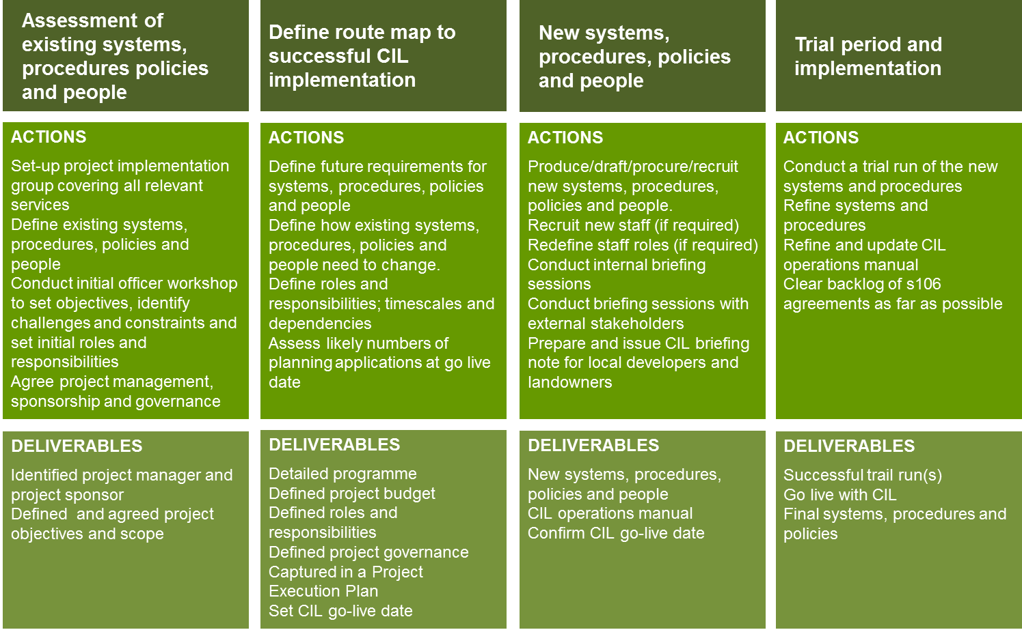
Stages, actions and deliverables
Notes:
This slide describe the main activities and products you can expect when implementing CIL. It is not an exhaustive list.

Slide 107
Summary
Start planning, and doing, now.
Use the good news story from CIL to energise the implementation process.
Make sure that the CIL income estimates you present always deduct an allowance for administration.
Notes:
In summary, you should start planning for implementation at an early stage.
We find it is helpful to use the good news story from CIL to energise the implementation process (including the estimated income)

Slide 108
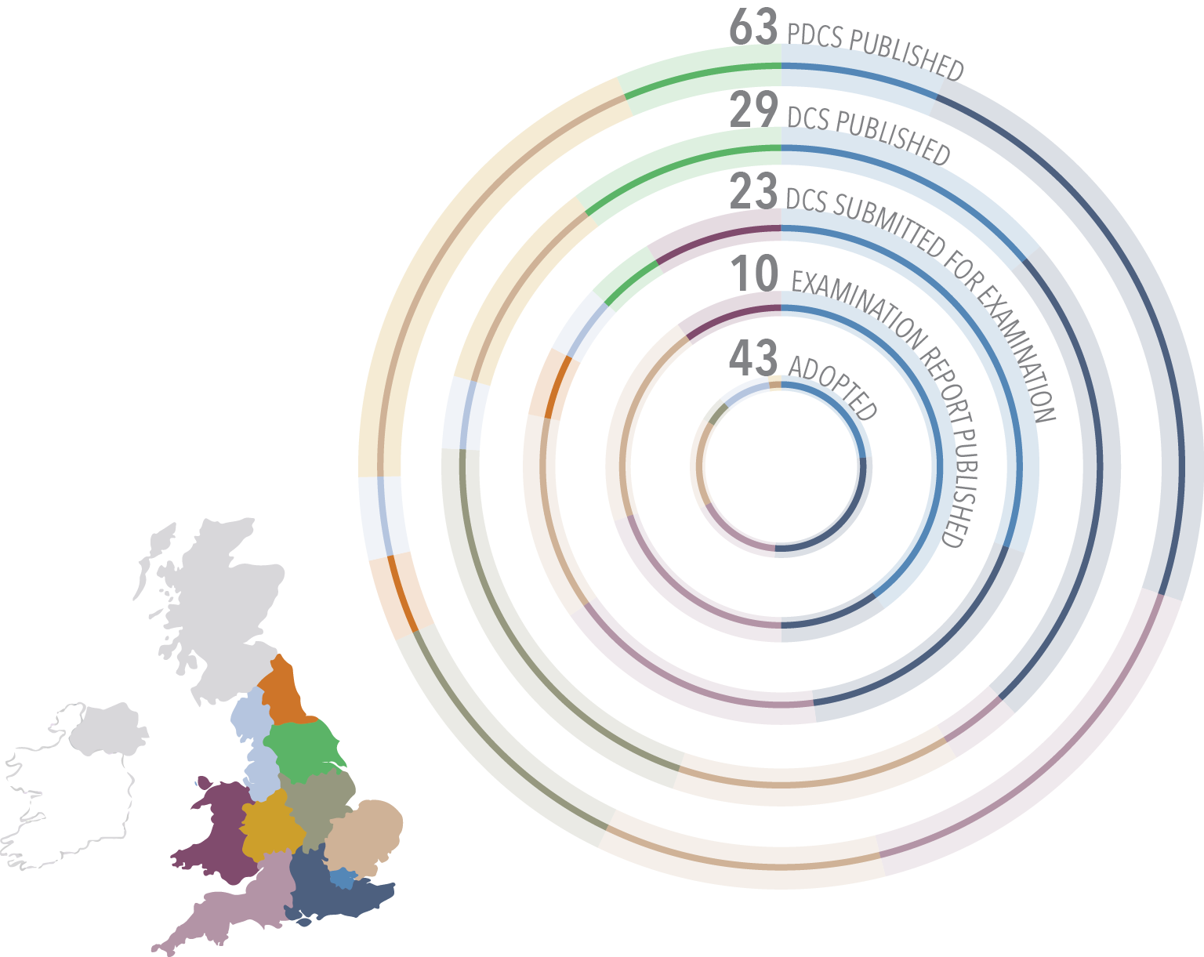
CIL around the country – less than 40 weeks to go
168
Notes:
This slide shows the state of progress for English and Welsh Authorities.

Slide 109


Questions
www.CILknowledge.com

