Slide 1
Karl Roberts
Assistant Director
Planning & Economic Regeneration
Arun District Council

Slide 2
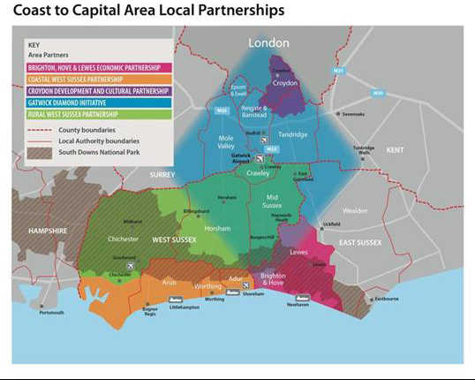
COASTAL WEST SUSSEX & GREATER BRIGHTON STRATEGIC PLANNING BOARD
Who and where are we?

Slide 3
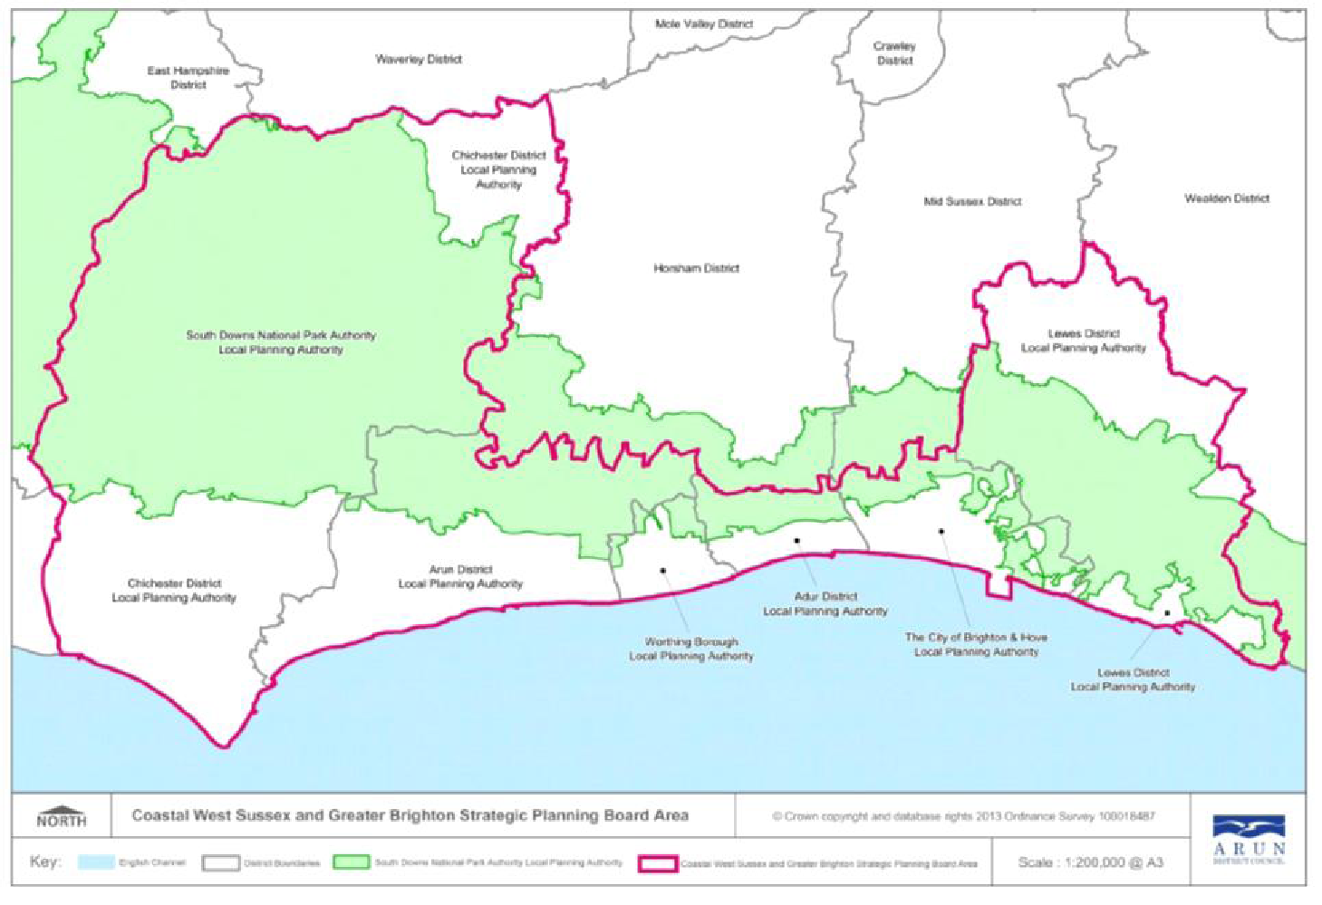

Slide 4
WHY DID WE COME TOGETHER?
Emerged out of work undertaken by the Coastal West Sussex Partnership on an Employment & Infrastructure Strategy (2012)
Manage Strategic Issues (LSS) – ‘larger than local’
Address in part the Duty to Co-Operate

Slide 5
WHAT HAS BEEN ITS IMPACT?
Agreed to create a Local Strategic Statement:
a framework to help integrate and align the investment priorities and plans of public and private sector bodies, including the Local Economic Partnership (LEP);
a clear set of priorities for funding opportunities; and
a mechanism for contributing to and coordinating work on strategic planning and economic activity in the wider area.

Slide 6
All authorities wanted the Statement to:
have a direct influence on individual Local Plans
highlight the strategic challenges along the coast, with possible ways of addressing these.
be ‘evidence-based’ and
be deliverable, with importance attached to the need for a delivery plan.

Slide 7
Authorities commissioned ‘A Duty to Cooperate Housing Study Report’
Reviewed the OAN for each authority
Good opportunity to discuss common issues

Slide 8
WHAT HAVE BEEN SOME OF THE CHALLENGES?
A mix of Councils (rural – urban; rich – not so rich; A County Council, A National Park Authority, A Unitary and Districts & Borough’s; Conservative & Green led plus NPA)
Local Plans have been well advanced so this has influenced the content of the LSS.
Linking in with the needs of the Local Enterprise Partnership

Slide 9
WHERE ARE WE NOW?

Slide 10
WHERE ARE WE NOW (2)?
Agreed to refresh the LSS
Agreed to appoint a part time, fixed term advisor to the Board
Working on the prioritisation of transport schemes across the Board area
Need to engage with other neighbouring partnerships (Gatwick Diamond)
Start thinking about other work to inform future plans

Slide 11
KEY LESSONS
Try and build on existing partnership arrangements
Have your CE’s & Leaders bought into the process?
Don’t try and take on too much at the beginning
How is your group to be resourced?

Slide 12
FURTHER READING
http://www.pas.gov.uk/4-plan-making/-/journal_content/56/332612/6057797/ARTICLE

