Slide 1
Focus on Enforcement
Alice Lester – Programme Manager
4th Nov - Bristol
www.pas.gov.uk

Slide 2
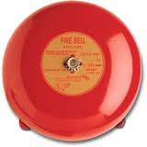
Housekeeping + Introductions
Notes:
Scott Britnell from Cotswold District Council – Scott will do the Enforcement Plans section
Izindi Visagie from Ivy Legal – Izindi will do the POCA section
Housekeeping points:
Toilets
Turn phones to silent
Feel free to tweet
Fire procedures
Where will lunch/refreshments be
Evaluation forms

Slide 3
Agenda and Aims
Enforcement Plans
Proceeds of Crime Act (POCA)
S215 Notices
Voluntary Start Notices
Notes:
A greater understanding of what they are and how they can be used. Help you to explain to Members and the public.
Help be more proactive and not seen as the ‘last resort’ service.

Slide 4
What is Planning Advisory Service for?
“The Planning Advisory Service (PAS) is part of the Local Government Association. The purpose of PAS is to support local planning authorities to provide effective and efficient planning services, to drive improvement in those services and to respond to and deliver changes in the planning system”
(Grant offer letter for 2014-15)
Notes:
DCLG funded
Live within the LGA
Focus for past few years has been on plan led system (includes neighbourhood plans)
Expect that to continue, but also with an increased emphasis on supporting performance – in fact that is explicitly referenced in the consultation document – para 22.
4

Slide 5
The Planning Advisory Service
We
Are funded by £2m from DCLG to the LGA
Work for English Planning Authorities
Have been around ever since 2005 (Planning Act) and subsequent reform
Reduce cost, risk and delay through pilots, toolkits, Q&A
We are not
A thinktank, “experts”, a lobby group or researchers

Slide 6
Duty to Cooperate
Strategic planning
Plans in place
Pre-app, PPAs, conditions
Essentials
Strategic issues
Enforcement
Leadership
Delivery
Evidence
CIL & S106s
Energy & climate change
Committee training & peer review
Local plans
Viability
Viability Training
Project mgmt
Good decisions
Peer challenges
Successful plan-making
Sustainability Appraisal
Housing needs
Improvement
Community engagement
Neighbourhood plans
Designation
Peer support
Resources
Events, toolkits and materials
Planning Quality Framework
Resource Review
Notes:
All of these things, and more, either being delivered, written, planned.
Grouped around priorities in the grant agreement, but also when we see a need for something, we do it.
Work in different ways – materials on the website, accessible to all
- events or small sessions with groups of authorities
- intensive, onsite, direct support
6

Slide 7
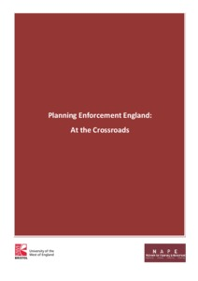
Enforcement work
Joint with NAPE
Need to build examples
4 ‘tools’ highlighted:
Enforcement Plans
Start Notices
S215 Notices
POCA
Notes:
Used the UWE/NAPE publication ‘Planning Enforcement England: At the crossroads’ from 2014. This highlighted that there are existing tools in the toolbox which are perhaps not being used as widely as they could be and suggested they would benefit from greater publicity and focus. We have picked this up for our advice note.
We do have examples when it comes to Enforcement Plans and also use of POCA but there can always be more.
So the purpose of today is also to get you sharing the work you have done, or sharing reasons why you haven’t been able to pick up these tools to date. If we understand the barriers we can improve the advice on how to overcome them.

Slide 8
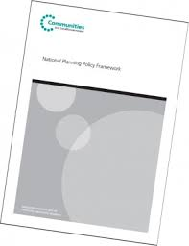
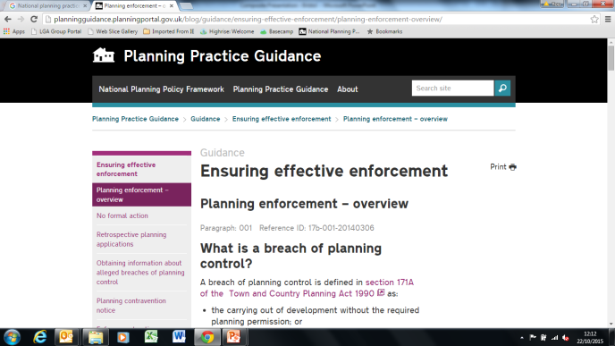
Enforcement Plans
NPPF Para 207
“local planning authorities should
consider publishing a local enforcement
plan to manage enforcement proactively”,
PPG
Adds nothing on this

Slide 9
Enforcement Plans - Process
Link to Corporate Enforcement Policy and Local Plans
Member involvement
Engage with officers (and end users)
Adopt through appropriate Committee/Cabinet

Slide 10
Enforcement Plans - Content
Local Plan link – support ‘themes’
Clear service standards
The need for compliance
Consider ‘Projects’ - Member buy-in on pro-active enforcement
Consider chargeable services
Use appendices and glossaries
Notes:
Be clearly linked and explained in the Local Plan
Set out clear service standards for investigating alleged breaches including performance indicators, prioritisation and monitoring
Explicitly support the ‘themes’ of the Local Plan
Also include and be clear about the need for compliance
Consider having a section on ‘projects’ where there is member buy in on pro-active enforcement - this is likely to be reviewed regularly as priorities change
Consider whether some form of chargeable services could work or at least be clear that referral to a chargeable pre-app service is the policy for rectifying appropriate breaches and that the planning enforcement case officer will be in attendance
Contain appendices and glossaries to demystify service if necessary

Slide 11
Enforcement Plans - Discussion
Who has a post-NPPF one?
Member involvement?
Local ‘projects’?
Advantages v disadvantages

Slide 12
POCA in Planning Enforcement
Introduction to POCA in Planning Enforcement
Applying POCA to Planning Enforcement Breaches
POCA procedure to secure confiscation
Examples of where LPAs have used POCA in Planning Enforcement

Slide 13
Introduction
“ The legislation is intended to deprive defendants of the benefit they have gained from relevant criminal conduct, whether or not they have retained such benefit, within the limits of their available means.”
House of Lords in R v May, Jennings v CPS and R v Green (2008)
Majority of cases involve offences of theft, dishonesty, drug dealing.
Planning Enforcement – underused, but increasingly better utilised.
Key advantages – profits forfeited and LPA receives portion of proceeds.

Slide 14
Selected planning offences relevant for POCA
Town and Country Planning Act 1990
S179 - failure to comply with an enforcement notice
S194 – false or misleading statements on CLUED application
S210 – non-compliance with TPO
S224 – non-compliance with Town and Country Planning Control of Advertisement – (England) Regulations 2007
Planning (Listed Buildings and Conservation Areas) Act 1990
S9 – Carrying out works to a listed building without consent
S43(1) – non-compliance with Listed Buildings Enforcement Notice

Slide 15
POCA Procedure
Consider restraint as soon as criminal investigation is initiated
Conviction
Ask Crown Court to proceed with confiscation order
The Crown Court must proceed under this section if the following two conditions are satisfied
He is convicted of an offence or offences in proceeding before the Crown court; or is committed to the Crown Court for sentence AND
The Prosecutor asks the court to proceed under this section, the court believes that it is appropriate to do so.

Slide 16
POCA Procedure
Prosecutor to provide statement of information (S16)
Statement by Accredited Financial Investigator
Should include specifics set out in Rule 5(2) of the Crown Court (Confiscation, Restraint and Receivership) Rules 2003 (SI 2003 No. 421))
In practice, will paint a picture of defendant, history, assets etc.

Slide 17
POCA Procedure
Court identifies whether case is general or particular criminal conduct matter
General –sch. 2; course of criminal activity and / or offence committed over a period of 6 months and defendant has benefited
If general, 4 assumptions MUST be made (S10)

Slide 18
POCA Procedure
Defendant to reply to statement of information (S17)
Court may request further specified information from defendant (S18)
Court decides whether Defendant has benefited from criminal conduct
(Remember R v Waya (2012) UKSC 51)

Slide 19
POCA Procedure
Court determines the recoverable amount
Defendant may prove s/he can only pay available amount
Court makes confiscation order
When confiscation with incentivisation scheme

Slide 20
Asset Recovery Incentivisation Scheme
When paid, proceeds from confiscation orders split:
Home Office 50%
Prosecuting authority 18.75%
Investigating authority 18.5%
HM Court Service 12.5%
Therefore, if LPA is prosecuting and investigating authority, it can receive 37.5% of proceeds

Slide 21
Enforcement of confiscation order
Payment due immediately
Time to pay immediately or up to 3 months by application if assets need to be realised
Enforced as a fine
Default sentence up to 10 years
Enforcement Receiver can be appointed to realise assets

Slide 22
Examples of POCA in Planning
Confiscation orders obtained in 2010
Hounslow Council obtained an order for £180k – flat conversion
Bishop Stortford obtained an order for £760k – park and ride facility
Confiscation obtained orders in 2011
Bexley Council initially obtained an order for £180k for proceeds from the sale of cars from the defendants home but unfortunately the defendant was unable to pay and was ordered to pay £3k
Richmond Council obtained an order for £110k against thrice convicted defendant for flat conversion

Slide 23
Examples of POCA in Planning
Confiscation orders obtained in 2012
Brent and Harrow obtained an order for £1.4m –single house converted into flats
Runnymede obtained an order for £250k for using green belt land for commercial purposes
Confiscation orders obtained in 2013
South Bucks DC obtained an order for £33k for unlawful operation of a car park in the Green belt
Ealing council obtained a £11k order for illegal use of an outhouse building as rental property
Barnet Council obtained a £75k order for converting 2 houses into flats
Haringey Council obtained an order for £310k – landlord convicted of unauthorised changes of use of single residential dwellings

Slide 24
Summary
Introduction
Using POCA for specific breaches of planning control
POCA procedure
Examples

Slide 25
POCA Discussion
Any questions?
What opportunities in your area
Barriers to using POCA
Advantages v disadvantages

Slide 26
S215 TCPA
“If it appears to the local planning authority that the amenity of a part of their area, or of an adjoining area, is adversely affected by the condition of land in their area, they may serve on the owner and occupier of the land a notice under this section.”
Non-compliance- summary conviction & level 3 fine
Further non-compliance- fine 1/10th for every day

Slide 27
S215 appeal
28 days to appeal to Magistrates’ court
that the condition of the land does not adversely affect the amenity of the land;
that the condition of the land has resulted in the ordinary course of events from the lawful use of or operations on the land’
that the requirements of the notice exceed what is necessary for preventing the condition of the land from adversely affecting the amenity of the land;
that the period for compliance is too short
Further appeal to Crown Court possible
Problem for LPA
Wide scope
Magistrates often inexperienced in Planning law
Delays

Slide 28
S215 Direct Action
LPA may enter the land and take the steps required by notice & recover from owner expenses reasonably incurred in doing so.
Some LPAs use regularly for small sites
Can be uncomplicated & inexpensive

Slide 29
S215 Notices
Do you use these and, if so, how regularly, and on what?
Is there a persistent local problem that use of S215 could help solve?
Are they widely understood in your council and if not, how will you ensure they are?
Advantages v disadvantages

Slide 30
Voluntary Start Notices
Compulsory in Scotland
Helps council proactively monitor development
Keep it simple – yields returns

Slide 31
Start Notices
Use in your area?
If not, why not? Resources?
Advantages v disadvantages

Slide 32
We need your feedback

Slide 33
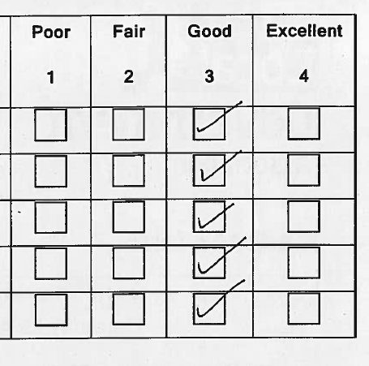
This is nice, but we want more
We need to know what you think
Comments triply welcome
We read all of them
We use your ideas to change what we do and how we do it

Slide 34
Follow-up evaluation
We employ Arup to follow-up on our work
On reflection, was today actually useful?
10 mins of feedback in return for £100’s of support
Our board use this to decide what we do with our grant. If we don’t get positive feedback we are unlikely to continue

Slide 35
Recent & forthcoming PAS activity
PAS Autumn Conference
Planning Decisions
Pre-Application Discussions

Slide 36
Three things to do before 10am tomorrow:
Sign up for the PAS Bulletin.
Follow us on Twitter.
Sign up to the Khub.

Slide 37
Please leave your badges
The support doesn’t end now:

