Slide 1
Neighbourhood Planning
Planning Advisory Service
Jan / Feb 2015

Slide 2
Localism and Growth
“Planning should be a positive process, where people come together and agree a vision for the future of the place where they live. It should also - crucially - be a system that delivers more growth. Our aim with the Localism Bill is not to prevent new building, but to promote it”
Greg Clark, Pro-localism and pro-development: A speech to the Adam Smith Institute, 2 February 2011
“Neighbourhood plans are the key to unlocking more house-building (…) If you give people power, they will use it responsibly. If you explain to them what their community and their country needs, they will do their bit to make sure it is provided. And if you give them a stake in a future in which beautifully designed homes with easy access to green space are, once again affordable for working people on ordinary wages, they will do what it takes to bring that future about”
Nick Boles, ‘Housing the next generation’ speech to Policy Exchange, 10 January 2013

Slide 3
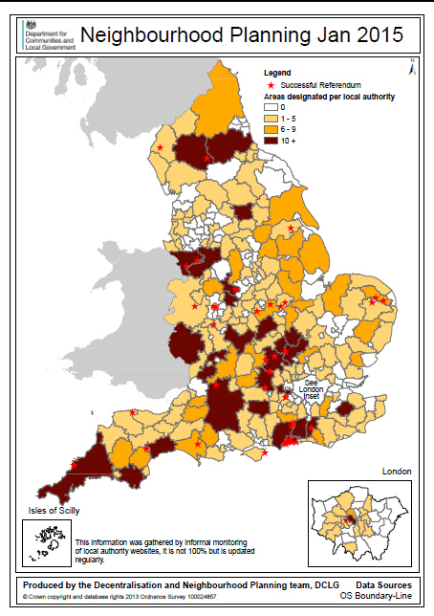
A growing movement
This data was informally gathered from internet monitoring and is being constantly updated

Slide 4
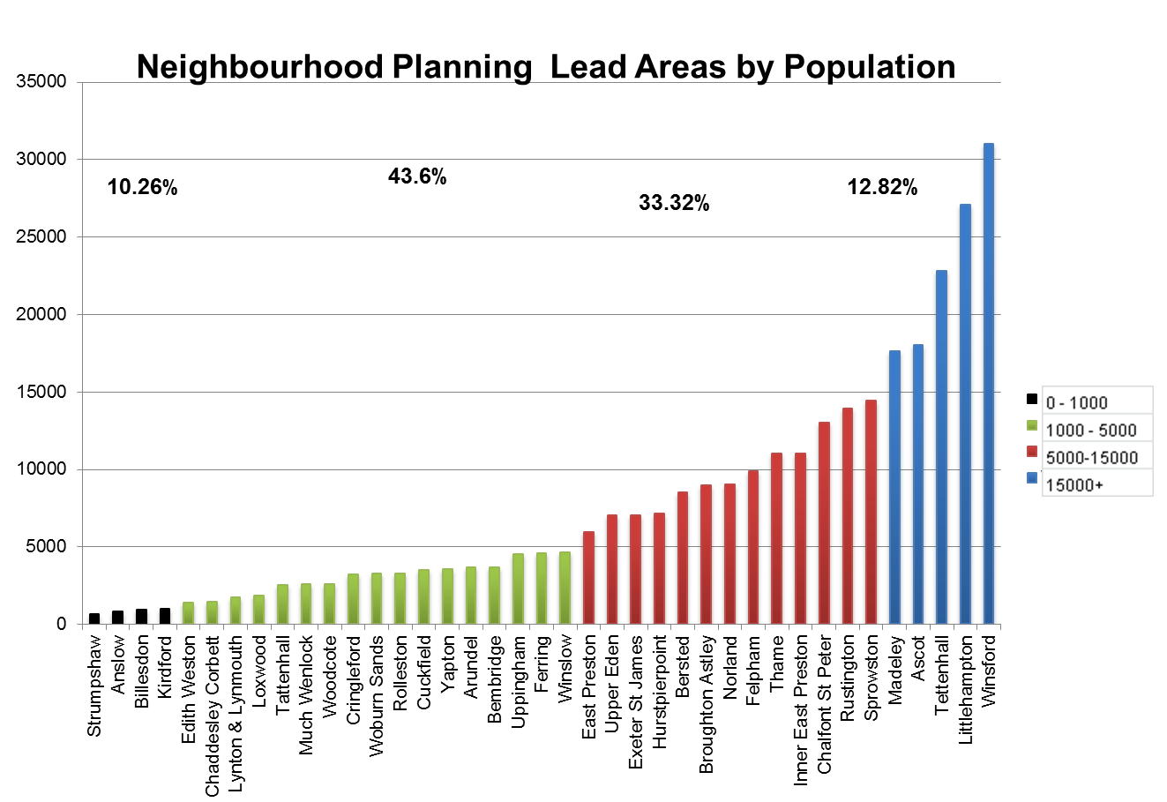
All shapes and sizes

Slide 5
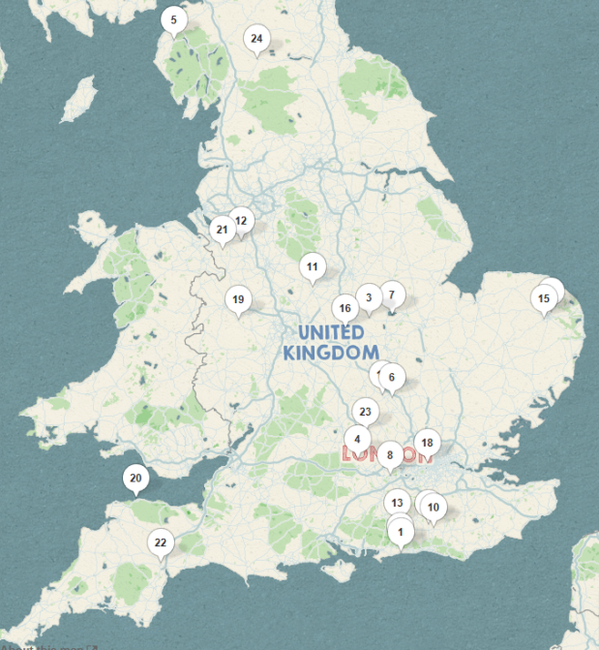
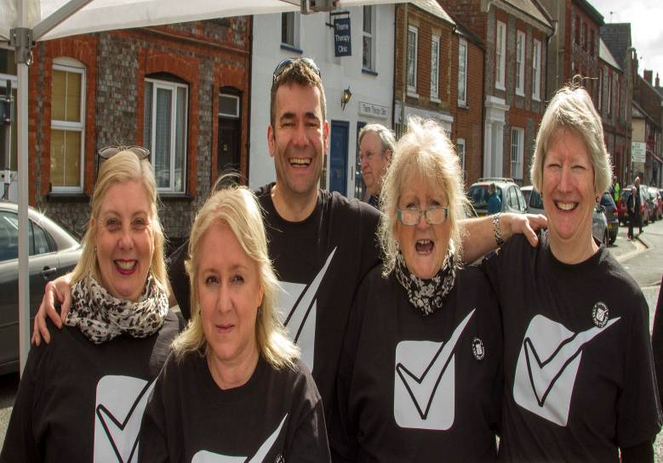
Applications 1323
Designations 1180
Pre- submission 191
Average
‘Yes’ vote
87%
Turnout 33%
Examination 115
42
26
7
33
At Examination
Passed Referendum
Neighbourhood plans
Passed Examination
MADE
Total:
(108)
(66)
(40)
(33)
Neighbourhood Planning
From the Ground Up
62%
of Local Authorities contain designated neighbourhood planning areas
Local Authorities
There are 336 local planning authorities
(not including county councils)

Slide 6
The starting point….
This decision can also be seen as the green light for projects which have been proposed.
The Steering Group has been eager to make a start with Queens Crescent Garden, the top priority project, and plans are being made for the setting up of a Community Interest Company to assume responsibility for the development and future management of this community green space

Slide 7
Neighbourhood planning review
“ We have, I think, now reached the point where there has been enough experience of neighbourhood planning with enough different kinds of communities for us to learn lessons and to ask whether there is not a version of neighbourhood planning that might be more easily accessible and quicker for some communities. We are doing that work, and we are very keen to hear from any hon. Members and communities with their thoughts on how we can achieve that”.
Nick Boles, Minister for Planning, 3 March 2014

Slide 8
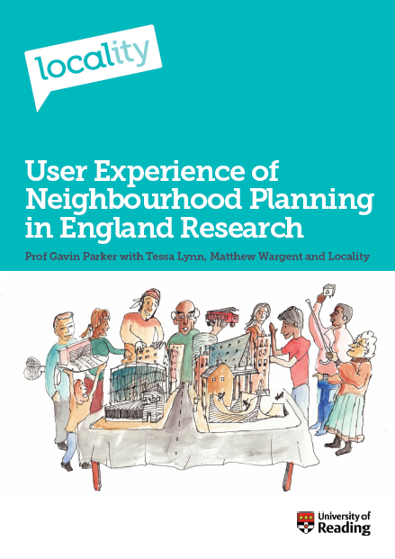
Primary research
Interviewed 120 groups producing a neighbourhood plan and convened six focus groups
50 forums & 70 from urban areas
75% per cent definitely or may use plan to allocate sites for housing
Over 90% reported that the process had gone ‘well’ or ‘OK’
59% proportionate to the task of developing a plan that will have statutory status
82% able to access the skills and knowledge needed for neighbourhood planning
Suggestions to reduce the burden focused on:
greater understanding of the effort required, and the scope of neighbourhood planning, at the beginning of the process
local authorities could be more proactive in encouraging neighbourhood planning in their area
production of toolkits and appropriate guidance
82 % stating that their authority had been ‘very’ or ‘somewhat’ supportive
more structured partnerships and agreed demarcation of roles and actions
dedicated liaison staff
more clarity about what to expect from local authorities under the duty to support.

Slide 9
Technical consultation on planning
statutory time limit within which a local planning authority must make a decision on whether to designate a neighbourhood area
removing the current statutory requirement for a minimum of six weeks of consultation and publicity by those preparing a neighbourhood plan or Order.
require those preparing a neighbourhood plan to consult certain landowners.
introduce a new statutory requirement (basic condition) to test the extent of the consultation undertaken during the preparation of a neighbourhood plan or Order (including a community right to build order).
clarify the information that should be submitted with a neighbourhood plan in order that its compatibility with obligations under the Strategic Environmental Assessment Directive

Slide 10
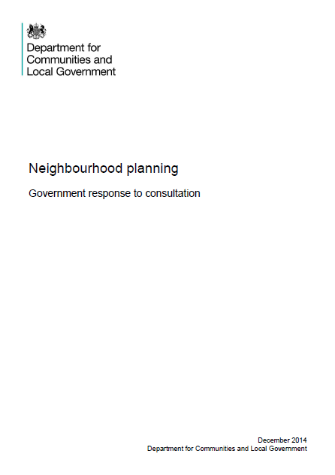
Regulatory reform
Prescribe the time period within which a local planning authority must make a decision on an application for a neighbourhood area to be designated.
20 weeks in a case where the area to which the application relates falls within the areas of two or more local planning authorities
8 weeks in other cases, where the relevant body is a parish council and the area to which the application relates is the whole of the area of the parish council
13 weeks in all other cases
In all cases the time period runs from the date immediately following that on which the application is first publicised by the local planning authority

Slide 11
Regulatory reform
One of the following documents must be included with a neighbourhood plan proposal when it is submitted to the local planning authority:
a statement of reasons for a determination under regulation 9(1) of the Environmental Assessment of Plans and Programmes Regulations 2004 that the proposal is unlikely to have significant environmental effects
an environmental report in accordance with paragraphs (2) and (3) of regulation 12 of the Environmental Assessment of Plans and Programmes Regulations 2004

Slide 12
Resources
31 October Ministers announced:
Additional £1 million for grants during this financial year
£100,000 to enable groups to organise workshops on neighbourhood planning in their local area
£12 million funding for 2015/16 for local authority new burdens
£22.5 million support package over 2015 to 2018

Slide 13
Neighbourhood planning support contract
£22.5 million support package over 2015 to 2018
50 % increase on current support programme
Grants of up to £8,000
Priority groups
- additional grants of up to £6,000
- access to direct technical support
££££££££££££££££££££££££££££££££££££££££££££££££££££££££££££££££££££££

Slide 14
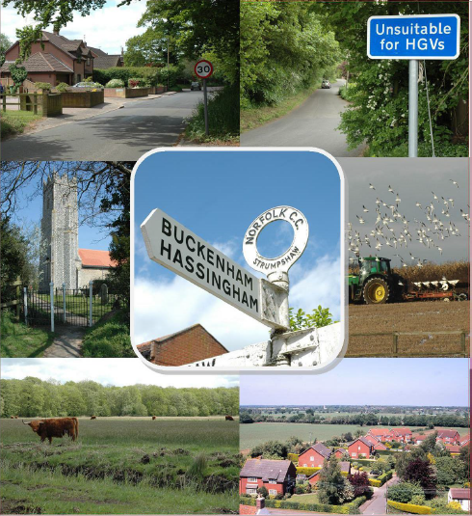
Case studies on cost …
In the small coastal village of Lympstone: £6,389
In the large Leicestershire village of Broughton Astley: £14,312
In the Exeter ward of St James: £10,450
In the deprived urban area of Heathfield Park: £19,500
In the coastal towns of Lynton & Lynmouth in Exmoor: £27,681
In the small Norfolk village of Strumpshaw: £4,220
Sample of spending £3,455 printing
£280 wood for posters £263 stationary and ink £141 miscellaneous costs (CDs, post, refreshments and photocopying) £44 land registry £36 room hire
TOTAL SPEND: £4, 220
Average: £13,758

Slide 15
Tools, templates & support

Slide 16
#neighbourhoodplanning
miranda.pearce@communities.gsi.gov.uk

