Slide 1
Planning Performance
Frances Wheat (Assistant Director Regeneration and Planning)

Slide 2
Our Story So Far
Pre 2013 - Traditional Target based culture (8/13 Weeks)
Benefits – Applications generally determined in timely manner
Problems – Targets dictated behaviour, too many checks/handovers, the process was king, system not fully focused on our customers.

Slide 3
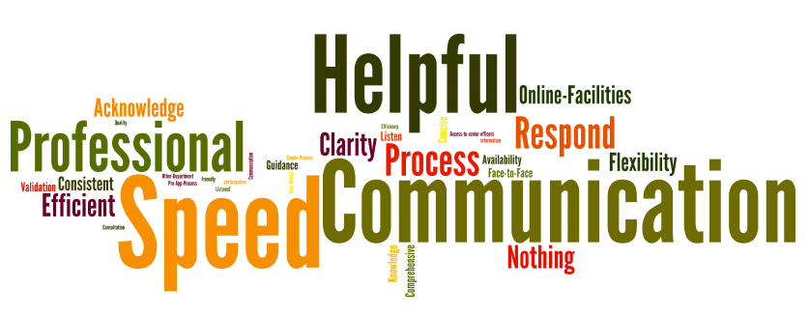
What our customers said…
What we do well…
What we could do better …
Notes:
3
In order to assess what matters to our customers we identified who our customer groups are (including agents, applicants, residents groups, complainants, neighbours and councillors) and surveyed 124 people from these groups.
We asked them to rate us out of 5 (1 being poor and 5 being good), what we do well and what we could do better.
We averages a 3.5 out of 5 which is good but does leave room for improvement
From the answers to the questions we asked clear customer priorities emerged – as you can see here when we do things well our customers value our speed and level of communication, when things go wrong it is generally because we are slow and don’t communicate well with our customers.
These clear themes of speed and communication which have informed what we are trying to achieve through redesigned the system.
OUR CUSTOMERS HAD PLENTY TO SAY AND HERE ARE A FEW QUOTES FROM OUR CUSTOMERS

Slide 4
How the story continued
New measures
Timeliness
Customer Service
Quality
Cost
2013 - System Thinking Review
Benefits - Removal of traditional targets, focus on getting things right first time (fewer repeat applications), move to electronic working
Problems – Still to many checks/handovers, applications generally taking longer to determine, system based on risk rather than on efficiency and customer need.

Slide 5
Camden Quality Indicator
Quality hardest to measure
Camden Quality Indicator measures quality of development and value added
Outcome based assessment
All majors applications are measured except change of use
Based on Camden Building for Life
Environment, Character, Streets, Design

Slide 6
Example of Camden Quality Indicator results
Planning approval
Total Score out of a possible 20
Submission of pre-app advice | 12.6
Approval of planning permission | 16.9
Percentage change / value added = 25%
range of average scores vary between 2.5 and 5
Notes:
This example is based on 13 planning applications from the 2013/2014 financial year. The value added is present both through the chart and as the values in each section have increases. In this example it shows that more of value has been added in the Design and character sections. It also illustrated in a percentage showing a 25% in total. The range for scores for the planning approvals score is between 2.5 and 5. The wide range could indicate why the score of 16.9 was below the desired score of 17 for a planning approval.

Slide 7
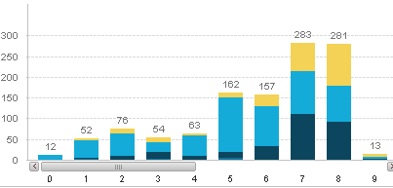
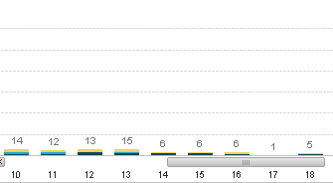
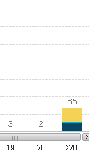
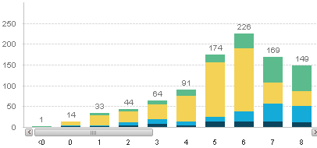
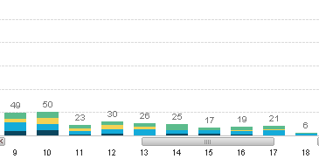
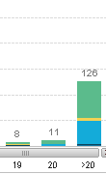
Time taken to decide applications: number of weeks from registered
Quarter 3 (October, November, December 2012)
Quarter 3 (October, November, December 2013)
Notes:
Reasons:
Pro:
Applications done in one go: historically withdrawn/ last minute refusal/ duplication of application- with no fee for 2nd application
Cons:
8 week target date removed- but no consistency in earlier decision making/ customer engagement- applications just taking longer for no justifiable reason/

Slide 8
Reflections – What we did next
Recognition that some parts of system not working for us, or our customers
Set up a trial team (Planning Solutions Team), designed new system for handling of applications (June 2014)
Focussed on less handovers, less checks, more efficiencies, and a better customer experience
Further roll in of staff in October 2014, and January 2015

Slide 9
What do our customers want ?
They told us two things:-
In most cases they wanted a timely decision
They wanted to communicate with the case officer

Slide 10
Translated into a service vision
Do things ‘right first time’
Focus on customer needs
Remove waste and inefficiencies
Focus on delivering customers a quality and value for money service
End-to-end responsibility within one team, working together to deliver positive outcomes

Slide 11
Highlights of change
Self Allocation - Take ONE AT A TIME, no historic caseload)
NOT DRIVEN BY TARGETS, more so the needs of customer.
ONE CASE OFFICER – No official validation stage process – no handovers
Approach to PROBLEM SOLVING FROM THE OUTSET
PROPORTIONATE APPROACH TO REPORT WRITING i.e. no objection, no report
CHANGE TO ROLE OF PLANNING TECHNICIAN

Slide 12
Timesheeting/Value Analysis
 | June 2013 | Nov 2014
Value Demand | 62% | 82%
Failure Demand | 38% | 18%
We have increased our ‘value demand’ from 62%
to 82% between June 2013 and Nov 2014.
Less time spent on dealing with failure demand i.e. progress chasing
More time to spend on adding value and helping customers
Dealing with applications in the same time as current system, however we are able to channel this time more effectively.
We are able to make decisions earlier with largely positive outcomes and happier customers (and officers).
Notes:
Failure demand = failure to do something or do something right for the customer i.e. progress chasing or complaints
Value demand = what the call centre exists to provide i.e. provide advice or guidance
By removing waste and not juggling tasks we are able to focus on spending more time getting the planning application
Moving forwards…
Transitional stage – likely time reduce further
Further reductions in failure demand

Slide 13
Key DM Measures Performance So Far
Timeliness
Customer Satisfaction

Slide 14
Capability Chart – DM Service

Slide 15
Capability Chart – PST

Slide 16
Customer Satisfaction
Case officers phone applicants when decision is ready – complete online. Survey question focuses on:-
A) Case officer contact
B) Clear advice for officer reasoning
C) Speed of decision
D) Overall satisfaction
100% of PST Customers either satisfied or very satisfied overall, regardless of outcome of the application, 80% for DM Service
Strong correlation between speed, communication and overall satisfaction across the service.

Slide 17
Sample of Comments
“Genuinely surprised about how quickly it took to deal with the application”
“I thought it was a good service. Friendly, relatively quick and clear”
“The case officer who dealt with the application was very helpful and process went very well”
“Outstanding the best service I've had. You've set the bar for the rest”
“Very smooth and efficient planning process! Probably the best from all the LA's we have to deal with. Also, I quite like the accessibility of the planning officers.”
“It's a terrific improvement. I'm going to fall off my chair with surprise at how quickly you dealt with the application”
This new approach helps everyone in the development process. My client will be so happy and can get the builders on site asap.

Slide 18
Overview & Challenges Ahead
Whole of DM service to be working in new way by May 2015
Ongoing monitoring of throughput, timeliness and customer satisfaction
Work out detail of final roll in so this works for the service and our customers.
Transition Phase. One big team and embedding the culture change

