Slide 1
Getting engaged in pre-application discussions
Created March 2015
www.pas.gov.uk
Notes:
This is a long presentation, but is intended for you to dip in and out of to use the most relevant aspects for your needs. There are other councillor presentations on our website that go into certain areas in more detail.

Slide 2
What is PAS ?
PAS is a DCLG grant-funded programme but part of the Local Government Association
Governed by a ‘sector led’ board
10 staff – commissioners, generalists, support
“PAS exists to provide support to local planning authorities to provide efficient and effective planning services, to drive improvement in those services and to respond to and deliver changes in the planning system”
Notes:
We provide

Slide 3
This presentation
The benefits of pre-application discussions
Probity and pre-determination
Options for informing, influencing and working with developers and your community in pre-application discussions
Notes:
Planning legislation does not require developers to share their proposed developments with the local planning authority prior to submitting a planning application, although the National Planning Policy Framework encourages this approach.
We know that people bringing forward developments really value the additional clarity that can come from an active, positive conversation with the Local Planning Authority (LPA) at the early stages of a development proposal being worked up – provided that such discussions are sufficiently comprehensive that they deal with the issues and reduce risk and time rather than adding extra processes to the planning system.
Encouraging developers to share their proposals early on also has benefits for councils and therefore its is worthwhile for LPAs to think carefully about how they can both encourage developers to share and to make the most of this opportunity to influence future development in their area.
This presentation is intended to help councillors to consider the pre-application discussion offer their council makes to developers and particularly the role of members in such discussions.

Slide 4
Benefits to the developer and the council
For the Developer
For the Council
time saving
reduced risk
manages community expectation and can increase support
reduces cost
raise the value of the scheme
knowledge about what is happening
a chance to influence and shape
demonstrate your leadership
attract inward investment
reduces costs and could save time
Notes:
The National Planning Policy Framework (NPPF) sets out an expectation that councils and developers should work together with statutory consultee bodies and the community as development proposals are worked up. The NPPF expects that such discussions should aim to:
Smooth the path by examining all the issues , mitigating any adverse impacts and capturing the benefits
Ensure that the community are given sufficient opportunity to input into the discussions
Avoid wasted effort and cost by identifying “show-stoppers” early and avoiding duplication
Integrating consideration of planning matters with other consents
For a developer, this process can reduce the risk and thereby increase the likelihood of finding investment funding for a development. By knowing what the aspirations and concerns of the community are, the developer has a better chance to build what will be more acceptable to the community. When the cost of housing is high, saving money by reducing the cost of the development process contributes to the provision of more affordable homes.

Slide 5
Effective pre-application – how to recognise it…
“ It should lead to high quality and appropriate development schemes being granted planning permission more quickly and with improved outcomes for the community”
Notes:
Effective pre-application discussions are not about always saying “yes” or about compromising the quality of the proposals that will be build in your area for the sake of a fast process.
The outcome of effective pre-application discussions is that there is a better chance that proposed developments will fit your aspirations for the area and include benefits for your community and that these developments will be built more quickly.
If you are not willing to come to the table, you have much less chance to persuade and influence.

Slide 6
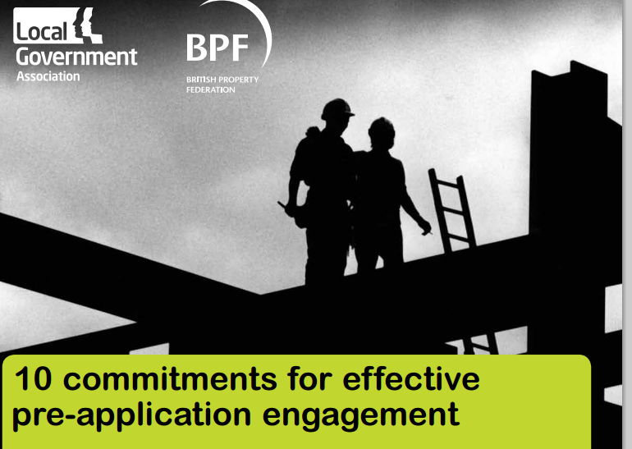
Cross sector agreement on how to make this happen
Commitment no 8
“Provide an opportunity for Councillors to be actively involved in pre-application discussions”
Notes:
In 2014, DCLG encouraged the LGA to bring together a group of councils, developer representatives, statutory consultee bodies and community representatives to think about what was needed to improve the contribution that pre-application discussions make to delivering sustainable, good quality developments.
The result of this cross sector work is a set of 10 commitments to working practices that will improve pre-application engagement across the country.
There are a total of 10 commitments – the full list is downloadable from the PAS website
Commitment number 8 is to establish opportunities for councillors to be actively involved in pre-application discussions.

Slide 7
A good pre-app offer involves:
a discussion, aimed at solving problems and improving developments
advice when/if problems are unresolvable
recognition of needs/constraints of developers and the council
engaging statutory consultees and other stakeholders
a proportionate response to the scale of a development and the issues it raises
Notes:
The way in which your council offers to manage pre-application discussions over development proposals will vary from council to council. But as an overview, these four points set out what developers will expect from a good offer of pre-application discussions.
Clear honest advice
A problem solving approach
Understanding the developer’s needs as well as the council’s
Getting the right people around the table for a comprehensive discussion
Having a process that reflects the complexity of the issues (simple schemes/ simple processes)

Slide 8
Member engagement in early discussions allows
The developer to explain what a proposal is – not what rumour fears that it will be
You to input your views, and those of the community view, into a scheme at a formative stage
You to ask questions
To jointly work on shaping the development into something good
Notes:
How you engage in pre-application discussions and what role you will be able to preform will differ, depending on your role in the council:

Slide 9
It gives you a chance to show that….
your area is a good place to invest in
you have a vision and are prepared to be proactive to achieve it
you can manage development opportunities to make the most for your communities
you act in the best interests of the whole community
Notes:
For ward members, being at the table when proposals are being discussed will help you to be a more effective local leader by giving you more opportunity to be an effective conduit of information about what is being proposed in your area, and, by influencing proposals for the benefit of local communities, to encourage better developments to be delivered more quickly.
Cabinet members, have the chance to learn of potential developments that can be shaped to offer benefits that contribute to the strategic development of the area, meeting local needs or providing infrastructure. This is a valuable avenue for promoting your area by demonstrating a willingness to lead on welcome investment opportunities.
For committee members who will eventually make decisions on a planning application, there is a chance to gain greater insight into the development, ask questions and probe consequences and decisions earlier in the process.

Slide 10
What has been the hold up?
Under previous guidance on standards in public life there was a clear (but artificial) line drawn between council roles:
community leaders and representatives
decision makers on planning applications
Notes:
Although there may be a general understanding about the potential advantages of members being an integral part of pre-application discussions for large sites, some members ( and indeed some monitoring officers in local authorities) have felt reticent to become engaged.
To a large extent this has been a legacy of previous codes of conduct for members which created a largely artificial differentiation between members’ roles as community leaders and decision makers.
But it is also recognised that members may be wary that participation in pre-application discussion could be equated to being too close to developers ( especially if there is local opposition to a development).
In both cases it is important that arrangements are in place to support members and help them to be most effective doing this important part of their role as community leaders.

Slide 11
Post Localism Act:
Predisposition (inclination/opinion) is fine; must have a willingness to listen to all material considerations before deciding how to vote
Predetermination (a ‘closed mind’) is not
Getting involved in a pre-application discussion does not, in itself, mean you are predetermined.
You can discuss, without having a closed mind
Notes:
but the system trusts you generally to approach decision-making with an open mind. Much depends on what you actually say, and in what context.
The Localism Act confirmed that Councillors should have an active role in the discussion of development proposals whether or not they are subsequently going to be involved in determining the application at planning committee.
This is all part of the ‘Localism Agenda’ – that councillors have a proper role to play in planning for the area and getting involved.
Objective of the changes: ‘Councillors should be free to campaign, to express views on issues and to vote on those matters, without fear of being unjustly accused of having a closed mind…because of it. We will be legislating …to make it clear that the normal activities of a councillor; campaigning, talking with constituents, expressing views on local matters and seeking to gain support for those views should not lead to an unjust accusation of having a closed mind on an issue that can lead to a legal challenge….The (Localism) Bill will give councillors the assurance that they can campaign, discuss and vote on issues with confidence.’ (Coalition proposal 2009)
The critical issue is that the decision taker should retain an open mind, not withstanding that he or she may be predisposed to support or oppose a proposal.

Slide 12
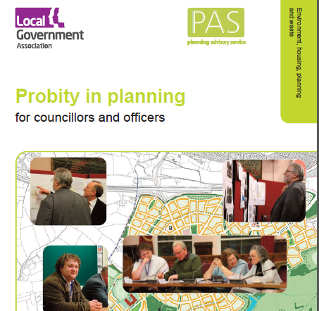
Probity in planning guide
Not a free–for-all
Still a need for propriety
Must still demonstrate fairness, openness and impartiality at all stages of the process
Perception is as important as reality
Notes:
Planning is often an emotive matter for those involved and it is of upmost
important that processes are not only carried out fairly but appear fair to an
unbiased observer. This minimises the risk of challenge to the Council as
Planning Authority but also to the individual Members from a conduct point
of view.

Slide 13
Establishing a protocol for your council
Much of the detailed work on pre-application discussions will be done by officers
Where and how you can/should get involved can be set out in a pre-application protocol
It will vary, depending on levels of activity, certainty of the policy framework etc
Notes:
Because each council has differing opportunities and ambitions for growth, alongside a wide variety of experience and interest in development from its community , the arrangements for engagement in pre-application discussions need to reflect the local situation.
For example, where a community has developed a neighbourhood plan for its area, the parish council or neighbourhood forum might well be regarded as a partner of the council for the purposes of early discussions on development proposals and will automatically be invited to join in discussions in a similar capacity to the ward councillor.
Or
In busy areas where there is a lot of development coming forward, it will be more usual to have a series of regular open briefing sessions in the diary so that members can be briefed on whatever schemes are coming forward at the moment. Whereas in quieter areas, arrangements will be set up for one off or unusually large developments.
If the council has large land holdings and there may be a need to consider how members outside the cabinet will be engaged in discussions about the form of developments where the council is also a promoter of the scheme.
Suggestion: You could invite people to think about the characteristics of their area which should be taken into account when thinking of members being involved in pre-application discussions in their area.

Slide 14
Option 1: concept stage
The (almost) blank sheet of paper
signposting an open door for significant new inward investment proposals
allows senior councillors to consider how a proposal would fit vision for the area and link to wider corporate objectives
an opportunity to encourage real community engagement at the earliest design phases
Notes:
When a developer comes to the council with a concept for significant proposed development, he or she is generally looking for a general steer – “Can I catch the interest of the council? Does this proposal align with their strategic objectives and is it worth my while spending more time and money developing this project further” The next point is “ If there are no absolute showstoppers, what are the reservations so that I can do more work on these in order to gain support?”
At this stage most developers will want to have such a high level discussion on a informal confidential basis. It allows the council to input ideas that will benefit the community at the earliest stages before work goes too far and its also a chance to flag up issues and policies that will have an impact when a subsequent application is considered.

Slide 15
How would that work?
Have a clear stance on confidentiality issues
Be informed of the likely issues
Keep a record of the conversations
Saves pain and cost if the idea is a non starter
A chance to think about other stakeholders who need to be engaged and when
Notes:
Unless your local monitoring officer has advised to the contrary, the most councils will accept that commercial sensitivity is sufficient grounds for such discussions to remain confidential within such limits as you set in regard to the time limits and who in the council needs to be involved.
Often the developer will most value a meeting with the leader or portfolio holder, but in some cases a meeting with the ward councillor will also be helpful as a way to identify who in the local community they should start talking with.
Getting a briefing from the officers or having them with you at the meeting will help avoid any embarrassing gaps between what you would like to support and what planning policy is going to make difficult to support later.
Make sure that there is a record of the meeting and follow it up with a note of what was agreed that can be shared with the developer to reduce the scope for each party to believe they heard what they wanted to hear rather than what was said. This will also be a helpful platform for your officers to carry on the more detailed discussions later.

Slide 16
Option 2: briefings
Introduction to a developing scheme
Keep abreast of new proposals
Understand objectives for the development
Understand constraints or explanation behind some design decisions
Ask questions
Ensure that developer knows first hand what you/community want from such a proposal
Notes:
Further along the process of working up a development proposal, the needs change somewhat. As more information becomes available, as studies are completed and design issues resolved, discussions provide an opportunity for members to gain more understanding of the design. This is especially valuable for both ward member, close to their communities, and members of planning committee as questions can be asked and potential impact or need issues aired.

Slide 17
How would that work?
formal briefings in a meeting
applicant or officers introduce proposal
to councillors or mixed audience with community reps (as appropriate)
an opportunity to ask questions/ discuss proposal in the spirit of improving the quality of the scheme and benefits it will provide for the community
keep a record of the discussion
Notes:
This is most usually a small somewhat formal meeting of councillors and key community groups and individuals. The purpose of the meeting is to brief those around the table and allow for some working discussion about the proposal in a positive spirit of problem solving and shaping to achieve an improved development.
The format will vary from council to council. Some councils prefer to have a briefing from their officers and some will give the prospective applicants an opportunity to present their scheme. If appropriate its good to have representatives from statutory consultees also present. The format seems to work best when the presentation is followed by an opportunity for the developer and or statutory consultees to be asked questions and make suggestions for improvement .
As previously, it’s a given that anything offered or agreed at these meetings should be recorded and the record shared with those present.

Slide 18
Option 3: interim reports
To give committee members early sight of a proposal
similar to the member briefing, but focussed on the planning committee
means that committee see a complex proposal before they are expected to make a decision on it
can be a discussion in public to increase transparency
Notes:
This option is more about briefing and presentation rather than a working discussion. However an interim presentation to the planning committee within the formal environment of the committee will allow for briefing on issues and for questions to be asked and explanations given. The advantage of this format is that members of the public have an opportunity to hear the presentation and discussion. In some councils they can also make short submissions or ask questions. It is important that its made clear that the committee are not being asked reach a conclusion or determine support or opposition to the proposal.
Whilst its equally possible to have such committee briefings after the application is submitted, if issues are ironed out through the pre-application phase, it should not be necessary. The application process will be more streamlined and council’s performance improved.

Slide 19
How would that work?
report from officers to the committee on a prospective application
appropriate for a small number of very significant proposals
before or after the main business of committee
a chance for members to ask the developer questions
NO DECISION - INFORMATION ONLY
Notes:
The advantage of this format is that members of the public have an opportunity to hear the presentation and discussion. In some councils they can also make short submissions or ask questions. It is important that its made clear that the committee are not being asked reach a conclusion or determine support or opposition to the proposal.
Whilst its equally possible to have such committee briefings after the application is submitted, if issues are ironed out through the pre-application phase, it should not be necessary. The application process will be more streamlined and council’s performance improved.

Slide 20
Option 4: discussion forums
Developer or the council can host a discussion about a scheme
Developer introduces their scheme in a public forum
Open discussion between developer, councillors and community members.
Can involve statutory and other consultees
Notes:
Discussion forums are public meetings called to allow for public discussion of planning proposals.
They differ from option 2 in that these are less working meetings so much as an opportunity for developers to present their proposals and for members of the community to comment, ask questions or lobby for the inclusion of benefits or mitigation of impacts.
As such they are closer to consultation than to engagement. They nonetheless are valuable as a means for developers to gain a broad understanding of how the community view their proposal and they have the opportunity to take issues away and seek solutions prior to the submission of a planning application.

Slide 21
How would that work?
One off or regular meetings on current pre-application proposals
Often chaired by a councillor
Invitation to attend or open forum
Discussion becomes part of the public consultation requirements
A record of attendance, of concerns raised and questions and answers given should be kept.
Notes:
If councils have a busy workload of larger proposals, these developer forums are often scheduled on a regular or semi regular basis but can equally be a one off event. However in either case it is helpful if the council’s protocol provides for such meetings to take place. The presence of officers to answer questions regarding council’s planning policies and to keep a record of discussion will ensure that the meeting builds better understanding of the proposal.

Slide 22
Interests
Detailed guidance is in the DCLG March 2013 guide “Openness and Transparency in Personal Interests”
Guiding principle: how a reasonable member of the public, with full knowledge of the facts, would view the councillors involvement
Pecuniary interests MUST be registered
Seek guidance from your monitoring officer
Notes:
Even though the Localism Act has allowed for a relaxation of guidance on participation and the scope to express views on proposals, there is also a need for councillors to take account of the code of conduct in relation to interests.
The Localism Act introduced a new criminal offence of failing to disclose or register members’ pecuniary interests and requirement for authorities to adopt a code of conduct. The Council’s Code of Conduct should establish what interests need to be disclosed and registered by a councillor. A disclosable pecuniary interest requires the withdrawal of the councillor from the committee when that pecuniary interest relates to an item under discussion by the committee. A precautionary approach would also indicate that if a member has a disclosable pecuniary interest in a proposal, involvement in pre-application discussions should equally be considered carefully.
ALWAYS CHECK WITH YOUR MONITORING OFFICER

Slide 23
The pre-application values
There are advantages to both the developer and the council when pre-application discussions are effective.
Wouldn't it be great if developers in your area always feel that they get such good value from early discussion of their proposals that they wouldn't dream of proceeding without it?
Notes:
To recap, The National Planning Policy Framework encourages councils to actively engage with prospective applicants to discuss their proposal. There are advantages to councils, communities and developers to having these discussions.
One of the 10 Commitments agreed by the cross sector working group to make the pre-application phase more effective for all parties was that elected members of the council should have the opportunity to be involved directly in the discussions.
Developers consider that pre-application discussions are most worthwhile when there is an opportunity to involve the members.
Having clearly understood arrangements for members to undertake this role is a sign of a worthwhile, well managed planning service.

Slide 24
In our Council we are working towards…
Pre-app brand values
Trust
Cost
Time
Reliability

Slide 25
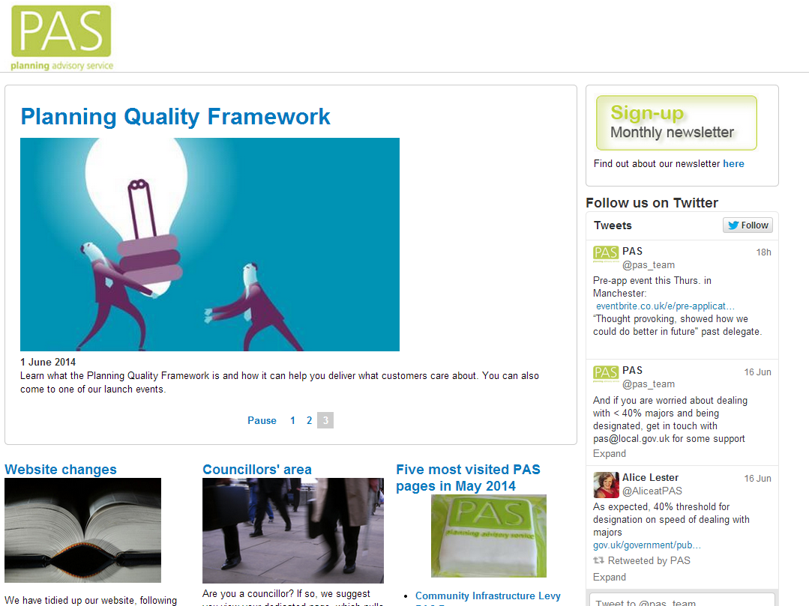
Notes:
Use our website, sign up for our newsletter, follow us on twitter

Slide 26
Contact PAS email pas@local.gov.uk
web www.pas.gov.uk
phone 020 7664 3000

