Slide 1
INTEGRATION IN DEMENTIA CARE A carer’s perspective
Barbara Pointon MBE
Former carer,
Ambassador for Alzheimer’s Society & Dementia UK
barbara@pointon.name

Slide 2
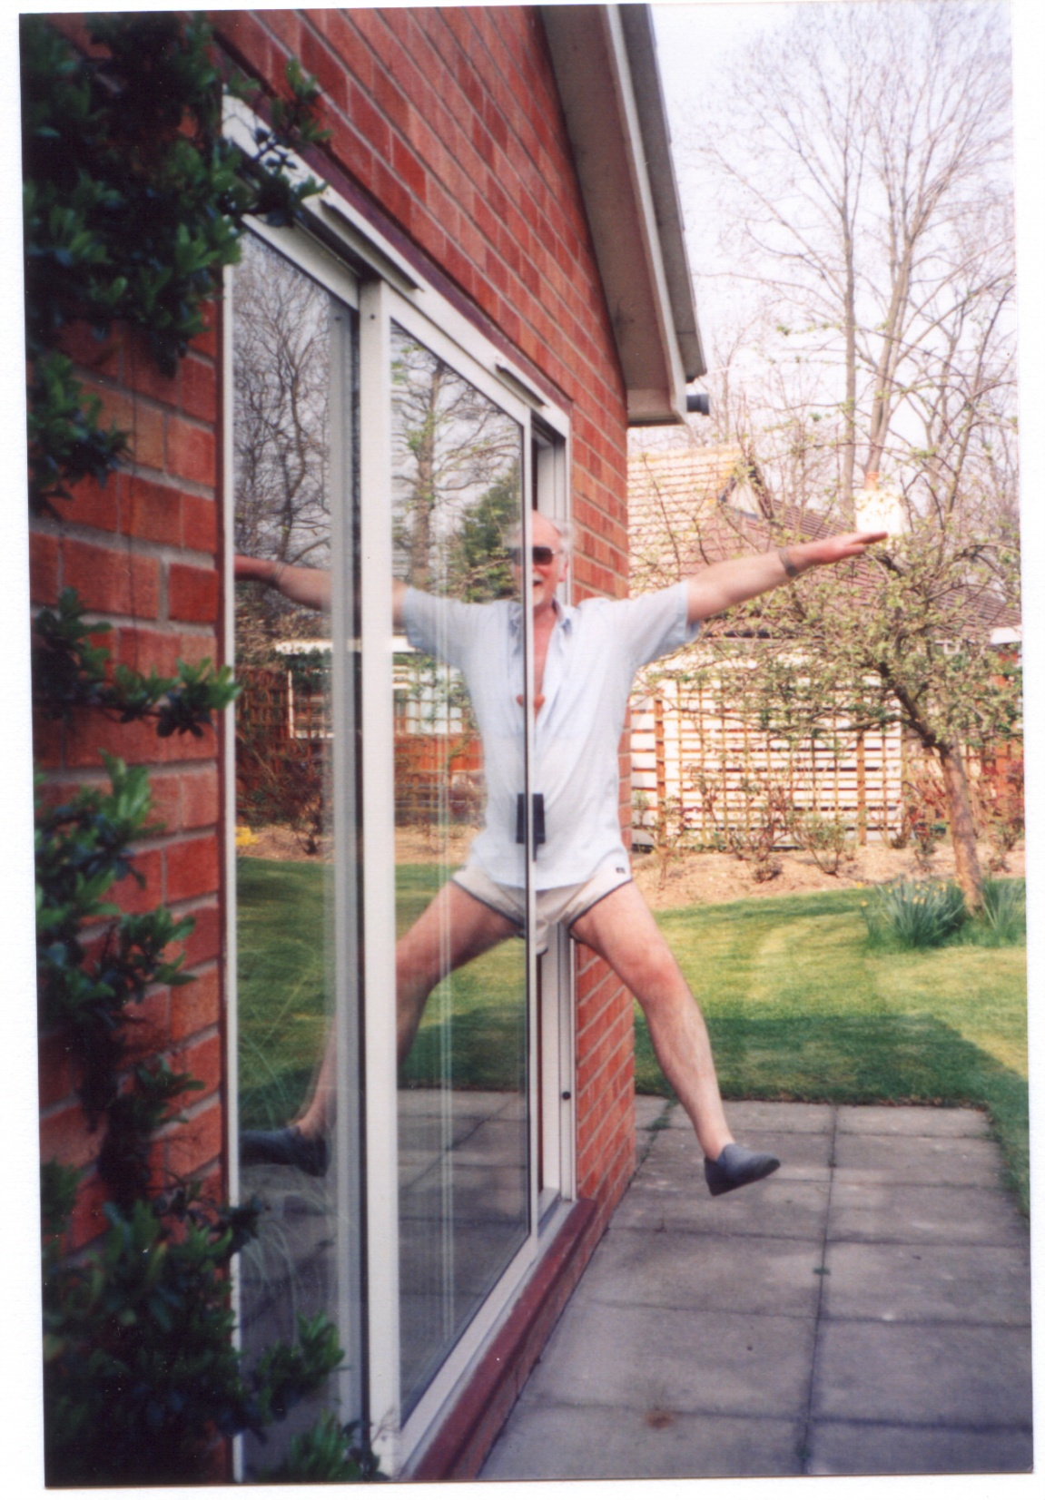
Malcolm in 1992, aged 51, just after he was diagnosed

Slide 3
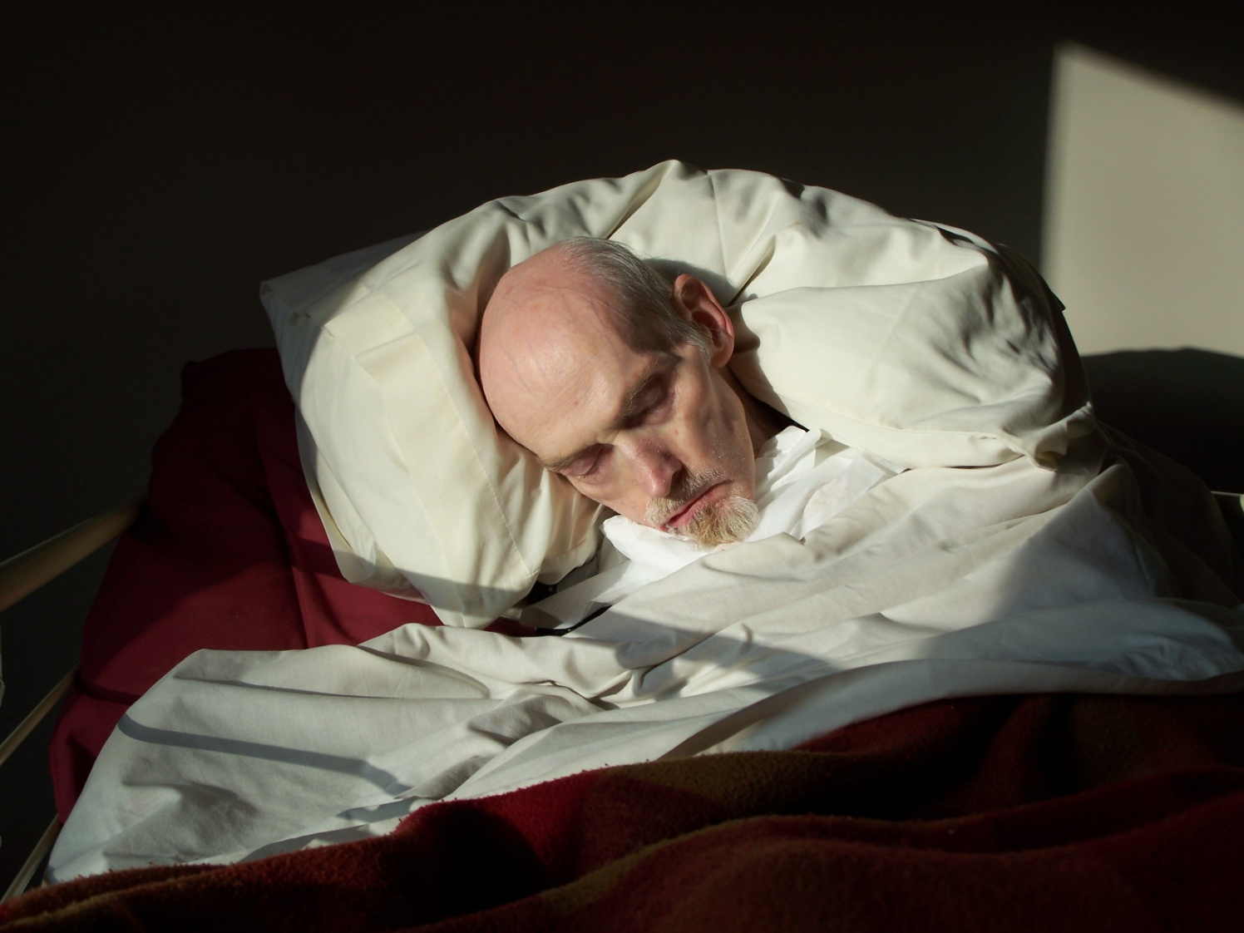
Malcolm, the day before he died, 2007, aged 66

Slide 4
Why special attention to dementia?
Over 100 types of dementia – risk increases with age
Half of people over 90 now have a dementia
The most feared: dementia tops the table 68% , cancer 25%
Cost to UK: £26.3 billion per annum – mostly spent in Social Care arena
Average cost to a family £22,000 a year
AND RISING:
Two thirds of people with dementia are cared for at home
Oldest old have children in their 70s and 80s unable to care
Carehome places only for very old/no-one to care ?– more of the ‘younger’ old having to be cared for in the community?

Slide 5
Crossing the boundaries
Weaving our way through 17 different services
Lost in the complexity with no one named professional designated as our advisor/guide and point of contact.
Integration enables:
An enlightened, simpler path for the carer, thereby providing
Better, more personalised care and support for the person with dementia, because of
Easier sharing of information and growth of mutual trust between the professional, client and carer

Slide 6
Post-diagnosis and ongoing support
No point in driving up the rate of diagnosis without an equivalent increase in carer support – already very patchy
Diminishing cognition and function = a special kind of care
May be months or years before the person with dementia needs services, but the carer cares from the start
Without advice, we give well-intentioned but the wrong kind of care
Making matters worse for the person with dementia: loss of self-esteem and confidence
Carer: “Doing things just to annoy me” – feeling hurt or resentful – worse for the carer’s well-being

Slide 7
Post-diagnosis and ongoing
GPs working in partnership with Social Care to identify a new carer and offer an assessment of their needs (which at this point in time carers may not easily acknowledge)
All carers need to be provided with access to expert advice about how to offer care and support from the beginning
An ongoing drip-drip of practical and emotional support
Personalised to their own situation and given by one named expert in dementia care
A generic leaflet/website or phone conversation is not enough.

Slide 8
The Web
Of
Care
(First 9 yrs)
Memory
Clinic
neurologist
& research
Daycare
GP
Social Worker
Community
Psychiatric
nurse
Domiciliary care
(daily visits)
Psychogeriatrician
& behavioural
psychologist
Malcolm and
Barbara
Respite
Care
(residential)
Dementia ward
and NHS respite unit
Care
Agencies
Dementia
Care
Adviser?
Music therapist
Nursing
Home
Sitting service
Live-in
Agency carer
for 8 months only
Alzheimer’s
Society &
peer support
(2yrs)
Carers’ Support
worker

Slide 9
The economic case for supporting carers
‘When carers are well-supported, they can provide better care for the person they care for and report better well-being themselves’ (Ablitt et al 2009)
Two good outcomes for the price of one!
Averts or delays expensive crises; carer cares for longer.
Current practice is late intervention – change to early preventative?
Care Act: ‘parity of esteem’ for carers
New national eligibility criteria for meeting carers’ health and well-being minimal needs: may be too late, and nothing about their need for drip-drip personalised, expert, tailored advice.
Eligibility for that advice should be gained at the point of diagnosis
Charging for supporting the carer who gives their care for free!!!!!!!

Slide 10
Out-of-
Hours
Doctors/
Paramedics
Consultant
geriatrician
Continence
Adviser
The Web of Care
(Last 7 yrs)
District
Nurses
Speech &
Language Adviser
GP
Care team
2 live-in carers (alternating weekly)
Replacement carer
[Some night nursing – Health]
Emergency carers
& Barbara
Dietician
Dementia
Advisory
Nurse?
Community
Dentist
Malcolm &
Barbara
Malcolm & Barbara
Occupational
Therapist
Social
Worker
Equipment
Service
Oxygen
service
Direct
Payments
Team;
Rowan
Org.
Wheelchair
Service
Alzheimer’s
Soc outreach
worker
Physiotherapist
Alternating
Mattress technician

Slide 11
An opportunity for integrated action
Everyone has a GP and local surgery, with practice nurses – a natural first point of call
Dementia affects the whole person, not just mental and physical states
A dementia advisory nurse/expert in dementia care located in primary care, shared between several surgeries
Jointly funded by Health, Social Care and maybe a dementia charity
Source of expert advice for carers, Agency domiciliary staff, carehome managers and staff, hospital wards, community ventures (e.g. peer support groups)

Slide 12
Improving communication and sharing information
Perplexing behaviour at daycare
Distress all round
No flow of information between memory clinic and care in the community as to what the person has difficulties with
‘Patient confidentiality’ is sometimes a barrier to good, enlightened care, and ‘can disadvantage people with dementia and their carer’ (Nuffield Council on Bioethics 2009)
The Care Act gives carers the much-needed right to be involved in all assessments and planning as partners in care.
A triangle of trust between the person with dementia, the professional and the carer

Slide 13
The carer treated as a partner in care

Slide 14
