Slide 1
Making Defensible
Planning Decisions
www.pas.gov.uk
Notes:
Up dated April 2022
The slides in this presentation provide the basis for and introductory presentation for this councillor training support.
Each time the presentation is used, it should be tailored to address the key issues around making defensible planning decisions following discussions with the LPAs lead planning officer.

Slide 2




What is PAS ?
“PAS exists to support local planning authorities
to provide efficient & effective planning services,
to drive improvement and to respond to and deliver
changes in the planning system”
Notes:
PAS is a DLUHC and DEFRA grant-funded programme
PAS is part of the Local Government Association (LGA)
Small team – commissioners, generalists and specialists, support
“PAS exists to provide support to local planning authorities to provide efficient
and effective planning services, to drive improvement in those services and to respond
to and deliver changes in the planning system”

Slide 3
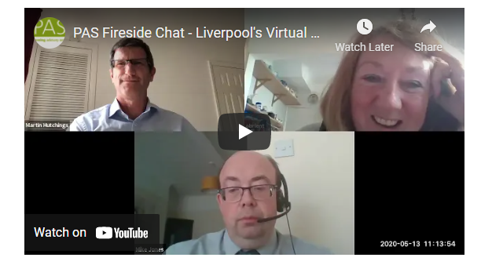
All new or a refresher?
New to planning/committee?
Refresh / update?
Pass on your experience
Notes:
This session is designed for those that have been around a while and those new to the decision making process. We’re not here to teach granny to suck eggs but equally there are less experienced councilors who would benefit from starting at the beginning on some topics and doing this can also serve as a good reminder/refresher for those that have are more experienced.
We’d encourage those with more experience to give the less experienced the benefit of what they’ve learned over the years on committee.
You are not expected to use all the slides in this presentation but just those that you think are most useful for your Council

Slide 4
Objectives for this session
Think about how decisions are made
And how they might be improved
So that you can justify them to:
  Applicants
  Residents
  Inspectorate
Avoid costly mistakes
Enhance Council’s reputation as sound and fair decision makers
Notes:
This is the standard set of objectives for this session (run through). Is everyone happy with these, or would like to add anything specifically?

Slide 5
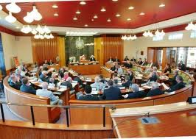
This is a discussion about…
Context for decision making
How a decision is made
Councillors’ role
Defensible decisions, consequences
Notes:
It’s important that this session is not dominated by the presenter talking to the audience and pointing at slides. The slides are here to guide the topics but the real value of this session is the interaction between the councillor delegates, including debate, discussion and questions. We’ll pause at various intervals to allow this, but please interject appropriately.
You may want to consider breaking up the presentation with quizzes and case studies to keep the interest of all participants.

Slide 6



The role of decision-making
Not just about stopping bad developments from happening
It is about delivering your Local Plan for the whole community
Being positive & proactive to encourage delivery
Notes:
It should be a positive and proactive process that delivers good development.
Refusals are failures that are the last resort rather than being a starting point for decision makers.
The role of the Planner should be celebrated as creating sustainable linked communities

Slide 7
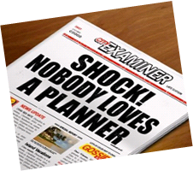
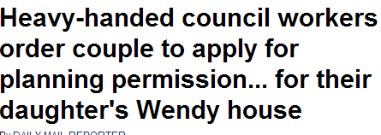

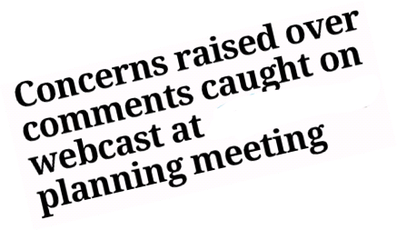
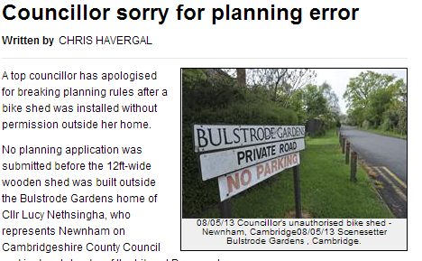

Planning creates headlines
Notes:
The decisions you make will be controversial – affects people’s lives as an applicant and/or resident or business owner/ community
How you make your decisions and reason for them must be transparent
The community widely misunderstands the Council’s obligations to both represent local people and meets its obligations to deliver sustainable communities
More articulate community, social media campaigns - Pressures on councillors as committee leaders and decision makers
Planning is done within parameters – law, the plan, the material considerations
Balance, evidence & bias
Can be difficult and make you popular – or not
Affects people’s lives
Involves balancing different priorities
Getting it wrong can be costly

Slide 8
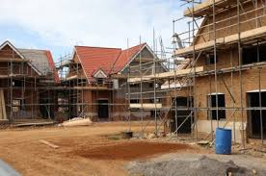
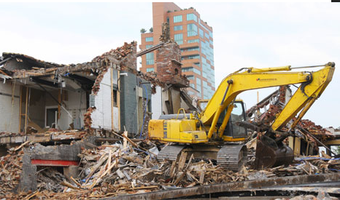
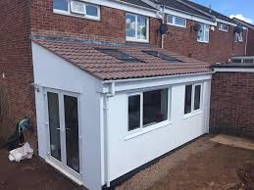
The context for decision making
‘Development’ requires planning permission
Some of which is ‘permitted’ (PD)
Recent changes in the Use Class Order have taken many changes of use out of the planning system e.g. Class E
Most decisions (99%) made by local councils
Refusals (and conditions) are open to appeal
Judicial Review and Ombudsman
Notes:
Planning permission is required for development
'Development' is defined by statute in the Town and Country Planning Act 1990 s55(1), as 'the carrying out of building, engineering, mining or other operations in, on, over or under land, or the making of any material change in the use of any buildings or other land'. This definition is clarified by the remainder of s55 and the inclusion of the Generally Permitted Development Order 1995 and the Use Classes Order 1987.
Most planning applications are determined by either district/borough councils (or unitaries) .
County Councils (or unitaries) determine specific applications for development associated with minerals and waste and the authority’s own development (eg. Schools)
Other agencies determine specific categories of development (eg. the Planning Inspectorate (PINS) Nationally Significant Infrastructure Projects (NSIPSs) – major national infrastructure projects, or development corporations which determine applications in certain areas to help drive regeneration )
The rules and powers are set out in the Town & Country Planning Act 1990 and associated legislation.
Town & Country Planning (General Permitted Development ) Order 2005 and subsequent amendments (The Town and Country Planning (General Permitted Development) (England) Order 2015. The Town and Country Planning (General Permitted Development) (England) (Amendment) Order 2018) specify which development can be implemented without the need for planning permission . This is referred to as “permitted development “.
Recent changes in the Use Class Order have taken many changes of use out of the planning system e.g. Class E

Slide 9

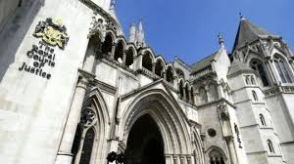

The decision can be challenged
Appeal; Secretary of State, PINS
Costs for unreasonable behaviour
Judicial Review and Ombudsman
Notes:
Need to have sound reasons and evidence (and to have followed appropriate procedures) for committee decision
3 types of appeal
Risk of costs
Judicial Review now less expensive and therefore more common
Ombudsman and complaints procedures – lessons learned ?
Reputation of your Council

Slide 10
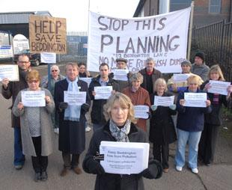
What decisions are made by Committee?
It is up to you. However ……
Committee should only make the decision when it needs public scrutiny
Don’t make the agendas too long – unfair on everyone
Only make the decision by Committee if it is in the public interest otherwise leave to officers
Most Councils have a delegation rate over 90%
Notes:
Write your scheme of delegation so that you are clear what applications need to be referred to Committee
Most Committee agendas only have a handful of items to allow the agendas to be manageable
Professional officers are employed by the Council to make Planning decisions so it should not be necessary for Committee to make the decisions on any more than 10% of applications

Slide 11
Planning in England is policy-led
  national policy
    National Planning Policy Framework (NPPF)
    National Policy Statements
    Specialist policy such as Gypsy and Traveller guidance
    Planning Practice Guidance
  local policy
    Development / local plan
  neighbourhood policies
    neighbourhood plans
Notes:
These are the basic frameworks for policy led decisions.

Slide 12
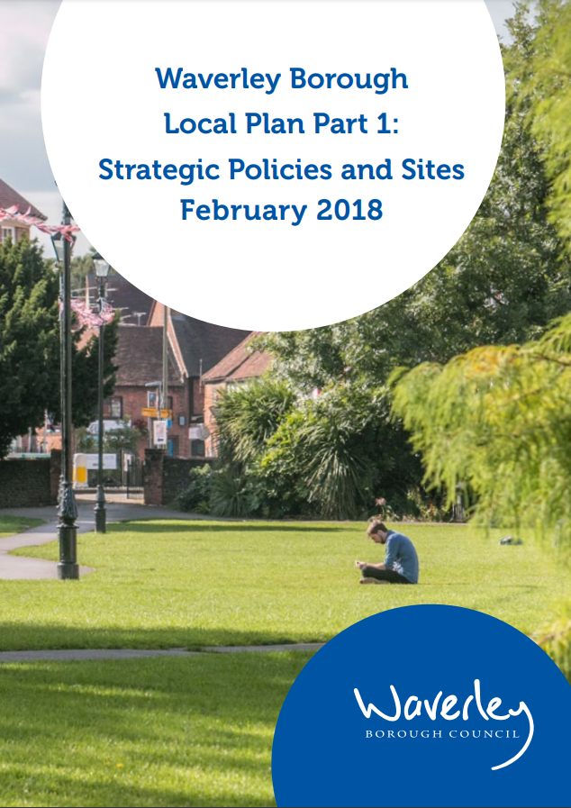


‘Basic principle’: start with the plan
“……have regard to the provisions of the development plan, so far as material to the application, and to any other material considerations”.
Notes:
Restated in 2004 TCP Compulsory Purchase Act
It’s the law.

Slide 13
What is the development plan?
Local Plans: development plan documents adopted by local planning authority
Know and understand your Local Plan
Neighbourhood plans: where supported by the local community at referendum and subsequently ‘made’ by the local planning authority

Slide 14

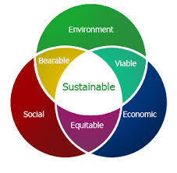
Sustainable development; the ‘presumption’
At the heart of the National
Planning Policy Framework
(NPPF)
2. Achieving sustainable
development
7.… the objective of sustainable
development can be summarised as
meeting the needs of the present
without compromising the ability
of future generations to meet
their own needs.
Notes:
The NPPF has the principle of ‘sustainable development’ running through it. Section 2, para 7 in the latest NPPF (July 2021) outlines the over-arching ECONOMIC, SOCIAL AND ENVIRONMENTAL objectives of sustainable development.
Sustainable development is summarized as meeting the needs of the present without compromising the ability of future generations to meet their own needs.

Slide 15
NPPF and decision making
For decision-taking this means:
Approve proposals that accord with an up-to-date
development plan without delay; or
Where there are no relevant development plan
policies, or the policies are out-of-date, grant
permission unless:
(i) policies in the NPPF provides a clear reason for refusal
(ii) adverse impacts of doing so outweigh the benefits
Notes:
15
So that sustainable development is pursued in a positive way, at the heart of the NPPF is a presumption in favour of sustainable development (paragraph
11). Extract from NPPF – key points are:
Accord with local plan
‘Without delay’
Where there are no policies or the policies are out of date (This includes, for applications involving the provision of housing, situations where the local planning
authority cannot demonstrate a five year supply of deliverable housing sites (with the appropriate buffer, as set out in paragraph 73); or where the Housing Delivery Test indicates that the delivery of housing was substantially below (less than 75% of) the housing requirement over the previous three years.
For decision-taking this means:
c) approving development proposals that accord with an up-to-date
development plan without delay; or
d) where there are no relevant development plan policies, or the policies which are most important for determining the application are out-of-date, granting permission unless:
the application of policies in this Framework that protect areas or assets of particular importance provides a clear reason for refusing the development proposed; or
any adverse impacts of doing so would significantly and demonstrably outweigh the benefits, when assessed against the policies in this Framework taken as a whole.

Slide 16
“Can we ignore the Development Plan?”
No, that would be unlawful (s38)
And anyway it’s your plan, so why would you?
Can you take a decision which seems to conflict with the Plan?
Yes – so long as it is based on the merits of the case, in the light of all other material considerations, for example:
    - a policy is out of date compared with national policy
    - the monitoring information shows that the situation “on the ground” has changed
    - an unforeseen opportunity has arisen
Notes:
It is important to always make reference to the Development Plan in any decision and be very explicit if you make a decision that is in conflict to the Development Plan as it will need to be clearly justified

Slide 17

Material Considerations
Material considerations are decided by statements of national policy or by decisions of the courts
the weight that should be attached to each consideration in any particular case is for the decision maker
Notes:
So remembering that “……have regard to the provisions of the development plan, so far as material to the application, and to any other material considerations”.
What are those material considerations?

Slide 18
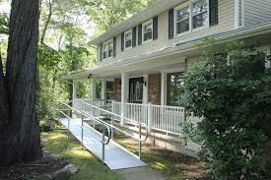
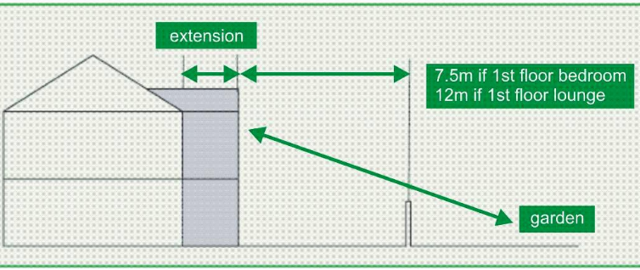
Material Considerations
Overlooking / loss privacy
Loss of light / overshadowing
Effect on listed building
Layout, density
Development plan
Previous decisions/appeals
Natural environment
Flood risk
Parking
Highway safety
Traffic
Noise
Design, materials
Govt. policy
Disabled access
Notes:
You may want to add to this list to highlight particular issues that have come before Planning Committee recently.
You may want to reinforce material and non material considerations through a quiz

Slide 19

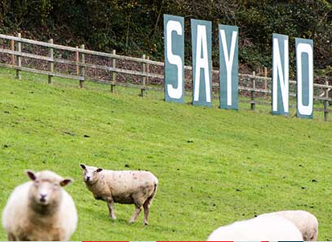
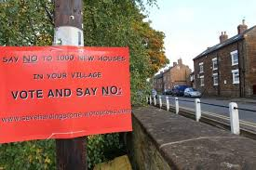
Non-material Considerations
House prices and house insurance
Personal circumstances
The conduct of the applicant
The strength or volume of opposition / objection
Loss of a private view
Damage to property or Party Wall Act matters
Loss of trade
Boundary disputes or covenants
Notes:
it is not the number of objections, but the evidence in support of the planning reasons for objection, that is the material consideration.
Private view is put in italics because a strategic public view could be a material planning consideration
With regard to Party Wall Act matters and covenants concerns of Members could be addressed through the use of an informative to ensure that an applicant is aware that they need to address such matters outside of the planning application process

Slide 20
Planning involves balancing issues
climate change
economic growth
countryside protection
meeting rural housing need
today’s pressures
long term strategies
town cramming
brownfield development
viability of town centres
retail “market forces”
individual interest
public interest
Notes:
Sometimes these are very difficult – hard choices to make.
Planning decisions made directly affect the right of people to use their land. Planning processes are established by planning laws, regulations and precedents.
Although all these matters are part of the balance some issues have greater weight than others e.g. lack of 5 year housing land supply significantly weighs the balance in favour of approval

Slide 21
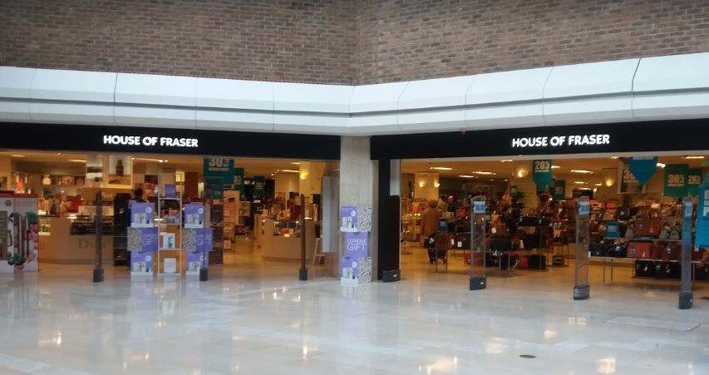
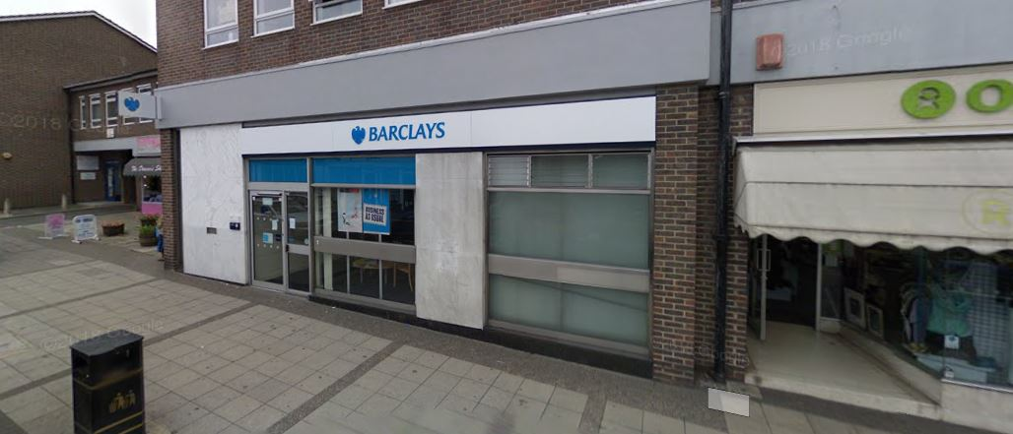
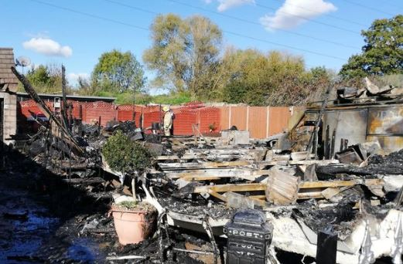
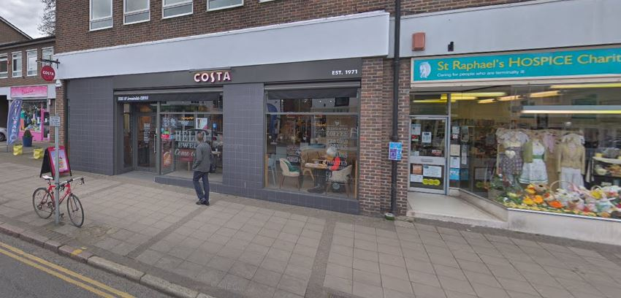
Things can change

Slide 22
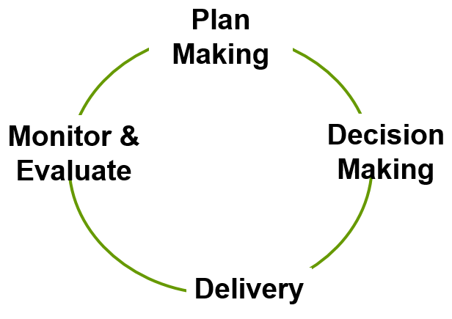
The wonderous circle of planning
Notes:
Decision making should not be seen as separate from the continuous cycle of plan making to decision making to delivery to monitoring and evaluation to plan making etc

Slide 23
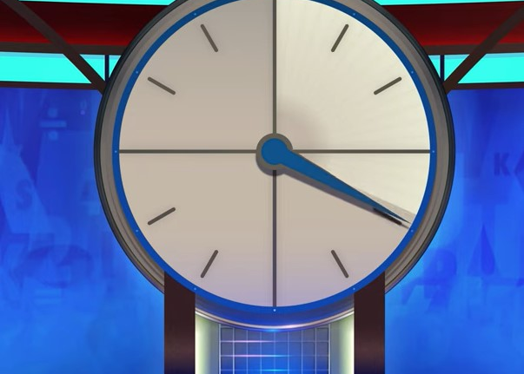
Delivering the plan and the 5yr ticking clock
Plan in place = Monitor & Drive the delivery
5 Year Housing Land Supply (5YHLS) – at any time but usually once a year
Housing Delivery Test (HDT)
Plans 5yr old = out-of-date
Continuous pressure to implement the Plan
Notes:
Members should always be aware of their housing land supply and how it impacts on decision making. When there is not an up to date Local Plan and / or a 5 year housing land supply this has a significant impact on the weight given to material planning considerations.
Housing need is the amount of housing needed over a given period in a specified area. This is also known as objectively-assessed need for housing. The terms ‘objectively assessed need’ and ‘housing need’ are the same thing. When determining what the housing need for an area should be the minimum local housing need (LHN) is the starting point and does not produce a housing requirement figure. Minimum local housing need is set out via the ‘standard method’ and uses a formula to identify the minimum number of homes to be planned for.
The housing requirement is the number of homes the plan actually seeks to provide during the plan period. This figure can be the same as, or higher or lower than, the LHN housing need figure
Housing land supply can be either the total amount of land allocated for housing development during a plan period or for an identified 5yr time period, otherwise known as 5yr housing land supply (5YHLS).

Slide 24
HDT & 5YHLS = Looking in both directions
Now
HDT | HDT | HDT | Yr 1 | Yr 2 | Yr 3 | Yr 4 | Yr 5
Looking backward 3yrs
Looking forward 5yrs
Notes:
The Housing Delivery Test is a % measurement of the number of net homes delivered against the number of homes required, as set out in the relevant strategic policies for the areas covered by the Housing Delivery Test, over a rolling three year period

Slide 25
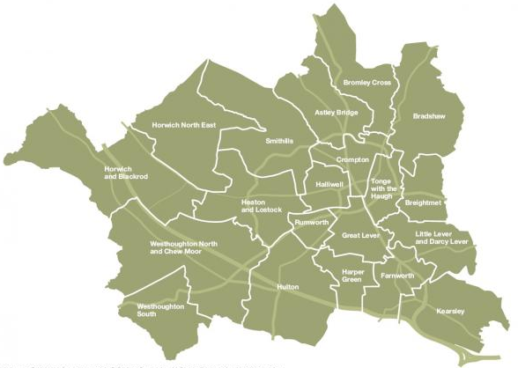
The councillor’s role depends on…
Member of the planning committee
Ward member
Cabinet member
Political Group member
or
Notes:
Councillors need to understand their role –this will vary depending upon the details and location of a development proposal.
The primary role of the members of planning committee is to make decisions for the benefit of the whole community, not factions or individuals.
Occasionally (for instance where development is proposed in their ward ) a member of the committee may choose to be a local advocate (either supporting or opposing the development). In these cases the member would be able to address the planning committee, but could not be a member of the committee determining that application.
Good decision making - adding value to decision making
- only getting involved where you can make a difference
- Having a good scheme of delegation

Slide 26
Duty of an elected member
Making decisions: your duty is to the whole community
  Avoid bias: predisposition v predetermination
  Consider the implications for the wider community not just those making representations
  Only take into account material planning considerations including precedents and previous decisions – “benchmarks”
  Base decisions on evidence not hunch – reasonableness
  Jurist or elected representative?
Notes:
It is a criminal offence to fail to disclose or register members’ interests.
The concept of predetermination has been abolished so that councillors are able to express an opinion on a proposal at an early stage, but still be involved in taking a decision upon it provided they retain an open mind
It is important for Members to understand the difference between Predisposition and Predetermination.

Slide 27
Examples of predisposition and pre determination
Predisposition – A councillor expresses concern about the impact of a development on local residents and will only support the application if conditions could be put in place to overcome the harm
Predetermination - A councillor makes a statement on social media to say that they will support local residents by voting against the development due to the harm it will cause
Notes:
A councillor who is predetermined must NOT sit on Planning Committee
A councillor who has a predisposition should sit on Planning Committee

Slide 28
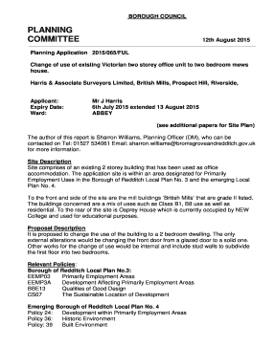


Committee application and determination
Prepare, read the papers!
How much weight to give to the issues?
Considered conditions/reasons before meeting?
Taken advice on legal/enforceable/reasonable?
Discussed concerns with officers before Committee?
Notes:
READ THE PAPERS IN ADVANCE & TALK TO OFFICERS IN ADVANCE TOO
Once it is agreed that an application will be determined by planning committee the committee member needs to be aware of their role in this process and the factors which should (and should not) be taken into account
This section will also provide councillors with an opportunity to discuss the usefulness of speaking at committee and committee site visits in the decision making process.
Always try and discuss concerns with officers before Committee so that Officers are

Slide 29
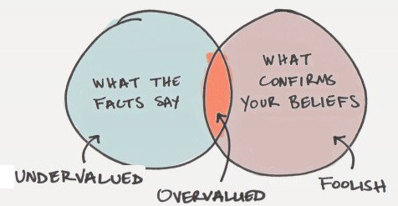
Avoiding unreasonableness
Lack of bias and personal taste
Precedents from appeal decisions after detailed examination of evidence
Precedents from Council decisions - consistency
Like a jury; evidence, material considerations
Notes:
The basis of the planning system is the consideration of private proposals against wider public interests. Much is often at stake in this process, and opposing views are often strongly held by those involved. Whilst planning committee councillors should take account of these views, the general role and conduct of councillors and officers is they should not favour any person, company, group or locality, nor put themselves in a position where they appear to do so. Councillors who do not feel that they can act in this way should consider whether they are best suited to serve on a planning committee

Slide 30

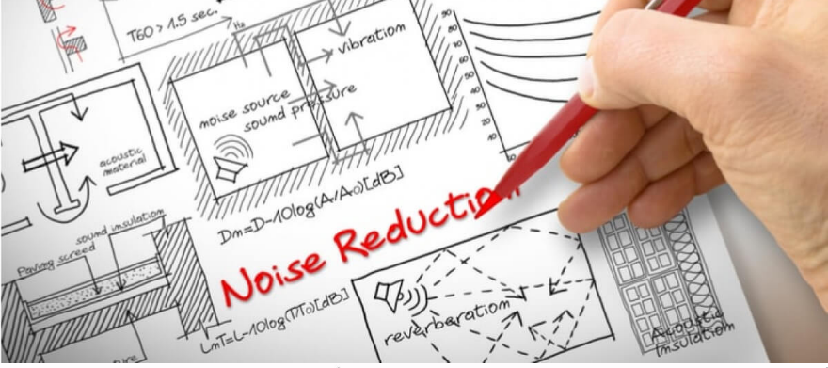

The Committee Decision
You are not expected to be experts
You are expected to listen to the experts…
… and apply judgement
accept the recommendation or…
… explain your ‘rebalancing’
Report & minutes = transparent audit
Notes:
The basis of the planning system is the consideration of private proposals against wider public interests. Much is often at stake in this process, and opposing views are often strongly held by those involved. Whilst planning committee councillors should take account of these views, the general role and conduct of councillors and officers is they should not favour any person, company, group or locality, nor put themselves in a position where they appear to do so. Councillors who do not feel that they can act in this way should consider whether they are best suited to serve on a planning committee

Slide 31


Overturns/different decisions
You CAN make a different decision to officers
But it MUST be justified on planning grounds
Committee must give justified planning reasons
May be subject to appeal (or other challenge)
Notes:
31
You CAN make a different decision to officers
But it MUST be justified on planning grounds (based on the plan and material
Committee must give justified planning reasons for decision (it cannot be left to officers)
May be subject to appeal (or other challenge), so reasons must be defensible

Slide 32
Reasons for refusal
Must be:
  Accurate
  Directly related to the development proposal
  Have regard to the development plan
  Relate to material considerations
You can always ask officers for advice

Slide 33

Ask yourself……
What is the “evidential basis” for the decision?
Is it clear why permission is refused?
Can you describe the harm...
… and why conditions would
not be sufficient ?
Is it clear what the policy
support is for the decision?
Have other material
considerations been given
the appropriate weight?
Notes:
Remember, all this can be challenged and unpicked at an appeal. You need total confidence in your decision. These are the things to ask.
Poor decision making (brought into focus via appeals) is wasteful – costs time and money. And bad for a council’s reputation.
What is the “evidential basis” for the decision?
Would anyone reading the decision – especially the applicant – understand why permission was refused?
Can you describe the harm that would result if the development went ahead? And why conditions would not be sufficient to mitigate that harm?
Is it clear what the policy support is for the decision?
Have all the other material considerations been given the appropriate weight?

Slide 34

Listen to what officers are telling you
Officers are there to help you make ‘sound’ decisions not force you to go with their recommendation
Ask officers for their opinion before you vote
Is the recommendation ‘finely balanced’ or ‘clearly in conformity with an adopted policy’?
Officers are there to help you before as well as during the meeting
Notes:
Committees work best when Members and officers work together. Officers give Members the information they need to make a decision and officers advise Members so that Members make sound decisions even when they are against the officer recommendation.
A ‘finely balanced’ decision means that it could be argued both way. A proposal that is ‘clearly in conformity with an adopted policy’ should not be overturned unless there are very clear evidenced reasons to do so.
It is really important that both Members and officers respect each other’s role in the decision making process

Slide 35
Managing meetings
During the debate, where the committee has reached a different balance of material considerations (to the officer recommendation) officers could be asked to explain to the committee before a motion is made:
  Which issues raised by the members/public can be given weight and why others cannot
  What conditions/reasons are likely to be found reasonable if challenged
  However as these are public sessions it is better for Members to seek advice before the meeting
Notes:
This is good practice
And if you want to talk this through with an officer before the committee that is fine – it is not predetermining yourself to ask these kinds of questions.

Slide 36
Bad evidence
“the housing density is much higher than the surrounding area”
xx: what do you mean by “the surrounding area”? and higher by how much, exactly?
xx: and what if it is? That’s not evidence of harm, is it?
“the change of use is unsociable and will cause a disturbance to local residents”
xx: What type of disturbance and where is the evidence to back this up?
xx: Has the applicant provided any consultant reports and can they be challenged?
xx: What are the hours of operation and will the use take place during unsociable hours?
“the site is a considerable distance from local facilities and the bus service is poor”
xx: which “local facilities”? how far is “a considerable distance”? how frequent is the bus service?
Notes:
“xx” is the kind of cross-examination point which would be put to a witness at a PLI – note the “forensic” nature of the exchange.
But even in written reps and hearings cases, the evidence will be carefully scrutinised by appellants and the Inspector

Slide 37
Good evidence is a combination of...
verifiable fact and informed and reasonable commentary upon the facts
“ the net density of the scheme is 90dph. This compares with an average of 22 dph within the area shown on my plan no 5. In my opinion this great discrepancy, while perhaps not conclusive, is an indication of the incompatibility of the design with the existing character of the area”
“the consultant’s report claims that noise will not impact on local residents but the hours of operation extend to 10pm and there is family housing in the area. Noise complaints from the business’s other premises in the town has led to action being taken by Environmental Health. The distance from housing is very similar at 100m from the premises.
“the nearest primary school / shop / etc to the site is about…..miles away along an unlit road with no separate footway. I consider it highly unlikely that anyone would make the journey on foot. There is a bus service, but it runs only twice a day. I conclude from this that the vast majority of trips to and from the development will be by private car.”

Slide 38

Committee application and determination
Come to committee with an open mind, not an empty mind
Notes:
This relates back to predisposition and predetermination. Members should go into the meeting having thought about the application and any concerns they have. They should then be ready to ask the questions to the officers to enable them to either agree with the officer recommendation or have sound reasons for going against the officer recommendation

Slide 39
The decision can be challenged
Appeal; Secretary of State, PINS
Costs for unreasonable behaviour
Judicial Review and Ombudsman
Notes:
Need to have sound reasons and evidence (and to have followed appropriate procedures) for committee decision
3 types of appeal
Risk of costs
Judicial Review now less expensive and therefore more common
Ombudsman and complaints procedures – lessons learned ?
Reputation of your Council

Slide 40
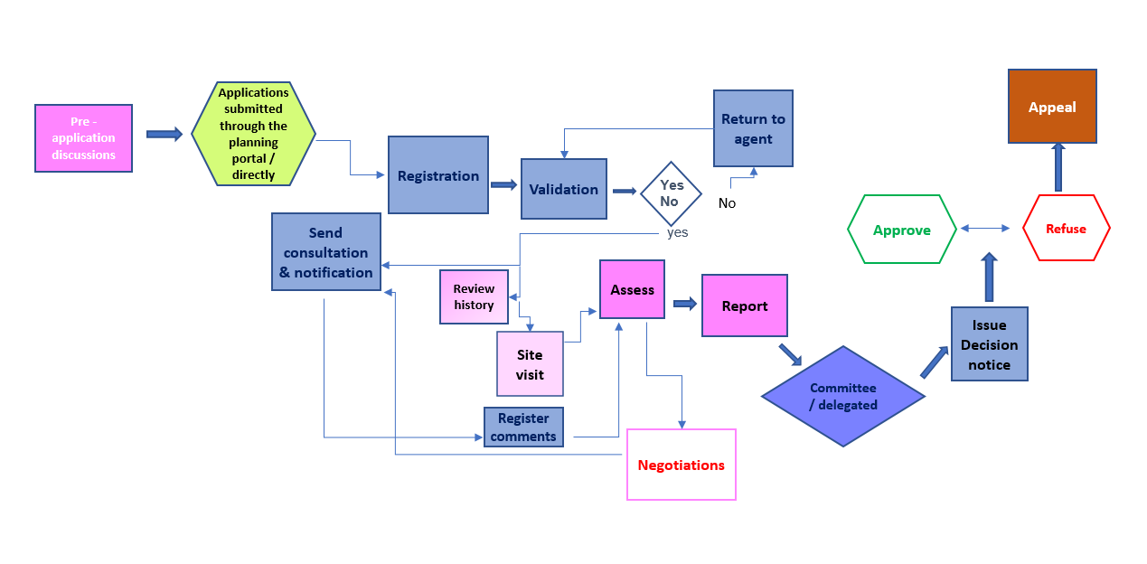
When to get involved: The life of a Planning Application
Notes:
This slide will take Members through the planning application process from start to finish. It is a good opportunity to have a discussion with Members on when they should get involved and when it is not appropriate. For example:
Pre apps – if the Council has a policy of involving Members then this is the best time to get involved
Registration / validation – no point because it is a procedural process
Formal consultation period – need to alert the case officer if Members have concerns and possible Member referral to Committee
Assessment – need to speak to the officer before this time but Members can take an active role in negotiations where appropriate to ensure residents’ concerns are understood
Report – Normally too late as the officer is bringing together all the issues and to form a recommendation
Prior to Committee – important that Members ensure that officers understand their concerns before the actual meeting
Appeal – If Members have made representations that have led to a refusal they can make additional comments to the Inspector to reinforce their objections if allowed and if appropriate

Slide 41
Summary: reasonableness and balancing material considerations
Decisions on behalf of whole community
Consistency expected - precedents
Presumption in favour of sustainable development - needs explaining often
Officer reports set out material considerations and recommendation but what if your balance is different to the recommendation?
Will you take advice and discuss this and your reasons / conditions in advance?

Slide 42
Making a planning decisions : key points
start with the policies in the development plan
consider any other relevant policy context, if necessary
take into account the assessment of your officers
take into account all other views – if material
look at the application on its own merits, and in its particular context
come to your view in the light of the officers’ assessment and recommendation

Slide 43
Take away tips
Follow codes of conduct
Start with the development plan
Take everything relevant into account
Seek advice from officers (planning and legal)
Carefully consider the evidence that might be needed to defend a decision at appeal

Slide 44
Take away tips …
Reach a decision that a reasonable decision maker, properly directed, could have reached
If you refuse, make sure you have sound planning reasons which are reasonable
Visit the results of your decisions - to improve quality and consistency of decision making

Slide 45
Understanding the jargon
AH – Affordable housing
AMR – Annual Monitoring Report
AONB – Area of Outstanding Natural Beauty
AQMA – Air Quality Management Area
BNG – Biodiversity Net Gain
CIL – Community Infrastructure Levy
CPO – Compulsory Purchase Order
DAS – Design and Access Statement
DP – Development Plan
EIA – Environmental Impact Assessment
GPDO – General Permitted Development Order
HDT – Housing Delivery Test
HER – Historic Environment Record
HMO – House in Multiple Occupation
HRA – Habitats Regulation Assessment
LBC – Listed Building Consent
LDC – Lawful Development Certificate
LDO – Local Development Order
LNR – Local Nature Reserve
LP – Local Plan
LPA – Local Planning Authority
NDO – Neighbourhood Development Order
NPPF – National Planning Policy Framework
OAN – Objectively Assessed Need
PD – Permitted Development
PINS – Planning Inspectorate
PPA – Planning Performance Agreement
PPG – Planning Practice Guidance
Pre app – pre application discussions
RIGS – Regionally Important Geological Sites
S106 – Planning obligation
SA – Sustainability Appraisal
SAC – Special Areas of Conservation
SEA – Strategic Environmental Assessment
SEP – Strategic Economic Plan
SFRA – Strategic Flood Risk Assessment
SHLAA – Strategic Housing Land Availability Assessment
SPA – Special Protection Areas
SPD – Supplementary Planning Document
SRN – Strategic Road Net
SSSI – Site of Special Scientific Interest
work
TA – Transport Assessment
TPO – Tree Preservation Order
UCO – Use Class Order
Notes:
This slide can be as long as you want it to be and a useful ‘takeaway’ for future reference

Slide 46
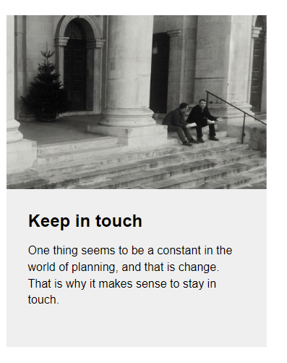
Stay in touch: we are at local.gov.uk/pas

