Slide 1
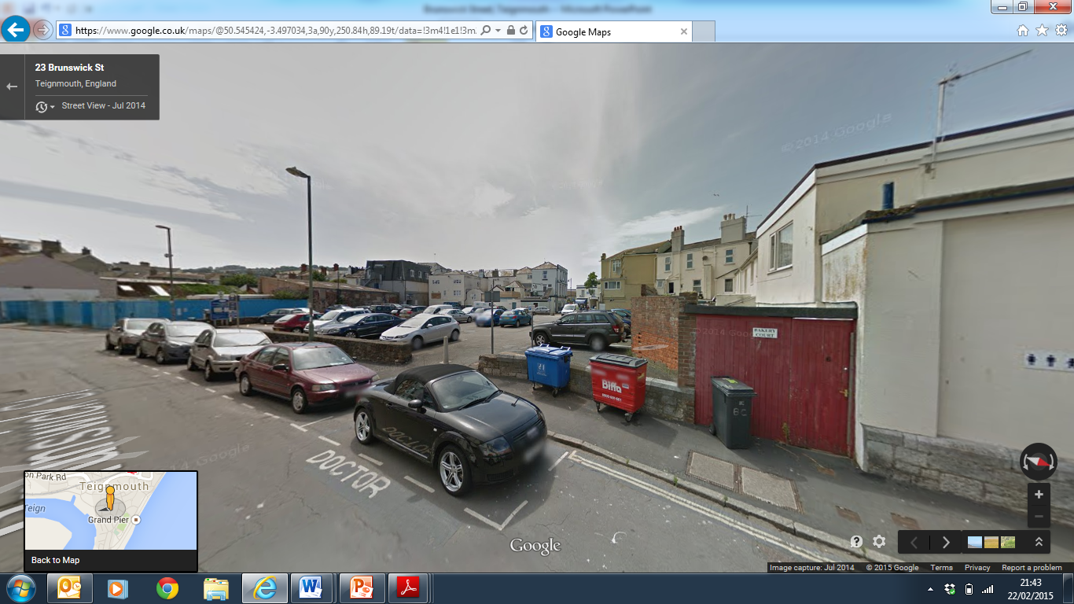

Brunswick Street, Teignmouth
Local Development Order
Mary Crew, PBA
24th February 2015
Notes:
Very exciting and potentially very rewarding project to work on
Site clearly has significant potential – a regeneration site in the town centre
Requires working through a myriad of issues in order to secure development

Slide 2
Brunswick Street LDO
PBA commissioned by PAS in November 2014 – have developed a project management role, working alongside Teignbridge DC
Site allocated in Local Plan for residential, retail/commercial and replacement parking, May 2014
Pilot project for LDO, October 2014
Notes:
History of the site dates back to the 2 WW when the site was bombed
A long established priority for regeneration in Teignmouth

Slide 3
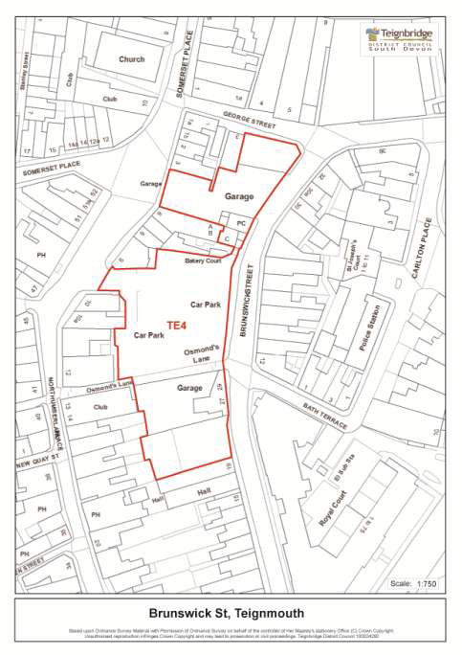
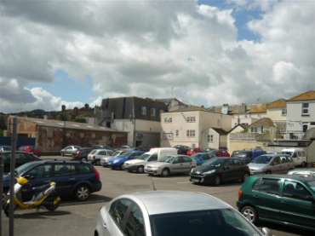
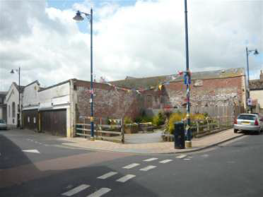
Brunswick Street
Notes:
Map shows the Local Plan allocation
Boundary for the LDO is not straightforward – buildings to be demolished and those which could potentially be refurbished and retained. A number of complex issues to address in this respect
Site encompasses a surface level car park
Also a 2WW Memorial Garden which is not well located

Slide 4
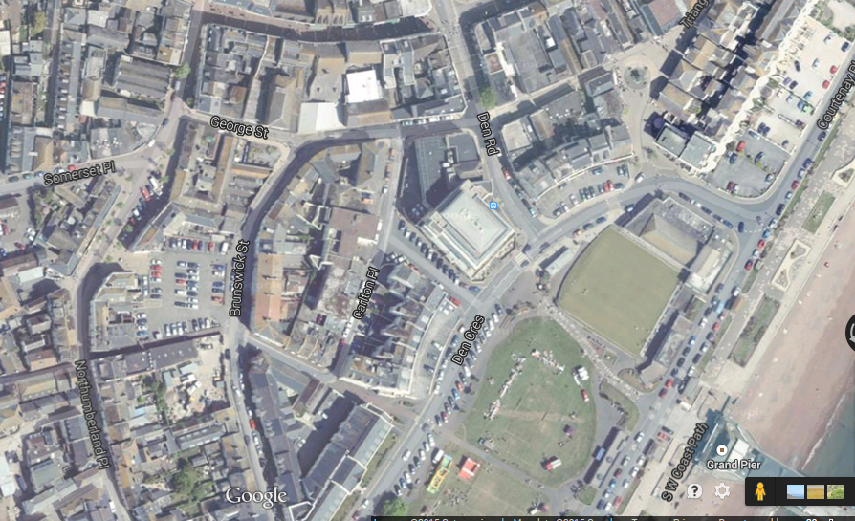
Notes:
Tight built form surrounding the site
The project is very much about how the site will integrate into Teignmouth as opposed o what it will offer on its own

Slide 5
Why an LDO for Brunswick Street?
Bring forward regeneration faster and avoid delays
Give developers confidence and certainty to bring regeneration forward
Give certainty about the likely type of development and uses
Bring investment into the town
Develop a cohesive and collaborative approach to the site
Notes:
Establish a momentum and a drive to bring forward development
Raise the profile of the site
Ensure a collaborative approach between Officers and with stakeholders

Slide 6
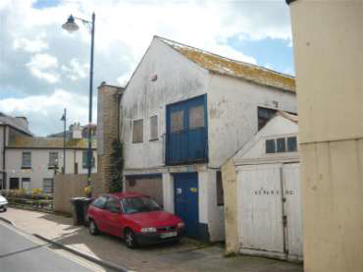
Key Issues
Design and conservation
Heritage
Flooding
Contamination
Car parking
Notes:
Sensitivities over which should be retained, given the Conservation Area status, and the need for demolition and rebuild to realise the regeneration potential
Clarity over which buildings are of architectural merit and those which are not viable - building survey underway at present
Flood Zone 3 status which remains unchanged post flood defence work
Constraints in terms of avoiding residential on the ground floor, or raising levels
Contamination relating to 2 former petrol filling stations
Car parking is a contentious issue in Teignmouth and the displacement of 56 spaces from the Brunswick Street site is to be provided elsewhere in the town – something that the council is addressing separetey

Slide 7
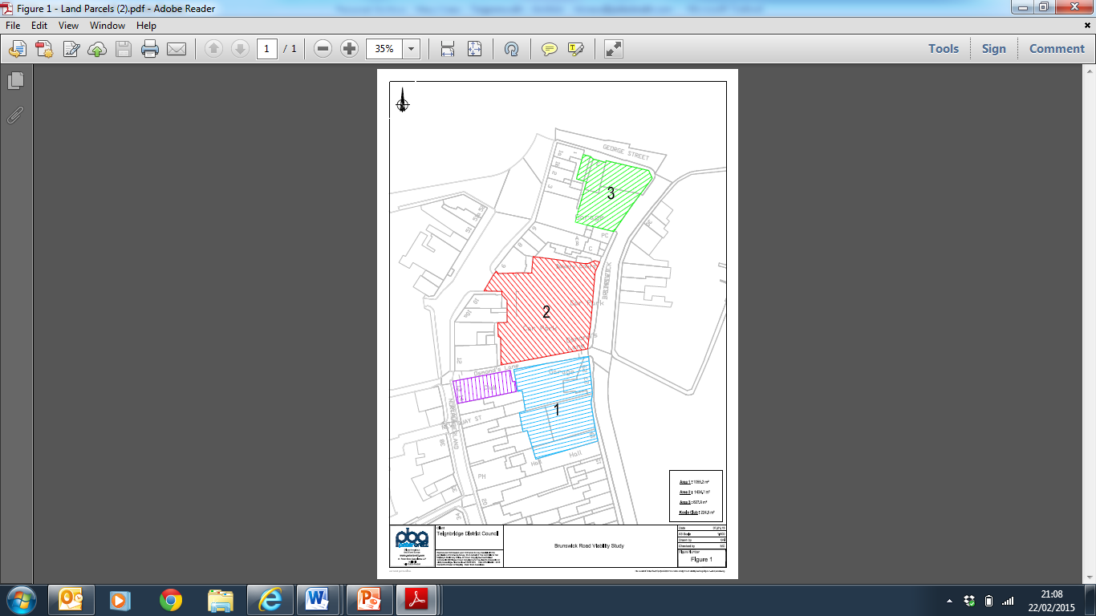
Viability
Residential
Hotel
Library
Community
Health
Retail
Workspace
Public square
Notes:
First step for PBA was to recognise viability as a critical factor in deliverability
Assess the uses/mix of uses which stack up financially
Divided the site into 3 parcels, phased
Most likely that development will be phased and it could be that the middle parcel (currently the car park) comes forward last, when a solution for a relocated car park has been sorted
Residential led and possible accommodation for the elderly
Hotel use, a boost to the local economy
We have explored the potential for relocating the existing library which is currently in an inaccessible location. Could act as a community hub on the Brunswick Street site
Community uses- come together and operate from a shared space
Potential for start up work space

Slide 8
Development Options
Residential with parking behind
Mixed use - community space with residential above focused around a new public square
Mixed use - convenience retail with residential above focused around a new public square
Small scale hotel with bar/restaurant

Slide 9
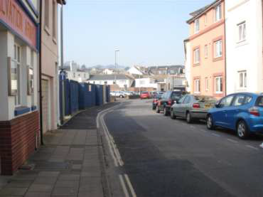
Delivery
A more clearly defined planning context is particularly beneficial to smaller developers
Statutory consultees
TC Manager
De-risks the site
Notes:
A case of being well prepared – establishing exactly what the site is capable of – in physical and economic terms
A thorough understanding of the constraints and opportunities to ensure that a prospective developer can hit the ground running

Slide 10
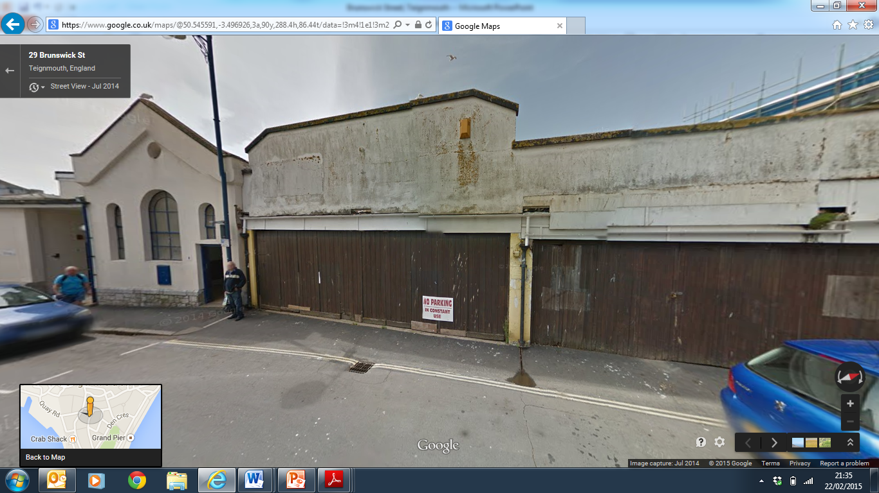
LDO Made Clear
Explain the benefits to developers
LDO a marketing tool
Notes:
Making it clear to developers the advantages of an LDO
We will invite agents and developers to the options workshop in March and expect that this will generate interest in the site and encourage constructive dialogue in terms of taking it forward

Slide 11
What the LDO Work Involves
Technical support and reports including viability, design, flood risk, contamination
Input from statutory consultees, stakeholders, local organisations and groups
Production of a ‘Statement of Reasons’ report and a Local Development Order for consultation
Public consultation and engagement
Notes:
Currently preparing for an options workshop with stakeholders, to be held in March
Drop in public consultation event also

Slide 12
Drafting the LDO
Details of which uses are permitted or not
Specific requirements e.g. relating to flood risk
Conditions and legal agreements
Phasing
Reference to other documents to comply with e.g. design guidance

Slide 13
LDO Timetable
March 2015 – consultation on draft LDO (28 days)
May 2015 – appraise feedback and revise LDO
July 2015 – finalise and ‘make’ LDO of the site

Slide 14
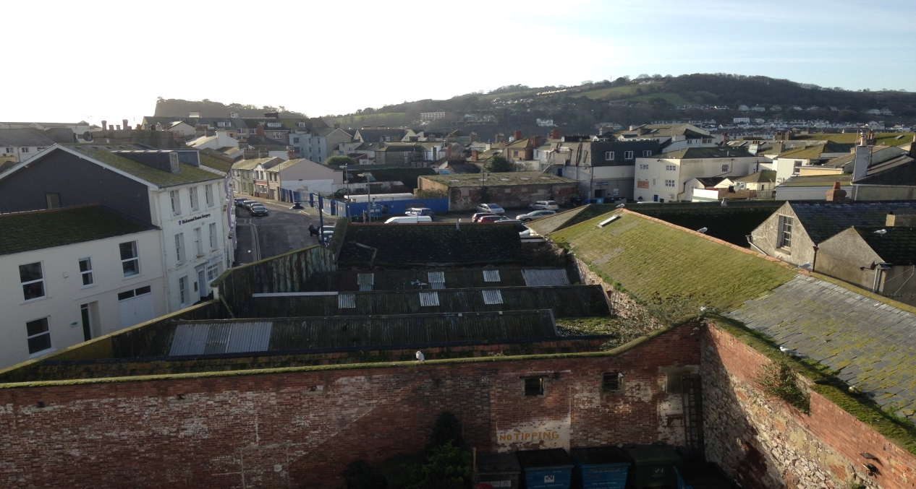
A Critical Site in Teignmouth
A simplified planning environment to encourage development to come forward
A front loaded approach to speed up development

