Slide 1
Positive Planning: Partnership Working
Southend Borough Council & Rochford District Council

Slide 2
Matters Addressed
Geography and Local Context
Legislation - Duty to Co-operate
Planning Policy Background
JAAP – joint working
Wider Partnership Working
Overall Benefits, Challenges & Key Outcomes of Partnership Working
Lessons Learned

Slide 3
1. Geography and Local Context

Slide 4
Thames Gateway South Essex (TSGE) and Surrounding Authorities

Slide 5
TGSE Topography

Slide 6
TGSE Context
TGSE comprises:
more than 650,000 people,
54,000 businesses
and a workforce of over 200,000
Lord Heseltine said it was “crucial to UK Competitiveness” as part of the Thames Gateway
Infrastructure:
Good road links with London – A127 and A13
Two mainlines into London – Fenchurch Street and Liverpool Street
London Southend Airport
London Gateway Port

Slide 7
TSGE

Slide 8
2. Legislation - Duty to Cooperate

Slide 9
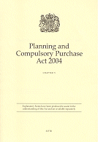
Planning and Compulsory Purchase Act 2004 (as amended)
Section 33A Planning and Compulsory Purchase Act 2004 (as amended by S110 Localism Act 2011)
States that a local planning authority, a county council in England, or a body, or other person, must co-operate
‘Activities’ covered under the Act includes the preparation of development plan documents and other activities that prepare the way for this or are a ‘strategic matter’
‘strategic matters’ are developments and/or infrastructure projects which would have a significant impact on at least two planning areas
Local authorities should consider whether to prepare joint local development documents

Slide 10
National Planning Policy Framework
Paragraph 179
Local planning authorities should work collaboratively in relation to strategic priorities
Should consider producing joint planning policies on strategic matters and informal strategies such as joint infrastructure and investment plans
Paragraph 182:
Demonstrate evidence of have effectively cooperated for cross boundary issues
Options of Joint committee, a memorandum of understanding or a jointly prepared strategy to show agreed position
Continuous process of engagement throughout

Slide 11
3. Planning Policy Background

Slide 12
East of England Plan (revoked)
Included Section and detailed policy on TGSE sub-region
Set the adopted minimum targets for dwellings and jobs
Policy E7 acknowledged support given to regional airport expansion at Southend to meet local demand and contribute to economic development

Slide 13
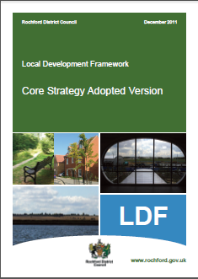
Local Planning Documents
Southend Core Strategy (2007):
KP3 ‘need to prepare a Joint Area Action Plan in partnership with Rochford District Council’, and Policy CP1 ‘seeks to promote economic regeneration recognising the contribution of London Southend Airport’
Rochford Core Strategy (2011):
Policies ED2 and ED4, which support the development of the airport and allocation of land for employment to be delivered through an Area Action Plan prepared jointly with Southend Borough Council

Slide 14
4. JAAP – joint working

Slide 15
London Southend Airport and Environs Joint Area Action Plan (JAAP)

Slide 16
The Need for a Partnership Approach
Established in Policy – approach set out in each Core Strategy
A cross boundary matter
Major employment growth, airport expansion, green belt changes and transport infrastructure is a strategic issue:
Delivering 7,200 net additional (jobs shared)
Major infrastructure for LSA in Southend and Rochford:
Control tower, railway station, terminal building, runway and hotel
Upgrade of road junctions along the strategic highway network and around the development - communication between the relevant highway authorities vital
JAAP also provides a key evidence base document for bidding for local growth fund and there is major advantages to a joined up approach for business case to Government

Slide 17
The Approach to the JAAP
Early and continuous dialogue between officers:
Regular meetings between key officers involved in the preparation of the JAAP
Senior management kept informed at all stages of production with regular update meetings
Regular contact with Committee sections at each Council to co-ordinate the approach to taking the JAAP through their respective committee
Regular meetings with communications teams from both authorities to ensure that the press releases and statements by Members are agreed and co-ordinated
JAAP was also on the agenda at the regular EPOA Officer meetings for discussion
Early and continuous dialogue with key partners:
An Airport and Transport Liaison Group was also set up so that there was regular dialogue between key officers from all disciplines as well as TGSE representatives and London Southend Airport and other parties where deemed appropriate
Early and continuous dialogue with Members
A formal joint committee set up meeting to make decisions at key stages for JAAP preparation and delivery – this is continuing through Implementation stage
The JAAP was also presented to TSGE Planning and Transport Board and TGSE Board for formal agreement

Slide 18
5. Wider Partnership Working

Slide 19
Purpose of Partnership:
The TGSE Partnership aims to coordinate regeneration in the sub-region
To help local authorities cooperate on planning, economic and transport matters
The partnership is led by business representatives and comprised the leaders of six authorities*:
Southend Borough Council
Rochford District Council
Thurrock Council
Basildon District Council
Castle Point Borough Council
Essex County Council
* membership during preparation of the London Southend Airport and Environs Joint Area Action Plan

Slide 20
TGSE Partnership Approach
Clear Reporting lines and Regular Meetings:
TGSE Planning and Transport Board – overseeing of key strategic planning documents and transport infrastructure strategy and schemes
TGSE Leaders Board for the six authorities involved in the sub-region
TGSE Planning and Transport Officer Group – reporting to TGSE Planning and Transport Board
TGSE Strategic Planning and Duty to Co-operate Group
Development of a Memorandum of Co-operation and Understanding, to agree and co-ordinate approach to key strategic issues and evidence base documents
Involvement of key partners:
London Southend Airport, London Gateway Port, Chamber of Commence, the Highway Agency and rail operatives etc.
Preparation of key evidence base document:
Strategic Housing Market Assessment (SHMA)
Strategic Flood Risk Assessment(SRFA)
Strategic Green belt review
Strategic Health Impact Assessments
Areas of interest for the Partnership include:
housing supply, economic development, retail, health, transport, gypsies and travellers, climate change, waste and minerals, environment, heritage, green belt and green grid

Slide 21
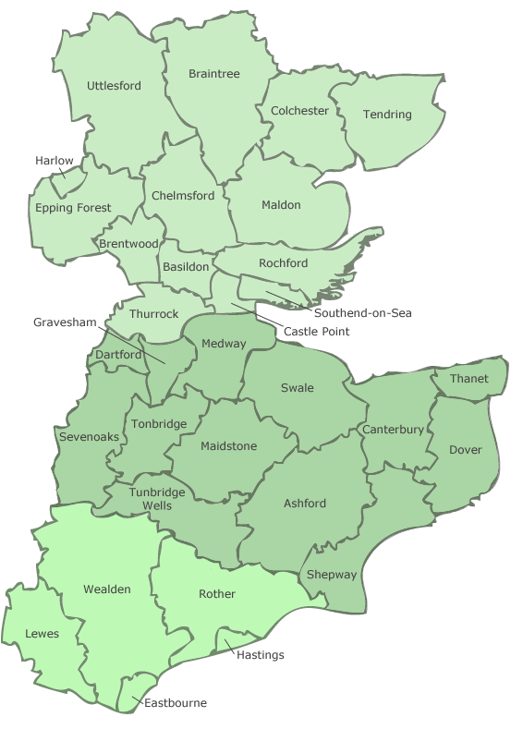
South East Local Enterprise Partnership (SELEP) & TGSE
The growth deals are area based on areas. These comprise:
East Sussex, Essex, Kent and Medway and Thames Gateway South Essex
£155.8m (of £442.2m) funding allocation for TGSE including:
£35.6m capacity improvements along the A127
£5m for development of A13 widening scheme
£9m Integrated Transport Package for Basildon
£7m Transport works to deliver the Southend Central Area Action Plan (SCAAP)
Investment package to support delivery of SCAAP
TGSE Local Sustainable Transport capital funding
£22.8m for growth hub business support & Skills Capital Funding
Just announced – extra £46.1m which is TGSE will go towards the JAAP, regeneration in Purfleet and new business environment in Southend

Slide 22
6. Overall Benefits, Challenges & Outcomes of Partnership Working

Slide 23
Benefits
Creates clear structures and processes:
for preparation, presentation, discussion and delivery of key planning policy documents, major schemes and infrastructure which affect boundaries wider than a single local authority
Substantial cost savings:
when combining the preparation of key evidence based documents – TGSE SHMA
Bigger Voice:
Authorities may feed into and combine responses on strategic matters beyond the sub-region (reporting of matters outside) and lobby where necessary
Successful funding bids:
Benefits when applying for funding from Government as a Partnership with clear approach and reporting structures, and with cross boundary and strategic projects, which feed into the SELEP Strategic Economic Plan, TGSE are able to demonstrate significant wider benefits for housing and economic development to meet Government Criteria
Clear Reporting of Duty to Corporate
Demonstrable and clear compliance with meetings recorded and minutes to help tell the story for an inspector

Slide 24
Challenges
Reach an acceptable and agreed solution:
potentially conflicting approaches to the content of policies among local authorities producing joint plans
Coordinating preparation:
writing and editing different sections of policy documents and funding documents between authorities and partners
Coordinating different departments within and between Councils:
to produce a cohesive, and deliverable, plan e.g. planning and asset management
Agreement between Partnership:
Resolution of potential conflicting political perspectives within TGSE Partnership area
Changes to political leadership of Councils
Members agreement from different local authorities to formally agree strategic matters (officers role and working relationship may be key to achieving the right outcome)
Overall it doesn’t feel like there were too many challenges to date so far but the approach to the duty is still in its infancy for the TSGE Partnership:
housing may create the key challenge

Slide 25
Key Outcomes
Delivery of ‘sound’ plans
Securing key and necessary funding from Government
Delivery of key Strategic evidence based documents with substantial cost saving through economies of scale
Enhanced working relationship between participant Councils to take the plan forward towards implementation
A workable solution to the duty to cooperate??

Slide 26
Lessons Learned
Where possible:
Investigate scope for joint working and planning
Agree a Memorandum of understanding and overall strategy
Align preparation of local plans and request same Inspector
Secure sub-regional strategy not merely agree to seek to agree in future
Create joint local authority committees to formalise process
Have regular meetings to monitor progress with partners and communication
Ensure there is robust evidence to demonstrate on-going and active engagement under Duty to address in written statement
Record and monitor all decisions and other actions even if they are not detailed in the Duty
Explore joint evidence base for economies of scale
Try and creating a good working relationship with fellow officers

