Slide 1
Assessing viability - A housebuilders perspective
Philip Barnes
Group Land and Planning Director
Barratt Developments PLC
July 2015

Slide 2
Structure
The history
Policy
Looking backwards
Our approach
The battle lines
Some ideas

Slide 3
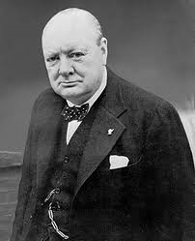
History shaped by various attempts to tax land “betterment”
Churchill’s Betterment Levy (1930s)
Development Land Tax (1970s)
Section 106 (1971 - now)
Planning Gain Supplement (1990s)
CIL (2012 - onwards)
Gordian Knot – why?
Planning system post 1947 was only half the job. Nationalised development rights but not land ownership or land value
Planning delivery = land, plans and building (not just plans and building)

Slide 4
Policy Background
"Pursuing sustainable development requires careful attention to viability and costs in plan making and decision taking. Plans should be deliverable . . . To ensure viability the costs of any requirement to be applied to development such as requirements for affordable housing, standards, infrastructure contributions or other requirements should, when taking account of normal cost of development and mitigation, provide competitive returns to a willing landowner and willing developer to enable the development to be delivery” (Para 173, NPPF)
"LPA's . . . should assess the likely cumulative impacts on development in their area of all existing and proposed local standards, SPD's and policies that support the development plan, when added to the nationally required standards. In order to be appropriate, the cumulative impact of these standards and policies should not put the implementation of the plan at serious risk, and should facilitate development through the financial cycle“ (Para 174, NPPF)
“Regulation 14 requires that a charging authority, in setting CIL rates ‘must aim to strike what appears to be the charging authority to be an appropriate balance between’ the desirability of funding infrastructure from CIL and ‘the potential effects (taken as a whole) of the imposition of CIL on the economic viability of development” (Para 7 CIL Guidance Note)

Slide 5
Policy Guidance
“…Sites and scale of development in the plan should not be subject to such a scale of obligations and policy burdens that their ability to be developed viably is threatened” (Para 001, NPPG)
“A competitive return for the landowner is the price at which a reasonable land owner would be willing to sell their land for development. The price will need to provide an incentive for the landowner to sell in comparison with the other options available (…current use value of the land or its value for a realistic alternative use that complies with planning policy)” (Para 024, NPPG)
“When discussing costs to be included in the viability process “all development costs should be taken into account”

Slide 6
Policy – in summary
Viability is a material consideration
“Requirements” must not threaten viability of either a plan or a development
Must ensure a competitive return for a willing landowner and willing developer
Why?
Housing crisis is a national priority – new viable supply is essential
Key Tools: Harman Report, RICS report on Planning and Viability and HCA Toolkit

Slide 7
What are these “Requirements”?
Affordable housing
S106
CIL
Lifetime Homes
Energy reduction measures
Funded by the land
Clear public benefits
For 85% of UK locations (excluding London)
Cannot afford 30% AH and CIL
30% AH + £15k/plot planning obligations via CIL S106 requires
£350 p.s.f. sales values

Slide 8
Our approach to measure viability (1/3)
All housebuilders use simple Residual Land Value model
Step 1
Step 2
Step 3
Gross Development Value
Anticipated sales value of completed development
Estimate £/sqm x total floor space
Discounted receipt from affordable homes
Gross Development Costs
Construction above and below ground
External works
Fees
Site Management
Preliminaries
CIL
Planning obligations
Finance
Sales and Marketing costs
Residual Land Value
What we pay the landowner
Minus
Equals

Slide 9
Our approach to measure viability (2/3)
We compete hard for land – our raw material
2nd hand sales prices dictate land price
GDV (sales values) is derived from sales values in 2nd hand market
GDV = Step 1 of defining residual land value (land price = output at Step 3 not a cost input at Step 2)
Profit is regarded as a cost land is not
Profit/build costs don’t move much
Variables = selling prices and land value
We need land value (from RLV model) to be high in order to beat competitors and secure land
Therefore we want:
Costs low – so long as buildable and meet BfL12
P.S.F. revenues high – so long as we know our sales team can reach them
This generates the winning bid

Slide 10
Easy to lose sight of wider financial benefits of new homes?

Slide 11
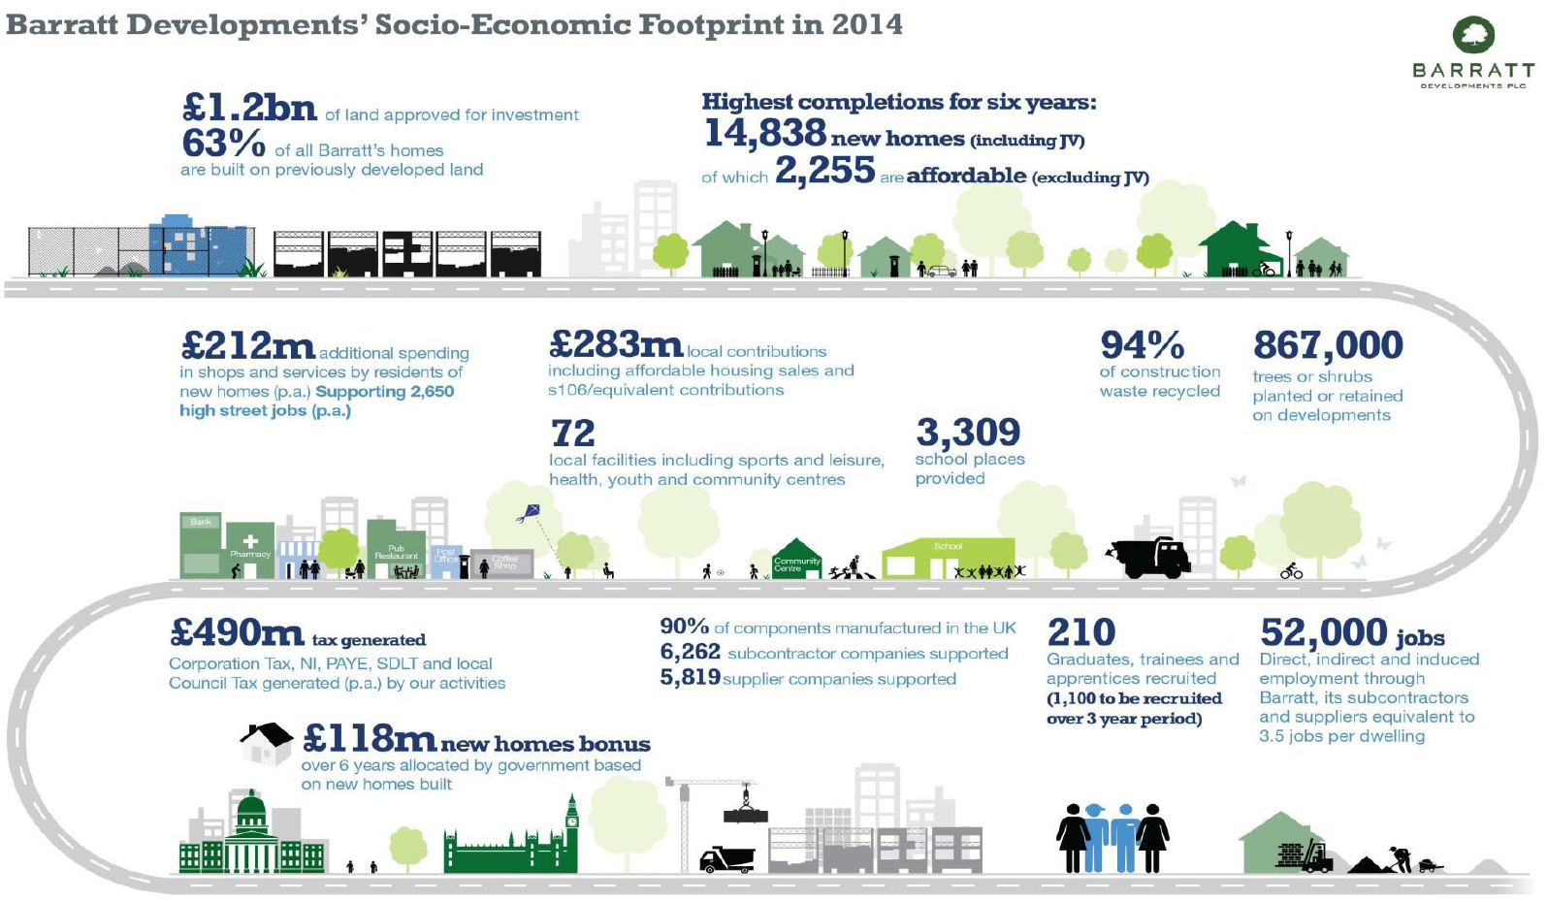

Slide 12
So where are the battle lines?
Profit
Externals
Sales values
Contingencies
Fees

Slide 13
Profit (1/2)
NPPG / Harman / RICS = Silent
20% of GDV (not cost)
Needs to be a competitive return to both landowner and developer
“Development is an activity that carries substantial risks in the best of circumstance and, in my experience, developers generally seek a return of 15-20%, ideally more, to reflect that fact” (Weybridge appeal)
“…The DV sets the level of profit required as 18%, whereas I would expect a figure of 20% to be used, bearing in mind the risks associated with the current housing market” (Lowestoft appeal)

Slide 14
Profit (2/2)
“ Profit 20% of GDV” (GDV – P16 EVA Affordable Housing And CIL – London Borough of Barking)
“The national housebuilders figures are to be preferred and that a figure of 20% of GDV, which is at the lower end of the range, is reasonable” (Shinfield Appeal)
“…The key potentially influential variables to be fed into the appraisals…were primarily the assumptions as to contributions to infrastructure and SAMM, existing use value, incentives to existing owners and developer’s profit. It is axiomatic that, unless the latter is anticipated to be adequate, the development simply would not take place” (Weybridge appeal)

Slide 15
Why do we need 20% profit in the appraisal?
Compensate for high risk
Protects us in the event of costs overrunning:
Virtually always do
Company profit 14% last year
Less than 0% for last 5 years
Our lenders expect this. They need a reason to lend to housebuilders!
The City expects this. They need a reason to buy Barratt shares
Investors will abandon Barratt if repeat pre 2007 irresponsible land buying:
Share price and market capitalisation falls
Unable to raise finance to do developments
Money is too expensive

Slide 16
What about blended profit?
Not acceptable to Barratt
Not supported by appeal decisions
Assumption of “no sales risk” is wrong
Contractor margin not appropriate for speculative development:
Speculating on planning, ground, build
No possibility of a “claim”
Margin should link to risk (Harman/RICS)
 | Open Market | Affordable
Profit level | 20% | 6%

Slide 17
Sales Values and Build Costs
Values
Use comparables
Selling prices not window prices
Costs
BCIS but must add externals and abnormals
Abnormals are a ‘normal development cost’ present on every site
Bespoke costs can sometimes be useful:
avoids penalising higher quality developments
but must be justified – can’t be “developers preference” at the expense of public interest

Slide 18
Land Value (1/2)
The RLV output (not input)
EUV or AUV plus significant uplift is appropriate for brownfield
Greenfield = c20-25% of GDV is what is needed to incentivise landowner to sell
Primary issue is that planning gives land it’s value
Landowners must be offered an attractive land value to release the site for development
Key is to capture the appropriate level of the land value uplift for communities – big issue is how?
Impossible for state to buy “at agricultural” and sell “at housing”
Shinfield Appeal : 50% of the uplift to landowner is reasonable

Slide 19
Land Value (2/2)
“Based upon our assessments of the ratio of Residual Land Value to GDV, we have taken a figure of 25% GDV … for the level at which RLV may need to reach in order to incentivise the landowner sufficiently to bring forward his parcel of land” (Para 3.19 EVA Darlington)
“There is however a degree of consistency in the treatment of land value as a percentage of GDV agreed with stakeholders across 3 Local Authority areas…
Leeds – 20%
East Riding – 20%
Selby – 25%”(Para 3.14 Pioneer Report into Land Value in Yorkshire)
“I am in any event not convinced, based upon experience, that the levels of land value as a share of GDV are realistic and that most landowners would be prepared to sell at figures in the region of 10% to 20% of GDV” (Para 2.13 PINS Report into Eden Valley Core Strategy)

Slide 20
Day to day areas of dispute
Inflated revenues
No allowance for contingencies
Costs with unrealistic/ally low externals, sales, marketing and finance costs
Profits – 20% of GDV sometimes not being accepted
Unrealistically low landowner incentivisation:
Landowners will not sell their family silver cheaply
Especially greenfield
Net developable areas vs gross development area
Gross internal area vs gross external area

Slide 21
Questions / Issues
Land promoters – where does their profit sit?
Can’t come out of ours!
Must differentiate between developers and builders
Role of existing use values (greenfield / brownfield)
Off plan vs allocated sites
KISS

Slide 22
Some ideas
Sharing costs for common evidence
Especially for local plans
Fast-track arbitration for application – 2-4 weeks result
Its not rocket science
Closer cross-sector partnerships
CLG / LGA / PAS / HBF / PINS / RICS
Joint sector guidance manual?
Regional presentations / road trip?

