Slide 1
Planning for an Ageing Society: Role of Local Authorities in Information and Advice
Simon Bottery
Director of Policy and External Relations

Slide 2
Three key priorities
Care Act duties
Shift in way of working
Channels

Slide 3
Care Act

Slide 4
Must/should include…
MUST
How to raise safeguarding concerns about any adult who may be
at risk.
The care and support system locally, including the process for
getting support.
How to complain or formally appeal.
When independent advocacy will be provided.
Paying for care and support (including charging arrangements).
The choice and types of support, and the choice of care providers
available in the area.
How to access independent financial advice on matters relating
to care and support.
SHOULD
Housing and housing-related support options
Treatment and support for health conditions
Preventative services (e.g. practical support, befriending,
handypersons)
Intermediate care services (e.g. aids and adaptations)
Benefits advice
Employment support
Transition from children’s services
Carers services and benefits
Sources of independent information, advice and advocacy
Planning for future care costs

Slide 5
Care Act
Self funders
Prevention
Financial information and advice
Housing

Slide 6
Resources
TLAP step-by-step guide to developing advice and information strategy
http://www.thinklocalactpersonal.org.uk/

Slide 7
Care Act advice and information
Every local authority must: “establish and maintain a service for providing people in its area with information and advice relating to care and support for adults, and support for carers”.
This does not mean that the local authority should provide all the elements itself. Instead, it should “understand, co-ordinate and make use of” the resources available across the community.

Slide 8
From provider to facilitator

Slide 9
Systems approach

Slide 10
Old, rights-based model…
Problem:
I’m have difficulty washing
I keep forgetting to take my pills
I’ve had several falls
I’m struggling to do my shopping and housework
Charity or community agency
ADVICE AND INFORMATION : where can I buy the support that I might want
INDEPENDENT FINANCIAL ADVICE: how will I fund cost?
GP or other medical professional
NOT ELIGIBLE FOR PAID-FOR SERVICES
LOCAL AUTHORITY
NEEDS ASSESSMENT: What OT/care support is needed?
FINANCIAL ASSESSMENT what care/support entitled to funding for?
SUPPORT OFFER
SERVICE CHOICE: what’s available and what is its quality?
Other statutory agency
Brokerage
HOUSING, BENEFITS & OTHER ADVICE: what other support exists?
INDEPENDENT ADVICE: CHALLENGE - is assessment correct and fair?
Friend, relative, carer
Needs met

Slide 11
Resource-based model
Health and prevention services
Pre-assessment
Council care services
Problem, issue or crisis
Needs assessment
Financial assessment
Support offer
Ineligible: needs
Ineligible: finances
Personal ‘cloud’ of advice, services and support
Housing options
Statutory benefits
Resolution or stability
Paid for products and services

Slide 12
Following Care Act: LA as ‘enabler’
Local authority public health and prevention duties
Pre-assessment/
assessment
LA care and support
Problem, issue, crisis or objective
Assess needs
Assess finances
Support offer
Ineligible: needs
Ineligible: finances
IPB
Personal budget
Personal ‘cloud’ of advice, services and support
Advice
Housing options
Statutory benefits
Resolution or stability
Paid for products and services

Slide 13
Co-production
“A way of working, whereby everybody works together on an equal basis to create a service or
come to a decision which works for them all.”
“It is built on the principle that
those who use a service are best
placed to help design it.”

Slide 14
Channels

Slide 15
“By the end of 2014, up to 78% of public sector organisations expect to have a clear Channel Shift strategy for delivering services via digital and lower cost channels.”
- iGov survey, Public Sector Channel Shift Strategies, October 2013

Slide 16
Internet usage, all 65+

Slide 17
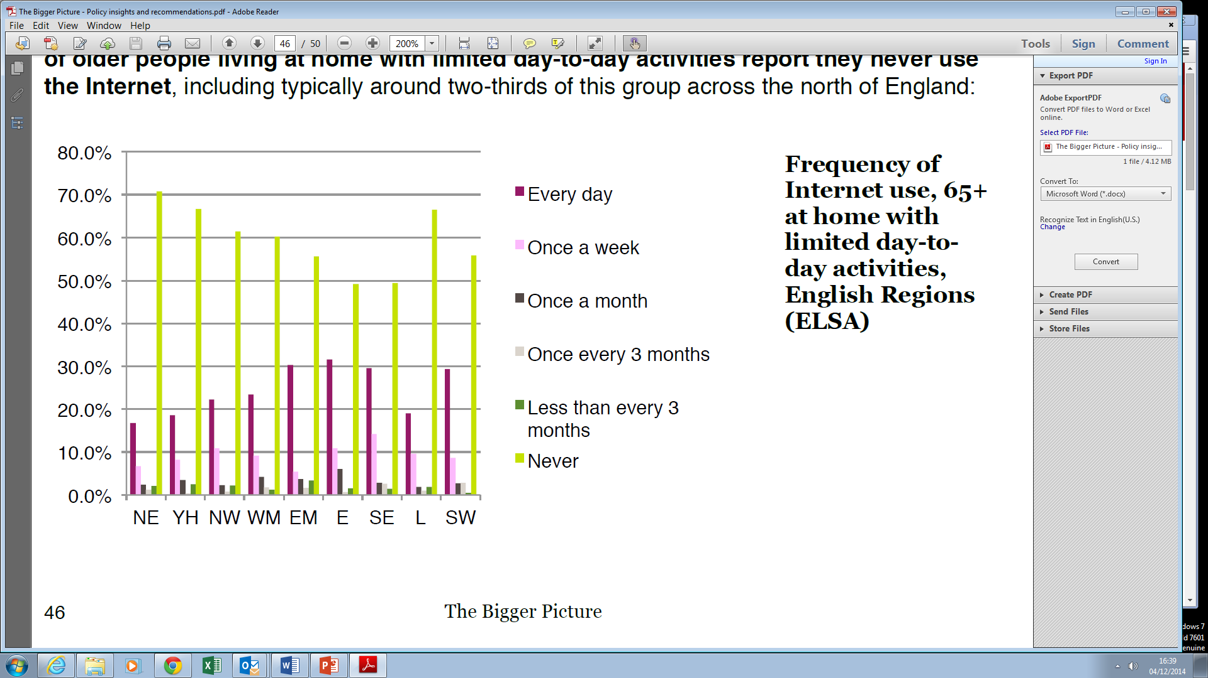
Internet usage, 65+ with disability

Slide 18
Actions

Slide 19
Actions
Strategic approach to advice and information
Enabler rather than provider
Review of channels – resist itch for digital

