Slide 1

“Keeping the lights on….”
How planning can help
Updated June 2015
www.pas.gov.uk
Notes:
Planning makes a significant contribution to both mitigating and adapting to climate change, through decision-making on the location, scale, mix and character of development. Planning is capable of doing this job over the long periods of time necessary to deal with impacts such as sea level rise.
Local authorities have a responsibility to help to secure progress on meeting the UK’s emissions reduction targets, both through direct influence on energy use and emissions (by, for instance, encouraging energy efficiency and renewable energy) and by bringing others together and encouraging co-ordinated local action.
A key part of any local authority strategy to encourage economic recovery and improve energy security should be to help to reduce the costs of buying in energy – by identifying renewable and local sources of energy, and also by reducing the amount of energy used. Planning can also give local communities real opportunities to take action on climate change by encouraging community-based development and active participation in plan-making, and by helping them to reap the rewards of green development.
1

Slide 2
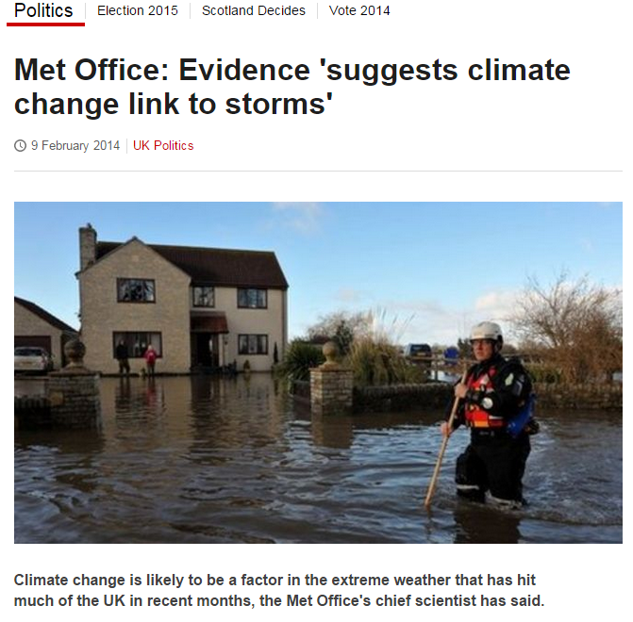
Aim of this briefing
To help you understand:
  planning’s relevance to climate change
  sustainable energy opportunities
  issues to consider in plan-making and in determining planning applications
It isn’t a debate about whether climate change is or isn’t happening
Notes:
Slide 2 – Aim
This briefing session is designed to give you an understanding of the impacts of climate change, the opportunities and issues that sustainable energy represents and those that you need to consider when developing spatial planning policies and in determining a planning application for stand-alone or building integrated sustainable energy installations in your area.
The content has been prepared for those either working directly in planning, for instance on the planning committee, or for those with an interest in managing the development of sustainable energy within the planning system.
The main points that I want you to come away with are:
1. The scale of the challenges posed by climate change and energy affordability/security means that we have to take difficult decisions about where and how we generate energy. You are making these decisions on the local scale through the planning system.
2. The policies in your development plan provide the framework for decision making. If they are flexible and up-to-date policies you will be able to balance your priorities appropriately for renewable energy applications.
3. This presentation is not about the small stuff. We are talking about your role in making some very important decisions that collectively have national and international significance. Through the Climate Change Act, we have committed to reduce UK CO2 emissions by 80% by 2050. Your planning policies and decisions are one of the key ways we will achieve this.

Slide 3
Why bother?
Maximise economic benefits: reduce cost of buying energy; cheaper fuel for communities
Help meet UK commitment to reducing emissions target
Build in resilience to extreme weather
Support community based development and community rewards
Make spatial policies and decisions that reduce dependency of fossil fuels
Provide green infrastructure with benefits such as cooling, flood resilience and access to green space and wildlife
Notes:
Planning makes a significant contribution to both mitigating and adapting to climate change, through decision-making on the location, scale, mix and character of development. Planning is capable of doing this job over the long periods of time necessary to deal with impacts such as sea level rise.
Local authorities have a responsibility to help to secure progress on meeting the UK’s emissions reduction targets, both through direct influence on energy use and emissions (by, for instance, encouraging energy efficiency and renewable energy) and by bringing others together and encouraging co-ordinated local action.
A key part of any local authority strategy to encourage economic recovery and improve energy security should be to help to reduce the costs of buying in energy – by identifying renewable and local sources of energy, and also by reducing the amount of energy used. Planning can also give local communities real opportunities to take action on climate change by encouraging community-based development and active participation in plan-making, and by helping them to reap the rewards of green development.

Slide 4
Issues for residents?
  When can I move back home after the flood? Will I be able to get house insurance?
  I’ve lost all my photos in the flood
  I have to drive my kids to school but petrol is so expensive
  I can’t afford to heat my house
  I was so sick in the heat wave
  The railway line is down again
  I’m worried that sea level rise will threaten my home.
Notes:
The impacts of climate change are increasingly being felt in our daily lives. Plus, reducing the impacts of climate change (for instance increasing energy efficiency) may address other issues in your area (such as fuel poverty) which diminish the quality of life of local residents.
The change many of us associate with climate change is rising sea levels, but temperature increases will also cause the UK to have wetter winters – resulting in greater flooding – and dryer summers, resulting in drought.
These personal issues arise from the negative impacts of climate change, due to:
increased flood risk
heat waves and other extreme weather events
an increase in the urban heat island effect
increased health risks for vulnerable groups, including the elderly.
Potential for coastal erosion from sea level rise
Which of these could cause issues for residents in your area? Do you have low lying areas, or even flood plains, that could be impacted by flooding? Are there homes in your community that have been known to flood already? What would happen if your area experienced a drought or heat-wave? Is there agriculture that could be affected, or would people be unable to work due to buildings over-heating?

Slide 5
For example: rising fuel costs
(Department of Energy & Climate Change, 1990-2010)
Notes:
5
This graph shows the average cost of fuel for a home with gas central heating over the last two decades, highlighting the costs of energy are increasing and over the last two decades have more than doubled. This means more of a households income is spent on energy expenditure, and less is available for other things. It could mean more people are falling into fuel poverty; struggling to keep their homes warm, with cold homes potentially leading to problems with damp and heath concerns.
In 2012, there were around 2.28 million households in fuel poverty in England, representing approximately 10.4 per cent of all English households. (Annual Fuel Poverty Statistics Report, 2014).
Energy efficiency improvements (for instance loft insulation, double glazing, internal or external wall insulation) can reduce fuel bills and reduce CO2 emissions at the same time.

Slide 6
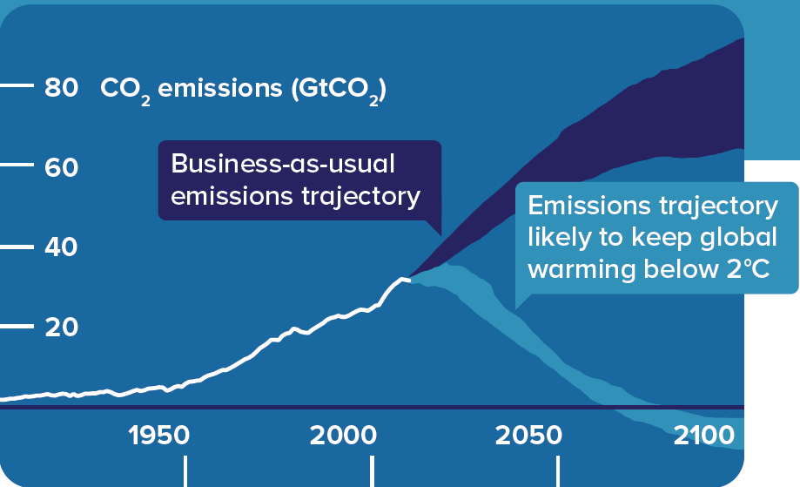
THE 2°C CHALLENGE
Limiting global warming to 2°C
Existing GHG emissions in the 21st century commit us to further warming and rising sea levels.
Source: http://www.cisl.cam.ac.uk
Notes:
It is very likely (>90% probability) that man-made greenhouse gas emissions caused most of the observed global temperature rise since the mid 20th century, according to the 4th and 5th IPCC Assessment Reports. Escalating green house gas emissions are linked to climatic changes which are having impacts the natural and built environments across the globe.
Due to existing GHG in the 21st century, we are already locked-in to future warming and sea level rise. Limiting climate change would require substantial (and sustained) reductions in GHG emissions which, together with adaptation, can limit climate change risks. The technologies and techniques which could be used to achieve the substantial and sustained reductions in emissions that could limit likely warming to 2°C already exist, but, implementing these reductions in GHG emissions pose huge technological, economic, social, and institutional challenges that must be planned for and integrated with one another.
We are facing the challenge of ‘how to limit the impact of climate change How can we limit warming to, or below, 2°C?

Slide 7
Extreme weather events in the UK
2003 | Heatwave | 2009 | Flooding Snow and ice
2004 | Flooding | 2010 | Flooding Snow and ice
2005 | Flooding | 2012 | Drought Flooding
2006 | Drought | 2013 | Hot weather Storms Flooding
2007 | Flooding Heatwave | 2014 | Storms Flooding
2008 | Flooding Snow and ice | 2015 | ??
TCPA table
Notes:
Extreme weather today is already very tangible, we are seeing a higher frequency of events and weather events with more intensity.
“All weather events are affected by climate change because the environment in which they occur is warmer and moister than it used to be.”
Trenberth (2012)
Planning for climate change and for limiting future climate change cannot simply be about reducing carbon. Developing positive renewable energy solutions is fundamental to the social and economic wellbeing of our society. The impacts of climate change are already having a major impact on communities and will intensify over the coming years, doing irreversible damage to some of our most valued ecosystems and landscapes - as well as damage to the infrastructure and social fabric of our towns and cities. While local communities must be at the heart of planning process, it is critical that long term social, economic and environmental costs and benefits must be considered together to mitigate the impacts of climate change and secure our collective future through adaptation measures.
We need to plan and prepare for:
Keeping people warm during longer and colder winters
Overheating and the urban heat island effect
Flooding and droughts
Whilst reducing carbon emissions, reducing energy usage, providing housing for a growing population, continued demographic change, …
For this to work, we must get the governance and policy for climate change right.

Slide 8
2007 floods
13 deaths
7,000 rescued by emergency services
55,000 properties flooded
Half a million people without mains water or electricity
£3.2 bn cost to the economy
Notes:
June 2007 was one of the wettest months on record in Britain. Average rainfall across the country was 5.5 inches (140 mm); more than double the June average. Some areas received a month's worth of precipitation in 24 hours. It was Britain's wettest May–July since records began in 1776. July had unusually unsettled weather and above-average rainfall through the month, peaking on 20 July as an active frontal system dumped more than 4.7 inches (120 mm) of rain in southern England.
Civil and military authorities described the June and July rescue efforts as the biggest in peacetime Britain. The Environment Agency described the July floods as critical and expected them to exceed the 1947 benchmark.

Slide 9
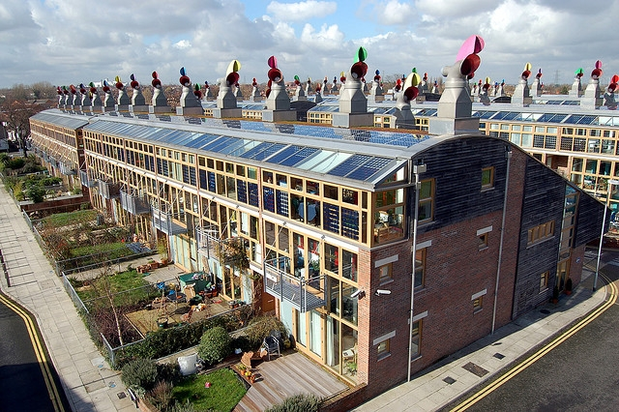
How can planning adapt to and mitigate against climate change?
Photo credit: telex4
Notes:
9
Your role is to respond to the current and future needs of your communities and through leadership, to take the initiative on major issues. You can use your planning policies and development management to bring forward innovative development, in the right location, that mitigates against climate change (e.g. renewable energy) and is resilient to its impacts. You can use Local Development Orders to support easier implementation of domestic scale renewable energy projects.
9

Slide 10
Financial as well as climate change incentive
Not just about ‘saving the planet’
Considerable financial incentives
To communities, with pay-backs/lower heating bills
To councils, as landowner/trading body
Notes:
Derbyshire CC have a financial strategy which includes providing solar farms on old industrial land and using the income to fund front line services.

Slide 11

National policy
Planning plays a key role in helping shape places to secure radical reductions in greenhouse gas emissions, minimising vulnerability and providing resilience to the impacts of climate change; and supporting the delivery of renewable and low carbon energy and associated infrastructure. This is central to the economic, social and environmental dimensions of sustainable development.’
Notes:
The Planning Act 2008 places statutory duties on local plan-makers to take action on climate change. It introduced statutory duties for local development frameworks to include policies on climate change. The Climate Change Act signs the UK up to a raft of commitments, the most important for you to consider is the legally binding target to achieve an 80% CO2 reduction by 2050 compared to a 1990 baseline. NPPF was accompanied by Technical Guidance on flood risk (taken from annex to PPS25) and by the web-based Planning Practice Guidance.
The key messages from current national policy are about planning guiding the location and layout of new development so that it will have the highest viable energy efficiency, use decentralised energy, reduce the need to travel, and have the fullest possible use of sustainable transport. The NPPF breaks these down into three guiding principles

Slide 12
NPPF: Sustainable energy principles
3 broad requirements of local authorities:
Plan for new development in locations and ways which reduce greenhouse gas emissions
Actively support energy efficiency improvements to existing buildings; and
When setting any local requirement for a building’s sustainability, do so in a way consistent with the Government’s zero carbon buildings policy and adopt nationally described standards.
Also see the Planning Practice Guidance
Notes:
12
It’s also about locating development where its vulnerability to the impacts of climate change is minimised. Plans could identify where strategic infrastructure, such as flood defences and energy generation, should be located.
PPG - • Local and neighbourhood plans should consider opportunities for RE & LC developments - Site allocations (e.g. for wind resource areas) - Criteria-based policies • Specific guidance for different types of RE: - for biomass, appropriate transport links, - for hydro-electric power, sources of water, - for wind turbines, predicted wind resource, considerations relating to air safeguarding, electromagnetic interference and access for large vehicles.
12

Slide 13
Sustainable energy principles
The NPPF also requires that planning authorities:
have a positive strategy to promote renewable and low carbon energy
design policies to maximise renewable and low carbon energy development whilst addressing adverse impacts
consider identifying suitable areas for renewable and low carbon energy sources
support community-led initiatives for renewable and low carbon energy
identify opportunities for decentralised renewable or low carbon energy supplies
Notes:
The NPPF also requires Local Authorities to promote renewable energy and stresses the responsibility on all communities to contribute to energy generation from renewable or low carbon sources.
Without a supportive local planning system the government’s climate change policies would not be effective. This is because other national climate change policies have already assumed that the planning system will play its part.

Slide 14
Deliver via local plan policies
Explore spatial and infrastructure questions such as:
Where should new employment and housing be located?
Can development be located to reduce travel?
What flood defences are needed?
Can development reduce the need for engineered drainage infrastructure and minimise water demand?
Can green infrastructure mitigate heat or flooding and maximise biodiversity?
What energy provision will we need in the future, such as district heating schemes?
Is there potential for new markets and supply chains as a result of moving to a low carbon economy?
Notes:
14
You can implement these principles in your plan and via your plan making decisions.
14

Slide 15
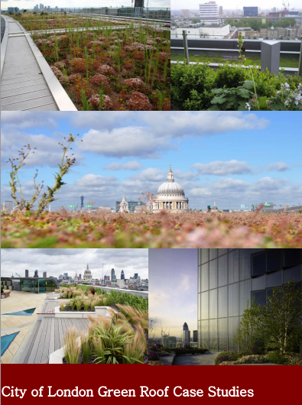
Adaptation example: green roofs can:-
Reduce the amount of surface water run off
Provide shelter and feeding opportunities for wildlife
Improve the buildings’ character and appearance
Provide extra heat and noise insulation
Help to improve air quality
Notes:
By planting on an otherwise desolate flat roof, several benefits were achieved including many which relate to adapting to a changing climate:
Reduces the amount of surface water running off the roof and so reducing the risk of flooding
Providing shelter and feeding opportunities for wildlife, thereby increasing biodiversity
Improving the character and appearance of the building and the surrounding area plus creating a new open space
Providing extra heat and noise insulation, whilst keeping the building cool in the summer
Helping to reduce the amount of dust and pollutants in the air; the plants help absorb pollutants in the air

Slide 16
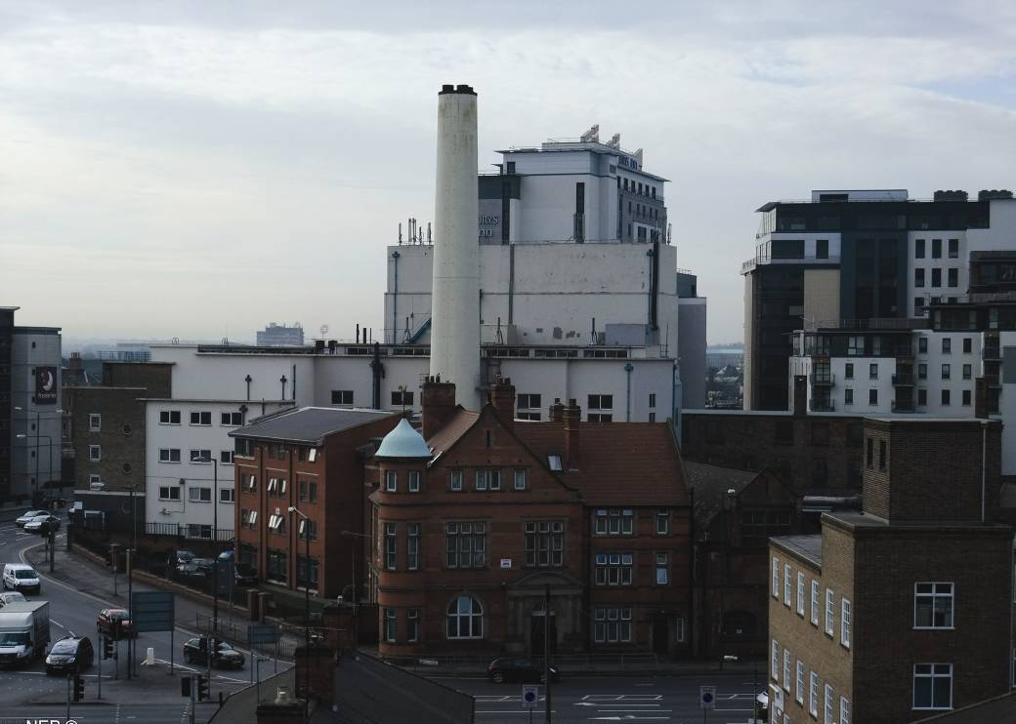
Local Plans: Mitigating Climate Change
Reduce the need to travel and increase sustainable transport options, such as walking and cycling
Be energy efficient through design and construction
Encourage sustainable travel such as cycling and walking
Support the development of renewable, decentralised and low carbon energy. Require its integration within development
Photo credit: Nottingham Energy Partnership
Notes:
Mitigation is about reducing carbon emissions. This means reducing the sources of carbon emissions like vehicles and fossil fuel power stations.
Many of the actions relevant to adaptation are also relevant to mitigation. For example, insulating a home makes it more comfortable for people in extreme weather, but it also reduces the amount of energy required to heat or cool the home. This in turn reduces the consumption of fossil fuels.

Slide 17
Provide guidance to developers
Orientation, avoiding solar gain in summer
Layout, using the natural landform, positioning of adjacent buildings
Cycle parking
Waste recycling
Sustainable drainage and landscaping (green roof)
Notes:
Many authorities have prepared sustainable design and construction supplementary documents to provide developers with further information on what is suitable in their local area.

Slide 18
Housing Standards Review
Code for Sustainable Homes withdrawn
Restriction on new and emerging local plans should not require standards exceeding the building regulations
Small sites (>10 houses) exempt from Allowable Solutions payments, but not Zero Carbon homes requirements
Optional new national technical standards should only be required through new Local Plan policies if they address a clearly evidenced need
Interim measures – apply existing standards, where adopted policy in place. Energy Performance requirements should not exceed outgoing Code level 4.
Notes:
Housing Standards
The Housing standards Review has withdrawn the Code for Sustainable Homes and streamlined the technical standards for new housing development, into a new mandatory national regime, to be administered as part of the Building Regulations.
New and emerging local plans should not require technical standards which exceed the requirements for compliance in the new building regulations.
New optional national technical standards (relating to Accessibility and wheelchair housing standards, Water efficiency standards and Internal space standards) should only be required through any new Local Plan policies if they address a clearly evidenced need. Such standards cannot be required through neighbourhood plans.
For the specific issue of energy performance, local planning authorities will continue to set and apply policies in their Local Plans which require compliance with energy performance standards that exceed the energy requirements of Building Regulations until the commencement of amendments to the Planning and Energy Act 2008 set out in the Deregulation Bill 2015.
This change is expected to happen alongside the introduction of the full requirements of the zero carbon homes policy in late 2016. The government has stated that at this time the energy performance requirements in Building Regulations will be set at a level equivalent to the (outgoing) Code for Sustainable Homes Level 4.

Slide 19
Building Regulations
Incremental changes to energy use and carbon emissions, to Zero Carbon requirement in 2016
Mainly involves fabric performance
Need for on-site renewable energy or connection to decentralised energy
Image credit: NHBC Foundation
Notes:
Building Regulations
Building regulations are changing and incrementally moving to a requirement for zero carbon development in 2016 for residential and 2019 for non-residential development. It is important to clarify the relationship between planning and building regulations so applicants are clear about upcoming changes and overlaps in information submitted to planning and building control.
Planning will no longer need carbon reduction policies as Part L demands higher carbon reductions, and cannot set out requirements for higher standards than the building regulations, or require particular BREEAM and Code for Sustainable Homes standards.
Sustainable energy technologies will play a major role in allowable solutions
Changes to the Building Regulations will result in greater use of decentralised and renewable energy.

Slide 20
  Zero Carbon Homes - hierarchy
energy efficiency: a high level of energy efficiency in the fabric and design of the dwelling.
carbon compliance: a minimum level of carbon reduction to be achieved from energy efficient fabric and on-site technologies (including direct connection to a heat network).
allowable solutions: a range of measures available for achieving zero carbon beyond the minimum carbon compliance requirements.
Photo credit: Vargklo
Notes:
Zero Carbon homes (by 2016), public sector buildings (by 2018) and non-domestic buildings (by 2019) are the government’s proposal to make sure the carbon emissions from the built environment are reduced drastically.
The framework for Allowable solutions has yet to be confirmed, but is likely to take the form either of a marketplace of third allowable solutions providers (providing off-site carbon abatement), payment to a fund investing in abatement projects or payment to the local authority for the residual CO2 emissions. Some authorities have already started collecting similar payments. DCLG are due to publish guidance on how this will operate in practice shortly.

Slide 21
Sustainable Urban Drainage Schemes (SUDs)
Local planning policy and decisions on major developments to ensure SuDS are used, unless demonstrated inappropriate
Current requirement to prioritise use of SuDS for all development in areas at risk of flooding still applies
Notes:
New measures effective from April 2015

Slide 22
So for an LPA
Consult the Lead Local Flood Authority and satisfy themselves that:
  The proposed minimum standards of operation are appropriate
  Through planning conditions and planning obligations that there are clear arrangements in place for ongoing maintenance for the lifetime of the development
  Ensure that the SuDS are designed to have maintenance and operational requirements which are economically proportionate.

Slide 23
Development Management
Does a development meet your policies?
Can development contributions support energy projects?
S106/CIL
Allowable Solutions
Notes:
Planning policies to address climate change are critical. Officers and members have a role in explaining local solutions to climate change and why certain policies are in place.
You can use development management to bring forward innovative development that is resilient to the impacts of climate change. Though the Allowable Solutions regime you can also lever in developer contributions for climate change related projects, such as sustainable energy or energy efficiency measures.
23

Slide 24

Renewable Energy
Photo credit: telex4
Image credit: CSE
Notes:
24
24

Slide 25
Renewable Energy
The NPPF requires that local authorities:
have a positive strategy to promote renewable and low carbon energy
design policies to maximise renewable and low carbon energy development whilst addressing adverse impacts
consider identifying suitable areas for renewable and low carbon energy sources
support community-led initiatives for renewable and low carbon energy
identify opportunities for decentralised renewable or low carbon energy supplies

Slide 26
What does renewable energy offer?
Job creation during construction, cheaper fuel bills, community pride, educational opportunities, improved air quality (eg from Combined Heat and Power projects).
An opportunity for community ownership in the project, and funds for community initiatives.
Increased security of supply from a more distributed energy system.
Less exposure to cost fluctuations of fossil fuels.
Biodiversity improvements with renewable energy projects (wind and solar), eg gapping up of hedgerows with native species, management of land to maximise biodiversity,

Slide 27
What are Renewable / Low Carbon energy technologies?
Renewable:
Solar photovoltaic
Solar thermal
Wind power
Hydro power
Wave power
Tidal power
Geothermal
Nuclear energy
Low Carbon
Heat pumps (ground, water and air sourced)
Energy from waste (mechanical or biological treatment and incineration)
Fuel cell technology and Energy Storage
District heating or energy
Combined heat and power
Biomass (used in direct combustion, anaerobic digestion, pyrolysis or gasification)
Notes:
Sustainable energy technologies
Sustainable energy is about moving away from energy generation from burning fossil fuels. But that doesn’t mean that all sustainable energy technologies work without fossil fuels. For example, a district energy network could burn gas to generate electricity, heat and cooling. This is considered to be low carbon because the power is generated in close proximity to where it is used and the heat is used in homes, reducing the energy wasted by transporting it hundreds of kilometres or the heat that is often wasted at out-of-town gas generation plants.
This is a list of the technologies that are considered sustainable. We’ll talk about the difference between zero and low carbon energy shortly.

Slide 28
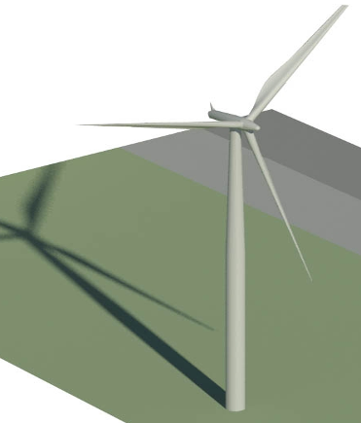
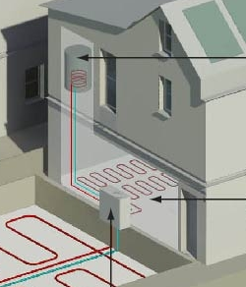
Two scales of energy projects
Commercial or Community Scale
Building integrated (microgeneration)
Notes:
Two scales of energy projects
There are two scales of energy projects: building integrated and strategic projects or infrastructure.
Commercial or Community scale projects either connect new and existing buildings (such as a district heating network) or are standalone energy projects (like a wind farm). Increasingly, community groups are developing their own projects either in isolation or in partnership with commercial developers.
Building integrated technologies are often classified as microgeneration, as they are small generators (i.e. Less than 50kW). These technologies can be integrated into new development or retrofitted onto existing buildings. This category includes heat pumps, solar panels, small wind turbines, biomass boilers, etc.
Planning permission could be required for projects that fit into either of these categories. Building integrated energy projects are often classed as permitted development providing the installation meets certain standards and is not within a listed building or conservation area. Large strategic projects over 50MW go to the Major Infrastructure Planning Unit within the Planning Inspectorate, with the exception of large wind farms which in the future will be determined by the Local Planning Authority.
Over the next few slides I’m going to give you a few examples of each. More detail about how they work is available on the Compare Renewables web resource.

Slide 29
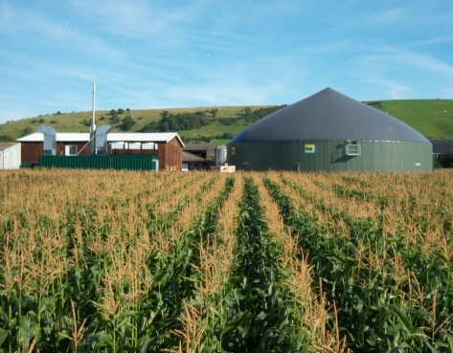
Types of renewable energy: Commercial or Community Scale: anaerobic digestion
Image credit: CSE
Notes:
Strategic projects: anaerobic digestion
Anaerobic digestion (AD) decomposes organic material in the absence of air. It is a well established and widely used energy from waste process. Any organic material can be used as fuel, such as agricultural, household and industrial residues and sewage sludge.
Biogas is the fuel that is produced from AD. After the gas is cleaned it can be burnt to produce heat and/or electricity. Additional bi-products produced can include solid and liquid residues that can be used as fertiliser.
Plants can be small, serving a few households or farm, or large, serving a wide area. Applications include community district heating using the waste heat from combustion and biogas cleaned and fed into the existing gas grid.
Common Planning Issues
- Traffic generation and Access for construction, feedstock supplies and maintenance.
- Visual and Landscape impact;
Noise, Odour control
Health and safety
Security and Lighting

Slide 30
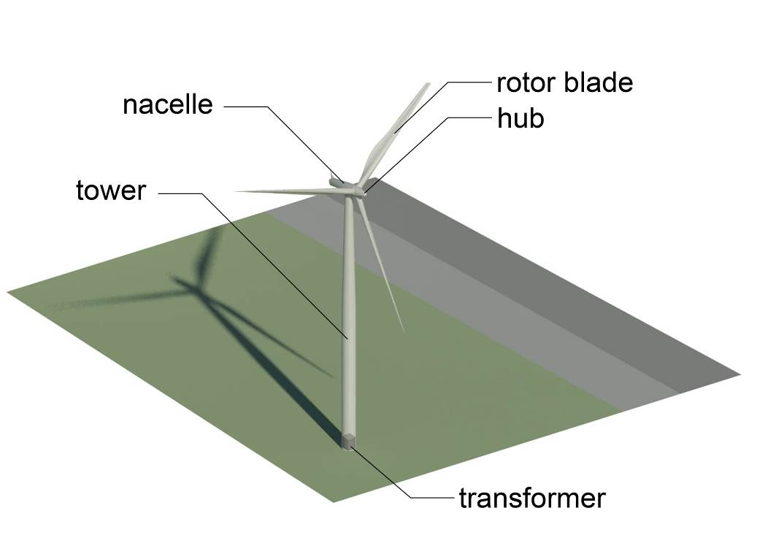
wind
Types of renewable energy: Wind
Notes:
Wind
Generating energy from the wind does not release any carbon emissions, though the turbines (like anything manufactured with non-renewable energy) do have “embedded carbon”. By replacing electricity generated from other sources such as fossil fuel power stations, wind energy can lead to an overall reduction in carbon emissions.
The energy used in manufacturing and installing wind turbines can also be paid back relatively quickly. For a large wind turbine on a good site this can be as quick as six to eight months. It is a very clean energy source, which does not release any pollution or produce any waste during operation.
The government is going to remove subsidies for onshore wind, and give local planning authorities consenting powers for all onshore wind farms.
Planning Issues
Landscape and Visual impact. It is often a case of weighing up the landscape and visual impacts against the benefits derived in terms of renewable energy creation
Heritage Impact
Noise
Impact on ecology – birds, bats, potential for ecological mitigation
Construction access for large components.
Impact on aviation (radar) and telecommunications

Slide 31
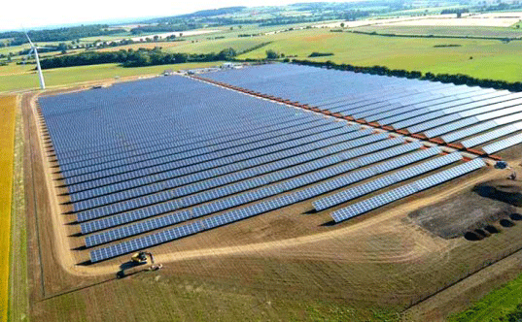
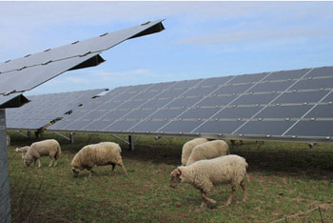
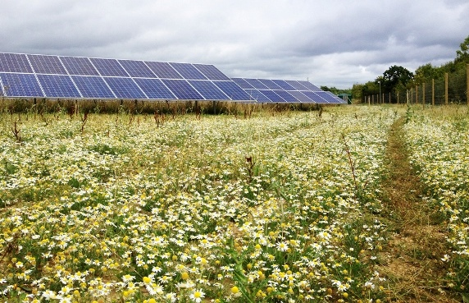
Types of renewable energy: Field based solar farm
Notes:
Planning Issues
Landscape and Visual impact – On a well located site, the visual impact can be very low, or can be mitigated altogether through hedgerow planting.
“Loss” of agricultural land, although solar farms tend to have a lifespan of 25 years and can be fully removed from the land. Sheep grazing can continue on the land beneath the solar cells.
Impact on ecology – Managed well, solar farms can have the potential to result in ecological enhancement of the land, compared to intensive agricultural usage.
Access during construction – can give rise to disruption, but installation is rapid.

Slide 32
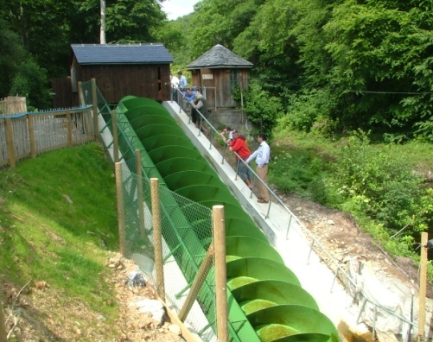
Types of renewable energy: Micro-hydro
Notes:
Planning Issues:
Visual Impact – often limited for a micro-hydro scheme
Construction access, disturbance and reinstatement
Ecological impact – migratory fish,
Impact on water flows and water quality
Flooding

Slide 33
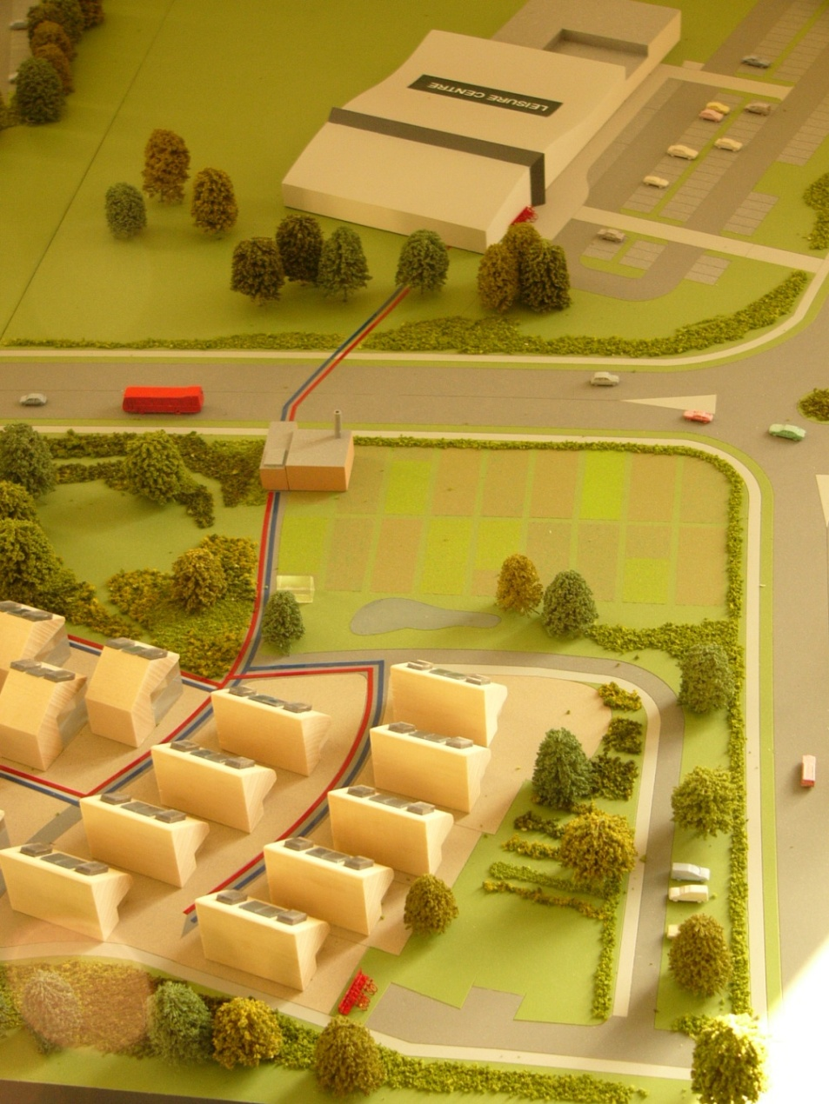
Types of renewable energy: District Heating Networks
Notes:
District heating schemes, or 'heat networks' supply heat from a central source directly to homes, businesses and other buildings such as schools, through a network of pipes carrying hot water. The chief benefit lies with the greater energy efficiency, compared to each individual building generating heat with its own boiler system.
District Heating networks can be powered by conventional fossil fuels or gas, or biomass boilers, or can utilise the waste heat from industrial processes. Feasibility for district heating will depend on the demand for space heating in an area, the density of the area (minimising the length of the network), the diversity of heat loads (mix of uses) and presence of anchor loads.
Different types of building occupiers have varying demands for heat: residential heating peaks in the early morning and during the evening, whilst during daytime it tends to be lower. Office space heating peaks in the morning but then tends to plateau through the rest of the day. Other uses, such as swimming pools, hospitals or prisons often referred to as “anchor loads” tend to have a flatter daily consumption profile and requiring large boiler plant anyway, may form the basis of a network initially. Combining different uses into a single district heating scheme can help to balance the load to create a more even pattern of use and optimise boiler efficiency.
The above illustration shows a leisure centre as the anchor load for a district heating network serving a housing estate.

Slide 34
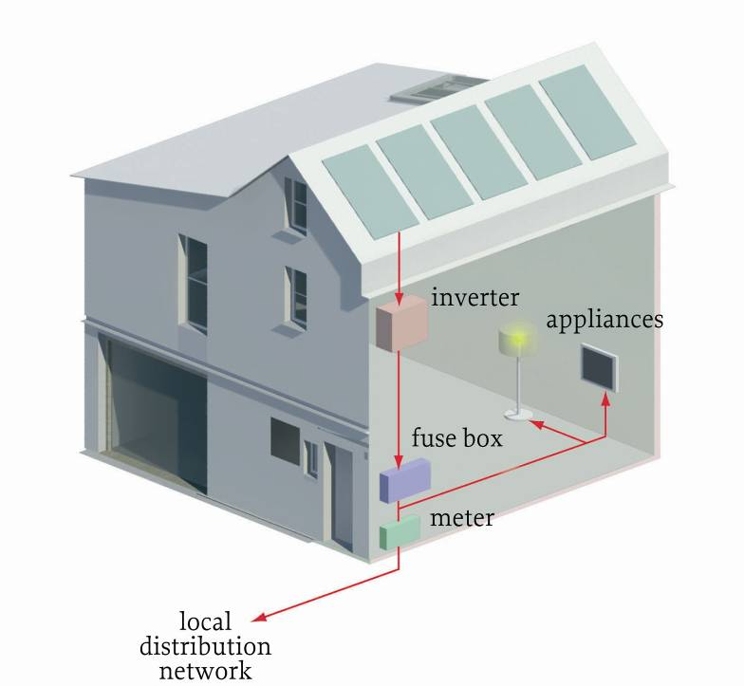
Types of renewable energy
Building integrated:
Solar PV
Notes:
Building integrated: solar PV
PV stands for photovoltaic. Photovoltaic cells convert sunlight directly into electricity. Domestic PV is permitted development under certain size parameters.
Solar PV is relatively versatile. Opportunities are principally determined by size and location. Panels can be installed on roofs, facades, car parks, railway embankments, vacant land or fields.
Solar thermal installations are slightly different. They use solar panels, called collectors, fitted to your roof. These collect heat from the sun and use it to warm water which is stored in a hot water cylinder.
Both solar technologies are best suited on south-facing roofs where the strongest sunlight is captured, but can be installed on east and west facing too. They are also best installed on a slope, so you will often see installations on flat-roofs mounted on a rack

Slide 35
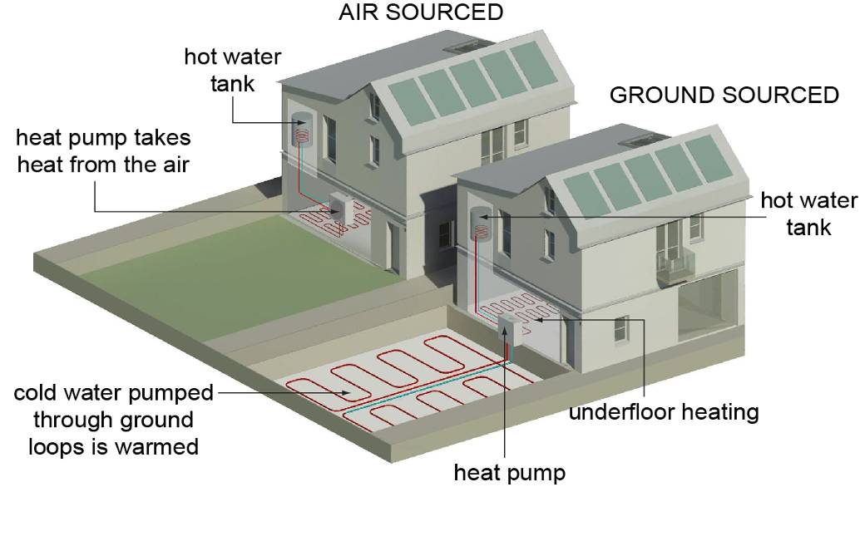
Types of renewable energy heat pumps
Notes:
Heat pumps
Heat pumps can be used to either provide space heating or hot water heating. In some cases they can also provide space cooling.
There are three main heat pump technologies: ground source, air source and water source. They use each “source” as a heat battery, collecting low-level heat and compressing it within the heat-pump to provide more usable heat. In the summer they can be used in reverse for cooling.
A well sited installation, where the heat source is good and the output temperatures aren’t too high (eg; where just space heating is required), can achieve an output of 4 kWh of heat for each kWh of electricity. The ratio, in this instance 4:1, is known as the coefficient of performance.

Slide 36
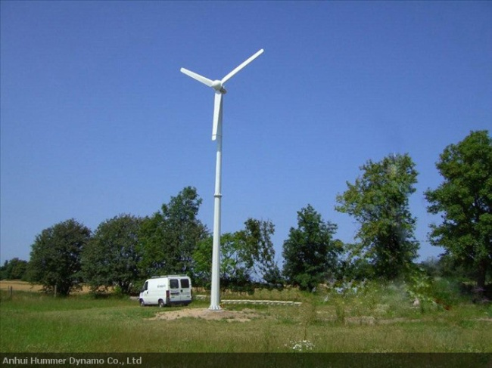
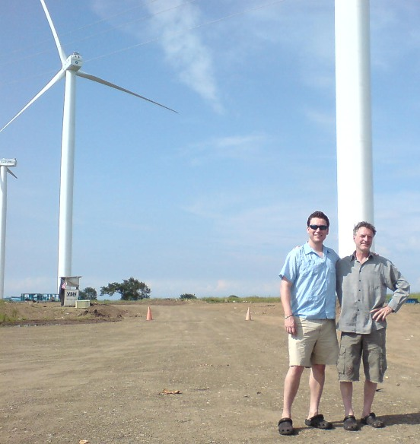
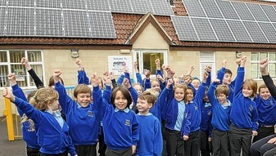
Renewables: size matters!
  20kW: 18m tower
  Power for 5-6 homes
  2MW (2000 KW): 80m tower,
  Power for 1,300 homes
  1 X 5MW solar farm (12 hectares - Power for 1,300 homes = 125 x ‘school’ sized systems
Notes:
In general, wind speeds increase with altitude and turbulence decreases. The amount of electricity increased by a wind turbine rises as a cube of wind speed. In other words, if wind speed doubles, the power output increases eight times.
As a result, the energy output from a turbine doesn’t increase proportionately with its size. The 80 metre wind turbine at the bottom, 4 times as large as the wind turbine at the top, produces 100 times more power!

Slide 37
The cost of renewable energy is falling
.. particularly solar energy which will soon become competitive with electricity from the National Grid, and to a lesser extent, wind.
“Despite the recent drop in oil price, we expect solar electricity to become competitive with retail electricity in an increasing number of markets globally due to declining solar panel costs as well as improving financing and customer acquisition costs.”
Deutsche Bank Market Report: Solar – Feb 2015
Notes:
The UK is not quite at Grid Parity - retail electricity prices are still below unsubsidized solar cost, but predictions are that the cost of solar generation will continue to fall.
Subsidies for solar energy are progressively being reduced, reflecting its increased competitiveness and the government has proposed the removal of subsidies for onshore wind power.
The consequences are that in the short to medium term, its likely that we will move to a more distributed energy network, and that demand for the installation of solar power will continue to grow, irrespective of government subsidies.

Slide 38
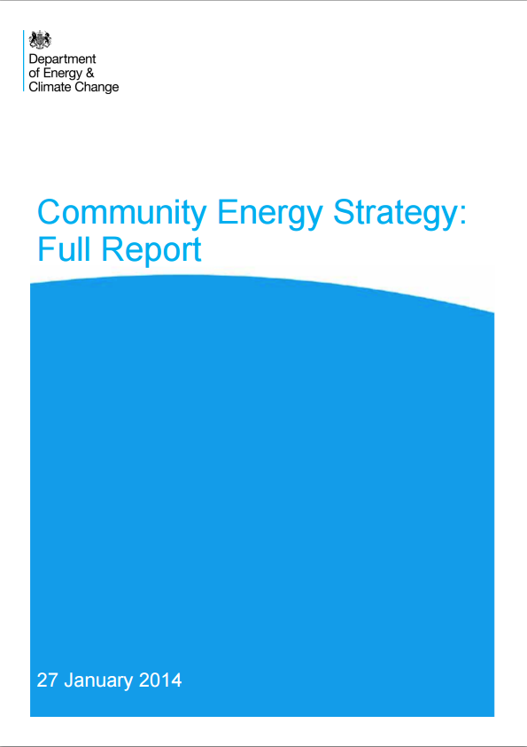
Community-Led Renewable Energy
  Significant ambition / potential for community generation – upper end = enough to power 1 million homes
  LPA’s to give more weight to positive benefits of community energy and a step-change in the support offered to projects
  Stresses importance of partnerships
  New £10 million Urban Community Energy Fund to complement existing £15 million rural fund
Notes:
The Urban Community Energy Fund (UCEF) and Rural Community Energy Fund (RCEF) is a £10 million government fund to offer community groups grants and loans of up to £150,000 to develop their own community energy projects.

Slide 39
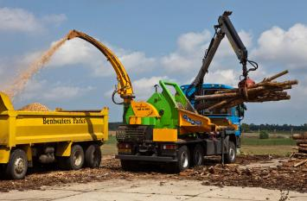
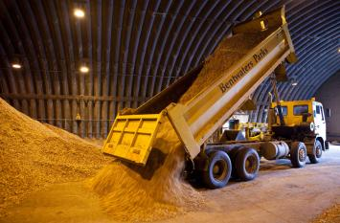
Examples: Suffolk County Biomass Plant
Wood Fuels Programme
Has produced a total heat output of 3.2MW
Saves about 420 tonnes of CO2 each year.
Approx 40 jobs created
Local school with biomass boiler (wood chip) – cheaper heating
Notes:
Example
This example shows some of the economic and social benefits of a particular sustainable energy project. Local wood-fuel producers have long-term contracts. This is a huge investment in the local economy. Suffolk estimates that in East Anglia about 40 jobs have been created through the biomass wood fuel industry in the last three to four years. By ensuring fuel is sourced locally to where it is consumed, the greater the carbon emissions saving due to reduced transport requirements.
Sarah Gallagher, Head Teacher of Rendlesham Primary School that was built with a biomass boiler, said:
“When we set up the school what interested me was the teaching and learning aspects. I knew that we’d have a woodchip burner and that seemed a good thing for a modern school. It helps us when we talk about being eco – we have a garden and we talk about turning the lights off – so it fits in with that. I suppose it opens the children’s eyes a little bit. It’s a little window in.”
The schools needed to apply for planning permission for the new woodchip boiler and any associated development. In some schools this involved replacing paved areas and service connections.

Slide 40
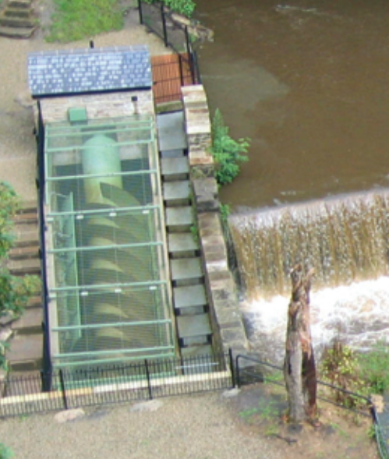
Torrs Hydro New Mills
Torrs Hydro New Mills Limited was founded in 2007
Community owned; 230 members raised £125k
Grant provided remaining £165k build cost
240,000kWh annual generation for re-investment
Notes:
Example
The Torrs Hydro New Mills hydropower turbine is an archimedes screw turbine with a rating of 63kW. The project was launched in 2007 with the installation occuring in September 2008, once planning permission and the relevant permissions and licenses were obtained from the Environment Agency.
Community Benefits
In total, the scheme cost around £330 000. A community share issue raised over £125 000, with grant funding providing another £165 000. The shareholders are mostly local people and businesses plus people from further afield who wish to support renewable energy schemes. Around 230 shareholders own the scheme, via an Industrial Provident Society (IPS). Each year, events are run for people and local school children to learn more of the scheme and are well attended. This pioneering scheme has generated nationwide interest and has put New Mills on the map. Shareholders can received interest on their shares, but the majority of the profits from the scheme will fund a community grants programme.

Slide 41

Fintry Wind Farm, (shared ownership)
Community owned Turbine, as part of a commercial wind farm
Feed-in Tariff payments have funded:
    Energy advice line for residents
    Energy efficiency upgrade of community buildings
    Installation of 91 renewable energy installations so far, including domestic systems at 22 properties.
    Energy efficiency grants
    Village community car club
    Community Orchard
    Draught-proofing workshops
    Fintry Renewable Energy Show!
Image credit: http://www.fintrydt.org.uk/
Notes:
Here the renewable energy project has funded further renewable energy and energy efficiency improvements, has built capacity in the community and increased community resilience, and funded community infrastructure.
Shared ownership of renewable energy has the potential to have a multiplier effect, unlocking really significant community benefits.

Slide 42
Lessons from Germany
It can pay!
Since 2007 about 170 municipalities have bought back from the grid from private companies
Over 50% total investment in renewable energy comes from private individuals and farmers
650 energy cooperatives
New income streams for councils, eg Munich municipal ‘Cities Utility’ made profits over 200 million Euros in 2012
Notes:
From TCPA SPECIAL project information

Slide 43
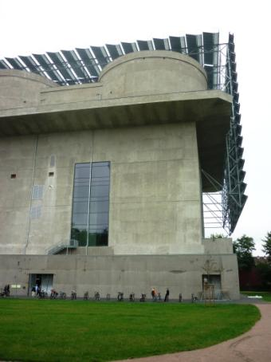
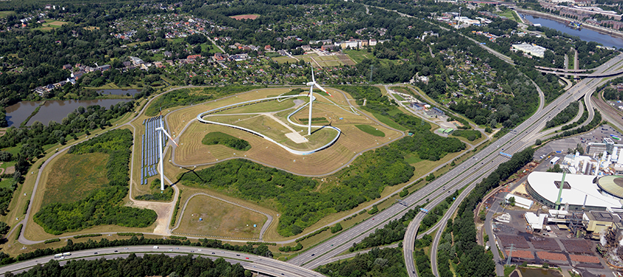
CASE STUDY (from TCPA): POSITIVE PLANNING FOR RENEWABLES
Hamburg Energy Hill, Germany: From a toxic waste landfill site to prime example of renewable energy generation
Notes:
This is an excellent example of positive planning for renewable energy.
From a toxic waste landfill site to prime example of renewable energy generation: the Georgswerder landfill site has been transformed into a renewable energy hill as part of the Internationale Bauausstellung IBA Hamburg (International Building Exhibition). It supplies around 4000 households with electricity using wind power and solar energy alone, and is being made accessible to the public as a vantage point over the city.
The project has integrated both adaptation and mitigation measures.
n addition to the energy generation, it provides public access to a large 20ha park including a raised walkway that provides views over the city. New habitats - meadows and woodland - have also been integrates to enhance biodiversity.

Slide 44
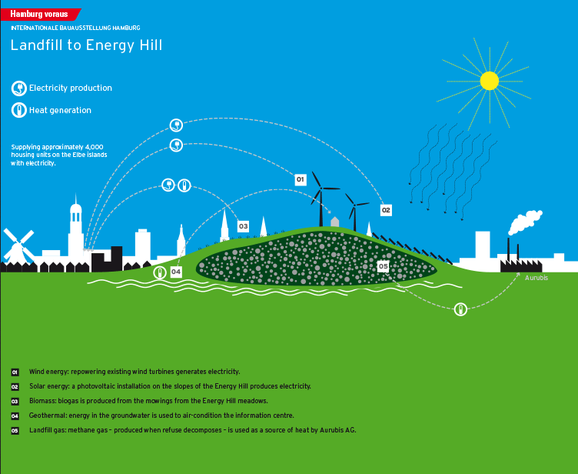

1. Wind power
2. Solar power
3. Biomass
4. Geothermal power
5. Methane gas
Notes:
From TCPA

Slide 45
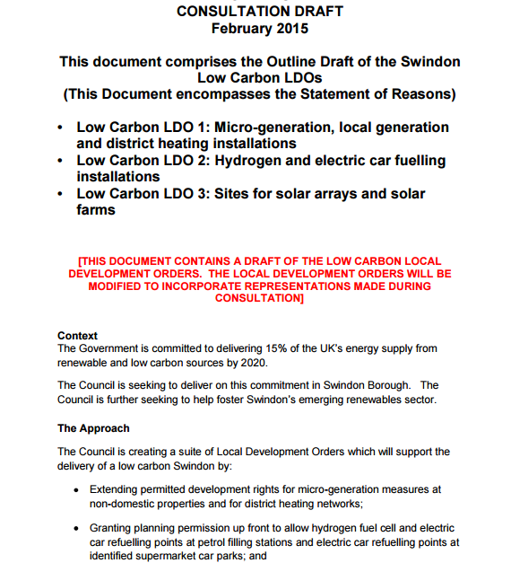
Swindon – Local Development Orders
Encourage renewable energy generation (PV)
Planners identify appropriate development sites for PV, grid connections and seek to collaborate with private developers to share the cost of substation upgrades
Providing solutions to local challenges of where to put renewables in a growth town where 28% the municipality is designated as an AONB.

Slide 46
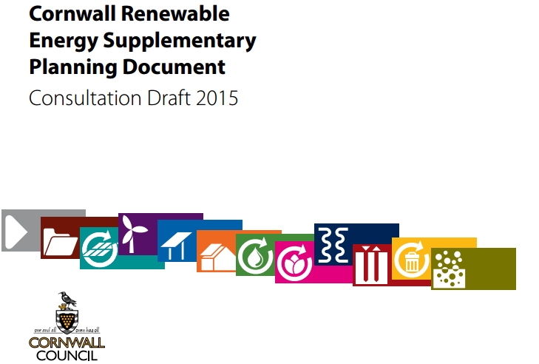
Cornwall – renewable energy policies
.
“Community ownership of renewable energy offers a significant opportunity for local communities in tackling many of the challenges which face them today and in the future. The opportunities for communities to take a share of the benefits from renewable energy are increasing. The SPD provides clarity for communities who wish to bring forward such proposals”

Slide 47
Renewable Energy applications
Do you have policies supporting community-led renewables?
What are the environmental, landscape, social and economic impacts of the proposal, both positive and negative?
Can impacts be minimised by conditions?
Can additional mitigation make the proposals acceptable?
How can community benefits be secured?
Notes:
Conclusions
Making decisions on renewable energy is not straightforward or simple. Your role is to balance the competing demands and conflicting priorities and reach a decision.
Here are a few things to keep in mind:
Is the local plan up to date?
Have things moved on since it was adopted?
Is there national policy that should be considered on this issue?
Does your local plan have targets in relation to renewable energy? Could you set some to work towards?
How much installed renewable energy capacity has been installed in your district? Has your district done its ‘share’? (The National Planning Policy Framework stresses the responsibility on all communities to contribute to energy generation from renewable or low carbon sources.)
Do the characteristics of your district mean you can take more?
What are the environmental, landscape social and economic impacts of the proposal?
Is the proposal going to result in social or economic benefits as well as carbon reductions? Are you considering those?
Can measures be put in place to mitigate visual impacts – e.g. Reinforcing hedges to screen a solar farm, undergrounding cables?
What weight do you give to a national organisation like the Victorian Society. Perhaps the income from the solar panels could be used to keep the listed building in good condition. That would make it an enabling development.
Have you given appropriate weight to the benefits of the development?
Is there a strong local drive for the project? What are the applicants goals?
What are the ownership arrangements of the project? Will it deliver ongoing community benefits or unlock further carbon saving initiatives?
Is the use temporary in nature? For instance a solar farm will mean the land can’t be farmed for arable purposes during the lease (normally 25 years), but the land can be fully reinstated used again for arable agriculture in the future, and can be grazed throughout the life of the solar farm. How should the “loss” of agricultural land be viewed in this context?
What were the factors on the other side of this decision? A conservation officer has commented on the detrimental heritage impacts of the development. Does your authority have a sustainability officer that could champion the other side of the story?
Can the impact be minimised through conditions?
A listed building in a conservation area may seem like a very difficult place to put solar panels. But could the proposal be modified to ensure the visual impact of the panels is minimised?
You could use a condition to remove the panels in 10-20 years time or only give consent for that period.

Slide 48
Who deals with what?
Local authorities - renewable energy projects of up to 50 megawatts and all onshore wind farms
National Infrastructure Planning - projects larger than 50 MW (except for onshore wind) and all offshore wind applications.
The government announced that local communities are to have the 'final say' on all onshore wind applications, with all onshore wind applications to be determined locally.
New requirements are that authorities should only grant planning permission for onshore wind turbines if the development site is allocated clearly for wind development in the local/neighbourhood plan; and the proposal has the backing of the affected local community.

Slide 49
Renewable Energy applications – Legitimate Planning considerations?
Concern | Legitimate Planning issue? | Comments and perspective from National Planning Guidance
Landscape and visual Impact | Yes | Also the use of high grade agricultural land (e.g. for solar) – Landscape and Visual harm to be weighed against public benefits
Heritage Impact | Yes | Harmful impacts to the significance of heritage assets to be weighed against the public benefit of development.
Impact on House Prices | No | But impact on residential amenity is a material consideration, including noise, outlook, shadow flicker, disturbance.
Blocks my view | No | You don’t have a right to a view, but the impact on public views is material. The impact on residential outlook is relevant
Amount of renewable energy too small / no need / subsidies | No | Even small scale projects are valuable. Applicants don’t need to demonstrate “need”. The subsidy regime for renewable energy projects is not a planning consideration.
Impact on openness of Green Belt | Yes | “Very special circumstances” needed to justify the development – but may the include wider environmental benefits associated with increased production of energy from renewable sources.
The “Wrong” type of renewable energy | No | The Authority is to consider the merits / acceptability of the development proposed.
Traffic congestion | Yes | Temporary construction impacts can be managed through Construction Management Plan.
Notes:
Residents and Councillors have many concerns about renewable energy proposals.
National Planning Policy Framework and appeal case law defines some of these issues as “material planning considerations”, i.e. legitimate considerations that can be taken into account in determining applications. Decisions based on issues that are not “material considerations” will be unsound, making these decisions challengeable, with the risk of costs being awarded against the Council.

Slide 50
What you can do next
Talk to your planners and Sustainability Officer
Engage with 3rd sector bodies, for example local energy groups, Transition Towns network, Parish Councillors
Identify infrastructure needs
Encourage LEP to take an active and regular interest – Are there economic benefits that can result from tacking climate change? Can you target Green / Renewable energy as growth sector in your area?
Share your good practice / promote Neighbourhood Planning groups to take the same approach
Notes:
50
Section 4: What you can do next
You can’t do it alone:
build support
gather and assess your evidence
make key decisions about the future location and type of development
set locally derived policies or implement national policy
talk to partners
set priorities.
This is quite a long list of potential next steps. You may want to vary these depending on local circumstances.
As an example of the potential economic potential of renewable energy, Hull, an area suffering from the decline in fishing, is reinventing itself as a renewable energy centre, operating as the base for off-shore wind farm development. The £160m Green Port Hull project is expected to generate up to 1000 jobs in the town.
Source: http://www.bbc.co.uk/news/uk-england-humber-28256668
50

Slide 51
What you can do next (cont.)
show leadership: appoint a cabinet member for sustainability
assess if the organisation is ‘fit for purpose’
explore the development of joint teams
prioritise your goals
consider starting small and building in steps
broker partnerships
ensure consistent decision making
promote your approach – sell benefits
develop incentives – lower bills
show commitment for the ‘long haul’

Slide 52
Use the General Power of Competence to develop climate change initiatives
Examples:
Council owned Wind Turbines - Bristol City Council
Partnership for Renewables – Bath and North East Somerset Council and Bath and West Community Energy
Energy Supply Companies - Southampton Geothermal Company
Notes:
This allows councils to:
carry out any lawful activity;
undertake any lawful works;
operate any lawful business ;
enter into any lawful transaction.
The General Power of Competence offers considerable flexibility for Councils to take leadership and develop initiatives and partnerships to combat climate change and promote sustainable energy!

Slide 53
Conclusions
Climate Change is the challenge for our generation / age.
Wholesale changes are needed to mitigate it and adapt to it.
The planning system is central to progress.
Sustainability and climate change adaptation and mitigation should be central to your Local Plan.

Slide 54
PAS support
Compare Renewables information on 8 sustainable energy technologies, 25 case studies, introductory material to energy issues http://www.local.gov.uk/compare-renewables
And TCPA led Climate Change Coalition – guidance for local authorities http://www.tcpa.org.uk/data/files/PCC_Guide_April_2012.pdf
Notes:
54
LGA
Compare Renewables is a resource on the LGA website that was developed specifically for councillors and senior officers. It gives you high level information about 8 sustainable energy technologies. It’s not intended as a resource for determining applications, but it will give you more information about how these technologies work.
There is also a range of information on the PAS website that you might find useful including case studies, discussion forums, publications and guidance.

