Slide 1
Pre-Application Advice in Kirklees
Simon Taylor – Head of Development Management

Slide 2
General
Direction of Travel
In Place to Assist
NPPF Paragraphs 188 – 195 – Pre-Application Engagement and Front Loading
Planning Practice Guidance
Appeals – What behaviour may give rise to a substantive award against a local planning authority?– ‘…refusing to enter into pre-application discussions…’
NPPG - Elected members are strongly encouraged to participate at the pre-application stage. S25 of the Localism Act 2011 highlights the fact that elected members do not have a ‘closed mind’ just because they have historically indicated a view on a matter relevant to the proposal.
S93 of the Local Government Act 2003 – Ability to Charge

Slide 3
Worthwhile Pre-application Engagement
Phillipa Silcock
19th June 2014
www.pas.gov.uk

Slide 4
Leeds City Region Development Management Charter
The Local Authority
The Developer
Agree with the Developer a timetable and milestones for the application to deliver a decision in the shortest period of time practicable;
Set out requirements for consultation (internal and external) and work with the Developer to ensure appropriate pre application public consultation takes place;
Set out the Local Authority’s aspirations for any legal agreement and land transactions;
Maintain a regular dialogue with the developer and ensure changes required by either the local authority of the Developer are made promptly.
Engage in meaningful pre application discussions, with adequate time allowed for the preparation of essential information and assessment proposals, including appropriate community consultation
Respond within the agreed timescales to requests for further information and/or revisions
Attend project meetings with relevant persons
Submit a complete planning application with appropriate supporting information as agreed with the Council, including a draft legal agreement where appropriate.

Slide 5
Drivers and Objectives
Drivers for Change
Objectives
Public Service Cuts
Open for Business Agenda
Employer Surveys
Too many doors into the Council
Declining performance
Support Business and Jobs
Getting the Right Outcome
Open Relationship
Smoothing the technical issues
DM performance

Slide 6
Barriers to Change
Could we provide a good enough service
Convincing Staff
Public Perception

Slide 7
The Pre-App Offer in Kirklees
Pre-2012
Post 2012
Website information
Validation Checklist
Full Duty Rota
Development Team
Website information
Validation Checklist (updated)
Duty Officer – Limited days and pre-booked
Paid for Pre-Application Service

Slide 8
Majors Pre-Application Advice
Old
New
Development Team approach
No ownership
Too long and resource intensive
Missed connections - Too DM focused
Free
Combined approach with Regeneration Team
Smaller Development Team with targeted technical input
Bespoke – client led
Staff own it
Income

Slide 9
The Service
http://www.kirklees.gov.uk/business/planningapplications/advice.aspx#anchor2

Slide 10
The Process
Joint approach between Regeneration and Majors Team
Assess need and send them to the right place
Assign officer - consistency
Meeting and selective technical advice
Written Response from Head of Service

Slide 11
Practice
Be flexible with approach – but set out the ground rules
The relationship is often more important
Written response not always essential or wanted
Be sure to give advice - not the policy
Don’t let fee dominate

Slide 12
What is Working ?
Lots of success with medium sized businesses looking to relocate
Best when ward members are engaged
Longer term dialogue improved
Agreeing timescales – feeds into performance and PPA’s
Staff involved like it
Income stream

Slide 13
DM Performance Does it work?

Slide 14
Feedback
Peer Review Feedback - Customers who apply for planning consent told us that the Council’s planning officers were generally accessible, supportive and creative. Businesses reported that planning officers were working more closely with economic development and regeneration officers in an attempt to focus on growth. This reflects the increased prominence given in internal strategies and personal targets to staff working to support the Council’s jobs and growth priority.

Slide 15
Income
Worthwhile but will not bail you out
About ¾ of the cost of a planning officer post per year

Slide 16
Improvement Plan
Engaging with Members
Getting medium sized local agents to use it
How to front load more of the technical assessments without excessive time
Use of more sophisticated PPA’s
Review Fees

Slide 17
END

Slide 18
Others

Slide 19
Results

Slide 20
Pre-Application Fees

Slide 21
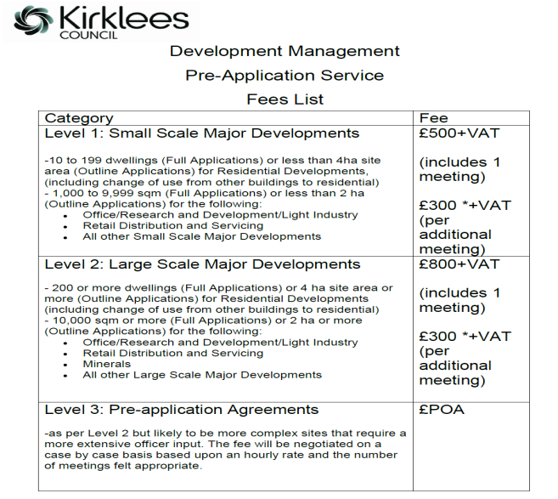

Slide 22
