Slide 1

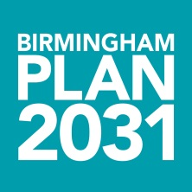
Place Making and Leadership
a view from Birmingham
Richard Cowell
Development Planning Manager
Planning and Regeneration Department
Birmingham City Council

Slide 2
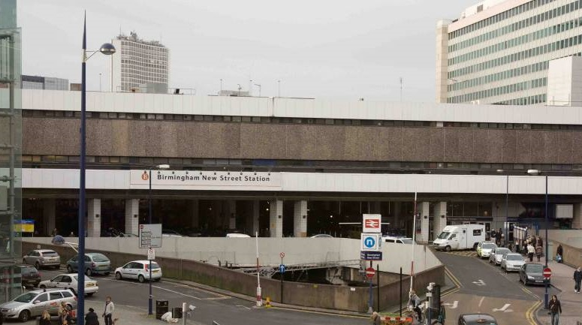
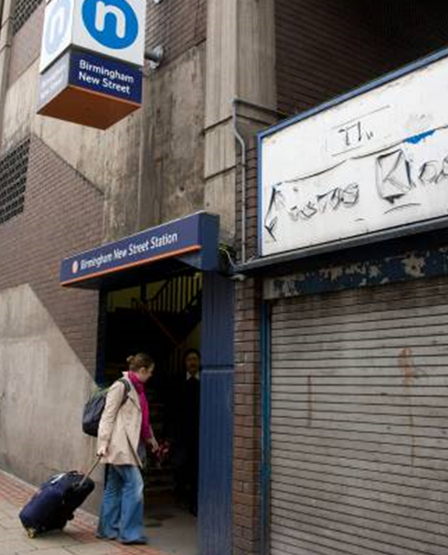
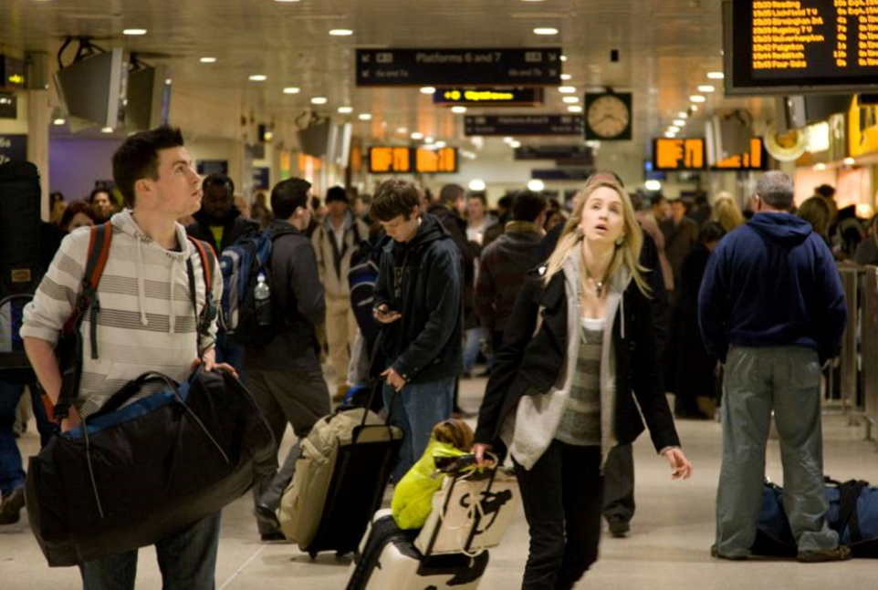
place making

Slide 3
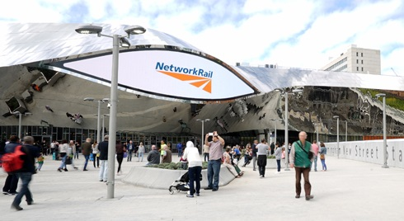
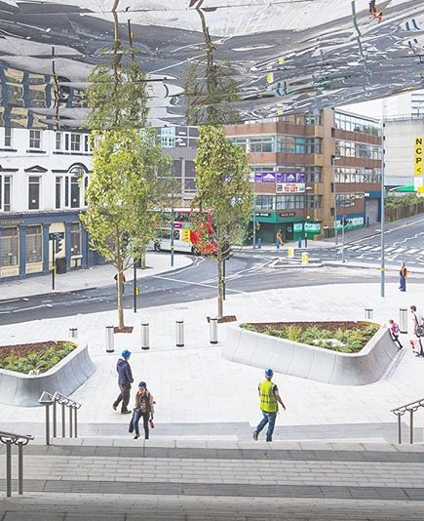
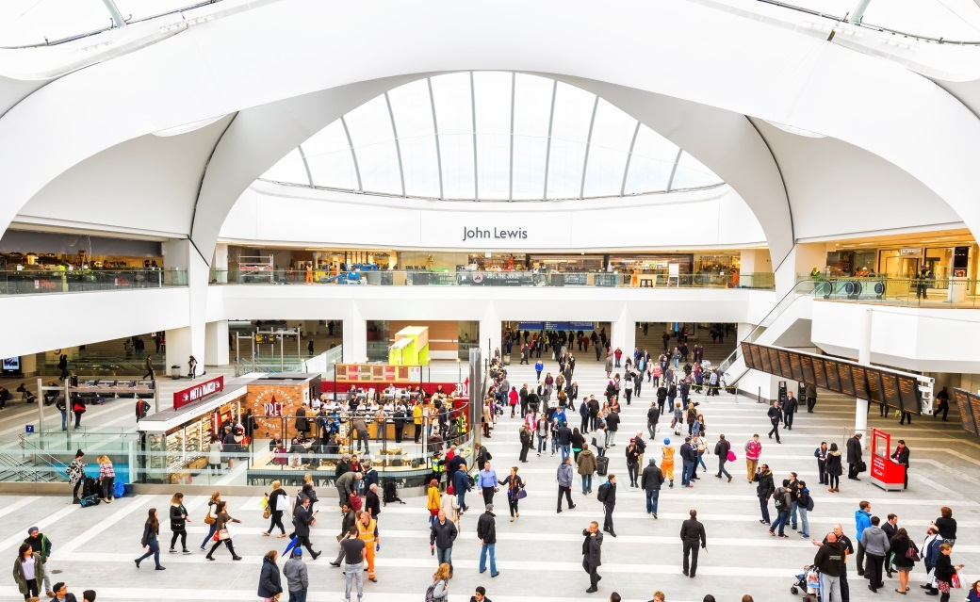
place making

Slide 4
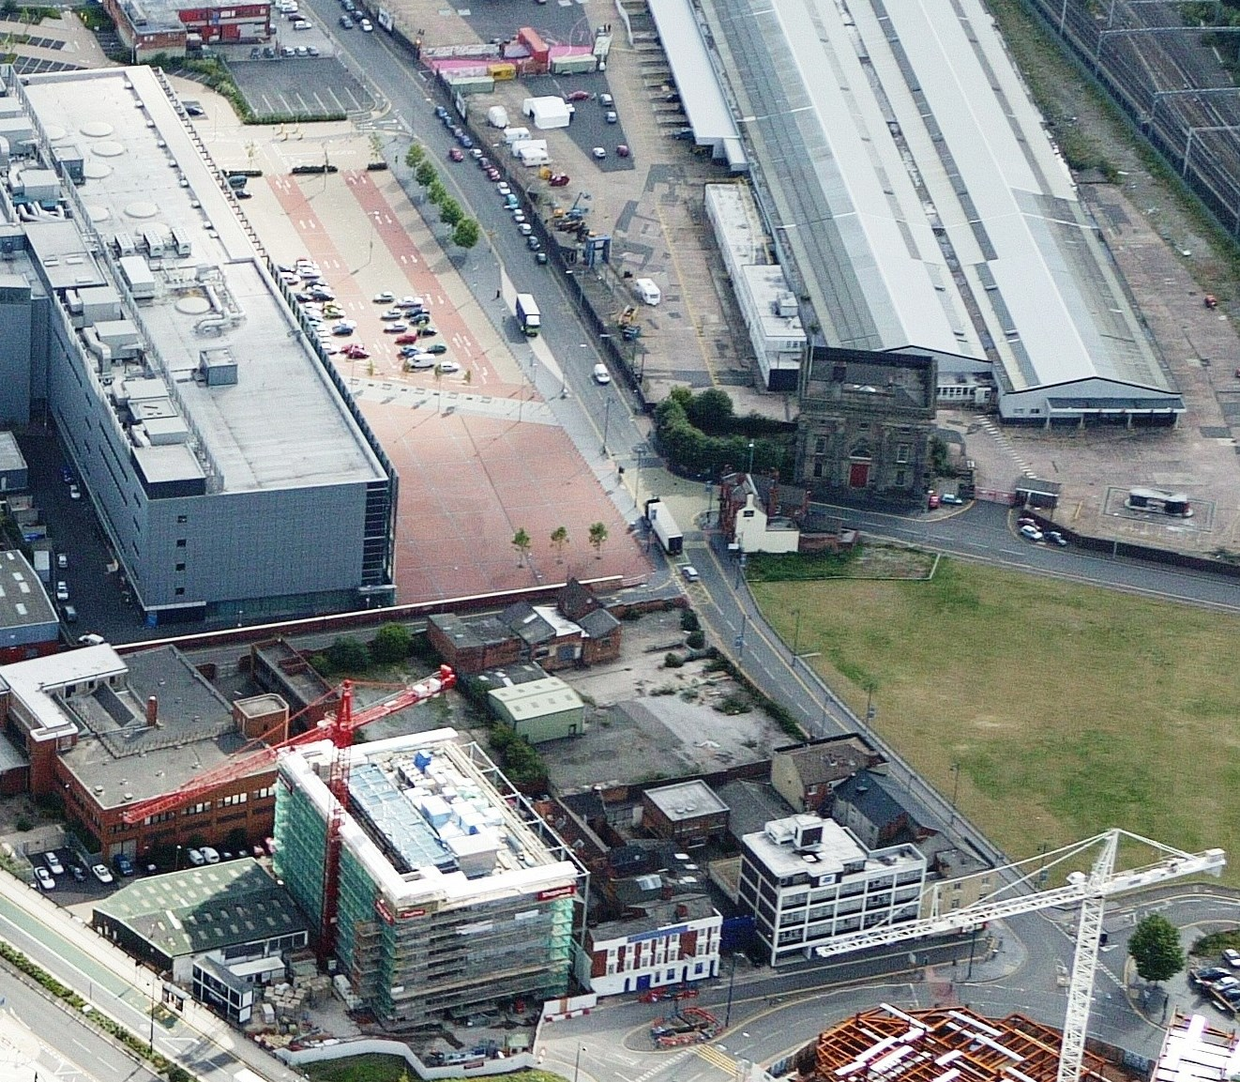
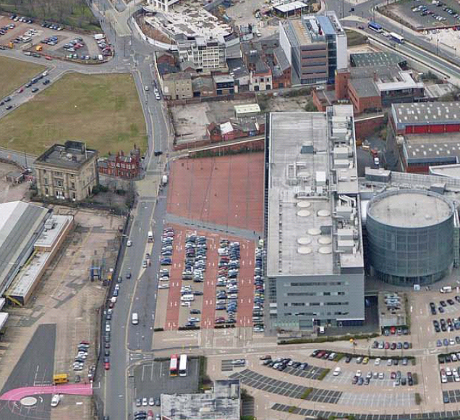
place making

Slide 5
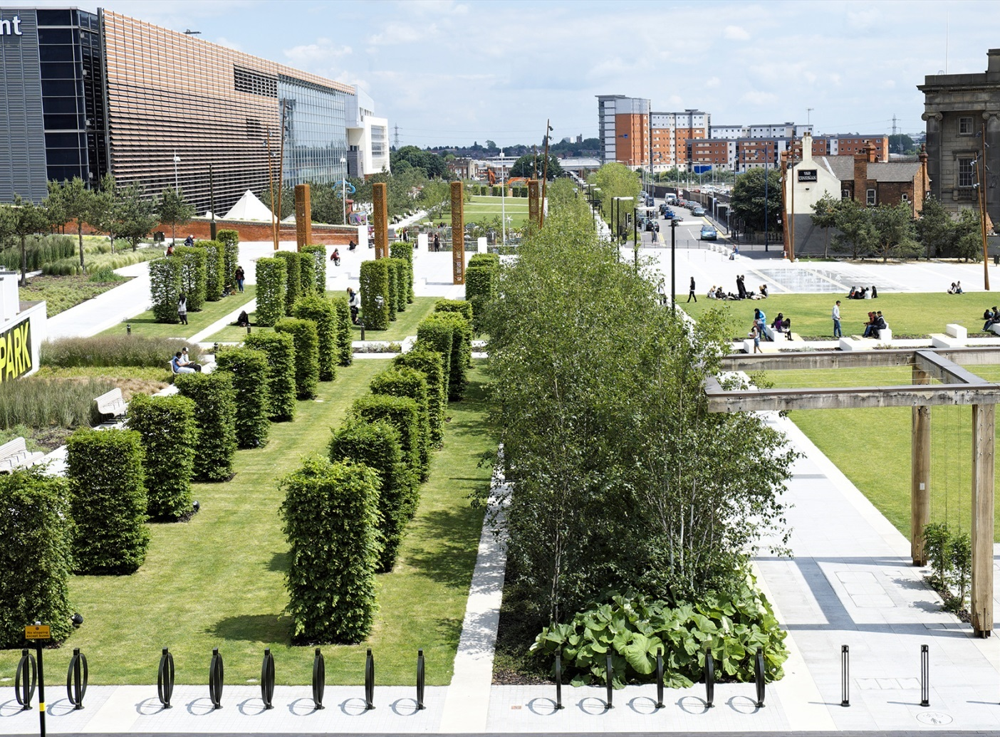
place making

Slide 6
leadership
“Leadership is the capacity to translate vision into reality”
Warren Bennis

Slide 7
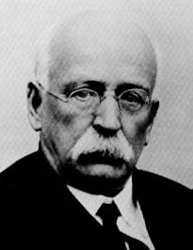
Ebenezer Howard
No training in urban planning or design
Opposed urban crowding/density
Hoped to create a ‘magnet’ people would want to come to

Slide 8
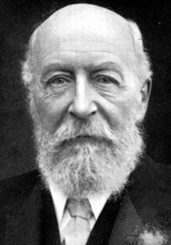
George Cadbury
“If each man could have his house, a large garden to cultivate and healthy surroundings - then, I thought, there will be for them a better opportunity of a happy family life”
George Cadbury

Slide 9
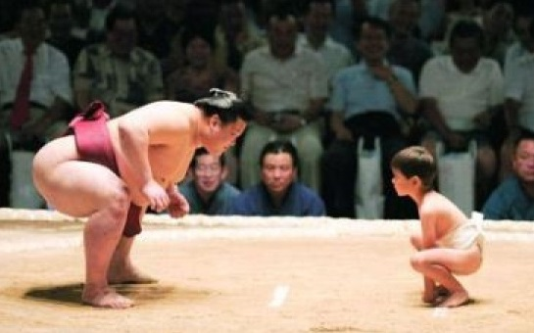
courage

Slide 10
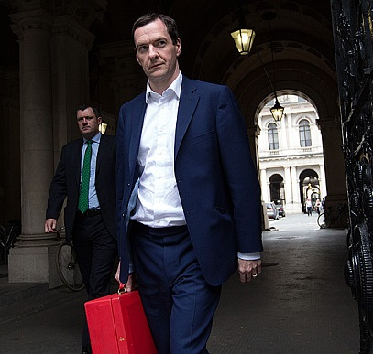
what is the Government’s view
Process
Reform
System
“Significant constraint”
Not all bad, there is the NPPF

Slide 11

bureaucracy

Slide 12
Birmingham’s approach
Setting the Vision
Effective Governance
Partnerships
Planning Certainty
Enabling

Slide 13
setting the vision

Slide 14
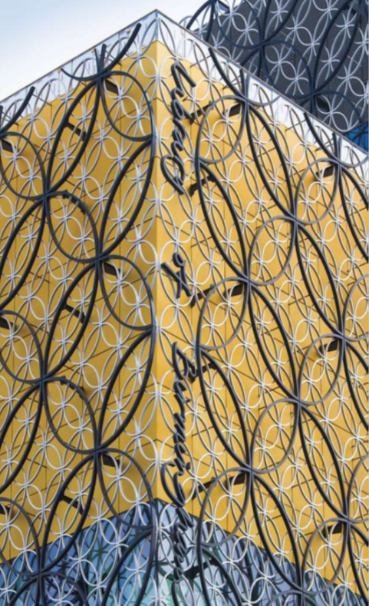
Birmingham’s growth agenda
Housing
- 150,000 additional people
- 80,000 households
Employment
- Over 100,000 new jobs needed
- 407 ha of employment land
required

Slide 15
Birmingham Development Plan
Planning for growth:
- 51,000 additional homes.
- 270,000 sqm. retail.
- 745,000 sqm. office.
Sustainable Urban Extension
Major employment growth
Environmental improvement and infrastructure

Slide 16
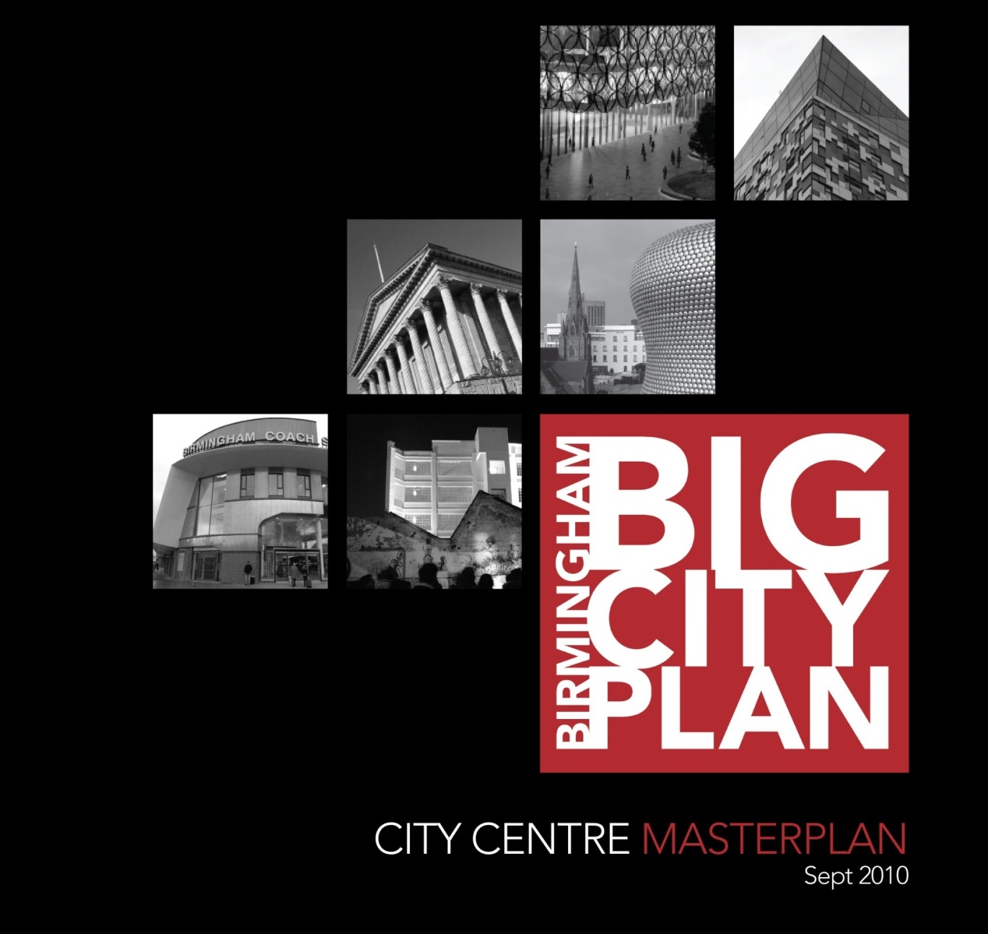

Slide 17
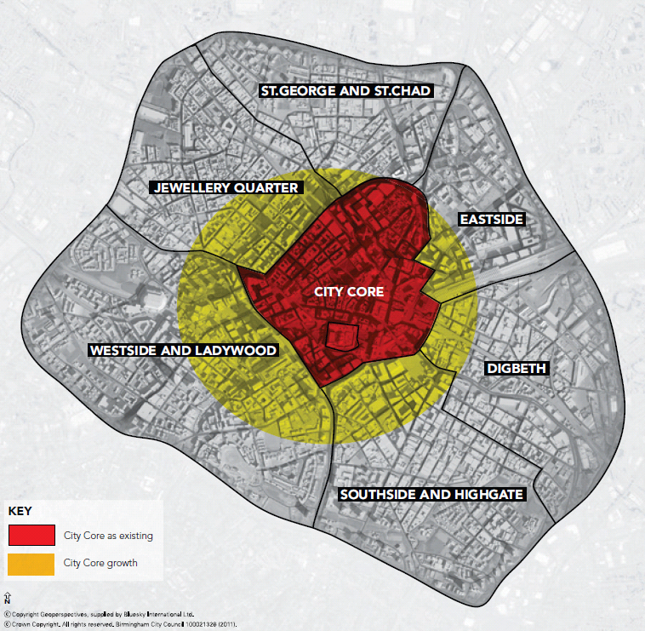
Growing the City Centre
Planning for:
- 12,800 new homes.
- 700,000 sq.m. office.
- 160,000 sq.m. retail.
Strengthen role as visitor and business destination and place to live and learn
Improved public realm and network of open spaces
HS2 Terminus station

Slide 18
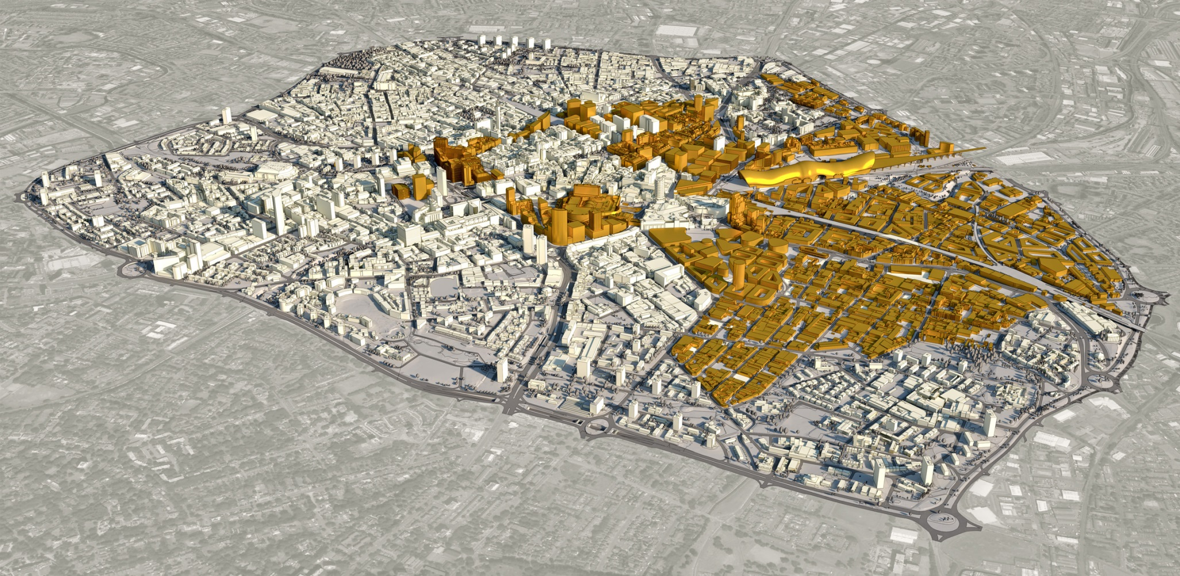
areas of transformation

Slide 19
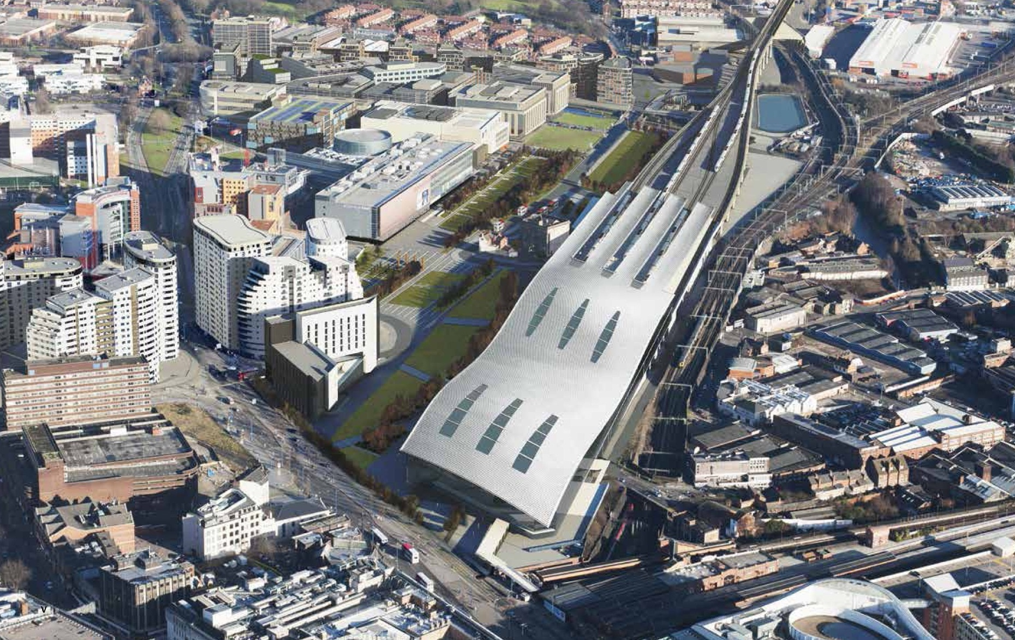
HS2 and the proposal for city centre terminus

Slide 20

Curzon HS2 masterplan

Slide 21
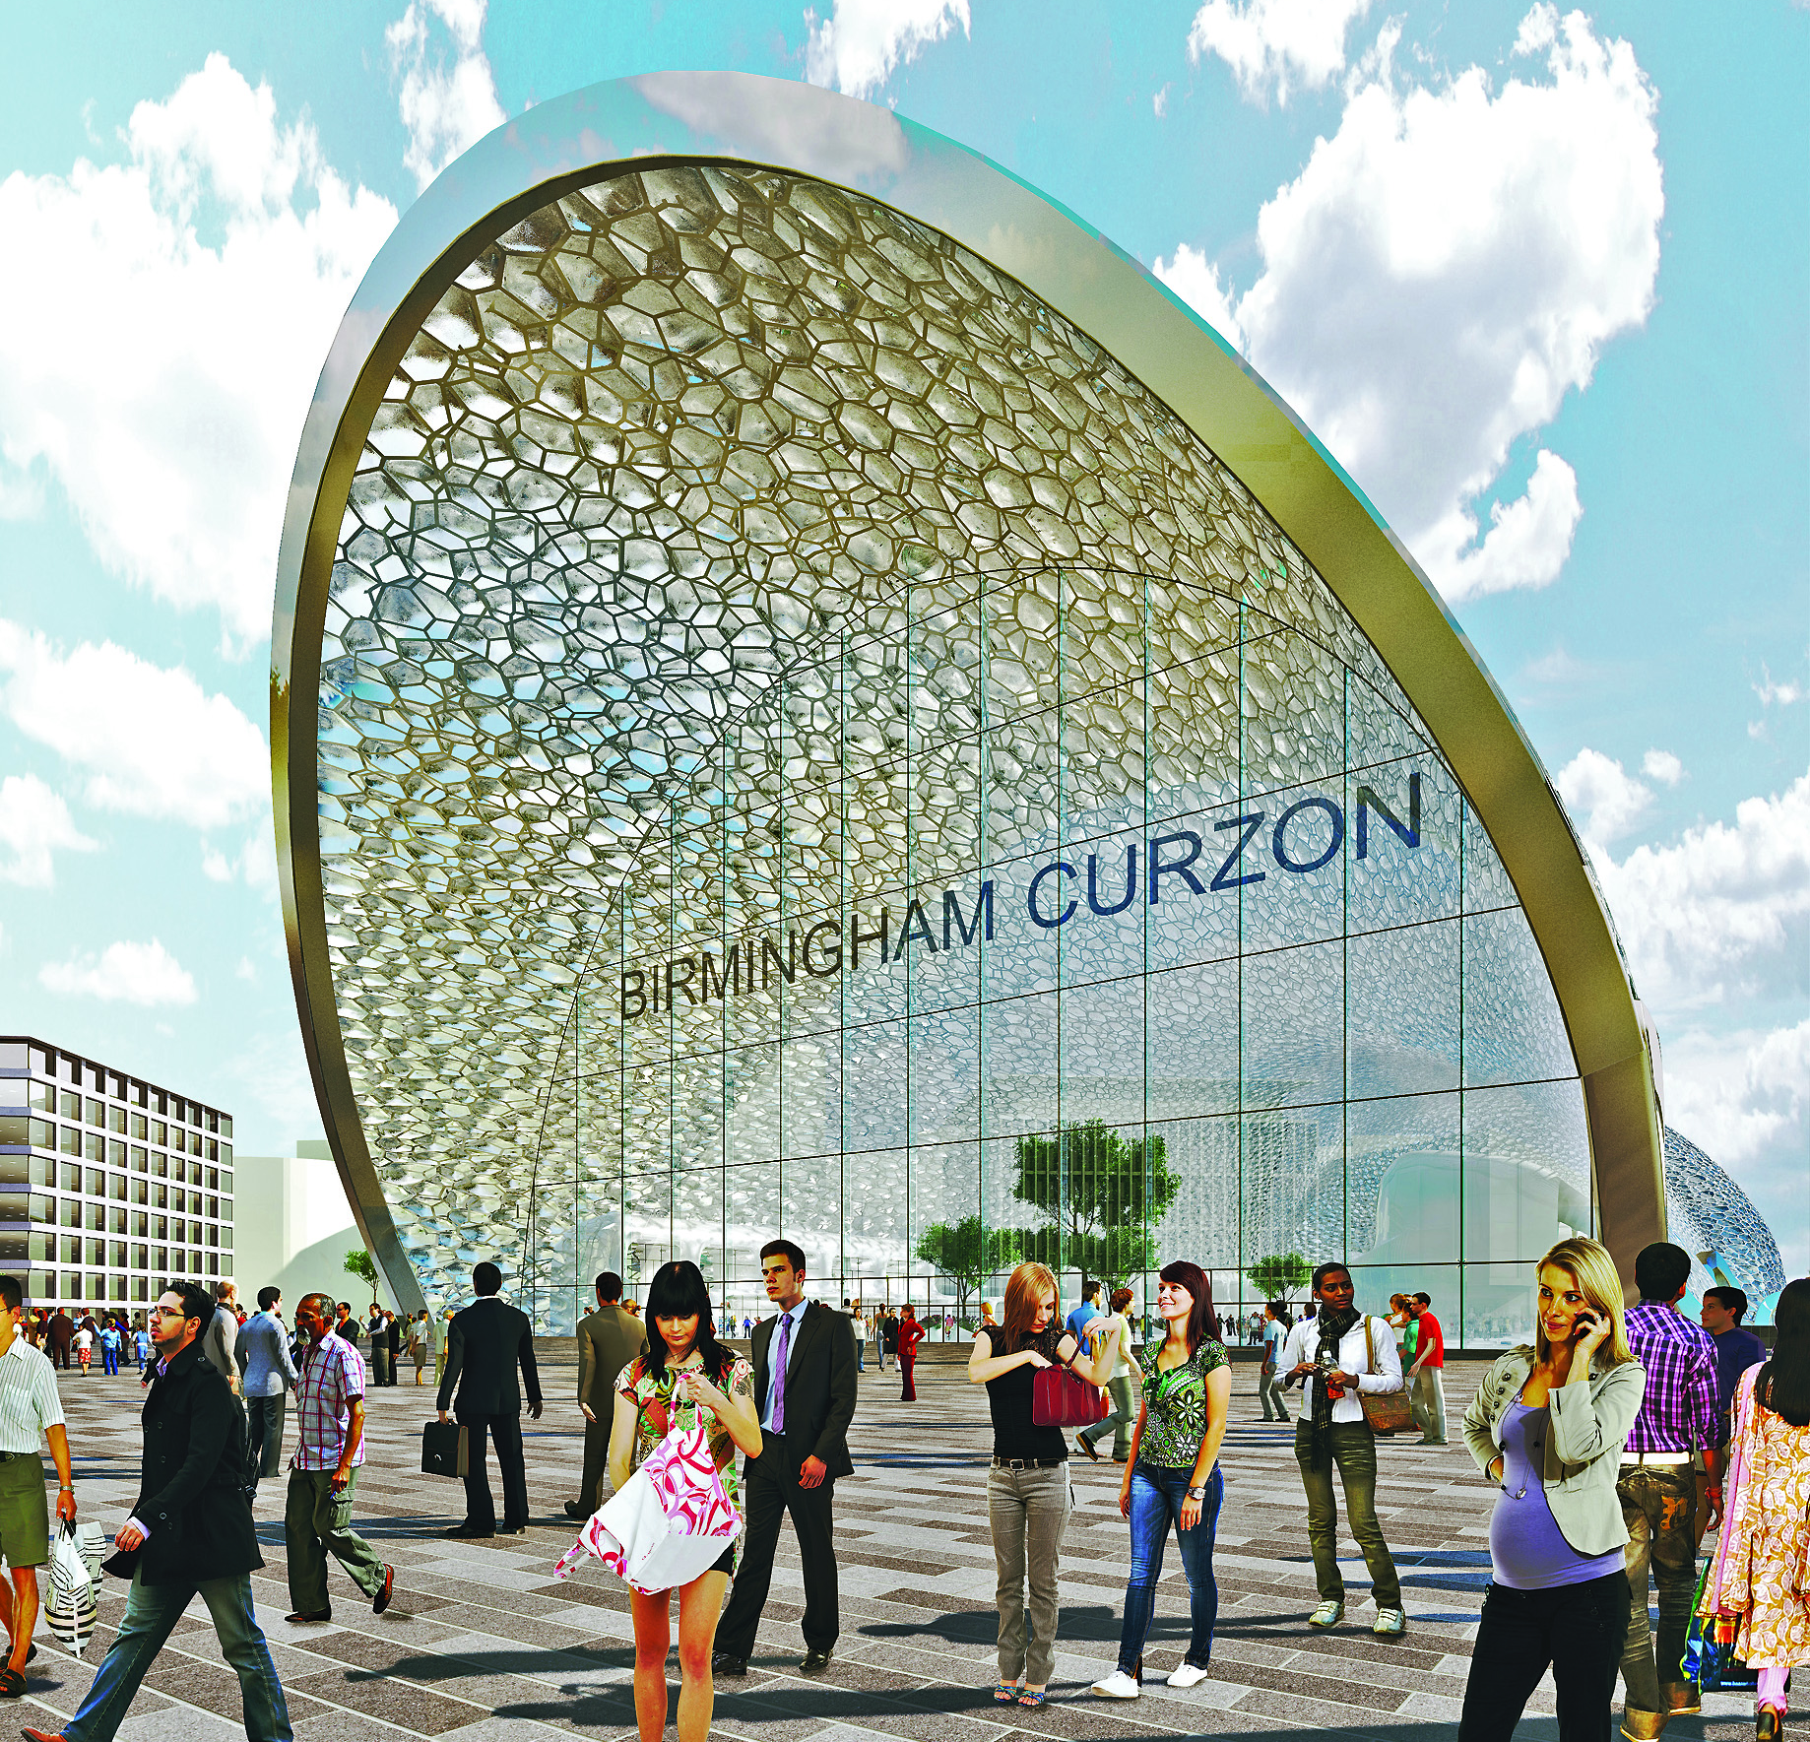
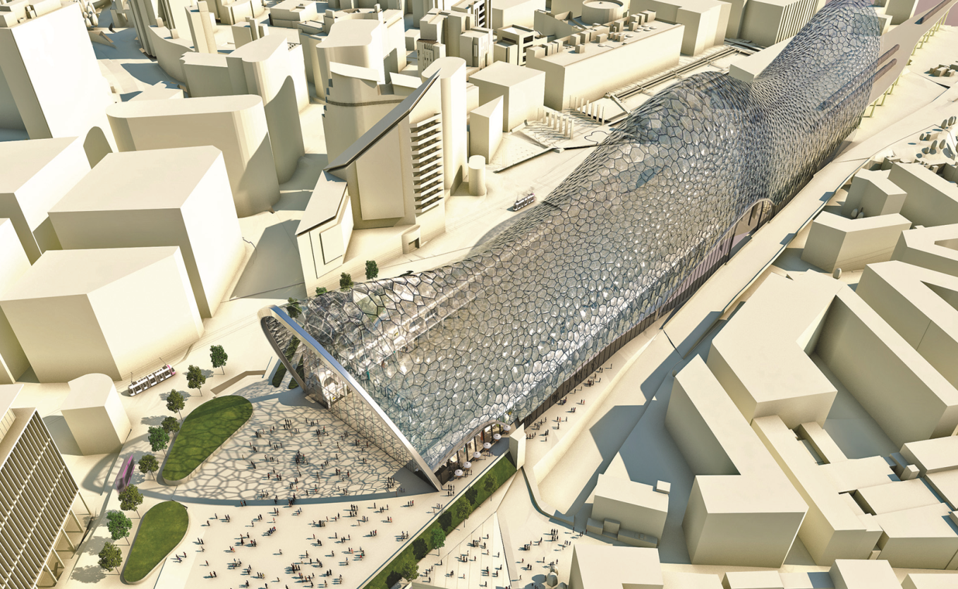
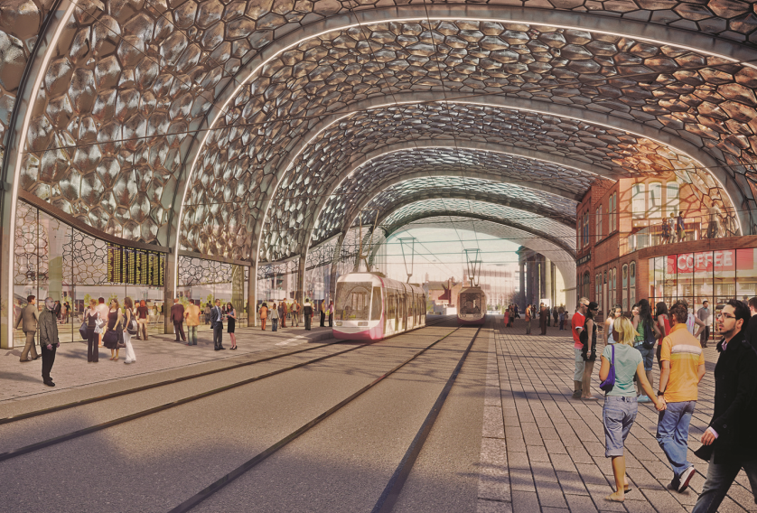
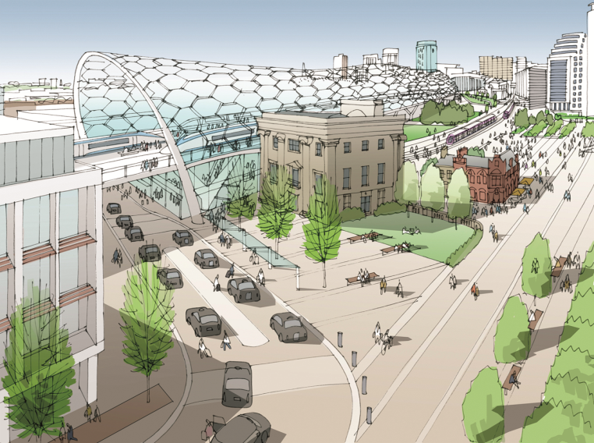
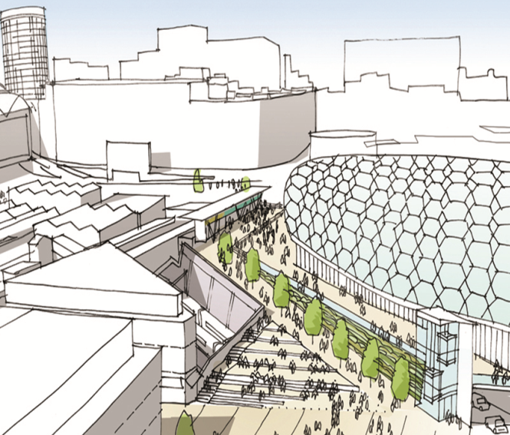
creating a destination

Slide 22
forming effective partnerships

Slide 23




working in partnership
Politicians
Communities
Developers / Landowners
Public sector
Education and training providers
LEP

Slide 24
providing planning certainty

Slide 25
planning performance figures
National target Birmingham 12/13 Birmingham 13/14
Majors 60% 84% 90%
Minors 65% 85% 86%
Others 80% 93% 94%
Done by 90% 93% 94%
delegation
Only 3% of all the decisions we make are appealed to the planning inspectorate and of the appeals we win approximately 75% of all cases

Slide 26
enabling and delivery

Slide 27
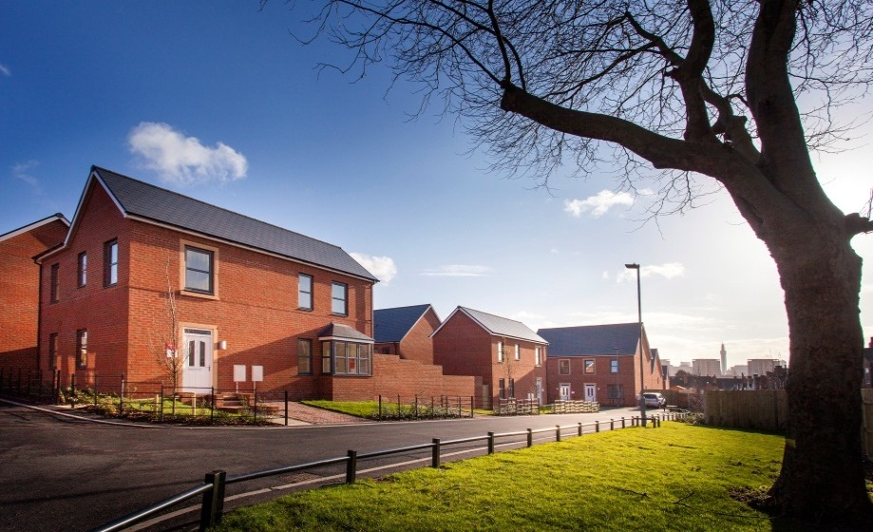
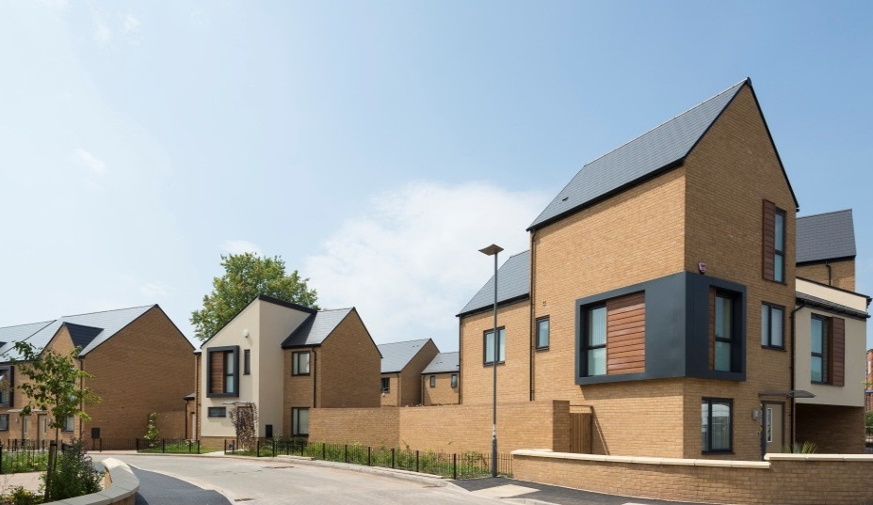
council as developer
Over 1,000 new homes completed since 2009
Development of over 2,000 more homes over next 5 years
Up to 700 completions projected in 2015-16
Council remains the largest developer in the city
‘INReach: set up to develop market rent homes across the city

Slide 28
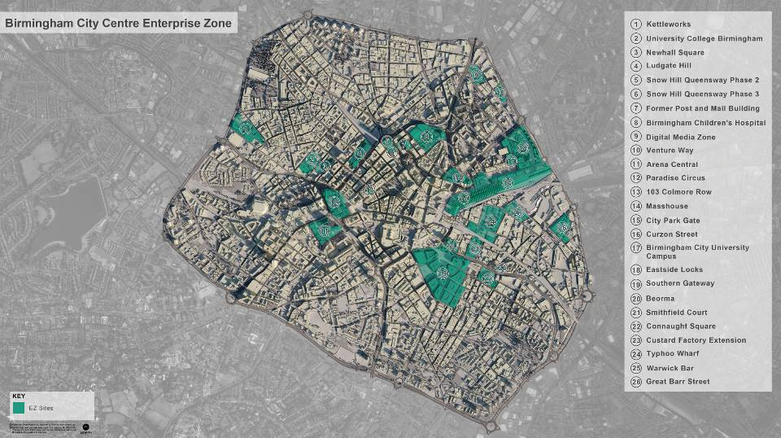
the Enterprise Zone

Slide 29
the EZ Investment Programme
£m
Connecting Economic Opportunities 17.66
Metro Extension 25.00
HS2 Growth Strategy - Curzon Site 30.00
HS2 Growth Strategy - Interchange Site 20.00
LEP Investment Fund 20.00
Paradise Circus Development 87.79
Birmingham Smithfield Development 45.47
Site enabling and access 14.94
Revenue projects/costs 13.60
Investment Programme Total 274.57

Slide 30
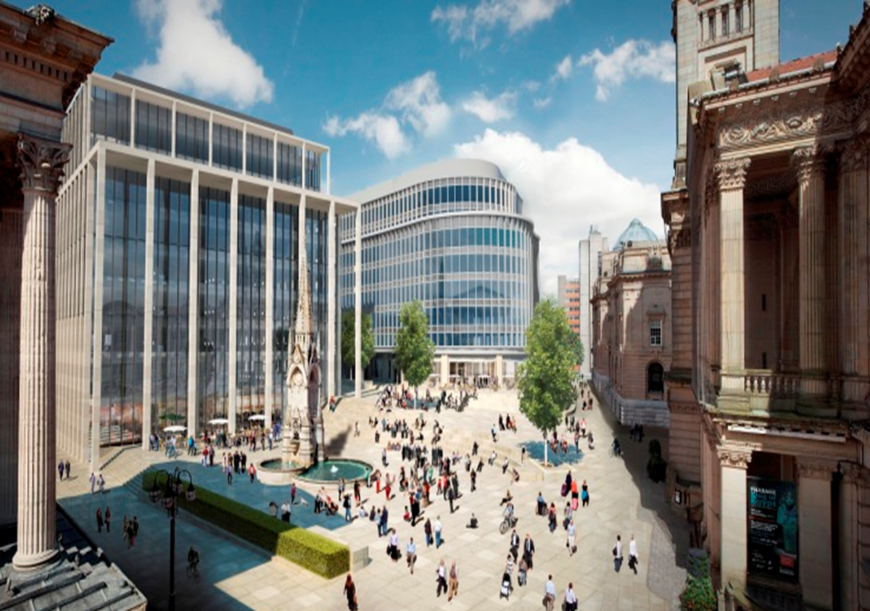
redevelopment of Paradise Circus

Slide 31
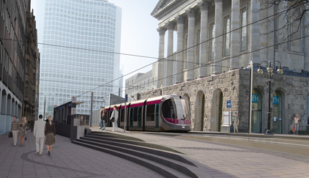
extending the Midland Metro

Slide 32
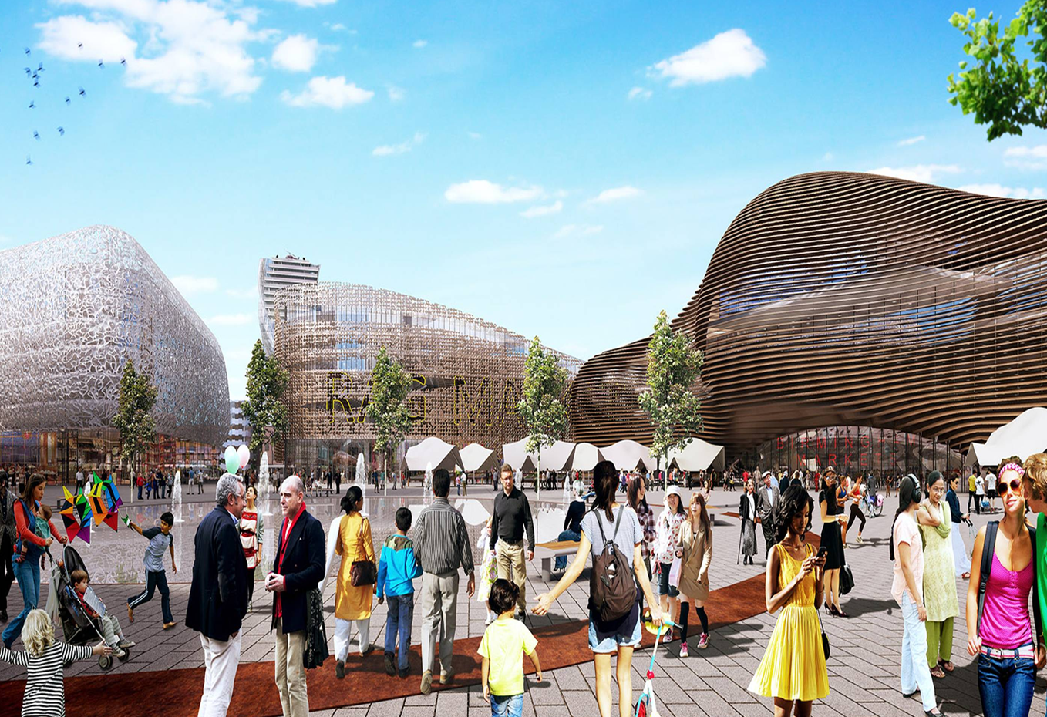
Birmingham Smithfield

Slide 33
effective governance

Slide 34
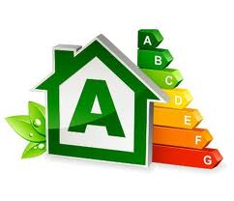
efficient use of resources
Re-organised the department to be outcome focussed
Brought planning management, development planning and regeneration together on an area basis
Added housing and education development functions
Introduced new IT - IPADS for Planning Committee
Supported training e.g. financial appraisals

Slide 35

graduate programme
Launched 2015
10 two-year paid positions
Range of funding including planning fees and planning performance agreements, Housing Revenue Account, LEP and Site Delivery Fund
Factors:
  Plan for the future
  Growth Agenda
  13 per cent of local government employees aged less than 30

Slide 36
The future planner
Planning Strategy
Planning Management
Housing Development
Design and Conservation
Regeneration
Finance, funding and delivery

Slide 37
the future

Slide 38
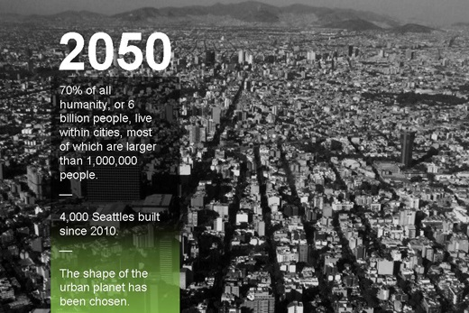
population growth and urbanisation

Slide 39
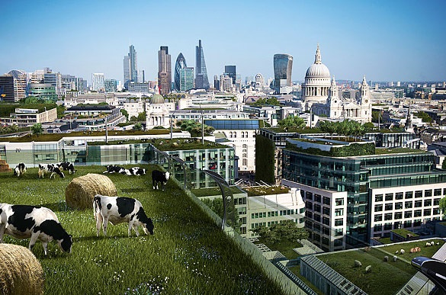
the future city

