Slide 1
What happens in planning authorities ?
Richard Crawley
Peer day Feb 2015
www.pas.gov.uk

Slide 2
Overview
Benchmark roundup
  Inventing the art
  Resources
  Productivity
  Customers
  Reflections
Planning Quality Framework
  Is it any good ?
  * One-off presentation alert *
Notes:
2014 total stats

Slide 3
Benchmark roundup
Benchmarking since 2009
  276 councils participated in total
  Confidential, but valuable dataset
Publish aggregate as a “state of the nation”
  Before we forget; for the benefit of the future
Need to find the right tone
  Warts ‘n’ all, but useful to councils
  Your view is the one that matters

Slide 4
Inventing the art
We had to make the basic building blocks
  What was the work called ? (‘Q’ codes had not kept up)
  What were our tasks called ? (and which were ‘value’ ?)
There is a value in this framework
We stole from building control
  Productive hourly rate = £50
  Compare / contrast with pre-app charges (!)

Slide 5
Resources
=Primary focus (we were preparing for fees)
Big decisions
  What was supposed to be covered by the fee ?
  … and what was RSG ?
Consequences to these decisions
  And not just for planning departments
  Vulnerable to workload fluctuations ? Or broader council spending pressures ?

Slide 6
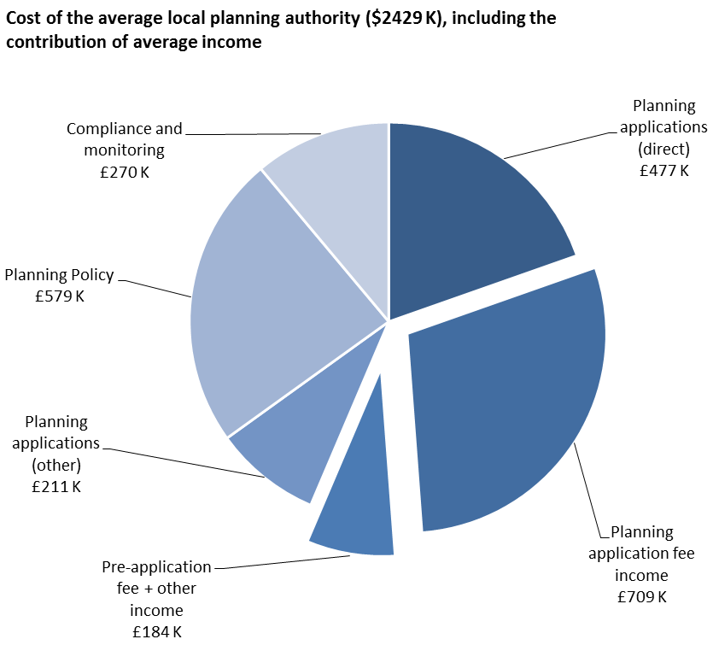

Slide 7
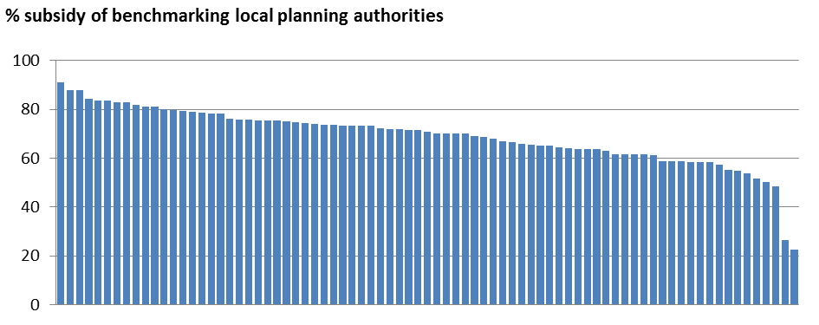
Subsidy = 30% (then)

Slide 8
Majors = profit. Avoid conditions !

Slide 9
Productivity
“We are not updating the 150 cases per officer thing”
  In the end, we have caved in
It’s gone down ☹
  Awkward. Work types ? Bloat since 2002 ?

Slide 10
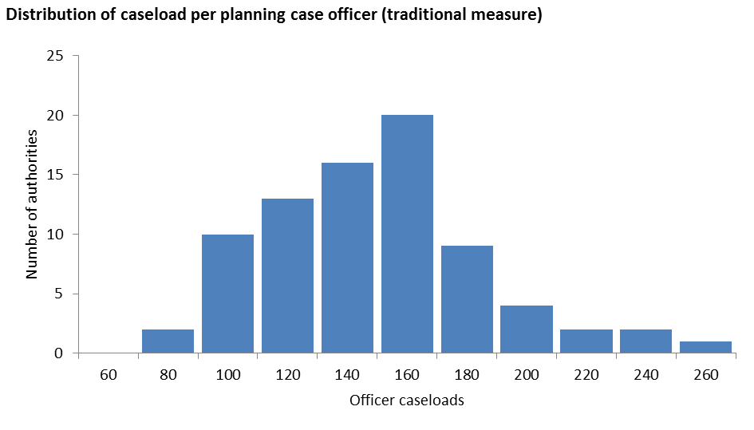
Caseload = 144 / case officer

Slide 11
Productivity revisited
In 2002, it was professional case officer + admin types. Now less differentiation.
Not cases per DC officer, but cases per human
  Derives total head count
  = less wiggle room
  In the ODPM study, this was “less than 100”

Slide 12
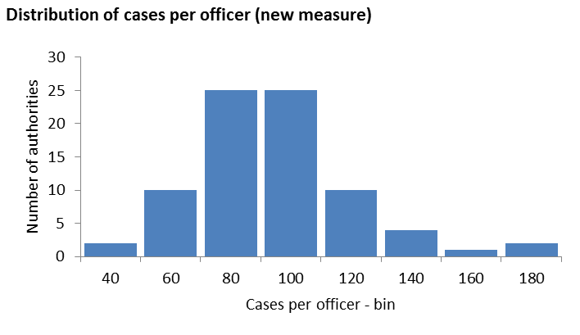
All-in figure is 88 cases per human

Slide 13
All-in figure is 88 cases per human

Slide 14
Drivers of productivity
Large authorities = higher productivity
Work mix = biggest impact
  Organise against workload of high numbers of simple applications. Fast track. Often urban.
Plus local factors (eg contamination)

Slide 15
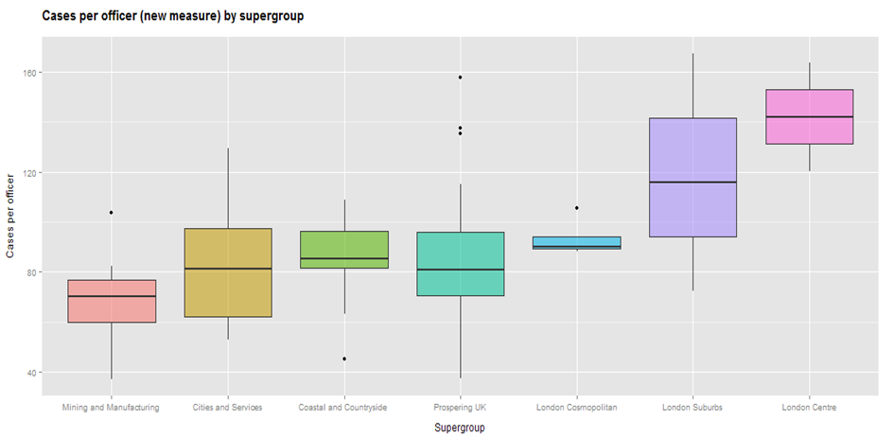
Supergroups = ONS classification

Slide 16
Customers
Individual councils failed to get enough volume to allow confidence
In aggregate we had clear messages
  Talk to us, generally. It’s just manners.
  Talk to us *especially* when there are issues
  We (generally) fail on customer care
These are not high volume environments, but we fail because we don’t acknowledge WIP and target culture

Slide 17
Reflections (on LPAs)
Massive shift in understanding
  Financial literacy
National indicators hide almost everything about performance
Planning work needs to be unpicked to be understood
Subsidy represents a risk to development
Communication is often weak

Slide 18
Reflections (on benchmarking)
Sustained collaborative effort
  Fantastic advert for ‘sector led’ work
  Great partnership with CIPFA
Raw data is great
  Allows you to ask questions late
Benefit beyond “improvement tool”
  Demonstrate excellence
Difficult to count things in policy

Slide 19
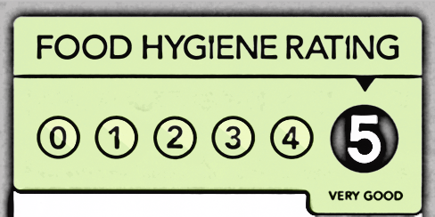
Benchmarking is dead. Long live PQF.
The basic building blocks have been adapted and recycled into the PQF
More focused on customers
Internal management tool / external ‘declaration’
Not an annual snapshot, but a continuous process
We want it to become a
“badge”. Over time.

Slide 20
Applications
Surveys
Quality
Back office data
Each qtr
Simple quality measures
Staff
Once/yr
Amenity groups
Once/yr
Councillors
Once/yr
Applicant
Each decision
Big scheme quality measures
Neighbours
Each decision
Mapping
1/off
map
Service Head
Once/yr
Quarterly
summary
Quarterly
summaries
Quarterly
summaries
Annual report

Slide 21
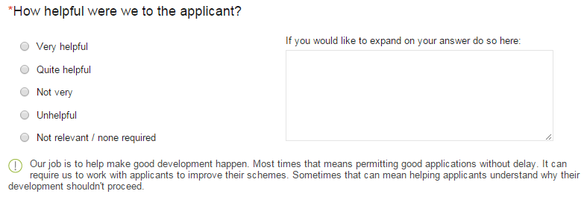
Customer Surveys
Agents, Applicants, Neighbours, Peers
Staff, councillors, amenities
Tied to an individual application
Help, Time, Information, Straightforward.

Slide 22
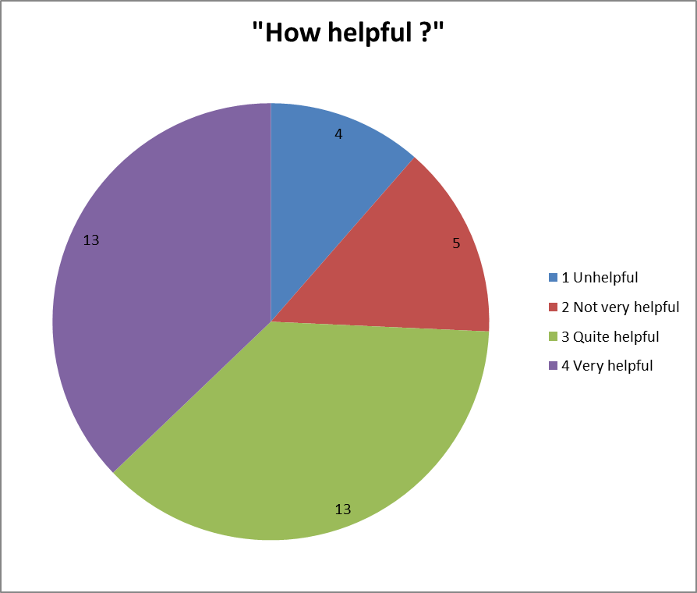
Customer Surveys
“We may be slow, but we offer a quality service”
  This allows you to test, prove
Same questions nation-wide
Early days

Slide 23
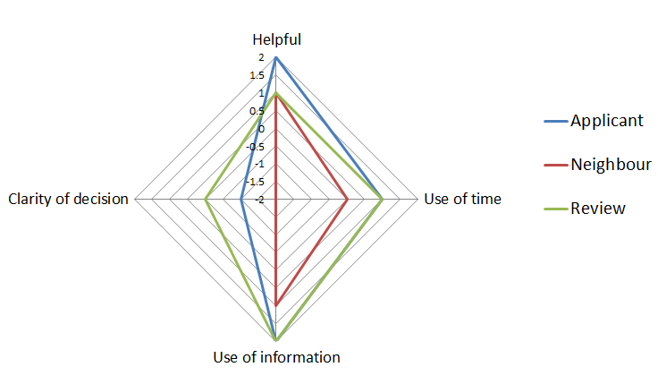
survey results
Application Ref: HA/FUL/4456/14

Slide 24
Plus head of service survey
Things are different. Why ?
  ICT ?
  Organisation ?
How happy are you ?
What are your plans ?
  Collaborations ? Shared approaches ?

Slide 25
Plus lots of data & pictures

Slide 26
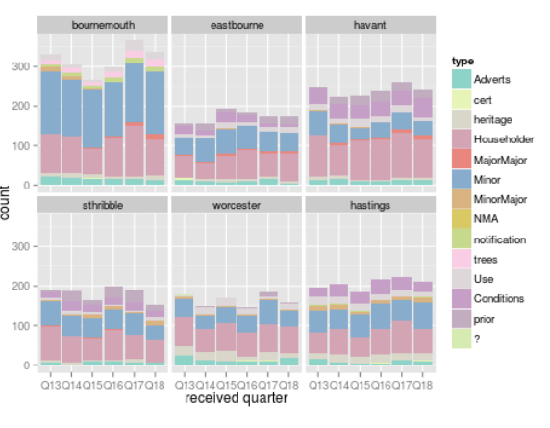

Slide 27
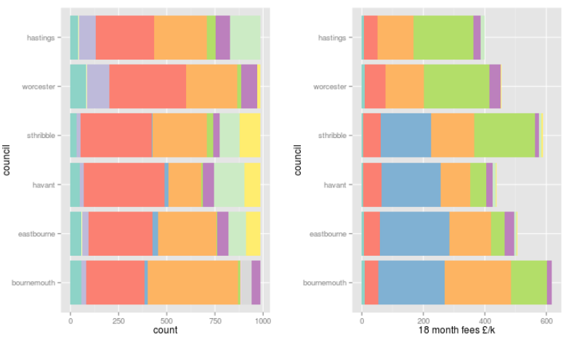
sampled
Everyone has same application count
Less mental juggling

Slide 28
sampled

Slide 29
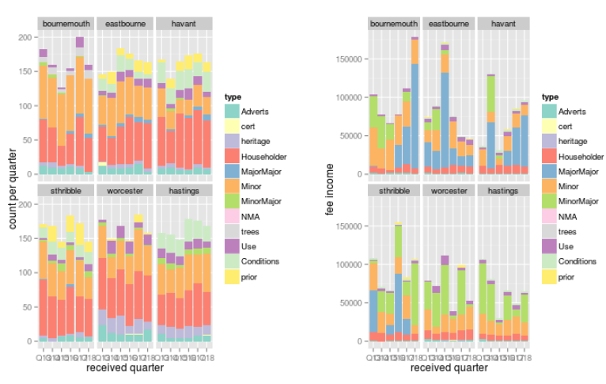

Slide 30
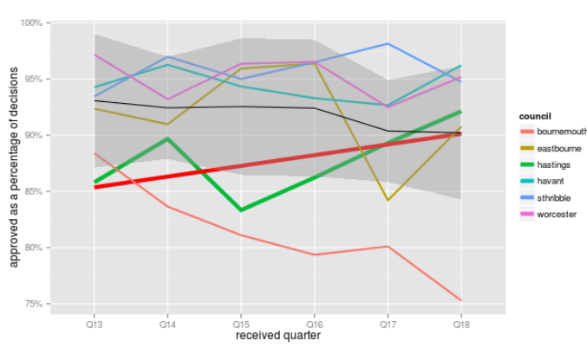
Approved ?

Slide 31
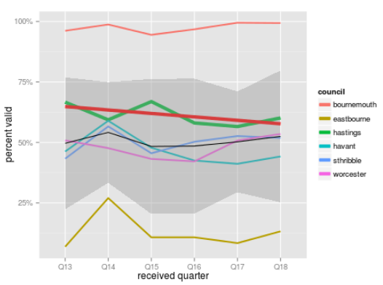
Valid ?

Slide 32
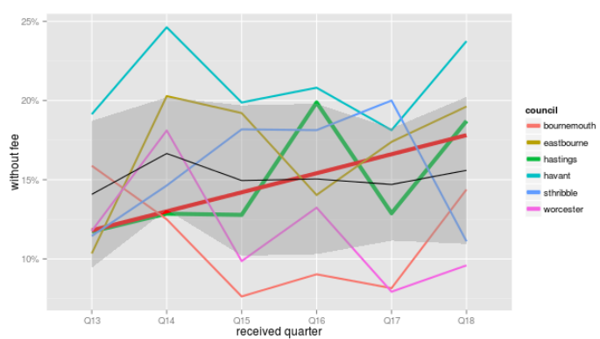
No fee ? (exc. heritage & trees)

Slide 33
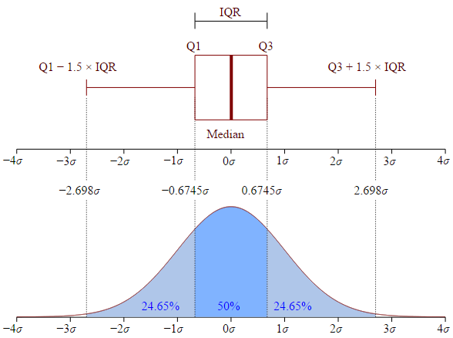
"Boxplot vs PDF" by Jhguch at en.wikipedia. Licensed under CC BY-SA 2.5 via Wikimedia Commons - http://commons.wikimedia.org/wiki/File:Boxplot_vs_PDF.svg#mediaviewer/File:Boxplot_vs_PDF.svg

Slide 34
"Boxplot vs PDF" by Jhguch at en.wikipedia. Licensed under CC BY-SA 2.5 via Wikimedia Commons - http://commons.wikimedia.org/wiki/File:Boxplot_vs_PDF.svg#mediaviewer/File:Boxplot_vs_PDF.svg

Slide 35
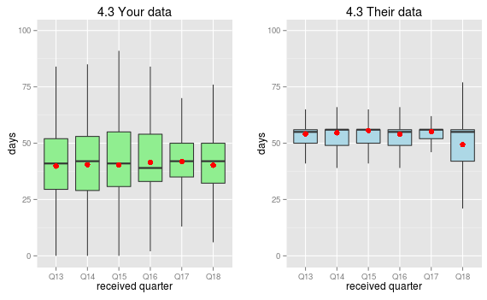
Ashford

Slide 36
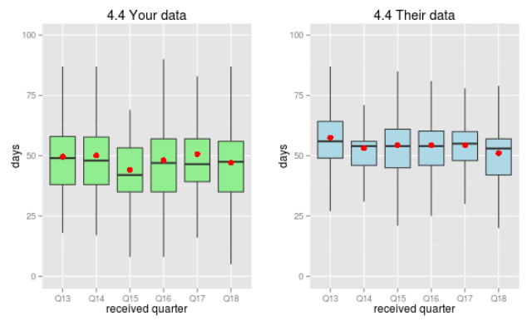
Hastings. End to end days. 12,000 cases compared using 30 numbers

Slide 37
More to come
Headcount
Investment
[need more testing]

Slide 38
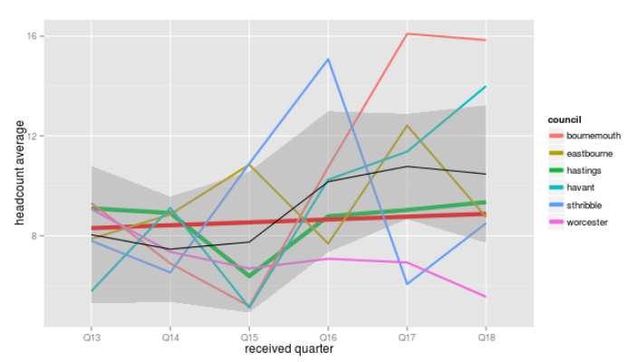
Is it getting busier ? [yes]

Slide 39
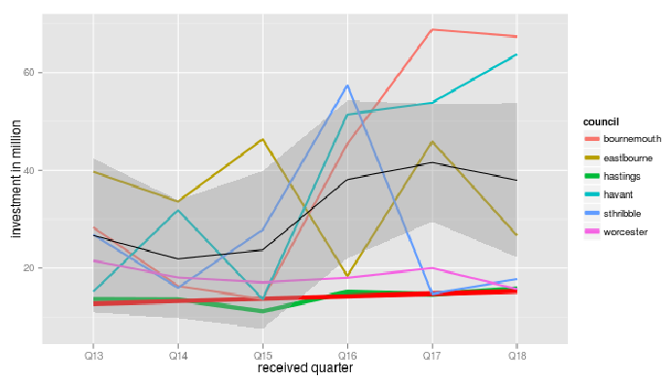
Dev value in our place = £60m/yr

Slide 40
What does it prove ?
Hastings is …
  Struggling financially. Cannot get close to cost recovery
  Getting busier
  Quicker than its peers
  [Results of survey tbc]
They might …
  Investigate refusals. Lower edge of group.
  Ask bournemouth about refunds / free goes
  Have a grown-up think about funding

Slide 41
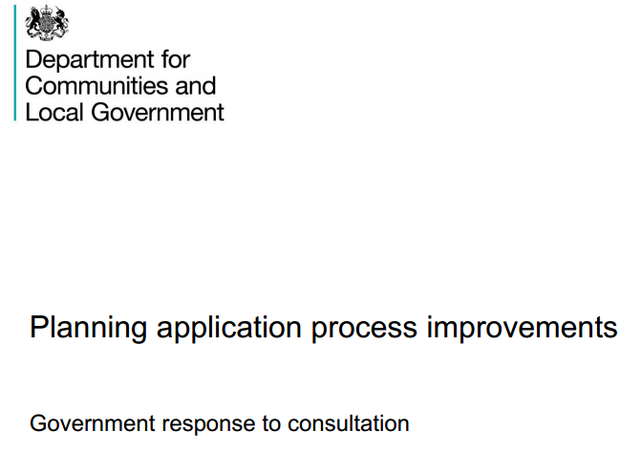
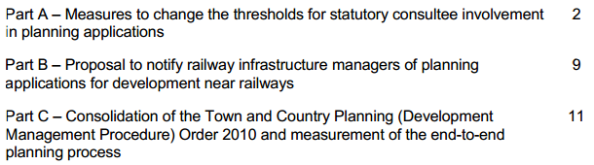
PAS Planning Quality Framework = consistent, relevant information to benchmark performance' (p12):

Slide 42
Solution in search of a problem ?
Purpose
Routine
Value
Or do something else …
Use it or lose it ?

