Slide 1
The Role of Technology in Health & Social Care
Chris Sawyer – Lead Technologist
Health + Care

Slide 2

Innovate UK
The UK Innovation Agency
  set up in 2007 to support UK economic growth
We look at the challenges that offer market opportunities
Identify where the UK has real capability
  and where the timing is right
We work with communities and other organisations
  finding the right form of support for companies in these areas
In 6 years....
Over 2800 active CR&D projects
>4000 business partnerships and almost all the UK’s universities
Together with partners and business, over £2.5bn invested in UK innovation
Notes:
Our goal is to accelerate economic growth and quality of life for UK citizens by stimulating and supporting business led innovation.

Slide 3




Our Role
To support innovation & growth of technology industry
To accelerate concept to commercialisation
To connect innovation landscape & collaboration
To develop innovation opportunities
  Local &global markets
Healthcare industry attracted to/remains in the UK
  Build investment in discovery and development
  Employ UK skill base
  Strengthen smaller biotechnology companies
  Bring together best of British academia and industry to create innovative solutions
Thematic Areas- Innovation Platforms
  Independent Living
  Regenerative Medicine
  Stratified Medicine
Biomedical catalyst
Notes:
We bring together organisations to collaborate and to develop and implement new innovative solutions.
We support the development of large scale demonstrators in order to develop and try-out new ideas.
We support companies and sub-contractors through funding.
We enable organisations from both the public and private sector to work together to truly understand the challenges and develop innovative solutions.

Slide 4
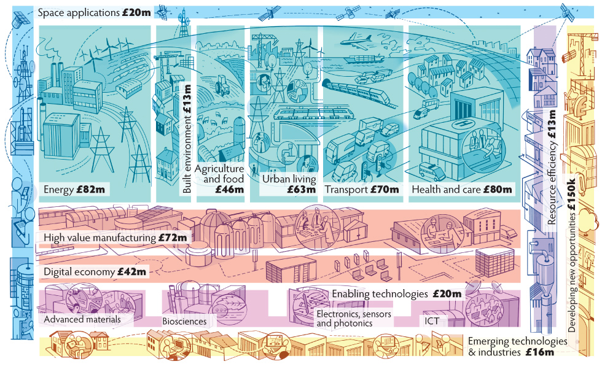
Anticipated commitments in priority areas, during 2014-15
Notes:
Much of our work is focused on a number of market and technology application themes - especially our innovation platforms and our collaborative research and development funding competitions. We call these themes our priority areas. They are areas of strategic importance to the UK, where the UK has strong capabilities, and where innovation - and our work - can make a real difference.
(Point out some of the areas)
The numbers here show roughly how much we will be investing in each priority area in the year 2014-15.

Slide 5

Assisted Living Innovation Platform (ALIP)
Meet the demand for independent living
Improve the quality of life
Innovation & application of technology
Opening new markets & opportunities
Notes:
5
So what do we do in ALIP.

Slide 6



Assisted Living Innovation Platform - highlights
Lifestyle ethos, interoperability and scalability
Social innovation, service design
delivering assisted living lifestyles
at
scale
Understanding barriers to market
Independence Matters
Business Models/Social & Behavioural Studies
Technology/product development
Ambient Assisted Living
2011-15
2010-12
2009/10
Long Term Care
Revolution
2007
2008
Home Based Systems and User Centred Design
Smart Care Distributed Environment
Notes:
We started off focused on technology and product development. We quickly realised that there are so many other factors to consider in this space, so over time opened the platform into other areas. Over the years we have run programs on product development, business modelling, behavioural studies, service design through to DALLAS which stands for Delivering Assisted Living Lifestyles at Scale. We have also recently launched a new program called the Long Term Care Revolution, which is focused on enabling the transformation of long term institutional care.

Slide 7





Four communities UK wide reach
More Independent
dallas is doing things differently........
Notes:
DALLAS is our large scale demonstrator and comprises of four communities across the UK.
More Independent – Liverpool
Year Zero – National
i-focus – National
Living it Up – Scotland
DALLAS goes beyond traditional health and social care focusing on new and innovative ways to improve peoples lives.
Target = 169,000 people by next summer

Slide 8
Year Zero is creating personalised electronic health records to allow people to take greater control of their own health and wellbeing, while transforming the relationship between patients and health care professionals.
Year Zero will digitise electronic health records for children, in the form of the eredbook, as well as providing health and care planning tools for the rest of the family.
Mi is a Liverpool-based scheme designed to enable people to take charge of their health, wellbeing and lifestyle through technology.
Mi allows people to live more independently in their own homes, offering peace of mind both to them and their family, whilst reducing the amount of time spent on appointments by supporting people to manage better at home.
Notes:
So at a high level the four DALLAS projects are:
Year Zero which is creating personalised digital health records including the e-redbook as well as providing health and care planning tools.
More Independent – Volunteer community champions providing local support. They also provide peer to peer training on digital technologies, such as i-pads usage. MI also provides access to AL products and services to support the community and has a smart house in the Liverpool museum.

Slide 9
Living it Up is a digitally-enabled community that supports better health, wellbeing and active lifestyles in Scotland.
LiU provides personalised experiences to keep people connected with one another and with their health and wellbeing. LiU services save time and are affordable, easy to operate and understand, and are ‘at the fingertips‘ of any person in Scotland.
i-focus collaborates with health organisations on interoperability and best practice to transform health and care by providing better service delivery through digital comms and technology.
Part of i-focus, Warm Neighbourhoods helps families stay connected by using simple sensor technology. It provides support and reassurance for families with vulnerable members who live alone.
Notes:
Living It Up, which is being led by NHS 24, has enlisted local communities over a three year period to help in the design and development of ways in which local services can be delivered digitally. It provides tailored advice on improving and managing health, care and wellbeing. The unique technology matches an individual’s needs and interests with professional information, local services, and beneficial activities and events in their community.
i-focus – Interoperability and standards enabling scalability. Also supports the development of innovative new digital technologies, such as Warm Neighbourhoods, which I will speak about shortly.

Slide 10
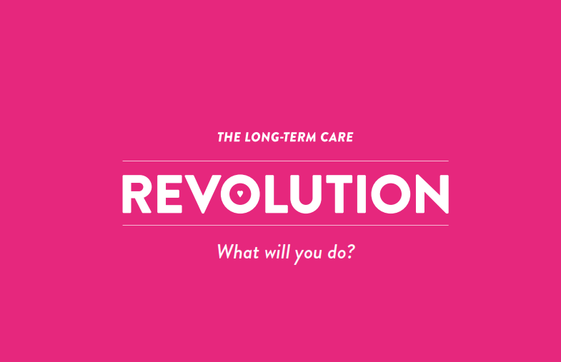
Notes:
Our newest programme is the LTCR

Slide 11
Vision Statement
The Long Term Care Revolution
To evolve the existing institutional model of long term care into a world class, cutting edge marketplace fit for the 21st Century.
One that will liberate people to live vibrant, dignified lifestyles enhancing their capabilities and purpose in life.

Slide 12
Its about radically rethinking institutional long term care.
Its about stimulating innovation, new models and markets for independent living in the future.
Its about creating new and desirable alternatives leading to structural and economic change for the future.
It is not about reforming what exists, but about constructing something new between now and 2040.
What is this revolution about?
Notes:
The LTCR is about radically rethinking current models of long-term care to create new and desirable alternatives leading to structural and economic change for the future. It is not about reforming what exists, but about constructing something new between now and 2040. To achieve this, The Long Term Care revolution will harness the thinking of the UK research community, the commitment of voluntary and charitable sector partners and the ingenuity of social, business, design and technology innovators and entrepreneurs.
We are just completing stage one, and are now moving into stage 2. Between now and March we will be looking to provoke debate on the subject leading through a mix of communication methods including roadshows, provocation paper and social media. If you are interested get involved. This will lead to a national challenge competition in 2015.

Slide 13

Technology in Health and Social Care

Slide 14
Assistive Technology Labels
Mobility
Telecare
Telehealth
Digital
Mhealth
Consumer
Health & Wellness
Independent Living
Notes:
Interchangeable terminology – focus on four titles.

Slide 15
It shouldn’t be about the technology!
Rapid pace of technological advancement
Transferable tech is able and waiting
But if and when and to what degree will it be needed in this space?
The person should be at the centre not the technology
Technology should be an enabler and part of the service
The need should be the driver
User-centric design
Notes:
It shouldn’t be about the technology, but the role that technology plays in Health and Social Care should be absolutely huge. The use of technology as part of a service should make everyone’s jobs easier and should help bring improved care to the person. It doesn’t have to be complex technology, but even the use of the simplest technology can make a difference. But it has to fit into the service and not have the service designed around the technology. The central fulcrum in all this should be the user, whether that be the person in their home, the clinician, or some other stakeholder.

Slide 16

Technology Challenges in Assisted Living....
Awareness
Sales
Approach
Market
Access
Product &
Service
Design
Quality
Standards,
Interoperability
& Integration
Organisational
Readiness &
Program
Management
Notes:
16
Awareness – Technologies and opportunities – How do I get by product seen above the others?
Sales Approach – Product versus program. Should be treated as an on-going program and not a box sell. This would help manage on-going issues and develop the relationship.
Organisational readiness – In my view one of the biggest challenges and one that has formed a huge obstacle to adoption.
QS&I – Lack of standards & interoperability. But how does this impact on solutions development and adoption?
Market Access – Where is the market and how do you penetrate?

Slide 17
Technology Snapshot
Telecare | Telehealth | Digital | Consumer
Low Tech | Low – Mid Tech | Low - Mid Tech | Low – Mid Tech
Low Cost | Mid Cost - | Free - Mid | Free - Mid
10 – 15 year old | 5 – 15 year old | 0 – 3 year old | 1 – 15 year old
Emerging Digital Solutions | Monitoring | Apps, advise, monitoring | Emerging Digital through to Blood Pressure Monitors
Slow tech development | Slow tech development | Fast tech development | Potential fast tech development
Notes:
Although technology in general has moved on at a frenetic pace, Assisted Living technology hasn’t really progressed that much in the past 10 – 15 years. Quick look at this table shows that Telecare and Telehealth has largely stagnated, although there are some emerging digital solutions, with the faster moving digital and consumer markets showing more potential. But with technology having progressed so far, I believe this creates an opportunity for the Assisted Living market. If industry can see a viable market, then existing underlying technologies can be modified and would be ripe for transfer. The challenge is, where is the market and where are the opportunities, which industry will need to see to invest.

Slide 18

Issues
Commercial
Sales approach
Market Access
Lack of Scale
Stagnant market negatively impacts innovation
Lack of investment
Traditional markets driven by industry
No clear ROI
Who is the customer/payer?
Resource intensive and complicated procurement
Notes:
Telehealth - Treated as a box sale rather than a program. In my opinion a short-term view.
Market Access – Large companies have better access, but a lot of innovation comes from SMEs who do not have the reach.
Lack of scale impacts on investment.
Market has largely been driven by industry.

Slide 19

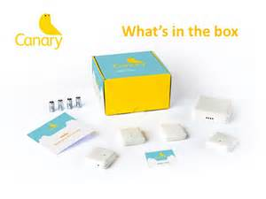

Challenges
Product/Service/Solutions
Product Design vs. User Needs
Collaborative Approach
Interoperability and Systems Integration
Product vs. Program
Part of a service and not a product
Visibility, Choice and Selection
Evidence
Awareness

Slide 20

Challenges
Commissioner
What’s available that meets my needs
What should I commission?
Interoperability and systems integration
Process and systems redesign
Lack of awareness of what is available
Need a strong Business Case
Return on Investment
WIIFM

Slide 21
Current State
Technology advancing at a rapid rate
Increase in digital solutions available to market
Lack of overall awareness of what is available
Increasing focus on the consumer
Huge investment in digital health
Products are becoming smaller and more discreet
The need should be the driver
But does technology address the current need?

Slide 22
Market Opportunity
Health & Social Care needs technology
Demands on the system are great and will only increase
Technology in some form can help release this burden
Global market is huge
Technology is becoming simpler
We are on the verge of a technological shift
Global giants heavily investing
What is the future vision?

Slide 23
Opportunity
Huge opportunity for technology to help provide
  Better Health + Care
  Cost Efficiencies
  Improved Communication
But
  One size doesn’t fit all
  Collaborative Approach
  Service Integration
  Designed around the user
Notes:
But even today I believe there is a huge opportunity for technology to help provide

Slide 24
Current/New Technologies
Canary Care | Smart Sensors | www.canarycare.co.uk
Advanced Digital Institute | iFocus – Warm Neighbourhoods Smart Sensors | http://www.adi-uk.com/i-focus.html
Umotif | Self-care Management | www.umotif.com
Active Protective | Smart Garments | www.activeprotect.co
Breezie | Internet made easy | www.breezie.com
Care Monster | Family Communication | http://caremonster.crushpath.me/info
Gerijoy | Virtual Care Companions | http://www.gerijoy.com/
Linked Senior | Dementia and Therapy Engagement Software | http://www.linkedsenior.com/
Roobrik | Online Decision Tools for Family Caregivers | http://roobrik.com/
Smartstones | Wearable non-verbal communication Device | http://www.smartstones.co/
Lively | Personal Emergency Response | http://www.mylively.com/
Wearables
Notes:
I’ve included a list of some current assisted living technologies, just to provide an insight into what has recently become available. This is just a short list of many that are available and goes some way to explaining the complexity and confusion of what to commission.

Slide 25

What will we see in the future?
Robots?
Artificial Intelligence?
Wearables?
Smart Materials?
RITA (Responsive InTerative Advocate)
http://rita.me.uk/demo/
Notes:
Google, Apple, Microsoft, Facebook
1. RITA (Responsive InTeractive Advocate) is the vision for a computer software-based advocacy and companion service that brings together three elements: a 3D virtual avatar and conversational agent, an ‘essence’ repository for storage and organisation of various forms of information pertaining to the user, and an empathetic communication system that is capable of understanding and responding to the psychological, social and emotional needs of the individual user.
2.
4. University of Kent, University of Portsmouth, Snook, Affective State

Slide 26
www.innovateuk.org
Email chris.sawyer@innovateuk.gov.uk

