Slide 1
Devolution What is it, and what does it mean for planning?
Paul Swinney
@paul_swinney

Slide 2
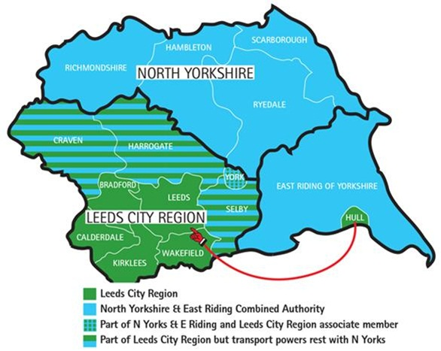
Devolution – where are we?
“We thought we would get a dozen or so. Thirty-eight was more than we expected.”
Greg Clark to the FT, 21st September
Source: Local Government Chronicle
Notes:
38 bids

Slide 3
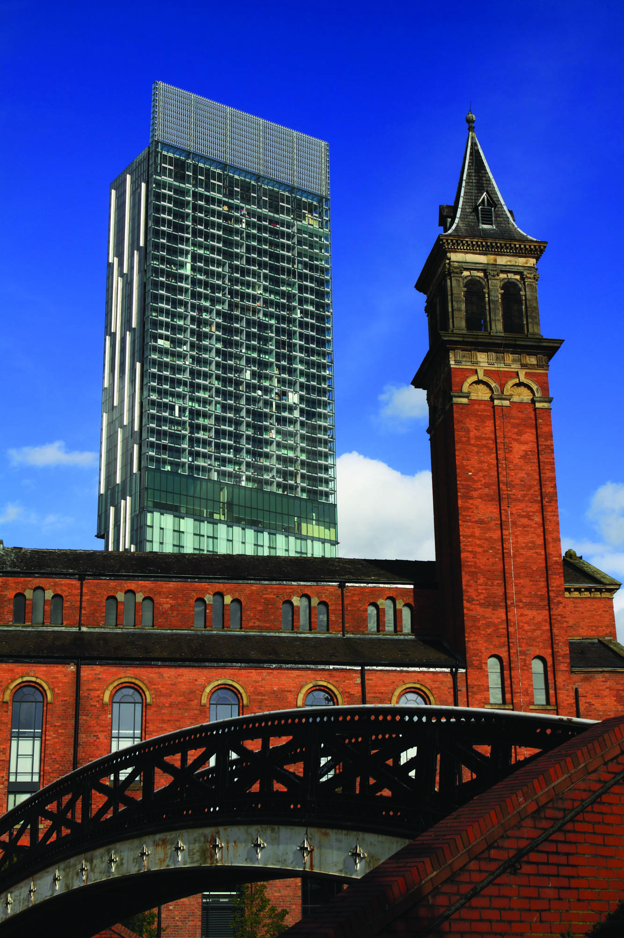
Will we get another Manchester?
Notes:
Political desire, but no imperative
Geography has to align
Only capacity to do a couple more

Slide 4
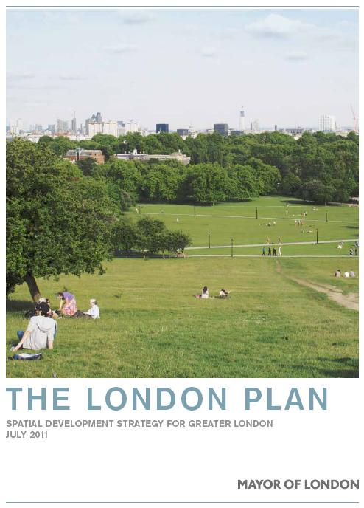
What role is there for planning?
Notes:
Co-ordination of policy
Strategic approach across LA boundaries for the good of the city-region

Slide 5
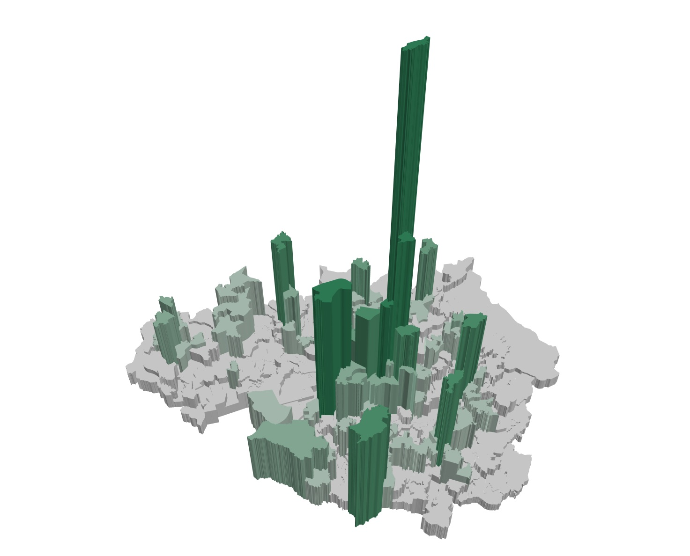
This requires an understanding of the city region economy

Slide 6
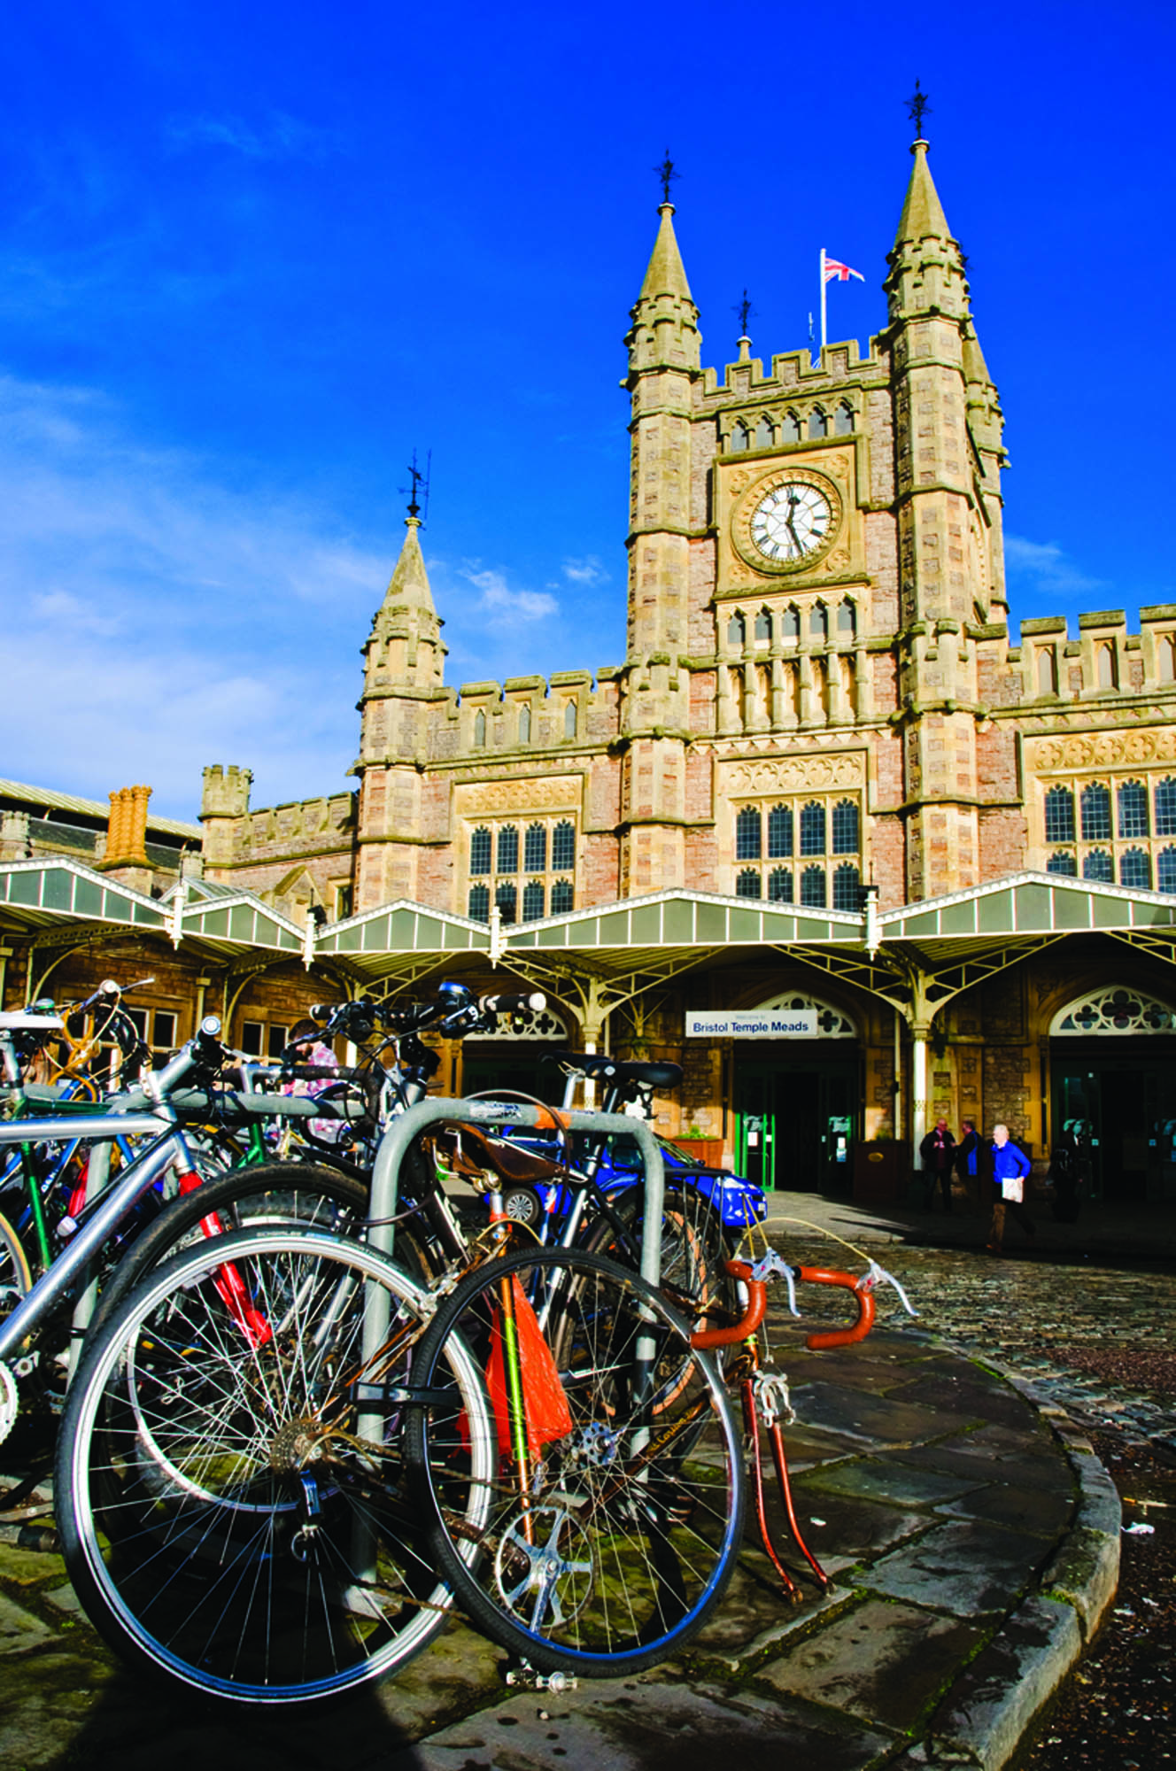
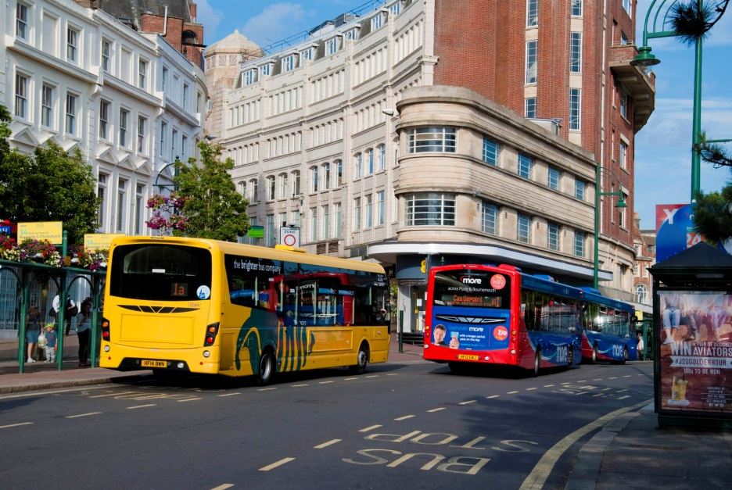
And goes beyond buildings

Slide 7
Devolution What is it, and what does it mean for planning?
Paul Swinney
@paul_swinney

