Slide 1
Planning Performance Agreements in Camden
Stuart Minty
Head of Development Management

Slide 2
Structure of presentation
Why Camden encourages PPAs
When we encourage PPAs
Camden’s service offer
Success so far
Examples
How Camden benefits

Slide 3
Why Camden encourages PPAs
1: Improves quality of planning process
Shared vision and policy objectives identified
Effective stakeholder involvement
Collaborative working
Fosters strong and productive
partnerships
An improved customer service
Better value in long term
Removal of 13/16-week time constraint

Slide 4
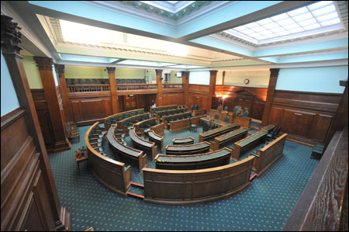
Why Camden encourages PPAs
2: Facilitates well informed, robust decision making
Effective transparent community engagement
Community empowerment and ownership
Building trust
Less objection, more support
Certainty through Member involvement
Avoidance of refusal and lengthy appeals
More sustainable and higher quality developments

Slide 5
Why Camden encourages PPAs
3: Facilitates workload planning
Core and ‘flexible workpool’ model
Discretionary pre-application advice paid for by those who benefit
Service can respond to development pressures
Fixed term contracts for additional staff

Slide 6
What sort of PPAs do Camden offer?
Pre-application
Application stage
Post decision
Significant clients/land owners who submit a number of applications and enquiries each year

Slide 7
When do we encourage a PPA
planning proposals that:
are strategic
require Environmental Impact Assessment
on larger sites that include a variety of land uses
have impact on strategic areas of environmental sensitivity
on sites with many constraints to be resolved
involve significant non-standard planning obligations
referable to GLA or Secretary of State;
significant impact on existing communities which require wide consultation/ involvement with stakeholders
unique to a local authority’s experience.

Slide 8
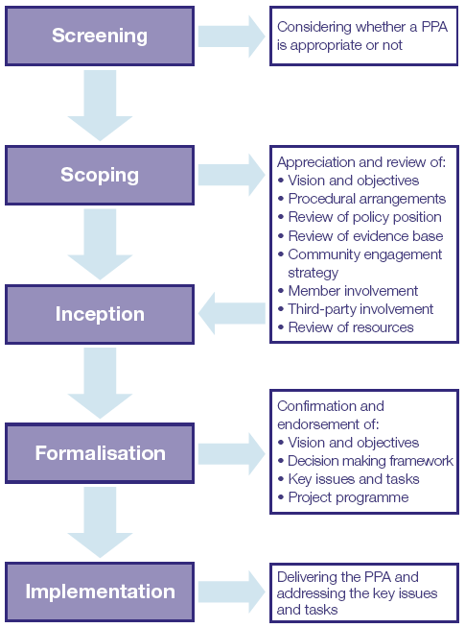
Camden’s PPA process

Slide 9
Camden’s charges
For a flat rate of £6,000 (exclusive of meeting costs), 2 types of PPA are offered:
Type 1: Pre-application through to decision PPA
Type 2: Post decision PPA to consider Approval of Details and s106 discharge of obligations
E.g. of meeting costs
Large major £4,000 for full pre-app meeting, £2,000 for breakout meeting/workshop
Development Management Forum £1,500 + cost of venue
Developers Briefing £1,000

Slide 10
Success so far
Steady increase in use of PPA
2010: 4
2011: 5
2012: 12
2013: 18
2014: 24
Some examples :
Kings Cross Central masterplan site
Housing Service’s Community Investment Programme
Francis Crick Centre (UKCRMI) - Kings Cross
Hawley Wharf - Camden Town
West End Lane development - West Hampstead
Kings College London Campus – Finchley Road
North East Quadrant – Regents Estate
79 Camden Rd
SAATCHI site - Fitzrovia

Slide 11
Development Zones

Slide 12
Case Study: Hawley Wharf
Mixed use scheme comprising 180 flats, school, commercial and town centre uses. EIA development and referable to the GLA.
This was a re-submission after a committee overturn
Screening: PPA was necessary
Scoping: Timetable of meetings agreed - including 2 x Member Briefings, a Development Management Forum for local community.
Vision and objectives, key stakeholders, policy position, procedural arrangements and committee date all agreed.
Implementation: First of 25 agreed meetings held in May 2012, with application presented at agreed Committee in November.
Key benefits: Community engagement resulted in only 30 objections (previously 170), Member involvement allowed more certainty and understanding of a very complex proposal.
Decision was to unanimously approve

Slide 13
So for Camden a PPA is not just about removing the time constraints…
a PPA will:
limit bureaucratic approach
promote shared objectives , visions, goals
allows flexibility
build trust and strong partnerships
give genuine voice to local communities
establish transparency and more certainty
result in well informed and robust decision
Ensures staff resource is available for discretionary service

Slide 14
Questions

