Slide 1
Session 3: The Mechanics of viability testing

Slide 2
A simple development viability appraisal
Data Collection
Calculation (Residual Value, Cashflow)
Reality Check
Interpretation
Use of data
Note: Will discuss consultation later – it is vital and required!
Notes:
Getting good information from the right sources is very important. How do the costs interrelate?

Slide 3

Data Collection
Rubbish in = Rubbish out
All inputs MUST be sourced!
Notes:
Ensure you are only looking at viability in your area, don’t get caught up with other markets. Don’t bother with sub-regional numbers and check you’re not picking up data from other nearby areas

Slide 4
Ask for information early
Landowners and site promoters should be prepared to provide sufficient and good quality information at an early stage……. This will allow an informed judgement by the planning authority regarding the inclusion or otherwise of sites based on their potential viability.
Harman Guidance – Page 23

Slide 5
Income Data
Notes:
For the simple model LPAs need to establish their GDV based on price per m2, this is incredibly important.

Slide 6
Income Data
Basic Prices by £/m²
Residential Prices – House v flats
Commercial / non-residential
Affordable Prices
New v existing
Incentives and discounts
Variance by location or situation?
Grants, subsidies
Notes:
Residential prices are very different between new and existing stock dwellings. Prices have gone up historically for both, but then a big drop when housebuilders tried to get rid of their stock. Existing stock houses also dropped. The best housing available on the market has recovered, new build prices are significantly above 2007 prices with big increases in last 6 months.
There is an element of smoke and mirrors around this, a developer will only build a product that will be viable and profitable therefore is caution needed. Do some market research e.g. ring site offices and talk to them as mystery shopper to find out true prices after negotiations and check Land Registry data. Again be mindful that prices will need to be converted to £per m2 so you may have to search on developer websites to get averages for GIA. Essentially you’re comparing new stock prices vs. existing.
With Affordable Hosuing prices LPAs should stay on top of monitoring. When Housing Association funding becomes more mature values should increase. When a Housing Association sells a unit it is buying an income stream to securitise to get a yield. Please note that higher values haven’t worked through to the market as yet.
Think about the mix of Houses v. flats in your area. Is it appropriate to put any weight on flats that aren’t coming forward and its difficult to get a mortgage for them? In some areas there are large clusters of student populations/buy to let flats. Newcastle are charging CIL for student housing but not residential units in their town centre.
Location of housing and local characteristics is obviously important to prices and this needs to be reflected in the modelling. Don’t just go by postcode either price can vary depending on the view.

Slide 7
Gross internal area?
BCIS (the costs) as ‘Rate per m² gross internal floor area for the building’
Direct from developers
Calculate – it will be an estimate
Notes:
You’ll need to estimate if there is no precise data

Slide 8
Income Data - Residential
Land Registry
Hometrack
Rightmove / Zoopla / Mouseprice
Halifax / Nationwide
CORE
Developers and RPs
Notes:
Plethora of data in this area:
Land registry – actual sales
Hometrack – can be expensive
Mouseprice – used by many developers
Halifax/Nationwide – caution is needed for these as they’re based on mortgage approvals
CORE (HCA funded providing a record of rents for Housing Associations - vital for AH rents as let prices are usually higher than what HA actually claim)
Zoopla does pounds per m2
You need to think about full tenures if values are working out quite similar to a developers you could lump them in together. Some LPAs do it separately to aid negotiations with developers

Slide 9
Notes:
For each builder/developer think about monitoring their names of housetypes. This way you can build up a database of GIA for £per m2

Slide 10
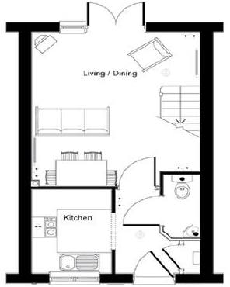
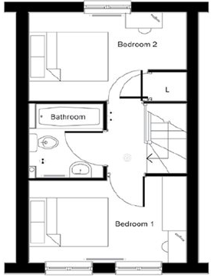
ASHLEY Barratt Homes
Whether you are looking for your perfect first home or looking for a more manageable property this two double bedroom home has everything you need. With an open plan lounge/dining area with separate fully fitted kitchen provides the perfect entertaining space on the ground floor which also has a useful downstairs WC. The first floor is home to two double bedrooms and separate bathroom.
Mid-Terrace, Cloakroom, 624 Square feet
http://www.barratthomes.co.uk/new-homes/warwickshire/H438401-Bluebell/plot-125
Notes:
Barratts tell you how big they are

Slide 11
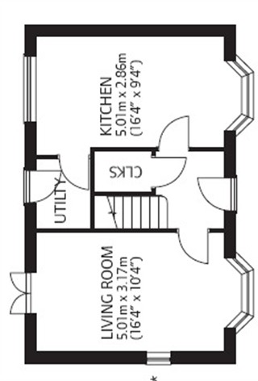
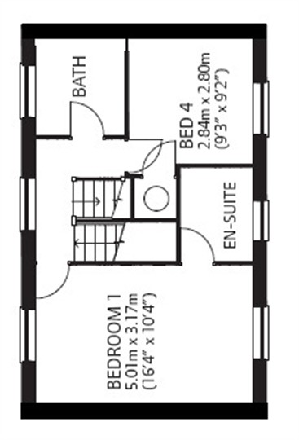
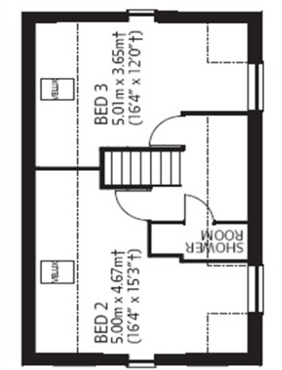
A 4 bedroom 3 storey house for sale in Leicester
The Cheltenham is a 4 bedroom 3 storey house for sale in Leicester which is set over 3 levels offering great flexibility in accommodation, ensuite to master bedroom a further family bathroom and shower room on the second floor. A spacious kitchen also with utility and living room. Good sized garden parking with a single garage

Slide 12
Income Data – Non-Residential
EGi Data / EGI Property Link
Agents
Valuation Office Agency
Developers
Notes:
Non-residential data is more difficult to get. LPAs that let their own portfolios should use this evidence as primary data to fend off developers assumptions for modelling.
The EGI is equivalent to Rightmove for commercial properties. The VOA have stopped their annual property report so you’ll have to speak to your local agents.

Slide 13
EGI – Propertydata
Notes:
The Egi looks at Historic deals, their location, rent, Capital Value. But it does not tell you condition of building or local site characteristics. It can be complicated with lots of data.

Slide 14

EGI Property Link
Notes:
Needs to be explained as Inspector will not always know how it works

Slide 15
Residential vs. commercial
Residential | Commercial
Purchaser usually buying a home they intend to occupy themselves | Purchaser usually buying a rental stream as well as the property itself
One customer: Usually a purchaser looking for a new home. | Two customers: Tenant looking for suitable premises and investor looking for a rental stream.
Usually valued using GIA | Usually valued using NIA

Slide 16
What is the ‘yield’?
The rent as a proportion of the purchase price
There is an inverse relationship between yields & values, i.e. a higher yield means a lower value & a lower yield means a higher value.
Yields are often used in development appraisals to estimate the value of the completed development when it is expected to be rented to a tenant (or tenants). This consequently usually applies to commercial property, although it can apply to residential property where it is also rented.

Slide 17
What affects yields?
Risk & future growth prospects (rental stream & capital value of property). High risk = high yield. But, the higher the future growth prospects = lower yield
Low risk = lower return e.g. savings in an ISA. In a casino you would be aiming for a higher 'yield' to compensate for the probability of failure
For the main investment classes Government Bonds (gilts) are low risk whereas stocks & shares are more high risk. Returns on property investment tend to be in the middle, offering more income & capital growth potential than gilts and less risk than shares

Slide 18
What affects property yields?
The tenant - Is it a strong tenant in terms of security of income (or rent)? Security is something you would normally expect to pay for, perhaps by accepting a lower initial return on your investment.
The area - Is the location suitable for a building of this quality? Is it declining or improving? Is the access good?
The building itself - What is it like? If the tenant goes bust, how easy will it be to find a new tenant? Do these and other lease clauses protect your investment e.g. upward only rent reviews etc.?

Slide 19
Yield example
Offices are normally bought by investors such as pension funds. Let us assume a pension fund wants to buy an office when it is fully occupied by a tenant(s)…
The developer should have a firm idea of what rent the building is likely to achieve e.g. £100,000pa.
In basic development appraisals, the initial rent is therefore used to help estimate the development value. The key question is therefore how much should this rent should be multiplied by to calculate what price a purchaser will pay.

Slide 20
Yield example (continued…)
The “multiplier” is calculated as 1 / yield. Therefore:
Development Value = Initial Rent x (1 / Yield) x 100
Let’s assume the pension fund requires a return of 6% pa. Therefore the value of the rented office building as an investment is calculated as follows:
£100,000 x (1 / 6) x 100 = £1.6m

Slide 21
Yield example (continued…)
The previous scenario did not include assumptions on future rent or prospects for capital growth of the asset i.e. it assumed the pension fund would receive a flat £100,000 pa in perpetuity.
Let us now assume the office is in a good location with a good tenant and good prospects for rental growth e.g. up and coming area, office market looking healthy locally etc. With this information the pension fund is likely to accept a lower initial yield e.g. 5%:
£100,000 x (1 / 5) x 100 = £2m

Slide 22
Yield example (continued…)
Let us now assume the pension fund are less convinced that the rent will rise in the future and they are worried that the tenant found by the developer are unlikely to stay solvent or remain in the area long term. With this information the pension fund is likely to want a much higher yield e.g. 10%:
£100,000 x (1 / 10) x 100 = £1m
These examples demonstrate the inverse relationship between yields & values. Clearly it would make no sense for the pension fund to pay over the odds for a riskier investment.

Slide 23
Rents, Yield and Capital Value
Development Value = Rent x (1 / Yield) x 100
Yield = (Rent / Value) x 100
Years Purchase (YP) = 1/Yield
Notes:
Must be able to explain to the examiner if they are not au fait with commercial property valuation mechanics (see manual for further information)

Slide 24
Rent to Value
Table 5.1 Capitalised typical rents £/m²
 | Rent£/m2 | Yield | Capitalised Rent £/m2
Large industrial | 41 | 7.0% | 586
Small industrial | 48 | 7.0% | 686
Distribution | 50 | 6.0% | 833
Large office | 93 | 6.5% | 1,431
Small office | 100 | 7.0% | 1,429
Large retail - Convenience | 130 | 5.0% | 2,600
Large retail - Other | 120 | 7.0% | 1,714
Small Retail | 105 | 7.0% | 1,500
Leicester Shops | 236 | 7.0% | 3,371
Other Shops | 150 | 11.0% | 1,364
Hotels |  | 6.5% | 2,150
Student Halls |  | 6.5% | 2,225
Leisure | 75 | 8.0% | 938
Notes:
Convert rents to capital values

Slide 25
Costs
Notes:
What costs do you need? BCIS do not include site costs – so land needs to be included.

Slide 26
Construction
BCIS
Site Costs
Abnormals
Contingency
Notes:
As stated BCIS does not include site costs (normally 10-20%) and contingency is not given enough consideration in the index. Contingency absolutely has to be considered alongside profit. Contingency will increase with risky sites.

Slide 27
BCIS
Notes:
The BCIS lists comprehensive costs, discuss here residential costs (as not very readable) re: viability studies. Some are unsophisticated in their approach to development costs. You need to show that you’ve looked at typologies in detail (Action Point – is the Harman appendix useful here?)

Slide 28
Construction
BCIS
Site Costs – 10% to 20%
Abnormals – site by site
Highways, flooding
demolition, design,
decontamination etc.
Contingency – 2.5% Greenfield
5% Brownfield
+7% on horrible sites
Notes:
The phasing of blocks of flats is very difficult due to construction methods and usual site conditions

Slide 29
Phasing and Build Rate
Size of site
Size of developer
Availability of mortgages
Pre 2007 45 to 50 per year
Now? 30 to 35 per year
Multiple developers
Notes:
Think about how certain typologies phased and sold.

Slide 30
Variables
Small Changes of cost or income can have a huge difference in result – the bigger the numbers the more sensitive.
  101-100=1 but 102-100=2
  1% change in price results in a 100% change in outcome
Scenarios – cost and price change
policy requirements
Notes:
The RICS guidance says that you should include lots of market value information for issues around price. The IMF/World bank has predicted a price fall over next 5 years in the order of 15-30% (yet Savills suggest an upturn!). LPAs should distance themselves from predictions as LPAs are not economists. If developers agent says prices are going up use the same assumptions.
You’ll need certainty of costs for very large infrastructure if it is at the heart of plan. It is suggested you employ a QS to report on BCIS figures.
If you encounter a very difficult developer/landowner then give up on that site and use a different one if you think the probability of the site coming forward in the first 5 years is low. Be mindful that objectors are sometimes developers who want to develop other land parcels in the area.
In sensitive situations get information from developers by engaging on an individual basis as it’s in their interests to help
You can use s106 to ensure developers contribute – also 123 list Monitoring must be fine grained

Slide 31
Building the model up and scenario testing
Discounted Cash Flow
  NPV
  IRR
Return On Capital Employed (ROCE)
Notes:
There are lots of different forecasting methods which you can use but avoid making up your own.
Harman talks about simulation and scenario testing. For example, if house prices increased by 5% then how many more sites would become viable?

Slide 32
Monitoring Viability
By reference to indices:
Costs BCIS
GDV Land Reg
Halifax / Nationwide
Composite Academetrics
Hometrack
Rightmove / Zoopla /
BUT – have new build followed wider market?
Notes:
Assume a 3 year cycle unless there is a major shift in market. If there are marginal increases consider change in development
If land registry has fallen this doesn’t mean new house prices have fallen – be careful! Too much reliance on indices can smooth out local/regional differences
Remember that even after adoption this is an on-going engagement process. So keep up with developers, build costs, refresh appraisals if numbers change and then revisit targets.
Caution is required if you’re thinking of employing a dynamic viability models (e.g. Waltham Forest, Croydon). If the market is tricky then it is best to keep to a simple model
With so many different indices remember that developers will use one that suits them best

Slide 33
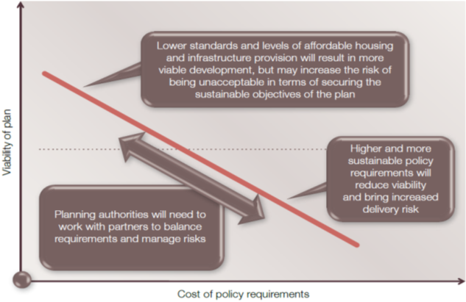
Assumptions and testing
“make some very cautious and transparent assumptions with sensitivity testing of the robustness of those assumptions
it is important that variations against baseline costs, as well as values, are tested.” (page 27 – Harman)
Notes:
There are ultimately 3 categories of sites: 1) those viable now 2) not yet but may be in future 3) unviable

Slide 34
PPG: How should changes in values and costs be treated in plan-making?
Plan makers should not plan to the margin of viability but should allow for a buffer to respond to changing markets and to avoid the need for frequent plan updating. Current costs and values should be considered when assessing the viability of plan policy. Policies should be deliverable and should not be based on an expectation of future rises in values at least for the first five years of the plan period.

Slide 35





Gross Development Value
All income from a Scheme
Construction
Site Remediation
Abnormals
Etc.
Fees
Design
Engineer
Sales
Etc.
Profit
Developers
Builders
Land
Existing / Alternative Use Value
+ premium (TLV/EUV+)
Policies/CIL
CIL, affordable housing, CfSH, open space etc.
Notes:
Local Plan policies and CIL charges can be influenced by the LPA. The LPA must agree with development community the methodology, assumptions and inputs for whole plan viability modelling e.g. costs, fees, profit level, land values etc.
The threshold of viability and Threshold Land Value is
Talk through the costs and discretionary costs
Members will have a view on what they’re prepared to sacrifice in policy terms.
The rule of thumb (1/3 of cost to land, 1/3 builder, 1/3 developer) is out of date now.

Slide 36
Carveth Read:
“It is better to be vaguely right
than exactly wrong”
Logic, deductive and inductive (1898), p. 351

